Slide 1
Car Sales Business Intelligence Dashboard
Turning Car Sales Data into Actionable Insights
Presenter: Kennedy Ezeugo
Date: 25 May 2025

Slide 2
Outline
Executive Summary
Introduction
Objectives
Dataset Overview
Exploratory Analysis
Dashboard App
Insights
Key Recommendations / Suggestions
Conclusion

Slide 3
Executive Summary
Purpose: Deliver a Power BI dashboard transforming vehicle sales data into insights.
Audience: Dealerships, auction platforms, vehicle remarketing teams.
Key Value: Optimize pricing, boost profitability, and drive smarter decisions.

Slide 4
Introduction

Slide 5
The "Vehicle Sales and Market Trends Dataset" provides a comprehensive collection of information pertaining to the sales transactions of various vehicles.This report will provide a concise overview of vehicle sales performance, hightlighting key trends, sales volume and top performing vehicle models.
Purpose of the analysis: Our goal is to deliver actionable insights that will support data-driven decisions, improve sales strategies, and drive business growth.

Slide 6
Dataset Overview
The dataset contains a total record of 548,400 vehicle sales transactions which took place within a period of 2024 to 2025.
Columns: Year, Make, Model, Trim, Body, Transmission, VIN, State, Condition, Odometer, Color, Interior, Seller, MMR, Selling Price, Sales Date, Time Zones.
Data Source: www.Kaggle.com

Slide 7
Project Aims
Provide business insights across sales, and marketing performance across time, location, car types and operation.
Track profitability using MMR vs. selling price.
Identify top performers and market trends.
Deliver an interactive and executive-friendly dashboard.

Slide 8
Project Objectives
Sales and revenue analysis
Profitability analysis
Inventory Performance Analysis
Market and Seller Analysis
Enhance Future Planning from the analysis
Interactive User Experience

Slide 9
Exploratory Data Analysis

Slide 10
Key performance Indicators (KPI)
From the analysis, a total revenue of $8Bn was recorded, with an averge selling price of $14K, giving a total profit of -$87M.
Within this period, a total of 548,000 vehicles that fall into different make, model and color was sold, with $7Bn in revenue in the present year (2015) as seen from the total year to date( Total YTD).
The year-over-year revenue growth stands at -1%, signaling a poor revenue growth between 2014 and 2015.
These numbers tell a story that the business is scaling is running loss already.

Slide 11
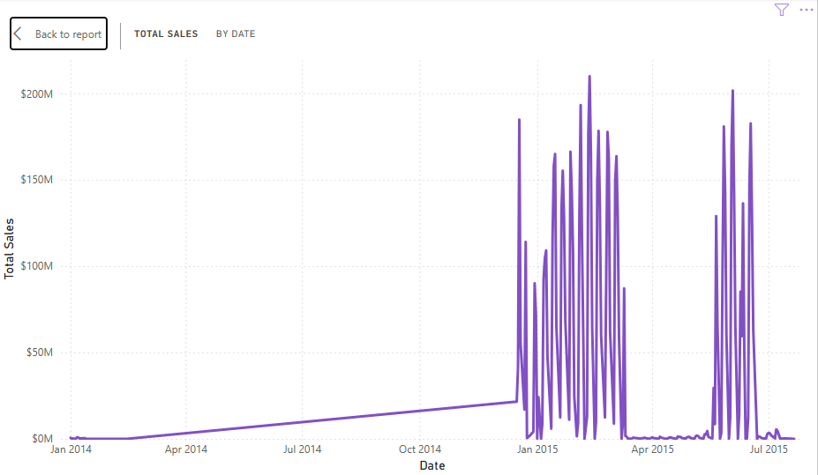
Trend Analysis
Sales Analysis
Weak upward sales trend from January to November 2014, showing seasonal peaks between december 2014 and April 2015, and between May and July 2025

Slide 12
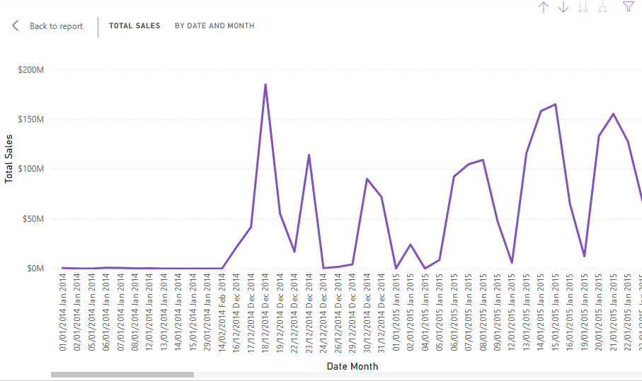
Confirmation of the Weak upward sales trend(say fluctuating price) from January to November 2014.

Slide 13
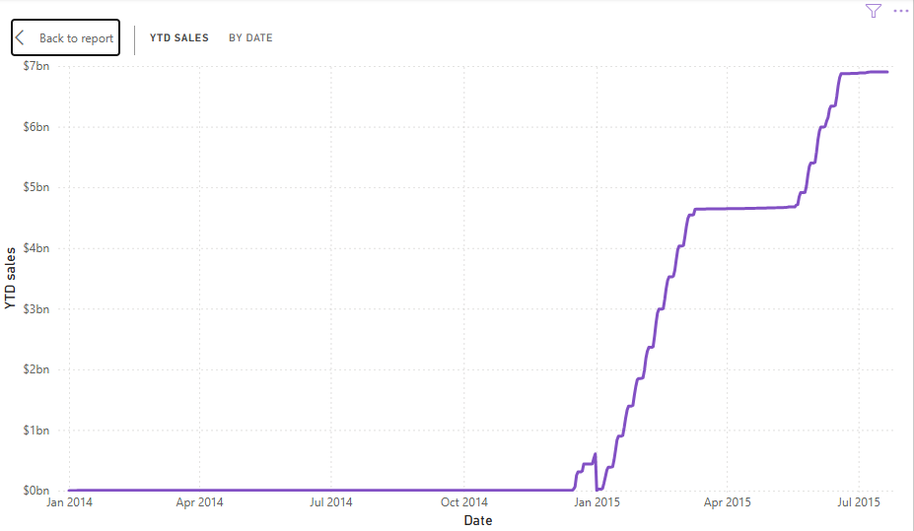
the YTD chart shows that despite a strong revenue accumulation, the overall profit remains negative, pointing to cost or margin issue.

Slide 14
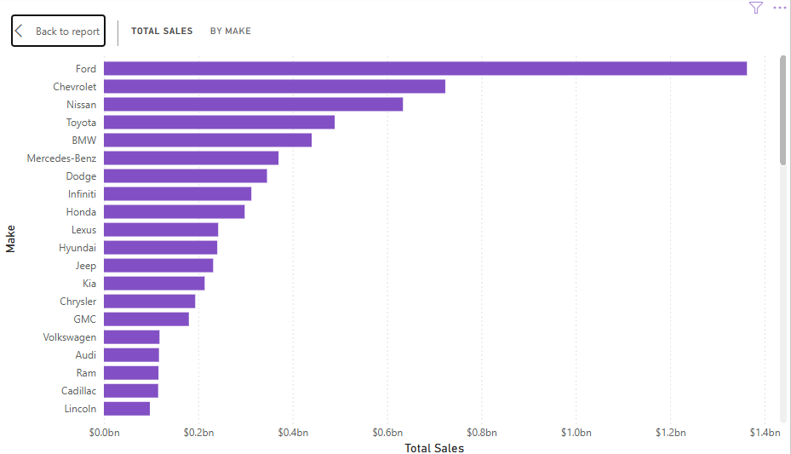
Sales Chart of Different Vehicle Make
Ford vehicles top the chart with a sales of almost $1.4bn

Slide 15
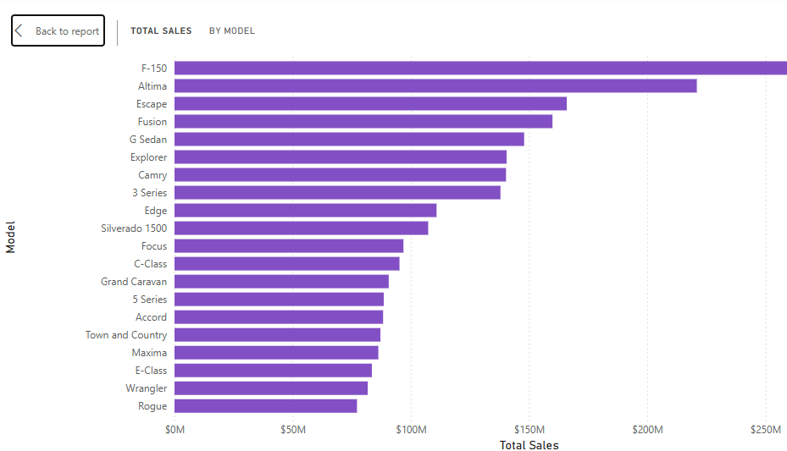
Sales Chart of Different Vehicle Model
T
Vehicles with model F-150, and Altima leads the chart with a sales record of over $200M

Slide 16
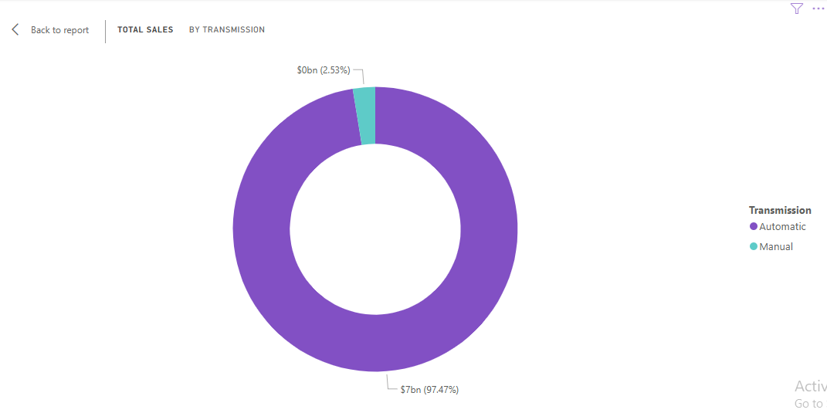
Sales Chart of Different Vehicle Transnission
T
Automatic Vehicles have higher sales than manual vehicles

Slide 17
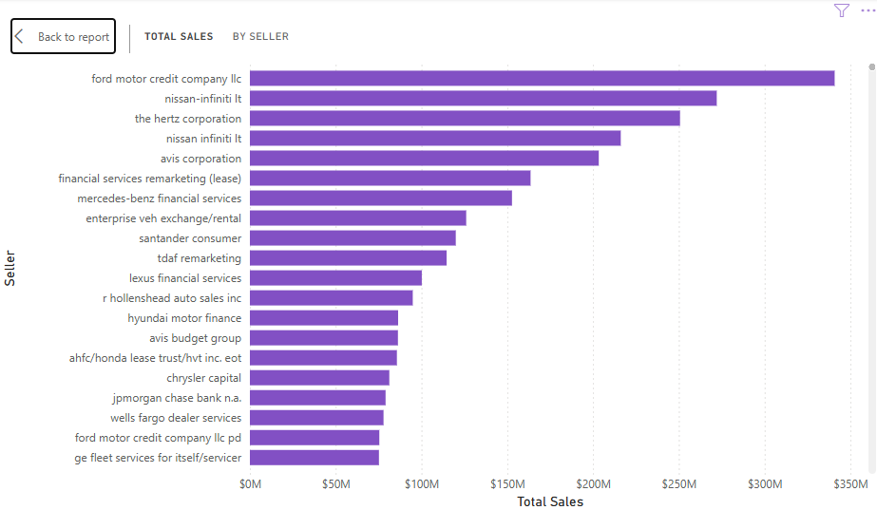
Sales Chart Comparism of different sellers
T
Ford motor credit company LLC, nissan-infiniti Lt, the hertz corporation, and avis corporation sold above $200M.

Slide 18
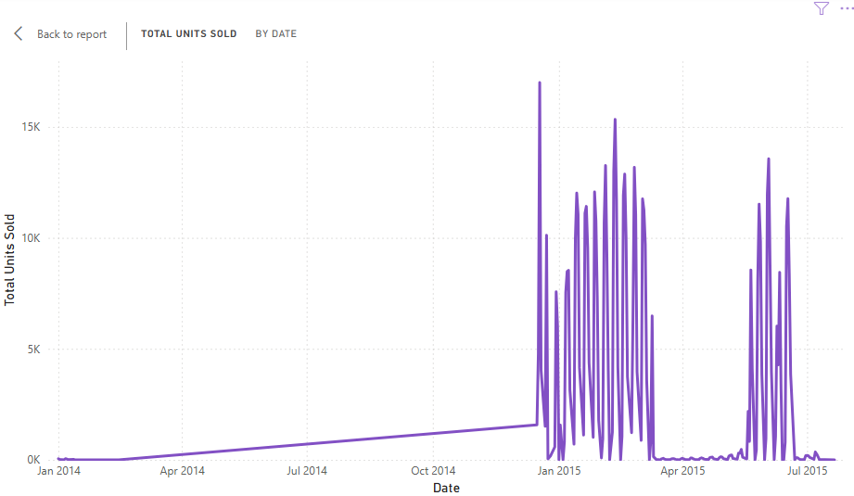
Unit Analysis
Total Unit Trend
T
Weak upward total units (vehicles) were sold from January to November 2014, shows seasonal increased units between december 2014 and April 2015, and between May and July 2025

Slide 19
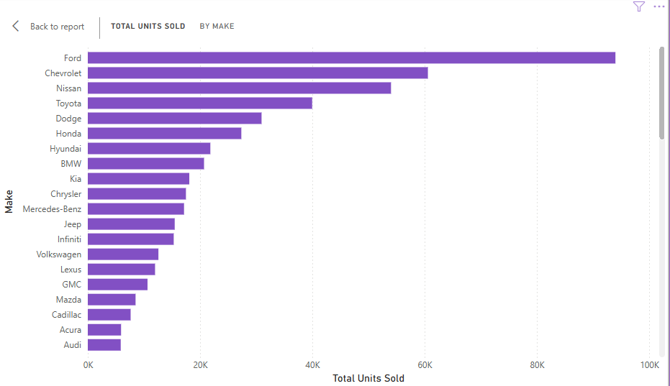
Unit Comparism Chart For different Vehicle Make
T
Ford vehicles top the chart with over 80,000 sold Ford vehicles

Slide 20
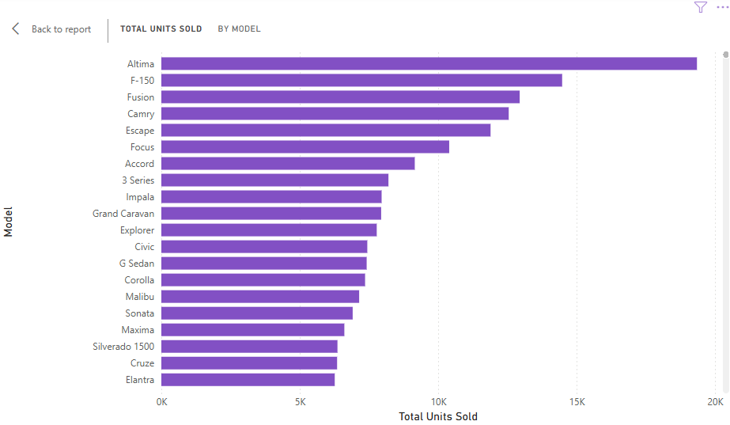
Unit Comparism Chart For different Vehicle Model
T
More Vehicles with model Altima and F-150 were sold

Slide 21
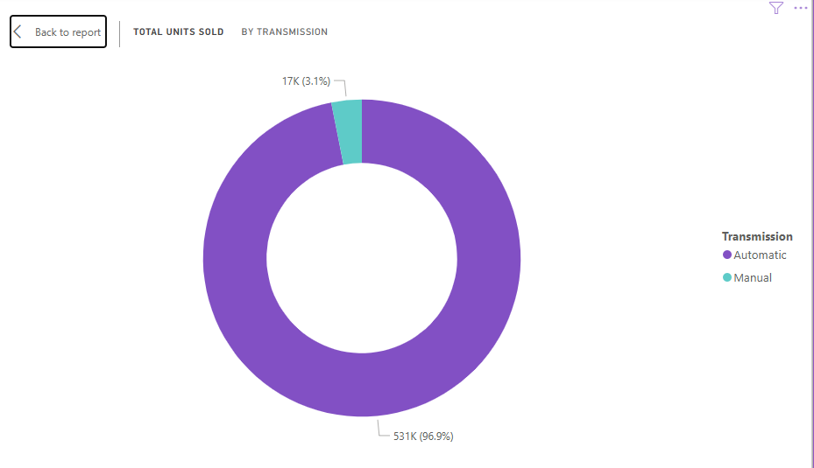
T
Unit Comparism Chart For Vehicle with different Transmission
More Automatic Vehicles were sold compared to manual vehicles

Slide 22
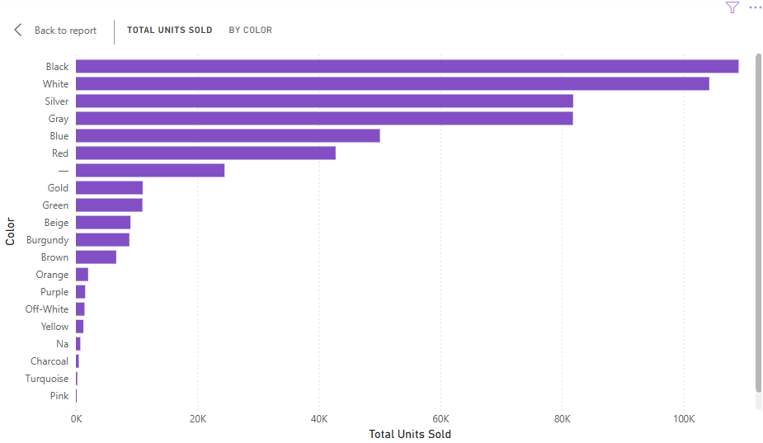
T
Unit Comparism Chart For different Vehicle Color
Black and white vehicles lead the chart with both having over 100,000 units sold

Slide 23
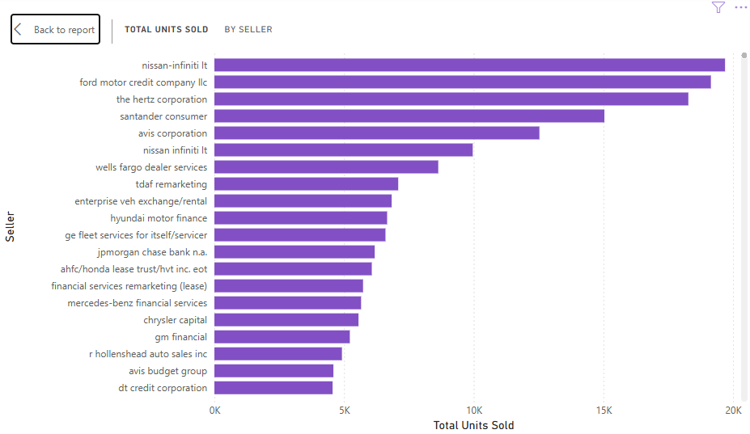
T
Unit Comparism Chart For different Vehicle Sellers
Nissan-infiniti Lt, Ford motor credit company LLC, the hertz corporation, and avis corporation sold 10,000 units each.

Slide 24
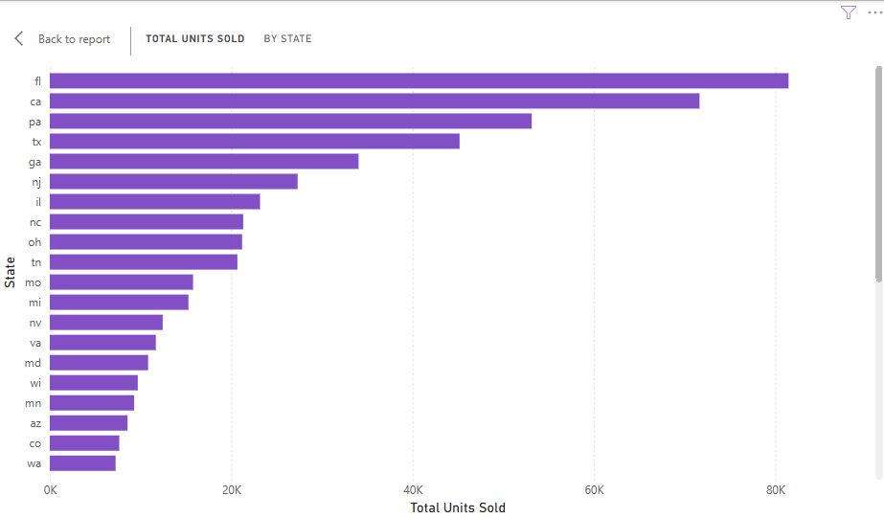
Geographic Analysis
T
Geographic Comparism Chart For different Vehicle Units
More vehicles are sold in Florida (fl), and Califonia (ca)

Slide 25
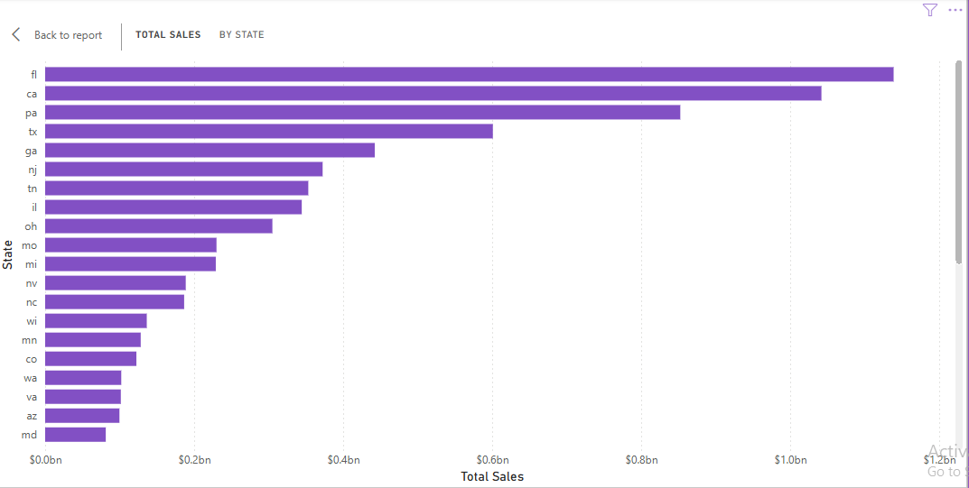
Geographic Comparism Chart For different Vehicle Sales
T
Florida (fl) and Califonia (ca) generated the highest revenue with total sales figure above $10bn

Slide 26
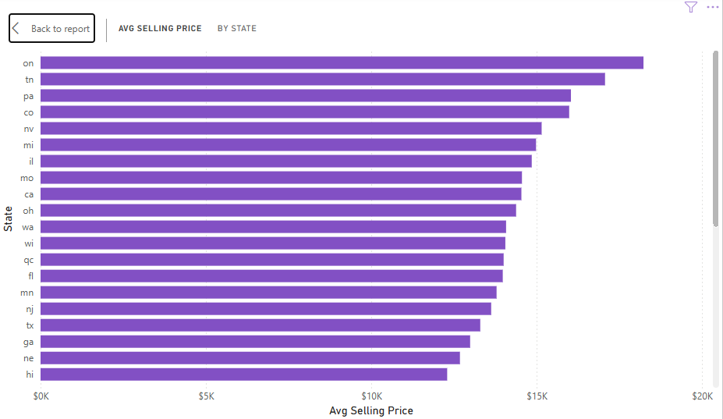
Geographic Comparism Chart of the Average Selling Price of different Vehicle Sales
T
Vehicles seems to be more expensive at on, tn, pa, co, and nv, as the average selling price exceeds $15,000.

Slide 27
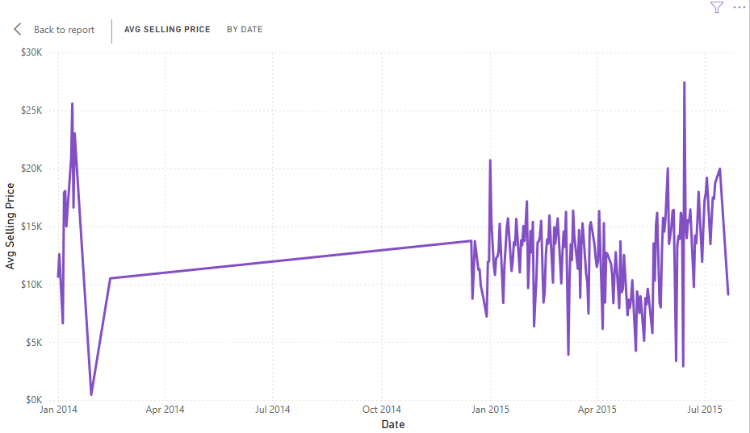
Price Analysis
Average Selling Price Trend Chart
T
Vehicle price declined between January 2014 and November 2014, and became choppy (fluctuate) afterward.

Slide 28
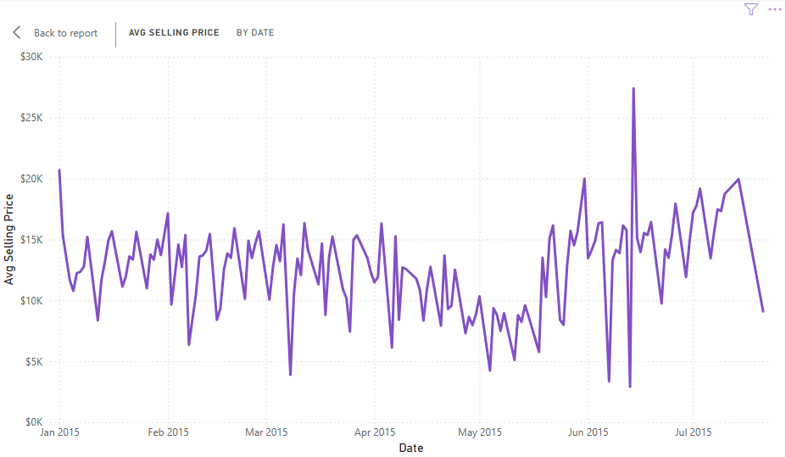
Average Selling Price Trend Chart
T
Confirmation of the choppy (fluctuating) price in 2015.

Slide 29
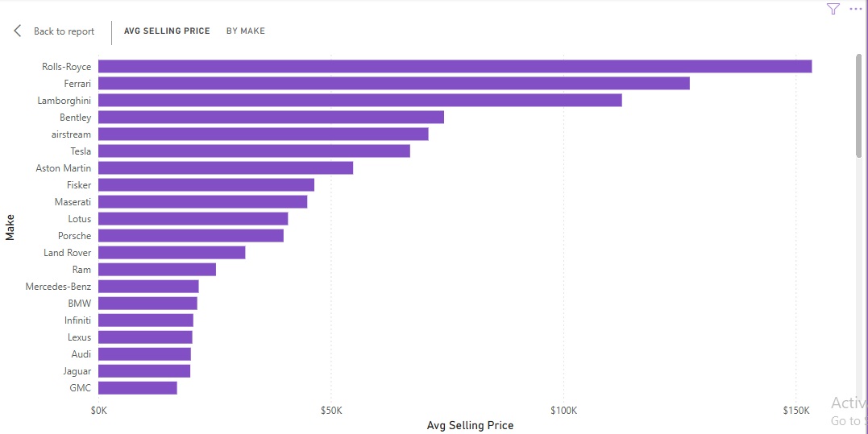
Average Selling Price Comparism Chart of different Vehicle Make
T
Rolls-Roysce and Ferrari are more expensive

Slide 30
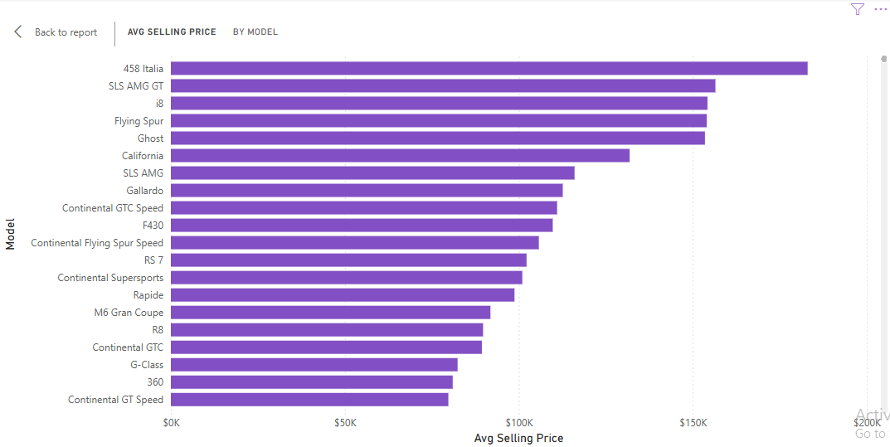
Average Selling Price Comparism Chart of different Vehicle Model
T
Vehicle model 485 Italia and SLS AMG GT sells at a more expensive price

Slide 31
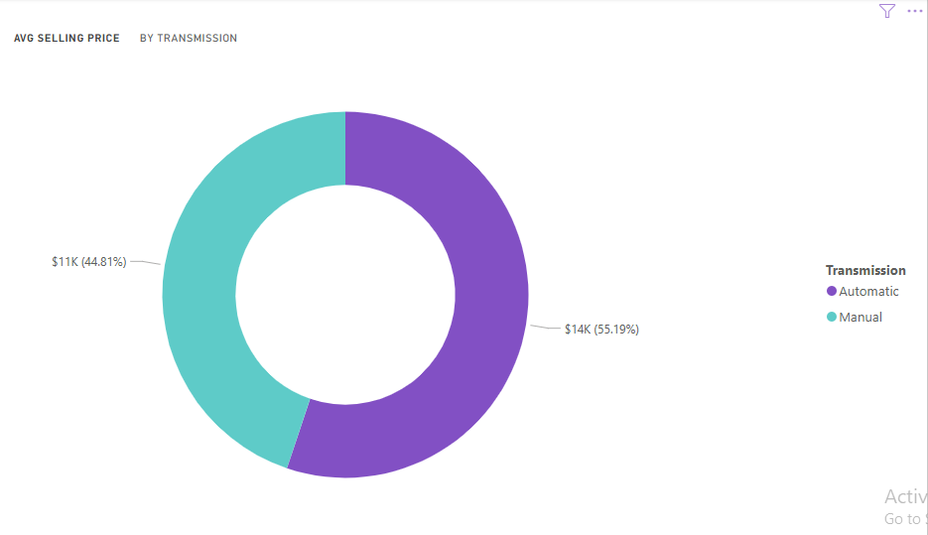
Average Selling Price Comparism Chart for Vehicle with different Transmission
T
Automatic vehicles are slightly more expensive than manual vehicles

Slide 32
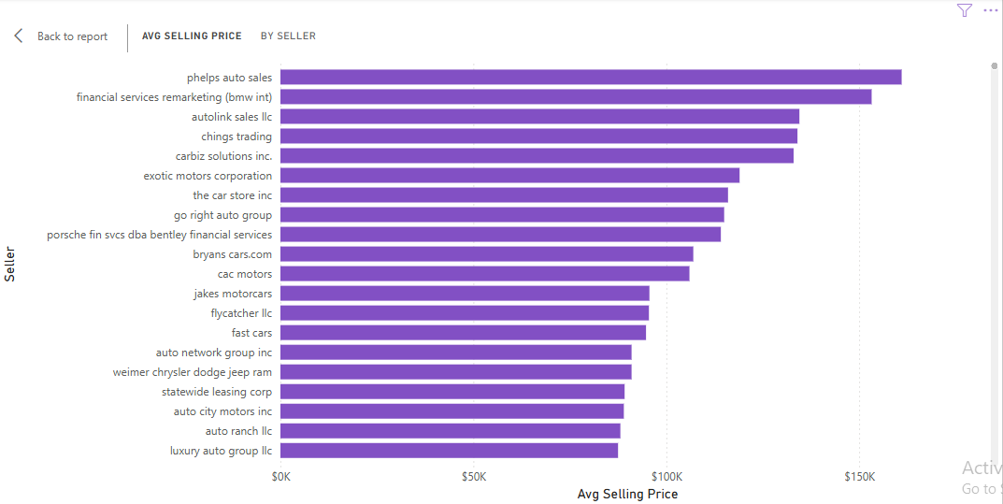
Average Selling Price Comparism Chart of different Vehicle Sellers
T
vehicles are more expensive at phelps auto sales and financial services remarketing(bmw int )

Slide 33
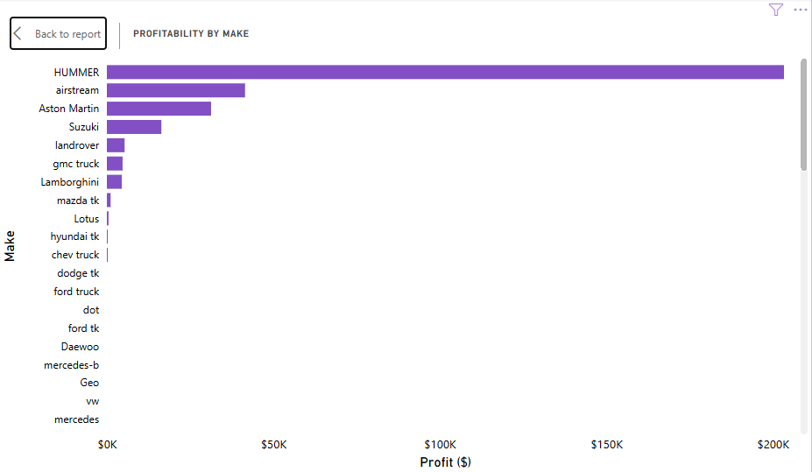
Profit Analysis
Profit Comparism Chart of different Vehicle Make
T
Hummer vehicles are more profitable as they generated over $200 Million profit.

Slide 34
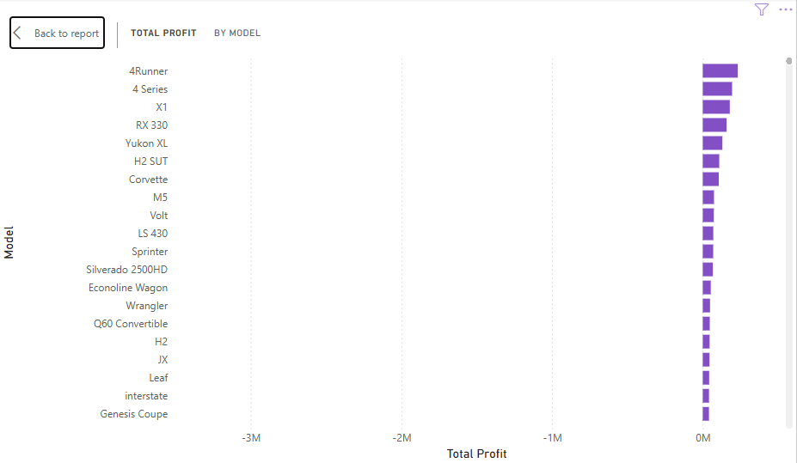
T
Profit Comparism Chart of different Vehicle Model
4Runner and 4 Series vehicles are more profitable

Slide 35
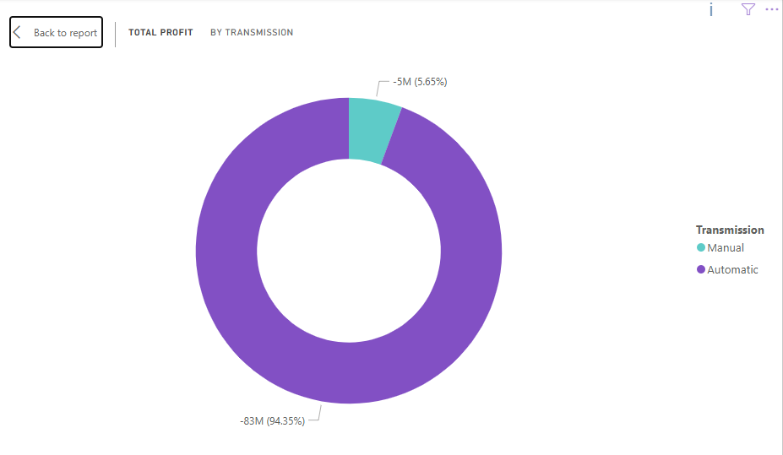
T
Profit Comparism Chart of Vehicle with different transmission
Automatic vehicles are more profitable

Slide 36
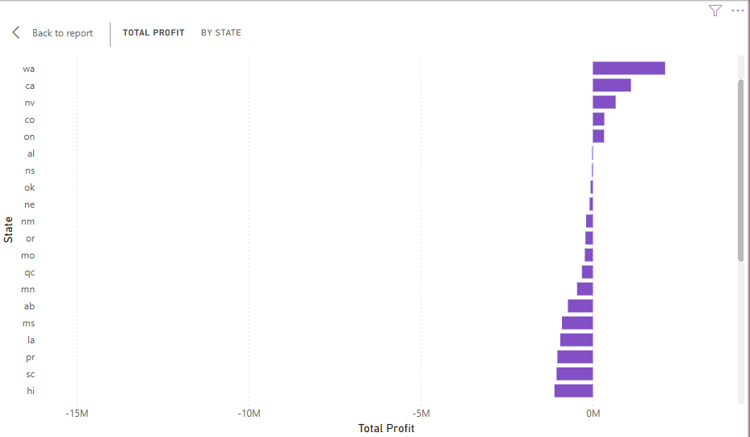
T
Profit Comparism Chart of different States
wa, ca, nv,co and on generated more profit.

Slide 37
Dashboard

Slide 38
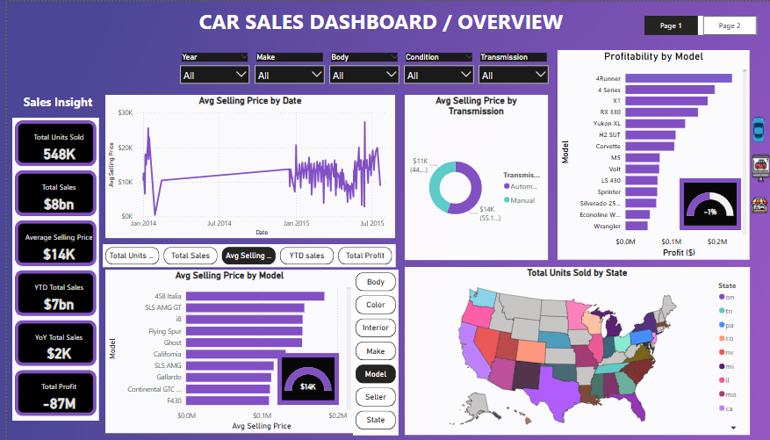
Photo of the Dashboard

Slide 39
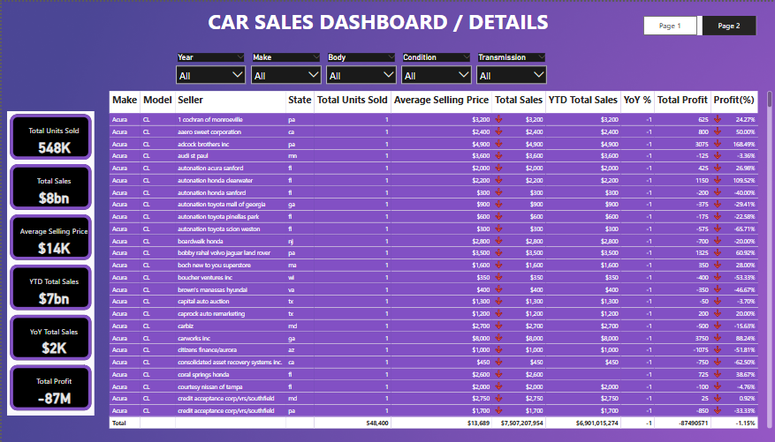
Dashboard App link: https://app.powerbi.com/view?r=eyJrIjoiN2I2MDgyNGMtYmUxOS00MjA5LTk4MzgtNDA2ZWMyMGI3MjQ4IiwidCI6IjYzYzQ3MTVmLTExNzAtNDFmYy04OTAwLWMwMTgzMzMwNGQ3YiJ9

Slide 40
Insights

Slide 41
1). Sales Over Time:
Sales fluctuated across the year, with some months( likely seasonal peaks) showing significantly higher units sold.
There are dips during off-seasons or due to external factors (such as economic conditions , inventory shortage, and so on).
2). Price Over Time:
Price also fluctuated across the year, with some months showing significantly lower average price per unit . This significantly shows that selling price sometimes exceeds or falls below the Manhein Market Report(MMR) benchmark, indicating inconsistency in pricing strategies.
Gaps between selling price and MMR could reveal potential profit or loss margin opportunities.
3). Sales by State:
Some States shows dominant sales volumes, possibly due to larger market size or stronger dealership presence while under performing states may represent untapped markets or areas need better market penetration.

Slide 42
Suggestions / Recommendations

Slide 43
Suggestions
Identify high sales months and plan promotions, inventor stocking and marketing ahead of those peaks. Also investigate months with low sales to uncover bottlenecks ( e.g., supply issues, pricing mismatch, demand drop, and so on).
Review pricing practices to ensure competitive yet profitable pricing, especially where you are consistently under MMR benchmark.
Focus on expansion, marketing, and dealership partnership in high performing states, and conduct deeper analysis on underperforming states and regions to understand barriers (such as low demand, competition, regulatory issues and so on).

Slide 44
Recommendation
Profit Optimization: Analyse which make/model gives the highest margins and prioritize them.
Inventory Management: Rotate slow-moving inventories aggressively to avoid holding cost.
Regional Strategy: Double down on top performing regions and plot promotional campaigns in weaker regions.
Data Driving Pricing: Set synamic pricing strategies and policies, leveraging MMR data, local demand, and historical sales trends.

Slide 45
Conclusion

Slide 46
The analysis of 548400 vehicle sales transactions between 2024 and 2025 uncovered critical insights that needs urgent attention.
from the sales trend, though seasonal peaks were observed (between December to April and May to July, it shows an overall weak upward trend indicating that growth is inconsistent and largely tied to seasonality.
For the top performers, ford make leads sales (contributing about $1.4 billion), model F-150 and Altima are the best sellers (with over $200 Million sales), and automatic vehicles outperform manual ones in both sales and profitability.
States like Florida (FL) and California (CA) dominates in unit sales and revenue, while regions like ON, TN, PA, CO, NV exhibit higher average selling price. These regional dynamics highlights where the business is strong, and where untapped opportunities or cost risks may exist.
fluctuations between the selling price and the Manheim Market Report (MMR) benchmark reveils inconsistent pricing strategies. Brands like Hummer, 4Runner, and $ Series stand out for profitability, emphasizing the importance of focusing on margin (not just sales volumn).

Slide 47
To turn these insights into action, the business must:
Optimize pricing and cost structure to reverse net losses.
Double down on top-performing products and regions.
Address underperformingareas with targeted strategies.
implement dynamic data-driven pricing to close MMR gaps.
Strengthen inventory management to reduce slow-moving stock risk.
With these focus strategies, the company can shift from reactive to proactive, improving profitability and driving sustainable growth.

