Slide 1

On the Equilibrium Dispersive Model M. Tirapelle and K. Katsoulas
Prosperity

Slide 2
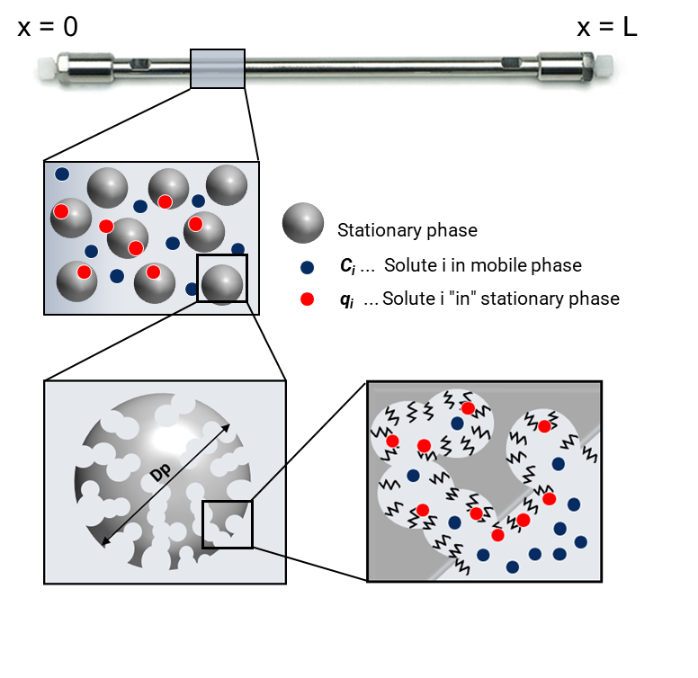

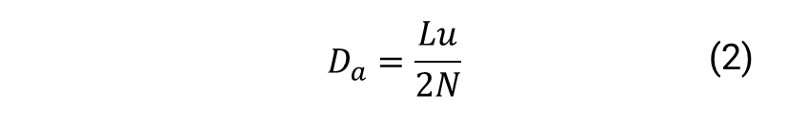
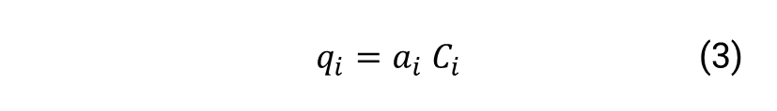
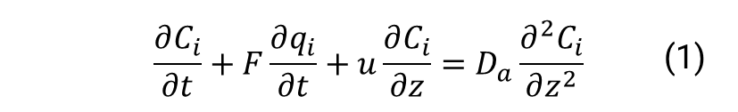
Modelling (i)
Equilibrium Dispersive Model (EDM)¹:
where $C_{i}$ and $q_{i}$ are the concentration in the mobile and stationary phases, respectively.
Apparent axial dispersion coefficient¹:
where $N$ is the Number of theoretical plates.
Linear adsorption isotherm:
where $a_{i}$is the equilibrium constant.
 | $$\frac{∂C_{i}}{∂t}+F\frac{∂q_{i}}{∂t}+u\frac{∂C_{i}}{∂z}=D_{a}\frac{∂^{2}C_{i}}{∂z^{2}}$$ | (1)
 | $$D_{a}=\frac{Lu}{2N}$$ | (2)
 | $$q_{i}=a_{i}{ C}_{i}$$ | (3)
Guiochon, G., Felinger, A., & Shirazi, D. G. (2006). Fundamentals of preparative and nonlinear chromatography. Elsevier

Slide 3
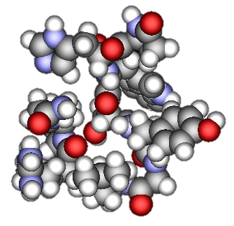



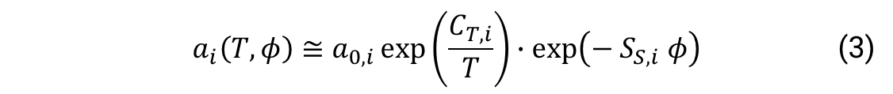

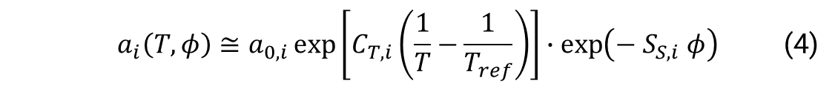
Modelling (ii)
To capture the effect of temperature (T) and volume fraction of organic modifier ($φ$), the Van’t Hoff theory of Gibbs free energy and the Linear Solvent Strength (LSS) theory have been considered. The equilibrium constant becomes:
The adsorption isotherm parameters $a_{0,i}$, $C_{T,i}$ and $S_{S,i}$ have to be estimated. Since the first trials revealed a strong correlation between $a_{0}$ and $C_{T}$, the model is changed to:
 | $$a_{i}\left(T,φ\right)≅a_{0,i}\exp\left(\frac{C_{T,i}}{T}\right)∙\exp\left(− S_{S,i} φ\right)$$ | (3)
Temperature
 | $$a_{i}\left(T,φ\right)≅a_{0,i}\exp\left[C_{T,i}\left(\frac{1}{T}−\frac{1}{T_{ref}}\right)\right]∙\exp\left(− S_{S,i} φ\right)$$ | (4)
Gradient

Slide 4

General problem
Control variables $u$:
Flowrate
Temperature
Amount of organic modifier
Unknown parameters $Θ$:
Number of Equivalent theoretical plates $N$
Adsorption isotherm parameters $a_{0,i}$, $C_{T,i}$ and $S_{S,i}$

