Slide 1
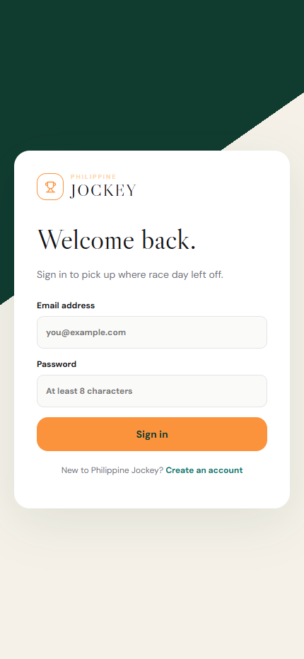
PHILIPPINE JOCKEY
How the system
flows
A visual guide to the Philippine Jockey experience
Visual guide | 16 October 2026
PHILIPPINE JOCKEY · SYSTEM OVERVIEW · 16 OCT 2026
01

Slide 2
SYSTEM FLOW MAP
The full race-day journey
01 · DISCOVER
02 · CHOOSE
03 · PREPARE
04 · TAKE PART
05 · FOLLOW
Home → Races
Club → Date → Race
Games → Selections
Cart → Review → Ticket
Live → Results
Find a featured race or open the schedule.
Choose where and when to race; open entries.
Learn the game and select horse(s).
Check selections, set wager, confirm.
Follow race updates, then see official placings.
Before the race
During the race
After the race
Race schedule · entries · game guide · bet review
Live center · video area · race updates
Results · winning horse · winning jockey
Profile, settings, favorites and betting history remain available as supporting destinations.
PHILIPPINE JOCKEY · SYSTEM OVERVIEW · 16 OCT 2026
02
HOW IT ALL CONNECTS

Slide 3
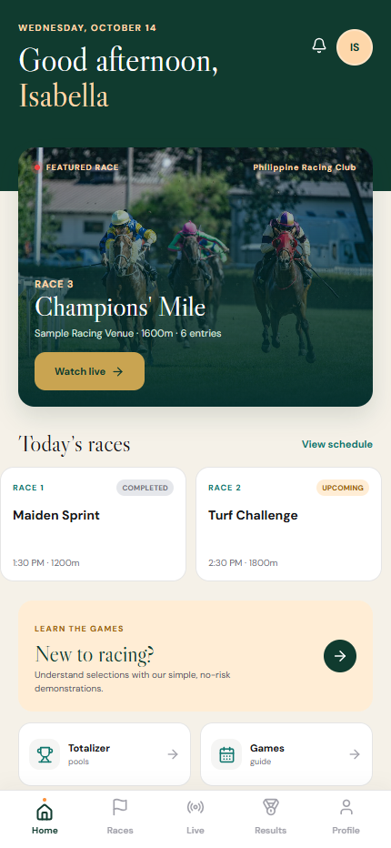
PRODUCT FLOW
The customer journey at a glance
01
02
03
04
05
HOME
RACES
LIVE
RESULTS
PROFILE
Discover today's
meeting and featured race
Choose club / date,
open a race and entries
Watch the stream and
follow race updates
Review official placings,
then contender profiles
Manage preferences,
favorites and account
Shared navigation
Supporting destinations
Mobile tab bar: Home · Races · Live · Results · Profile
Games & Guide · Totalizer · Betting history · Favorites · Notifications · Settings
The five main destinations stay within reach through the mobile navigation.
PHILIPPINE JOCKEY · SYSTEM OVERVIEW · 16 OCT 2026
03
EXPERIENCE

Slide 4
PLACE A BET
Betting flow · from race discovery to ticket
1
Pick a club / race
2
Pick a game
3
Pick runner(s)
Browse meeting dates, clubs, race cards, and entries.
WIN · PLACE · FORECAST · TRIFECTA and supported game rules.
Selection count follows the game requirement; review odds snapshot.
6
Track ticket
5
Confirm
4
Cart & review
Betting history and ticket status after placement / settlement.
Show confirmation and the ticket reference.
Edit or remove tickets; set wager from presets / allowed range.
All wagers shown here are play-money only; no real currency is used in this demo.
PHILIPPINE JOCKEY · SYSTEM OVERVIEW · 16 OCT 2026
04
BETTING

Slide 5
BETTING FLOW
Bet flow · from chosen game to ticket
CHOOSE
SELECT
CHECK
SET
CONFIRM
Pick a game
Choose horses
Review bet cart
Choose wager
Receive ticket
WIN · PLACE
FORECAST · TRIFECTA
Follow the game's
selection guide
Edit or remove
your selections
Use a preset or
enter an amount
See confirmation
and open history
Before you confirm
After you confirm
Check the race, game, selected horses and wager total. If a selection is incomplete, return to the relevant step and finish it.
The system shows a ticket confirmation. Open Betting History to find the ticket again and follow its status.
Play-money demonstration
Review before confirming
Find tickets in history
PHILIPPINE JOCKEY · SYSTEM OVERVIEW · 16 OCT 2026
05
TAKE PART

Slide 6
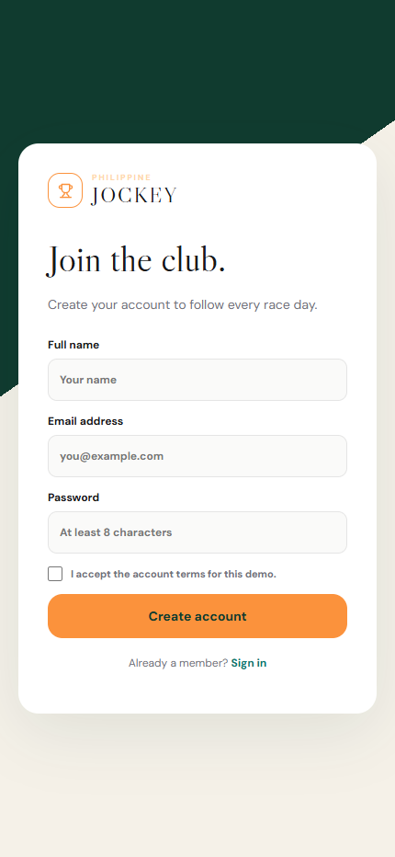
PRE-RACE
Create an account or sign in
SIGN IN
CREATE ACCOUNT
Return to the racing experience.
Create a profile to get started.
PHILIPPINE JOCKEY | SYSTEM OVERVIEW | 16 OCT 2026
06
PRE-RACE

Slide 7
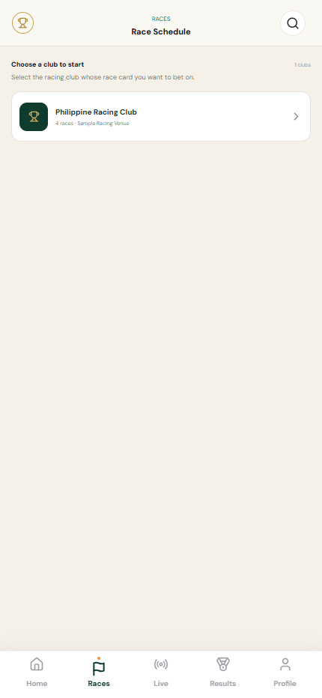
MOBILE SCREENSHOTS
Mobile UI · Home and club selection
HOME
RACES · CLUB PICKER
Featured race, schedule, games and bottom navigation.
The user chooses a racing club before seeing its card.
Captured from the running mobile website at 430 × 932 px. Names and race details may be demo content.
07
PHILIPPINE JOCKEY · SYSTEM OVERVIEW · 16 OCT 2026
MOBILE SCREENS

Slide 8
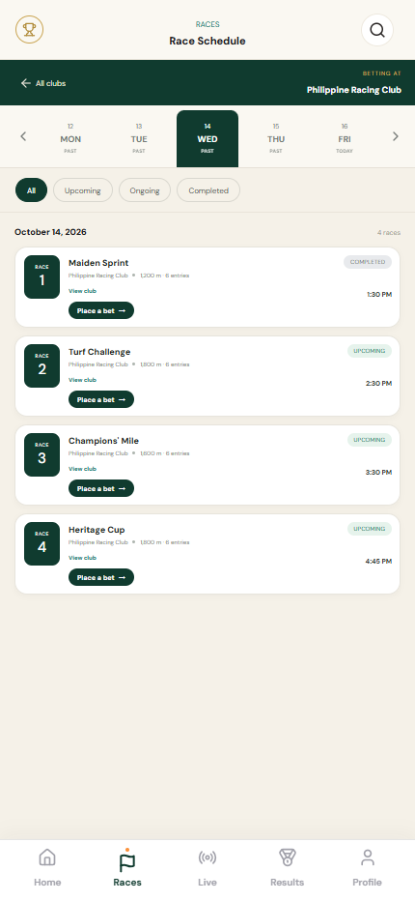
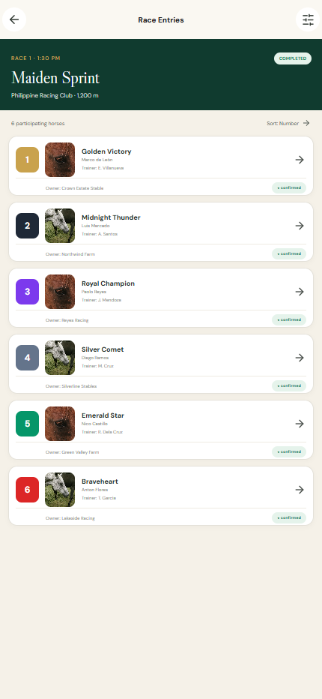
MOBILE SCREENSHOTS
Mobile UI · Race card and entries
RACE SCHEDULE
RACE ENTRIES
Date rail, race status filters and club context.
Runner number, horse, jockey, trainer and owner.
Captured from the running mobile website at 430 × 932 px. Names and race details may be demo content.
08
PHILIPPINE JOCKEY · SYSTEM OVERVIEW · 16 OCT 2026
MOBILE SCREENS

Slide 9
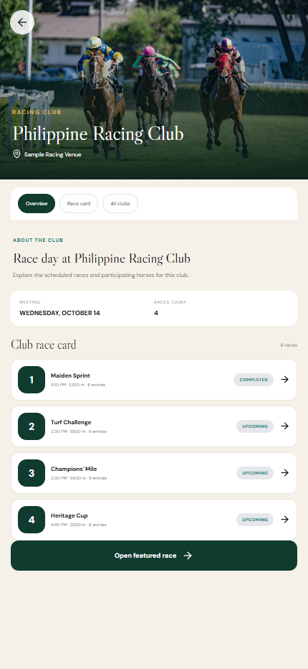
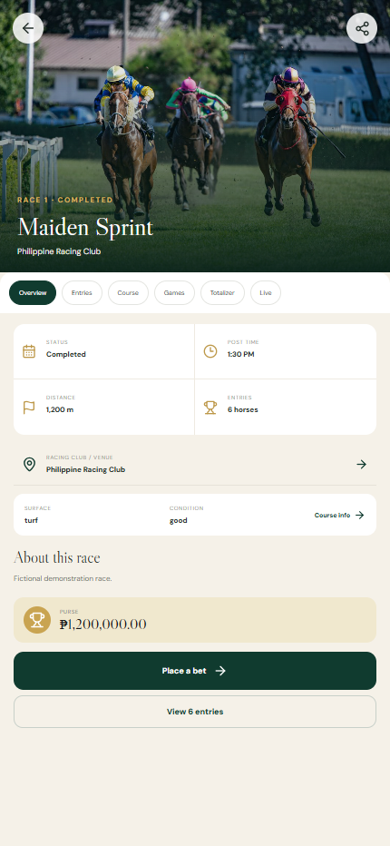
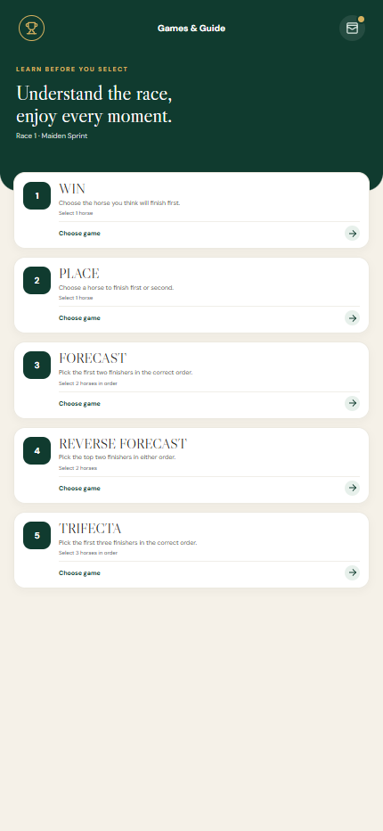
PRE-RACE
Open a club, race, and game
CLUB PROFILE
RACE DETAILS
CHOOSE A GAME
Browse the club and its race card.
Check time, distance, entries, and venue.
Compare the available game types.
PHILIPPINE JOCKEY | SYSTEM OVERVIEW | 16 OCT 2026
09
PRE-RACE

Slide 10

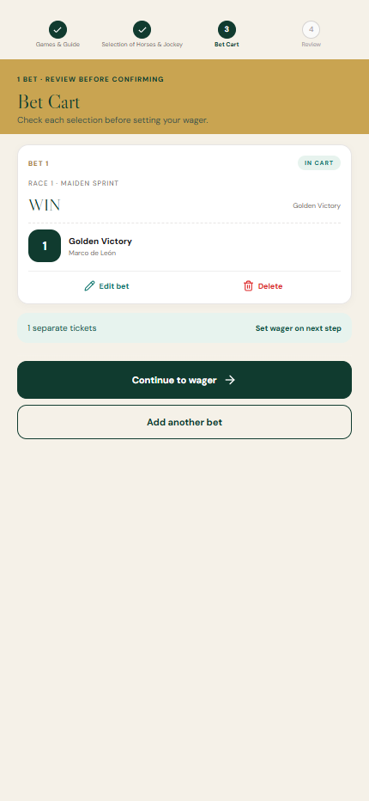
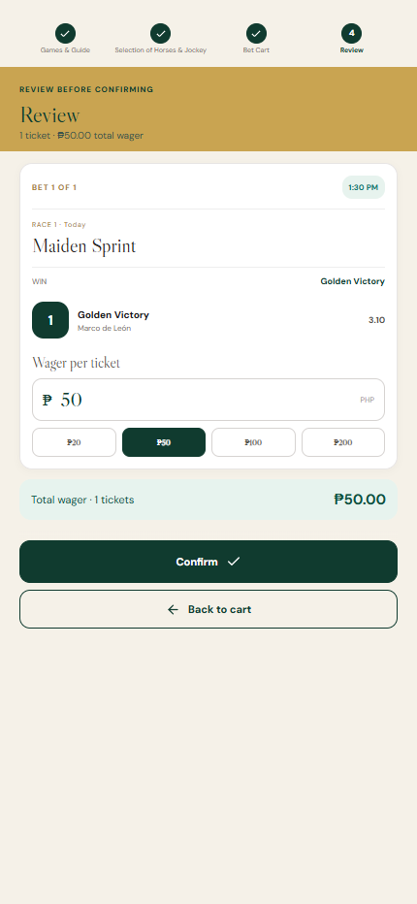
MOBILE SCREENSHOTS
Mobile UI · Games and wager review
GAMES & GUIDE
BET CART
REVIEW
Choose the betting market and learn selection rules.
Review chosen runners and remove or edit a ticket.
Set wager, verify total, then confirm the play-money ticket.
Captured from the running mobile website at 430 × 932 px. Names and race details may be demo content.
PHILIPPINE JOCKEY · SYSTEM OVERVIEW · 16 OCT 2026
10
MOBILE SCREENS

Slide 11
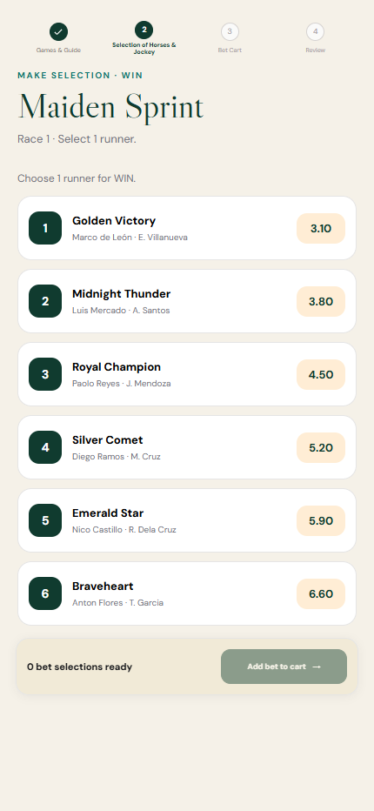
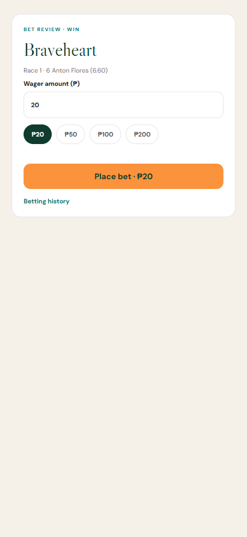
PRE-RACE
Choose runners and confirm a ticket
RUNNER SELECTION
TICKET CONFIRMATION
Pick the horse or horses for the game.
Review the ticket and its reference.
PHILIPPINE JOCKEY | SYSTEM OVERVIEW | 16 OCT 2026
11
PRE-RACE

Slide 12
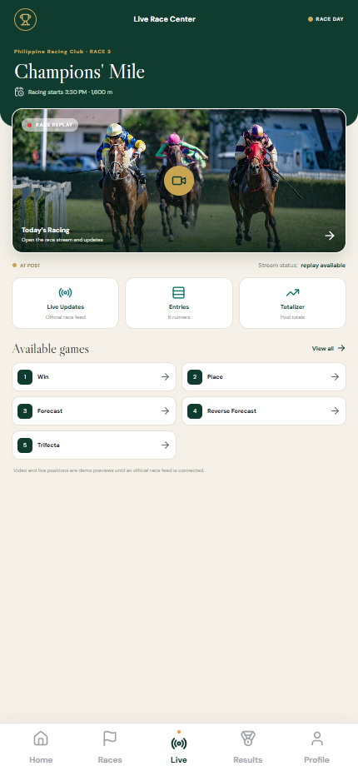
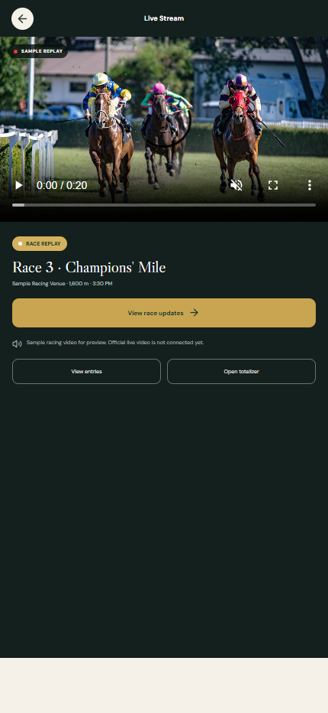
DURING THE RACE
Watch the race live
LIVE CENTER
LIVE STREAM
Open the race stream and live tools.
Watch the race and open race updates.
PHILIPPINE JOCKEY | SYSTEM OVERVIEW | 16 OCT 2026
12
DURING THE RACE

Slide 13
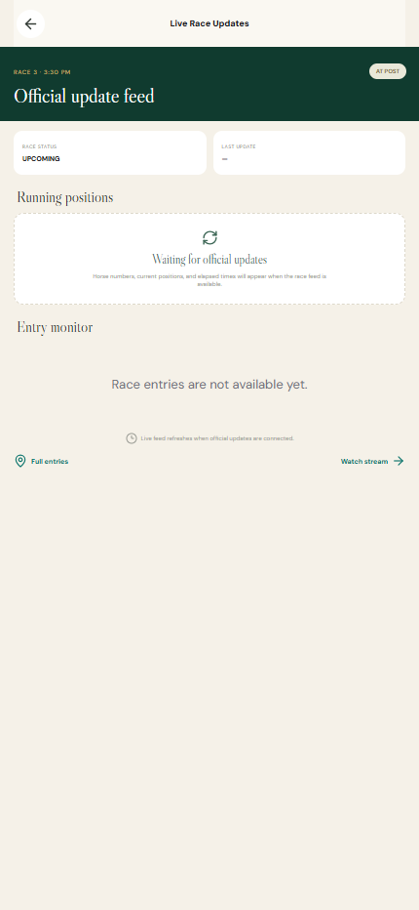
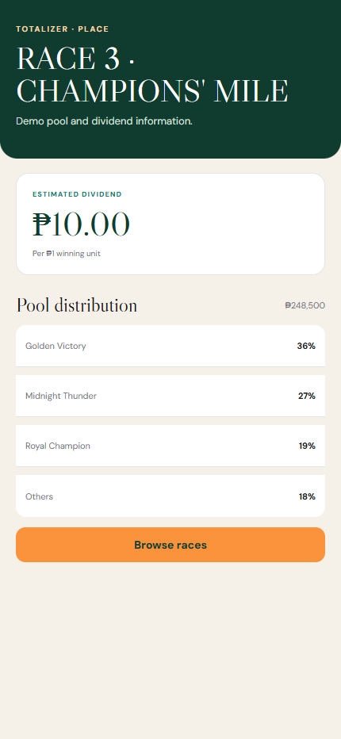
DURING THE RACE
Follow updates and pool information
RACE UPDATES
TOTALIZER
Follow official positions and entrant status.
Review available pools and current totals.
PHILIPPINE JOCKEY | SYSTEM OVERVIEW | 16 OCT 2026
13
DURING THE RACE

Slide 14
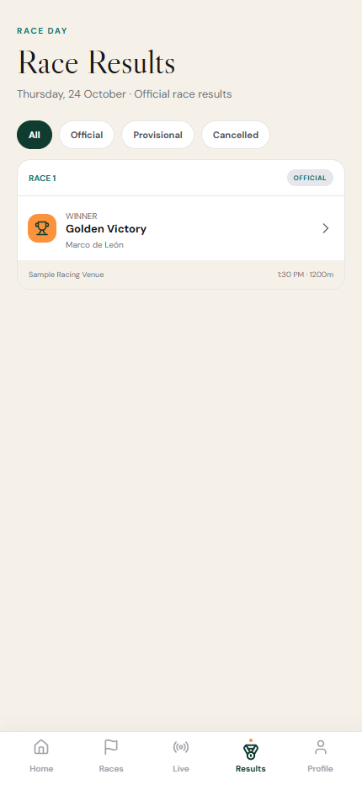
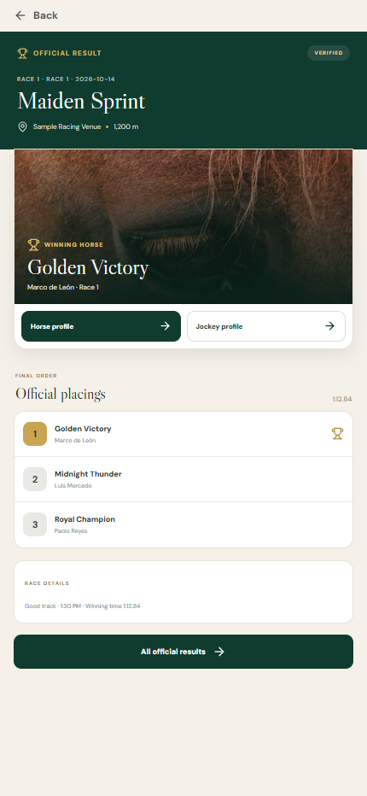

POST-RACE
Review official race results
RESULTS
OFFICIAL RESULT
RESULT DETAIL
Browse finished and provisional races.
See confirmed placings and race details.
Open a race result and its contenders.
PHILIPPINE JOCKEY | SYSTEM OVERVIEW | 16 OCT 2026
14
POST-RACE

Slide 15
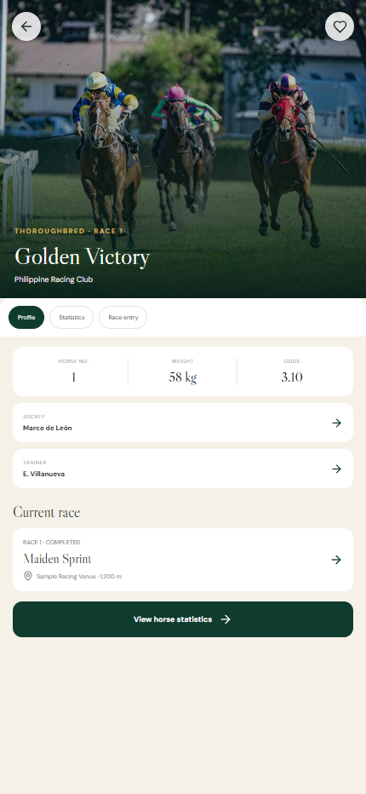
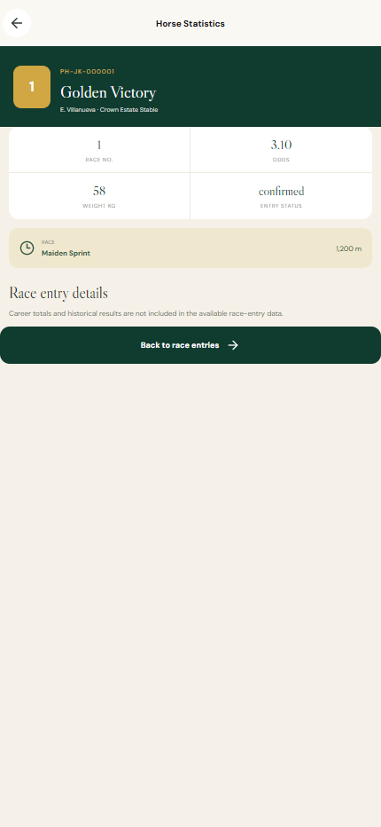
POST-RACE
Explore the winning horse
HORSE PROFILE
HORSE STATISTICS
Review the horse's details and race record.
See form, finishes, and recent performance.
PHILIPPINE JOCKEY | SYSTEM OVERVIEW | 16 OCT 2026
15
POST-RACE

Slide 16
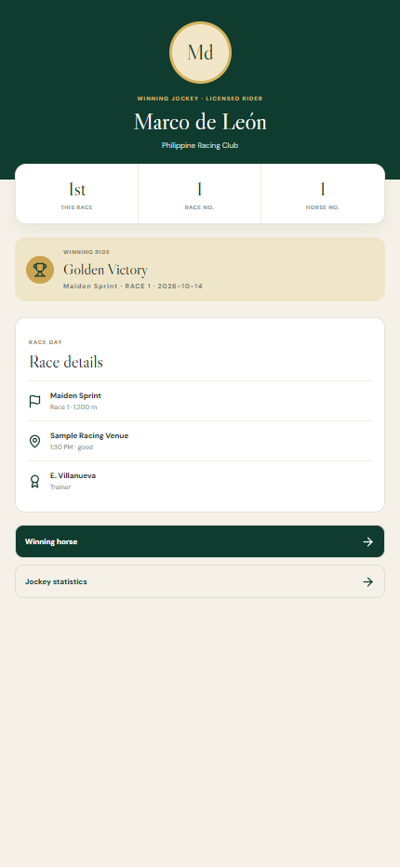
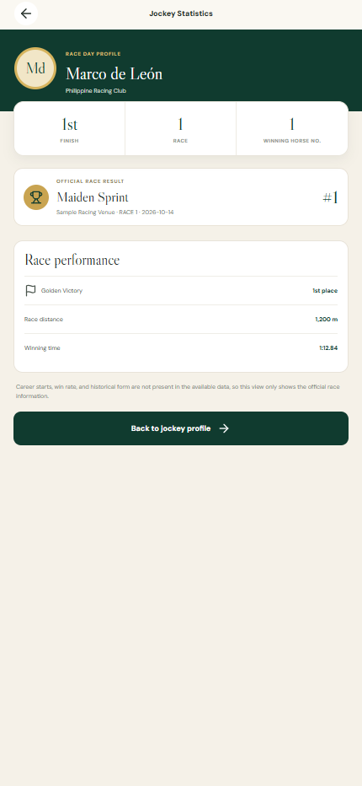
POST-RACE
Explore the winning jockey
JOCKEY PROFILE
JOCKEY STATISTICS
Review the winning jockey's profile.
See participation and recent results.
PHILIPPINE JOCKEY | SYSTEM OVERVIEW | 16 OCT 2026
16
POST-RACE

Slide 17
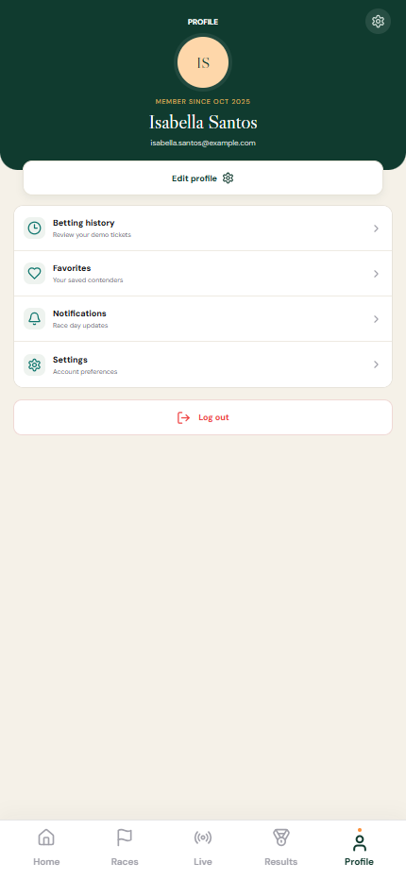
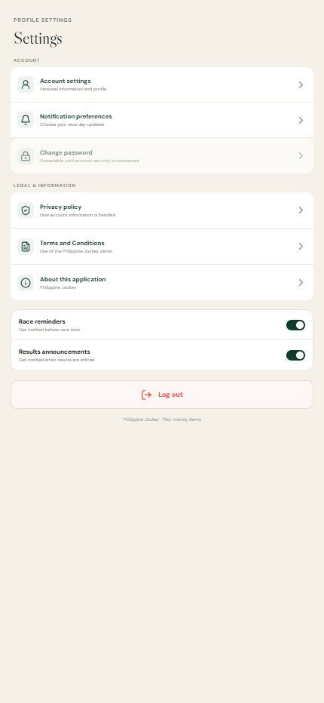
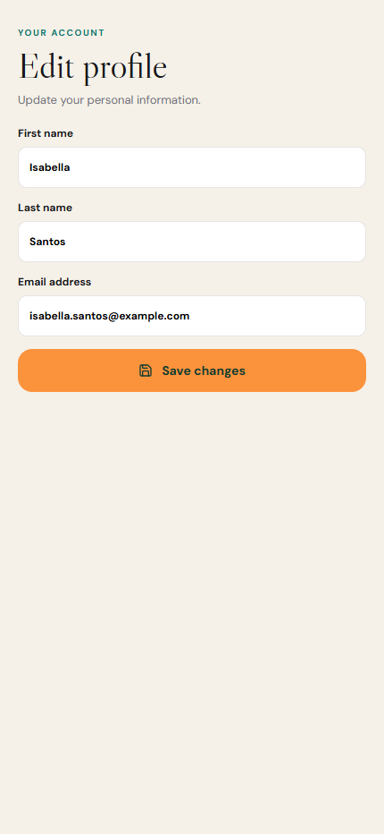
PROFILE
Manage your profile
PROFILE
SETTINGS
EDIT PROFILE
Open account tools and saved information.
Manage preferences and account options.
Update the profile details.
PHILIPPINE JOCKEY | SYSTEM OVERVIEW | 16 OCT 2026
17
PROFILE

Slide 18

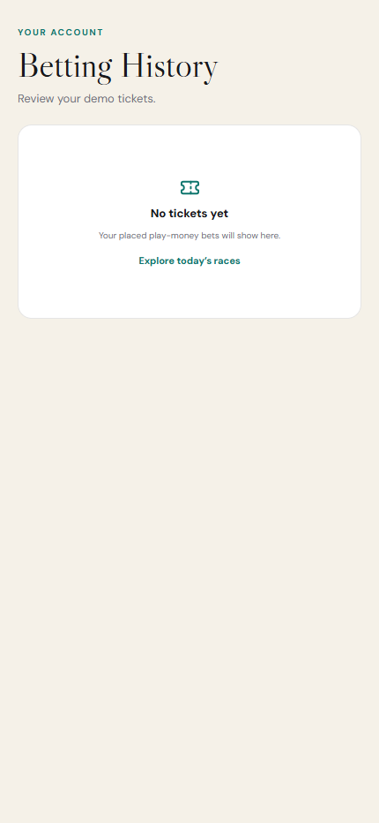
PROFILE
Open saved racing activity
FAVORITES
BETTING HISTORY
Return to saved horses and jockeys.
Review past demo tickets.
PHILIPPINE JOCKEY | SYSTEM OVERVIEW | 16 OCT 2026
18
PROFILE

Slide 19
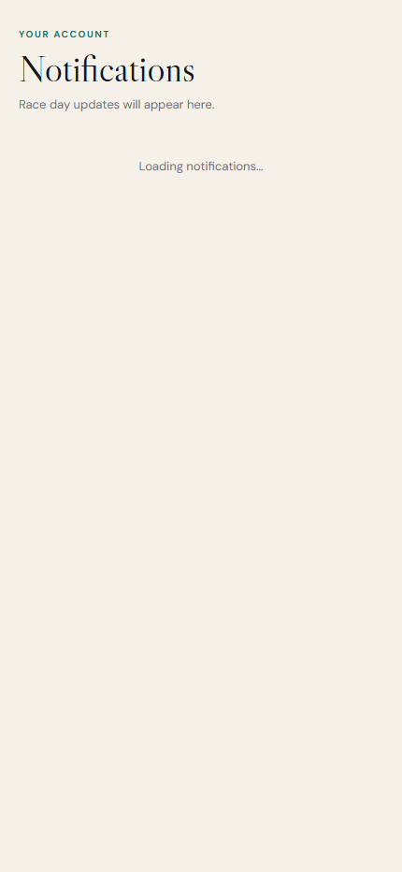

PROFILE
Notifications and rewards
NOTIFICATIONS
REWARDS
Review race-day and account updates.
Review available rewards and progress.
PHILIPPINE JOCKEY | SYSTEM OVERVIEW | 16 OCT 2026
19
PROFILE

Slide 20
SYSTEM FLOW
One clear journey from race discovery to results
DISCOVER → CHOOSE → PLACE A PRACTICE BET → FOLLOW LIVE → SEE RESULTS
Then explore the winning horse, jockey and race history.
Discussion prompts
Does each screen make the next action obvious?
Where should a visitor be able to return or change a choice?
What race-day information should be easiest to find?
PHILIPPINE JOCKEY · SYSTEM OVERVIEW · 16 OCT 2026
20
THANK YOU

