Slide 1

PHILIPPINE JOCKEY
How the system
flows
A visual guide to the Philippine Jockey experience
Visual guide | 16 October 2026
Horse photo is a local demo fallback and does not identify a real race entrant.
Mathias Reding / Unsplash
PHILIPPINE JOCKEY · SYSTEM OVERVIEW · 16 OCT 2026
01

Slide 2
PLACE A BET
Betting flow · from race discovery to ticket
1
Pick a club / race
2
Pick a game
3
Pick runner(s)
Browse meeting dates, clubs, race cards, and entries.
WIN · PLACE · FORECAST · TRIFECTA and supported game rules.
Selection count follows the game requirement; review odds snapshot.
6
Track ticket
5
Confirm
4
Cart & review
Betting history and ticket status after placement / settlement.
Show confirmation and the ticket reference.
Edit or remove tickets; set wager from presets / allowed range.
All wagers shown here are play-money only; no real currency is used in this demo.
PHILIPPINE JOCKEY · SYSTEM OVERVIEW · 16 OCT 2026
02
BETTING

Slide 3
SYSTEM FLOW MAP
The full race-day journey
01 · DISCOVER
02 · CHOOSE
03 · PREPARE
04 · TAKE PART
05 · FOLLOW
Home → Races
Club → Date → Race
Games → Selections
Cart → Review → Ticket
Live → Results
Find a featured race or open the schedule.
Choose where and when to race; open entries.
Learn the game and select horse(s).
Check selections, set wager, confirm.
Follow race updates, then see official placings.
Before the race
During the race
After the race
Race schedule · entries · game guide · bet review
Live center · video area · race updates
Results · winning horse · winning jockey
Profile, settings, favorites and betting history remain available as supporting destinations.
PHILIPPINE JOCKEY · SYSTEM OVERVIEW · 16 OCT 2026
03
HOW IT ALL CONNECTS

Slide 4
PRODUCT FLOW
The customer journey at a glance
01
02
03
04
05
HOME
RACES
LIVE
RESULTS
PROFILE
Discover today's
meeting and featured race
Choose club / date,
open a race and entries
Watch the stream and
follow race updates
Review official placings,
then contender profiles
Manage preferences,
favorites and account
Shared navigation
Supporting destinations
Mobile tab bar: Home · Races · Live · Results · Profile
Games & Guide · Totalizer · Betting history · Favorites · Notifications · Settings
The five main destinations stay within reach through the mobile navigation.
PHILIPPINE JOCKEY · SYSTEM OVERVIEW · 16 OCT 2026
04
EXPERIENCE

Slide 5
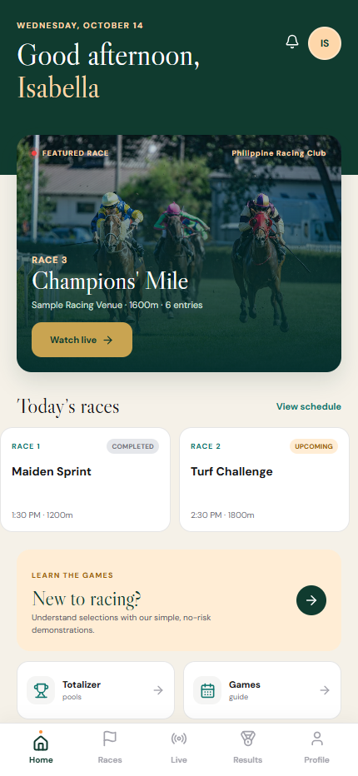
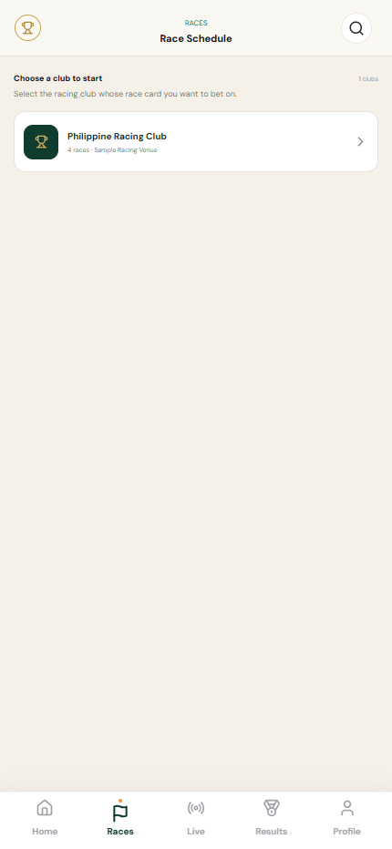
MOBILE SCREENSHOTS
Mobile UI · Home and club selection
HOME
RACES · CLUB PICKER
Featured race, schedule, games and bottom navigation.
The user chooses a racing club before seeing its card.
Captured from the running mobile website at 430 × 932 px. Names and race details may be demo content.
05
PHILIPPINE JOCKEY · SYSTEM OVERVIEW · 16 OCT 2026
MOBILE SCREENS

Slide 6
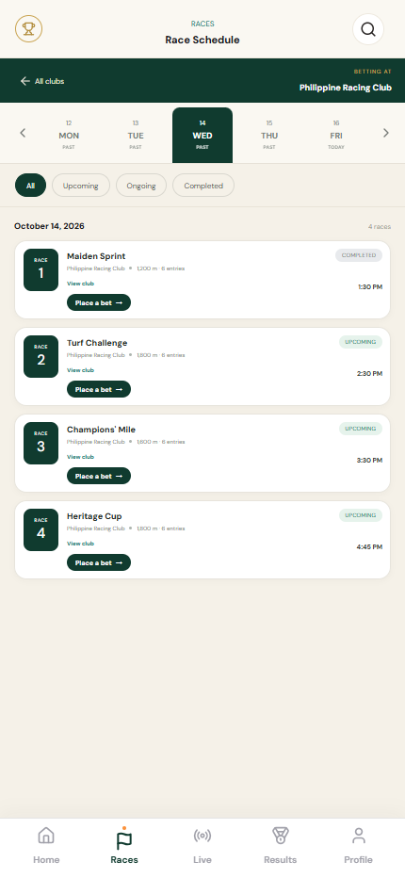
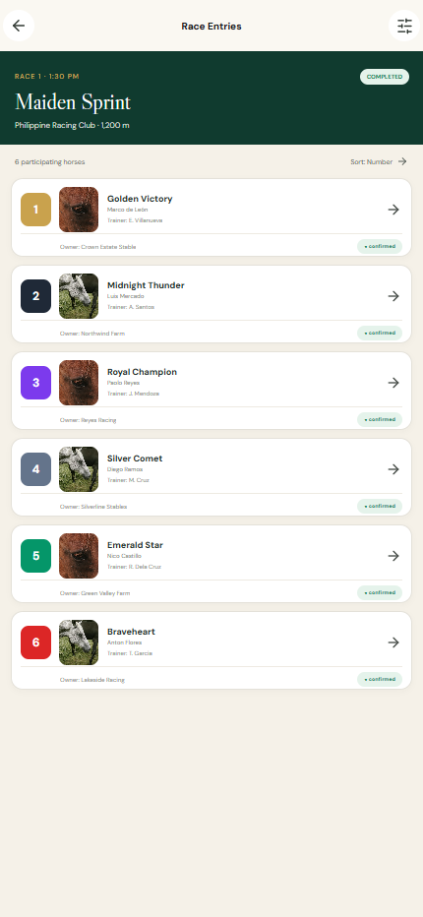
MOBILE SCREENSHOTS
Mobile UI · Race card and entries
RACE SCHEDULE
RACE ENTRIES
Date rail, race status filters and club context.
Runner number, horse, jockey, trainer and owner.
Captured from the running mobile website at 430 × 932 px. Names and race details may be demo content.
06
PHILIPPINE JOCKEY · SYSTEM OVERVIEW · 16 OCT 2026
MOBILE SCREENS

Slide 7
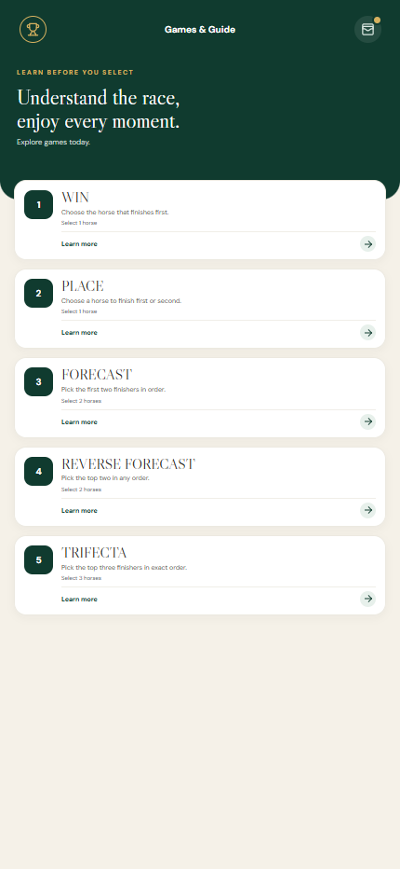
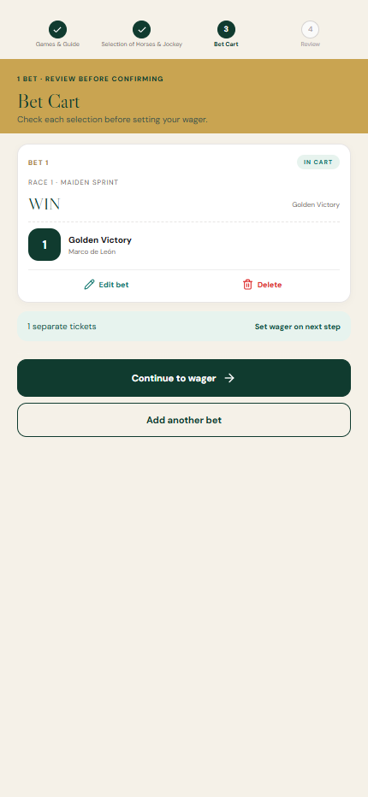
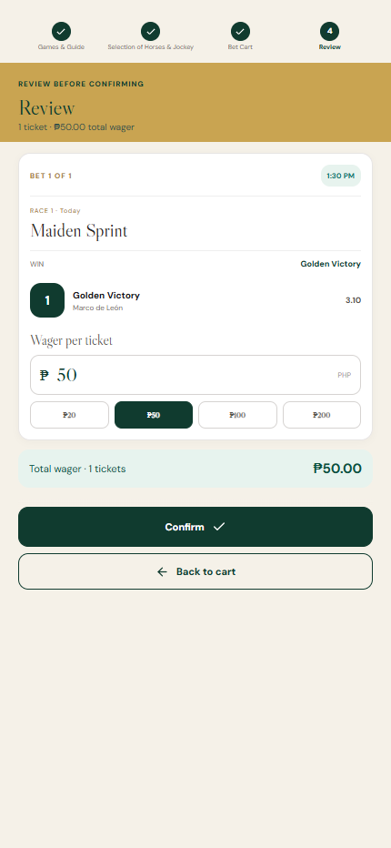
MOBILE SCREENSHOTS
Mobile UI · Games and wager review
GAMES & GUIDE
BET CART
REVIEW
Choose the betting market and learn selection rules.
Review chosen runners and remove or edit a ticket.
Set wager, verify total, then confirm the play-money ticket.
Captured from the running mobile website at 430 × 932 px. Names and race details may be demo content.
PHILIPPINE JOCKEY · SYSTEM OVERVIEW · 16 OCT 2026
07
MOBILE SCREENS

Slide 8
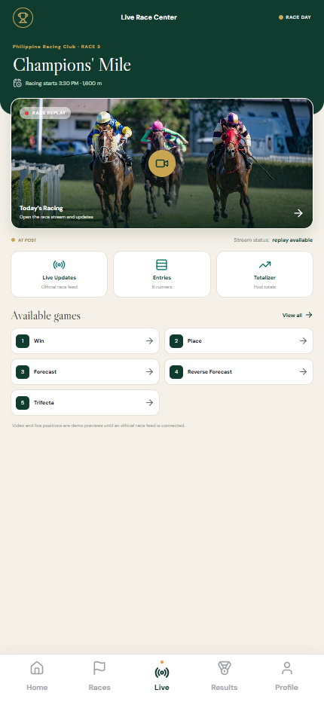
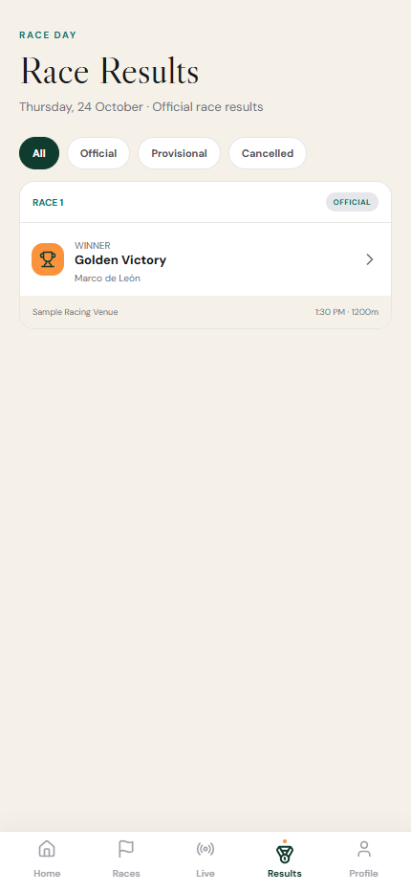
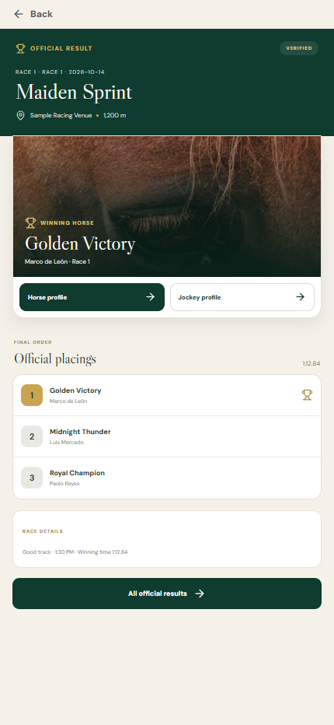
MOBILE SCREENSHOTS
Mobile UI · Live and post-race
LIVE CENTER
RESULTS
OFFICIAL RESULT
Stream entry point and race-day updates.
Filter the result list by official / provisional / cancelled.
Placings link to horse and jockey profiles.
Captured from the running mobile website at 430 × 932 px. Names and race details may be demo content.
PHILIPPINE JOCKEY · SYSTEM OVERVIEW · 16 OCT 2026
08
MOBILE SCREENS

Slide 9
BETTING FLOW
Bet flow · from chosen game to ticket
CHOOSE
SELECT
CHECK
SET
CONFIRM
Pick a game
Choose horses
Review bet cart
Choose wager
Receive ticket
WIN · PLACE
FORECAST · TRIFECTA
Follow the game's
selection guide
Edit or remove
your selections
Use a preset or
enter an amount
See confirmation
and open history
Before you confirm
After you confirm
Check the race, game, selected horses and wager total. If a selection is incomplete, return to the relevant step and finish it.
The system shows a ticket confirmation. Open Betting History to find the ticket again and follow its status.
Play-money demonstration
Review before confirming
Find tickets in history
PHILIPPINE JOCKEY · SYSTEM OVERVIEW · 16 OCT 2026
09
TAKE PART

Slide 10
ACCOUNT FLOW
Account flow · sign in and manage your profile
01
WELCOME
02
ACCOUNT
03
HOME
04
PROFILE
Choose sign in or create an account
Enter your details and continue
Arrive at your race-day dashboard
Open history, favorites and settings
Your race-day tools
A clear return path
Betting history · favorites · rewards · notifications · profile settings.
Use the bottom navigation to return to Home, Races, Live, Results or Profile from the main screens.
The same core destinations are designed for mobile website and app visitors.
PHILIPPINE JOCKEY · SYSTEM OVERVIEW · 16 OCT 2026
10
YOUR ACCOUNT

Slide 11
RACE LIFECYCLE
Race-day flow · before, during and after
BEFORE
DURING
AFTER
Schedule → club → race → entries
Live center → stream → updates
Results → official result → profiles
Dates / status chips / race details / runner list.
Bet entry point is attached to the race.
Stream and update screens exist. Live video and real-time positions need a confirmed provider/feed.
Result detail → winning horse and jockey → statistics. Use official status and result timestamps.
Operational owner to confirm: race status transitions, official result publication, feed freshness, and incident corrections.
PHILIPPINE JOCKEY · SYSTEM OVERVIEW · 16 OCT 2026
11
RACING

Slide 12
POST-RACE FLOW
Post-race flow · result to contender insight
01
02
03
04
Results list
Official result
Winner profile
Jockey profile
Filter by result status
Placings · time · venue
Horse profile / statistics
Race performance / stats
Clear result labels
Current profile limitation
Show an official result only after it has been declared. Include the published time and tell users if a correction is made.
Available contracts do not include full historical horse/jockey career records. The UI avoids inventing career totals.
Website routes: /results → /result/[id] → /horse/[id] or /jockey/[id] → /statistics
PHILIPPINE JOCKEY · SYSTEM OVERVIEW · 16 OCT 2026
12
RESULTS

Slide 13
MAIN DESTINATIONS
Where each part of the experience takes you
DESTINATION
WHAT YOU CAN DO
NEXT STEP
Home
View the featured race and today's highlights
Open schedule or live race
Races
Choose a club, date, race and horse
Open entries or place a bet
Games
Understand Win, Place, Forecast and more
Choose selections
Live
Open the live race center and updates
Return to races or results
Results
See race finish order and official result
Explore winning contenders
Profile
Open account tools, favorites and history
Manage personal preferences
The five-tab mobile navigation keeps the main journey within easy reach.
PHILIPPINE JOCKEY · SYSTEM OVERVIEW · 16 OCT 2026
13
NAVIGATION

Slide 14
STATUS CHANGES
How a race and a bet move forward
RACE
Upcoming
Ongoing
Completed
Official
Waiting for post time
Race is in progress
Race has finished
Results are declared
BET
Draft
Review
Confirmed
History
Choose game and horses
Check ticket and wager
Ticket is created
Check ticket progress
The key hand-off
Race details guide the choice. The bet ticket keeps the selection together. Results complete the race story.
PHILIPPINE JOCKEY · SYSTEM OVERVIEW · 16 OCT 2026
14
WHAT HAPPENS NEXT

Slide 15
HELPFUL MOMENTS
If a user gets stuck, make the next step clear
No races on this date
No horse selected
Offer nearby dates and let the user switch days.
Return to race entries and explain the game requirement.
Wager needs attention
Bet was not completed
Show the total clearly and explain how to correct it.
Keep selections available so the user can review again.
Live video unavailable
Result is not official yet
Keep race updates and schedule details easy to reach.
Label the result clearly and guide users back later.
Every interruption should preserve the user's place and show a simple next action.
PHILIPPINE JOCKEY · SYSTEM OVERVIEW · 16 OCT 2026
15
GUIDANCE AND FEEDBACK

Slide 16
RACE-DAY CONTENT
What users need to see at every step
FIND A RACE
MAKE A CHOICE
FOLLOW THE STORY
Club name and location
Meeting dates and race status
Distance, time and entry count
Game instructions and selection count
Horse / jockey / trainer details
Wager amount and ticket summary
Live status and useful race updates
Clear provisional / official result labels
Winning horse and jockey profiles
Also keep help, account settings and betting history easy to find from the main navigation.
Demo note: the current experience uses play-money bets; race content and photos can be sample material.
PHILIPPINE JOCKEY · SYSTEM OVERVIEW · 16 OCT 2026
16
A COMPLETE EXPERIENCE

Slide 17
PRESENTATION FLOW
A simple walkthrough for any audience
1
Start at Home
Point out the featured race and bottom navigation.
2
Choose a club and race
Show the date rail, race status, and horse entries.
3
Build a practice bet
Choose a game, select horses, review the cart and wager.
4
Follow race day
Open Live and explain where race updates appear.
5
Close the race story
Show results and open the winning horse / jockey profiles.
This order follows the way a race-day visitor naturally explores the system.
PHILIPPINE JOCKEY · SYSTEM OVERVIEW · 16 OCT 2026
17
SHOW THE EXPERIENCE

Slide 18
SYSTEM FLOW
One clear journey from race discovery to results
DISCOVER → CHOOSE → PLACE A PRACTICE BET → FOLLOW LIVE → SEE RESULTS
Then explore the winning horse, jockey and race history.
Discussion prompts
Does each screen make the next action obvious?
Where should a visitor be able to return or change a choice?
What race-day information should be easiest to find?
PHILIPPINE JOCKEY · SYSTEM OVERVIEW · 16 OCT 2026
18
THANK YOU

