Slide 1
PHILIPPINE JOCKEY
Product flows
& page guide
A walkthrough of the mobile app and web experience—from sign-in to race day, bets, results, and account tools.
APP + WEB · DEMO EDITION
Product overview · October 2026 · Currency: PHP (₱)

Slide 2
PHILIPPINE JOCKEY / PRODUCT OVERVIEW
What the product does
Discover racing
Place demo bets
Follow outcomes
Browse race days, clubs, race cards, horses, jockeys, tips, and live race information.
Choose a race and game, select runners, set a stake, review the ticket, and see confirmation.
Check results, podiums, dividends, tickets, win notifications, favorites, and profile tools.
Designed as one racing experience across
Expo mobile app
›
Shared domain UI/data
›
Next.js web app
Important: this repository is a frontend demo. It currently uses mock data and simulated wallet/betting behavior; no real money is accepted or paid out.
Play-money demo · Mobile app and web · Philippine Peso (₱)
02

Slide 3
PHILIPPINE JOCKEY / PRODUCT OVERVIEW
How people move through the app
Splash
›
Onboarding
›
Welcome / Sign in / Sign up
›
Home dashboard
PRIMARY APP TABS
Shared secondary pages
Home
Dashboard, live feature, today's races, shortcuts, My Bets
Race detail and entries
Bet selection and cart
Review and confirmation
Ticket detail and betting history
Horse / jockey / club profiles
Games, guides, rewards, totalizer
Races
Meeting calendar, clubs, filters, race cards
Live
Stream preview, updates, entries, totalizer, available games
Results
Official/provisional/cancelled result list and details
Profile
Demo balance, edit profile, history, favorites, notifications, settings
Play-money demo · Mobile app and web · Philippine Peso (₱)
03

Slide 4
PHILIPPINE JOCKEY / PRODUCT OVERVIEW
Flow 1 · Account access
Splash
›
Onboarding
›
Welcome
›
Log in or sign up
›
Home
Sign up
Sign in / sign out
Collects first name, last name, email, mobile, and password. The demo creates a client-side session and sample account.
Sign in opens the app session. Profile offers log out. Auth routes are shared by mobile and web; current demo mode can bypass authentication.
Routes: /splash · /(onboarding)/onboarding · /(auth)/welcome · /(auth)/login · /(auth)/signup
Play-money demo · Mobile app and web · Philippine Peso (₱)
04

Slide 5
PHILIPPINE JOCKEY / PRODUCT OVERVIEW
Flow 2 · Dashboard to race card
Dashboard
›
Race schedule
›
Choose date / club
›
Race detail
›
Entries
Dashboard entry points
Race discovery
Race detail
Live race feature
Today's race cards
Promoted games
My Bets
Shortcuts to guides and utilities
Pick a meeting date and racing club. Filter by race status or search. Tap a card to inspect the race.
See venue, race conditions, entries, participants, game markets, tips, and routes into betting.
Routes: /(tabs)/index · /(tabs)/races · /race/[id] · /race/[id]/entries · /horse/[id] · /jockey/[id] · /club/[slug]
Play-money demo · Mobile app and web · Philippine Peso (₱)
05

Slide 6
PHILIPPINE JOCKEY / PRODUCT OVERVIEW
Flow 3 · Place a demo bet
Race
›
Market
›
Runner selection
›
Bet cart
›
Review
›
Confirmation
›
Ticket
1 · Select
2 · Review
3 · Track
Choose a race and supported market (WIN, PLACE, FORECAST, TRIFECTA, and others). Select runner(s) and enter a stake.
Review the selection, stake, and ticket summary before submitting. This is a simulated play-money action.
The app shows a confirmation and ticket details; tickets can be revisited from My Bets / Betting History.
Routes: /selection/[id] · /bet-cart · /review · /bet-complete · /ticket/[id] · /betting-history
Play-money demo · Mobile app and web · Philippine Peso (₱)
06

Slide 7
PHILIPPINE JOCKEY / PRODUCT OVERVIEW
Flow 4 · Live race experience
Live tab
›
Stream preview
›
Live updates
›
Entries
›
Totalizer / games
Live center
Pools and markets
The live tab shows the featured race, a stream preview, update link, race entries, totalizer, and available games. The included stream is demo content.
Totalizer pages show sample pool/dividend information. Games routes explain available bet types and can start a selection flow.
Routes: /(tabs)/live · /live/stream · /live/updates · /totalizer/[id] · /totalizer/pool/[id] · /totalizer/dividend/[id] · /games · /games/[id]
Play-money demo · Mobile app and web · Philippine Peso (₱)
07

Slide 8
PHILIPPINE JOCKEY / PRODUCT OVERVIEW
Flow 5 · Race result to winner notification
Results list
›
Result detail
›
Match ticket to result
›
Win notice
›
Profile notifications
Result detail
Bet win notification
Users can inspect official placements, podium, winning time, dividends, race summary, and horse/jockey profiles.
When official results are compared with the user's saved tickets, the demo can create a notification describing a winning ticket and its simulated return.
Routes: /(tabs)/results · /result/[id] · /notifications · /ticket/[id]
Play-money demo · Mobile app and web · Philippine Peso (₱)
08

Slide 9
PHILIPPINE JOCKEY / PRODUCT OVERVIEW
Flow 6 · Profile and account tools
Profile
›
Choose account tool
›
Edit / review
›
Return to profile
Balance & withdrawal
Betting history
Favorites
Displays a demo balance. Withdrawal is not processed.
View tickets and their current demo status.
Save and revisit horses or contenders.
Notifications
Settings & profile
Review updates and simulated bet-win notices.
Edit basic profile details and account preferences.
Routes: /(tabs)/profile · /withdraw · /edit-profile · /settings · /favorites · /betting-history · /notifications · /rewards
Play-money demo · Mobile app and web · Philippine Peso (₱)
09

Slide 10
PHILIPPINE JOCKEY / PRODUCT OVERVIEW
Mobile app · Page inventory
Entry & auth
Main tabs
Splash · Onboarding · Welcome · Login · Sign up
Home · Races · Live · Results · Profile
Racing
Betting
Race detail · Entries · Result detail · Horse profile/statistics · Jockey profile/statistics · Club profile
Selection · Bet cart · Review · Bet complete · Ticket detail · Betting history
Live & info
Account & pools
Live updates · Stream · Games · Game detail · Racing guide · JockeyPH guide · Contender
Notifications · Settings · Edit profile · Rewards · Withdraw · Totalizer · Pool · Dividend
Play-money demo · Mobile app and web · Philippine Peso (₱)
10

Slide 11
PHILIPPINE JOCKEY / PRODUCT OVERVIEW
Web app · Page inventory
Public access
Dashboard and racing
Login · Register
Dashboard · Races · Race detail · Entries · Results · Result detail
Betting and live
Profile and info
Selection · Bet cart · Review · Bet complete · Betting history · Live · Stream · Updates
Profile · Edit profile · Settings · Notifications · Favorites · Rewards · Withdraw · Games · Guides · Totalizer · Horse/jockey/club pages
Web dashboard navigation includes Home, Races, Race Program & Tips, JockeyPH Guide, Live, Results, and Profile. A mobile tab bar supports small screens.
Play-money demo · Mobile app and web · Philippine Peso (₱)
11

Slide 12
PHILIPPINE JOCKEY / PRODUCT OVERVIEW
Data, wallet, and integration status
Current demo seam
Demo wallet
Future Django API
Screens call a shared API client. Mock mode provides local sample races, results, tickets, and profile data.
Balance is sample UI state. Bet placement, winnings, and withdrawals do not move real funds or connect to a live ledger.
A contract documents expected endpoints, but the backend must implement, secure, and connect persistence before data is database-backed.
Frontend mock data
›
API contract
›
Django endpoints
›
Database + ledger
A real wallet requires server-side balance and immutable transaction records, authenticated APIs, idempotent operations, and reconciliation. Do not trust client-side balance changes.
Play-money demo · Mobile app and web · Philippine Peso (₱)
12

Slide 13
PHILIPPINE JOCKEY / PRODUCT OVERVIEW
The complete customer journey
Sign in
›
Discover a race
›
Study runners
›
Place a demo bet
›
Follow live race
›
Check official result
›
Review ticket & notice
User outcome
Product boundary
One connected journey links discovery, runner information, a bet ticket, race coverage, result detail, and follow-up notification.
The current implementation demonstrates the experience with mock data and play-money values. Database persistence and real payment processing are future backend work.
Thank you · Philippine Jockey · App + Web
Play-money demo · Mobile app and web · Philippine Peso (₱)
13

Slide 14


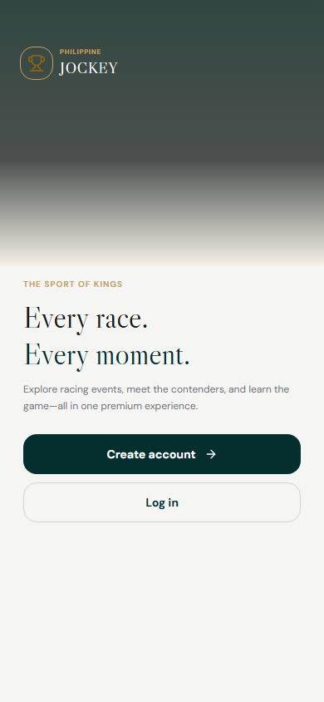
APPENDIX / MOBILE SCREENSHOTS
Mobile screen gallery · pages 1–3 of 43
Splash
Onboarding
Welcome
/splash
/onboarding
/welcome
Play-money demo · Mobile app and web · Philippine Peso (₱)
14

Slide 15
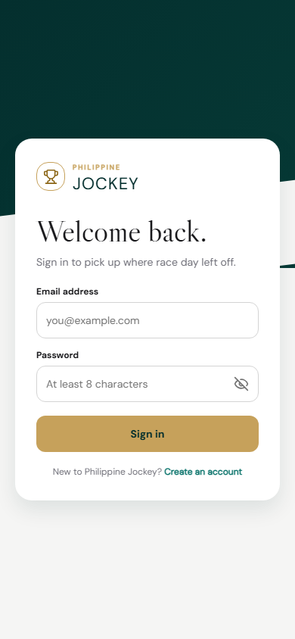
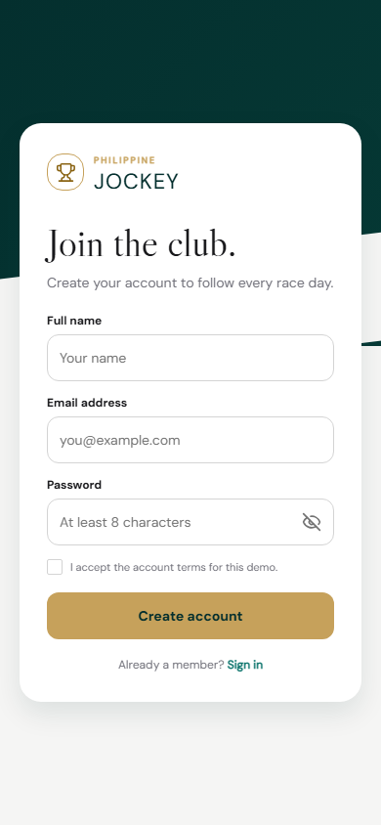
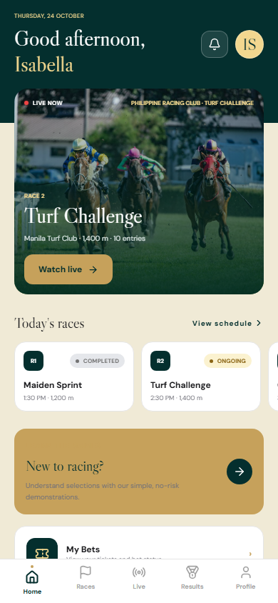
APPENDIX / MOBILE SCREENSHOTS
Mobile screen gallery · pages 4–6 of 43
Login
Sign up
Home dashboard
/login
/signup
/
Play-money demo · Mobile app and web · Philippine Peso (₱)
15

Slide 16
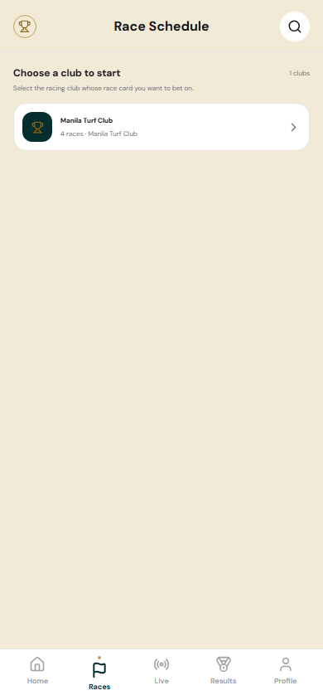
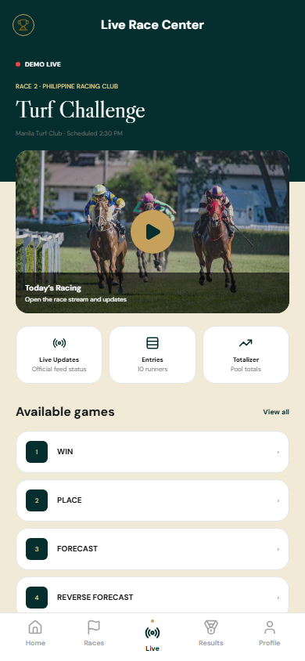
APPENDIX / MOBILE SCREENSHOTS
Mobile screen gallery · pages 7–9 of 43
Dashboard
Races
Live
/dashboard
/races
/live
Play-money demo · Mobile app and web · Philippine Peso (₱)
16

Slide 17
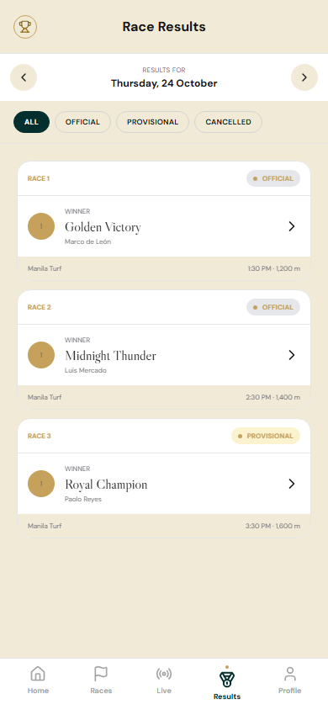
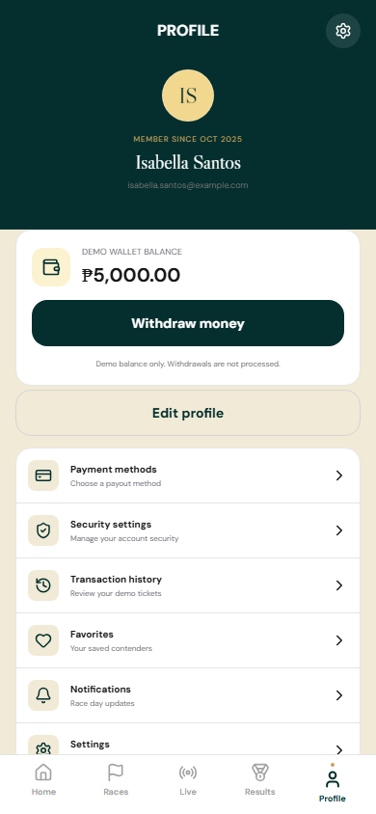
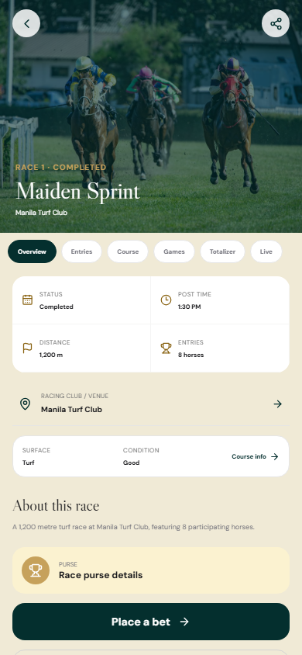
APPENDIX / MOBILE SCREENSHOTS
Mobile screen gallery · pages 10–12 of 43
Results
Profile
Race detail
/results
/profile
/race/race-1
Play-money demo · Mobile app and web · Philippine Peso (₱)
17

Slide 18
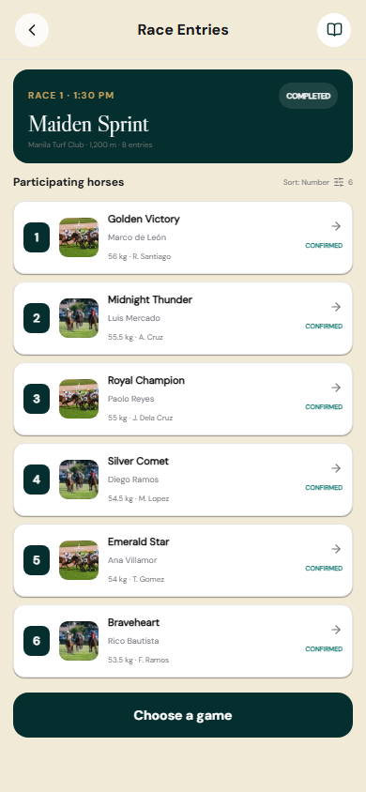
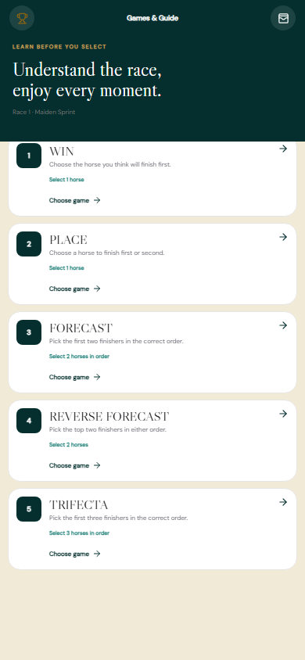
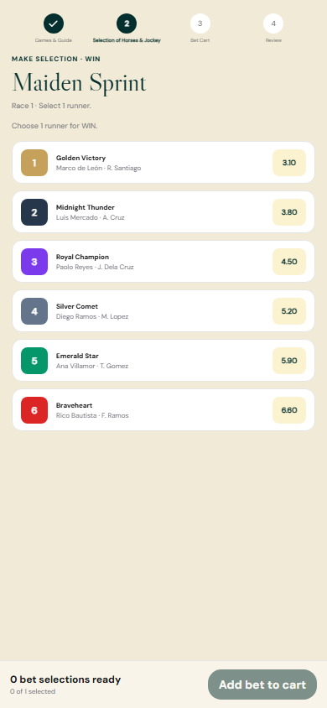
APPENDIX / MOBILE SCREENSHOTS
Mobile screen gallery · pages 13–15 of 43
Race entries
Race bet screen
Bet selection
/race/race-1/entries
/race/race-1/bet
/selection/race-1?market=WIN
Play-money demo · Mobile app and web · Philippine Peso (₱)
18

Slide 19
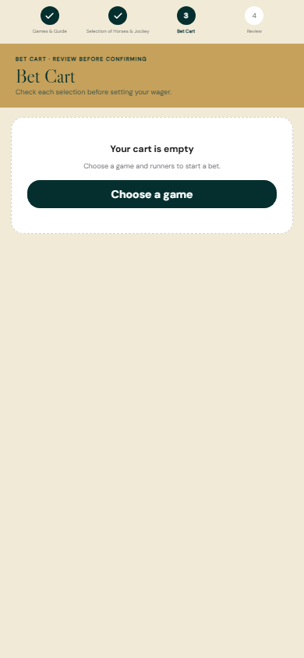

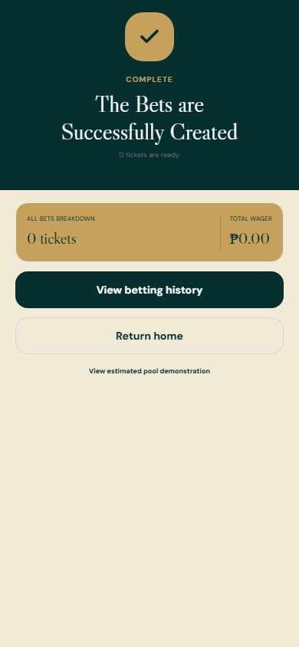
APPENDIX / MOBILE SCREENSHOTS
Mobile screen gallery · pages 16–18 of 43
Bet cart
Bet review
Bet confirmation
/bet-cart
/review
/bet-complete
Play-money demo · Mobile app and web · Philippine Peso (₱)
19

Slide 20
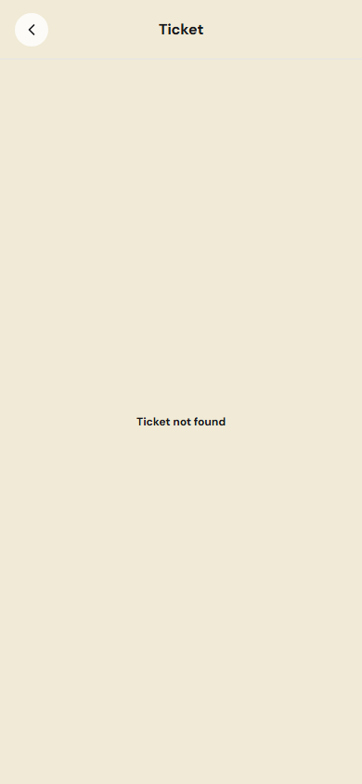
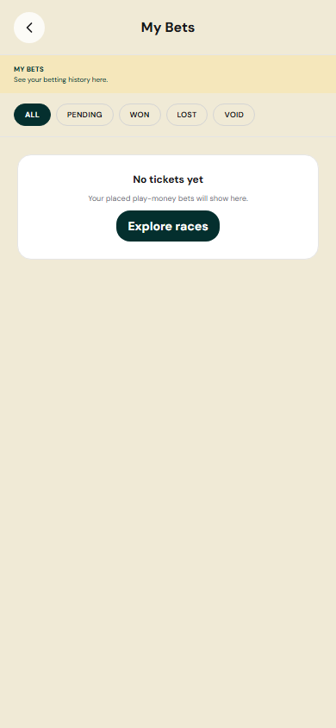
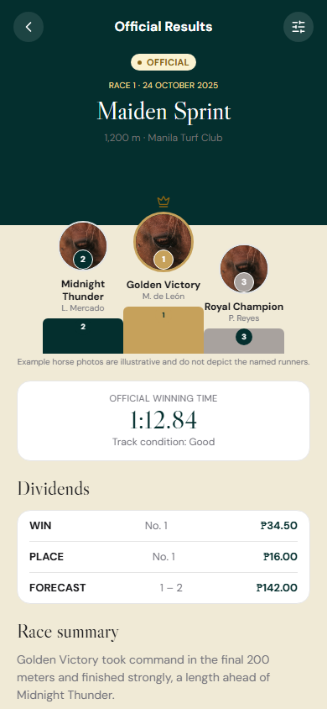
APPENDIX / MOBILE SCREENSHOTS
Mobile screen gallery · pages 19–21 of 43
Ticket detail
Betting history
Result detail
/ticket/PJA-DEMO-001
/betting-history
/result/res-1
Play-money demo · Mobile app and web · Philippine Peso (₱)
20

Slide 21
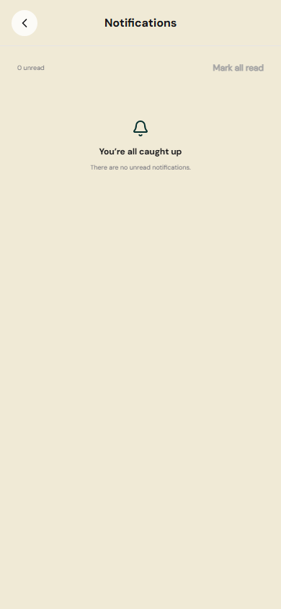
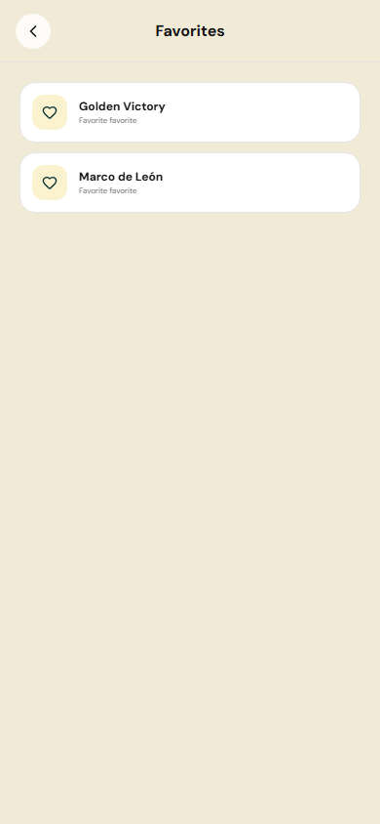
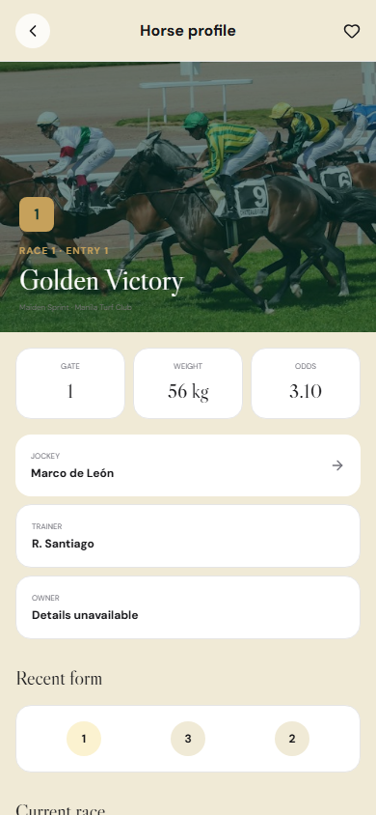
APPENDIX / MOBILE SCREENSHOTS
Mobile screen gallery · pages 22–24 of 43
Notifications
Favorites
Horse profile
/notifications
/favorites
/horse/r1?race=race-1
Play-money demo · Mobile app and web · Philippine Peso (₱)
21

Slide 22
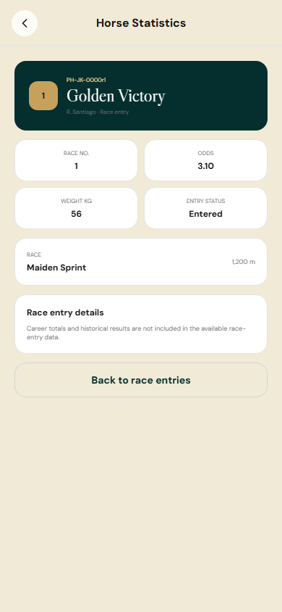
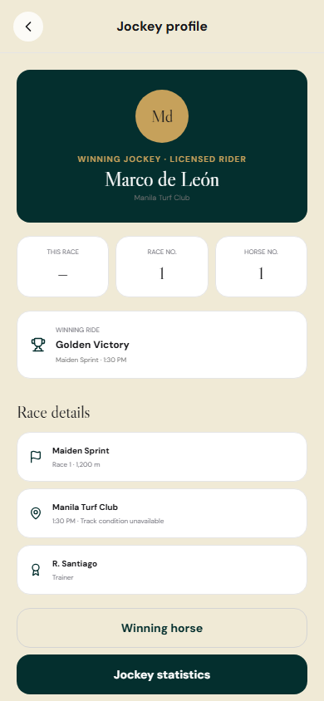
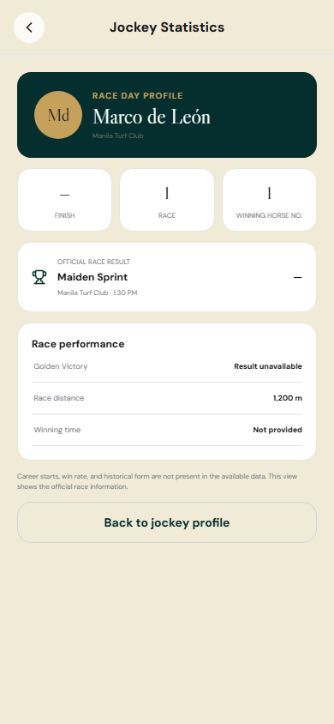
APPENDIX / MOBILE SCREENSHOTS
Mobile screen gallery · pages 25–27 of 43
Horse statistics
Jockey profile
Jockey statistics
/horse/r1/statistics?race=race-1
/jockey/marco-de-leon?race=race-1
/jockey/marco-de-leon/statistics?race=race-1
Play-money demo · Mobile app and web · Philippine Peso (₱)
22

Slide 23
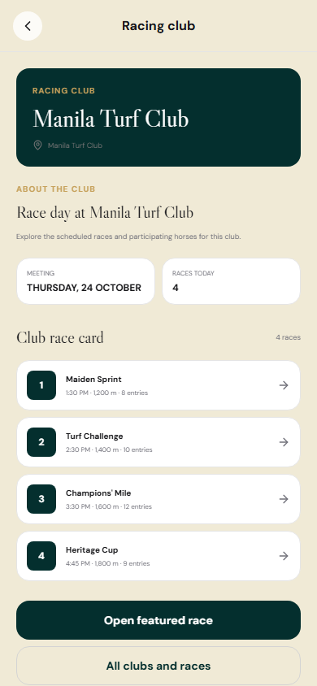
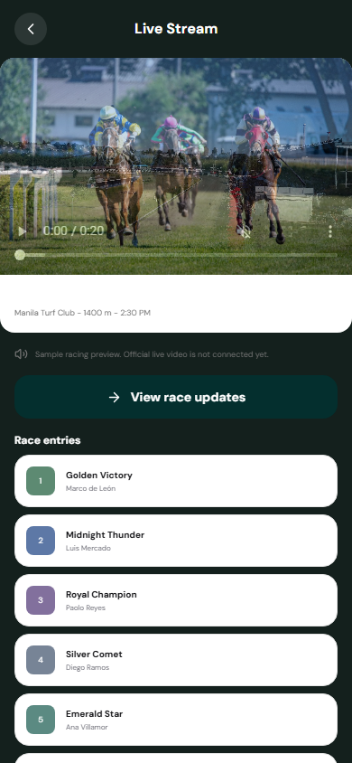
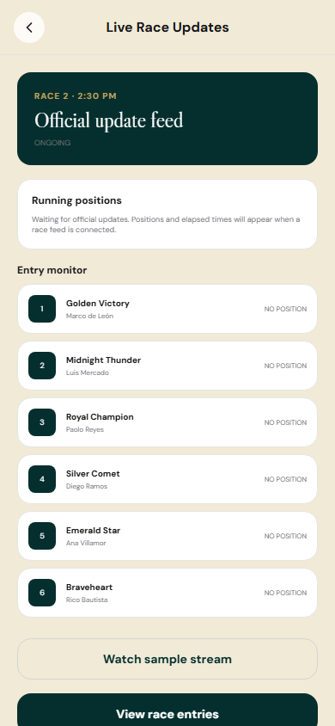
APPENDIX / MOBILE SCREENSHOTS
Mobile screen gallery · pages 28–30 of 43
Club profile
Live stream
Live updates
/club/manila-turf-club
/live/stream
/live/updates
Play-money demo · Mobile app and web · Philippine Peso (₱)
23

Slide 24
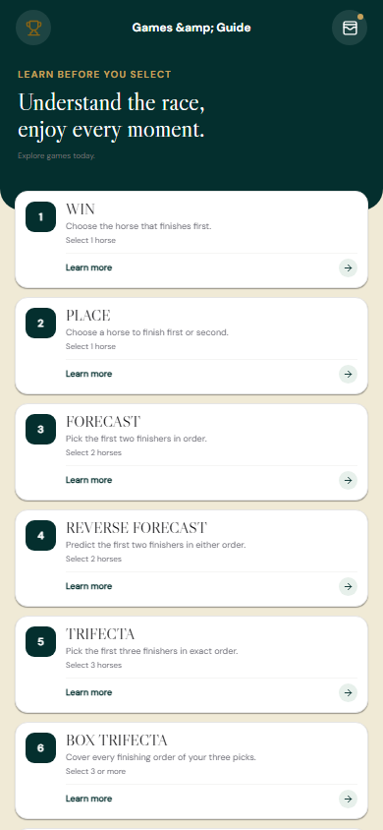
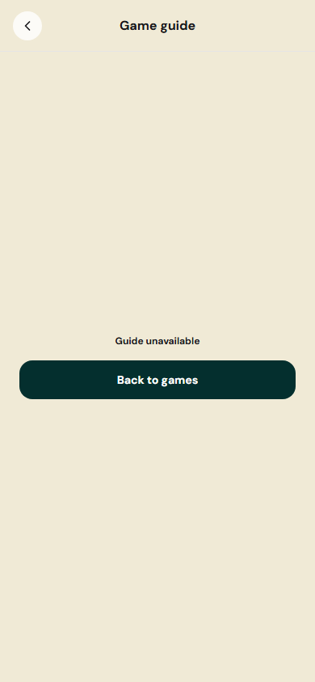
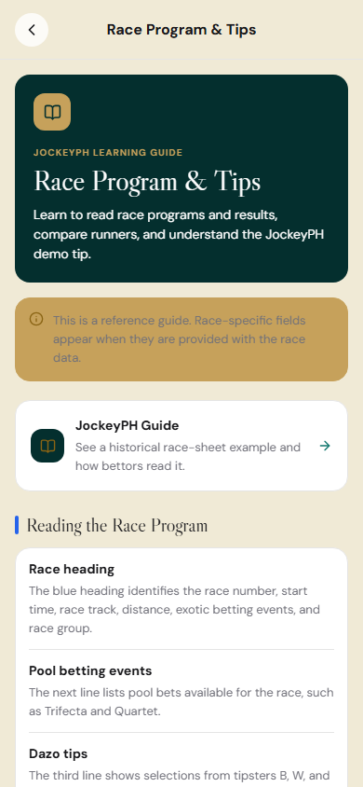
APPENDIX / MOBILE SCREENSHOTS
Mobile screen gallery · pages 31–33 of 43
Games
Game detail
Racing guide
/games
/games/win
/racing-guide
Play-money demo · Mobile app and web · Philippine Peso (₱)
24

Slide 25
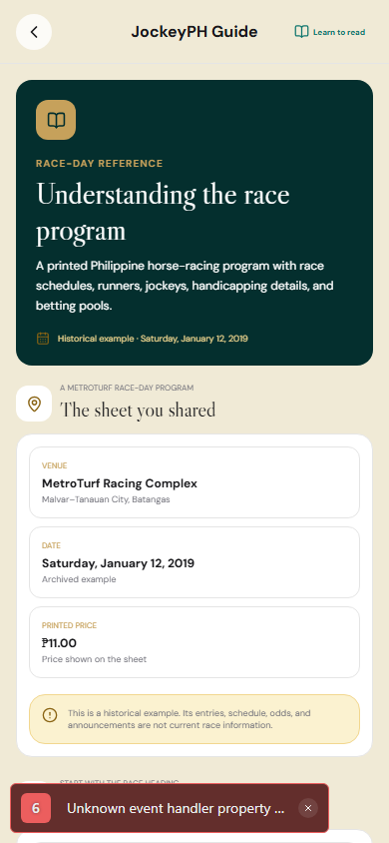

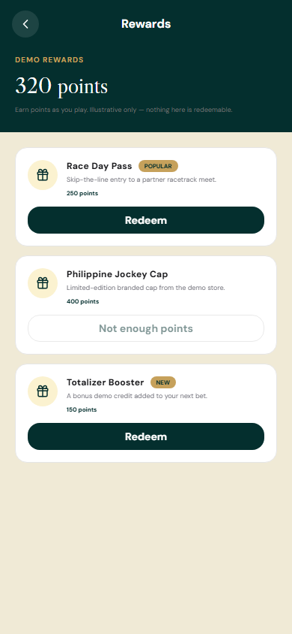
APPENDIX / MOBILE SCREENSHOTS
Mobile screen gallery · pages 34–36 of 43
JockeyPH guide
Contender
Rewards
/jockeyph-guide
/contender
/rewards
Play-money demo · Mobile app and web · Philippine Peso (₱)
25

Slide 26
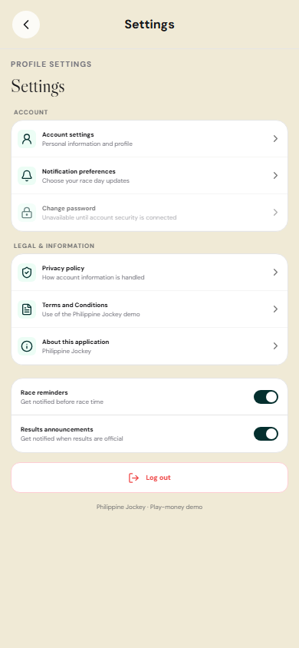
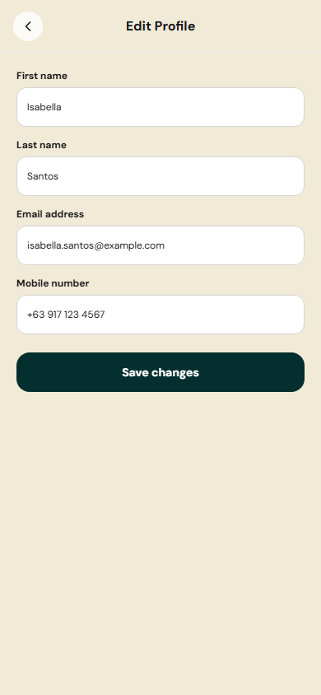
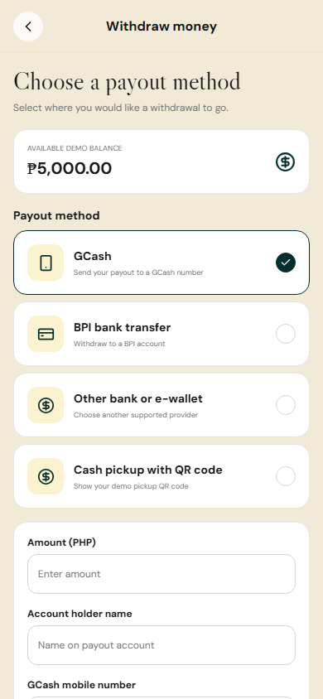
APPENDIX / MOBILE SCREENSHOTS
Mobile screen gallery · pages 37–39 of 43
Settings
Edit profile
Withdraw demo balance
/settings
/edit-profile
/withdraw
Play-money demo · Mobile app and web · Philippine Peso (₱)
26

Slide 27
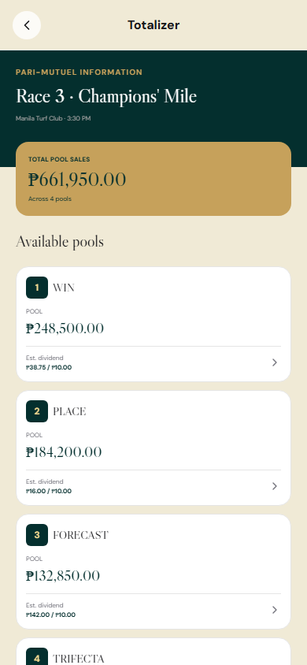
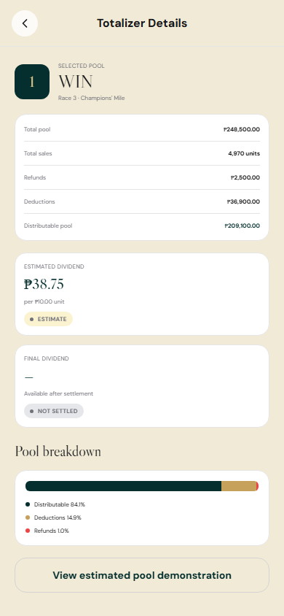
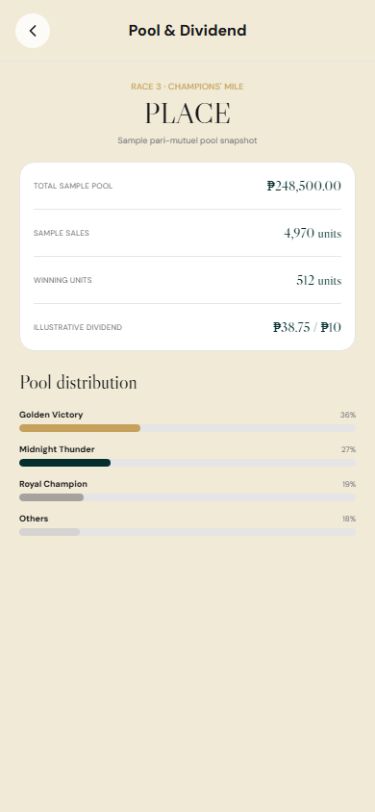
APPENDIX / MOBILE SCREENSHOTS
Mobile screen gallery · pages 40–42 of 43
Totalizer
Pool detail
Dividend detail
/totalizer/race-3
/totalizer/pool/pool-win-r3
/totalizer/dividend/pool-place-r3
Play-money demo · Mobile app and web · Philippine Peso (₱)
27

Slide 28
APPENDIX / MOBILE SCREENSHOTS
Mobile screen gallery · pages 43–43 of 43
Registration
/register
Play-money demo · Mobile app and web · Philippine Peso (₱)
28

