Slide 1
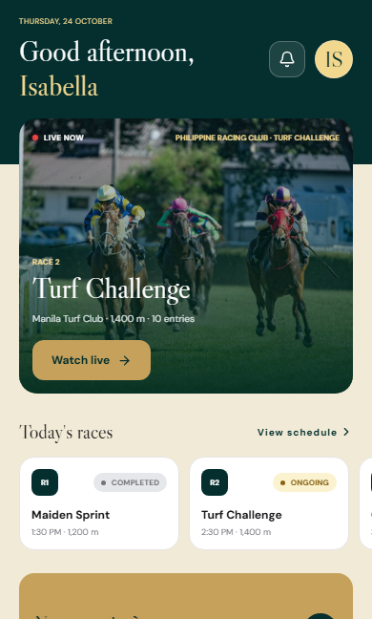
JOCKEY
RACING INFORMATION PLATFORM
JOCKEY
Racing,
within reach.
Programs. Form. Results.
A connected racing experience with membership access.
SAVED MOBILE INTERFACE / 18 OCT 2026
PRODUCT SHOWCASE / 19 OCTOBER 2026
01
Notes:
Open with the product, rather than the technology. JOCKEY connects discovery, race information and results. The cover shows the saved mobile home interface; current web membership is covered later.
Image provenance: actual saved mobile UI capture, 18 October 2026. This predates the latest web directory, header and membership refinements. UI values are illustrative records, not official racing coverage. Cropping changes framing only.
[Sources]
SETUP.md: current access policy, plans, generated seed and deployment status.
RECONSTRUCTION.md: race information and recorded-history behavior.
FE/jockey_frontend-main/docs/mobile-screenshots/06-home-dashboard.png
FE/jockey_frontend-main/docs/mobile-screenshots/manifest.json: capture-to-route mapping.
[/Sources]

Slide 2
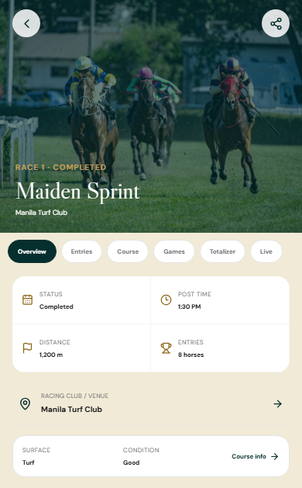
JOCKEY
THE CUSTOMER JOURNEY
One place to follow race day
01
Discover the meeting
Start with the date, venue and race program.
02
Study the field
Open runners, connections and recorded form.
03
Follow the result
Return for the finish order and published detail.
SAVED MOBILE INTERFACE / 18 OCT 2026
PRODUCT SHOWCASE / 19 OCTOBER 2026
02
Notes:
The current web entry point is the public racing calendar. Meeting programs, profiles, statistics and results require membership. This slide establishes the story followed by the next three product screens. The mobile program image is a saved interface capture, rather than a screenshot of the current web calendar.
Image provenance: actual saved mobile UI capture, 18 October 2026. This predates the latest web directory, header and membership refinements. UI values are illustrative records, not official racing coverage. Cropping changes framing only.
[Sources]
SETUP.md: current access policy, plans, generated seed and deployment status.
RECONSTRUCTION.md: race information and recorded-history behavior.
FE/jockey_frontend-main/docs/mobile-screenshots/12-race-detail.png
FE/jockey_frontend-main/docs/mobile-screenshots/manifest.json: capture-to-route mapping.
[/Sources]

Slide 3
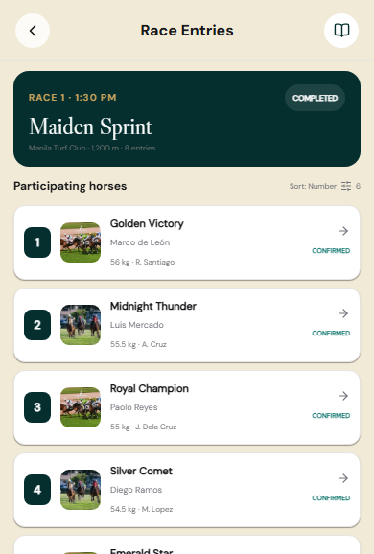
JOCKEY
STUDY THE FIELD
Know the field before the start
A program makes the race tangible.
Declared runners
Assigned riders and connections
Weights and entry status
Each runner leads to a deeper profile.
SAVED MOBILE INTERFACE / 18 OCT 2026
PRODUCT SHOWCASE / 19 OCTOBER 2026
03
Notes:
Use the entries screen to explain the practical value of a program. The current information platform also preserves declarations after results and links horses by permanent IDs. The saved mobile capture includes an older betting-oriented experience outside this crop; membership information is the scope of this showcase.
Image provenance: actual saved mobile UI capture, 18 October 2026. This predates the latest web directory, header and membership refinements. UI values are illustrative records, not official racing coverage. Cropping changes framing only.
[Sources]
SETUP.md: current access policy, plans, generated seed and deployment status.
RECONSTRUCTION.md: race information and recorded-history behavior.
FE/jockey_frontend-main/docs/mobile-screenshots/13-race-entries.png
FE/jockey_frontend-main/docs/mobile-screenshots/manifest.json: capture-to-route mapping.
[/Sources]

Slide 4
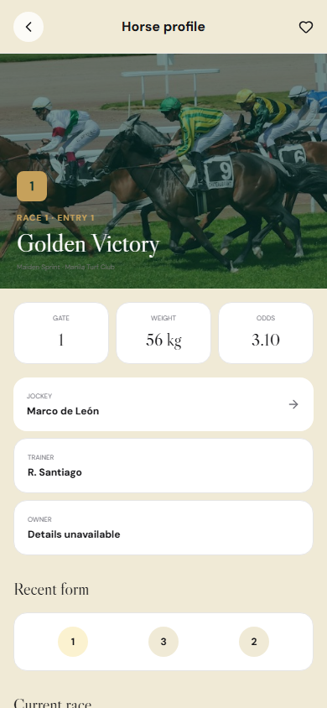
JOCKEY
EXPLORE THE RUNNER
Look beyond the race number
Connections give every runner context.
Horse identity and pedigree
Jockey, trainer and owner links
Recent and comparable form
The current web platform links these pages to recorded history.
SAVED MOBILE INTERFACE / 18 OCT 2026
PRODUCT SHOWCASE / 19 OCTOBER 2026
04
Notes:
The screenshot illustrates the existing mobile horse profile and its connection links. The reconstructed web profile adds pedigree, permanent IDs and recorded recent/comparable form. Explain that distinction if asked: the capture predates those web refinements, and the displayed odds and example horse are not authoritative data.
Image provenance: actual saved mobile UI capture, 18 October 2026. This predates the latest web directory, header and membership refinements. UI values are illustrative records, not official racing coverage. Cropping changes framing only.
[Sources]
SETUP.md: current access policy, plans, generated seed and deployment status.
RECONSTRUCTION.md: race information and recorded-history behavior.
FE/jockey_frontend-main/docs/mobile-screenshots/24-horse-profile.png
FE/jockey_frontend-main/docs/mobile-screenshots/manifest.json: capture-to-route mapping.
[/Sources]

Slide 5
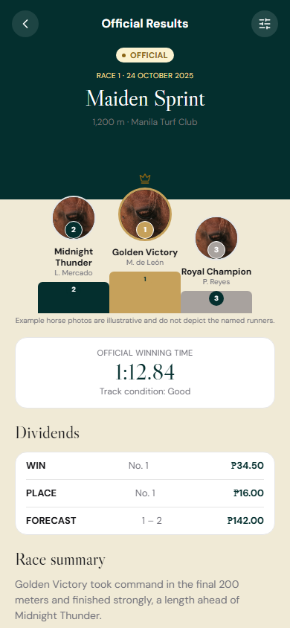
JOCKEY
REVIEW THE OUTCOME
See the result, then the detail
The racing story continues after the finish.
Finish order
Official timing where recorded
Published dividend information
The original program stays available alongside the result.
SAVED MOBILE INTERFACE / 18 OCT 2026
PRODUCT SHOWCASE / 19 OCTOBER 2026
05
Notes:
Result pages preserve the route back to the original race program. Current web dividends are stored publications with event legs and correction relationships; missing information stays unavailable. The saved interface image shows illustrative finish positions and dividend values, not a verified operator publication.
Image provenance: actual saved mobile UI capture, 18 October 2026. This predates the latest web directory, header and membership refinements. UI values are illustrative records, not official racing coverage. Cropping changes framing only.
[Sources]
SETUP.md: current access policy, plans, generated seed and deployment status.
RECONSTRUCTION.md: race information and recorded-history behavior.
FE/jockey_frontend-main/docs/mobile-screenshots/21-result-detail.png
FE/jockey_frontend-main/docs/mobile-screenshots/manifest.json: capture-to-route mapping.
[/Sources]

Slide 6
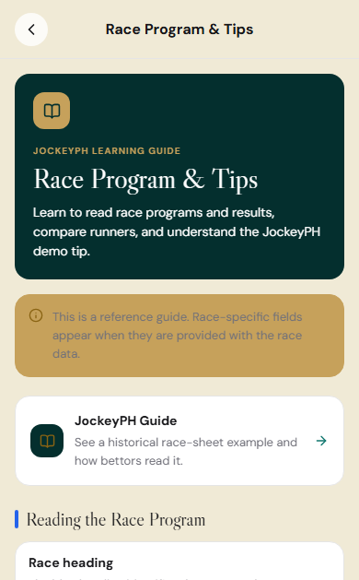
JOCKEY
LEARN THE LANGUAGE OF RACING
Give new visitors a starting point
Learn the program.
Understand the form.
Interpret the result.
The learning guide stays public.
SAVED MOBILE INTERFACE / 18 OCT 2026
PRODUCT SHOWCASE / 19 OCTOBER 2026
06
Notes:
Education supports discovery before a subscription decision. The current web guide has eight illustrated chapters covering programs, form, statistics, results, dividends and terminology. This image is the saved mobile guide and retains earlier reference wording; it is not the current redesigned web guide.
Image provenance: actual saved mobile UI capture, 18 October 2026. This predates the latest web directory, header and membership refinements. UI values are illustrative records, not official racing coverage. Cropping changes framing only.
[Sources]
SETUP.md: current access policy, plans, generated seed and deployment status.
RECONSTRUCTION.md: race information and recorded-history behavior.
FE/jockey_frontend-main/docs/mobile-screenshots/33-racing-guide.png
FE/jockey_frontend-main/docs/mobile-screenshots/manifest.json: capture-to-route mapping.
[/Sources]

Slide 7
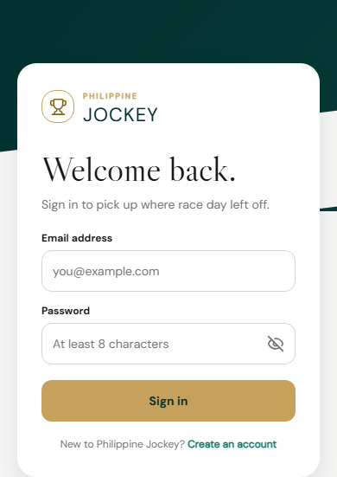
JOCKEY
MEMBERSHIP MODEL
A simple membership rule
DAILY ACCESS
MONTHLY ACCESS
₱50
₱499
24 hours
One calendar month
Choose a plan. Sign in. Confirm payment.
Demo confirmation unlocks access. No money is charged.
SAVED MOBILE INTERFACE / 18 OCT 2026
PRODUCT SHOWCASE / 19 OCTOBER 2026
07
Notes:
These are the current configurable web plan prices. Both plans unlock the same protected racing information. Daily access lasts 24 hours; monthly access uses a calendar month. Confirm payment is now a normal page button, with no iframe or payment-provider integration. This slide uses the saved sign-in screen only; it does not pretend to show the current membership page. There is no automatic renewal.
Image provenance: actual saved mobile UI capture, 18 October 2026. This predates the latest web directory, header and membership refinements. UI values are illustrative records, not official racing coverage. Cropping changes framing only.
[Sources]
SETUP.md: current access policy, plans, generated seed and deployment status.
RECONSTRUCTION.md: race information and recorded-history behavior.
FE/jockey_frontend-main/docs/mobile-screenshots/04-login.png
FE/jockey_frontend-main/docs/mobile-screenshots/manifest.json: capture-to-route mapping.
web/src/features/subscriptions/subscription-flow.tsx: direct confirmation buttons and activation.
[/Sources]

Slide 8
JOCKEY
DEPTH BEHIND THE EXPERIENCE
Enough depth to explore
132
306
2,036
horses
races
finishing records
Varied programs, connections, histories and event relationships.
Generated showcase data / current local workspace totals
PRODUCT SHOWCASE / 19 OCTOBER 2026
08
Notes:
These counts describe generated local showcase records, not users, revenue or official live coverage. A fresh database receives 128 newly seeded horses; the local total includes four earlier retained records. The reproducible seed supports demonstrations on another configured database. An authorized source is needed before presenting real racing coverage.
[Sources]
SETUP.md: current access policy, plans, generated seed and deployment status.
RECONSTRUCTION.md: race information and recorded-history behavior.
[/Sources]

Slide 9
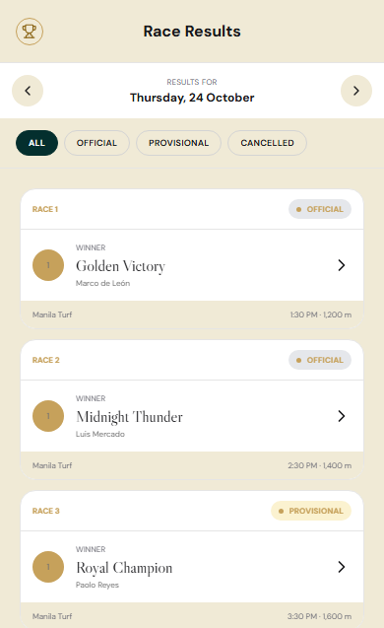
JOCKEY
WHAT IS WORKING
The core journey is working
Connected racing information
Programs, profiles, form and results.
Account and access flow
Sign-in, membership activation and favorites.
Verified locally
Production build and end-to-end account checks passed.
SAVED MOBILE INTERFACE / 18 OCT 2026
PRODUCT SHOWCASE / 19 OCTOBER 2026
09
Notes:
The existing saved results-list interface supplies the visual. The current local web implementation has passed its production build, 86 backend tests, 82 existing frontend tests, 17 UI tests and seven HTTP journey checks. The verification script exercises registration, membership activation, SSR race/horse and directory/participant pages, favorites, refresh and logout. These checks are not production load testing; fresh browser and device QA of the web updates remains outstanding.
Image provenance: actual saved mobile UI capture, 18 October 2026. This predates the latest web directory, header and membership refinements. UI values are illustrative records, not official racing coverage. Cropping changes framing only.
[Sources]
SETUP.md: current access policy, plans, generated seed and deployment status.
RECONSTRUCTION.md: race information and recorded-history behavior.
FE/jockey_frontend-main/docs/mobile-screenshots/10-results.png
FE/jockey_frontend-main/docs/mobile-screenshots/manifest.json: capture-to-route mapping.
BE/jockey_backend-main/scripts/verify_web_auth.py: expanded subscriber page checks.
[/Sources]

Slide 10
JOCKEY
THE NEXT DECISION
Move into a
controlled pilot.
01 Authorize the racing data source.
02 Assign payment and deployment owners.
03 Agree on pilot scope and success measures.
Explore JOCKEY: dev6.comclark.com
PRODUCT SHOWCASE / 19 OCTOBER 2026
10
Notes:
Close with a concrete stakeholder decision. Pricing is a configurable current proposal, and real payments still require a verified provider integration. Data authority, production deployment, restoration testing and browser/device QA remain launch dependencies. Agree on pilot scope and success measures before setting a launch date. The environment URL comes from the user-provided screenshots and was not independently checked during this build.
[Sources]
SETUP.md: current access policy, plans, generated seed and deployment status.
RECONSTRUCTION.md: race information and recorded-history behavior.
User-provided platform screenshots: dev6.comclark.com environment URL.
[/Sources]

