Slide 1
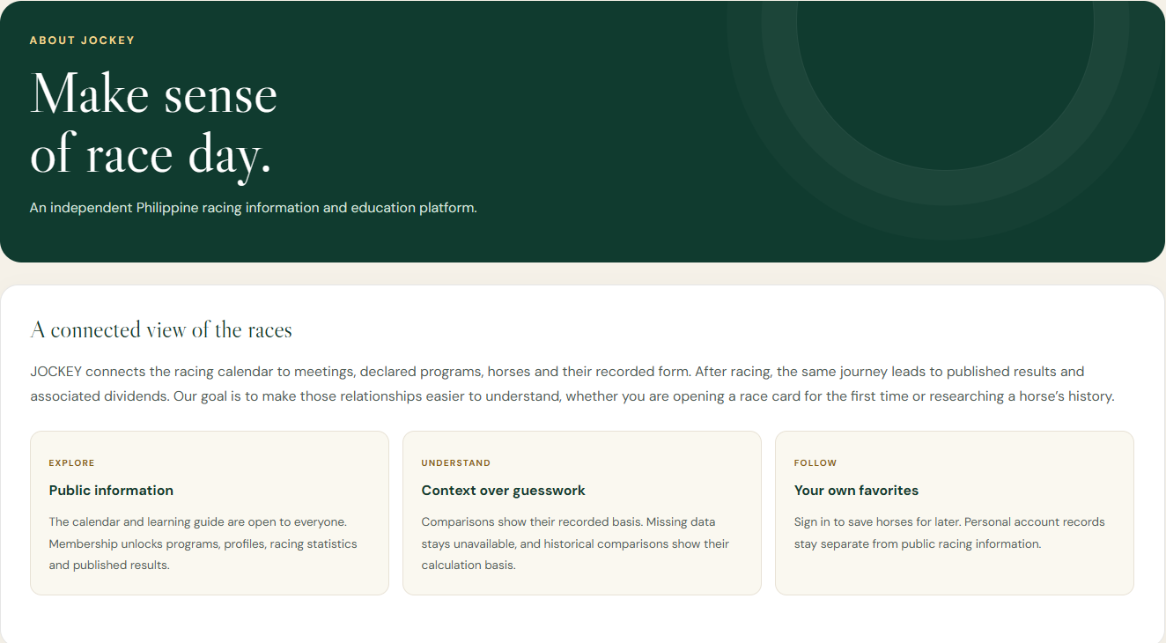
JOCKEY
THE WEBSITE WE BUILT
JOCKEY
Race day,
connected.
Calendar. Programs. Form. Results.
Stakeholder product showcase
WEBSITE SHOWCASE / 19 OCTOBER 2026
01
Notes:
Introduce the reconstructed JOCKEY website as a connected racing information and education platform. The screenshot is the actual About page supplied in ppt images. The following slides follow a visitor from public discovery to membership and deeper racing information.
[Sources]
ppt images/aboutus.png: user-supplied screenshot of the reconstructed website.
SETUP.md: membership policy, demo activation and deployment requirements.
RECONSTRUCTION.md: information model and recorded-history behavior.
[/Sources]
Screenshot provenance: the website images supplied in the workspace's ppt images folder. UI text and data are retained; framing uses native PowerPoint cropping. Example racing records do not establish official live coverage.

Slide 2
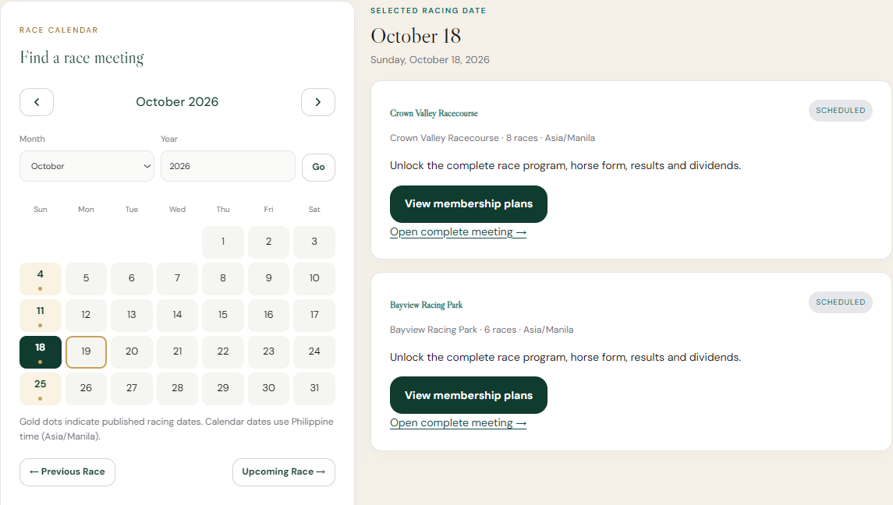
JOCKEY
01 / DISCOVER
Start with the racing calendar
Choose a date
See venues and meeting summaries.
Explore freely
Full programs open through membership.
WEBSITE SHOWCASE / 19 OCTOBER 2026
02
Notes:
The calendar and meeting summaries are public. This exact screenshot shows the selected racing date, two venues, and membership prompts where protected program details would appear. Date navigation stays meaningful even before a visitor subscribes.
[Sources]
ppt images/no membership homepage.png: user-supplied screenshot of the reconstructed website.
SETUP.md: membership policy, demo activation and deployment requirements.
RECONSTRUCTION.md: information model and recorded-history behavior.
[/Sources]
Screenshot provenance: the website images supplied in the workspace's ppt images folder. UI text and data are retained; framing uses native PowerPoint cropping. Example racing records do not establish official live coverage.

Slide 3
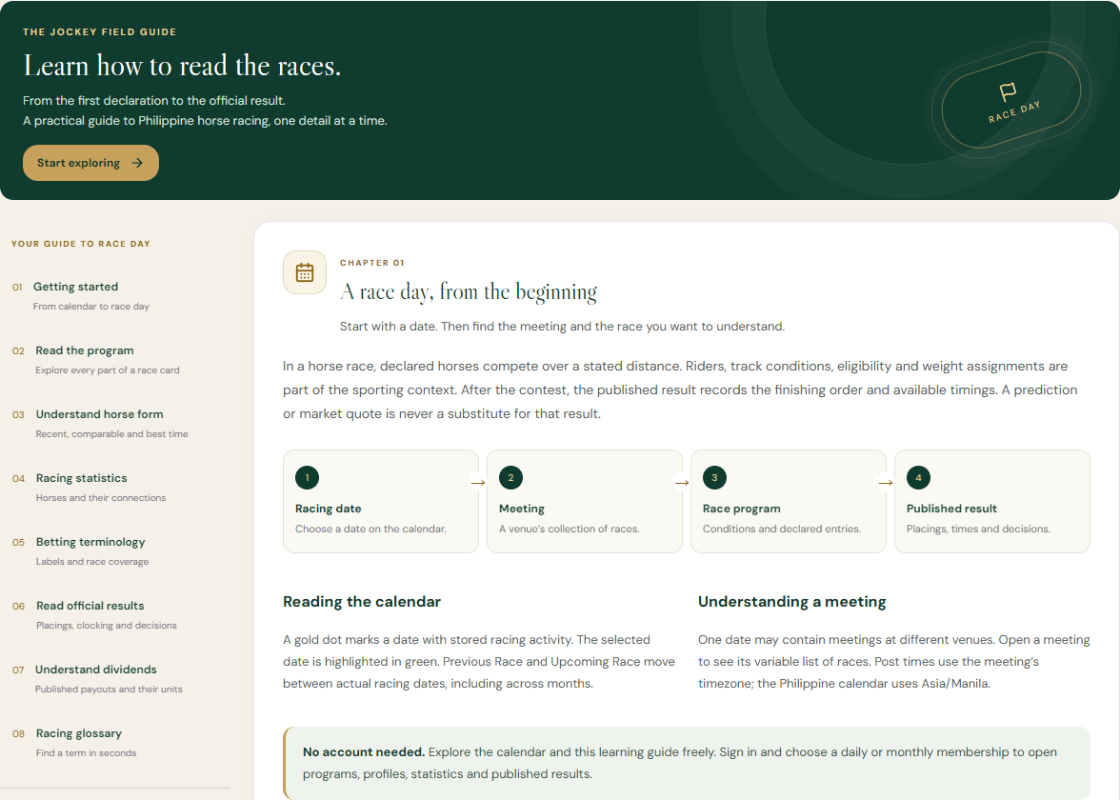
JOCKEY
02 / LEARN
Give newcomers a way into racing
Read the program.
Understand form.
Interpret results.
Eight illustrated chapters, open to everyone.
WEBSITE SHOWCASE / 19 OCTOBER 2026
03
Notes:
The public learning guide covers getting started, programs, horse form, racing statistics, terminology, results, dividends and a glossary. The visible chapter connects racing date, meeting, program and published result. It supports understanding before a subscription decision; no conversion outcome is claimed.
[Sources]
ppt images/learn_to_race_free.png: user-supplied screenshot of the reconstructed website.
SETUP.md: membership policy, demo activation and deployment requirements.
RECONSTRUCTION.md: information model and recorded-history behavior.
[/Sources]
Screenshot provenance: the website images supplied in the workspace's ppt images folder. UI text and data are retained; framing uses native PowerPoint cropping. Example racing records do not establish official live coverage.

Slide 4
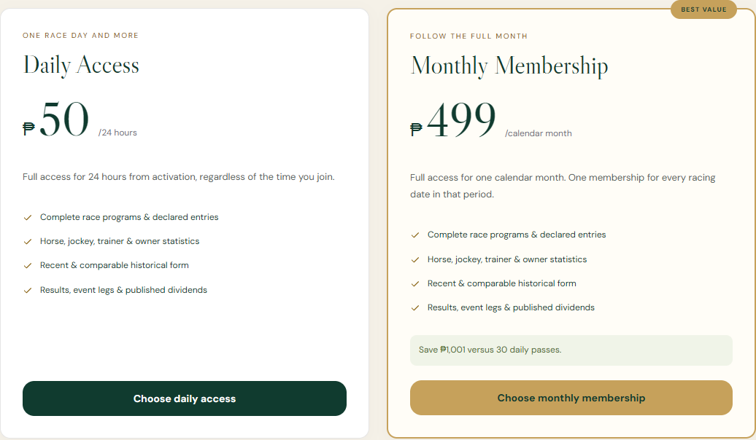
JOCKEY
03 / JOIN
Two plans. The same racing access.
DAILY ACCESS
₱50
24 hours
MONTHLY ACCESS
₱499
One calendar month
WEBSITE SHOWCASE / 19 OCTOBER 2026
04
Notes:
Both plans unlock programs, form, statistics, results and dividends. Daily lasts 24 hours; monthly uses a calendar month. Prices are configurable in admin. The current demo journey is choose a plan, sign in or create an account, then Confirm payment. Confirmation activates membership without collecting money. No real payment provider or automatic renewal is implied. The supplied membership screenshot shows the actual pricing page; signup.png is available as supporting evidence of registration.
[Sources]
ppt images/pay_membership.png: user-supplied screenshot of the reconstructed website.
ppt images/signup.png: user-supplied screenshot of the reconstructed website.
SETUP.md: membership policy, demo activation and deployment requirements.
RECONSTRUCTION.md: information model and recorded-history behavior.
[/Sources]
Screenshot provenance: the website images supplied in the workspace's ppt images folder. UI text and data are retained; framing uses native PowerPoint cropping. Example racing records do not establish official live coverage.

Slide 5
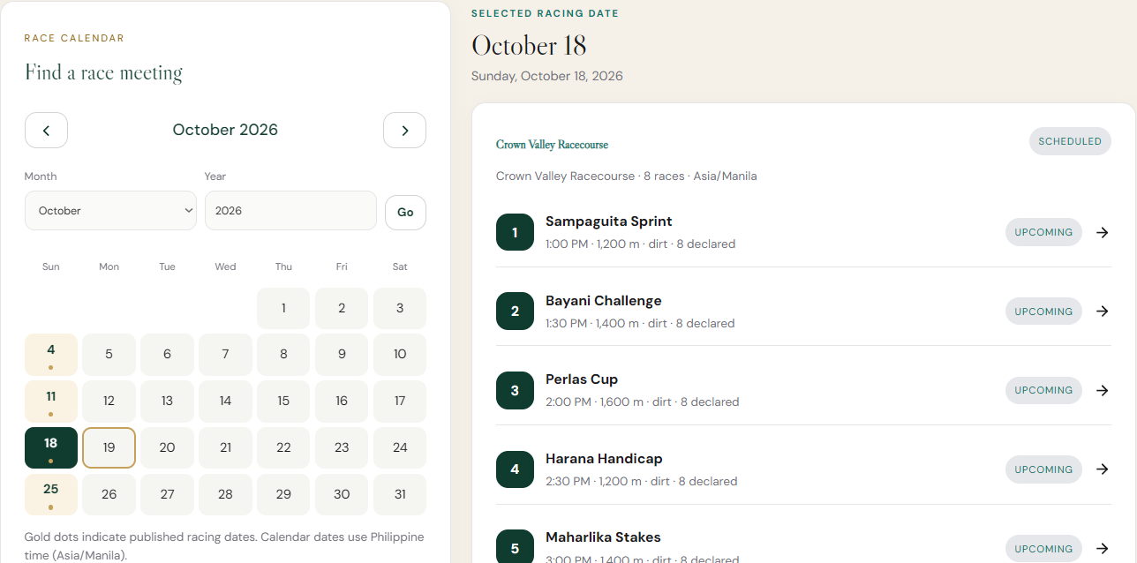
JOCKEY
04 / UNLOCK
Membership opens the race program
Same calendar.
More detail.
Open the races within each meeting.
WEBSITE SHOWCASE / 19 OCTOBER 2026
05
Notes:
This is the actual subscribed homepage. Compared with the public calendar on slide 2, the meeting card now reveals its scheduled races, post times, distances, surfaces and declarations. The selected date is retained. All screenshot values are supplied example records; membership flow is demonstrated without a real charge.
[Sources]
ppt images/paid_homepage.png: user-supplied screenshot of the reconstructed website.
SETUP.md: membership policy, demo activation and deployment requirements.
RECONSTRUCTION.md: information model and recorded-history behavior.
[/Sources]
Screenshot provenance: the website images supplied in the workspace's ppt images folder. UI text and data are retained; framing uses native PowerPoint cropping. Example racing records do not establish official live coverage.

Slide 6
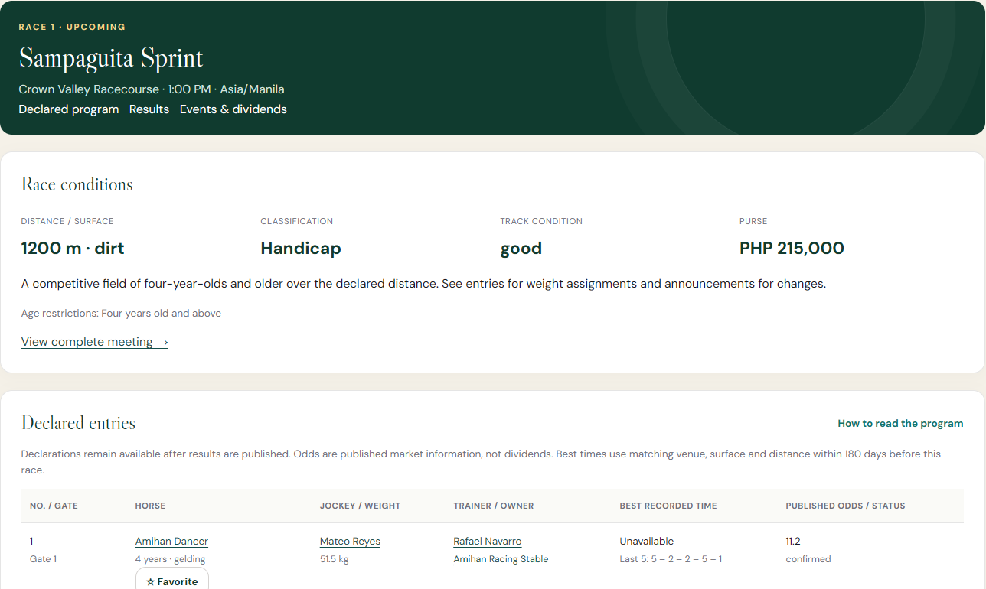
JOCKEY
05 / STUDY THE FIELD
One program connects the racing detail
Race conditions
Distance, surface, class and purse.
Declared entries
Runners, riders, weights and profile links.
WEBSITE SHOWCASE / 19 OCTOBER 2026
06
Notes:
Use Sampaguita Sprint as the on-screen example. The program includes race conditions, classifications, purse and declared entries. Links lead to the complete meeting and to horses and participants. The lower table includes recent form and declaration details. Missing comparable times remain unavailable, as shown; no timing is invented.
[Sources]
ppt images/paid_racing_info.png: user-supplied screenshot of the reconstructed website.
SETUP.md: membership policy, demo activation and deployment requirements.
RECONSTRUCTION.md: information model and recorded-history behavior.
[/Sources]
Screenshot provenance: the website images supplied in the workspace's ppt images folder. UI text and data are retained; framing uses native PowerPoint cropping. Example racing records do not establish official live coverage.

Slide 7
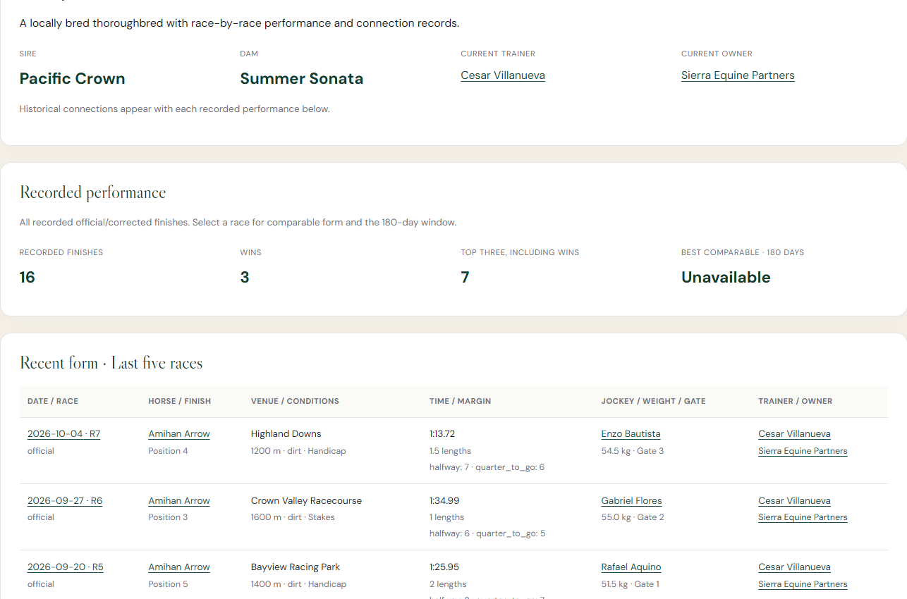
JOCKEY
06 / FOLLOW THE HORSE
Trace the horse beyond one race
Pedigree
Sire, dam and current connections.
Recorded form
Finishes, timing and the latest five races.
WEBSITE SHOWCASE / 19 OCTOBER 2026
07
Notes:
The supplied horse profile shows pedigree, current trainer and owner, recorded performance totals and recent form rows. These histories link back to races and their connections. Comparable form depends on an appropriate race context, and the screen explicitly marks unavailable comparable timing. Counts here describe the example horse only.
[Sources]
ppt images/horses_zoomed.png: user-supplied screenshot of the reconstructed website.
SETUP.md: membership policy, demo activation and deployment requirements.
RECONSTRUCTION.md: information model and recorded-history behavior.
[/Sources]
Screenshot provenance: the website images supplied in the workspace's ppt images folder. UI text and data are retained; framing uses native PowerPoint cropping. Example racing records do not establish official live coverage.

Slide 8
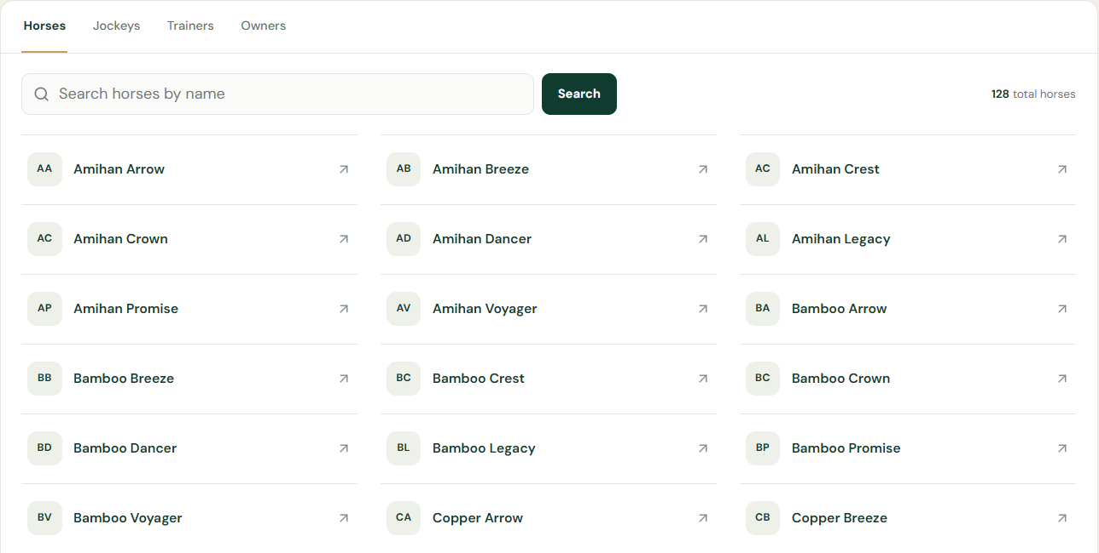
JOCKEY
07 / EXPLORE THE DIRECTORY
Find the horses and people behind racing
128
horses
18
jockeys
12 trainers
10 owners
Search by name. Open any profile.
WEBSITE SHOWCASE / 19 OCTOBER 2026
08
Notes:
The screenshot demonstrates the actual compact directory with active category tabs and a name search. Counts are read from this supplied website capture and the corresponding jockey, trainer and owner screenshots: 128 horses, 18 jockeys, 12 trainers and 10 owners. They describe generated demonstration data in that installation, not customers or authoritative coverage. This avoids substituting the different local workspace total.
[Sources]
ppt images/horses.png: user-supplied screenshot of the reconstructed website.
ppt images/jockeys.png: user-supplied screenshot of the reconstructed website.
ppt images/trainers.png: user-supplied screenshot of the reconstructed website.
ppt images/owners.png: user-supplied screenshot of the reconstructed website.
SETUP.md: membership policy, demo activation and deployment requirements.
RECONSTRUCTION.md: information model and recorded-history behavior.
[/Sources]
Screenshot provenance: the website images supplied in the workspace's ppt images folder. UI text and data are retained; framing uses native PowerPoint cropping. Example racing records do not establish official live coverage.

Slide 9
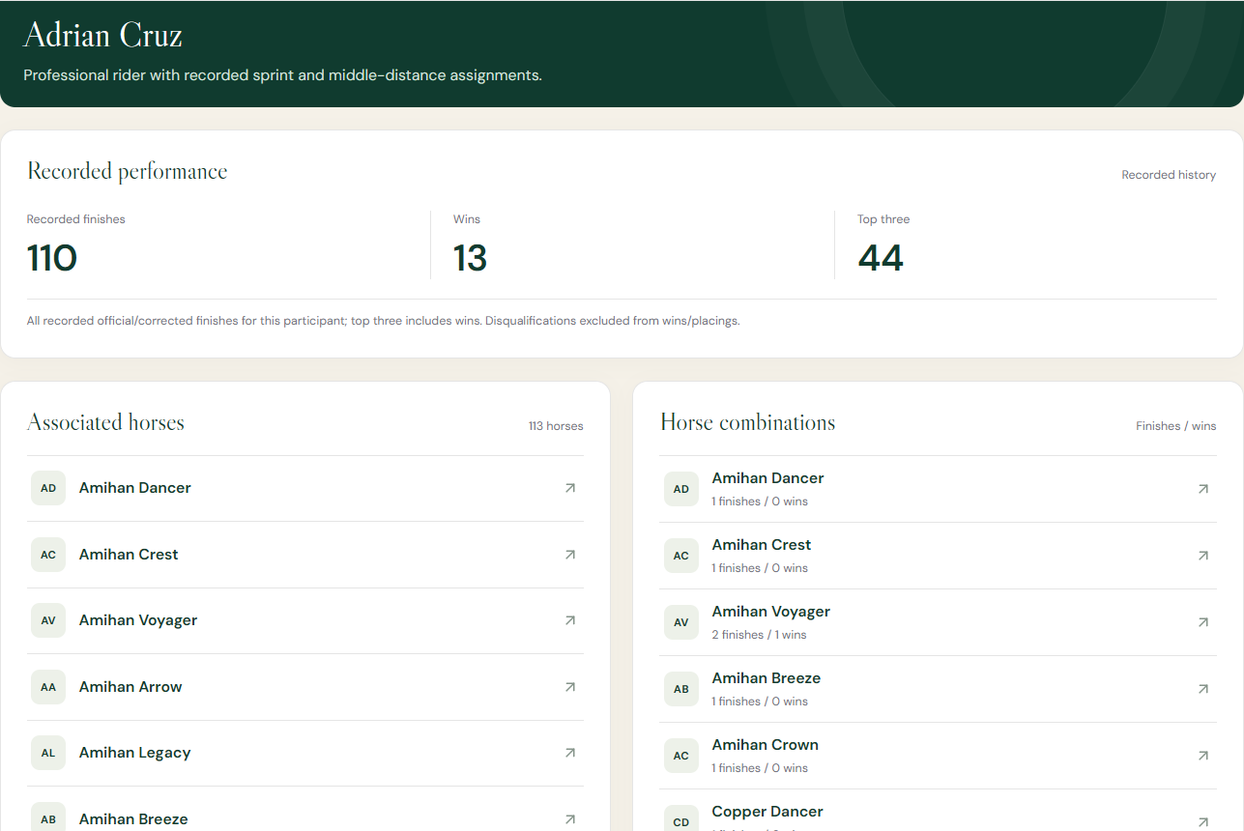
JOCKEY
08 / UNDERSTAND THE CONNECTIONS
Every rider has a recorded history
Performance at a glance
Finishes, wins and top-three results.
Follow the partnerships
Horse associations and combination records.
WEBSITE SHOWCASE / 19 OCTOBER 2026
09
Notes:
Adrian Cruz is the example shown. The profile ties recorded performance to associated horses and horse/rider combinations. These are records in the demonstration database, not verified real-world career claims. The detail table below, shown in jockeys_zoomed(1).png, links recent finishes back to races and their connections.
[Sources]
ppt images/jockeys_zoomed.png: user-supplied screenshot of the reconstructed website.
SETUP.md: membership policy, demo activation and deployment requirements.
RECONSTRUCTION.md: information model and recorded-history behavior.
[/Sources]
Screenshot provenance: the website images supplied in the workspace's ppt images folder. UI text and data are retained; framing uses native PowerPoint cropping. Example racing records do not establish official live coverage.

Slide 10
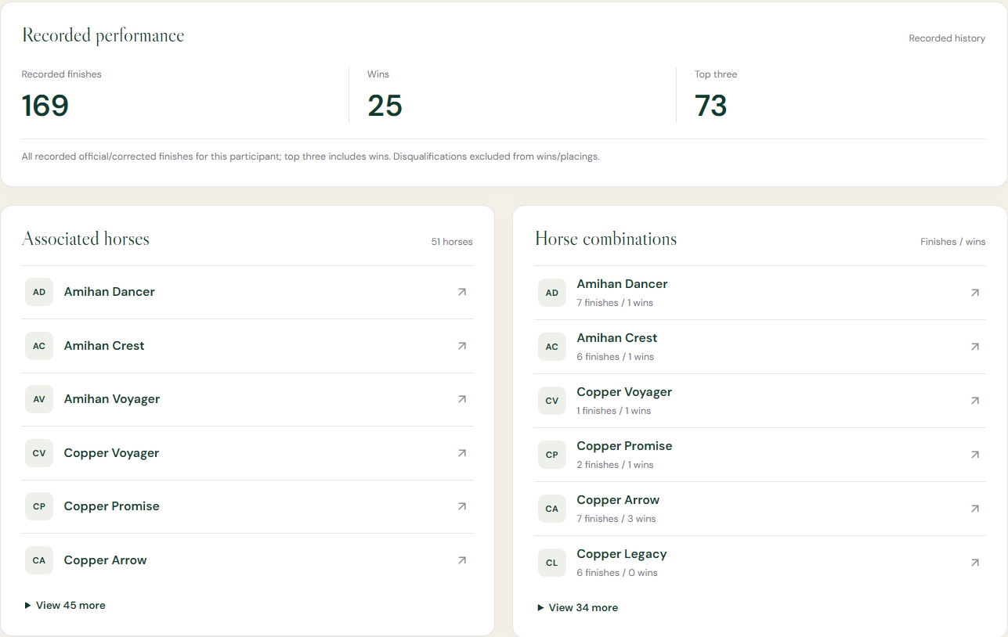
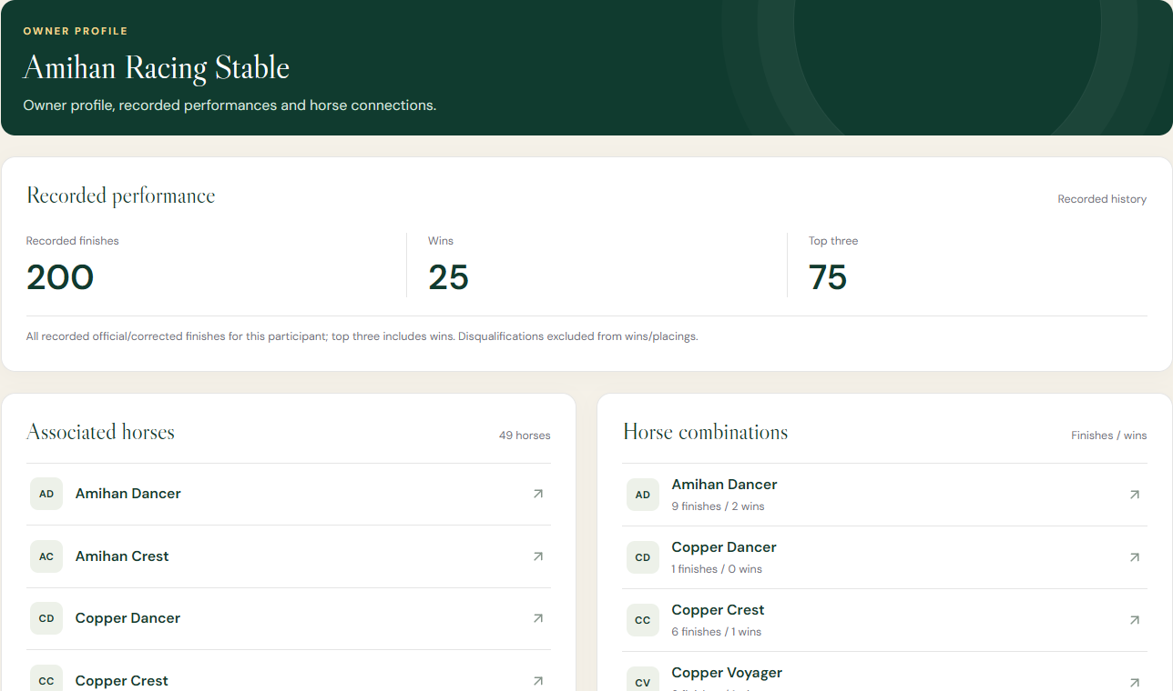
JOCKEY
09 / CONNECT THE WIDER TEAM
Trainers and owners complete the picture
TRAINER RECORD
OWNER RECORD
Each profile leads back to horses, combinations and finishing records.
WEBSITE SHOWCASE / 19 OCTOBER 2026
10
Notes:
These are the actual trainer and owner profile screenshots supplied by the user. Both share the participant structure: recorded performance, associated horses and combinations, followed by recent results. The consistent pattern helps users explore connections without learning a different screen for every role.
[Sources]
ppt images/trainers_zoomed.png: user-supplied screenshot of the reconstructed website.
ppt images/owners_zoomed.png: user-supplied screenshot of the reconstructed website.
SETUP.md: membership policy, demo activation and deployment requirements.
RECONSTRUCTION.md: information model and recorded-history behavior.
[/Sources]
Screenshot provenance: the website images supplied in the workspace's ppt images folder. UI text and data are retained; framing uses native PowerPoint cropping. Example racing records do not establish official live coverage.

Slide 11
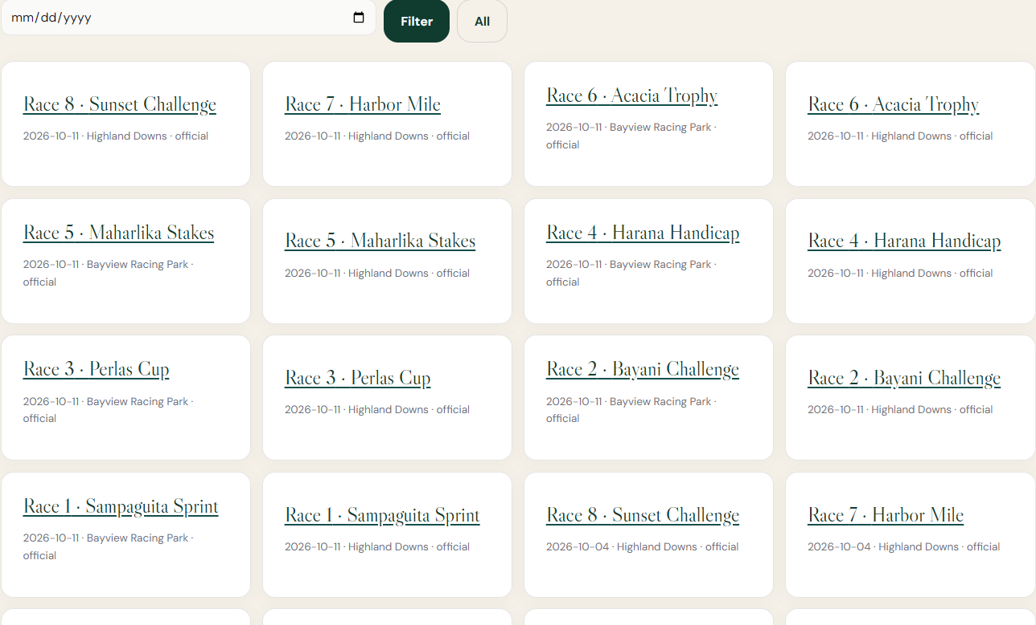
JOCKEY
10 / REVIEW THE OUTCOME
The journey continues through results
Filter by date
Browse published outcomes.
Reopen the race
Keep program and history connected.
WEBSITE SHOWCASE / 19 OCTOBER 2026
11
Notes:
The screenshot is the website Results page, despite the source filename races.png. It shows a date filter and linked published race results across venues. The information journey preserves the program after results and can lead into published event/dividend records. No unprovided dividend screenshot is invented here.
[Sources]
ppt images/races.png: user-supplied screenshot of the reconstructed website.
SETUP.md: membership policy, demo activation and deployment requirements.
RECONSTRUCTION.md: information model and recorded-history behavior.
[/Sources]
Screenshot provenance: the website images supplied in the workspace's ppt images folder. UI text and data are retained; framing uses native PowerPoint cropping. Example racing records do not establish official live coverage.

Slide 12
JOCKEY
STAKEHOLDER TAKEAWAY
One connected
racing website.
Discover freely.
Unlock programs and racing intelligence.
Follow horses, connections and results.
Explore the platform: dev6.comclark.com
WEBSITE SHOWCASE / 19 OCTOBER 2026
12
Notes:
Close by bringing the journey together, then move into the live website. Stakeholders can evaluate the public/member boundary and connected information flow. For an operational paid launch, authoritative data, verified payment processing and production validation are still required. The current payment button is a demonstration of access activation, not a money transfer. No launch date, revenue or adoption claim is made.
[Sources]
ppt images/aboutus.png: user-supplied screenshot of the reconstructed website.
ppt images/pay_membership.png: user-supplied screenshot of the reconstructed website.
ppt images/paid_homepage.png: user-supplied screenshot of the reconstructed website.
SETUP.md: membership policy, demo activation and deployment requirements.
RECONSTRUCTION.md: information model and recorded-history behavior.
[/Sources]
Screenshot provenance: the website images supplied in the workspace's ppt images folder. UI text and data are retained; framing uses native PowerPoint cropping. Example racing records do not establish official live coverage.

