Slide 1

Department of Computer Science and Engineering
(Cyber Security)
PROJECT TITLE: KPI Monitoring System (KPI Hub)
COURSE: Web Programming
NAME: K Kenneth Prathap
REG NO: 241901048
GUIDE: Swathi Lakshmi, Asst. Professor

Slide 2



PROJECT TEAM AND SUPERVISION
STUDENT
GUIDE
INSTITUTION
K Kenneth Prathap
Register No: 241901048
B.E. Computer Science and Engineering (Cyber Security)
Swathi Lakshmi
Assistant Professor
Rajalakshmi Engineering College
Department of Computer Science and Engineering (Cyber Security)
Project: KPI Monitoring System (KPI Hub), a web development project
Course: Web Programming | III Year / V Semester, Odd 2026–2027

Slide 3
ABSTRACT
5
Modules
Dashboard, Employees, KPI, Attendance, Report
KPI Hub is a web-based system for monitoring employee performance with Key Performance Indicators (KPIs) in one place.
Users manage employees, record KPI data (Tasks, Bugs and Hours) and attendance. Each score is calculated automatically as (Tasks × 5) + (Bugs × 3) + (Hours × 0.5) and rated Excellent, Good or Poor.
A dashboard shows summary cards and a ranked leaderboard, and a Report page summarises performance. It is built with React and Vite and stores data in the browser’s localStorage.
3
Rating levels
Excellent, Good and Poor
1
Scoring formula
Based on Tasks, Bugs and Hours

Slide 4






OBJECTIVES
Employee records
Keep employee details together in one place.
Automatic scoring
Calculate each KPI score from Tasks, Bugs and Hours.
Performance rating
Classify every score as Excellent, Good or Poor.
Attendance tracking
Record employee attendance alongside KPI data.
Live leaderboard
Rank employees by score on the dashboard.
Reports
Summarise team performance in a Report page.

Slide 5




EXISTING SYSTEM
Manual calculation
Scores are worked out by hand, which is slow and error-prone.
Scattered records
Employee, KPI and attendance data are kept in separate places.
Manual KPI tracking
Employee KPIs and attendance are recorded and scored by hand, typically in spreadsheets or on paper.
No instant ranking
Comparing employees takes extra effort every time.
Limited visibility
There is no single dashboard showing team performance at a glance.

Slide 6


PROPOSED SYSTEM: KPI HUB
Automatic scoring
Instant rating and ranking
Score = (Tasks × 5) + (Bugs × 3) + (Hours × 0.5), calculated for every employee.
Excellent, Good or Poor status and a ranked leaderboard.
Centralised records
Dashboard and reports
Employees, KPI data and attendance managed in one web app.
Summary cards, leaderboard and a Report page for performance.
Runs in the browser: React + Vite front end with data stored in localStorage.

Slide 7
SYSTEM ARCHITECTURE
PRESENTATION
React, HTML, CSS, Bootstrap, Chart.js
Dashboard
Employees
KPI
Attendance
Report
LOGIC
JavaScript, React Router
React Router
Page navigation
KPI score engine
Tasks×5 + Bugs×3 + Hours×0.5
Rating and ranking
Excellent / Good / Poor
DATA
Browser localStorage
Employees
Employee records
KPI entries
Tasks, Bugs, Hours
Attendance
Attendance records

Slide 8
SYSTEM WORKFLOW
1 Open KPI Hub
2 Add employees
3 Enter KPI data
4 Calculate score
5 Assign rating
6 Update dashboard
Move between pages from the sidebar.
Create records with name, role and department.
Record Tasks, Bugs and Hours; mark attendance.
Tasks×5 + Bugs×3 + Hours×0.5.
Compare the score with the thresholds.
Cards, leaderboard and reports refresh.
RATING RULE
Excellent
120 or above
Good
90 and above, below 120
Poor
Below 90
Every step reads from and writes to the browser’s localStorage.

Slide 9
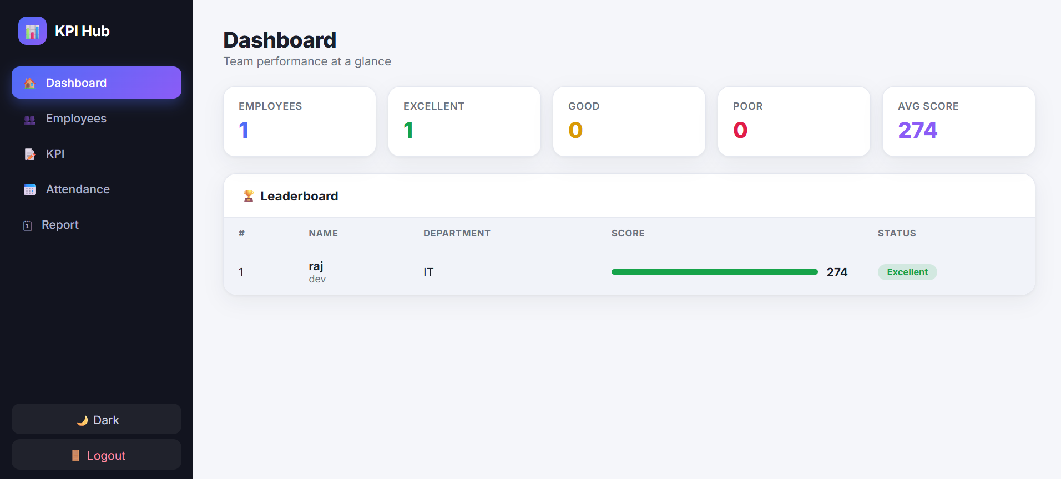
DASHBOARD
1
Sidebar
Dashboard, Employees, KPI, Attendance and Report, plus a Dark mode toggle and Logout.
2
2
Summary cards
Employees, Excellent, Good, Poor and Avg Score at a glance.
1
3
3
Leaderboard
Rank, name, department, score bar and status for each employee.
Sample view: one employee, raj (IT), scores 274 and is rated Excellent, so the Avg Score card also shows 274.

Slide 10
CORE MODULES
Employee Management
KPI Scoring
Employees page
KPI page
Create and manage employee records. Name, role and department appear on the leaderboard.
Enter Tasks, Bugs and Hours. The score and rating are calculated automatically.
Attendance
Leaderboard and Reports
Attendance page
Dashboard and Report pages
Record and review employee attendance.
A ranked leaderboard on the dashboard; the Report page summarises performance.

Slide 11
KPI SCORING LOGIC
Score = (Tasks × 5) + (Bugs × 3) + (Hours × 0.5)
× 5
Tasks
5 points per task
× 3
Bugs
3 points per bug
× 0.5
Hours
0.5 points per hour
Excellent
Score ≥ 120
Good
Score ≥ 90 and < 120
Poor
Score < 90
In the dashboard sample, a score of 274 is above the Excellent threshold of 120.

Slide 12




IMPLEMENTATION DETAILS
Component-based UI
Built with React and Vite; each page (Dashboard, Employees, KPI, Attendance, Report) is a component.
Page navigation
React Router switches between pages from the sidebar.
Scoring logic
JavaScript calculates the score from Tasks, Bugs and Hours and applies the rating thresholds.
Data storage
Employees, KPI entries and attendance are saved in the browser’s localStorage.
Styling and theme
HTML, CSS and Bootstrap provide the layout; the Dark toggle switches the theme.

Slide 13






TECHNOLOGIES USED
React
Component-based user interface
Vite
Fast development server and build tool
JavaScript
Application and scoring logic
HTML
Page structure and markup
CSS
Custom styling and light/dark theme
Bootstrap
Responsive layout and components
Chart.js
Charts for performance data
React Router
Navigation between pages
localStorage
Browser-side data storage

Slide 14
SOURCE CODE: KPI SCORING LOGIC
// (Tasks × 5) + (Bugs × 3) + (Hours × 0.5)
export function calculateScore(tasks, bugs, hours) {
return tasks * 5 + bugs * 3 + hours * 0.5;
}
// Excellent ≥ 120, Good ≥ 90 and < 120, Poor < 90
export function getStatus(score) {
if (score >= 120) return "Excellent";
if (score >= 90) return "Good";
return "Poor";
}
calculateScore
Applies the KPI formula to Tasks, Bugs and Hours and returns the score.
getStatus
Maps the score to a rating: Excellent (≥ 120), Good (≥ 90 and < 120) or Poor (< 90).
JavaScript, written from the project’s KPI formula and rating thresholds.

Slide 15


HARDWARE AND SOFTWARE REQUIREMENTS
Hardware
Software
Standard PC or laptop
No GPU required
No server required; the app runs in the browser
Node.js and npm for the React and Vite build
VS Code or another code editor
Modern browser: Chrome, Edge or Firefox
PROJECT LIBRARIES
React, Vite, React Router, Bootstrap, Chart.js
DATA STORAGE
Browser localStorage; no database setup needed

Slide 16

CONCLUSION
KPI Hub replaces manual KPI tracking with one dashboard that scores, rates and ranks employees automatically.
Every score follows a single formula: (Tasks × 5) + (Bugs × 3) + (Hours × 0.5).
Automatic
Score and rating are calculated from Tasks, Bugs and Hours.
Centralised
Employees, KPI data and attendance live in one app.
Lightweight
Runs in the browser with localStorage; no server needed.

