Slide 1
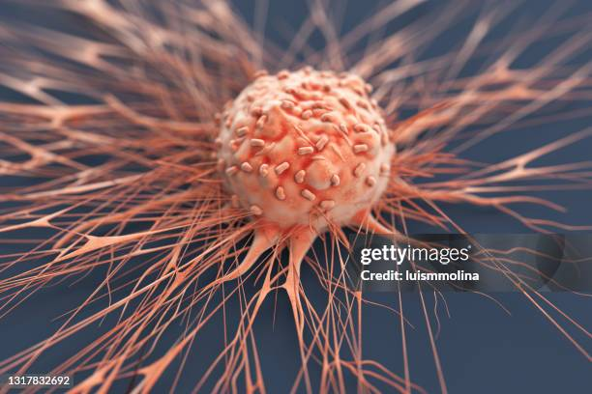
Skin Vision AI
Revolutionization Skin Cancer Detection
Group number (assigned by mentor): 2

Slide 2
Problem Statement:
Automated deep learning aids accurate, fast, multi-class skin cancer detection.

Slide 3
Concept behind proposed solution
Leveraging deep learning for skin cancer detection
Leveraging deep learning for skin cancer detection.
Classifying skin lesions using neural network.
Automated skin cancer detection using AI.
Evaluating CNN model on test dataset .
Enhancing efficiency in lesion classification process.
Supporting better outcomes for skin patients.

Slide 4
Description of techniques and technology used in creative solution to reach a specific goal
Dataset : Ham10000
The dataset contains 10,015 dermoscopy images of seven skin cancer types.
Preprocessing:
Splitting datasets
Handle duplicate image
labelling images
Normalisation.
Reshaping
Classification model : Inception-ResNetv2 Convolution Neural Network
Fine Tuning : Fine-tuning is a technique used to improve the performance of a pre-trained deep learning model on a new task or dataset
Notes:
Computer vision tasks include methods for acquiring, processing, analyzing, and understanding digital images

Slide 5
Project’s purpose and goals
Develop a deep convolutional neural network architecture for skin cancer classification that can learn relevant features from skin lesion images and accurately classify them as benign or malignant.
Train the proposed model on a large dataset of skin lesion images to achieve high accuracy and generalization performance.
Evaluate the proposed model's performance on a test dataset and compare it with other state-of-the-art methods for skin cancer classification.
Develop a web-based tool that can be used by dermatologists and healthcare professionals for real-time skin cancer classification using the proposed CNN model.

Slide 6










Prototype Model
Actinic keratoses ‘akiec’ (6705 images)
Dermatofibroma ‘df’ (1113 images)
Benign keratosis ‘bkl’ (1099 images)
Pre- processing
Classificatio n Model
Feature Extraction
Output image
Melanoma ‘mel’ (514 images)
Input Image
Fine Tuning
Melanocytic nevi ‘nv’ (327 images)
Vascular Lesions ‘vasc’ (142 images)
Basal cell carcinoma ‘bcc’ (115 images)

Slide 7
Feasibility of Solution
Deep CNN’s show strong potential in skin cancer image classification.
They effectively learn patterns to distinguish various skin lesions types.
Performance can match to that of trained dermatologists.
High-quality annotated datasets are crucial for reliable model training.
Dataset size and diversity greatly impact CNN classification accuracy.
CNNs enable fast, automated, and accurate skin cancer diagnosis

Slide 8
Usability of Solution
Speed: CNNs enable fast, real-time skin lesion classification in clinics.
Accuracy: CNNs achieve dermatologist-level performance in cancer detection task.
Automation: Automates diagnosis, easing workload for medical professionals.
Objectivity: Provides consistent, unbiased classification of skin lesions.
Scalability: Efficiently handles large datasets for widespread screening use.
Integration: Easily integrates into clinical workflows for seamless diagnosis support

Slide 9
Advantages & Disadvantages:
Advantages | Disadvantages
Analyze large images volumes quickly and accurately. | Requires high computational power and hardware.
Pre-trained models reduces training data requirement. | Depends on dataset quality and diversity.
Fine-tuning boosts system efficiency and performance. | Models can be difficult to interpret.
HAM10000 dataset improves generalization across conditions | May lack biological insight into cancer.

Slide 10
References:
Ms. H. R. Mhaske, Mrs. D. A. Phalke , “ MELANOMA SKIN CANCER DETECTION AND CLASSIFICATION BASED ON SUPERVISED AND UNSUPERVISED LEARNING” 2021
Dr. S.Karpagavalli ,A. Kalaivani ,"A Deep Ensemble Model for Automated Multiclass Classification Using Dermoscopic Images"
Cauvery K , P C Siddalinga swamy ,Sameena Pathan ,"A Multiclass Skin Lesion classification approach using Transfer learning based convolutional Neural Network"
Automatic Detection of Melanoma with Yolo Deep Convolutional Neural Networks Yali Nie1 , Paolo Sommella2 , Mattias O’Nils1 , Consolatina Liguori2 , Jan Lundgren1
Classification of Skin Cancer Dermoscopic Images using Transfer Learning ,Haseeb Younis ,Muhammad Hamza Bhatti ,Muhammad Azeem.
Attention-guided deep convolutional neural networks for skin cancer classification, Arshiya Aggrawal,Nisheet Das,Indu Sreedevi.
Deep Convolutional Neural Network (DCNN) for Skin Cancer Classification Nour Aburaed∗ , Alavikunhu Panthakkan† , Mina Al-Saad‡ , Saad Ali Amin§ and Wathiq Mansoor¶
Deep Neural Network based Mobile Dermoscopy Application for Triaging Skin Cancer Detection. Ahmed Ech-Cherif,Mohammed Misbhauddin ,Mohammed Ech-Cherif
Vijaya Mishra ,Akash Kumar V ,Monika Arora "Deep convolution neural network based automatic multi- class classification of skin cancer from dermoscopic images "

Slide 11


Team Members
Kenneth Lobo
E23CSEU1418
Soham Das
E23CSEU1412
Mentor name: Shashi Shreya

Slide 12
Thank You

