Slide 1


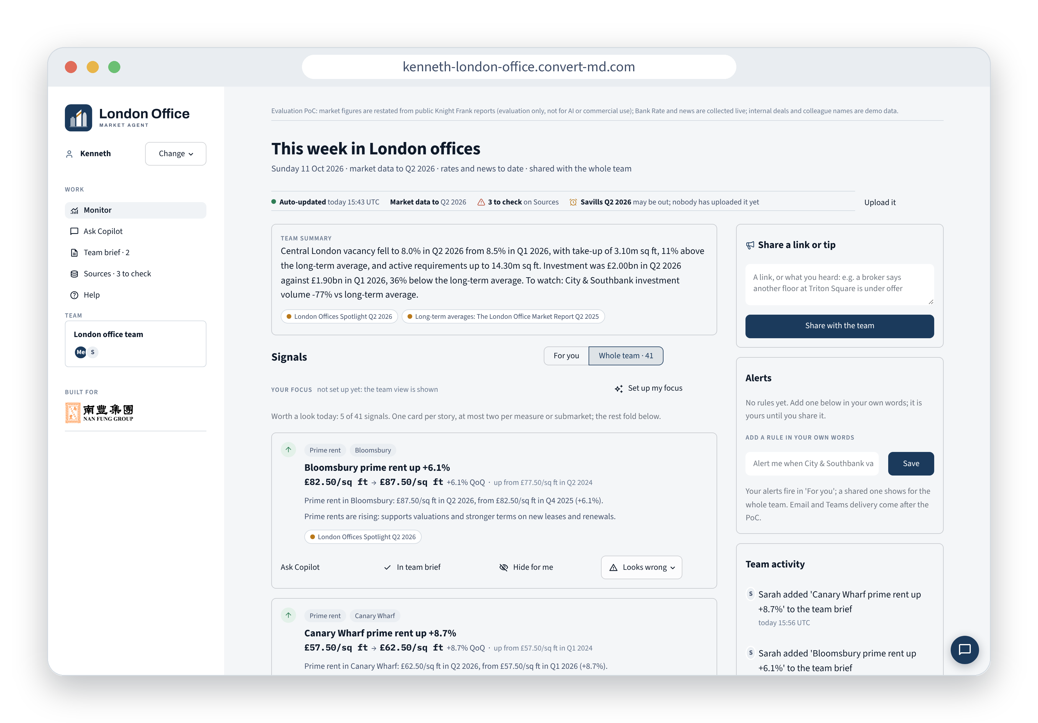

PROOF OF CONCEPT · FOR THE BUSINESS TEAM
Know what moved in London offices before Monday's meeting
One AI market agent the whole team shares. It watches the market, answers questions with the source behind every number, and writes the weekly brief.
Try it now, no login
kenneth-london-office.convert-md.com
Code: github.com/Kenneth0416/nanfengtest
Line: Central London vacancy, Q1 2024 to Q2 2026 (9.9% to 8.0%)
Notes:
One sentence: the team doesn't lack data, it lacks a way to notice what changed, trust the number, and turn it into a brief. This is a working proof of concept, live at the address on the slide; the screenshot is the real Monitor page from this morning. The faint line behind the title is real data: Central London vacancy falling from 9.9% to 8.0%.
Data notice: market figures are restated from public Knight Frank research for evaluating this PoC only. Knight Frank's terms don't allow AI use of its content, so a production version runs on the reports the team already subscribes to.

Slide 2
A REAL MONDAY · 11 OCTOBER 2026
What the agent flagged for the team this week
Read overnight from 9 agency reports, Bank of England data and 81 news items. Four things worth a meeting:
8.0%
6.4pp
−77%
540k sq ft
Central London vacancy
White City Grade A gap
City & Southbank investment
City Core speculative space
Down from 8.5% last quarter and 9.9% in Q1 2024. Take-up 3.10m sq ft, 11% above the long-term average.
Grade A 11.5% vacant against 17.9% for all space; the gap widened from 5.0pp last quarter.
£0.37bn traded in Q2 2026 against a long-term average of £1.60bn a quarter.
81 Newgate Street, EC1: under construction, no pre-let, due Q4 2026.
SO WHAT FOR US
Demand is back: hold firmer terms on lettings and renewals.
SO WHAT FOR US
Flight to quality: refurbish older floors or price them to let.
SO WHAT FOR US
Few comparables: take care with valuations; fewer rival bidders.
SO WHAT FOR US
New competition for City tenants near St Paul's from this quarter.
Also this week: Canary Wharf prime rent +8.7% to £62.50/sq ft. Each figure opens the report page it came from, and one click puts it in the team brief.
Sources: Knight Frank, London Offices Spotlight Q2 2026 and The London Office Market Report (long-term averages), restated for evaluating this PoC only; developer and planning announcements (81 Newgate Street). The agent's own signals, 11 Oct 2026.
Notes:
This is the agent's real output from this week, not a mock-up: the four cards are the top of 'Worth a look today' on Monitor. The 'so what' line is the conversation the team should have; the agent writes a version of it on each card and links every number to the report and quarter it came from.
Flight to quality shows up as the gap between Grade A and overall vacancy, the clearest way to see occupiers choosing the best space.

Slide 3
WHY IT MATTERS
Fewer hand-offs, nothing lost in the retelling
Today a market number passes through several people before it reaches a decision. Each hop costs a message and drops a detail.
TODAY: ONE FIGURE, HAND TO HAND
WITH THE AGENT: EVERYONE READS THE SAME LIBRARY
Agency report
City Core vacancy 6.1% · Q2 2026 · all grades
6.1% City Core vacancy
Analyst's spreadsheet
City vacancy 6.1%
quarter and source dropped
Q2 2026
all grades
Knight Frank report
uploaded by a colleague, dated
footnote [1] in the brief
Email to the deal team
City vacancy around 6%
City Core becomes 'the City'
The number travels with its quarter, its definition and its source, in Monitor, in every Copilot answer and in the brief. Nobody retypes it, so nothing falls off.
IC slide
City vacancy ~6%, tight
"Which quarter? Whose figure?" Another email.
Why? ask the Copilot, answered with the source
Looks wrong? one flag, and the whole team sees it
Ask, don't email
Anyone asks the Copilot directly and gets the table, the chart and the report behind it. No request queue.
Context never drops
Publisher, period and definition stay attached to every figure, wherever it is shown or exported.
One catch reaches everyone
A tip, a flag or an upload by one colleague is visible to the whole team at once, with their name.
Notes:
The real cost today is the hand-offs. A figure from an agency report is copied into a spreadsheet, summarised in an email and pasted on a slide; each step drops something, usually the quarter, the source or the exact submarket, and the next reader has to write back and ask. The example on the left is City Core vacancy, 6.1% in Q2 2026.
With the agent, everyone reads from one shared library. The figure carries its quarter, definition, publisher and who uploaded it into every screen, answer and brief, so there is nothing to retell. Questions go straight to the Copilot instead of an analyst's inbox, and anything one person spots or flags, the whole team sees.

Slide 4
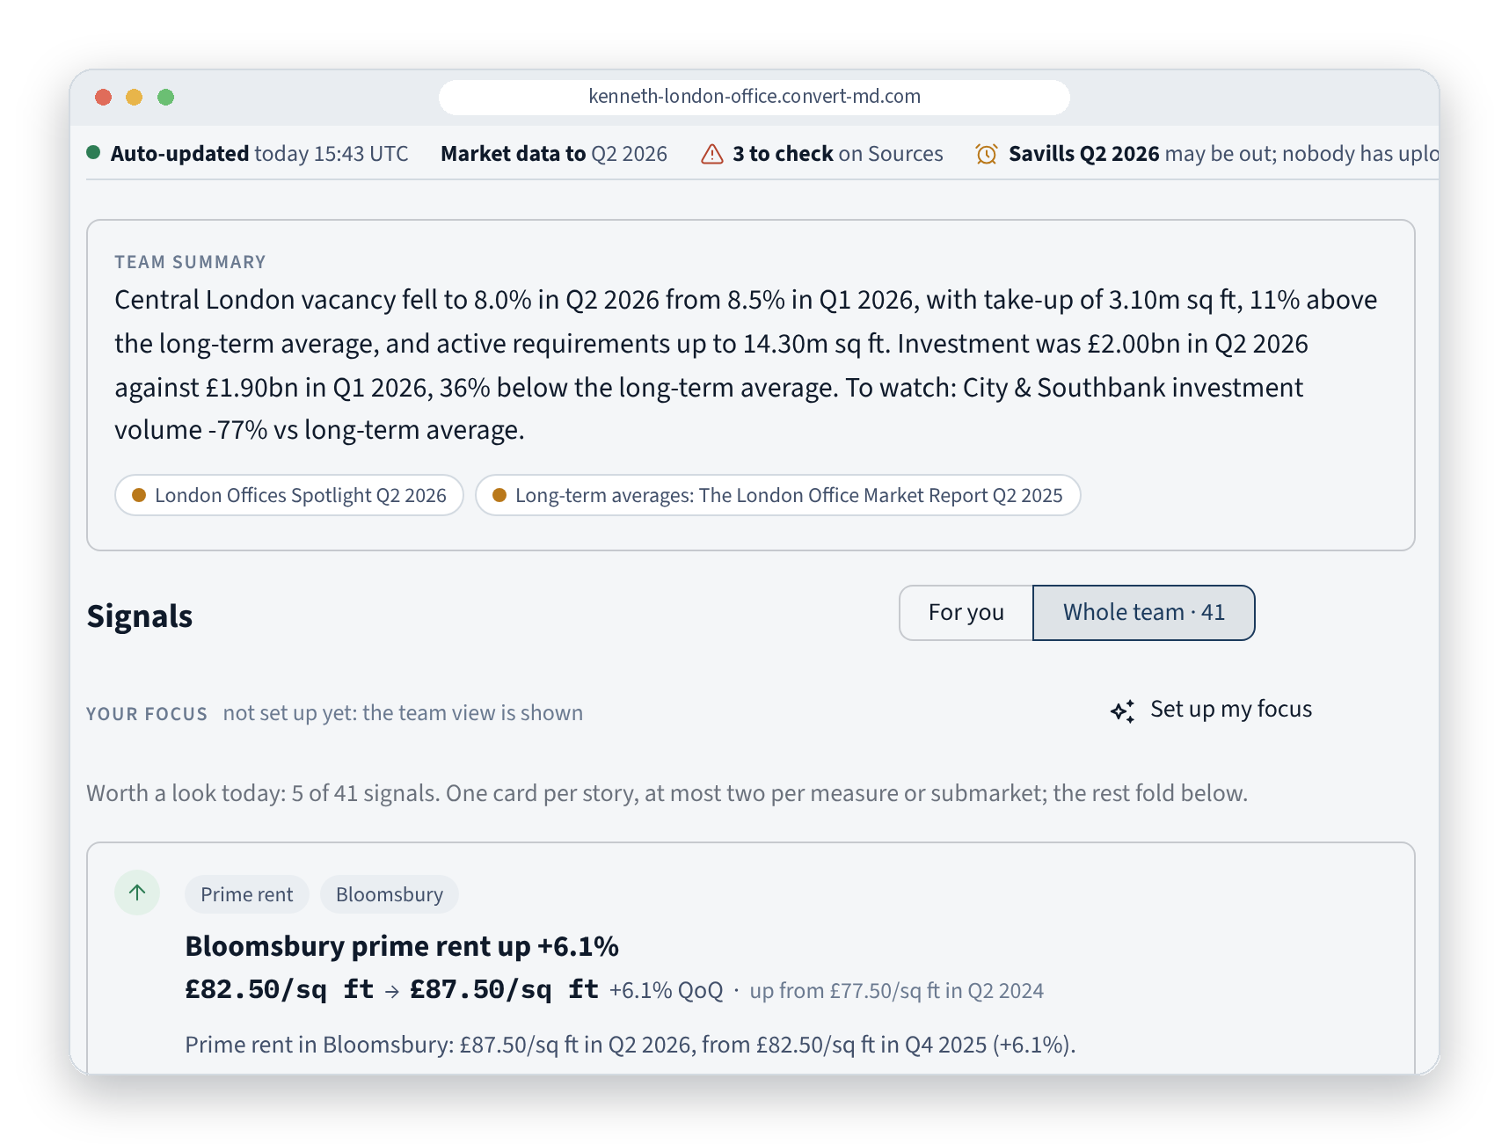
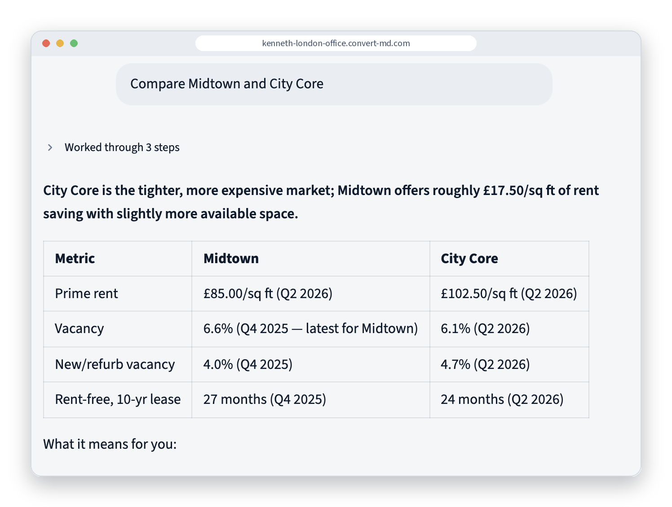
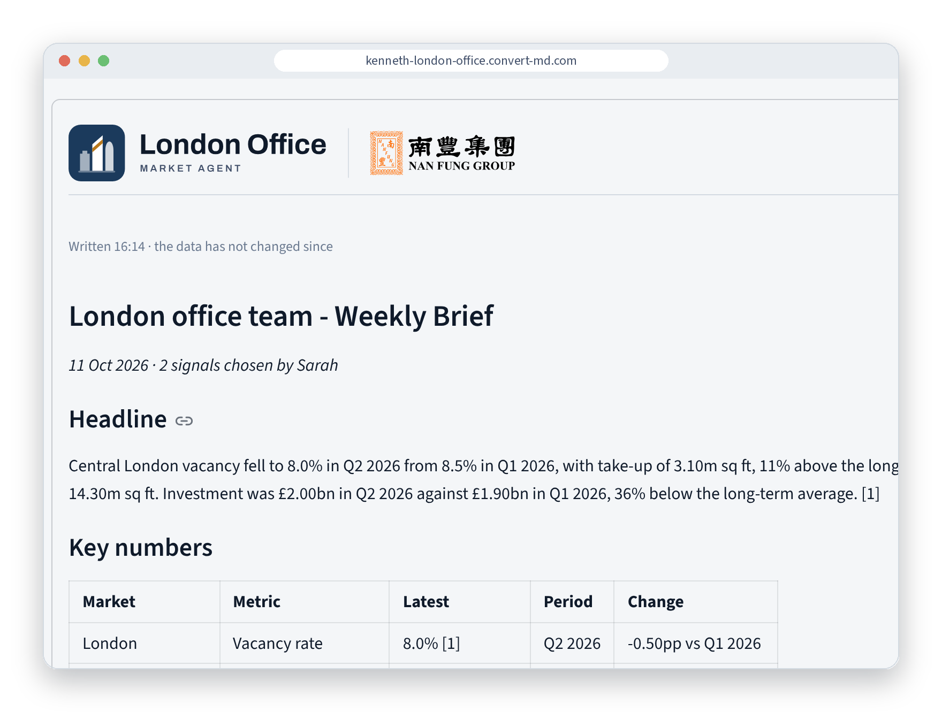
HOW THE TEAM USES IT
One shared workspace, three jobs
No roles to choose. Everyone sees the same market; each person can set their own focus in one sentence.
MONITOR Stay ahead
COPILOT Decide
TEAM BRIEF Report
The week in two sentences, then the five signals worth a look, each with its source. Alerts in plain English.
Ask from any page. Answers come with tables, charts and the report behind every number.
Anyone adds signals; one click writes a footnoted brief, a Word or PDF note, or slides.
Head of fund reads it in three minutes on Monday.
Acquisitions compares Midtown and the City before an IC meeting.
Asset management sends the same brief to the board and the IC.
Notes:
Three jobs the business team already does every week: keep up with the market, make a call, report upwards. One tool for all three, shared by the whole team, so a signal one person spots can go straight into the brief someone else writes. The people named are examples of how different roles would use it, not separate versions of the app. All three screenshots are the live PoC.

Slide 5
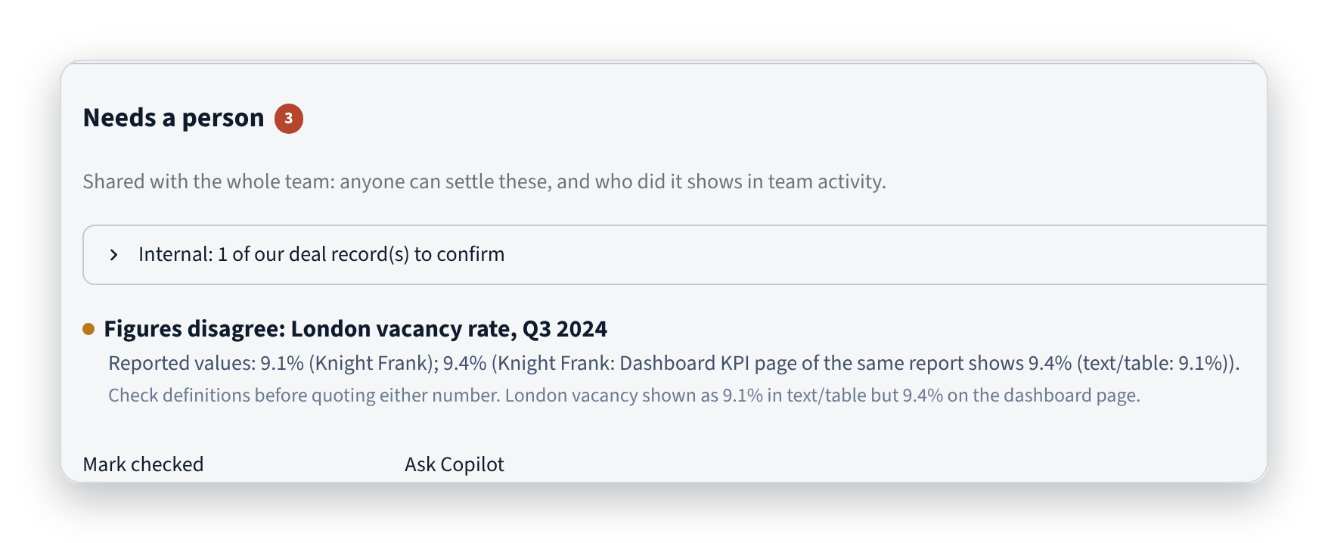
NUMBERS YOU CAN PUT IN A BOARD PAPER
Every number has a source and a check
The agent never makes up a figure: numbers come only from the team's library, each with publisher, period and who added it.
THREE KINDS OF SOURCE
EVERY FIGURE READ FROM A REPORT PASSES THREE CHECKS
Open data, collected by itself
Bank of England rates and news feeds, every morning, because their licences allow it.
1
In the page
The number must appear on the page it was read from.
2
Plausible
Outside a sensible range for that measure? Flagged.
3
Agrees with others
Compared with other publishers for the same quarter.
Agency reports, uploaded once
Knight Frank, Savills, BNP Paribas: their terms bar automatic collection, so any colleague uploads the PDF for everyone.
Our own deals, kept internal
Lettings and valuations we did, typed, photographed or uploaded; marked internal or quotable.
UNDER THE HOOD
12 Python skills, 52 tools, 9 reading playbooks. Xiaomi MiMo models (swappable for Claude or GPT); a durable agent engine that resumes after a crash.
A real catch: the same Knight Frank report gives London vacancy as 9.1% in its table and 9.4% on its dashboard page. The agent kept both, warned the team, and any colleague can settle it.
Notes:
This is the slide that decides whether the team will put the agent's numbers in a board paper. Three kinds of source, kept apart and labelled everywhere. Every figure the agent reads from a PDF has to pass three checks; anything doubtful goes into a shared queue and shows with a warning until someone settles it. The example on screen is real: the agent found that one Knight Frank report disagrees with itself.
Why Knight Frank is upload-only: its website terms forbid automated collection and AI use. The agent read those terms itself and classified it that way. For this PoC the figures are restated from public reports for evaluation only.

Slide 6
NEXT STEP
Try it today, then run a four-week pilot
READY NOW
THE PILOT, FOUR WEEKS
WHAT WE NEED FROM YOU
The agency reports we already subscribe to
One owner for flagged figures
A yes on where data is hosted and which AI model we use
Live and open to try
No login. Updates itself every morning at 06:30 UTC.
Three to five people
Fund, acquisitions, asset management and research.
Tested with the live model
Copilot, PDF reading, briefs and three people at once.
Measured, not assumed
Questions colleagues answer themselves, figures that need a person, briefs sent without corrections.
97 automated tests pass
Open code; one command starts it on any server.
Built during the pilot
Email and Teams digest; jobs and pipeline feeds (Nomis, City of London); EPC ratings.
Scan to try it
Ask: "Compare Midtown and City Core"
Honest about gaps
Anything not built yet says so on screen.
Then decide
Roll out, change, or stop.
kenneth-london-office.convert-md.com
github.com/Kenneth0416/nanfengtest
Data notice: market figures in this PoC are restated from public Knight Frank research for evaluation only (its terms don't permit AI use); Bank Rate and news are live; internal deals and colleague names are demo data.
Notes:
Close with the ask. Everything on the left is done: the app is live, tested with the real model, and open source. The pilot is small and measured: four weeks, three to five people, and three numbers we agree up front. What I need from the business is the reports we already pay for, one person to own flagged figures, and a decision on data hosting and the model. Scan the code and try it now.

