Slide 1


R Workshop Bonus Simulation for Power
Steve Mooney
University of Washington
SER 2022

Slide 2
Credit
https://bmcmedresmethodol.biomedcentral.com/articles/10.1186/1471-2288-11-94

Slide 3
Power basics
As a reminder, power is the probability of avoiding a Type II error given that the alternative hypothesis is true.
P(reject H₀|H₁ is true)
Under a traditional approach, power is computed analytically

Slide 4
The problem…
Power calculations get increasingly complex as analytic techniques get more complex. How do you calculate power for:
Observational studies with strong time-varying confounding
Analyses using principal components to predict an outcome
Studies where complex survey samples were used
A scenario where you expect heteroskedasticity
etc.

Slide 5
Simulation approach
Power is defined in relation to a particular statistical test, so...
... if you know how to compute that test...
... and you know how to simulate your data generating process...
... then you can compute power by simulation rather than work through (potentially untenable) math.
Admittedly, simulation costs CPU time. But CPU time is CHEAP!

Slide 6
Simulation approach
Because the two-sample t-test is simple, we’ll first explore simulation for power for that scenario to compare the simulation approach to the analytic approach.
The value of the simulation approach is that it scales better with analytic complexity, so starting simple may seem like a waste of time. But simple also gives you a baseline to tweak the code from/chance to check against existing tools.

Slide 7
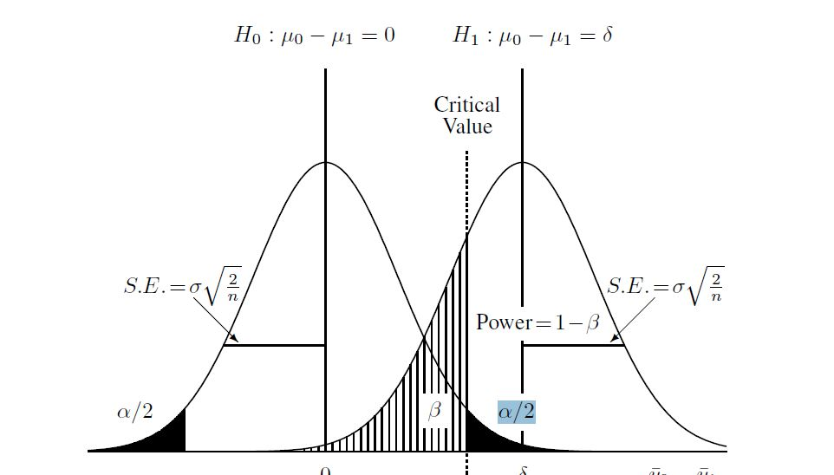
Two-sample t-test power, visually

Slide 8
Code
computePower <- function(effect, sd, nTotalSubjects, nTreated,
nIterations, alpha=0.05){
pVec <- rep(NA,nIterations)
exposure <- c(rep(1,nTreated),rep(0,nTotalSubjects - nTreated))
for (i in 1:nIterations){
resid <- rep(rnorm(nTotalSubjects,0,sd))
outcome <- effect*exposure + resid
m <- lm(outcome~exposure)
pVec[i] <- summary(m)$coefficients["exposure","Pr(>|t|)"]
}
power <- length(pVec[pVec<alpha])/length(pVec)
return(list(power=power,p=pVec))
}

Slide 9
Code
1. Get some residuals
computePower <- function(effect, sd, nTotalSubjects, nTreated,
nIterations, alpha=0.05){
pVec <- rep(NA,nIterations)
exposure <- c(rep(1,nTreated),rep(0,nTotalSubjects - nTreated))
for (i in 1:nIterations){
resid <- rep(rnorm(nTotalSubjects,0,sd))
outcome <- effect*exposure + resid
m <- lm(outcome~exposure)
pVec[i] <- summary(m)$coefficients["exposure","Pr(>|t|)"]
}
power <- length(pVec[pVec<alpha])/length(pVec)
return(list(power=power,p=pVec))
}

Slide 10
Code
computePower <- function(effect, sd, nTotalSubjects, nTreated,
nIterations, alpha=0.05){
pVec <- rep(NA,nIterations)
exposure <- c(rep(1,nTreated),rep(0,nTotalSubjects - nTreated))
for (i in 1:nIterations){
resid <- rep(rnorm(nTotalSubjects,0,sd))
outcome <- effect*exposure + resid
m <- lm(outcome~exposure)
pVec[i] <- summary(m)$coefficients["exposure","Pr(>|t|)"]
}
power <- length(pVec[pVec<alpha])/length(pVec)
return(list(power=power,p=pVec))
}
2. Compute outcomes given exposure status, exposure effect, and residual

Slide 11
Code
computePower <- function(effect, sd, nTotalSubjects, nTreated,
nIterations, alpha=0.05){
pVec <- rep(NA,nIterations)
exposure <- c(rep(1,nTreated),rep(0,nTotalSubjects - nTreated))
for (i in 1:nIterations){
resid <- rep(rnorm(nTotalSubjects,0,sd))
outcome <- effect*exposure + resid
m <- lm(outcome~exposure)
pVec[i] <- summary(m)$coefficients["exposure","Pr(>|t|)"]
}
power <- length(pVec[pVec<alpha])/length(pVec)
return(list(power=power,p=pVec))
}
3. Fit a model to these data

Slide 12
Code
computePower <- function(effect, sd, nTotalSubjects, nTreated,
nIterations, alpha=0.05){
pVec <- rep(NA,nIterations)
exposure <- c(rep(1,nTreated),rep(0,nTotalSubjects - nTreated))
for (i in 1:nIterations){
resid <- rep(rnorm(nTotalSubjects,0,sd))
outcome <- effect*exposure + resid
m <- lm(outcome~exposure)
pVec[i] <- summary(m)$coefficients["exposure","Pr(>|t|)"]
}
power <- length(pVec[pVec<alpha])/length(pVec)
return(list(power=power,p=pVec))
}
4. Get the p-value for the effect coefficient

Slide 13
Code
computePower <- function(effect, sd, nTotalSubjects, nTreated,
nIterations, alpha=0.05){
pVec <- rep(NA,nIterations)
exposure <- c(rep(1,nTreated),rep(0,nTotalSubjects - nTreated))
for (i in 1:nIterations){
resid <- rep(rnorm(nTotalSubjects,0,sd))
outcome <- effect*exposure + resid
m <- lm(outcome~exposure)
pVec[i] <- summary(m)$coefficients["exposure","Pr(>|t|)"]
}
power <- length(pVec[pVec<alpha])/length(pVec)
return(list(power=power,p=pVec))
}
5. Power is the proportion of p-values that are less than alpha

Slide 14
Power curve
Can loop to build power curves
# Power curve for sample size
sizes <- seq(100, 3000, by=50)
powerVals <- vector(length=length(sizes))
for (i in 1:length(sizes)) {
powerVals[i] <- computePower(effect=0.15,sd=1,
nTotalSubjects=sizes[i],nTreated=sizes[i]/2,
nIterations=100)$power
}
powerCalc <- data.frame(sizes, powerVals)
ggplot(powerCalc) + aes(x=sizes, y=powerVals) + geom_smooth(se=F) + geom_point() +
scale_x_continuous("Sample Size") +
scale_y_continuous("Power")

Slide 15
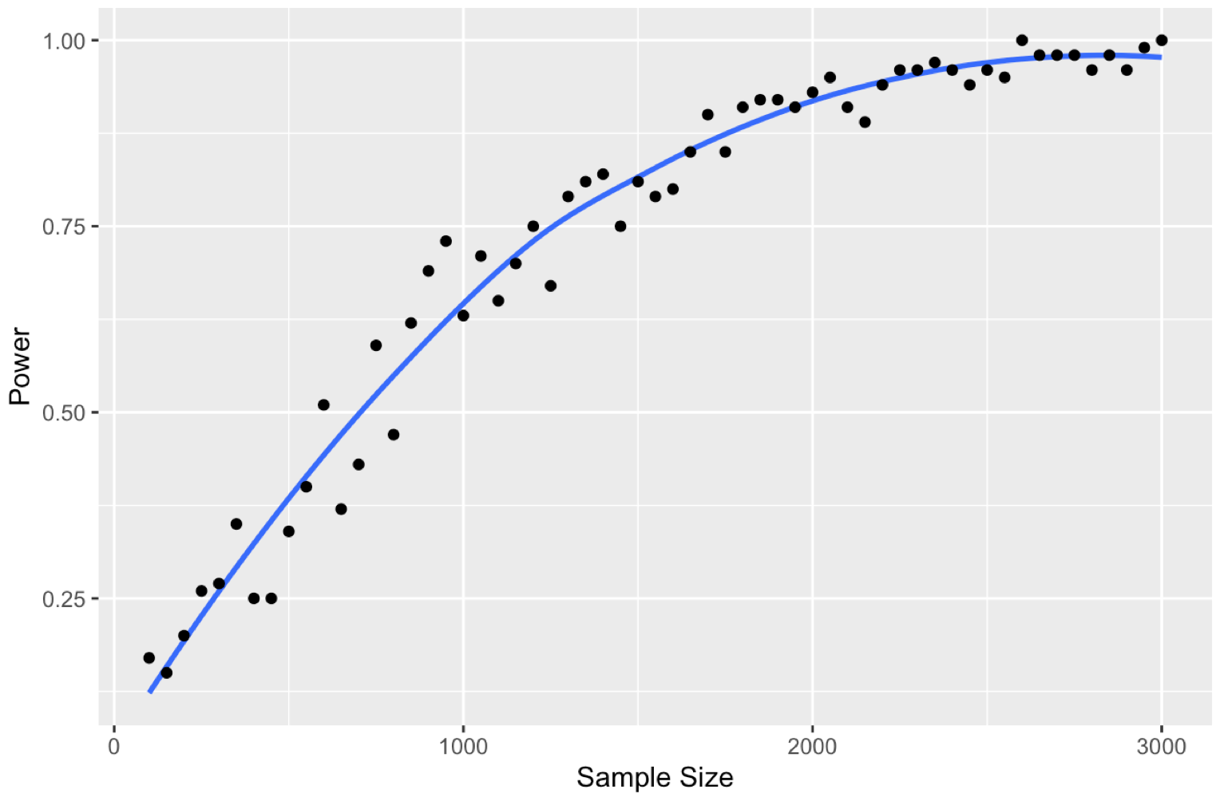
Power curve

