Slide 1


R Workshop, Part 4 (A case study in using R for analysis)
Steve Mooney
University of Washington
SER 2022

Slide 2

Original Problem Statement
Hypothesis: prenatal exposure to phthalates causes obesity in children

Slide 3
About Phthalates
Phthalates are a broad class of chemicals, some naturally present in foods, some used as plasticizers
may be endocrine disruptors
Hard to measure external dose – usually measure urinary metabolites

Slide 4

Initial Analysis
Characterized 9 phthalate metabolites in urine samples from pregnant women
Compared with body size of kids at age 7

Slide 5
An aside on molecular epidemiology and metabolites…
Suppose Z is a chemical which is metabolized as: Z -> Z1 -> Z2 -> Z3
Z3 is excreted in urine
Z2 causes cancer
Metabolic efficiency varies between people
If person A has more urinary Z3 than person B does, who is at higher risk for cancer owing to Z exposure?

Slide 6
… but anyway
It turns out that the levels of these 9 metabolites are log-normally distributed and are correlated
So, analytic plan: use PCA to identify components of variance, and use components to predict obesity status

Slide 7

Reviewer feedback
How do we know if your results generalize outside your sample if you use component scores?

Slide 8
So… our goal:
See how similar the components identified by a PCA for NHANES women age 15-45 are to the components identified by the PCA in the our cohort

Slide 9
Specific plan
Download relevant NHANES data
Load NHANES data into R
Filter to women aged 15-45
Log transform phthalate metabolite variables
Run a PCA and compute component scores
Compare to component scores in CCCEH
A Bonus question: what do we do about the complex survey sampling used by NHANES?

Slide 10
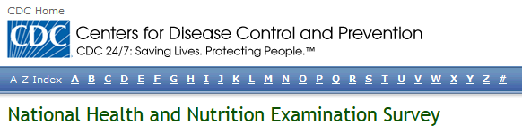
Get the data
NHANES is publically available on the CDC's site
We want demographics and phthalates for 2005-2006
(Copied to GitHub for this workshop)

Slide 11
Get the data into R
The data come as a xport file, so we'll need an external package to load them:
library(SASxport)
demo <- read.xport('<yourpath>/DEMO_D.XPT')
phthalates <- read.xport('<yourpath>/PHTHTE_D.XPT')

Slide 12
Merging data
We haven't talked about merging in this workshop yet.
Google "R merge data frame"
Looks like merge() should work:
nhanes <- merge(demo, phthalates, by='SEQN')

Slide 13
Filtering to women 15-45
Q: Remember how to do this?
women <- nhanes[nhanes$RIAGENDR == 2,]
women1545 <- women[women$RIDAGEEX >= 15*12 &
women$RIDAGEEX <= 45*12,]
nrow(women1545)

Slide 14
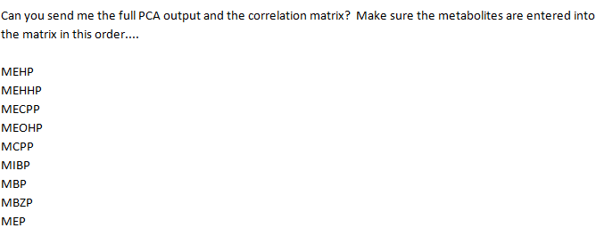
Find the variables
Get the documentation file on the NHANES site

Slide 15
Log transform variables
Using indexing by name, we can log-transform them all at once
log_phthalate_column_names <- paste('Ln', phthalate_column_names, sep='')
log_phthalate_column_names
women1545[,log_phthalate_column_names] <- log(women1545[,phthalate_column_names])

Slide 16
Log-transform variables
This bulk operation is elegant, but in practice, I didn’t do it that way initially. See code for two other versions

Slide 17
Loops
There are several ways to loop in R, but the most common is using for:
for (i in somevector) {
#do something with i
}
Sometimes it's easier to use the positional index, in which case the code takes this form:
for (i in 1:length(somevector)) {
#do something with somevector[i]
}

Slide 18
Loops vs. alternatives
Computer scientists love vectorized operations, higher-order functions (e.g. apply), etc.
They are elegant (I think) and allow for writing compact code
But many computer programmers find looping to be the natural way to think about repeated operations
It's usually a wash in terms of performance in R (and elsewhere)

Slide 19
Doing the PCA
Okay, so we've finally gotten the data we need – log transformed urinary phthalate levels for women aged 15-45 in 2005-2006 NHANES.
So how do we do the PCA?

Slide 20
Which PCA function?
Let's pick from among the PCA packages:
http://gastonsanchez.com/blog/how-to/2012/06/17/PCA-in-R.html
(Which I found by searching for 'PCA in R')

Slide 21
So, some options
stats::prcomp
stats::princomp
FactoMineR::PCA
ade4::dudi.pca
amap::acp
Also… psych::principal, probably others

Slide 22
FactoMineR
FactoMineR's PCA comes recommended
And FactoMineR's PCA allows for row weights, which is desirable since this is weighted data…
… so let's try it

Slide 23
Using FactoMineR
Read the documentation and fiddled a little eventually setting on the following code:
library(FactoMineR)
complete_women1545 <- women1545[complete.cases(women1545[,log_phthalate_column_names]),]
pca.result <- PCA(complete_women1545[,log_phthalate_column_names],
row.w=complete_women1545$WTMEC2YR)
round(pca.result$eig[,1:2], 2)

Slide 24
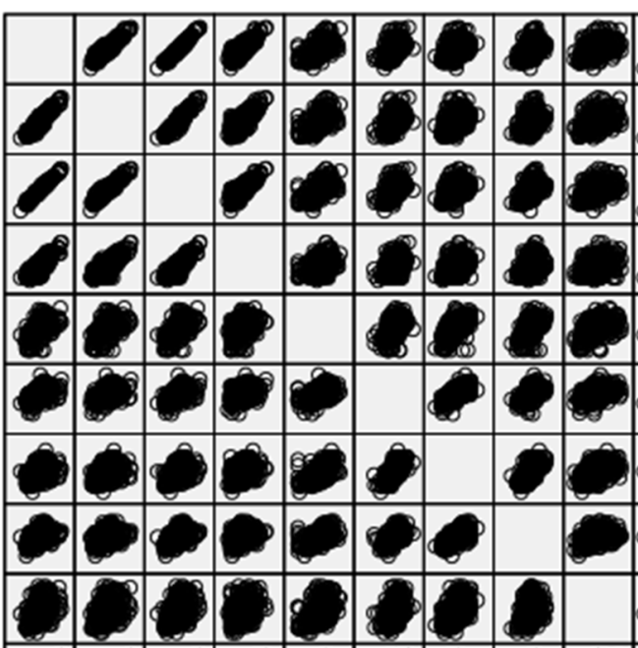
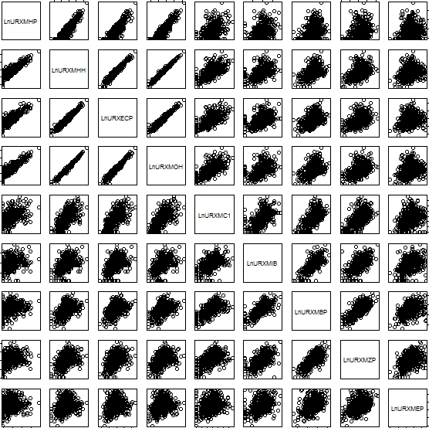
So, how does NHANES compare to CCCEH?
CCCEH
NHANES

Slide 25

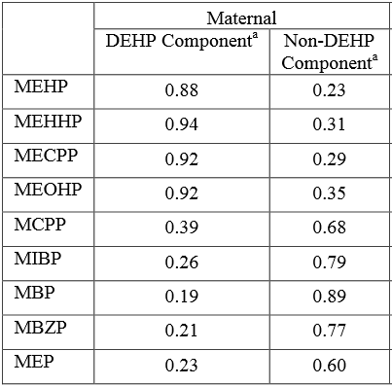
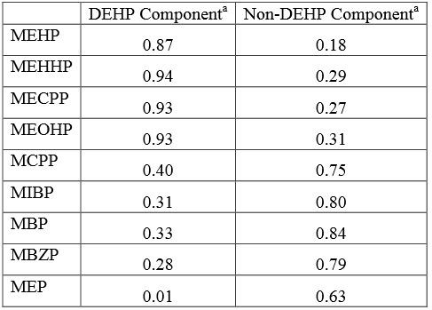
PCA: CCCEH vs. NHANES
NHANES
CCCEH

Slide 26
Complex survey weighting
Complex surveys often use clustered, stratified sampling
Not going to get into the details, but essentially, you need to specify the clusters and strata correctly to get the right standard errors
So, does just specifying the row weights work for us?

Slide 27
PCAs and complex surveys
PCAs in complex survey data is an area of active research:
PCAs should account for the survey design, but they generally don't in practice
Technically, this is non-trivial
Biases do not appear to be huge for our purposes here
Read more: https://www.amstat.org/sections/SRMS/Proceedings/y2008/Files/302340.pdf
(Sample code in accompanying file)

