Slide 1
Elevate Your Graphics Game: Violin Plots
Spencer Childress
Notes:
Introduce ourselves
Background
RAs have expressed interest in providing statistical support
There are a lot of tasks RAs can help statisticians with

Slide 2
Outline
A Real-World Example
The Box-and-Whisker Plot
Side-by-Side
The Violin Plot
Kernel Density Estimates
Descriptive Statistics
Jittered, Grouped, and Trend Lined
Prepping the Data
Plotting – Now with Panels
The Macro: %violinPlot

Slide 3
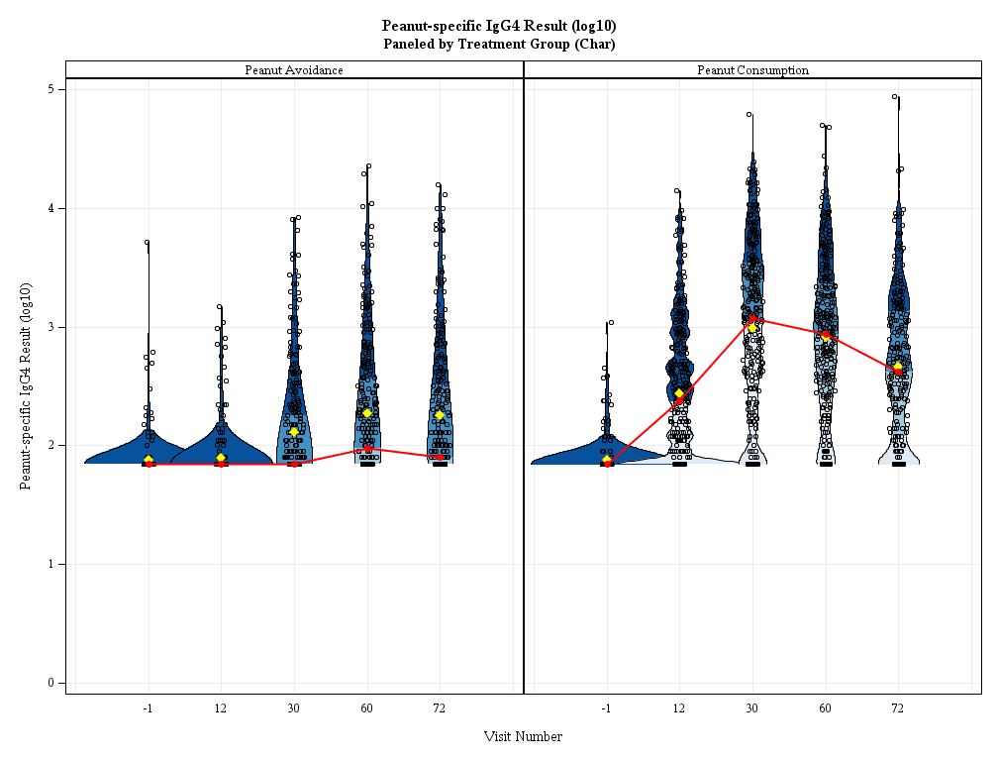
A Real-World Example

Slide 4
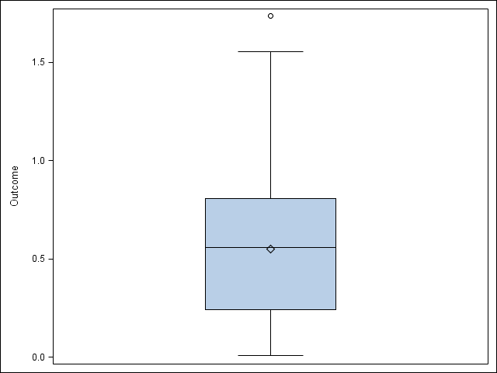
The Box-and-Whisker Plot
Outcome
Five-number summary
Quartiles
Range
Outliers
Outside 1.5x interquartile range
Quick and easy
Rigid and potentially misleading
3rd
Median
1st

Slide 5
Code Snippet: PROG SGPLOT
proc sgplot
data = exampleData;
vbox outcome;
run;

Slide 6
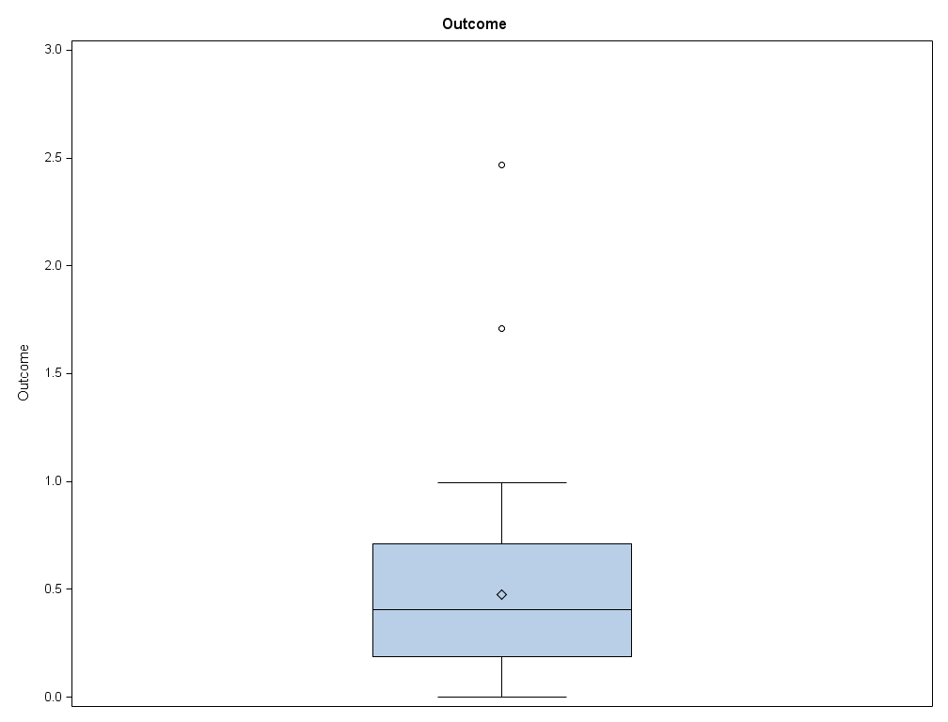
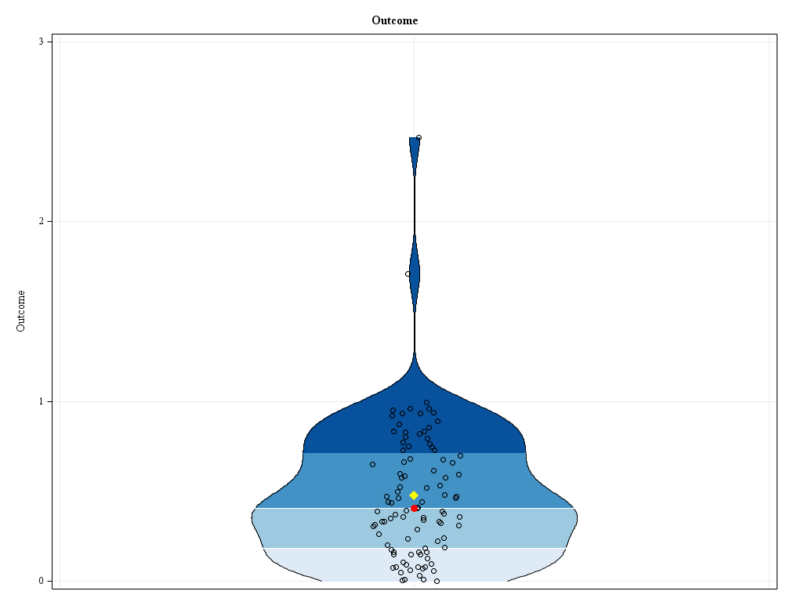
Side-by-Side
Box-and-whisker plot
Violin plot

Slide 7
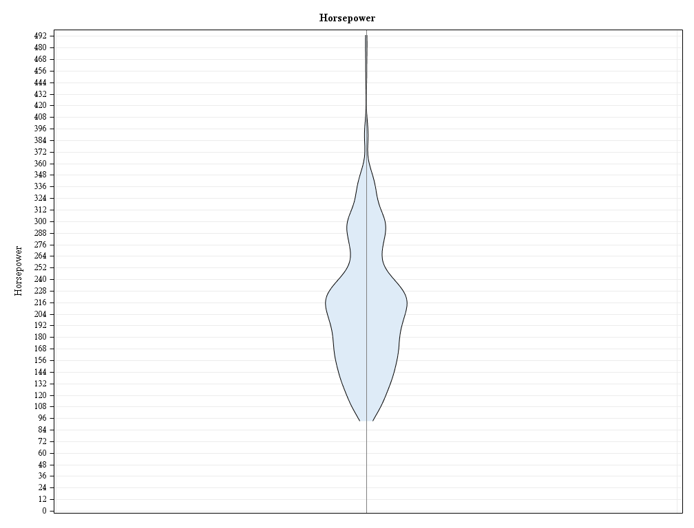
The Violin Plot
Probability density curve
Mirrored
Width represents density of data
Height represents range of data
Just like box-and-whisker plot
Needs some statistics

Slide 8
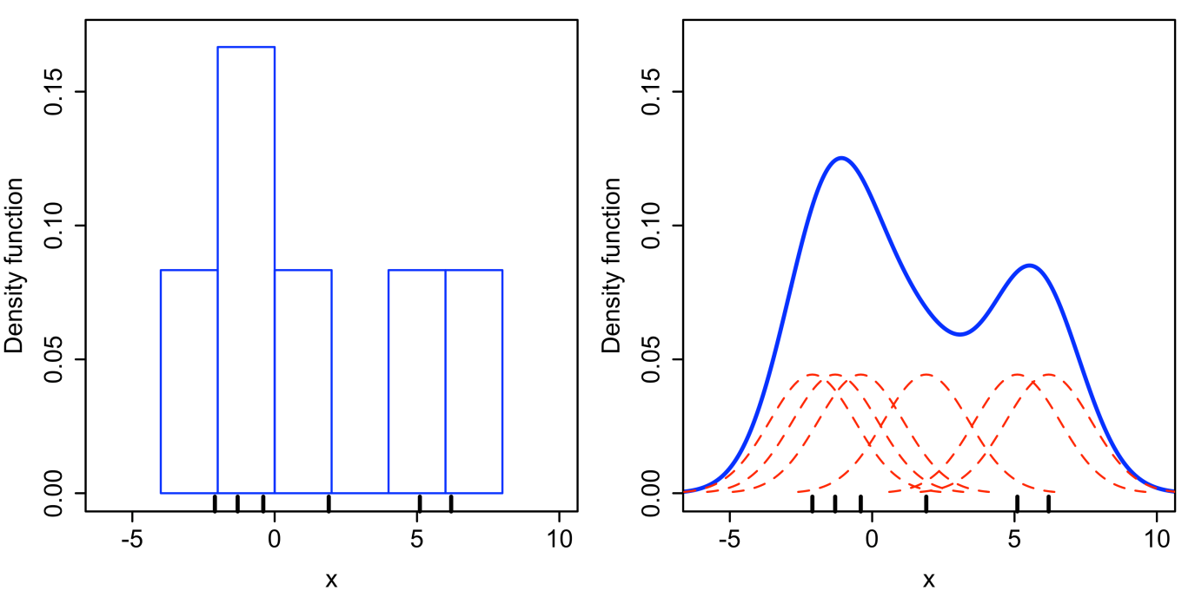
Kernel Density Estimation (KDE)
Estimates of the probability density function of a random variable
When plotted, like a histogram with infinite bins

Slide 9
Code Snippet: PROC KDE
proc kde
data = cars;
univar horsepower /
out = KDE;
run;

Slide 10
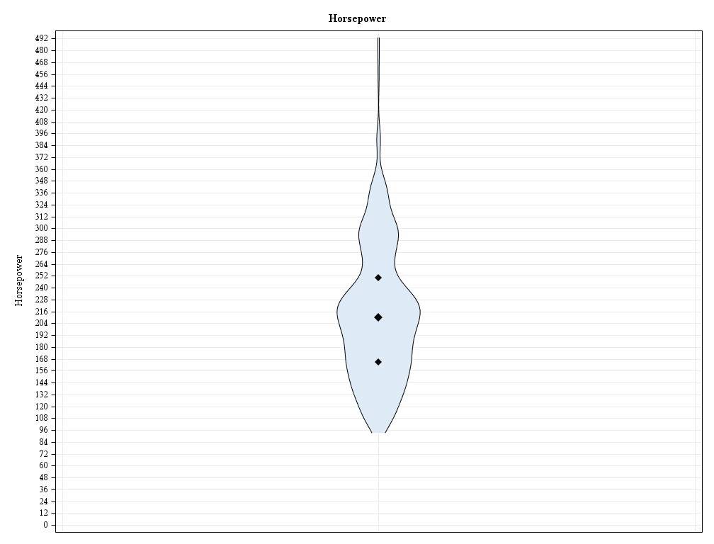
Descriptive Statistics
Range is already present
What about quartiles?
Not really elegant
And what about the mean?
3rd
Median
1st

Slide 11
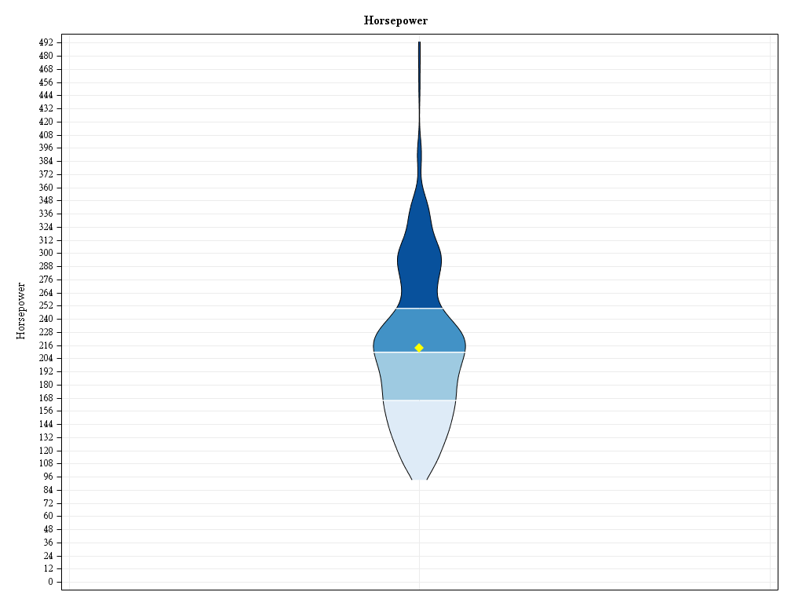
Descriptive Statistics
Colored quartiles
Mean
Five-number summary and then some
Mean

Slide 12
Code Snippet: PROC MEANS
proc means noprint nway
data = cars;
var horsepower;
output
out = statistics
mean = mean
p25 = quartile1
median = median
p75 = quartile3;
run;

Slide 13
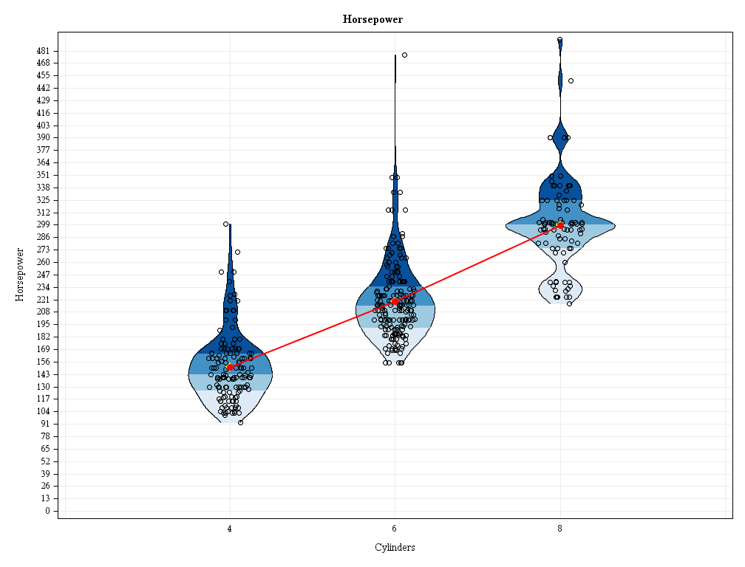
Jittered, Grouped, and Trend Lined

Slide 14
Prepping the Data
Stack literally everything:
KDEs
Descriptive statistics
Actual data points

Slide 15
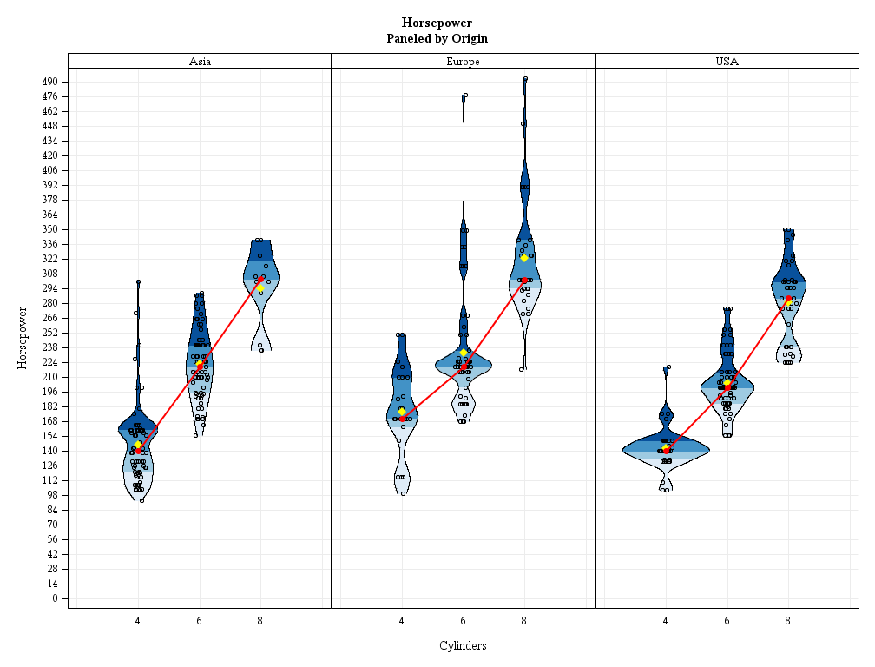
Plotting – Now with Panels

Slide 16
Code Snippet: PROC SGPANEL
proc sgpanel
data = carsKDEstatistics;
panelby
origin / novarname
rows = 1;

Slide 17
Code Snippet: BAND Statement
band
y = horsepower
lower = density
upper = mirror / fill outline
group = quartile
lineattrs = (
pattern = solid
color = black);
lower
y
upper

Slide 18
Code Snippet: SCATTER Statement
scatter
x = jitteredCylinders
y = horsepower /
markerattrs = (
symbol = circle
size = 6px
color = black);
x

Slide 19
Code Snippet: SERIES Statement
series
x = cylinders
y = horsepowerMedian /
lineattrs = (
color = red
thickness = 2px);
series

Slide 20
The Macro: %violinPlot
%violinPlot
(data = cars
,outcomeVar = horsepower
,groupVar = cylinders
,panelVar = origin
,byVar =
,outPath = .
,outName = violinPlot
,widthMultiplier = 1
,jitterYN = Yes
,quartileYN = Yes
,quartileSymbolsYN = No
,meanYN = Yes
,trendLineYN = Yes
,trendStatistic = Median
);

Slide 21
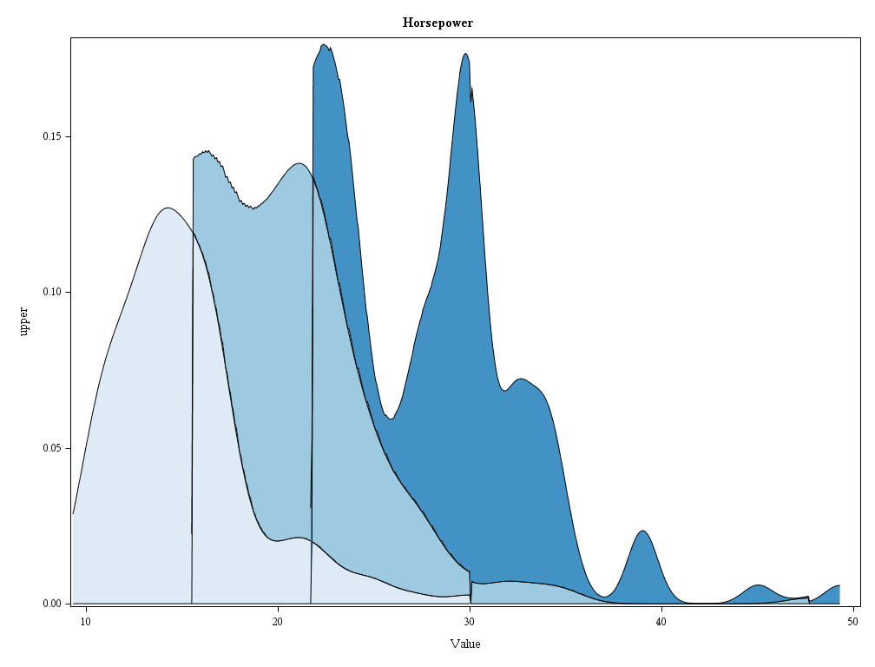
Other Applications – Stream Graph

Slide 22

Questions!?
github.com/RhoInc/
sas-violinPlot

