Slide 1
Elevate Your Graphics Game: Violin Plots
Spencer Childress
Notes:
Introduce ourselves
Background
RAs have expressed interest in providing statistical support
There are a lot of tasks RAs can help statisticians with

Slide 2
Outline
The Box-and-Whisker Plot
The Five-Number Summary
Side-by-side
The Violin Plot
Descriptive Statistics
Grouped and Jittered
Trend Line
Prepping the Data
Plotting the Data
The Macro

Slide 3
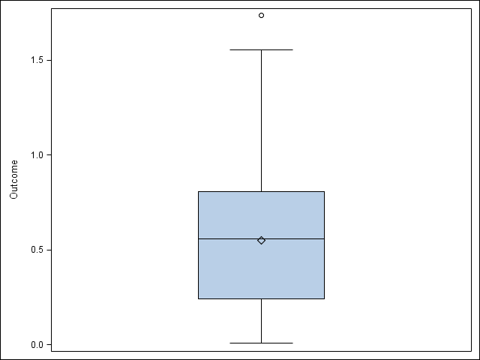
The Box-and-Whisker Plot
Outcome
Five-number summary
Quartiles
Range
Outliers
Outside 1.5x interquartile range
Quick and easy
Rigid and potentially misleading
3rd
Median
1st

Slide 4
Box-and-Whisker Plot – Code
proc sgplot
data = exampleData;
vbox outcome;
run;

Slide 5
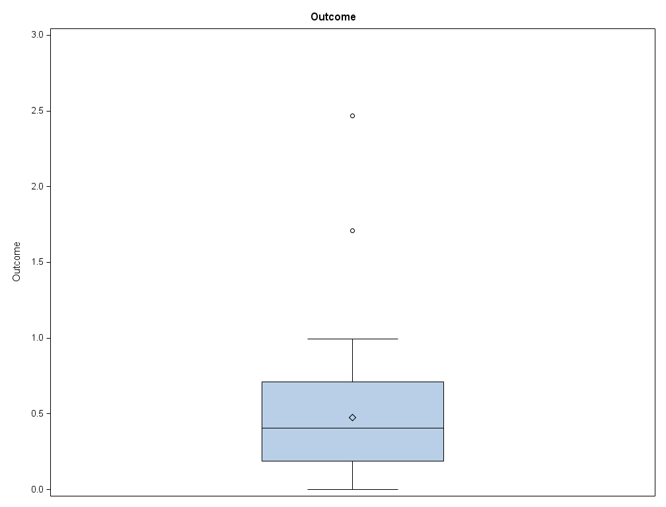
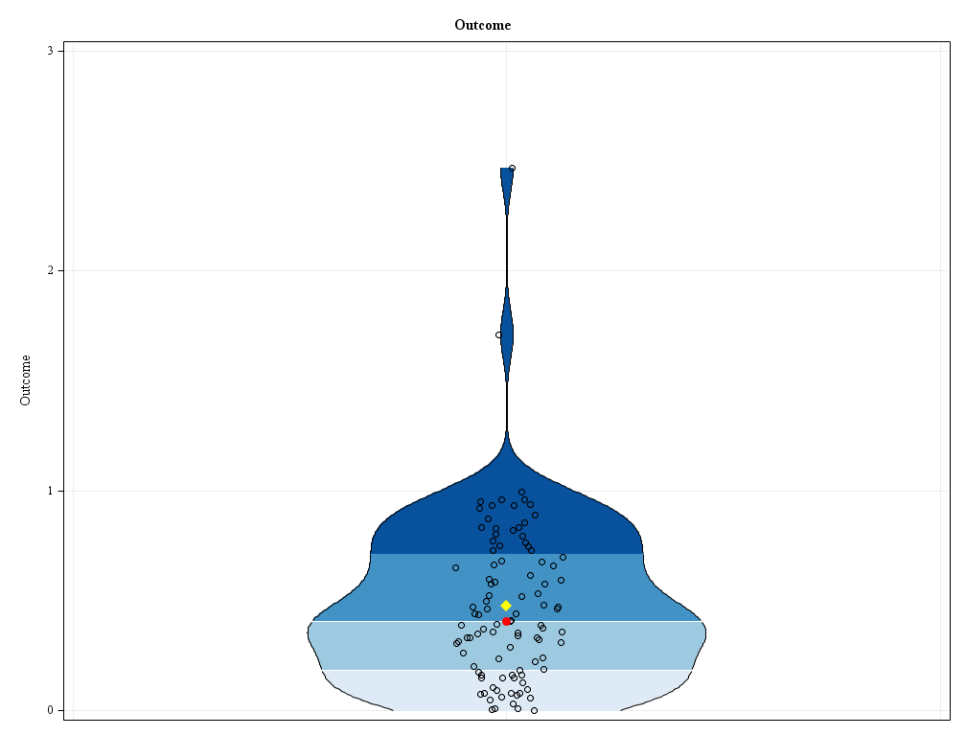
Side-by-Side
Box-and-whisker plot
Violin plot

Slide 6
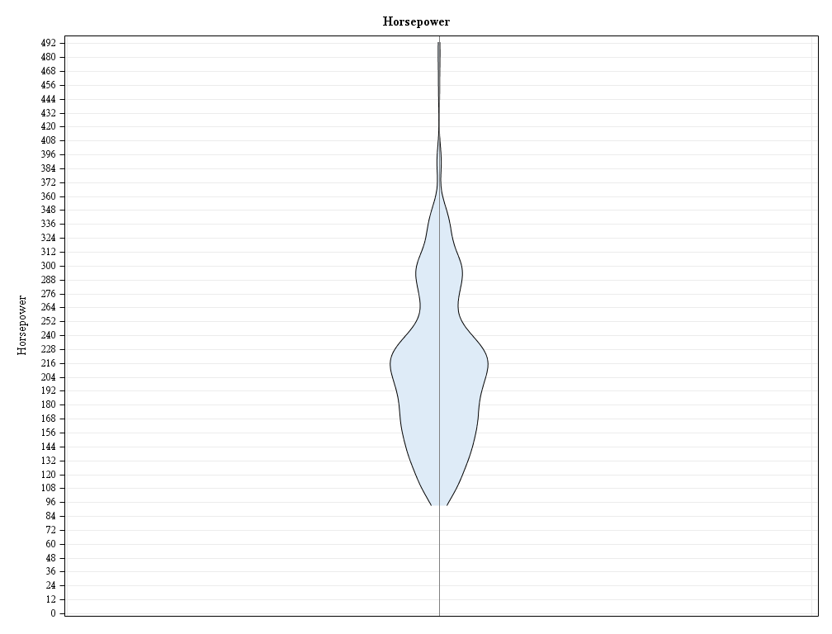
The Violin Plot
Probability density curve
Mirrored
Width represents density of data
Height represents range of data
Just like box-and-whisker plot
Needs some statistics

Slide 7
Violin Plot – Probability Density
proc kde
data = cars;
univar horsepower /
out = KDE;
run;

Slide 8
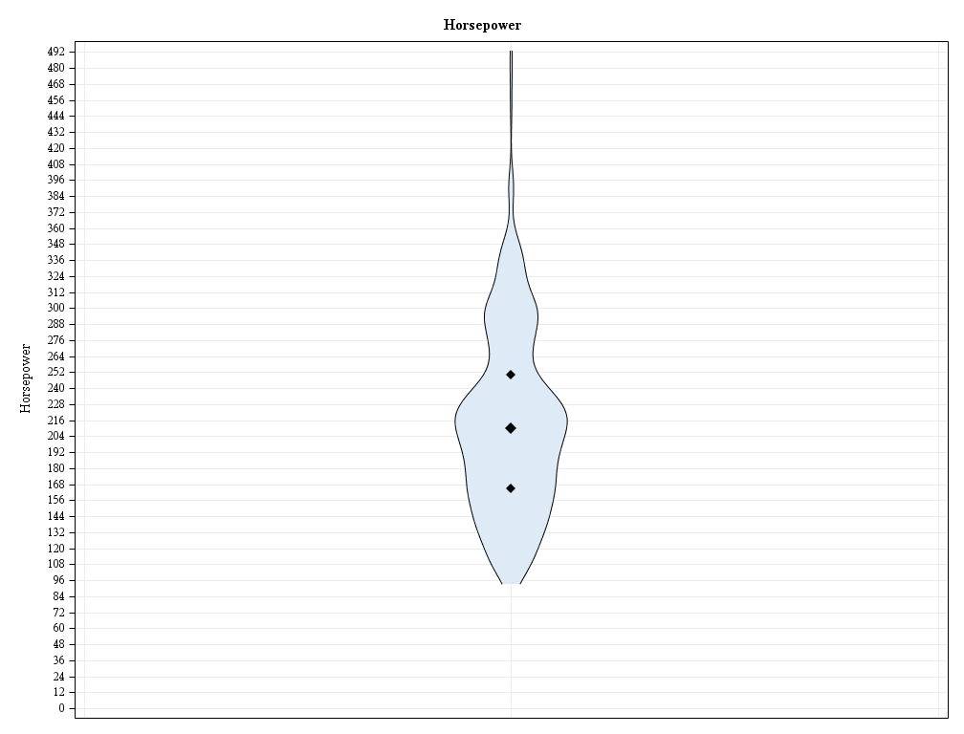
Violin Plot – Descriptive Statistics
Range is already present
What about quartiles?
Not really elegant
And what about the mean?
3rd
Median
1st

Slide 9
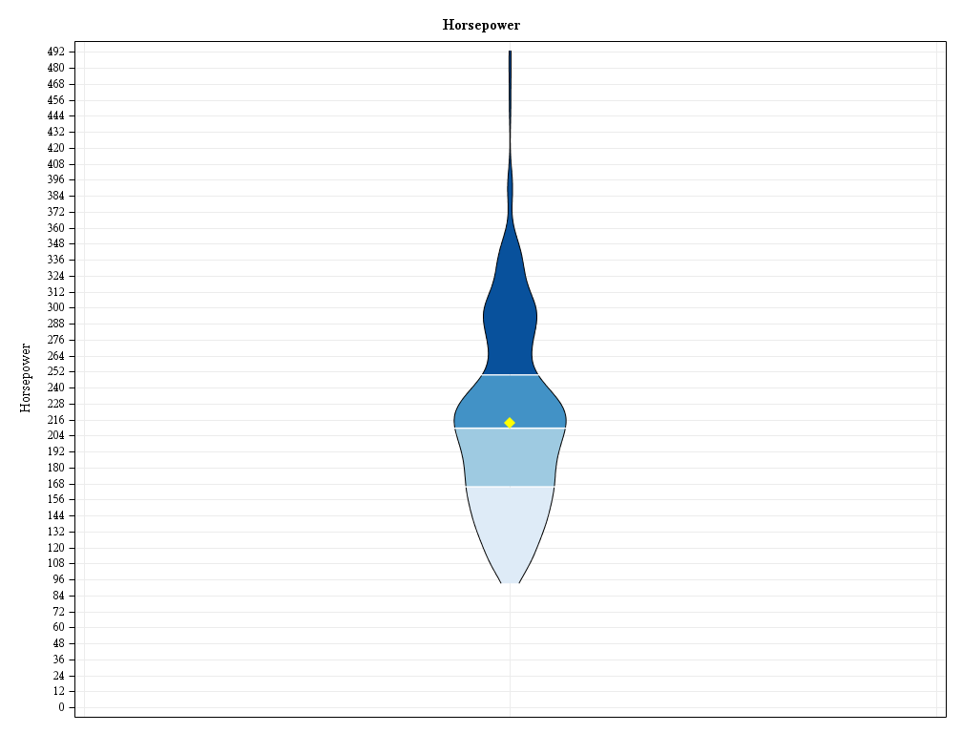
Violin Plot – Descriptive Statistics
Colored quartiles
Mean
Five-number summary and then some
What about the data points?
Mean

Slide 10
Violin Plot – Descriptive Statistics
proc means noprint nway
data = cars;
var horsepower;
output
out = statistics
mean = mean
p25 = quartile1
median = median
p75 = quartile3;
run;

Slide 11
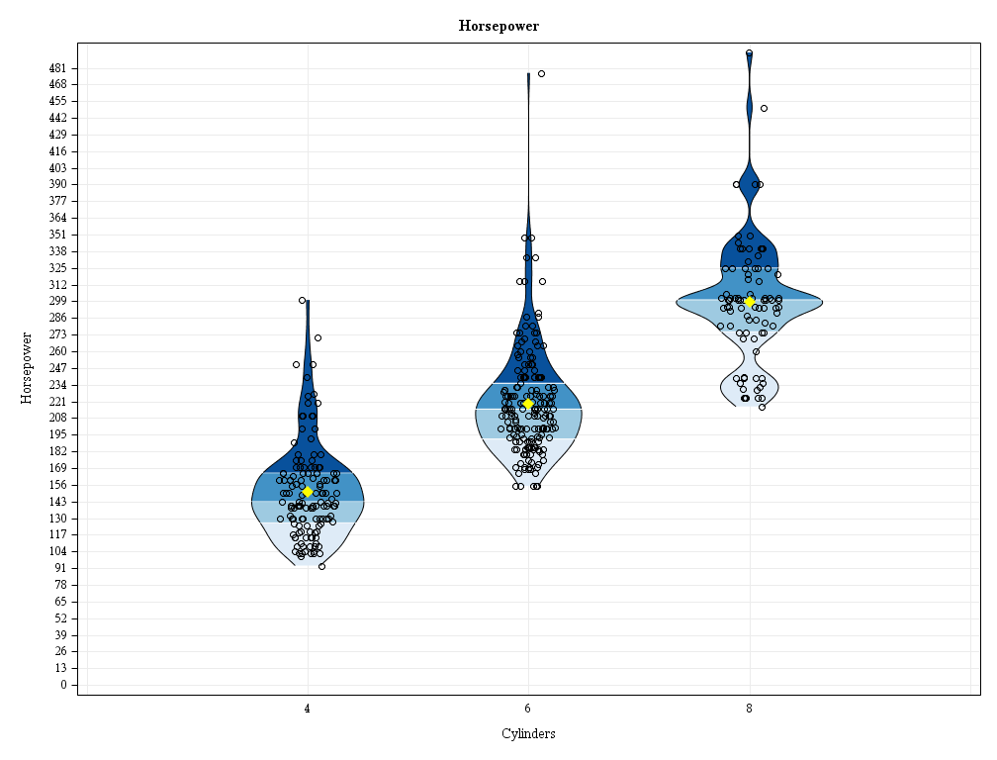
Violin Plot – Grouped and Jittered

Slide 12
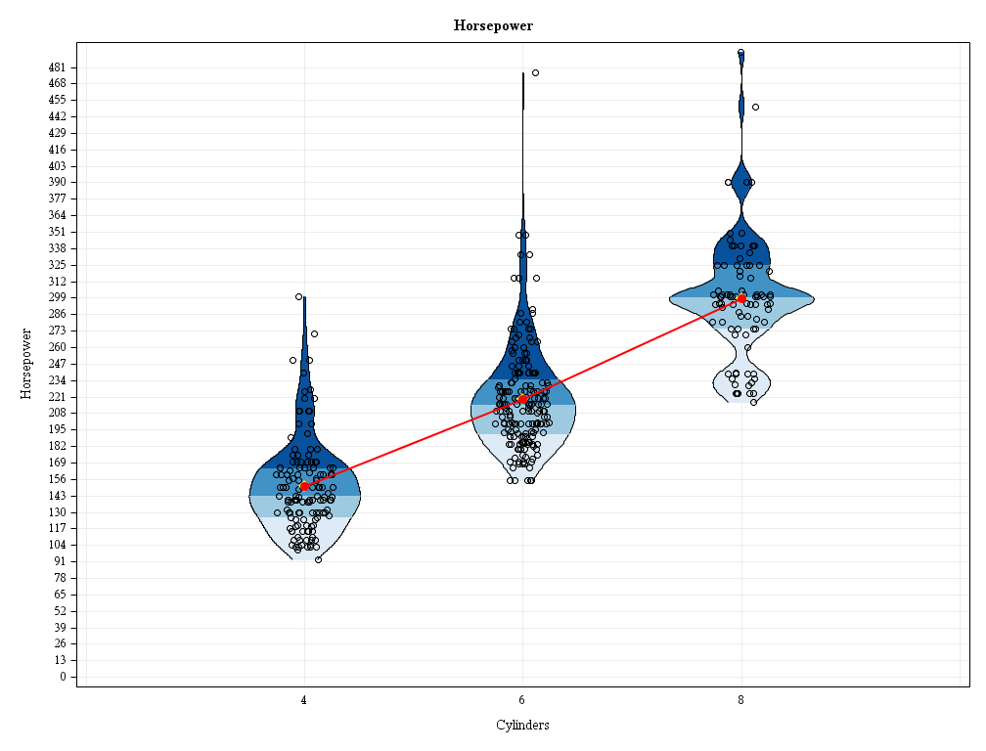
Violin Plot – Trend Line

Slide 13
Violin Plot – Prepping the Data
Just stack all the stuff together: KDEs, descriptive statistics, actual data points

Slide 14
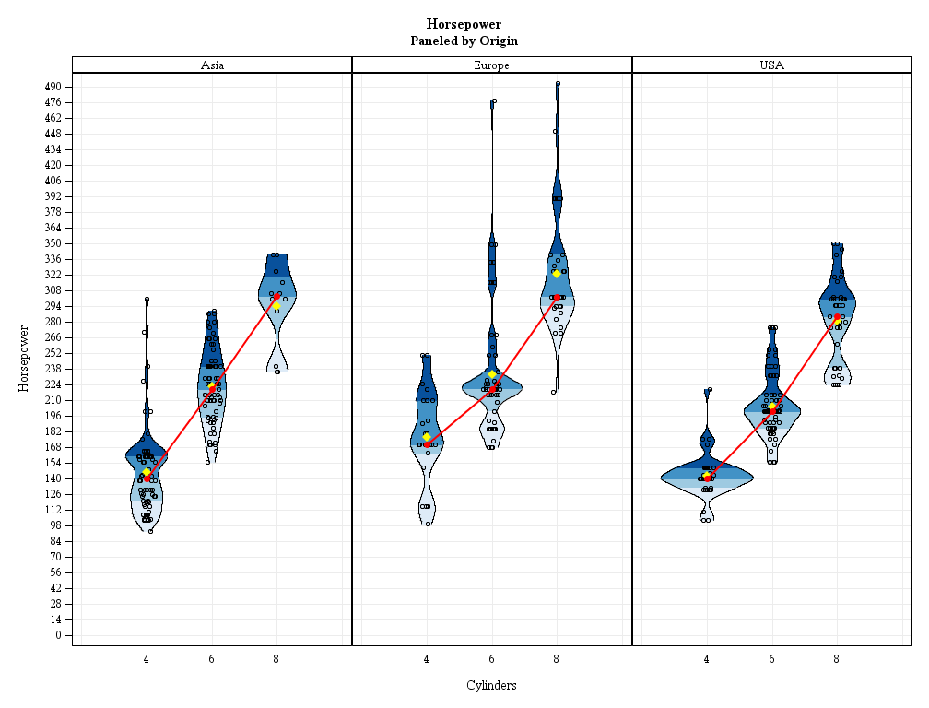
Violin Plot – Plotting the Data

Slide 15
Violin Plot – Plotting the Data
proc sgpanel
data = carsKDEstatistics;
panelby
origin / novarname
rows = 1;

Slide 16
Violin Plot – Plotting the Data
band
y = yBand
lower = lowerBand
upper = upperBand / fill outline
group = quartile
lineattrs = (
pattern = solid
color = black);

Slide 17
Violin Plot – Plotting the Data
scatter
x = jitteredCylinders
y = horsepower/stats /
markerattrs = (
symbol = circle
size = 6px
color = black);

Slide 18
Violin Plot – Plotting the Data
series
x = cylinders
y = horsepowerMedian /
lineattrs = (
color = red
thickness = 2px);

Slide 19
%violinPlot
%violinPlot
(data = cars
,outPath = .
,outName = violinPlot
,outcomeVar = horsepower
,groupVar = cylinders
,panelVar = origin
,byVar =
,widthMultiplier = 1
,jitterYN = Yes
,quartileYN = Yes
,quartileSymbolsYN = No
,meanYN = Yes
,trendLineYN = Yes
,trendStatistic = Median
);

Slide 20
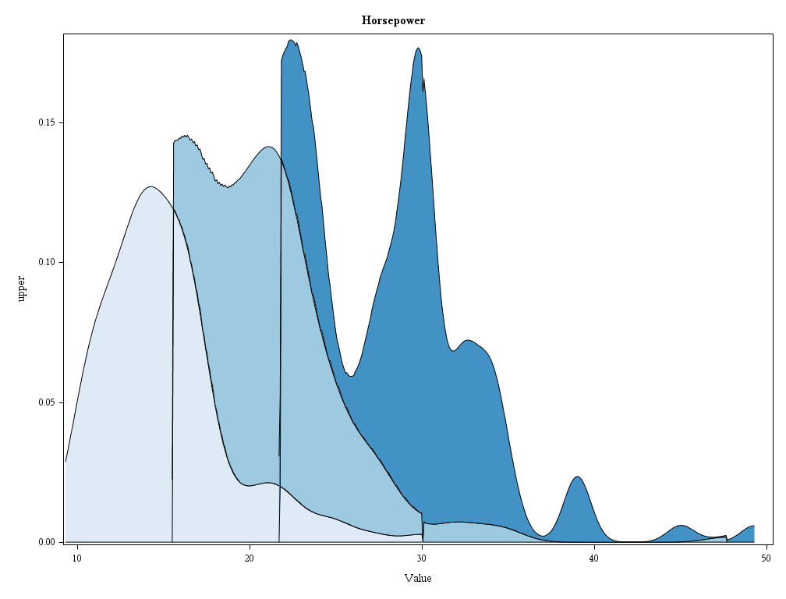
Other Applications – Stream Graph

