Slide 1
Elevate Your Graphics Game: Violin Plots
Spencer Childress, Rho, Inc.
PharmaSUG 2016
Paper #DG15

Slide 2
Outline
A Real-World Example
The Box-and-Whisker Plot
Side-by-Side
The Violin Plot
Kernel Density Estimates
Descriptive Statistics
Added Effects
Prepping the Data
Plotting – Now with Panels
The Macro: %violinPlot

Slide 3
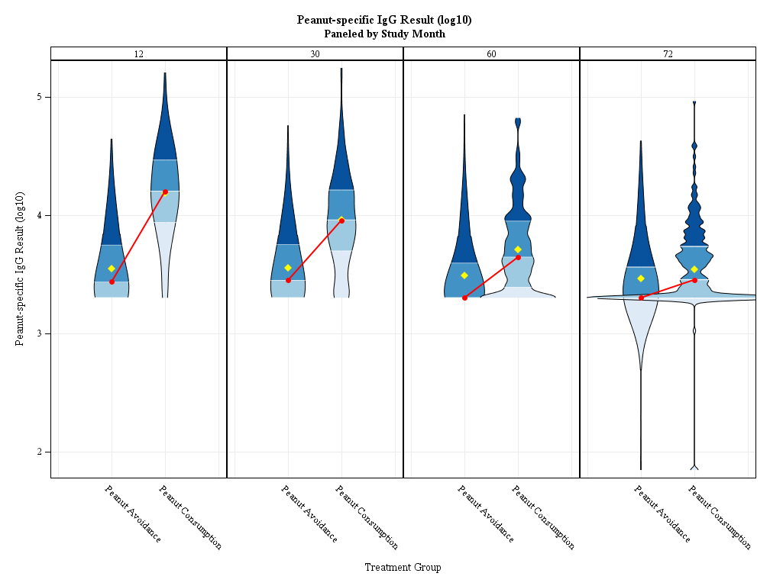
A Real-World Example

Slide 4
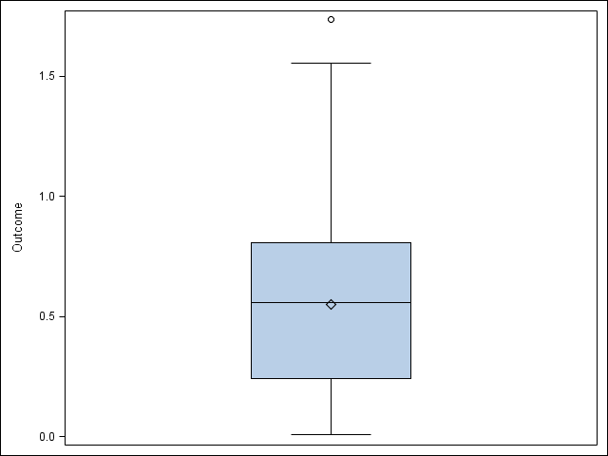
The Box-and-Whisker Plot
Outcome
Five-number summary
Quartiles
Range…
Outliers
Outside 1.5x interquartile range
Quick and easy
Rigid and potentially misleading
3rd
Median
1st

Slide 5
Code Snippet: PROG SGPLOT
proc sgplot
data = exampleData;
vbox outcome;
run;

Slide 6
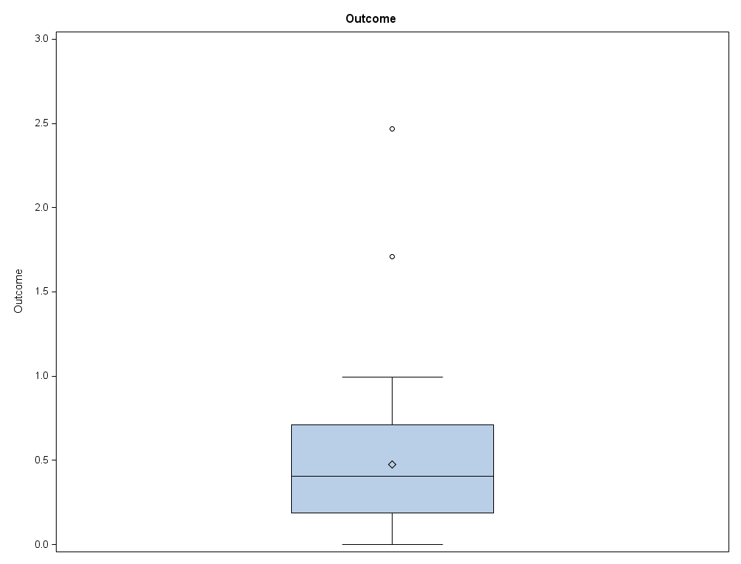
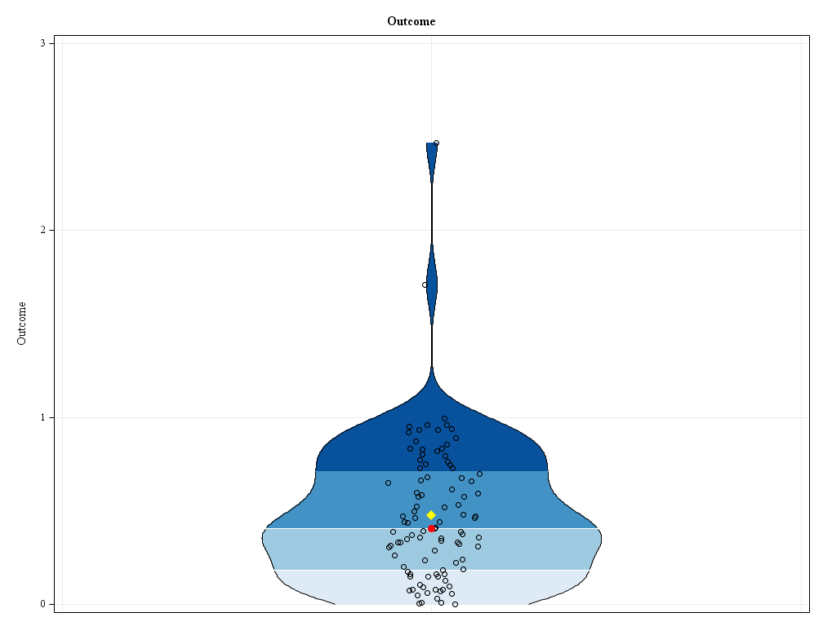
Side-by-Side
Box-and-whisker plot
Violin plot

Slide 7
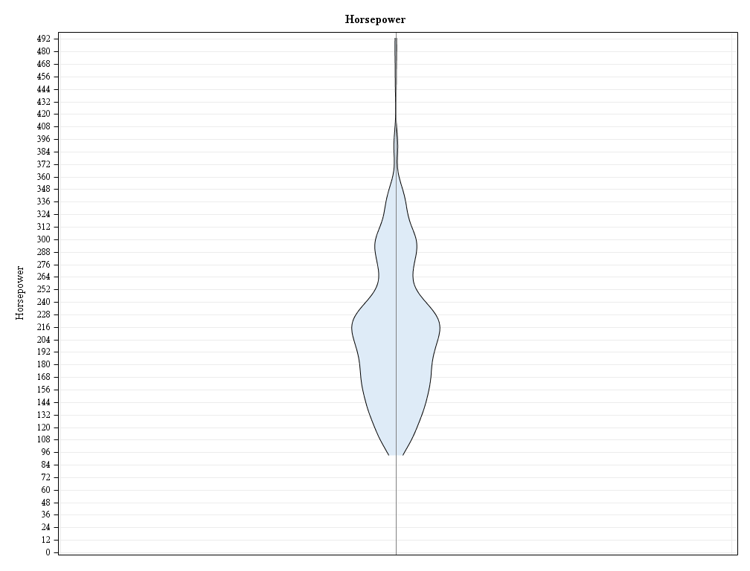
The Violin Plot
Probability density curve
Mirrored
Width represents density of data
Height represents range of data
Just like box-and-whisker plot
Needs some statistics

Slide 8
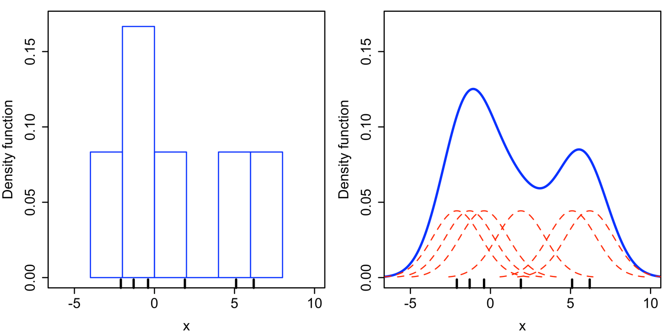
Kernel Density Estimation (KDE)
Estimates of the probability density function of a random variable
When plotted, like a histogram with infinite bins

Slide 9
Code Snippet: PROC KDE
proc kde
data = cars;
univar horsepower /
out = KDE;
run;

Slide 10
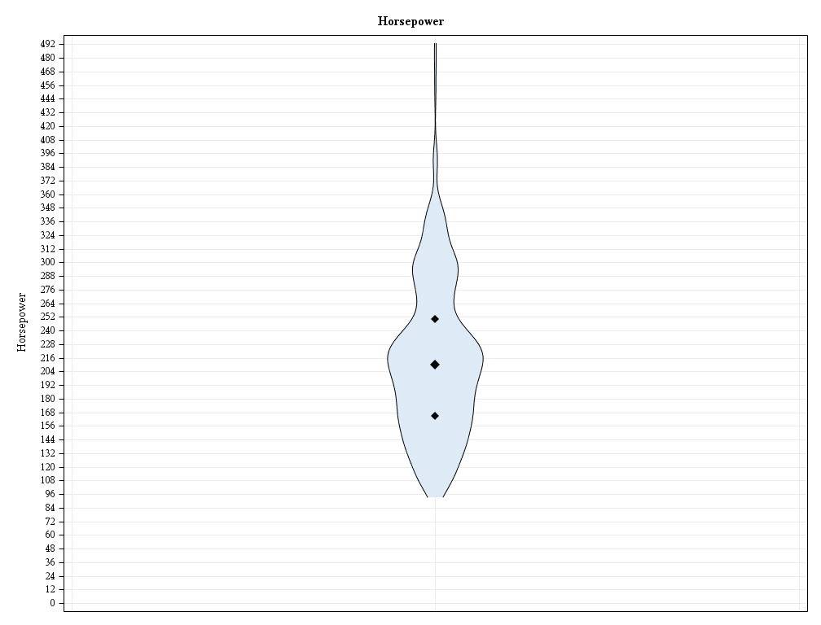
Descriptive Statistics
Range is already present
Calculate and plot quartiles
Not really elegant
A mean would be useful too
3rd
Median
1st

Slide 11
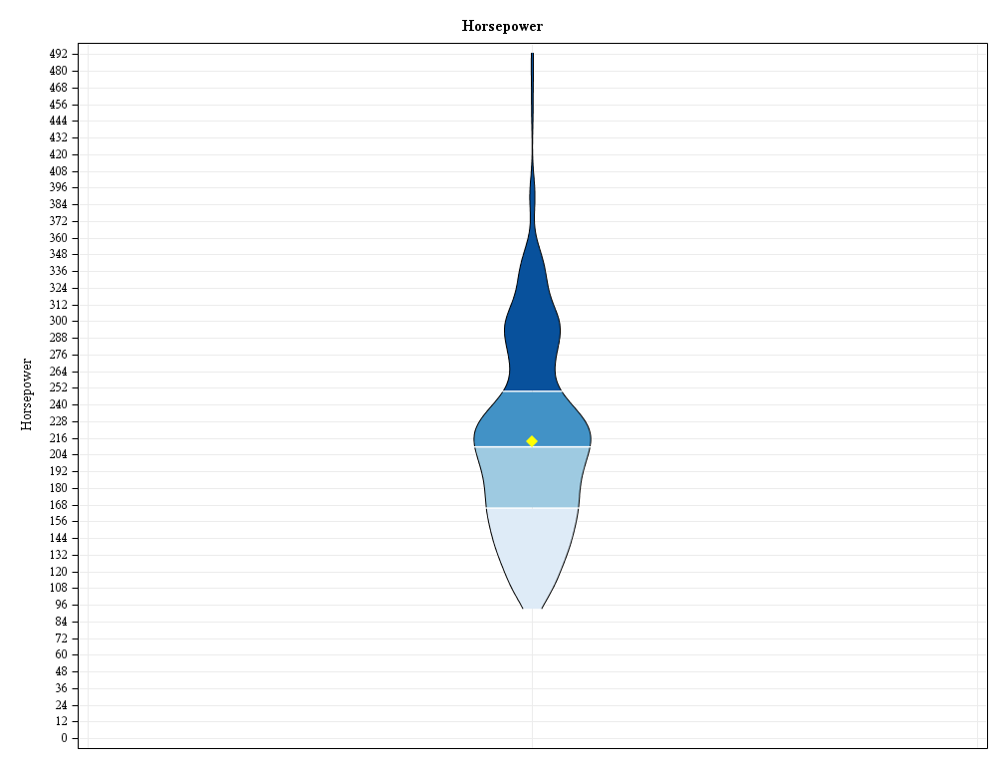
Descriptive Statistics
Color plot by quartiles
Five-number summary achieved
Overlay mean for added detail
Mean

Slide 12
Code Snippet: PROC MEANS
proc means noprint nway
data = cars;
var horsepower;
output
out = statistics
mean = mean
p25 = quartile1
median = median
p75 = quartile3;
run;

Slide 13
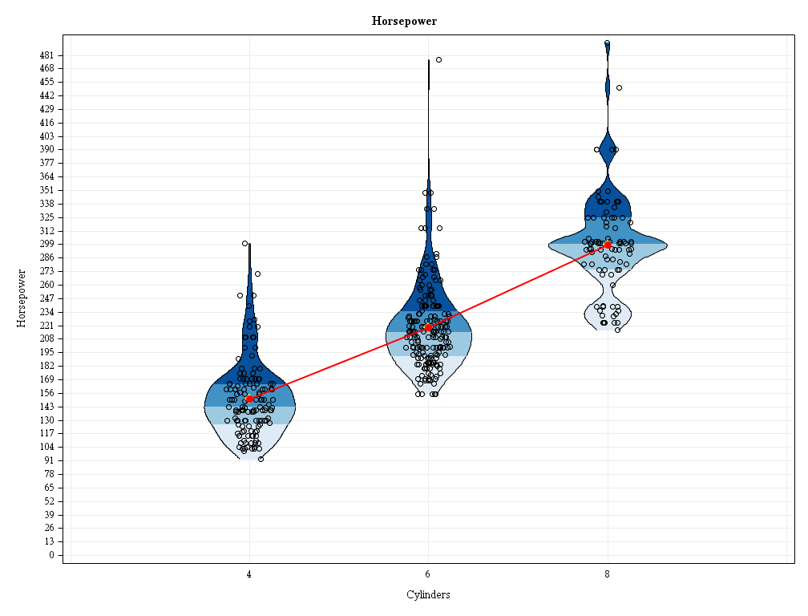
Added Effects
Plotting by group allows for comparisons
Trend line might communicate change over time
Jittered points provide insight into the quantity and magnitude to individual data points

Slide 14
Prepping the Data
Stack everything together:
KDEs
Descriptive statistics
Actual data points

Slide 15
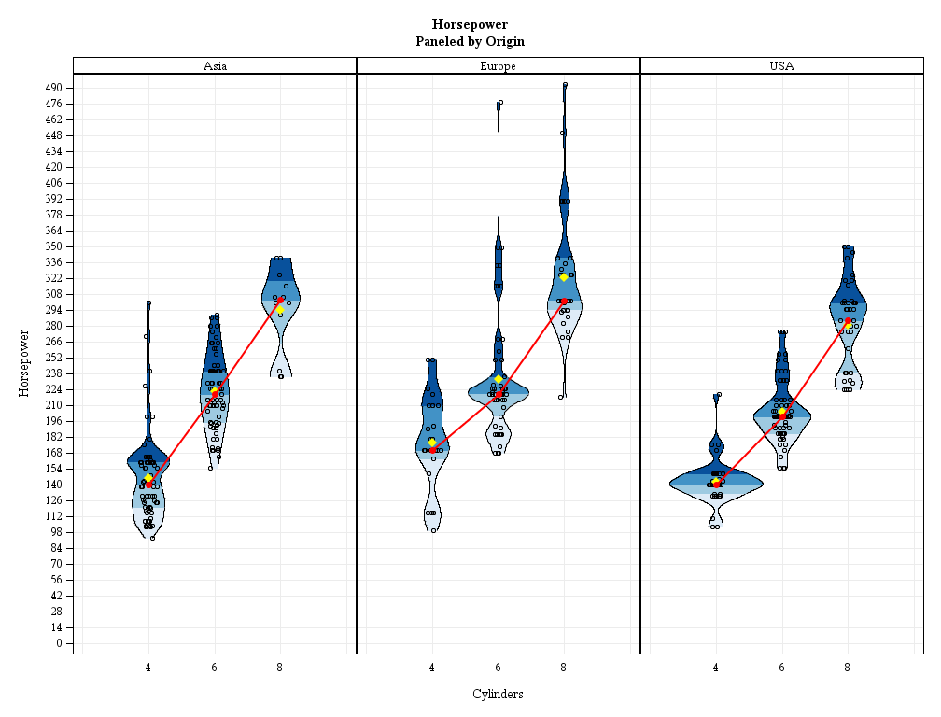
Plotting – Now with Panels

Slide 16
Code Snippet: PROC SGPANEL
proc sgpanel
data = carsKDEstatistics;
panelby
origin / novarname
rows = 1;

Slide 17
Code Snippet: BAND Statement
lower
band
y = horsepower
lower = density
upper = mirror / fill outline
group = quartile
lineattrs = (
pattern = solid
color = black);
y
upper

Slide 18
Code Snippet: SCATTER Statement
scatter
x = jitteredCylinders
y = horsepower /
markerattrs = (
symbol = circle
size = 6px
color = black);
x

Slide 19
Code Snippet: SERIES Statement
series
x = cylinders
y = horsepowerMedian /
lineattrs = (
color = red
thickness = 2px);
series

Slide 20
The Macro: %violinPlot
%violinPlot
(data = cars
,outcomeVar = horsepower
,groupVar = cylinders
,panelVar = origin
,byVar =
,outPath = .
,outName = violinPlot
,widthMultiplier = 1
,jitterYN = Yes
,quartileYN = Yes
,quartileSymbolsYN = No
,meanYN = Yes
,trendLineYN = Yes
,trendStatistic = Median
);

Slide 21
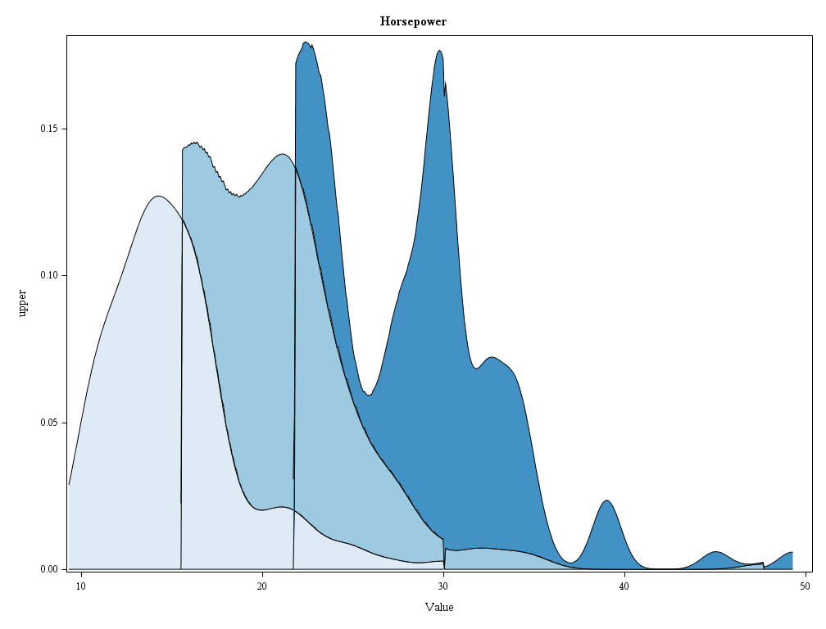
Other Applications – Stream Graph

Slide 22
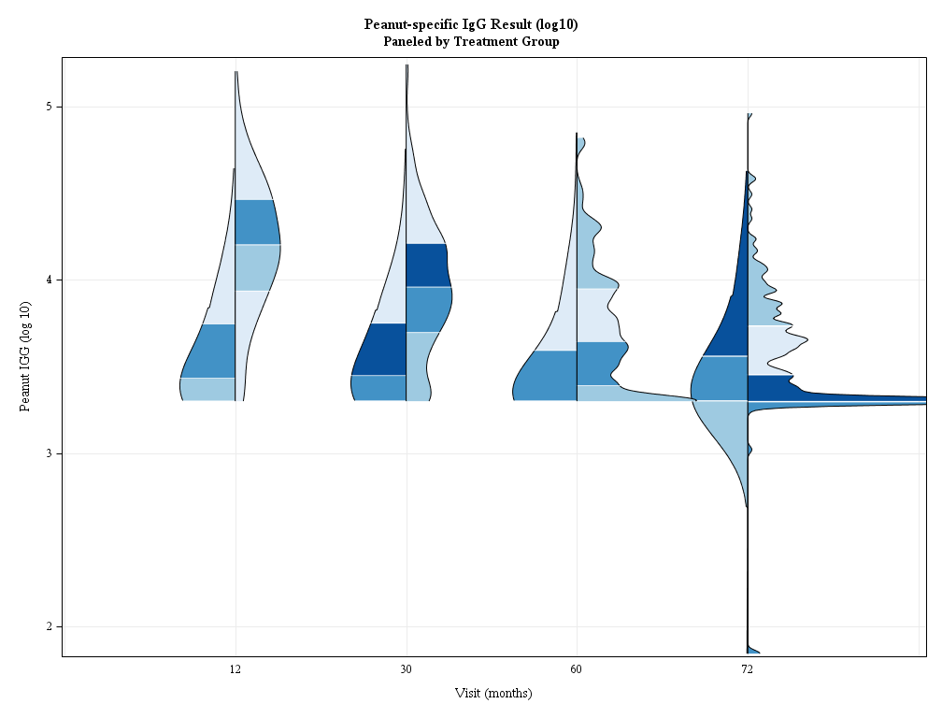
Other Applications – Side-by-Side Density Curves

Slide 23

Name: Spencer Childress
Organization: Rho, Inc.
Address: 6330 Quadrangle Drive
City, State ZIP: Chapel Hill, NC 27517
Work Phone: 919 595 6638
Fax: 919 408 0999
E-mail: spencer_childress@rhoworld.com
Web: github.com/RhoInc/sas-violinPlot
Twitter: @samussiah

