Slide 1
AMES HOUSING SALE PRICE PREDICTION
DSI 8 PROJECT 2

Slide 2
PROBLEM STATEMENT
To predict the price of homes at sale for the Ames Iowa Housing dataset using data from Ames Assessor’s Office for sales from 2006 to 2010.

Slide 3
DATA CLEANING
Missing values
Replace with ‘None’ or 0
Replace with mode or mean
Features were combined if they were measuring the same aspect of the house e.g. Basement Area, Porch Area and Living Area
Ordinal features measuring quality were replaced with numeric values
Dummies were used for nominal discrete features

Slide 4
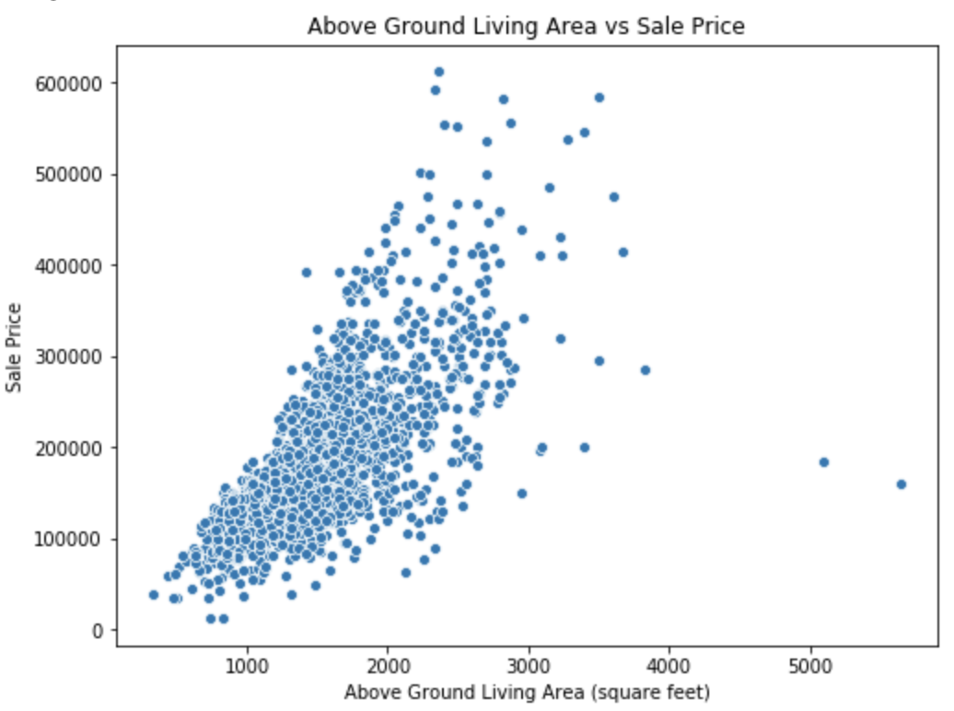
Outliers
Following the data dictionary, we also note that there are 5 outliers in the dataset where Gr Liv Area > 4000.
2 of them were in the train set.

Slide 5
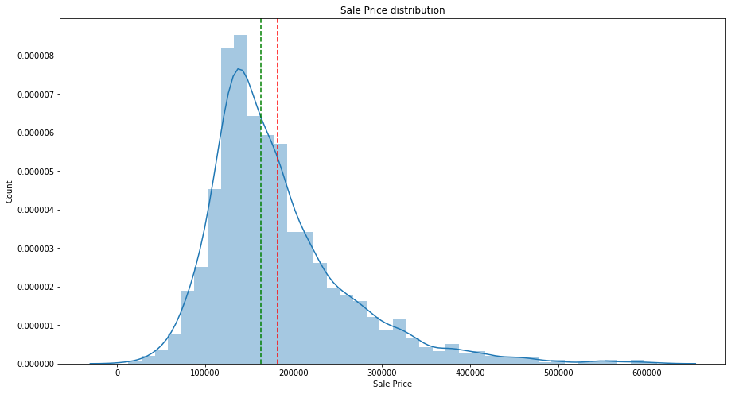
DATA VISUALIZATION - Target (Sale price)
Green dot line = Median
Red dot line = Mean
Normally distributed, but skewed towards the left
Most sale prices range between 100000 to 300000.

Slide 6
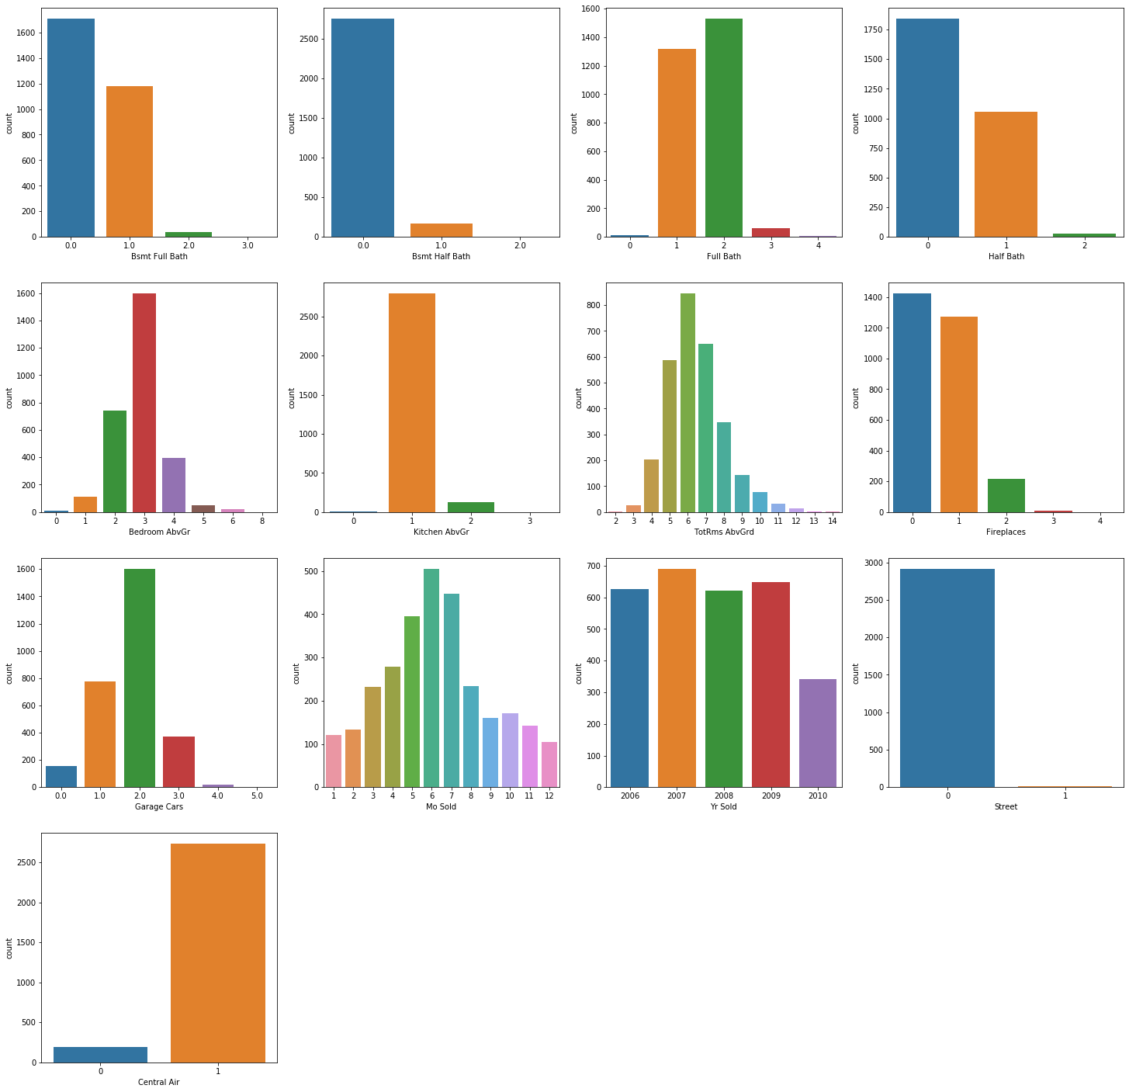
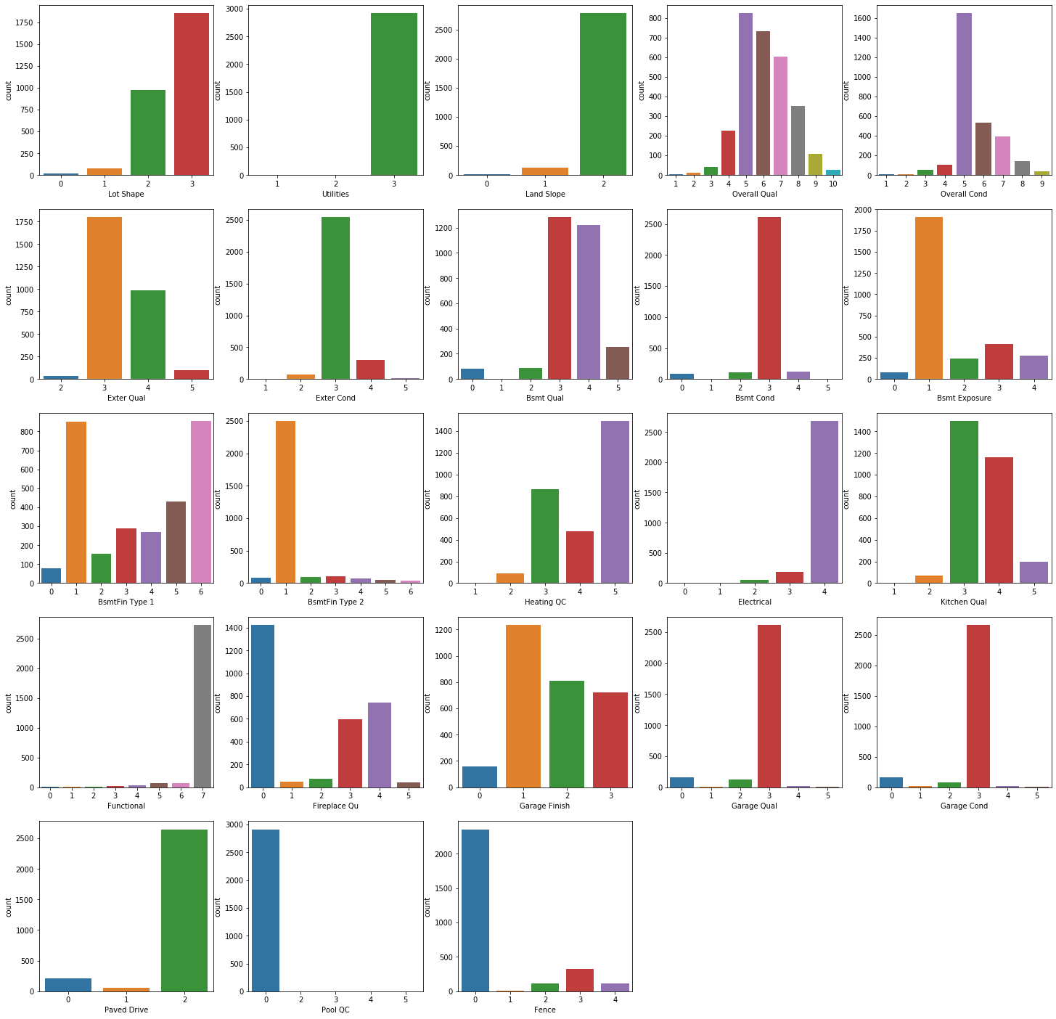
DATA VISUALIZATION - Ordinal / Discrete
Split the visualization based on type of data

Slide 7
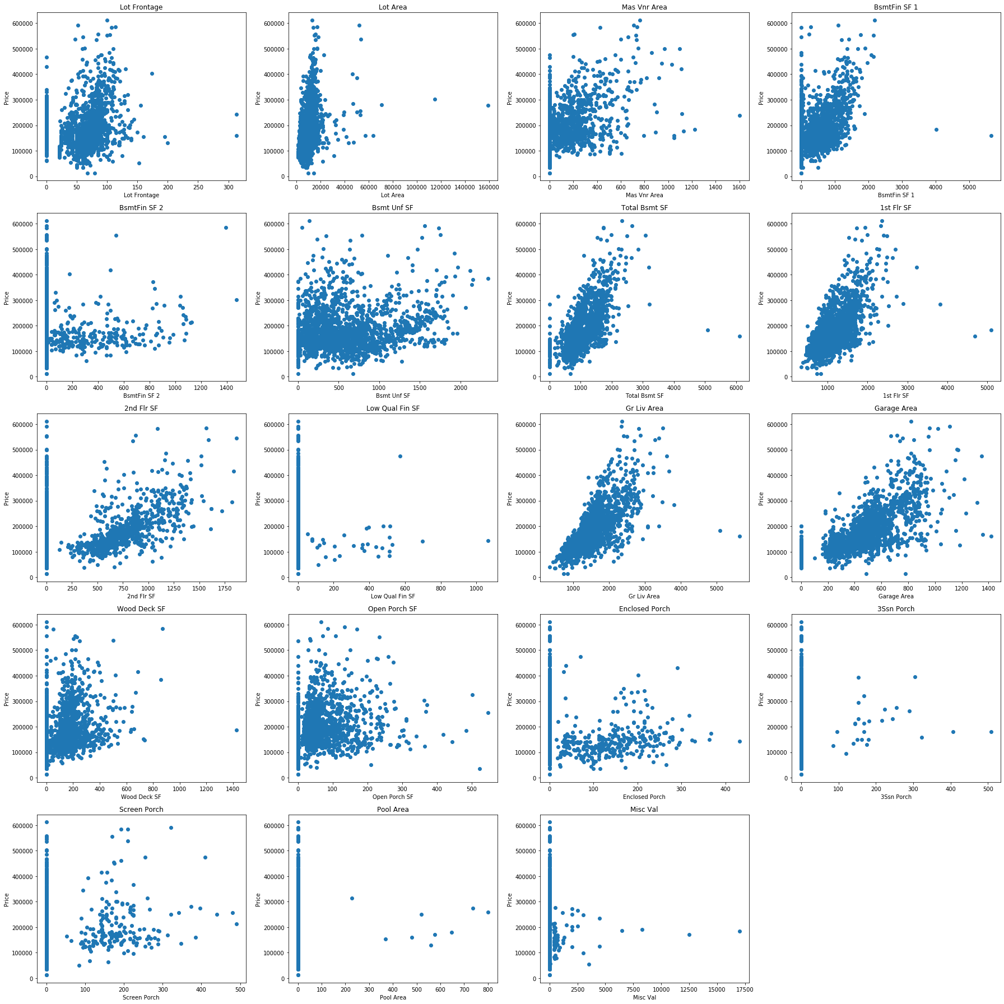
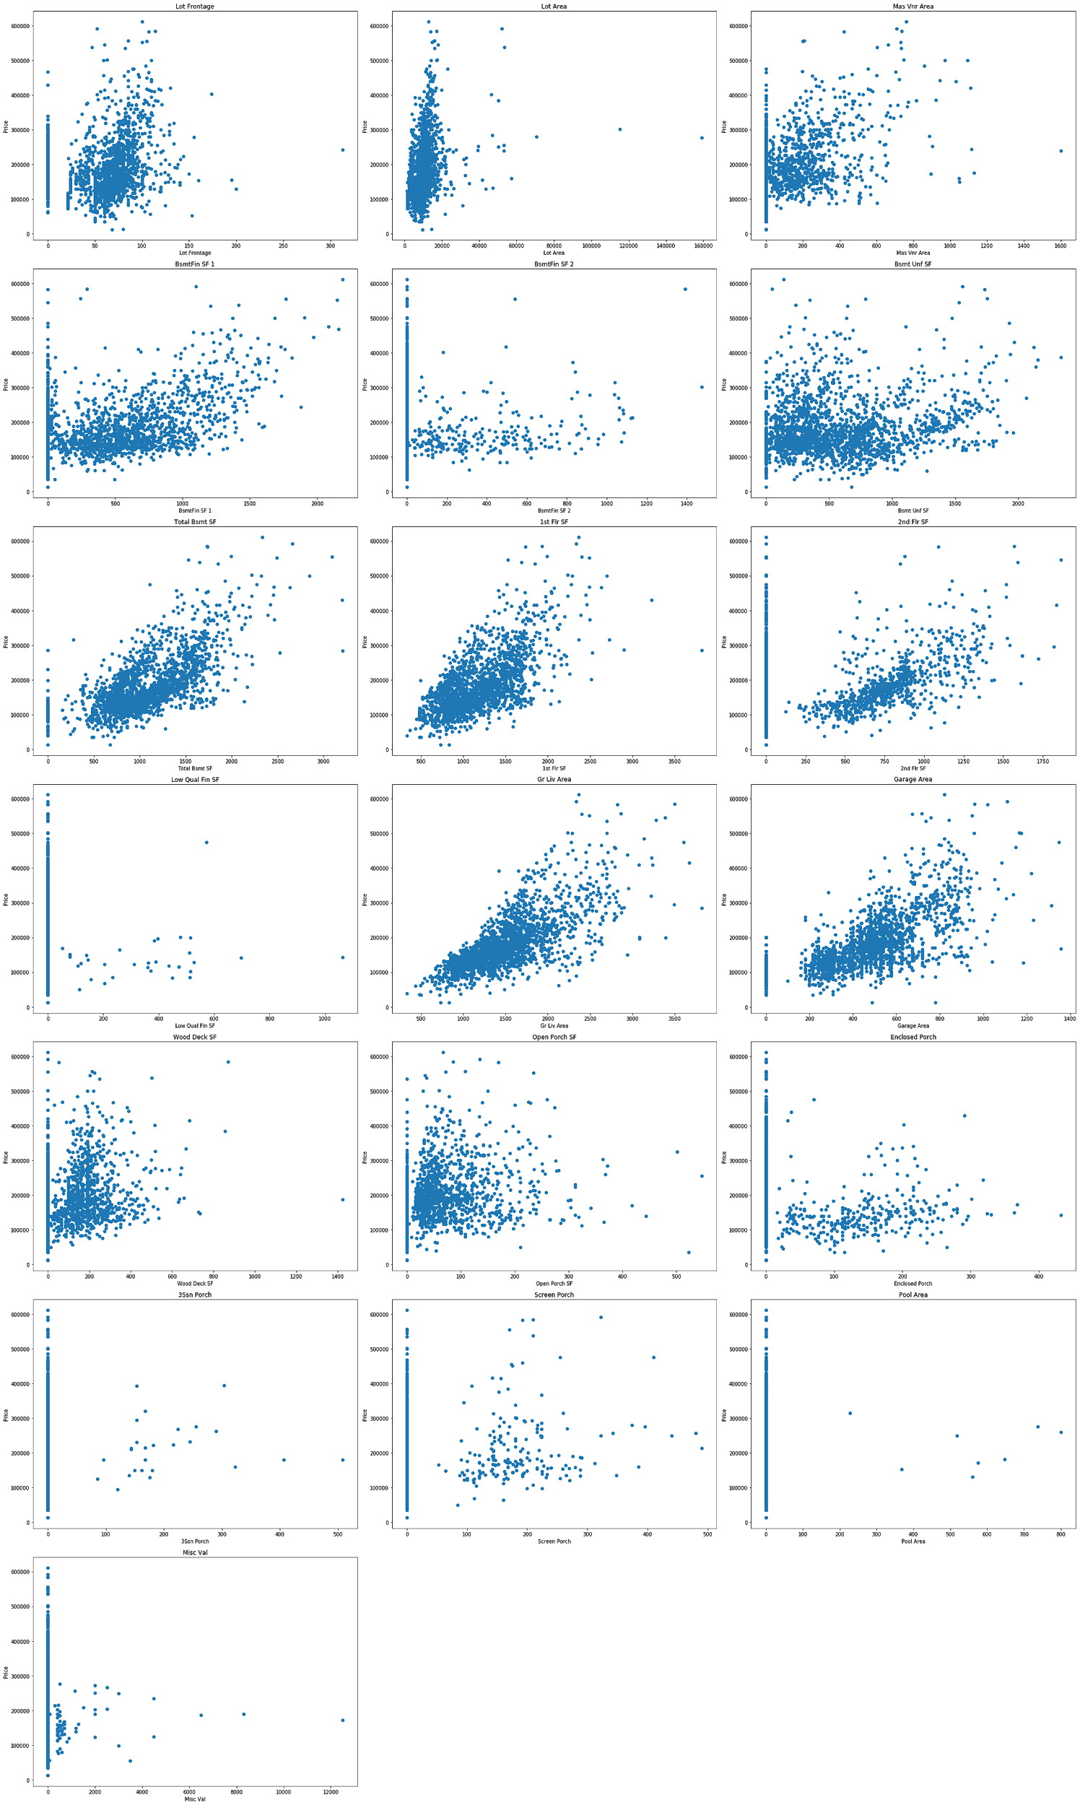
DATA VISUALIZATION - Continuous/Numeric variables

Slide 8
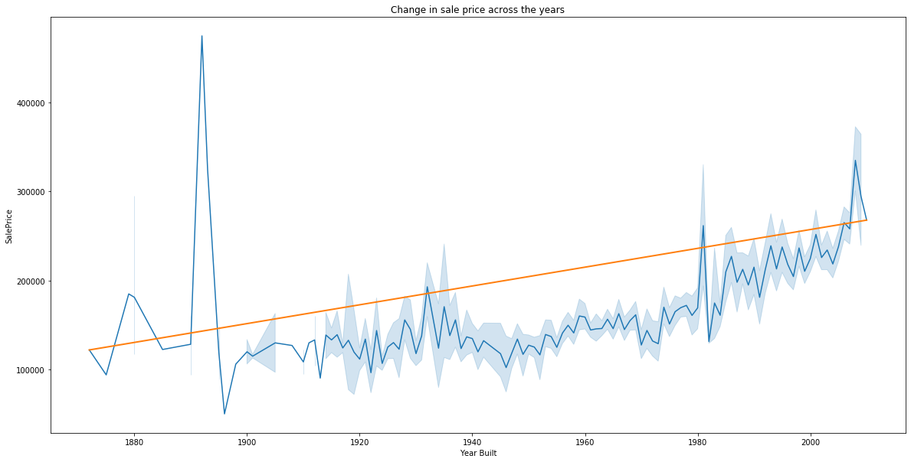
DATA VISUALIZATION - Sale price over time

Slide 9
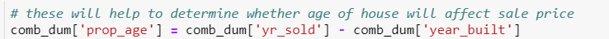
Feature Engineering

Slide 10
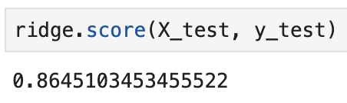
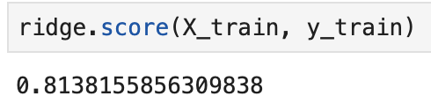
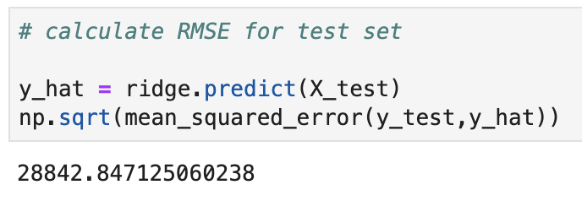

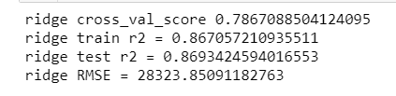

MODELLING - Ridge was chosen
Kenneth Cheong
Kenneth Chew
RMSE
Ferdi Garcia

Slide 11
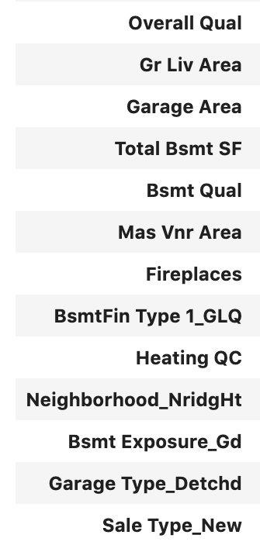
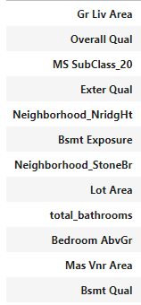
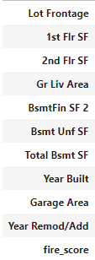
FINAL SELECTED FEATURES
Kenneth Cheong
Kenneth Chew
Ferdi Garcia

Slide 12
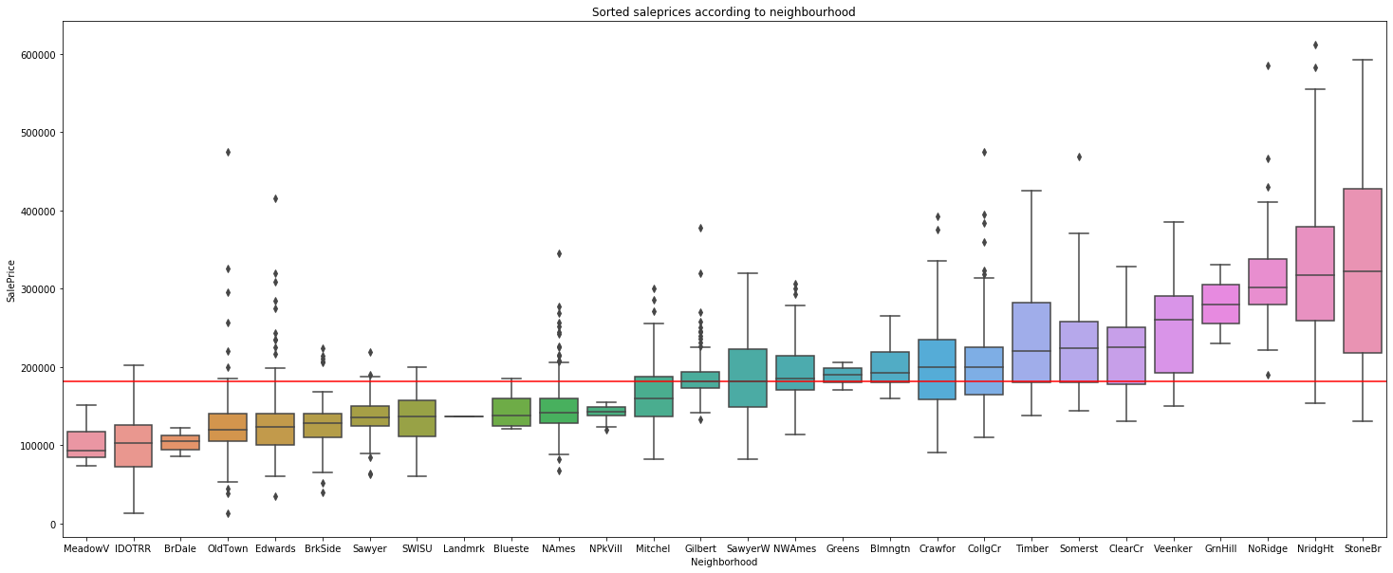
Neighbourhood median prices

Slide 13
CONCLUSION & RECOMMENDATION
Northridge Heights is the highest priced area!
High perceived quality/condition of the different aspects of the property matters
Adding a fireplace could increase the sale price by $9,813
Remodelling is a good way to increase sale price
In future, we could look at interaction between lot shape and neighbourhood.
Houses build around expensive neighbourhoods can sometimes be more irregular than houses built on flat land. We see houses built on hills or ridges have to follow the slope contours to provide strong foundation for the house.

