Slide 1
Reddit API, webscrapping and NLP
DSI 8 PROJECT 2

Slide 2
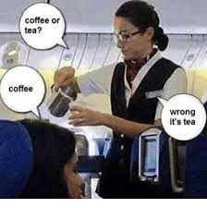
PROBLEM STATEMENT
To predict the category of new posts that comes in into either Tea subreddit or not tea (Coffee) subreddit.

Slide 3
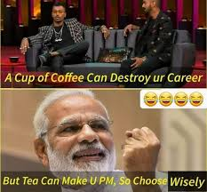
Problem statement
Making the right decision based on your immediate surroundings will help you with your social standing
For people who are not able to tell when to drink coffee or tea

Slide 4
DATA EXTRACTION and CLEANING
Used reddit API to extract JSON data from subreddit posts
Tea subreddit as our target
Coffee subreddit as our alternate
Scrapped subreddit and to mimic human behavior by using time.sleep
Combined both subreddits into a combined pandas df.

Slide 5
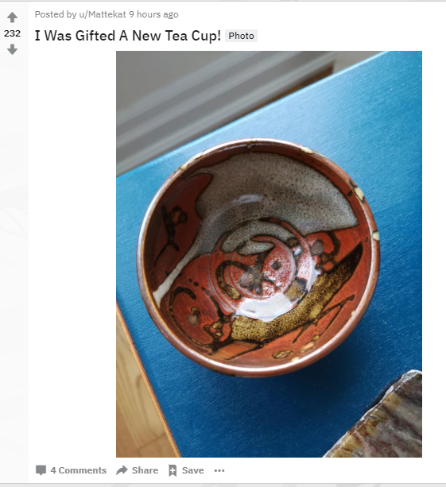
Data cleaning and understanding
Some of the reddit posts were actually repeated because reddit API caps at 1000 posts.
Drop duplicates based on the titles
Another problem is that some reddit posts are actually pictorial in nature; Picture posts instead of text.
Combined the title and the self-text to create a new feature: title & text.

Slide 6
Data cleaning and understanding
The text had much non-natural language words such as ‘/n’ and also ‘/r/’; and had to be removed. Other stop words and http links are also included and will need to be dropped as well.
Tokenizer used is based on regular expression tokenizer
Lemmatization done to return words to their stem word.

Slide 7
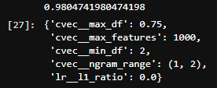
Models 1: Count vectorizer and Logistic Regression
Simplest answer for a logistic regression problem
Pipeline to review hyper-parameters that can be tuned
Max -> Ignore terms that appear in more than 75% of the document
Min -> Ignore terms that appear less than 2 times in the document

Slide 8

Models 1I: Count vectorizer and Naïve Bayes (MultinomialNB)
Naïve Bayes helps simplify the problem when each feature is realistically dependent on each other.

Slide 9
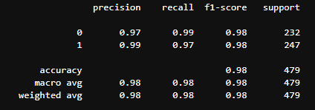
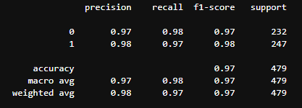
Model Selection:
Model 1: Logistic Reg ( V ) Model II: Naïve Bayes

Slide 10
CONCLUSION & RECOMMENDATION
Getting the right fix in the morning however is not a simple question and can be a difficult choice to decide when the people around you have vastly differing opinions.
Knowing these people’s perspective beforehand is therefore quintessential in understanding what beverage you should be drinking; especially around them.
To preserve your social relationships amongst different cliques and group of friends and colleagues, you therefore need to first understand which camps of beverage people belong to

Slide 11


