Slide 1
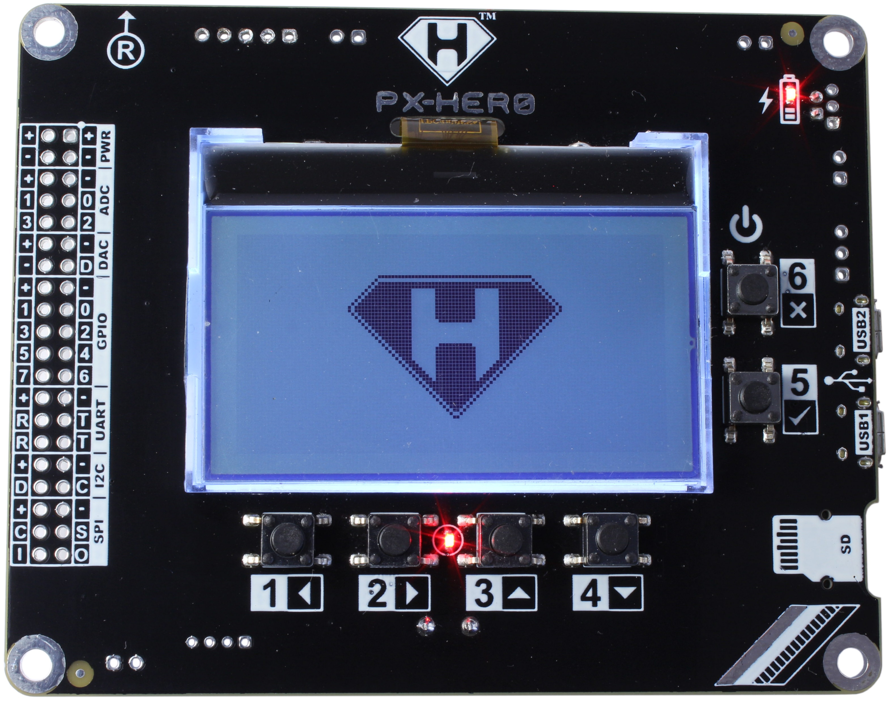
128x64 Graphic LCD with backlight
Charger LED
Peripheral Connector
PWR
ADC x 4
DAC x 1
GPIO x 8 / PWM x 4
UART x 2
I2C x 1
SPI x 1
User / Power Button
USB2
USB-Serial Bridge
USB1
STM32
MicroSD card
User LED
User Buttons

