Slide 1
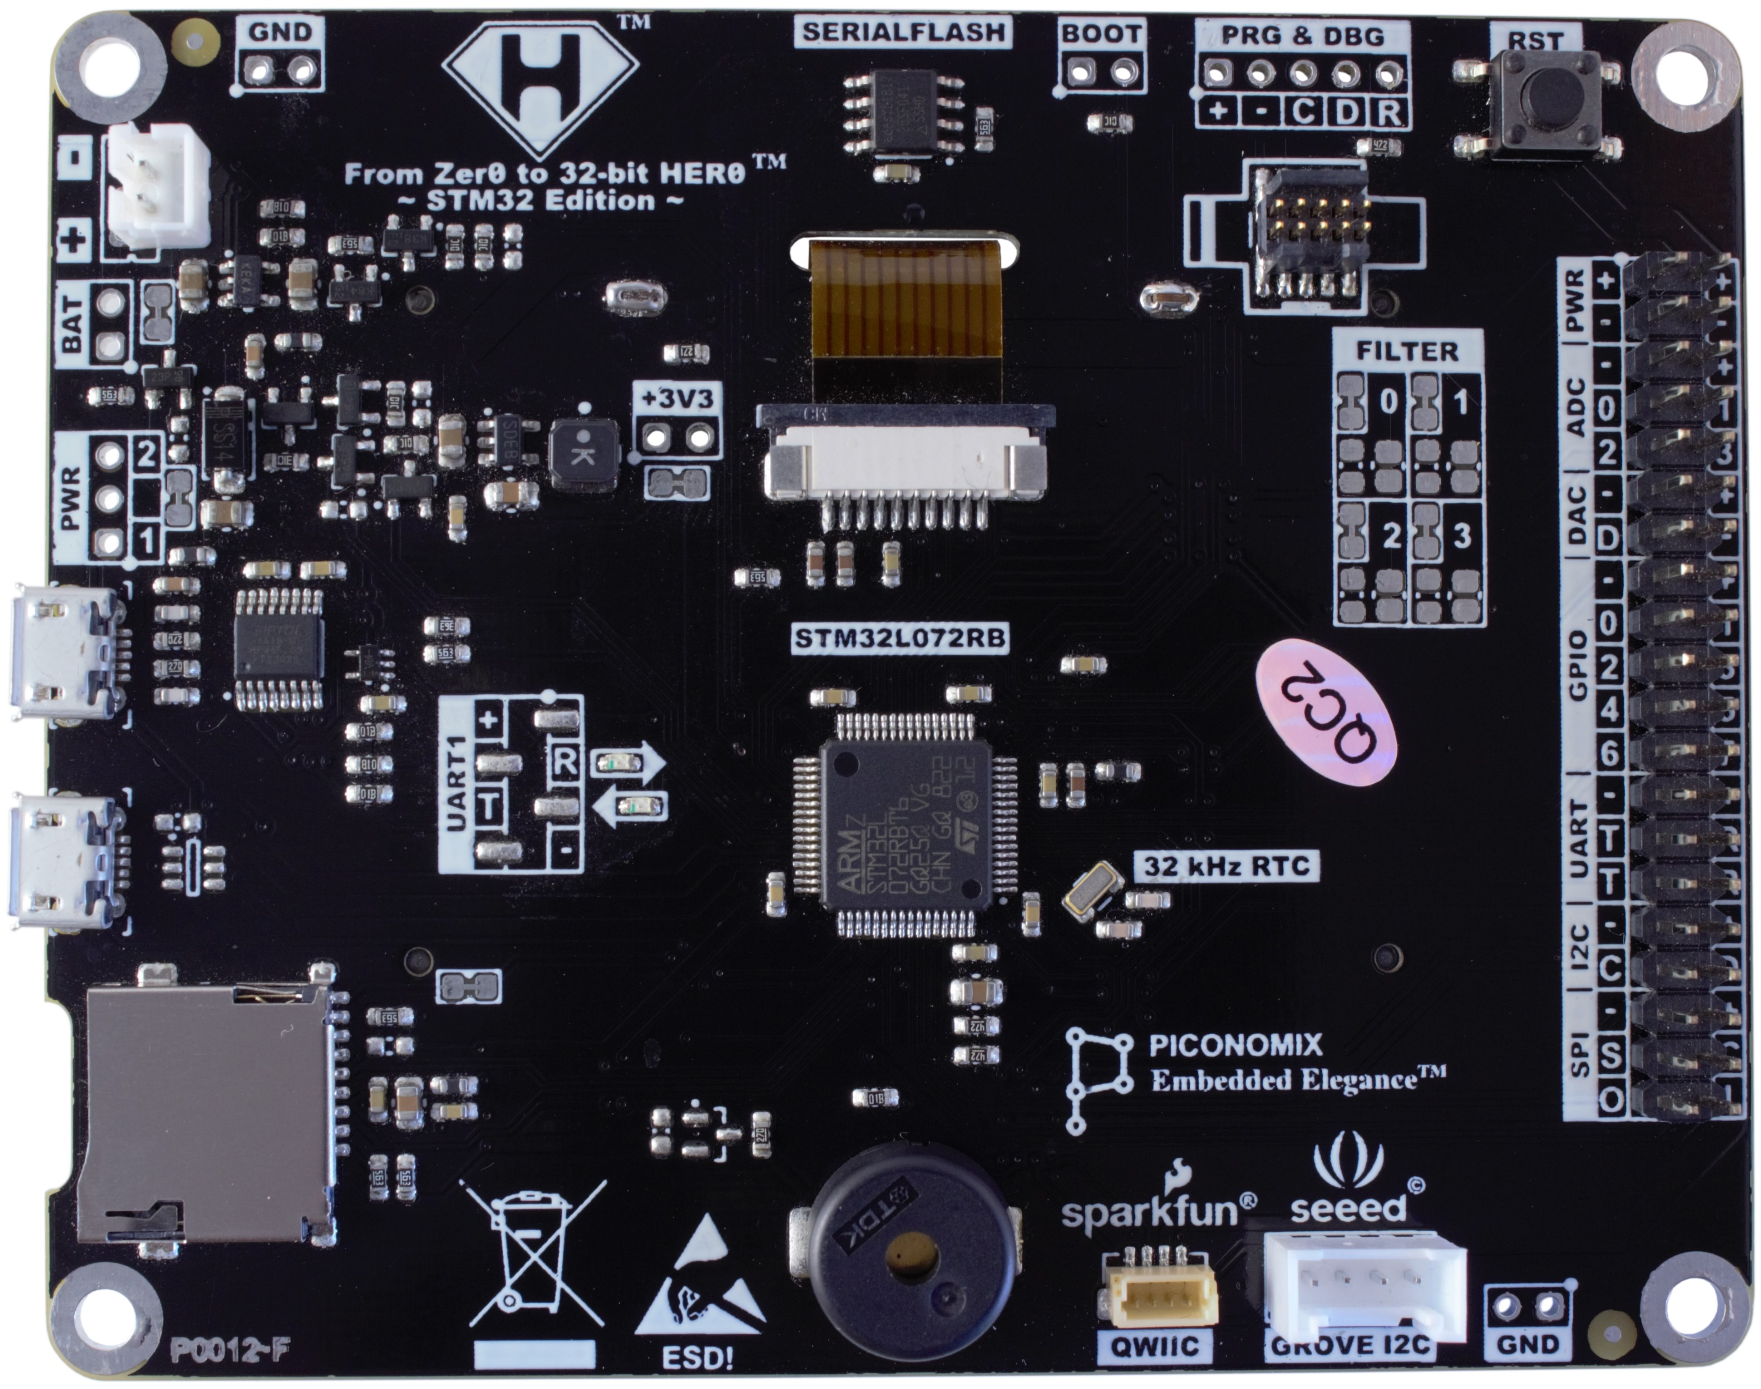
+3V3 step-down DC-DC regulator
Serial Flash
BOOT
selection
Prog & Debug
connector
Reset button
Standard ARM Cortex debug connector
Li-Po
battery connector
Peripheral connector
PWR
ADC x 4
DAC x 1
GPIO x 8 / PWM x 4
UART x 2
I2C x 1
SPI x 1
USB2
USB-Serial Bridge
USB1
STM32
MicroSD card
Buzzer
Sparkfun Qwiic
STEMMA QT
Seeed
GROVE I2C

