Slide 1
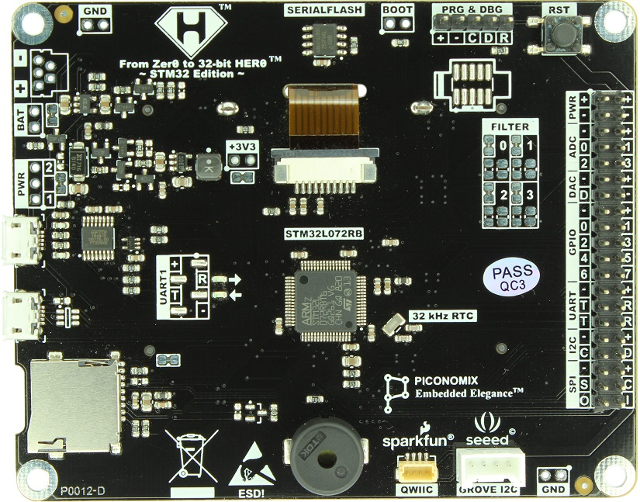
+3V3 step-down DC-DC Regulator
Serial Flash
BOOT
Selection
Prog & Debug
Connector
Reset Button
Standard ARM Cortex Debug
Connector
Li-Po
Battery connector
Peripheral Connector:
PWR
ADC x 4
DAC x 1
GPIO x 8
UART x 2
I2C x 1
SPI x 1
USB2
(USB-Serial Bridge)
USB1
(STM32)
µSD card
Buzzer
sparkfun
QWICC
seeed
GROVE I2C

