Slide 1
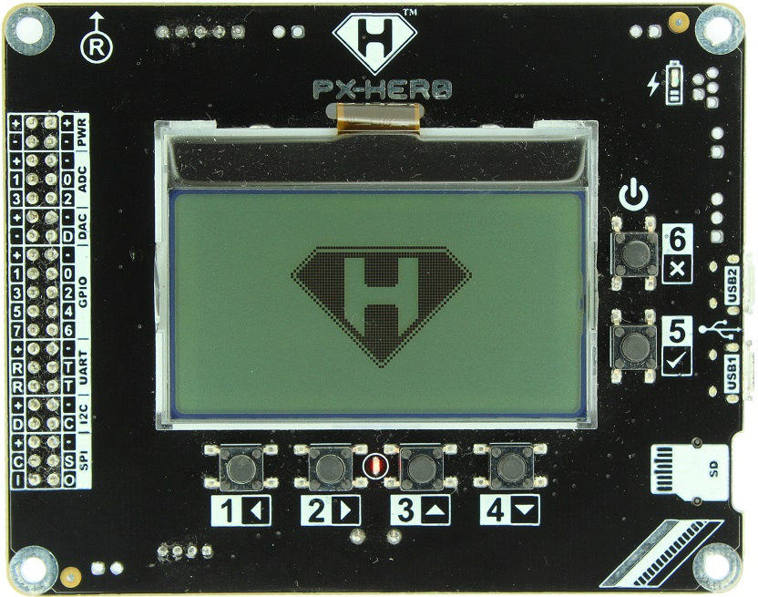
128x64 Graphic LCD with backlight
Peripheral Connector:
PWR
ADC x 4
DAC x 1
GPIO x 8
PWM x 4
UART x 2
I2C x 1
SPI x 1
Charger LED
User / Power Button
USB2
(USB-Serial Bridge)
USB1
(STM32)
µSD card
User LED
User Buttons

