Slide 1
Bayesian vs Likelihood inference/models

Slide 2

Likelihood
L(H) ……… likelihood of a hypothesis H
P(D|H) …. probability of obtaining the data D given that the hypothesis H is true
K ………….. a positive constant

Slide 3
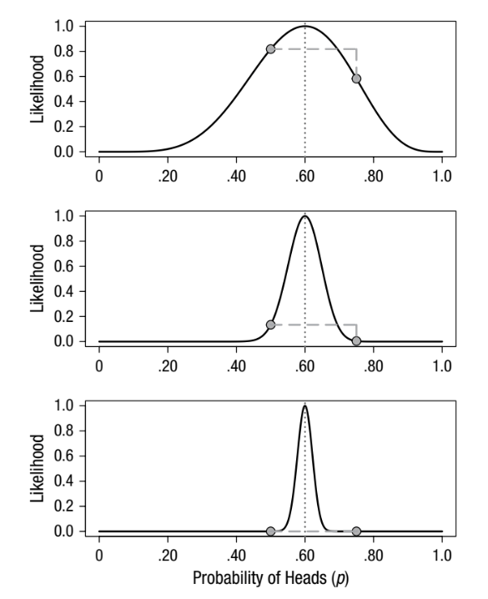

Slide 4
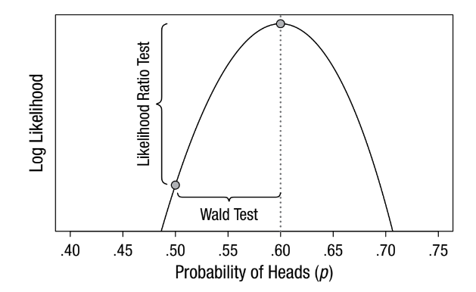
Inference using likelihood function
Maximum likelihood estimation
Likelihood ratio test
Wald tests

Slide 5
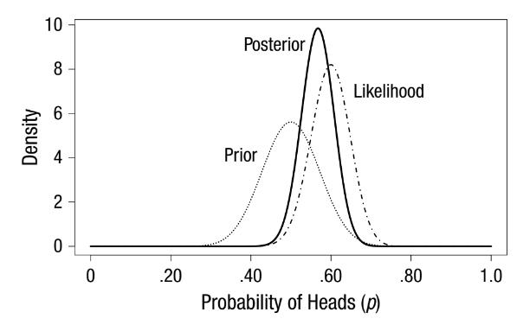
Bayesian inference

Slide 6
Discussion/Exercise
Which teacher (Thomas, Palle, Iker) is the smartest given the data?

