Slide 1
Machine-Learning
Trading Signals
MINI-PROJECT · B.TECH CSE (AI & ML) · MANIPAL INSTITUTE OF TECHNOLOGY
A comparative study against technical baseline strategies
Ishan Singh · Kenneth Martin
Mentors Dr. Narendra V G · Dr. Ashwath Rao B
School of Computer Engineering · 2026
SPY · daily adjusted close · 2010–2025 (data used in this study)
Notes:
Good morning. We are Ishan Singh and Kenneth Martin, and our mini-project asks a simple question: can machine learning produce better trading signals than the simple rules traders have used for decades? The amber line is real data: the daily SPY price from 2010 to 2025, the same data our models were trained and tested on. Over the next fifteen minutes we will show how we built the system, how we tested it honestly, a live demo, and what the evidence actually says.

Slide 2
Can a model learn when to be in the market?
THE BIG IDEA
RULE-BASED
LEARNED
if SMA(10) > SMA(50): long
else: cash
if P(Up | 42 features) ≥ τ: long
else: cash
vs
Written by hand and fixed forever: the classic moving-average crossover baseline.
Five model families learn P(Up) from 2011–2019 data; the threshold τ is chosen on 2020–2021.
Same data · same execution · same costs — so any difference comes from the signal itself.
Tested on SPY (an S&P 500 ETF), Apple (AAPL) and Microsoft (MSFT): daily prices 2010–2025 from Yahoo Finance.
Notes:
Here is the core idea. On the left is a rule a human writes once: buy when the 10-day average is above the 50-day average. On the right, instead of a fixed rule, a model looks at 42 features and estimates the probability that the next move is up, and we invest only when that probability clears a threshold tau. The important design decision is fairness: both approaches get exactly the same data, the same execution timing and the same trading costs, so any difference really comes from the signal. We test this on three liquid instruments: SPY, an exchange-traded fund that tracks the S&P 500, plus Apple and Microsoft, using daily prices from 2010 to 2025.

Slide 3
Four easy ways to fool yourself in a backtest
01 · THE PROBLEM
01
02
03
04
Look-ahead bias
Leaky validation
Free trading
Weak baselines
Features or labels that quietly use tomorrow's data, so the backtest trades on information nobody had.
Random K-fold on a time series lets the model train on the future of the days it is tested on.
Ignoring fees, slippage and when orders actually fill. High-turnover strategies die on costs.
A model at 51% sounds better than a coin flip, but 'always predict Up' already scores 49.5% on SPY.
→ too-good accuracy
→ optimistic CV scores
→ paper-only profits
→ base-rate 'skill'
Each trap inflates results. The framework was designed to close all four.
Notes:
Why is this hard? Because a trading backtest is very easy to get wrong in ways that make results look better than they are. First, look-ahead bias, where some feature or label secretly uses future data. Second, random cross-validation on time series, which lets the model learn from the future of the days it is tested on. Third, ignoring trading costs and execution timing. And fourth, weak baselines: a model at 51 percent sounds better than a coin flip, but simply predicting 'up' every day already scores 49.5% on SPY. Our framework was designed to close all four of these traps.

Slide 4
Small evaluation choices flip the conclusion
02 · WHY IT MATTERS
Naive persistence — Sharpe ratio vs. one-way cost (bps), test 2022–2025
0.58 → 0.01
AAPL Random Forest Sharpe when fills move from the next open to the same day's close (sensitivity run)
−0.21 … 1.58
95% bootstrap interval for SPY buy-and-hold's Sharpe ratio (0.66) over the four test years
Persistence (‘tomorrow repeats today’) is profitable before costs and deeply negative after them. AAPL and MSFT nearly coincide.
Sharpe ratio = annualised mean return ÷ annualised volatility (risk-free rate 0). 1 bp (basis point) = 0.01%.
Notes:
Here is why this matters, using our own results. The chart shows a naive 'tomorrow repeats today' strategy. A quick definition first: the Sharpe ratio is the annualised return divided by the annualised volatility, so it measures return per unit of risk, and a basis point is a hundredth of a percent. With zero costs this strategy actually has a positive Sharpe ratio on all three tickers; at realistic costs it becomes deeply negative. On the right: the same Random Forest on Apple goes from a Sharpe of 0.58 to 0.01 just by changing the assumed fill price from the next open to the same day's close. And the 95 percent interval on buy-and-hold's own Sharpe ratio runs from −0.21 to 1.58. Four years of data is a small sample, so we need statistics, not single numbers.

Slide 5
What we set out to do
03 · OBJECTIVES
01
Build moving-average crossover and buy-and-hold baselines in one backtester with realistic transaction costs.
DELIVERED
02
Engineer SMA, EMA, RSI, MACD and Bollinger-band features for XGBoost and LSTM directional signals.
DELIVERED
03
Compare ML signals with the baselines on predictive and risk-adjusted metrics across market conditions.
DELIVERED
04
Stretch goal: test whether news sentiment found by retrieval-augmented generation (RAG) makes the signals more robust.
FUTURE WORK
BEYOND THE SYNOPSIS Logistic Regression · Random Forest · soft-vote ensemble · walk-forward evaluation · bootstrap CIs · live dashboard
Notes:
These are the four objectives from our synopsis. The first three are delivered in full: technical baselines in one cost-aware backtester, technical-indicator features for XGBoost and an LSTM, and a comparison on both prediction and trading metrics. The fourth, a news-sentiment layer built with retrieval-augmented generation, or RAG, was a stretch goal. We deliberately did not implement it, because doing it correctly needs a time-stamped news archive for 2010 to 2025; fake or leaky sentiment would invalidate the whole comparison. We return to it in future scope. We also went beyond the synopsis with three extra models, walk-forward testing, bootstrap intervals and a live dashboard.

Slide 6
A leakage-safe, cost-aware comparison framework
04 · OUR SOLUTION
01 Look-ahead bias
Point-in-time features. Scale-invariant ratios only; tests recompute them on truncated data and require identical values.
02 Leaky validation
Chronological splits. Train → validation → test with a 2-day purge; purged CV for the tabular models, a purged hold-out slice for the LSTM.
03 Free trading
Realistic execution. Decide at the close, fill at the next open, and pay 15 bps (10 fee + 5 slippage) on every unit of turnover.
04 Weak baselines
Baselines and intervals. Majority class, persistence, MA crossover and buy-and-hold, with block-bootstrap 95% CIs.
Every main result uses all four safeguards; sensitivity runs relax one at a time and are labelled.
Notes:
Our solution maps one safeguard to each trap. Against look-ahead bias, every feature is a point-in-time, scale-invariant ratio, and our tests recompute features on truncated data and require identical values. Against leaky validation, splits are strictly chronological with a two-day purge, and tuning uses purged time-series cross-validation for the tabular models and a purged hold-out slice for the LSTM. Against free trading, we decide at the close, fill at the next open, and charge 15 basis points on every unit of turnover. Against weak baselines, we compare with four baselines and report bootstrap confidence intervals.

Slide 7
System architecture: from raw prices to decisions
05 · ARCHITECTURE
01 Data
02 Features
03 Targets
04 Split
Yahoo Finance OHLCV, validated and adjusted
42 point-in-time, scale-invariant indicators
Down / Neutral / Up from next-open returns
Chronological train / val / test + purge
data_loader.py
features.py
targets.py
preprocessing.py
05 Models
06 Signal rule
07 Backtester
08 Evaluation
LR · RF · XGBoost · LSTM · ensemble
τ chosen on validation; walk-forward runner
Next-open fills, 15 bps per unit turnover
Metrics, bootstrap CIs, calibration
models.py · lstm_model.py
experiment.py
backtester.py
evaluation.py
OUTPUTS result tables · 46 figures · experiment report · IEEE report · interactive dashboard reporting.py · report/ · app/
Notes:
This is the architecture; each box maps to modules in our src folder. The first row prepares the data: download and validate daily prices from Yahoo Finance, compute 42 point-in-time features, build the Down, Neutral, Up target, and split chronologically with a purge. [click] The second row is learning and verification: five model families produce probabilities, a threshold rule turns them into positions, the backtester simulates next-open fills with costs, and the evaluation module computes metrics, bootstrap intervals and calibration; the experiment runner also drives the walk-forward and robustness runs. [click] Everything ends in generated outputs: tables, figures, reports and the dashboard. Nothing in the results is typed by hand.

Slide 8
Built on the open-source Python stack
06 · TECH STACK
DATA
MODELLING
EVALUATION
DELIVERY
Acquire & engineer
Learn P(Up)
Measure honestly
Show & share
Python
scikit-learn
SciPy
Streamlit
3.14.3
1.8.0
statistics
interactive dashboard
pandas
XGBoost
matplotlib
Plotly
2.3.3
3.2.0
46 figures
dashboard charts
NumPy
PyTorch
pytest
Jupyter
2.4.3
2.11.0 · CPU
301 tests
3 executed notebooks
yfinance
python-docx
Yahoo Finance OHLCV
IEEE report builder
Versions as recorded for the reported run (results/metrics/run_summary.json). One configuration file, config.yaml, with a fixed seed (42).
Notes:
The stack is entirely open source. pandas and NumPy for data, scikit-learn for Logistic Regression and Random Forest, XGBoost for gradient boosting and PyTorch for the LSTM. Evaluation uses SciPy and matplotlib, and the code is covered by 301 pytest tests. For delivery we built a Streamlit dashboard with Plotly charts, executed Jupyter notebooks, and a script that generates the IEEE report. The versions shown are exactly those recorded for the reported run.

Slide 9
Time only flows forward: chronological splits
07 · METHODOLOGY
2011
2012
2013
2014
2015
2016
2017
2018
2019
2020
2021
2022
2023
2024
2025
2026
2-day purge
2-day purge
TRAIN 2,243 days
VAL · 503
TEST 1,001 days
TRAIN · 2011–2019
VALIDATION · 2020–2021
TEST · 2022–2025
Fit every model. Tabular models are tuned with purged time-series CV (4 folds, gap 2) on log loss; the LSTM on a purged hold-out slice.
Choose ensemble members (log loss) and the threshold τ from 14 values (Sharpe).
Never used for fitting or for choosing τ. Main results come from here; robustness checks re-use it and are labelled.
Rows are never shuffled. Each label looks two opens ahead, so the last two rows before every boundary are purged from the earlier segment.
Notes:
Time only flows forward, so our splits do too. We train on 2011 to 2019, which is 2,243 trading days, validate on 2020 and 2021, and keep 1,001 test days from 2022 to 2025 that are never used for fitting or for choosing anything. Hyperparameters are tuned inside the training period only: purged time-series cross-validation for the tabular models, and a purged hold-out slice for the LSTM. The validation period chooses the trading threshold and the ensemble members. Because each label looks two opens ahead, we purge the last two rows before each boundary so no label overlaps the next segment.

Slide 10
Walk-forward: retrain every year, trade the next
07 · METHODOLOGY
2011
2012
2013
2014
2015
2016
2017
2018
2019
2020
2021
2022
2023
2024
2025
2026
2016
2017
2018
2019
2020
2021
2022
2023
2024
2025
Train, expanding
Validation: τ and ensemble
Test year, traded out-of-sample
10 folds × 3 tickers
Notes:
A single split could just be lucky, so we also ran a walk-forward test. The bars you just saw move to the bottom row and become one of 10 folds. For every test year from 2016 to 2025, we retrain on all data up to two years before it, choose the threshold and the ensemble on the year just before it, and then trade the test year out-of-sample. The tabular models are re-tuned in every fold; the LSTM keeps its architecture and re-tunes only its class weighting. The training window grows each year, like a real trader who keeps learning. This gives ten years of out-of-sample trading for each ticker.

Slide 11
42 point-in-time features, one executable target
08 · IMPLEMENTATION
42 FEATURES · 5 GROUPS
TARGET · WHAT THE MODEL PREDICTS
14
15
6
3
4
close t
open t+1
open t+2
Returns · 14
lags 1, 2, 3 and 5 days, momentum 5–60 days, overnight and intraday moves, range
features known, predict
enter, or stay in cash
exit, or re-decide
Technical · 15
close/SMA and close/EMA (5–50), RSI(14), MACD, Bollinger %B and width
r_{t} = O_{t+2} / O_{t+1} − 1
Volatility · 6
ATR(14), realised volatility 5/20/60 days, vol ratio, normalised return
Volume · 3
relative volume (5 and 20 days), volume z-score
Regime · 4
volatility percentile, close/SMA200, golden cross, 252-day drawdown
DOWN r < −0.1%
NEUTRAL |r| ≤ 0.1%
UP r > +0.1%
Only ratios, never price levels, so back-adjusted prices cannot leak the future. A test recomputes features on truncated data and requires identical values.
SPY test days: Up 49.5% · Down 41.2% · Neutral 9.4%
Notes:
On the left are the 42 features in five groups: returns, technical indicators such as RSI, MACD and Bollinger bands, volatility, volume and market regime. All of them are ratios rather than price levels, so adjusted prices cannot leak future information, and a test checks this. On the right is the target. After the close on day t we compute features and predict; we can only trade at the next open, t plus one, and the position is held until the following open. So the return we predict is open t+2 over open t+1, split into Down, Neutral and Up with a plus or minus 0.1 percent band.

Slide 12
Five model families, tuned without peeking
08 · IMPLEMENTATION
LR
RF
XGB
LSTM
ENS
Logistic Regression
Random Forest
XGBoost
LSTM network
Soft-vote ensemble
Linear, L2-regularised
300 bagged trees
Gradient-boosted trees
PyTorch, 1 layer
Two members, chosen on validation
SELECTED
SELECTED
SELECTED
SELECTED
SELECTED
C = 0.001
all three tickers
depth 3
min leaf 80/20/80
depth 2
η 0.03
100 trees
hidden 32/16/16
window 10 days
SPY: LR + LSTM
AAPL: RF + XGB
MSFT: LR + RF
Where values differ they are shown as SPY / AAPL / MSFT. Tabular models are tuned on log loss with purged time-series CV; the LSTM is tuned and early-stopped on a purged slice at the end of the training period.
INSIGHT Tuning picked the most regularised option in almost every grid: there is little stable signal to fit.
BASELINES majority class · naive persistence · MA crossover (10/50) · buy-and-hold
Notes:
We trained five model families: Logistic Regression, Random Forest, XGBoost, a small LSTM in PyTorch, and a soft-vote ensemble whose two members are chosen on the validation set. All tuning used log loss inside the training period: purged time-series cross-validation for the tabular models, and a purged hold-out slice for the LSTM. The selected values are telling: Logistic Regression chose C = 0.001, the strongest regularisation in its grid, the trees chose depth 2 or 3, and the LSTM chose a short window. When tuning keeps choosing the simplest model, it usually means there is little stable signal to learn, which already hints at the results. We also built four baselines.

Slide 13
From probability to position, net of costs
08 · IMPLEMENTATION
DECISION RULE
BACKTEST · EACH DAY t
τ = 0.375 (SPY · XGBoost)
cost_{t} = c · |p_{t} − p_{t−1}| · E_{t−1}
E_{t} = (E_{t−1} − cost_{t}) · (1 + p_{t} r_{t})
CASH
LONG
P(Up)
0
0.5
1
Long at the next open when P(Up) ≥ τ, otherwise cash (long-only).
τ comes from 14 values (0.30–0.65) and is chosen by validation Sharpe, never on test.
Chosen τ ranged 0.30–0.45 across the 15 model–ticker pairs.
Also backtested: an argmax rule (long when Up is the most likely class).
p = position (0 or 1) · r = next-open return · E = equity · c = 15 bps per unit turnover (10 fee + 5 slippage)
REPORTED FOR EVERY STRATEGY
cumulative return
annual return
volatility
Sharpe
Sortino
max drawdown
Calmar
win rate
turnover
trades
costs paid
Notes:
Here is how a probability becomes a trade. If the model's probability of an up move is at least tau, we go long at the next open; otherwise we hold cash. Tau is picked from 14 values using validation Sharpe only; the test set never influences it. The backtester on the right charges costs on every change in position, 15 basis points per unit of turnover, before applying the day's return, and it compounds equity day by day. Every strategy, baselines included, goes through exactly this code, and we report the full set of metrics for each.

Slide 14
Engineered like research software
09 · KEY FEATURES
301
1
24 min
automated tests
command for all results
full experiment on a CPU
pytest, including look-ahead and truncation-invariance checks
python -m scripts.run_experiment
seeded and deterministic (seed 42)
46
6
2,000
figures, generated
dashboard tabs
bootstrap resamples per CI
plus a Markdown experiment report; the IEEE report has its own builder
Streamlit app with live re-training on fresh data
circular block bootstrap, block length 20
All counts are measured from the repository: tests collected by pytest, figures in results/figures, runtime from results/metrics/run_summary.json.
Notes:
We built this like research software rather than a one-off notebook. There are 301 automated tests, including tests that check that features never use future data. One command reproduces every result, figure and the experiment report, and the IEEE report has its own build script. The full run takes about 24 minutes on a CPU and is seeded, so it is repeatable. It generates 46 figures and the reports, there is a six-tab dashboard, and every confidence interval uses 2,000 block-bootstrap resamples.

Slide 15
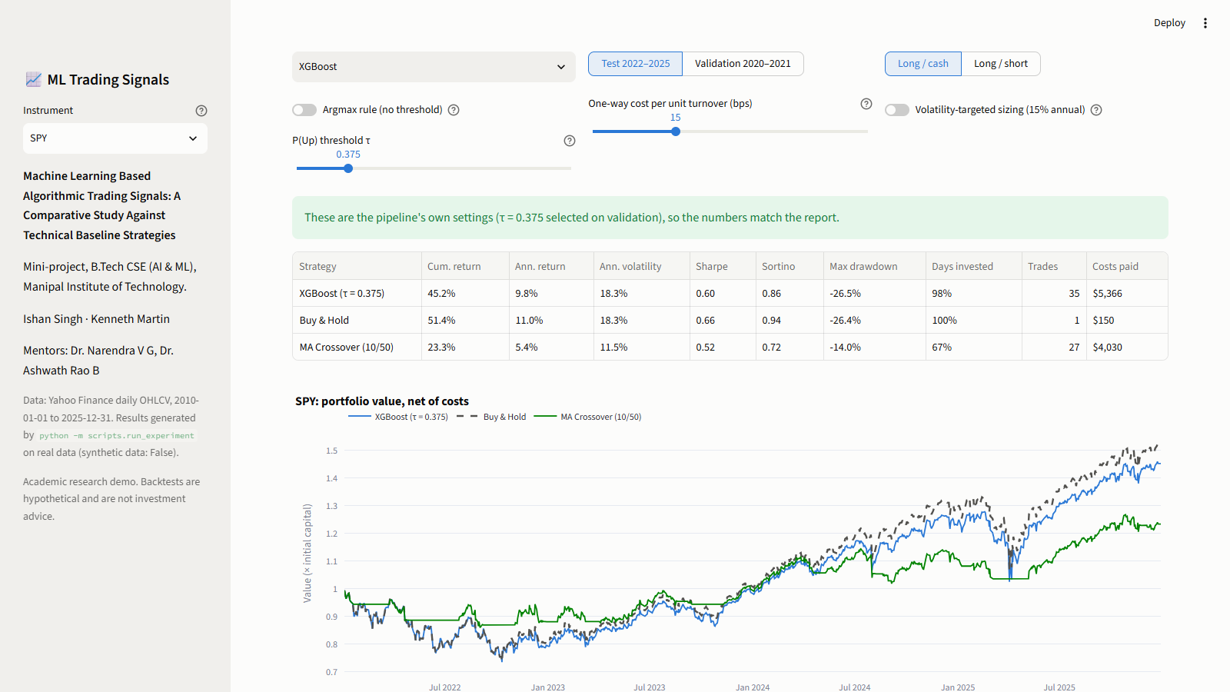
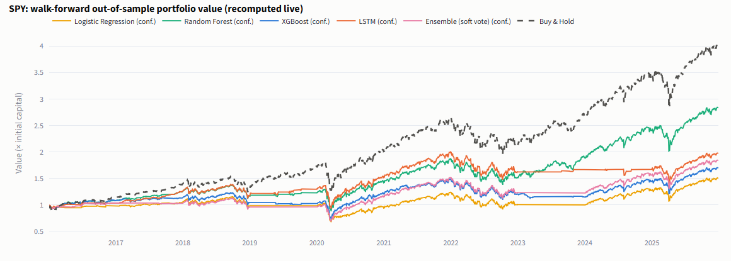
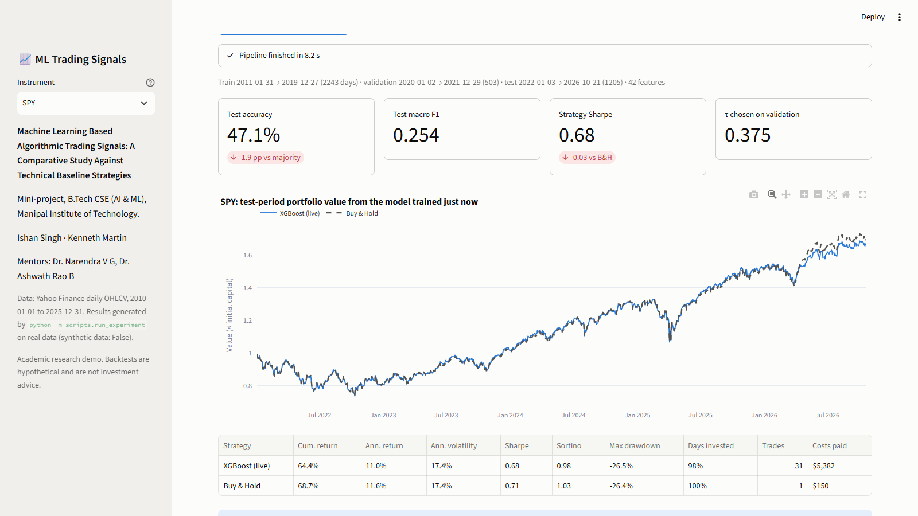
The working system: an interactive dashboard
10 · LIVE SYSTEM
REAL SCREENSHOTS · LOCALHOST:8501 · CAPTURED 24 OCT 2026
INTERACTIVE BACKTEST model · τ · costs · sizing, recomputed live
WALK-FORWARD 2016–2025
Dashed: buy-and-hold, finishing above all five ML strategies (SPY, walk-forward).
TRAIN A MODEL LIVE fresh data
Fresh download → retrain → backtest in 8.2 s; opened on the next slide.
Notes:
This is the working system: a Streamlit dashboard, and these are real screenshots of it running. The large view is the interactive backtest. You pick a model, move the threshold, change costs or turn on volatility sizing, and our own backtester recomputes every number from the saved out-of-sample probabilities. On the right are the walk-forward tab, where buy-and-hold finishes above all five ML strategies, and the live-training tab, which the next slide opens. There are six tabs in total, and if time permits I can switch to the running app now.

Slide 16
Retrain live, with ten more months of data
10 · LIVE SYSTEM
REAL SCREENSHOT · ONE RUN, NOT PART OF THE REPORTED RESULTS
TRAIN A MODEL LIVE SPY · XGBoost · the study's tuned settings
LIVE RUN · 24 OCT 2026
8.2 s
fresh download → features → split → XGBoost with the study's settings → τ → backtest (no re-tuning)
1,205
test days to 21 Oct 2026, 204 more than the study's test set
0.68 vs 0.71
Sharpe over the whole live window: XGBoost vs buy-and-hold
Consistent with the results that follow.
Notes:
This tab runs the core pipeline live for one model. It downloads fresh data, builds the features, splits the data, trains XGBoost with the hyperparameters we tuned in the study, picks tau on validation and backtests, all in about 8 seconds because nothing is re-tuned. Because the data are current, the test window now runs to 21 Oct 2026, which adds 204 test days beyond our study's test set. Over the whole window XGBoost reached a Sharpe ratio of 0.68 against 0.71 for buy-and-hold, and its accuracy was 1.9 points below the majority class, consistent with the results we show next. This is one live run, kept separate from the reported results.

Slide 17
Accuracy: none reliably beat 'always predict Up'
11 · RESULTS
Test accuracy minus 'always predict Up', percentage points (95% bootstrap CI)
47.2–51.0%
test accuracy, 5 models × 3 tickers
49.5–50.2%
accuracy of 'always predict Up', the majority class
1 / 15
differs reliably from that baseline: SPY XGBoost, 2.3 pp worse
Notes:
Now the results, starting with prediction. Each bar is a model's test accuracy minus the accuracy of always predicting up, which is the most common class, with 95 percent bootstrap intervals. The models scored between 47.2 and 51.0%, while the trivial majority-class predictor scored 49.5 to 50.2%. Almost every interval crosses zero. The only model that is reliably different is SPY XGBoost, and it is worse. At a daily horizon, none of our models predicted direction reliably better than the base rate.

Slide 18
Trading: none of the 15 reliably beat buy-and-hold
11 · RESULTS
τ-rule strategies: Sharpe minus buy-and-hold, test 2022–25 (95% bootstrap CI)
4 / 15
above buy-and-hold on Sharpe; all of their 95% intervals include zero
5 / 15
identical to buy-and-hold: the validation-chosen τ kept them invested on every test day
−48%
naive persistence on SPY, after 492 trades and costs
■ coral: 95% interval excludes zero (reliably worse)
Argmax rule (slide 13): 2 of 15 above buy-and-hold (SPY LR 0.76 vs 0.66, MSFT LR 0.60 vs 0.51); no intervals computed.
Notes:
Trading results. Each bar is how much a strategy's Sharpe ratio beat or trailed buy-and-hold over the test period, with bootstrap intervals. 4 of the 15 ML strategies had a slightly higher Sharpe, but every one of those intervals includes zero. 5 strategies were literally identical to buy-and-hold, because the threshold chosen on the bullish 2020-21 validation period kept them invested every day. The only reliable difference is SPY XGBoost, in red, which was worse. For contrast, the naive persistence baseline lost 48 percent on SPY once costs were included. One caveat, shown under the chart: with the simpler argmax rule, 2 of 15 strategies were above buy-and-hold, both Logistic Regression, but we did not compute intervals for that rule, so we make no claim either way.

Slide 19
Walk-forward and robustness checks agree
11 · RESULTS
Walk-forward 2016–2025: Sharpe ratio, retrained every year, out-of-sample
0 / 15
ML strategies beat buy-and-hold over the ten walk-forward years
ROBUSTNESS CHECKS · HOLD-OUT TEST 2022–2025
COSTS 7 / 15 beat buy-and-hold at 0 bps, 0 / 15 at 40 bps
SIZING 15% volatility targeting cut max drawdown by 21–44% at a similar Sharpe, by holding less
ASSUMPTIONS Binary target or close fills (no LSTM, reduced grids): 3–5 of 12 beat buy-and-hold, and the winners change
Notes:
The walk-forward test tells the same story over ten years. Buy-and-hold is the white bar, the moving-average crossover is grey, and amber is the best ML model for each ticker, picked with hindsight. Even with that cherry-picking, ML never beat buy-and-hold: 0 of 15. The robustness checks on the right use the 2022 to 2025 hold-out test, and they agree. With zero costs, 7 strategies edge ahead, but at 40 basis points none do. Volatility targeting cut drawdowns by 21 to 44 percent at a similar Sharpe ratio, simply by holding less when markets are volatile; that is risk control, not prediction. And changing the target or the fill price changes which strategies 'win', a classic sign of noise.

Slide 20
Challenges we handled, limitations we report
12 · CHALLENGES
CHALLENGES WE HANDLED
LIMITATIONS WE REPORT
01
Leakage at every step
Purged splits, point-in-time features and tests that fail on any look-ahead.
01
Weak daily signal
Liquid large caps have near-zero daily autocorrelation; ~50% accuracy is expected.
02
Thresholds collapsing to buy-and-hold
A bullish 2020–21 validation often picks 'always invested'; we report it rather than hide it.
02
Survivorship bias
SPY, AAPL and MSFT were chosen in hindsight; weaker or delisted stocks could differ.
03
An unstable LSTM on ~2,200 training days
A small one-layer network, early stopping on a purged slice and fixed seeds.
03
Multiple testing
Many models × thresholds × assets, and no deflated-Sharpe correction.
04
Unfinished live bars
Live data can include today's partial session; a guard drops it before 16:15 New York time.
04
Simple cost model
A flat 15 bps; no market impact, spreads, borrow costs or taxes.
05
A 24-minute experiment
Reduced grids for walk-forward, and a separate results folder for every flag combination.
05
Price and volume only
No news, macro, fundamental or order-book data.
Notes:
On the left, the main engineering challenges we handled. Leakage can creep in at every step, so we built tests that fail on any look-ahead. Thresholds chosen on a bull-market validation period often collapse to buy-and-hold, and we report that honestly. The LSTM is unstable with only about 2,200 training days, so we kept it small. Live data can include today's unfinished bar, which we now drop. On the right are the limitations we state openly: a weak daily signal, survivorship bias from choosing successful stocks, many comparisons without a multiple-testing correction, a simple cost model, and price data only.

Slide 21
Where this goes next
13 · FUTURE SCOPE
THE STRETCH GOAL, DESIGNED LEAKAGE-SAFE · NEWS SENTIMENT VIA RETRIEVAL (RAG)
01
02
03
04
05
Time-stamped news
Retrieve before close t
Score sentiment
Daily features
Same protocol
GDELT, SEC 8-K filings, licensed archives
vector index by ticker and publication time
a financial model such as FinBERT
mean, count, spread; lagged one bar
same splits, τ rule and backtester
DATA
STATISTICS
PRACTICE
A broader, fairer universe
Stronger evidence
From backtest to live
Include delisted stocks to remove survivorship bias, and test weekly and intraday horizons.
Deflated Sharpe ratio and multiple-testing control; calibrate probabilities before thresholding.
Host the dashboard publicly and paper-trade the signals on live data with risk-based sizing.
Notes:
Future work starts with the stretch goal. A correct news-sentiment layer needs time-stamped articles, retrieval that only sees documents published before the decision time, a financial sentiment model such as FinBERT, daily features lagged by one bar, and then exactly the same evaluation protocol. Beyond that: a broader universe including delisted stocks, stronger statistics such as the deflated Sharpe ratio, and moving from backtest to paper trading on live data.

Slide 22
What we can claim
14 · CONCLUSION
1
ML did not reliably beat simple baselines at a daily horizon.
No model reliably beat 'always Up' on accuracy (one was reliably worse); τ-rule: 0 of 15 beat buy-and-hold in walk-forward.
2
The contribution is the framework, not a trading edge.
Leakage-safe, cost-aware, covered by 301 tests and reproducible with one command.
3
Position sizing changed risk more than any forecast changed returns.
Volatility targeting cut max drawdown by 21–44% at a similar Sharpe ratio, by holding less, with no forecast at all.
Notes:
To conclude, three claims we can defend. First, at a daily horizon, machine learning did not reliably beat simple baselines, either on accuracy or on risk-adjusted returns, which is consistent with how efficient liquid large caps are. Second, our real contribution is the framework: leakage-safe, cost-aware, tested and reproducible, so a negative result here is trustworthy. Third, position sizing mattered more than prediction: volatility targeting cut drawdowns by a fifth to almost a half at a similar Sharpe ratio, simply by holding less when markets are volatile.

Slide 23
Thank you
Questions and discussion
CODE github.com/KennethMartin06/ml-based-algorithmic-trading-signals
DEMO streamlit run app/streamlit_app.py
TEAM Ishan Singh · Kenneth Martin · MIT Manipal
Notes:
Thank you. The code, results and reports are in our repository, and the dashboard runs with a single Streamlit command. We are happy to take questions, and we can open the live dashboard to explore any result in more detail.

