Slide 1

xkcd on git
Mouse over:
If that doesn't fix it, git.txt contains the phone number of a friend of mine who understands git. Just wait through a few minutes of “It's really pretty simple, just think of branches as...” and eventually you'll learn the commands that will fix everything.
Source: http://xkcd.com/1597/

Slide 2
svn to git
15 years of new concepts
Introduction
Network structure
Git data structures part 1
Git data structures part 2
Branches
Summary

Slide 3
svn to git
15 years of new concepts
Introduction
Network structure
Git data structures part 1
Git data structures part 2
Branches
Summary

Slide 4
A bit about me
Kenneth Nielsen, PhD from CINF
  knielsen@fysik.dtu.dk
  https://github.com/KennethNielsen/presentations
git (and github) user for 3 years
Co-maintainer of SoCo (2 years)
Love git (almost as much as Python)
  python-tips
A bit of a gear head
  Like to learn about tech

Slide 5
Credits
“Introduction to Git with Scott Chacon of GitHub”
  https://www.youtube.com/watch?v=ZDR433b0HJY
  Quite simply the best introduction I have seen
  I use some figures from there (with permission)
“Tech Talk: Linus Torvalds on git”
  https://www.youtube.com/watch?v=4XpnKHJAok8
  Original creator of git
  Strong opinions (and language)
  Distribution and trust

Slide 6
More background than tutorial
Talk of difficult transition
  Here to share my love for the tool
Todays presentation is not a tutorial
  Although I would be happy to do one
Experienced learners
Other challenges
  Why does git insist on being that much different?
  Learn git in the context of svn (bad experience)

Slide 7
Git != SVN
Network structure
How git thinks about its data
Internal data structure
Workflows
Network structure
How SVN thinks about its data
Internal data structure
Workflows
!=

Slide 8
Learning tool number 2
Tool 1
Tool 2
Implementation
Implementation
High level concepts
High level concepts
Low level concepts
Low level concepts
Records versions of code
Packages of work (commit)
A history
Zero knowledge

Slide 9
DEMO
Make local repo
Make changes
Add the changes
Commit the changes
Use the log

Slide 10
svn to git
15 years of new concepts
Introduction
Network structure
Git data structures part 1
Git data structures part 2
Branches
Summary

Slide 11
Network structure
Structure of “machines” involved with work on the project

Slide 12
Network structure
Svn
Git
Node
Server
Node
Node
Client
Node
Node
Node
Client
Client
Client
Client
Node
Client
Node
Client
Node
Node
Node
Node

Slide 13
Network structure in git
Truly distributed
No special one-true-server
All nodes are the same
Large flexibility
  Maybe more than you need
Git networks the same way trust does

Slide 14
clone
clone, create a clone of an archive
Clone means clone
  You get it all
The most common way to get an archive
git clone address_to_archive

Slide 15
remote
A remote is a reference to another copy of the same archive
Need not be a network location
Cloning will automatically create a remote called origin

Slide 16
Gitlab network structure
Gitlab instance
GPAW main archive
Clone of GPAW under my profile
Node
One time clone
Node
Integration of work
Start feature work
of newest upstream work
One time clone
Feature work
Node
Clone of GPAW on my computer
Local computer

Slide 17
DEMO
Cloning on gitlab
Cloning
Adding a remote (upstream)

Slide 18
Almost everything is local
Have clone (all info)
Most things are possible locally
Git does as many things as it can locally
  Fast, not limited by network speed
  Available with no network

Slide 19
Almost everything is local
Local
add
commit
branch
merge
log
status
Over the network
clone
push
fetch
pull = fetch + merge

Slide 20
svn to git
15 years of new concepts
Introduction
Network structure
Git data structures part 1
Git data structures part 2
Branches
Summary

Slide 21
How does VCS' think about their data
Affects work flows
Has implications for performance and usability
  Operations on files vs. entire archive
  Branching and merging
Fundamentally different between SVN and git
SVN is a file based delta storage system
  Tracks files and stores metadata
Git is snapshot based
  Tracks snapshots of the entire archive

Slide 22
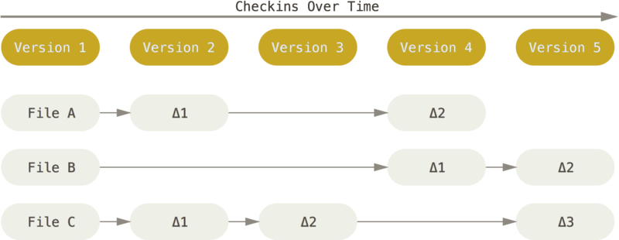
File based delta storage (SVN)

Slide 23
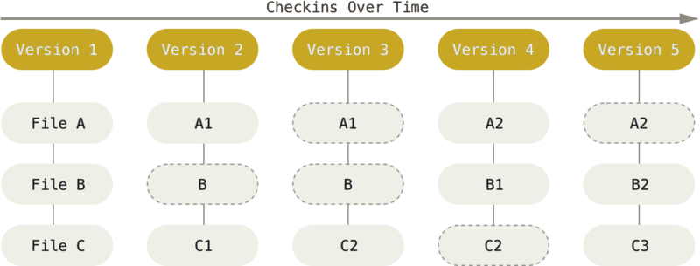
Snapshot based (git)

Slide 24
“add” means something completely different
SVN tracks files
  “add” means “Here is a new file that I want you to track”
Git does not
  Uses the “add” verb for something completely different
  “add” to staging area (middle area before commit)
  “add” to next commit

Slide 25
The staging area
Working
Directory
Unsaved work
Staging
Area
Middle area
before commit
Under
version
Control
Saved work
add
commit

Slide 26
Why the extra step?
Allows for crafted commits
Selective commiting
Choose only to stage certain files
Choose to only stage certain diff chunks
Can be circumvented
  git commit -a
I would not recommend it (“add” confusion)

Slide 27
svn to git
15 years of new concepts
Introduction
Network structure
Git data structures part 1
Git data structures part 2
Branches
Summary

Slide 28
The git data structure
Three kinds of objects;
  Blobs: File content
  Tree: Directory manifest
  Commit: A saved snapshot

Slide 29
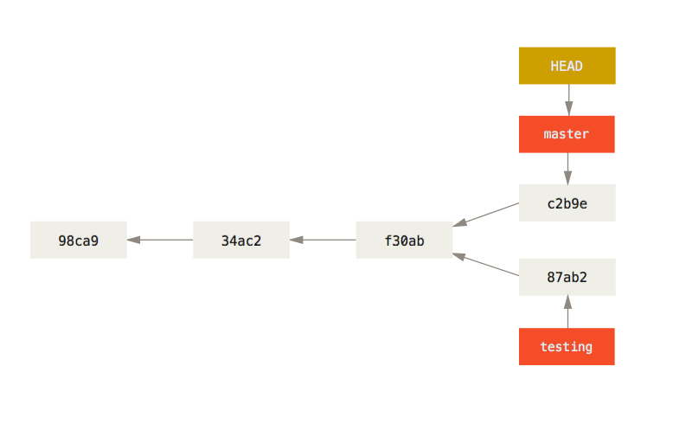
History is a tree of commits

Slide 30
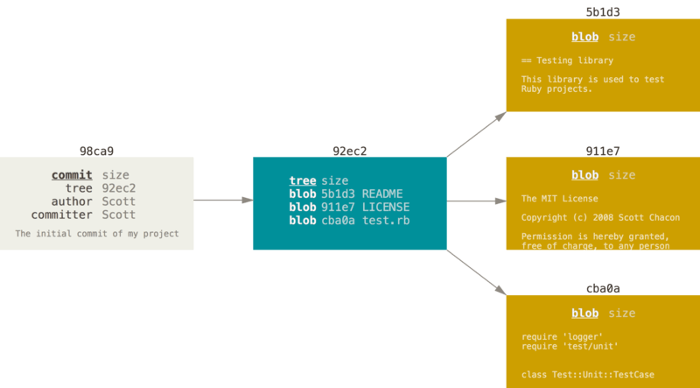
Each snapshot is directory tree

Slide 31
Git uses checksums (hashes)
All object content is saved in files
Object filenames are the hashes of the content
Hashes are checked on checkout
Prevents un-detected archive corruption

Slide 32
svn to git
15 years of new concepts
Introduction
Network structure
Git data structures part 1
Git data structures part 2
Branches
Summary

Slide 33
Branches
Branches are nothing more or less than a pointer into a tree of commits

Slide 34
Branches
Branches are cheap
  A 41 byte file (really)
Only you ever see them
  Remember that you have your own copy on Gitlab to work up against
Git is good are merging them
Branches are good for containment
… and in git they are usable

Slide 35
Branches
Use branches for everything
Feature work (each on its own branch)
  A new feature
  A bug fix
  An experiment
  A savepoint, before doing something “dangerous”

Slide 36
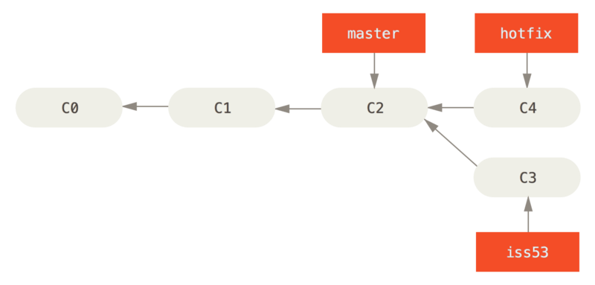
Merging

Slide 37
THE END

Slide 38
Indexing arrays
In [2]: a = np.arange(6).reshape((2, 3))
In [3]: a
Out[3]:
array([[0, 1, 2],
[3, 4, 5]])
In [4]: a[1, 1]
Out[4]: 4
In [5]: a[1, :]
Out[5]: array([3, 4, 5])
In [6]: a[:, 1]
Out[6]: array([1, 4])
In [7]: a[:, -1]
Out[7]: array([2, 5])

Slide 39
Types - Exercises
Create with arange, linspace and random.random
Reshape an array created with random.random
Get information (ndim, shape, size, dtype) of that array
Try simpel math on the arrays

Slide 40
array – Type along
Type along session in the terminal:
array

