Slide 1
Python part 2 - numpy
The scientific Python ecosystem
numpy array
Indexing
ufuncs (elementwise functions)
Aggregates
Broadcasting
Masks and fancy indexing

Slide 2
The program
Move through each of the topics in the outline
For each topic there will be:
  A presentation by me
  A “type along” session, where we type the new things together
  A few exerciser (the exercises are meant mainly for typing repetition, so most are simple)

Slide 3
Python part 2 - numpy
The scientific Python ecosystem
numpy array
Indexing
ufuncs (elementwise functions)
Aggregates
Broadcasting
Masks and fancy indexing

Slide 4
The ecosystem for scientific computing in Python
numpy – arrays and math functions
  polynomials, sin, exp, etc.
scipy – algorithms for arrays
  fitting, smoothing, searching, FFT, etc..
matplotlib – plotting
scitkits – SciPy toolkits
  scikit-learn: Machine learning
  scikit-parse: Sparse matrices
The core

Slide 5
Installing extra packages
(Possibly your operating system package systems, Linux, Mac)
Use the tool of your Python package distribution
  Anaconda: conda install pymysql
For anything not in there, use pip:
  pip install scikits.sparse

Slide 6
An ecosystem of sevaral sources
Upside: There is a lot of stuff out there A LOT
Downside: Need to learn a little something about installing extra packages
  However, most likely all of what you will need is in Anaconda (numpy, scipy and matplotlib)

Slide 7
Python part 2 - numpy
The scientific Python ecosystem
numpy array
Indexing
ufuncs (elementwise functions)
Aggregates
Broadcasting
Masks and fancy indexing

Slide 8
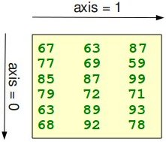
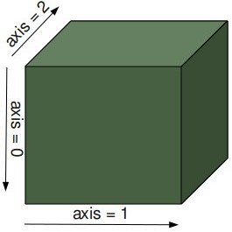
The numpy array
Multidemonsional array
Single typed
Indexing and slicing
Fancy indexing
Attached aggregate methods:
  sum, mean, min, max, etc
http://www.python-course.eu/numpy.php

Slide 9
Create a numpy array
Call array() on a sequence (of sequences)
Use special functions for initializing arrays with default values:
arange(a, b, stepsize): From a to b in steps of
linspace(a, b, n): From a to b with n elements
ones(shape) and zeroes(shape): Array of ones or zeroes with shape
empty(shape): Like above, but un-initialized
random.random(shape): Random numbers

Slide 10
Creating a numpy array
In [1]: import numpy as np
In [2]: myarray = np.array([1, 2, 3])
In [3]: myarray
Out[3]: array([1, 2, 3])
In [4]: myarray = np.array([[1, 2], [3, 4]])
In [5]: myarray
Out[5]:
array([[1, 2],
[3, 4]])

Slide 11
Creating a numpy array
In [2]: mylinspace = np.linspace(0.1, 0.7, 3)
In [3]: mylinspace
Out[3]: array([ 0.1, 0.4, 0.7])
In [4]: myones = np.ones((2, 3))
In [5]: myones
Out[5]:
array([[ 1., 1., 1.],
[ 1., 1., 1.]])

Slide 12
Information about arrays
array.ndim: Number of dimensions: 2
array.shape: The shape: (2, 3)
array.size: The total number of elements: 6
array.dtype: The data type: float64

Slide 13
Information about an array
In [3]: myones.ndim
Out[3]: 2
In [4]: myones.shape
Out[4]: (2, 3)
In [5]: myones.size
Out[5]: 6

Slide 14
Reshape array
array.reshape(shape): Reshapes an array to a new size
  Fast (without copy if possible)
  New view with different strides
One dimensions size can be inferred, by settings it to -1

Slide 15
Reshaping
In [11]: myrandom = np.random.random(6)
In [12]: myrandom
Out[12]:
array([ 0.62830269, 0.90818518, 0.82203743, 0.56732933, 0.26770021, 0.48429263])
In [13]: myrandomarray = myrandom.reshape((2, 3))
In [14]: myrandomarray
Out[14]:
array([[ 0.62830269, 0.90818518, 0.82203743],
[ 0.56732933, 0.26770021, 0.48429263]])

Slide 16
Math with arrays
All the normal math operators works elementwise
  + - * ** / (careful)
Can also use scalars and arrays (elementwise)
  array([1.0, 2.0]) * 2

Slide 17
Math with arrays
In [46]: a = np.arange(1, 2, 0.2)
In [47]: b = np.arange(2, 3, 0.2)
In [48]: a
Out[48]: array([ 1. , 1.2, 1.4, 1.6, 1.8])
In [49]: b
Out[49]: array([ 2. , 2.2, 2.4, 2.6, 2.8])
In [50]: a + b
Out[50]: array([ 3. , 3.4, 3.8, 4.2, 4.6])
In [51]: a * b
Out[51]: array([ 2. , 2.64, 3.36, 4.16, 5.04])

Slide 18
array – Type along
Type along session in the terminal:
array

Slide 19
Types - Exercises
Create with arange, linspace and random.random
Reshape an array created with random.random
Get information (ndim, shape, size, dtype) of that array
Try simpel math on the arrays

Slide 20
Python part 2 - numpy
The scientific Python ecosystem
numpy array
Indexing
ufuncs (elementwise functions)
Aggregates
Broadcasting
Masks and fancy indexing

Slide 21
Indexing arrays
Work as with lists, but with super powers
Single integer index [1]
Slicing [2: 4]
Slicing without numbers to get everythin [:4]
Negative indexing [-1]
But now for each dimension
The indeces for each dimension is separated by comma: [3, 4] and [:, 0]

Slide 22
Indexing arrays
In [2]: a = np.arange(6).reshape((2, 3))
In [3]: a
Out[3]:
array([[0, 1, 2],
[3, 4, 5]])
In [4]: a[1, 1]
Out[4]: 4
In [5]: a[1, :]
Out[5]: array([3, 4, 5])
In [6]: a[:, 1]
Out[6]: array([1, 4])
In [7]: a[:, -1]
Out[7]: array([2, 5])

Slide 23
indexing and slicing – Type along
Type along session in the terminal:
indexing and slicing

Slide 24
Types - Exercises
Create a 2d array and on only one dimension:
  index
  slice with 2, 1 or 0 arguments
  Use negative indeces
The try on both dimension the same and notice that you can combine any way you want

Slide 25
Python part 2 - numpy
The scientific Python ecosystem
numpy array
Indexing
ufuncs (elementwise functions)
Aggregates
Broadcasting
Masks and fancy indexing

Slide 26
ufuncs
Short for universal function
Can work on multidimensional arrays in an element-by-element fashion
Are vectorized forms of functions that can take and return scalar input and output
All the usual suspects:
  exp, sqrt, reciprocal, sin, cos, tan, arcsin .., sinh ..,
  and many many more:
http://docs.scipy.org/doc/numpy/reference/ufuncs.html#available-ufuncs

Slide 27
ufuncs
All the ordinary math operations ...
… and all the ordinary comparison operators ...
… are ufuncs too
(I just didn't tell you before)

Slide 28
Using ufuncs
In [1]: import numpy as np
In [2]: import matplotlib.pyplot as plt
In [3]: x = np.linspace(0, np.pi*2, 1000)
In [4]: y = np.exp(np.sin(x) + 1)
In [5]: plt.plot(x, y)
Out[5]: [<matplotlib.lines.Line2D at 0x7fcb7a5bfd10>]
In [6]: plt.show()

Slide 29
ufuncs – Type along
Type along session in the terminal:
ufuncs

Slide 30
ufuncs - Exercises
Create x-values with arange
Create y-values from different (more complicated) function expressions using a combination of ufuncs and ordinary math operators
Plot as you experiment

Slide 31
Python part 2 - numpy
The scientific Python ecosystem
numpy array
Indexing
ufuncs (elementwise functions)
Aggregates
Broadcasting
Masks and fancy indexing

Slide 32
Aggregates
Aggregates are functions on arrays that return smaller arrays (reduces them)
There are many aggregate functions:
  min, max, sum, prod, mean, std, var, any, all, median, percentile
  argmin, argmax (Returns indeces instead of values)
Variants that ignore NaN
  nanmin, nanmax etc.
Some are available on the arrays, some in numpy
  np.percentile

Slide 33
Aggregates
In [25]: a = np.arange(6).reshape(2, 3)
In [26]: a
Out[26]:
array([[0, 1, 2],
[3, 4, 5]])
In [27]: a.sum()
Out[27]: 15
In [28]: a.min()
Out[28]: 0

Slide 34
Aggregates axis argument
Remember the array axis
Aggregate functions all takes an optional axis argument
  array.sum(axis=0)
Will do the operation along that axis
http://www.python-course.eu/numpy.php

Slide 35
Aggregates with axis
In [34]: a
Out[34]:
array([[0, 1, 2],
[3, 4, 5]])
In [35]: a.sum(axis=0)
Out[35]: array([3, 5, 7])
In [36]: a.sum(axis=1)
Out[36]: array([ 3, 12])
In [37]: a.mean(axis=0)
Out[37]: array([ 1.5, 2.5, 3.5])

Slide 36
aggregates – Type along
Type along session in the terminal:
aggregates

Slide 37
aggregates - Exercises
Make a 2d (or 3d) array
Test several of the aggegates like, min, sum, prod etc. on this array
Experiment with the axis argument

Slide 38
Python part 2 - numpy
The scientific Python ecosystem
numpy array
Indexing
ufuncs (elementwise functions)
Aggregates
Broadcasting
Masks and fancy indexing

Slide 39
Broadcasting
A set of rules that makes ufuncs operate on arrays of different sizes and/or dimensions
One of the more advanced features
Can be used to make to
  Repeat a smaller array in calculations with larger
  To make certain outer operations on arrays
Makes it possible to repeat parts of an array without copying

Slide 40
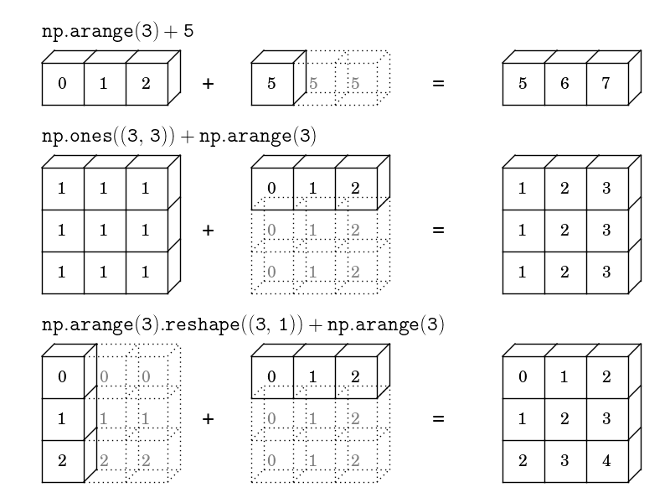
Broadcasting
http://studiosmile.pl/master-invalid-floating-point-operation.htm
https://speakerdeck.com/jakevdp/losing-your-loops-fast-
numerical-computing-with-numpy-pycon-2015

Slide 41
The rules of broadcasting
If number of dimension differ, left pad the smaller shape with 1s
If the dimensions do not match, then broadcast to the dimension with size=1
If neither of the non-matching dimentions are 1, then raise an error

Slide 42
broadcasting – Type along
Type along session in the terminal:
broadcasting

Slide 43
More on nearest neighboors
For a more complete 3d example, see this presentation:
https://speakerdeck.com/jakevdp/losing-your-loops-fast-numerical-computing-with-numpy-pycon-2015
By Jake VanderPlas

Slide 44
broadcast - Exercises
While making sure that you understand the broadcasting rules thet governs each of these examples:
  Experiment with doing math between scalars and 1s or 2d arrays
  Experiment with math between 1d and 2d arrays
  Experiment with an outer operation between 2 1d arrays

Slide 45
Python part 2 - numpy
The scientific Python ecosystem
numpy array
Indexing
ufuncs (elementwise functions)
Aggregates
Broadcasting
Masks and fancy indexing

Slide 46
Masking and fancy indexing
Arrays can be indexed by ints and slices
An optional third int in a slice gives the step
  myarray[::2] (every other)
  myarray[::-1] (reverses)
But they can also be indexed by sequences
  myarray[[1, 3, 5]]
And with a boolean arrays, to select only elements

Slide 47
fancy indexing – Type along
Type along session in the terminal:
fancy indexing

Slide 48
fancy indeces - Exercises
Reverse the order of the rows in a 2d-array
Set all values in a random array between 0.2 and 0.8 to infinity
Select a list of rows from an array

Slide 49
On Python and for loops

Slide 50
For loops over arrays are slow
Python is fast to develop in, because it is dynamic, dynamically typed and high level
Python is slow for repeated simple tasks because it is dynamic, dynamically typed and high level
With the tools we learned today, loops can be pushed into the compiled layer, which is very fast
Numerical problems in Python must be vectorized!!!

Slide 51
Numerical problems in Python must be vectorized!!!
If for-loops over arrays cannot be avoided, certain techniques can be used to speed them up
Out of scope for this session

Slide 52
Python part 2 - numpy
Summing up

Slide 53
Summary
Express the complete vectorized problem with:
  Indexing and slicing
  ufuncs
  Aggregates
  Broadcasting
  (Fancy indexing)
Numpy has a wide range of general purpose ufuncs for many purposes (look for them)
Have func with numpy

Slide 54
References and more material
“Loosing your Loops: Fast Numerical Computing with Numpy” Jake VanderPlas,
https://www.youtube.com/watch?v=EEUXKG97YRw https://speakerdeck.com/jakevdp/losing-your-loops-fast-numerical-computing-with-numpy-pycon-2015
“100 numpy exercises”
http://www.labri.fr/perso/nrougier/teaching/numpy.100/
Documents on http://www.numpy.org/ including “Numpy for Matlab® Users”
And much more, use google

Slide 55
Hope you had fun.
See you for the rest of part 2 tomorrow.
scipy and matplotlib

Slide 56
THE END

