Slide 1
Python part 0
Introduction
What is a computer program
Math
Types
Variables
Containers
Loops
Boolean expressions
Control flow (if-elif-else)
Functions
Summary

Slide 2
Python part 0
Introduction

Slide 3
The program
Move through each of the topics in the outline
For each topic there will be:
  A presentation by me
  A “type along” session, where we type the new things together
  A few exerciser (the exercises are meant mainly for typing repetition, so most are simple)
There will also be a few short detours along the way

Slide 4
Why program? To do cool stuf
To do data treatment (reproducably)
Talk to equipment - to use it for things that the manufaturer did not think of
To combine data from different sources
To produce good looking graphs
To automate tedious and/or time consuming tasks
And because its fun – programming is like Lego for adults

Slide 5
Why program? For reproduceability
As scientists we often rely need to:
  Repeat the same data treatment for different data sets
  Repeat a procedure
  Repeat repeat repeat
But people are not very good at repeating simple tasks (they get bored or forget)
Computers on the hand are great at repeating
Why not let them do it

Slide 6
The “super coder” myth
That programming skills are somehow special and something that only people with a predeposition can do
That skills are distributed in a bimodal fashion with only super-ninjas and those that cannot not at all
FALSE!

Slide 7
The “super coder” myth is bogus
Programming is a skill just like any other and anyone can develop along the skill levels
It takes teaching, repetition and practice, just like any other skill
Relax, enjoy learning something new and don't panic, if you do not feel able to program facebook from scratch by the end of the day
That's normal!

Slide 8
A bit about wording
I have chosen to be accurate with wording
Might seem a little abstract
E.g:
  Object An object “is a thing” in a program
  Sequence A sequence is “a string of somethings”
  etc.

Slide 9
Python
Will use Python
  Ease of use
  Emphasis on readability
  Popularity in the scientific community
MANY or all of the concepts we talk about are general and used in many programming environments

Slide 10
Python part 0
What is a computer program
Math
Types
Variables
Containers
Loops
Boolean expressions
Control flow (if-elif-else)
Functions

Slide 11
What is a computer program
A set of instructions
Executed in order
Needs to be correct, follow a syntax
Think of it like ...
A cooking recipy
Give a chef instructions one at a time
Directions
1. In a large bowl, sift together the flour, baking powder, salt and sugar. Make a well in the center and pour in the milk, egg and melted butter; mix until smooth.
2. Heat a lightly oiled griddle or frying pan over medium high heat. Pour or scoop the batter onto the griddle, using approximately 1/4 cup for each pancake. Brown on both sides and serve hot.
http://allrecipes.com/recipe/good-old-fashioned-pancakes/

Slide 12
What is a computer program
with sift:
apply flour
apply baking powder
apply salt
apply sugar
make center well
apply egg
apply milk
apply melted butter
while not well mixed:
mix with spoon
Pseudo-code to make pancake batter. Yum!

Slide 13
The interpreter
Usually programs are written as sequences of instructions in a file
In Python (unlike all languages) you actually can give it instructions live
For this you use the “the interpreter”
Usually used to experiment or test
We will use it to learn interactively

Slide 14
Python part 0
What is a computer program
Math
Types
Variables
Containers
Loops
Boolean expressions
Control flow (if-elif-else)
Functions

Slide 15
Math
All the usual suspects
Except division, may not do what you want
Order of operations as you would expect
PEMDAS
Operator | Action
+ | Plus
- | Minus
/ | Division (careful)
* | Multiplication
** | Raise to power
( ) | Used for precedense

Slide 16
Math
With division / between integers performs flooring integer division
  e.g. 3/4=0
To turn it into float, convert one to float first
  float(3)/4 = 0.75
Can use exponential notation
4E-8 = 4 * 10^-8
Let's get started typing

Slide 17
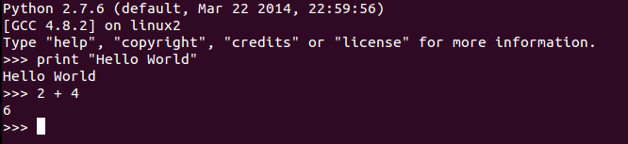
Start the Python interpreter
Start the Python interpreter from your program menu
The Python version
First “instruction”
>>> Indicates a prompt
i.e. “enter stuff here”
Result of
first “instruction”

Slide 18
Math
Type along session in the terminal:
Math

Slide 19
Python part 0
What is a computer program
Math
Types
Variables
Containers
Loops
Boolean expressions
Control flow (if-elif-else)
Functions

Slide 20



Types
In computer programs, items (called objects) have a type
The type determines:
  What data it can contain
  How it interacts with other objects of the same or a different type
    In short, what you can do with it
  (If it can be changed)
In short, an objects type defines its functionality
Type: Shoe
Type: Box
Type: Integer
http://www.clipartpanda.com/clipart_images/shoes-clip-art-5293230
http://www.clipartpanda.com/categories/wooden-box-clipart
http://4vector.com/free-vector/number-in-green-rounded-square-clip-art-115333

Slide 21
Types
You have already met a few types
The most fundamental are:
float is short for floating point
number and is the universal
representation for fractional
numbers in science.
Also sometimes referred to as
single → single precision float
double → double precision float
Type | Example
int | 47
float | 47.0
string | “fourtyseven”
bool | True
NoneType | None
This one we haven't seen before. It means:
“nothing to see here”

Slide 22
The type function
The type function can be used to get the type of an object
>>> type(47)
<type 'int'>
>>> type(47.0)
<type 'float'>
>>> type('fourtyseven')
<type 'str'>
>>> type(True)
<type 'bool'>

Slide 23
Wait, what is a function?
A function gathers useful and re-useable bits of work together
A function:
  Takes input and produces output (just like in math)
  And/or can perform tasks
The different inputs to a function are called “arguments”
Functions can be “called” or “invoked”
Function can “be given” or “passed” arguments

Slide 24
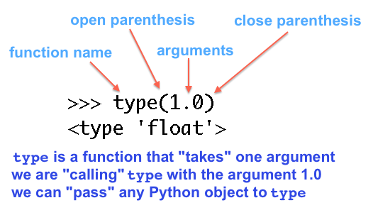
The anatomy of a function call
https://openhatch.org/wiki/Boston_Python_Workshop_8/Friday/Tutorial#Types

Slide 25
Types – Type along
Type along session in the terminal:
Types

Slide 26
Types - Exercises
Get the type of different objects with type()
Try math on objects that you would not expect to work
  E.g. multiply a strings, booleans and numbers
  Does it work?
  What is the type
  Is there a logic to it?

Slide 27
The command history
Try and press the up arrow in the interpreter
The interpreter keeps a history of what you have entered
Makes it easy to go back and repeat actions
Simple press up arrow untill the correct command and then enter

Slide 28
Working with strings

Slide 29
Working with strings
Strings are fundamental (also for scientists)
'This is a string'
To concatenate strings use +
To add the string representation of an object to a string, use str(object)
' and “ are synonomous
The used quote needs to be escaped inside the strings

Slide 30
Working with strings
>>> 'The start ' + 'and the end'
'The start and the end'
>>> 'Concatenating a number to the string ' + str(1)
'Concatenating a number to the string 1'
>>> 'It\'s necessary to quote'
"It's necessary to quote"
>>> "It's necessary to quote"
"It's necessary to quote"

Slide 31
Strings – Type along
Type along session in the terminal:
Types

Slide 32
Strings - Exercises
Exercise 1-4 on
http://www.codecademy.com/courses/python-beginner-en-kSQwt/0/1
(Keep this page open for later)

Slide 33
Python part 0
What is a computer program
Math
Types
Variables
Containers
Loops
Boolean expressions
Control flow (if-elif-else)
Functions

Slide 34
Variables
A variable is a nametag for an object
Almost like math variables
Can “be” of any type
Giving an object a name is called assignment
>>> x = 47
>>> x
47
>>> type(x)
<type 'int'>
>>> 2 * x
94

Slide 35
Mix and match, variables and object
You can mix variables with objects in expression
Think if it as if variables are replaced by the object they refer to
>>> a = 22
>>> b = 2
>>> the_answer = 2 * a - b
>>> the_answer
42

Slide 36
Assignment to a variable
What happens if you try and assign a variable to a varaible?
  a = 47
  b = a

Slide 37
Assigment to a variable
You cannot assign a variable to another variable
It will fall through and point to the same object
>>> a = 47
>>> b = a
YES!
NO!
a
47
a
47
b
b

Slide 38
Variables
Variable names can only contain letters and underscores (no spaces)
Keep consistent, use lowercase underscore
  measurements
  measurement_set
  number_of_measurements
Must be descriptive, to help yourself read your program
  Yes: number_of_points, length_of_queue etc.
  No: number, length, size, my_integer etc.

Slide 39
About output
About of an expression will be printed to screen …
… unless assigned to a variable
Functions can both change the value of something that you pass in and return it
>>> 4
4
>>> a = 4
>>> a
4

Slide 40
Variables – Type along
Type along session in the terminal:
Variables

Slide 41
Variables - Exercises
Assign objects of different types to variables
Try expressions with variables only
Try expressions with a combination of variables and objects
Assign a number to a variable (a=47),
  assign a new vairable to that first variable (b=a)
  check the value of a and b
  change the value of a
  check the value of a and b

Slide 42
Python part 0
What is a computer program
Math
Types
Variables
Containers
Loops
Boolean expressions
Control flow (if-elif-else)
Functions

Slide 43

Containers
Creating a variable for every measure that you need is impractical
Containers can contain several objects and make it easy to access them
Containers are in themselves objects
  that a variable can point to
list
[0]
[1]
[2]
0
1
2
list_if_measurement_ids
47
89
112

Slide 44
The simples container – the list
Ordered: Objects are in order in slots
In-homogenuous: A list can contain a mix of different types of objects
Objects are assigned and retrieved with integer indeces
Create a list by typing [] or calling list() on a sequence

Slide 45
A list
Separated by comma
Start and end
square parenthesis
>>> list_of_objects = [47, 1.0, True]
>>> list_of_objects
[47, 1.0, True]
Objects

Slide 46
Indexing lists
To index a list use the [index_number]
Index numbers are 0-based (first one is 0)
>>> list_of_objects = [47, 1.0, True]
>>> list_of_objects[0]
47
>>> list_of_objects[2]
True
>>> list_of_objects[0] = 7
>>> list_of_objects
[7, 1.0, True]

Slide 47
List – Type along
Type along session in the terminal:
List

Slide 48
Add elements in a list
Primarily with append
>>> list_of_objects
[7, 1.0, True]
>>> list_of_objects.append(9)
>>> list_of_objects
[7, 1.0, True, 9]

Slide 49
Hold on, what is a method?
A method is a functions that:
  Is attached to an object
  Performs actions on this object
All objects have methods, even ints
the dot
my_list
method that work on my_list
Type: list
Content: [1, 2, 3]
append
pop
count

Slide 50
A list has quite a few methods
Call the dir function of an object to find its methods
append adds an object to the end
count counts occurences of an object
index returns first index of an object
insert insert object at index
remove removes first accurence of object
pop remove and return from index
… more

Slide 51
List – Type along
Type along session in the terminal:
List

Slide 52
List - Exercises
Make a list with [] and with list() (e.g. by calling it in a string)
Get objects out and save new values by index
Try and write two integers as index separated by ':' e.g. mylist[1: 3]
Make a list with two elements in and try:
my_variable_a, my_variable_b = mylist
Try the index and count methods
Exercises 9 and 11 on codeacademy
Call dir and help e.g. on a list and a string and read a litte about some of the methods

Slide 53
A mapping container – the dict
Short for dictionary
An un-ordered mapping of keys to values
Objects are retrieved or assigned with keys
Create a dict with {} or by calling dict() on a sequence of two-object sequences
['title']
dict
['id']
['comment']
['type']
47
dict_with_metadata
'NiCu particles'
'This is the one'
4

Slide 54
Creating a dict
key, value pair
key value pairs
separated by ,
Start end end
curly parenthesis
key and value
separated by :
>>> mydict = {key0: value0, key1: value1}
>>>
>>> dict([[key0, value0], [key0, value0]])

Slide 55
Index by keys
Index a dict by a key
Like look up word in a dictionary
A key can be any object that cannot be changed
>>> mydict = {'title': 'CuZn', 0: True}
>>> mydict
{0: True, 'title': 'CuZn'}
>>> mydict[0]
True
>>> mydict['title']
'CuZn'
Index with square
parenthesis like list
The key

Slide 56
Also assign by key
To assign a new value to an existing key, use: [key]
>>> mydict
{0: True, 'title': 'CuZn'}
>>>
>>> mydict['title'] = 'CuZn nano particles'
>>>
>>> mydict
{0: True, 'title': 'CuZn nano particles'}
>>> mydict['title']
'CuZn nano particles'

Slide 57
Dicts has lots of useful methods
keys() list of all the keys
values() list of all the values
items() list of all the key-value pairs
pop() return value and remove it
update() update values with values from another dict
get() is like [] but does not give an error if the key is not in the dict
… and many more ...

Slide 58
Dict – Type along
Type along session in the terminal:
Dict

Slide 59
Dict - Exercises
Make a dict by entering it with {}
  Try and use different types as keys and values
Get objects out by indexing
Assign a new value to one of the keys
Try the keys, values and items methods
Make a new dict that share some keys and has a few new ones compared to the first one and try and use the update
Try len() on a dict
Call dir and help on a dict and read a litte about some of the methods

Slide 60
Python part 0
What is a computer program
Math
Types
Variables
Containers
Loops
Boolean expressions
Control flow (if-elif-else)
Functions

Slide 61
Loops
Loops are fundamental to programming
Repeat a part of program with different input
E.g. once for every data set
Python makes it easier
Program
Start loop:
Code block

Slide 62
Loops – for
The for loop
Execute the block once for every object in sequence
And make that object available in code block
Used whenever you want to do the same thing for a sequence of somethings
Think: foreach measurement in my set, analyse and plot

Slide 63
Loops for - example
>>> colors = ['magenta', 'cyan', 'crimson']
>>> for color in colors:
... print color
...
magenta
cyan
crimson

Slide 64
Loops for - example
The “placeholder” variable name,
the the object in the sequence
will be assigned one after another
The sequence
>>> colors = ['magenta', 'cyan', 'crimson']
>>> for color in colors:
... print color
...
magenta
cyan
crimson
The prompt changes to … to indicate a block of code
Notice the : that indicates that a block of code is about to start
The spaces indicate a block
The result
The block of code

Slide 65
About code blocks
Indicates a “group on lines of code”
That belongs to the line just before
Sometimes done with parenthesis – in Python we use indentation
The : indicates the beginning of a block
for color in colors:
....mystr = color + “ yeah”
....print mystr
That block will continue as long as the lines are indented
Use 4 spaces for indentation. Your editor will help you, just press tab

Slide 66
Loops – Type along
Type along session in the terminal:
Loops

Slide 67
Loops - while
The while loop
Execute the block for as long as an expression evaluates as True
Used e.g. when one needs to check if something is complete
Think “keep doing this as long as ...”

Slide 68
Loops – while example
Check, execute (again) if True
Block
counter = 3
while counter > 0:
print counter
counter = counter – 1
print 'Boom!'
# Output
3
2
1
Boom!

Slide 69
Loops – while, more examples
Empty a container
>>> colors = ['magenta', 'cyan', 'crimson']
>>> while len(colors) > 0:
... print colors.pop()
...
crimson
cyan
magenta
>>> colors
[]

Slide 70
Loops – while, more examples
Loop forever
>>> while True:
... # Keep doing this until the end of time
... print “I am still here”
...
I am still here
I am still here
I am still here
I am still here
I am still here

Slide 71
About comments
Comments are lines of code that are not executed
Used to explain the program to yourself
A comment is made by starting a line with #
# Perform super fancy calculation
result = 2 + 2

Slide 72
Programming Python in a file
The interpreter is really good for trying things out, but we do not want to keep typing the same things over and over again
Python code can also be executed from a file
We will write these files with an text editor called “Spyder”

Slide 73
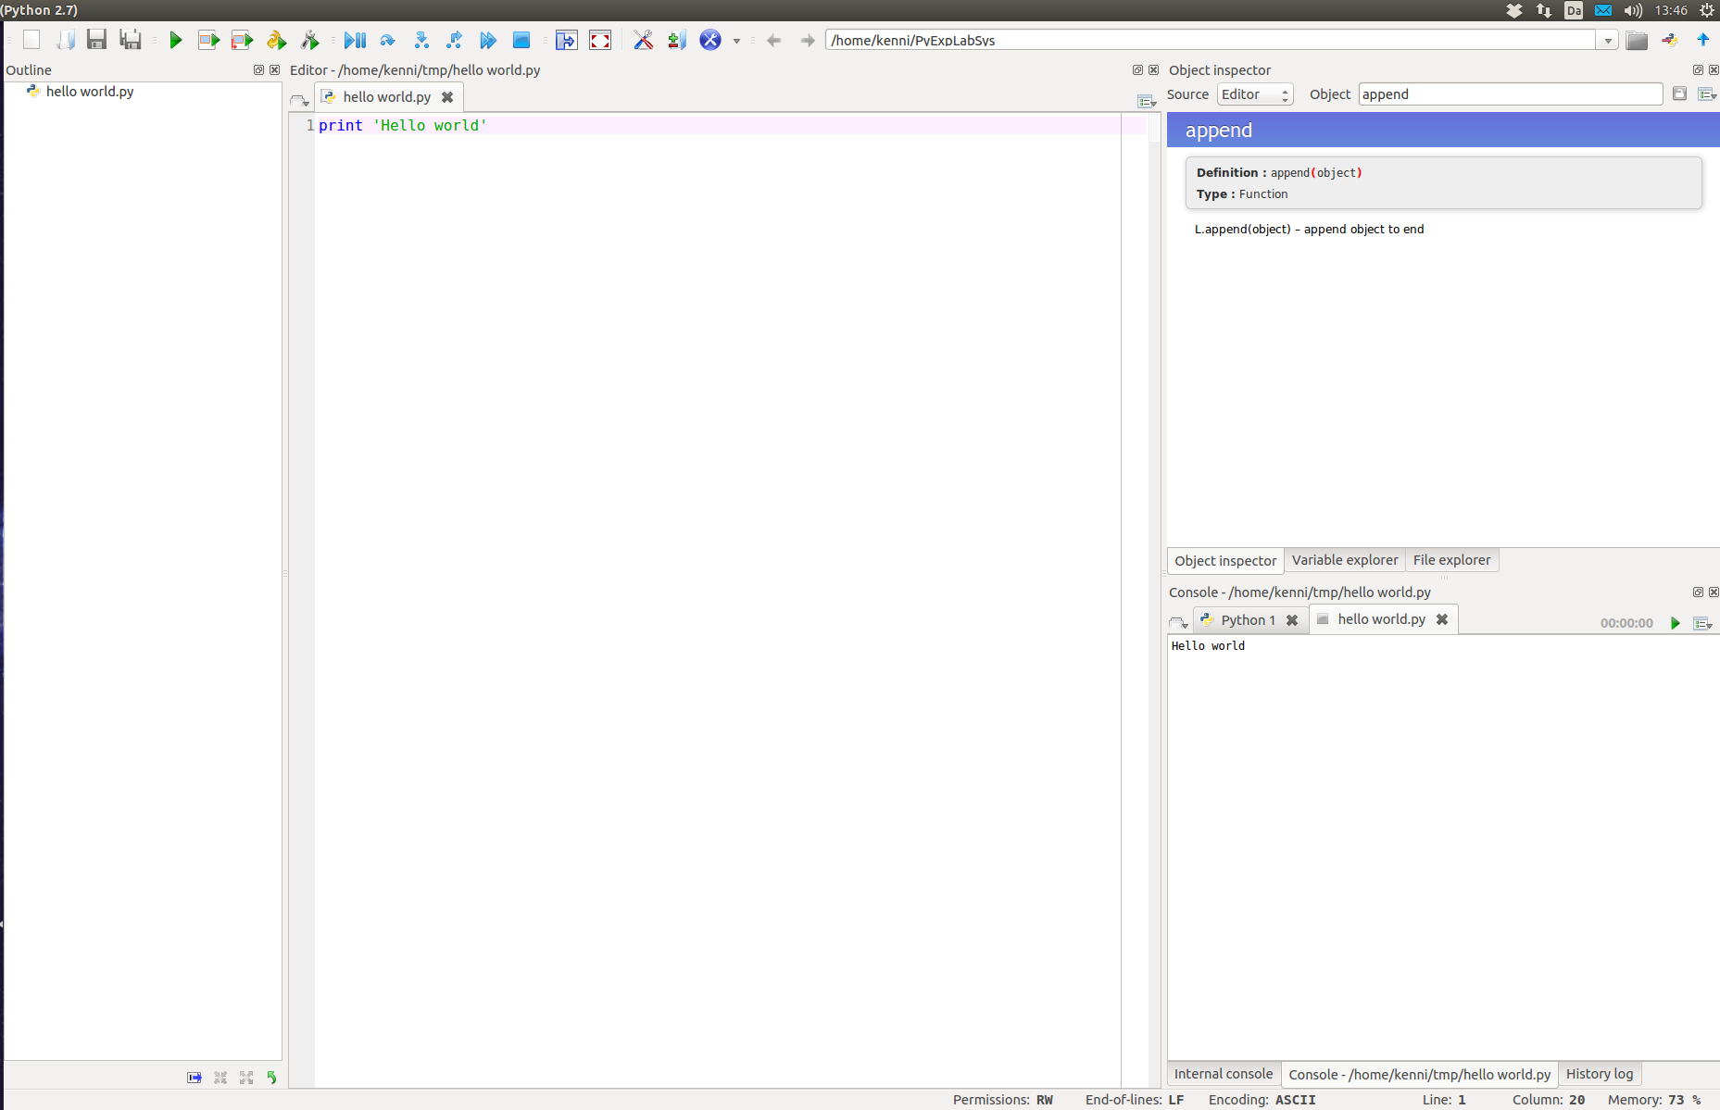
Spyder

Slide 74
Exercises now in spyder
All type along sessions and exercises from now on are in Spyder

Slide 75
Loops – Type along
Type along session in the terminal:
Loops

Slide 76
Loops – Exercises IMPORTANT!!!
Make a list of strings and make a new list, by looping over the old, modify the strings and append it to the new list
Make a variable with the value 1. Make a while loop that keeps multiplying it with 0.5 until the result is below 1E-8. Print out the result: 7.450580596923828e-09
Work through problems 12-19 on codeacademy

Slide 77

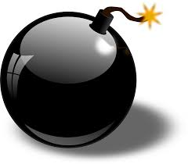
“Loop like a native”
https://www.youtube.com/watch?v=EnSu9hHGq5o
In Python we never ever use integer indeces to access object in a sequence (except arrays)
Because it is error prone (of by one errors)
People behind Python has taken care you do not need to
for color in colors:
print color
YES
range(5) returns [0, 1, 2, 3, 4]
for index in range(len(colors)):
print colors[index]
NO!!!
http://www.clipartbest.com/fireworks-drawing
http://www.clipartlord.com/category/military-clip-art/bomb-clip-art/

Slide 78
for loops the good way
What if I need the index?
Get the index along with the object
  enumerate()
What if I have more than one sequence?
Loop over several sequences at once
  zip()

Slide 79
Remember unpacking?
Assign several value from a list to multiple variables at once
>>> mylist = [47, -1]
>>> value1, value2 = mylist
>>> value1
47
>>> value2
-1

Slide 80
enumerate – enumerate objects
Returns index-object pairs
Can only be used directly in for loops
  For use else-where call list on it: list(enumerate(...))
Notice un-packing in a for loop
>>> for index, color in enumerate(colors):
... print 'Color ' + str(index) + ' is ' + color
...
Color 0 is magenta
Color 1 is cyan

Slide 81
zip – pair objects in sequences
Turns a pair of sequences into a sequence of pairs
Can also only be used directly in for loops
>>> colors = ['magenta', 'cyan', 'crimson']
>>> shapes = ['square', 'circle', 'triangle']
>>> for color, shape in zip(colors, shapes):
... print color, shape
...
magenta square
cyan circle
crimson triangle

Slide 82
You are now a native
Congratulations, you are now a Python native
That is 90% of what you need to know, to loop like a native
Enjoy!
http://www.clipartbest.com/fireworks-drawing

Slide 83
Loop like a native – Type along
Type along session in the terminal:
Loop like a native

Slide 84
Loop like a native – Exercises IMPORTANT!!!
Make a list of measurement descriptions e.g: ['C1s', 'O1s']
Make a list of measurment ids e.g: [47, 147]
Loop over both the lists and print a plot legend out by concatenating them e.g: 'C1s – 47'
Instead of printing them, add them to a new list of legends
Using enumerate and this new list, print out a new set of legends in which they are enumerated e.g: 'Plot 0: C1s – 47'
Experiment with using three lists in zip
Experiment with using 2 lists in zip, but where they do not have the same length. What happens?

Slide 85
Python part 0
What is a computer program
Math
Types
Variables
Containers
Loops
Boolean expressions
Control flow (if-elif-else)
Functions

Slide 86
Boolean expression
An expression that evaluates to True of False
Used to make checks and perform decisions
Simple (binary) operators are:
Operator | Explanation | Example | Result
> | greater than | 5 > 5 | False
>= | greater than or equal | 5 >= 5 | True
< | smaller than | -3 < 10 | True
<= | smaller than or equal | 47 <= 1 | False
== | equals (carefull with floats) | 10 == 10 | True
!= | not equals | 10 != 10 | False
in | in (a sequence) | 4 in [1, 2, 4, 7] | True

Slide 87
Boolean expressions
>>> 4 < 5
True
>>>
>>> 5 != 10
True
>>> 5 != 10
True
>>>
>>> 7 in [1, 2, 3]
False
>>> 3 in [1, 2, 3]
True

Slide 88
Special operator not
not is a single argument operator that negates the following expression
Special syntax for in (and is) for readability
Also works with !=
Works on the argument after
(the result of 4 < 5)
Works on the arguments
before and after (4 and 5)
>>> not 4 < 5
False

Slide 89
not
>>> 4 < 5
True
>>> not 4 < 5
False
>>> 4 in [2, 4, 6]
True
>>> not 4 in [2, 4, 6]
False
>>> 4 not in [2, 4, 6] # Also works
False

Slide 90
Putting boolean expression together
Boolean axpression can be put together to create more complex expressions for checks or decisions
Binary operators and and or
and - True when both are True
or – True when at least one is True

Slide 91
Truth tables
and
or
A | B | Result
True | True | True
True | False | False
False | True | False
False | False | False
A | B | Result
True | True | True
True | False | True
False | True | True
False | False | False

Slide 92
Putting boolean expressions together
>>> 4 < 5 and 1 < 2
True
>>> 4 < 5 and 1 > 2
False
>>> 4 < 5 and not 1 > 2
True
>>> 4 < 5 and 2 in [2, 3]
True

Slide 93
Boolean expressions – Type along
Type along session in the terminal:
Boolean expressions

Slide 94
Boolean expressions – Exercises
Make an expression that checks if a number is in range i.e. between two others
Make two sets of metadata in a dict e.g:
{'label': 'C1s', 'monochromator': True}
{'label': 'O1s', 'monochromator': False}
While testing on both
  Make an expression that checks whether it is a C1s measurement
  Make an expression that checks whether it is monochromated
  Make an expression that checks for both conditions
  Make an expression that checks for either
  Make an expression that check fo C1s and NOT monochromated

Slide 95
Python part 0
What is a computer program
Math
Types
Variables
Containers
Loops
Boolean expressions
Control flow (if-elif-else)
Functions

Slide 96

Control flow (if-elif-else)
Used to make decisions
Code is executed from the top down
A decision represents a cross-roads
Execute only certain lines of code depending on a boolean expression
  Aha! That is what they are for
Decisions are very fundamental to all programming
http://www.123rf.com/clipart-vector/intersection.html

Slide 97
The if statement
The simple if statement is used to optionally execute something
Think “If these conditions are met, also do this”
“If pan-cake plate is empty, make more”
The condition, notice
this is a boolean expression
The : that denotes a block
The if keyword
if len(pancacke_stack) == 0:
make_more_pancakes()
The block to execute
if the condition is True

Slide 98
The if-else structure
Do something if and in all other cases do something else
Think “If this is the case, do this, and if not, do something else”
Classic cross-roads
Always execute one block or the other
if len(pancacke_stack) == 0:
make_more_pancakes()
else:
keep_eating()
Notice: No condition
after an else statement
The else block

Slide 99
The if-elif-elif-elif-else structure
elif is short for “else if”
Adds the option, to one or more extra specific conditions to the decision, before the default else
if len(pancacke_stack) == 0:
make_more_pancakes()
elif len(pancake_stack) == 1:
heat_up_pan()
else:
keep_eating()
Note: The elif also
has an condition
The elif block

Slide 100
The complete if-elif-else structure
Note, the else is optional, also after elif
The complete allowed structure is:
  1 if
  Followed by 0 or more elif
  Followed by 0 or 1 else

Slide 101
if-elif-else – Type along
Type along session in the terminal:
if-elif-else

Slide 102
if-elif-else – Exercises
Make a structure that checks a number and optionally prints out a message if the number is <0
Make a structure that checks if there is content in a list and prints out two different message is there is and if there is not
Make a structure that cheks an age, <13(child), >65(senior) and in between (adult) and prints out an appropriate greeting for each age group
Make a structure that checks if a number is in range, is it if prints out the number and if not prints out a warning

Slide 103
Python part 0
What is a computer program
Math
Types
Variables
Containers
Loops
Boolean expressions
Control flow (if-elif-else)
Functions

Slide 104
Functions
A group of lines with well-defined (optional) input and (optional) output
Used to:
  Re-use certain pieces of code
  Organisation, to break up code into logical parts
Very fundamental to the way programs are structured
Think “Functions perform a well defined job”
This is where programming starts to get pratical

Slide 105
The anatomy of a function
def adder(a, b):
result = a + b
return result

Slide 106
The anatomy of a function
Start and end parenthesis
atound the arguments
(Optional) The arguments,
simply names
The name of the function
: to denote the start
of a block
The def keyword
indicates a function
definition
def adder(a, b):
result = a + b
return result
The block
(optional) return statement
and return value

Slide 107
More on functions
Variables defined inside functions, including arguments, exist only inside the function
The arguments are optional, but the () are not
The return statement is optional, if missing the function will return None
  Remember None means “nothing to see here”

Slide 108
Arguments
Arguments are used in order
def adder(a, b):
result = a + b
return result
adder(1, 2)
# a will be 1 and b will be 2

Slide 109
Function examples
Perform task, no return
def print_metadata(metadata):
print 'Title: ' + metadata['title']
print 'Id: ' + str(metadata['id'])
print 'Comment: ' + metadata['comment']
my_meta = {'title': 'C1s', 'id': 47, 'comment': 'This is the one'}
print_metadata(my_meta)

Slide 110
Function examples
Perform task, with return
def make_metadata_string(metadata):
result = 'Title: "' + metadata['title']
result = result + '" Id: ' + str(metadata['id'])
result = result + ' Comment: "' + metadata['comment'] + '"'
return result
my_meta = {'title': 'C1s', 'id': 47, 'comment': 'This is the one'}
metadata_string = make_metadata_string(my_meta)
print metadata_string
# Output
Title: "C1s" Id: 47 Comment: "This is the one"
There is a better way to format
numbers into strings, we will talk
about that in part1

Slide 111
Function can call other functions
Function can call other functions
This is the way you make structure when complexity of you task increases
They can also call themselves (recursion), but be carefull, that can produce infinite loops

Slide 112
Function can call other functions
def perform_subtask0():
print 'Hello'
def perform_subtask1():
print 'world'
def perform_task():
perform_subtask0()
perform_subtask1()
perform_task()

Slide 113
functions – Type along
Type along session in the terminal:
functions

Slide 114
functions – Exercises
Write a function “calculate” that performs a calculation with several parameters and call it
Write a function “do_calculate” that calls the “calculate” and call it
Write a function that returns the sum of every other element in a list
Write a function that, given a list, returns a new list where all objects are multiplied by 2

Slide 115
Putting it all together

Slide 116
Putting it all together
# ... get_data and get_normalization not show
def analyze_data_set(data_set, normalization):
# Fancy analysis
return result
def analyze_data_sets(data_sets):
normalization = get_normalization(data_sets)
results = []
for data_set in data_sets:
result = analyze_data_set(data_set, normalization)
results.append(result)
return results
def main():
data_sets = get_data()
results = analyze_data_sets(data_sets)
# plot data sets and results
main()

Slide 117
Python part 0
Summary

Slide 118
Scientists Summary
Math: Take care with division
Objects have a type that defines what they can do
Variables are names for objects
Lists and dicts are the bread and butter of containers
Use for and while loops for repetition
  And loop like a native
Boolean expressions, put together and, or
If-elif-else to make decisisions
Functions for calculation, organisation and code re-use

Slide 119
Homework
Getting good at a new syntax (e.g. Pythons) has a lot to do with muscle memory
Start writing Python and do it today
Work through this tutorial:
https://openhatch.org/wiki/Boston_Python_Workshop_8/Friday/Tutorial
(and do actually type all the examples), for the repetition and for getting to type some more
The link above is also to a large part the inspiration to this presentation

Slide 120
More optional homework
http://codingbat.com/python
Elementary exercise that you can run on the website. Good for that muscle memory.
http://learnpythonthehardway.org/book/
(Don't mind the comments about using a specific environment)

Slide 121
Have fun and see you at part 1

Slide 122
THE END

Slide 123
Extra slides, won't need them

Slide 124
Extras
abs()
min()
max()
bool()
any()
all()
is
id()
sum()
round()

