Slide 1
Git workshop
Kenneth Nielsen
18/3-16

Slide 2
Get the presentation
git clone https://github.com/KennethNielsen/presentations

Slide 3
git workshop
Summary from last time
GitLab exercise (main)
New feature branch and conflicts
Smaller topics and questions
Tools

Slide 4
git workshop
Summary from last time
GitLab exercise (main)
New feature branch and conflicts
Smaller topics and questions
Tools

Slide 5
Git != SVN
Network structure
How git thinks about its data
Internal data structure
Workflows
Network structure
How SVN thinks about its data
Internal data structure
Workflows
!=

Slide 6
The staging area
Working
Directory
Unsaved work
Staging
Area/
index
Middle area
before commit
Under
version
Control
Saved work
add
commit
checkout

Slide 7
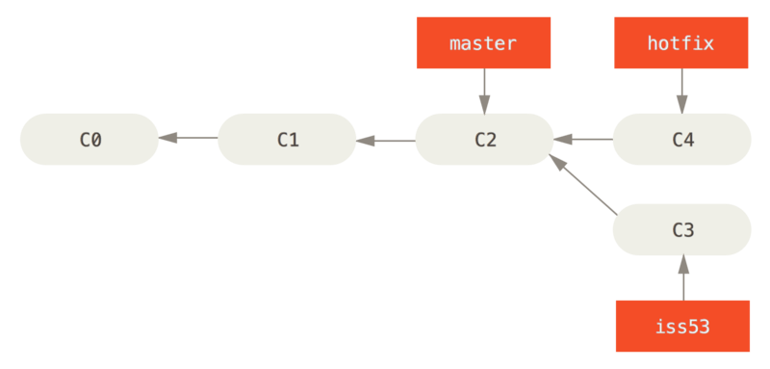
Git history is a tree of snapshots
Figure from “Pro Git” by Scott Chacon, https://git-scm.com/book/en/v2

Slide 8
Branches
A branch, in git, is nothing more or less than
a pointer into the tree of commits

Slide 9
Almost everything is local
Local
add
commit
branch
merge
log
status
...
Over the network
clone
push
fetch
pull = fetch + merge

Slide 10
Network structure
SVN
Git
Node
Server
Node
Node
Client
Node
Node
Node
Client
Client
Client
Client
Node
Client
Node
Client
Node
Node
Node
Node

Slide 11
Gitlab network structure
Gitlab instance
GPAW main archive
Clone of GPAW under my profile
Node
One time clone (fork)
Node
Integration of work
Start feature work
of newest upstream work
One time clone
Feature work
Node
Clone of GPAW on my computer
Local computer

Slide 12
A single question from last time

Slide 13
git workshop
Summary from last time
GitLab exercise (main)
New feature branch and conflicts
Smaller topics and questions
Tools

Slide 14
A few aliasses
git config --global --add alias.cm "commit -m"
lol = log --graph --decorate --pretty=oneline --abbrev-commit
ba = branch -a
b = branch
st = status
cm = commit -m

Slide 15
The GitLab workflow
Setup on GitLab
Make feature branch
status
log
diff
branch
On the side
Commit work
Make Merge Request
Main workflow
Incorporate changes
from feedback
Resolve conflicts
It's merged - celebrate

Slide 16
Command summary
git checkout -b feature_branch
git add <file>
git commit -m “Commit message”
git push origin feature_branch
Adjust according to review:
  git add, commit and push

Slide 17
git workshop
Summary from last time
GitLab exercise (main)
New feature branch and conflicts
Smaller topics and questions
Tools

Slide 18
Skipped from the main exercise
Settings up password-less ssh access
Make feature branch (really)
Resolve conflicts
  Merge
  Rebase

Slide 19
Setting up password-less ssh access

Slide 20
Make feature branch (really)

Slide 21
Make feature branch (really)
Feature branches should be created from newest state in “upstream”
  Minimize risk of duplicate work
  Minimize risk of conflicts
  Get newest code
But how?
At least 3 different appraches are floating around the internet :|

Slide 22
Gitlab network structure
Gitlab instance
GPAW main archive
Clone of GPAW under my profile
Node
Node
Integration of work
Start feature work
of newest upstream work
One time clone
Feature work
Node
Clone of GPAW on my computer
Local computer

Slide 23
The procedure
Fetch newest state of upstream
Merge into local branch
Checkout local branch
Make branch

Slide 24
From the ASE wiki the one that you should use
git fetch upstream
git checkout master
git merge upstream/master --ff-only
  (on fail of previous) git reset --hard upstream/master
git checkout -b new_feature_branch

Slide 25
Without a merge (just for fun)
git fetch upstream
git checkout upstream/master
  (Detached head warning)
git checkout -b new_feature_branch
Will not synchronize you local master branch with upstream master, but also you do not really need it

Slide 26
Without a merge, part deux
git fetch upstream
git checkout -b new_feature_branch upstream/master --no-track
Will not synchronize you local master branch with upstream master, but also you do not really need it

Slide 27
master as a tracking branch (wow)
One-time only:
  git checkout master
  git branch --set-upstream-to=upstream/master
Then:
  git checkout master
  git pull (--ff-only)
  git checkout -b new_feature_branch
Will give errors if you accidentally commit to master

Slide 28
Resolve conflicts

Slide 29
Resolve conflicts
Fix it, so that your branch can be merged
You are the logical candidate
Helps the friendly maintainer
  At some point he may even insist that you do it yourself

Slide 30
Resolve conflicts
Two ways
  Merge the other way
  Rebase of upstream/master
Remember, what we want is for our feature_branch to be mergable into upstream/master

Slide 31
With a reverse merge
Remember the goal is for our feature_branch to be mergable into upstream/master
No write access to upstream/master
Merge upstream/master into feature_branch
Then merging feature_branch into upstream/master is a simple fast-forward merge
Let's try it

Slide 32
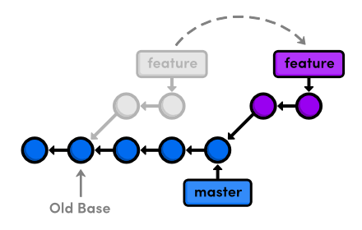
Rebase
Pretend that your work was based of the current state of upstream/master
http://rypress.com/tutorials/git/rebasing

Slide 33
Rebasing
Has a reputation for being magical
Not the case
Let's try

Slide 34
Command summary
With a reverse merge
  git checkout feature_branch
  git fetch upstream
  git merge upstream/master
With a rebase
  git checkout feature_branch
  git fetch upstream
  git rebase upstream/master

Slide 35
git workshop
Summary from last time
GitLab exercise (main)
New feature branch and conflicts
Smaller topics and questions
Tools

Slide 36
Smaller topics and questions
git help
Tracking branches
Interactive add patch mode (add -p)
Fun with log (subsets, filtering)
Fun with diff (~syntax)
Ooops, I did it again! (made changes on master)
Continue work on feature branch after MR
Rewrite local history (interactive rebase)
Revert an old commit

Slide 37
git help
Standard command line type help pages
Always available … but not always helpful
  Getting better
git help
git help command

Slide 38
Tracking branches
Tell git that two branches “belong together”
Means that we can pull and push without arguments
git branch --set-upstream-to=<branch>

Slide 39
Interactive patch add
Makes it possible to split work into different commits …
  … even within the same file

Slide 40
Fun with log
Subsets
Search

Slide 41
Fun with diff
diff shows diff of actual changes
Can also show diff between two commits
By hash or relative to branch

Slide 42
I accidentally made changes to master
And JJ says I have to use a feature branch
Happens often when you are new to git
What now?

Slide 43
Accidentally made changes on master
The solution varies depending on:
If you didn't commit the changes:
  git stash
  make the feature branch
  apply the stash
If you did:
  Make the feature branch
  git cherrypick
  reset master

Slide 44
Continue work on feature branch after MR
How to
  Work on feature branch
  Send in MR for feature branch
  Keep expanding the feature based on earlier work?
Make a new feature branch of the old one and it will work

Slide 45
Rewrite local history (interactive rebase)
Rewrite the newest part of the history that you just added in a feature branch
Used to craft well rounded commits
Never rewrite history others have seen
  It will give them weird conflicts if they based of your work
Can be a nice way to remove commits from small fixes that was forgotten

Slide 46
revert a old commit
Cannot remove it
  Git history is immutable
    Well, you can, but you shouldn't
Revert will add a new commit that reverts the changes

Slide 47
git workshop
Summary from last time
GitLab exercise (main)
New feature branch and conflicts
Smaller topics and questions
Tools

Slide 48
Tools
Bash prompt for git users
Git plugins for editors and IDEs
Graphical git tools

Slide 49
Bash prompt for git users
Many options available
E.g. always show the current branch
  Help to prevent that accidental work on master
Git prompt with lots of information
  https://github.com/magicmonty/bash-git-prompt
Simpler git prompt
  https://github.com/jimeh/git-aware-prompt

Slide 50
emacs git integration (of course)
Comes with the generic version control front end called VersionControl or VC
  https://www.emacswiki.org/emacs/VersionControl
  C-x v d (directory status)
  C-x v i (register file i.e. add)
  C-x v v (check in i.e. add and commit)
More emacs git frontends at:
  https://www.emacswiki.org/emacs/Git

Slide 51
Eclipse plugin
EGit
http://www.eclipse.org/egit/
See also: https://marketplace.eclipse.org/content/mylyn-gitlab-connector

Slide 52
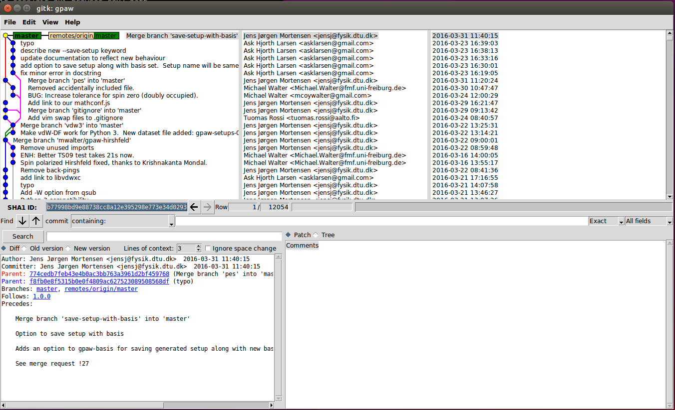
Graphical tools - gitk
gitk - A commit (and repository) viewer
Make tree views of the history

Slide 53
Graphical tools - git gui
Create commits, use blame
https://git-scm.com/docs/git-gui
Works like a git subcommand
  git gui blame myfile
  git gui browser master
  git gui citool - or just git citool

Slide 54
Graphical tools - git cola and gitkraken
git-cola - yet another commit creator
gitkraken - fancy slick gui - non-free
More on:
https://git-scm.com/download/gui/linux

Slide 55
That's it!

