Slide 1
Flight No | Origin | Destination | Date | Time | First Name | Last Name | Seat # | Date of Birth
Schema Definition
First Name
Last Name
Seat #
Date
Flight No
Origin
Destination
Flight No
Origin
Destination
Date
Time
First Name
Last Name
Seat #
Date of Birth
Boarding Pass
Custom Form Recognizer
Driving
License
First Name,
Last Name,
DoB
Face Pic
Built-in Id Recognizer
Emotion
30 Seconds
Video
Video Indexer
Face Pic(s)
Luggage
X-ray
Images
Custom Image/Obj Recognizer
Luggage

Slide 2






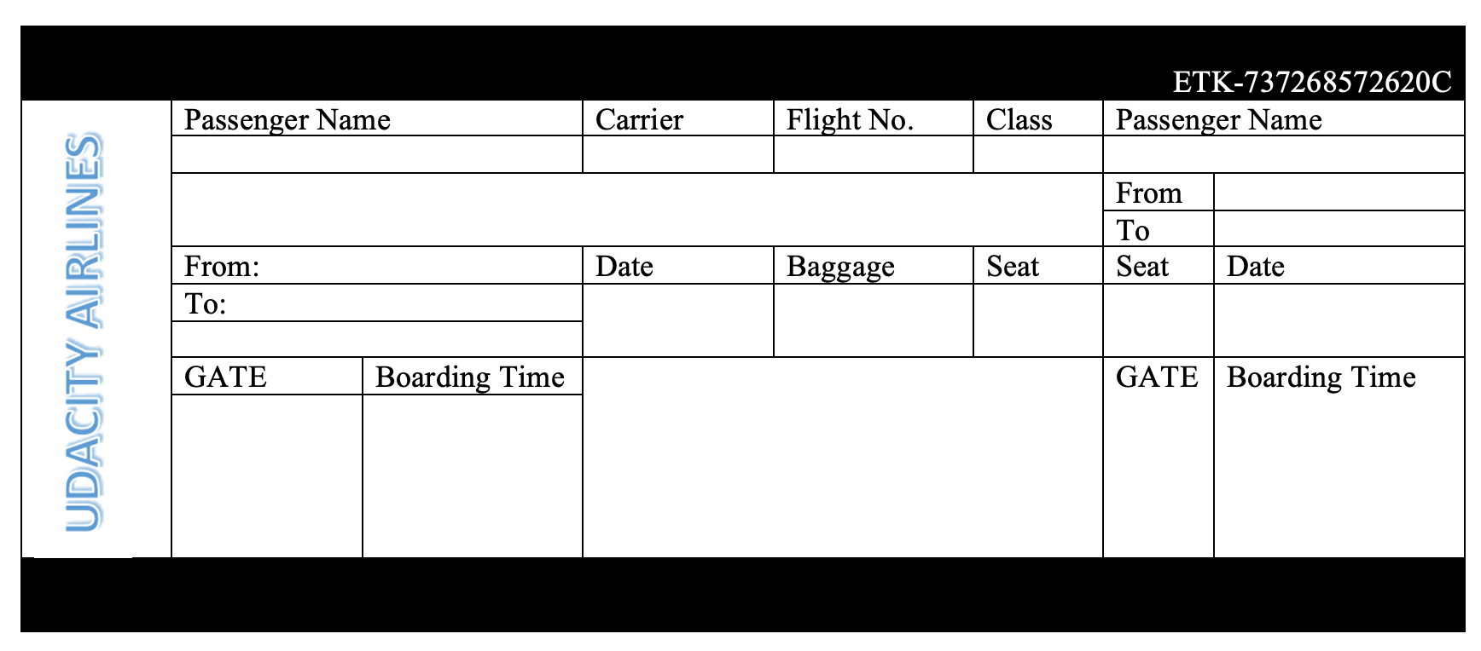
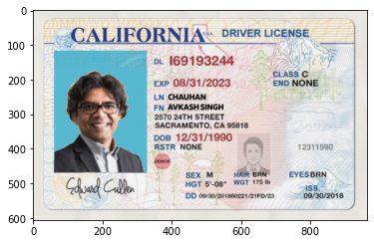
Various Azure Services and Run-time Environment
Azure
Blob
Storage
Storage
API
Kiosk
Dashboard
Azure Cloud
Processing
Engine
Form
Recognizer
Vision
API
Video
Analyzer
Face
API
Runtime: Python
Boarding Pass
Driving
License
Video
Input

Slide 3

Automated Passenger Onboarding Kiosk
Video
Analyzer
Emotion | Sentiment
Video
ID
Recognizer
ID
Name | DoB
Boarding Pass
Digital ID
Custom
Form
Recognizer
Personal Info
Flight Specific Info
Boarding Pass

Slide 4

Automated Passenger Onboarding Kiosk
Video
Analyzer
Emotion | Sentiment
Video
ID
Recognizer
ID
Name | DoB
Boarding Pass
Digital ID
Custom
Form
Recognizer
Personal Info
Flight Specific Info
Boarding Pass

Slide 5
Automated Passenger Onboarding Kiosk - Simulator
Video
Analyzer
Emotion | Sentiment
Video
ID
Recognizer
ID
Name | DoB
Custom
Form
Recognizer
Personal Info
Flight Specific Info
Boarding Pass

Slide 6
Data Collection and Validation Process
Personal Info
Flight Specific Info
First Name
Last Name
Seat #
Date
Flight No
Origin
Destination
Flight Validation
Flight No
Origin
Destination
Date & Time
Seat No
Identity Validation
First and Last Name
Date of Birth
Boarding Experience
Emotion
Sentiment
First Name,
Last Name,
DoB
Face Pic
Name | DoB
Face Pic(s)
Sentiment
Emotion
Emotion | Sentiment

Slide 7

Overall Architecture
Diagram
Azure Blob
Azure Face
Azure Computer
Vision
Azure Form
Recognizer
Azure ML
Studio

Slide 8
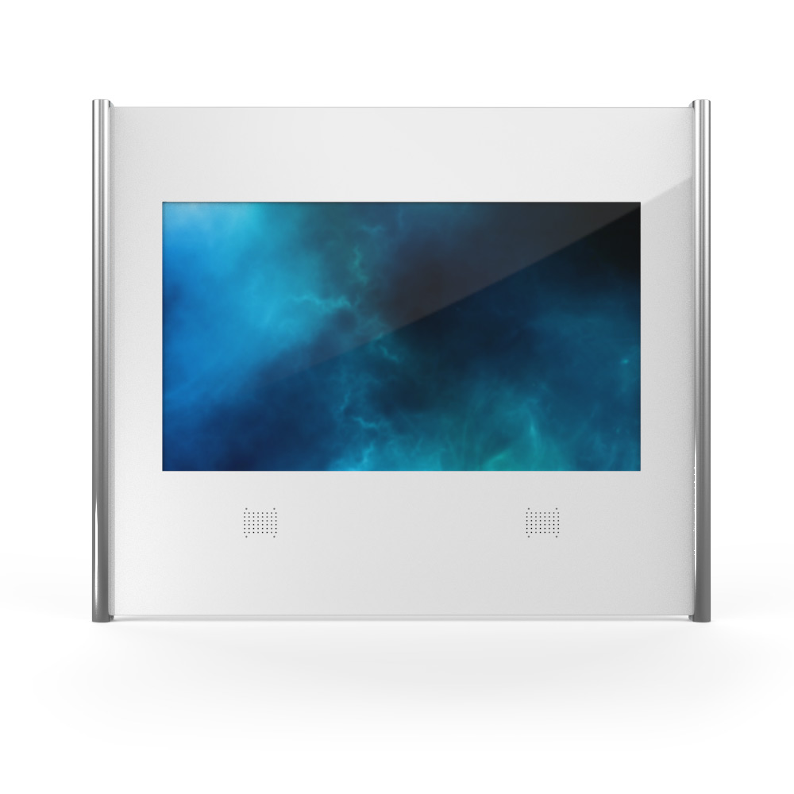
Dear Mr. Avkash Chauhan
You are welcome to flight # A123 leaving at 4:30 PM from San Francisco to Chicago.
Your seat number is A5, and it is confirmed.
We have found a prohibited item into your carry-on baggage, and it is flagged for removed.
Your identity is verified so please board to the plane.

