Slide 1
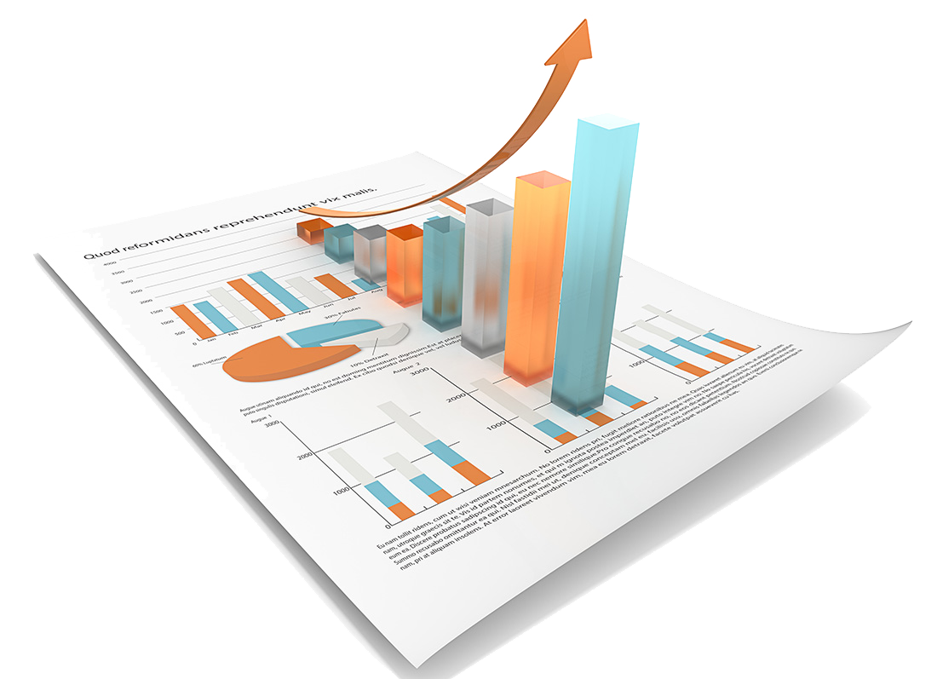
Team name: QuantInvestment
MAFS 5210 INVESTMENT MODELS
PROJECT ONE
MULTIFACTOR BACK TESTING

Slide 2
1
Data Description
2
Factors
Contents
3
Strategy Logic
4
Back Testing Performance

Slide 3
01
1
Data Description

Slide 4
Basic Information
Hang Seng Index
Period: Recent Ten Years’ Monthly Data(2010-Present)
Data Source: Bloomberg (Daily->Monthly)
Universe: The constituents of HIS (About 50)
Columns:
Factors + Dates + Stock Codes +Weight in HIS + Return
“One of the earliest stock market indexes in Hong Kong. Publicly launched on 24 November 1969, the HSI has become the most widely quoted indicator of the performance of the Hong Kong stock market.” –HSI
Data Format: (First three Rows Demo)
DT | TICKERS | WGT | PX | DIVIDEND | LEVERAGE | PRICEMO | RETURNVOL | MCAP | EY | RtnM | GICS
01/27/2017 | 1 HK | 3.311631 | 93.45 | 2.7662 | 0.4646 | -0.87 | 18.746 | 360500 | 9.1565 | 0.06314 | 20105010
01/27/2017 | 101 HK | 0.509954 | 19.2 | 3.9062 | 0.286 | 3.14 | 26.265 | 86353.45 | 7.1611 | 0.167883 | 60102010
01/27/2017 | 1038 HK | 0.543954 | 62.55 | 3.4852 | 0.0934 | NA | 20.171 | 165799.8 | 6.1186 | 0.013776 | 55101010

Slide 5
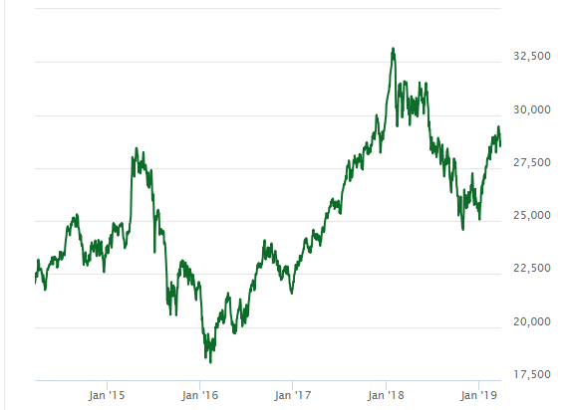
Basic Information
Hang Seng Index
Period: Recent Ten Years’ Monthly Data(2010-Present)
Data Source: Bloomberg (Daily->Monthly)
Universe: The constituents of HIS (About 50)
Columns:
Factors + Dates + Stock Codes +Weight in HIS + Return
“One of the earliest stock market indexes in Hong Kong. Publicly launched on 24 November 1969, the HSI has become the most widely quoted indicator of the performance of the Hong Kong stock market.” –HSI
Data Format: (First three Rows Demo)
DT | TICKERS | WGT | PX | DIVIDEND | LEVERAGE | PRICEMO | RETURNVOL | MCAP | EY | RtnM | GICS
01/27/2017 | 1 HK | 3.311631 | 93.45 | 2.7662 | 0.4646 | -0.87 | 18.746 | 360500 | 9.1565 | 0.06314 | 20105010
01/27/2017 | 101 HK | 0.509954 | 19.2 | 3.9062 | 0.286 | 3.14 | 26.265 | 86353.45 | 7.1611 | 0.167883 | 60102010
01/27/2017 | 1038 HK | 0.543954 | 62.55 | 3.4852 | 0.0934 | NA | 20.171 | 165799.8 | 6.1186 | 0.013776 | 55101010

Slide 6
1
Data Description
Factors | Description | Abbreviation in codes
Close Price | The final price on a given trading day | PX
Dividend Yield | Dividend /Share price | DIV
Leverage | Total Debt/Shareholders’ Equity | LEV
Price Momentum | Technical analysis indicator on price tendency | PMOM
Return Volatility | A statistical measure of the dispersion of returns | RTNVOL
Market Capitalization | Total dollar market value of all of a company’s outstanding shares | MCAP
Earning Yield | Earnings per share /Current market price per share | EY
Return | Monthly return | RTNM
GICS | Global Industry Classification Standard | GICS
Data Sources: Bloomberg

Slide 7
02
2
Factors

Slide 8
2
Factors
Composite Score
Value:
Dividend Yield
Earnings Yield
Quality:
Leverage
Risk:
Size:
Momentum:
Return Volatility
Market Cap
Price Momentum

Slide 9
Why These Factors
Widely used in the many famous models
Believed to be of the most significant factors for different investors
Covered risk, quality, value etc. widely
For Example:
Market Cap: F-F Model
DIV, earnings and Leverage: Value Investment theories
Momentum: Technology Analysis
These factors are the best candidates！

Slide 10
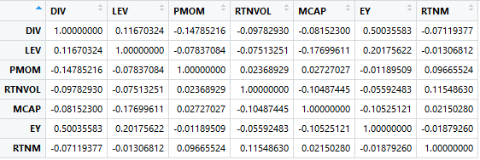
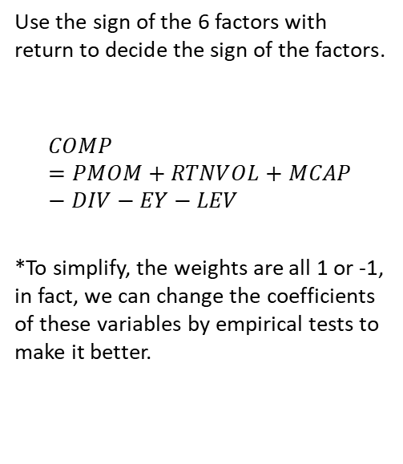
How to Combine
Use the sign of the 6 factors with return to decide the sign of the factors.
$$COMP=PMOM+RTNVOL+MCAP−DIV−EY−LEV$$
*To simplify, the weights are all 1 or -1, in fact, we can change the coefficients of these variables by empirical tests to make it better.

Slide 11

2
Reasons why this factor should work
Dividend yield
Definition
The dividend yield is the ratio of the annual dividend compared to the current share price and is expressed as a percentage.
Reasons
It is known the dividend yield will rise when the share price falls and decline when the share price rises.
High dividend yields can make a stock look quite attractive and can often be a basis in deciding what stocks you would like to invest your money in.
Historical evidence suggests that a focus on dividends may amplify returns rather than slow them down. For example, according to analysts at Hartford Funds, since 1960, more than 82% of the total returns from the S&P 500 are from dividends.

Slide 12
2
Reasons why this factor should work
Earnings yield
Definition
The earnings yield refers to the earnings per share for the most recent 12-month period divided by the current market price per share.
Reasons
Economic theory suggests that investors in equities should demand an extra risk premium of several percentage points above prevailing risk-free rates (such as rates on Treasury bills) in their earnings yield to compensate them for the higher risk of owning stocks over bonds and other asset classes.
Earnings yield is more of a return metric about how much an investment can earn back for investors, rather than a valuation metric about how much the investment is valued in the market by investors.

Slide 13
2
Reasons why this factor should work
Leverage
Definition
Leverage results from using borrowed capital as a funding source when investing to expand the firm's asset base and generate returns on risk capital.
Reasons
The result is to multiply the potential returns from a project. At the same time, leverage will also multiply the potential downside risk in case the investment does not pan out.
Companies can use debt to invest in business operations in an attempt to increase shareholder value.

Slide 14
2
Reasons why this factor should work
Return Volatility
Definition
Return Volatility is a statistical measure of the dispersion of returns for a given security.
Reasons
Investors would like to earn the highest possible return, with the lowest possible risk
However, in investing, there is generally a trade-off between risk and return. That is, the higher the long-term potential return from an investment, the higher the short-term volatility.

Slide 15
2
Reasons why this factor should work
Market Cap
Definition
Market capitalization refers to the total dollar market value of a company's outstanding shares.
Reasons
Using market capitalization to show the size of a company is important because company size is a basic determinant of various characteristics in which investors are interested, including risk.
Investing in large-cap companies does not necessarily bring in huge returns in a short period of time, but over the long run, these companies generally reward investors with a consistent increase in share value and dividend payments.
Mid-cap companies are in the process of expanding.
Small-cap companies are considered higher risk investments due to their age, the markets they serve, and their size.

Slide 16
2
Reasons why this factor should work
Price Momentum
Definition
Stocks that had relatively high returns over the past three to twelve months should return to investors above average returns over the next three to twelve months.
Reasons
This investment strategy was first theorized by Narasimhan Jegadeesh and Sheridan Titman in their publication "Returns to Buying Winners and Selling Losers: Implications for Stock Market Efficiency”.
One of the conclusions from that study is stated below: Buying past winners, and selling past losers, allowed investors to achieve above average returns over the period 1956 to 1989. Particularly, stocks that were classified based on their prior 6-month performance and held for 6 months realized an excess return of over 12% per year on average.

Slide 17
03
3
Strategy Logic

Slide 18
3
Strategy Logic
6 Factors Dividend Yield, Leverage, Price Momentum , Return Volatility, Market Cap, Earning yield,
1 Universe/Benchmark Hang Seng Index Constituents
1 Month Rebalance Frequency Per Month
1 Weighting Scheme Cap-weighted

Slide 19
04
4
Back Testing Performance

Slide 20
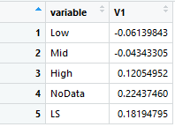
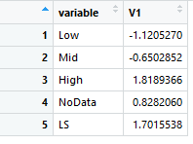
4
Back Testing Performance
Performance stats:
1) Excess return & Risk adjusted return
Ex Rtn:
Rdj Rtn:

Slide 21
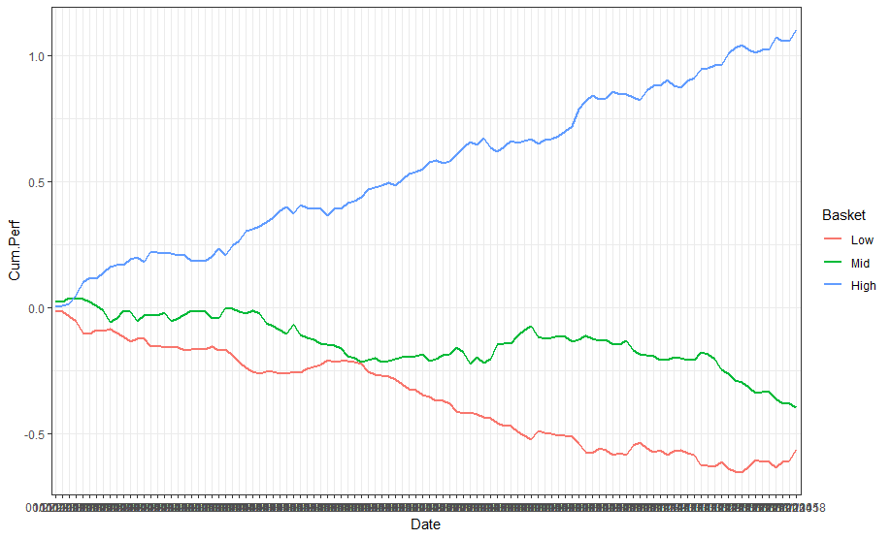
4
Back Testing Performance
2) Performance chart
Wow！

Slide 22
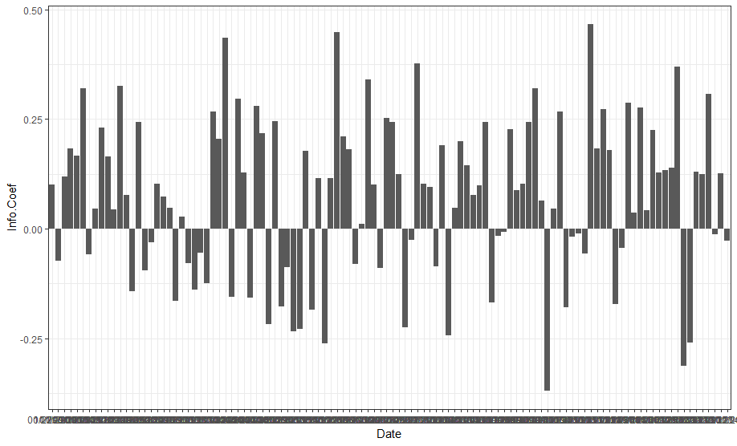
4
Back Testing Performance
3) Information coefficient
More IC bars on the top:
Prediction Power is high.

Slide 23
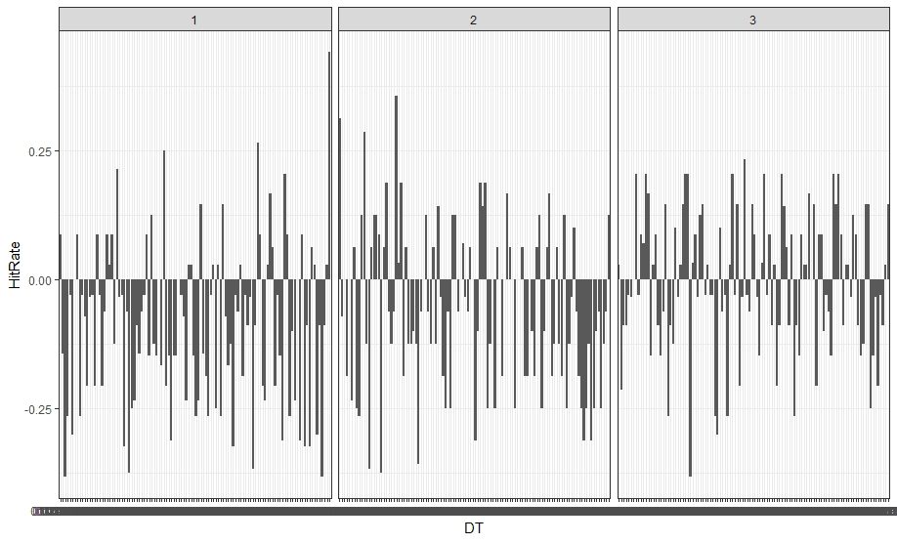
4
Back Testing Performance
4) Hit rate

Slide 24
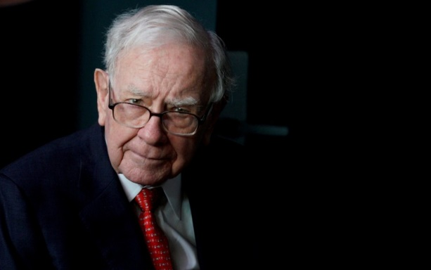
4
Back Testing Performance
5) Turnover
Mean To Long:
0.356503
Mean To Short:
0.4980819
☹The transaction cost
may be a little higher
than the example.

Slide 25

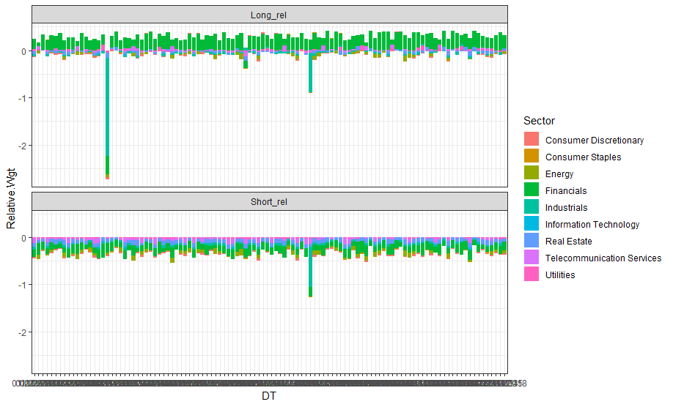
4
Back Testing Performance
6) Sector tilt
We also tried the Sector tilt and
sector neutral technology.
Here is the snap of result.

Slide 26
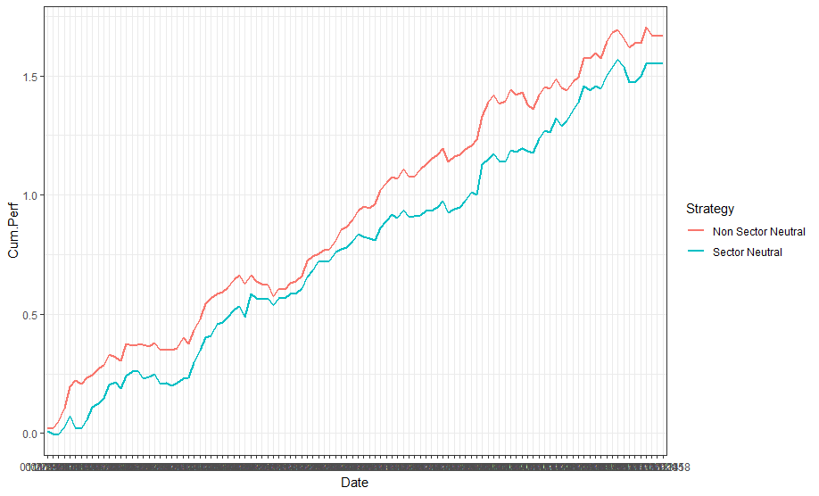
4
Back Testing Performance
Performance: Sector neutral strategy

Slide 27

Something to say~
There are a lot of efforts we took I can not cover here.
There are also a lot of ideas still require justification.
I hope this work matters and will finally lead us somewhere.
A long way to go, and we will keep going for it!

Slide 28
Thanks
Team name: QuantInvestment Date：2019.3.30

