Slide 1
RecallRelay
Evidence-driven recall response
New evidence changes the recall scope.
Verified memory changes the next action.
Daytona HackSprint Singapore
31 October 2026
Functional prototype
Live sponsor services, synthetic order data
01
Notes:
RecallRelay connects incomplete recall evidence to verified operational responses. All supply-chain records and order operations shown in this deck are synthetic. Nosana, Neo4j Aura and Daytona are real live integrations.

Slide 2
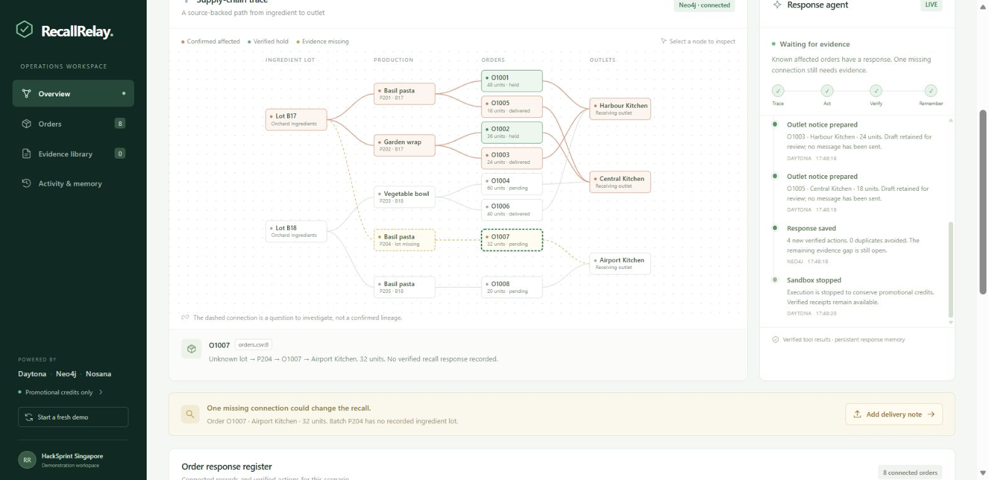
A missing lot number leaves a delivery unresolved
For a central kitchen, one recalled ingredient can affect several products and receiving outlets.
32 units
Airport Kitchen
Batch P204 has no ingredient-lot assignment.
The agent retains the evidence gap.
Singapore MSE highlights the need for swift, precise recalls and traceability records.
02
Notes:
Primary context: Ministry of Sustainability and the Environment, Written Reply to Parliamentary Question on Product Recall & Traceability, 25 February 2026. https://www.mse.gov.sg/latest-news/written-reply-to-parliamentary-question-on-product-recall---traceability-/ . Screenshot: assets/03-evidence-gap.png, captured from the running prototype on 31 October 2026. Fictional records: fixtures/production.csv and fixtures/orders.csv.

Slide 3
New evidence changes the affected network
Delivery note DN-003 confirms that batch P204 used recalled lot B17.
Observed demo result | Initial trace | After evidence
Confirmed affected orders | 4 | 5
Units on verified hold | 84 | 116
Unresolved lot connections | 1 | 0
One additional 32-unit hold. Four previously verified actions reused.
03
Notes:
Measured demonstration results: assets/demo-results.json. Evidence fixture: fixtures/delivery-note-DN-003.txt. Initial held quantities are 48+36=84 units. New evidence adds order O1007 with 32 units, giving 116 held units. Another 42 affected units were already delivered and receive two notice drafts.

Slide 4
Three live services with distinct roles
Service | Role in the agent loop | Inspectable output
Nosana | Interprets the source notice and delivery note | Structured identifiers checked against the source
Neo4j Aura | Traces relationships and retains response memory | Connected lot, batch, order and outlet paths
Daytona | Executes actions in an isolated synthetic order ledger | Read-back receipts confirm shipment holds
The bounded action policy uses graph context and verified history.
04
Notes:
Implemented service clients and verification: integrations.mjs. Source interpretation: interpret(). Relationship traversal: traceGraph(). Evidence writes: connectEvidence(). Durable action memory: loadMemory() and remember(). Isolated execution and read-back: sandboxActions(). The model does not generate executable code or arbitrary Cypher.

Slide 5
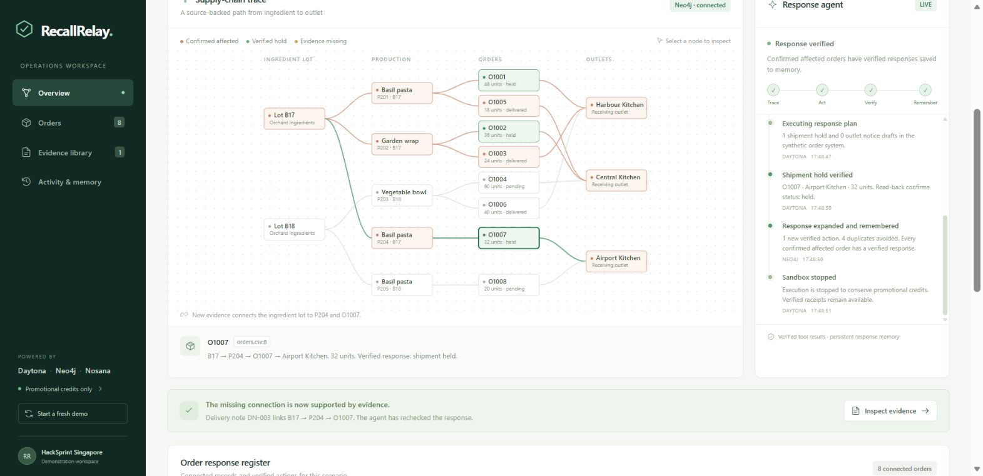
The new connection triggers only the additional action
32
additional units
on verified hold
4 earlier actions
reused from memory
The new source connects B17 to P204, then to order O1007 and Airport Kitchen.
05
Notes:
Actual screenshot: assets/05-expanded-response.png. New evidence establishes the B17/P204 relationship in Neo4j. Daytona verifies the additional O1007 hold. The agent reuses the four existing verified actions. Screenshot depicts synthetic supply-chain records and simulated order operations.

Slide 6
Verified results and a repeat run with no duplicates
5.8s
0
to the first verified hold
new actions on the repeat run
Final observed result | Value
Units on verified hold | 116
Notice drafts for delivered orders | 2
Domain tests passed | 7
One fresh synthetic run. Service and network timing varies. No commercial time-saving claim.
06
Notes:
Measured data: assets/demo-results.json. Fresh run started 2026-10-31T09:48:12.489Z. First verified shipment hold at 5.768 seconds, shown rounded to 5.8 seconds. Completed response and sandbox stop at 8.097 seconds. Repeat run reuses all five verified actions. Test command: node --test tests/domain.test.mjs. Timing is one observation, not a benchmark against manual work.

Slide 7
A pilot for central kitchens and food distributors
Working today
Next pilot
Source inspection and connected recall scope
Verified shipment holds and notice drafts
Persistent response memory and evidence export
Connect actual production and delivery records
Resolve ambiguous evidence with an operator
Validate against a known recall case
Every verified response retains its source evidence.
07
Notes:
Product status: Functional Prototype. The next-pilot items are proposed work, not completed integrations or customer commitments. All current order changes are simulated, notices remain drafts, and all records are fictional. The prototype does not claim production regulatory compliance.

