Slide 1
HRP Method of Diversified Portfolios Building
Zehao Dong, Xinyu Guo, Run Qiao,
Peicheng Wang, Yukang Zhou
2019-12-08

Slide 2
Outline
Portfolio Construction
-- Risk Parity Method
-- Markowitz’s Effective Frontier
-- Hierarchical Risk Parity(HRP) Method
Evaluation of Portfolios
-- Expected Return
-- Volatility
-- Sharpe Ratio
-- Out-of-sample P&L
Notes:
For decades, building profitable portfolios has plagued investment managers. Many methods have been used so far, the most famous of which are Markowitz's efficient frontier and risk parity.
The portfolio optimization machine framework suggests how academic theories about the relationship between risk and return explain the problems we observe in real life. Although scholars have convinced investors that higher-risk investments should produce higher returns, we have not generally observed this relationship.

Slide 3
Risk Parity
Risk parity is a portfolio allocation strategy using risk to determine allocations across various components of an investment portfolio.
Notes:
Risk parity is a conceptual approach to investing which attempts to provide a lower risk and lower fee alternative to the traditional portfolio allocation.
The risk parity approach attempts to equalize risk by allocating funds to a wider range of categories such as stocks, government bonds, credit-related securities and inflation hedges.

Slide 4

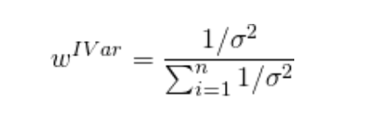
Inverse Variance Portfolio (IVP)
The weight of each random variable is inversely proportional to its variance.

Slide 5
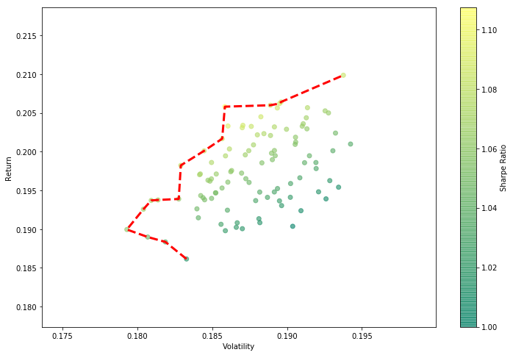
Revisit of Markowitz: Mean-Variance analysis
Simulation of Diversified Portfolios
100 randomly generated portfolios
Notes:
So firstly we should revisit the traditional methods of Markowitz. We want to try the simulation methods to generated randomly diversified portfolio. I generate weights on a uniform distribution, then rescale it so that the weights add up tp 1, then shows these portfolios in their volatility and returns, in the traditional Mean Variance analysis way.

Slide 6
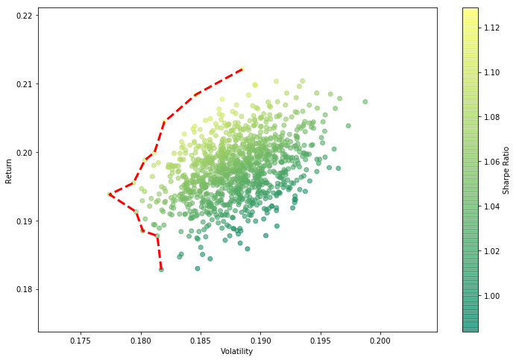
Revisit of Markowitz: Mean-Variance analysis
Simulation of Diversified Portfolios
1,000 randomly generated portfolios
Notes:
Now we enlarge the simulation times of our portfolios generating, as you can see as the points get more and more, gradually we can the scatter points forms a certain shape

Slide 7
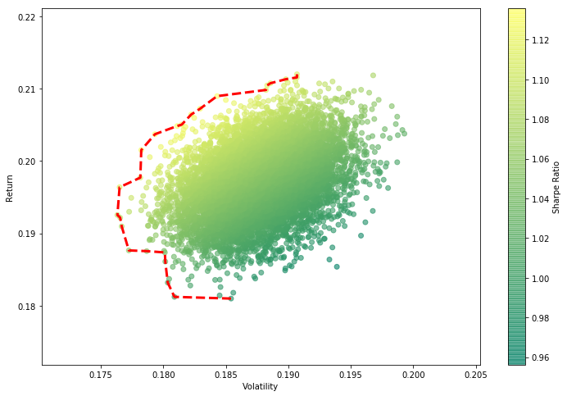
Revisit of Markowitz: Mean-Variance analysis
Simulation of Diversified Portfolios
10,000 randomly generated portfolios

Slide 8
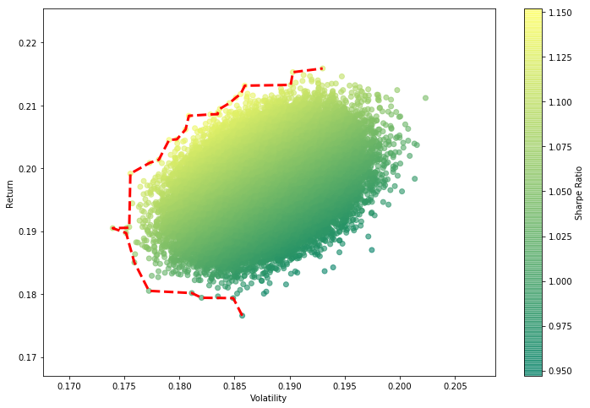
Revisit of Markowitz: Mean-Variance analysis
Simulation of Diversified Portfolios
100,000 randomly generated portfolios
Notes:
By plotting the left bound of the portfolios, we can get the Markowitz effective frontier by our simulation, it means the minimum variance we can achieved given a certain level of return.

Slide 9
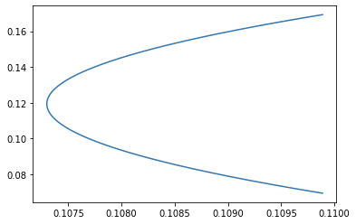
Revisit of Markowitz: Mean-Variance analysis
Effective Frontier
(without long constraint)
Simulation of Diversified Portfolios

Slide 10
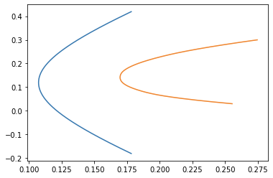
Revisit of Markowitz: Mean-Variance analysis
Effective Frontier
(with long constraint)
Simulation of Diversified Portfolios

Slide 11
Revisit of Markowitz: Mean-Variance analysis
Pros
Increased efficiency than simulation
Exact solution
Deriving the frontier of all possible portfolios
Cons
Reliance on the invertibility of covariance matrix
- The inversion is prone to large errors when the covariance matrix is numerically ill-conditioned.
- The more correlated the investments, the greater the need for diversification, but the inverse matrix is more unstable, then more likely we will receive unstable solutions

Slide 12
Revisit of Markowitz: Mean-Variance analysis
Pros
Increased efficiency than simulation
Exact solution
Deriving the frontier of all possible portfolios
So we need a method that can avoid the inversion of covariance matrix!
Cons
Reliance on the invertibility of covariance matrix
- The inversion is prone to large errors when the covariance matrix is numerically ill-conditioned.
Notes:
- The more correlated the investments, the greater the need for diversification, but the inverse matrix is more unstable, then more likely we will receive unstable solutions

Slide 13
Hierarchical Risk Parity(HRP) Method
Stage 1: Tree Clustering
Stage 2: Quasi-Diagonalization
Stage 3: Recursive-Bisection

Slide 14
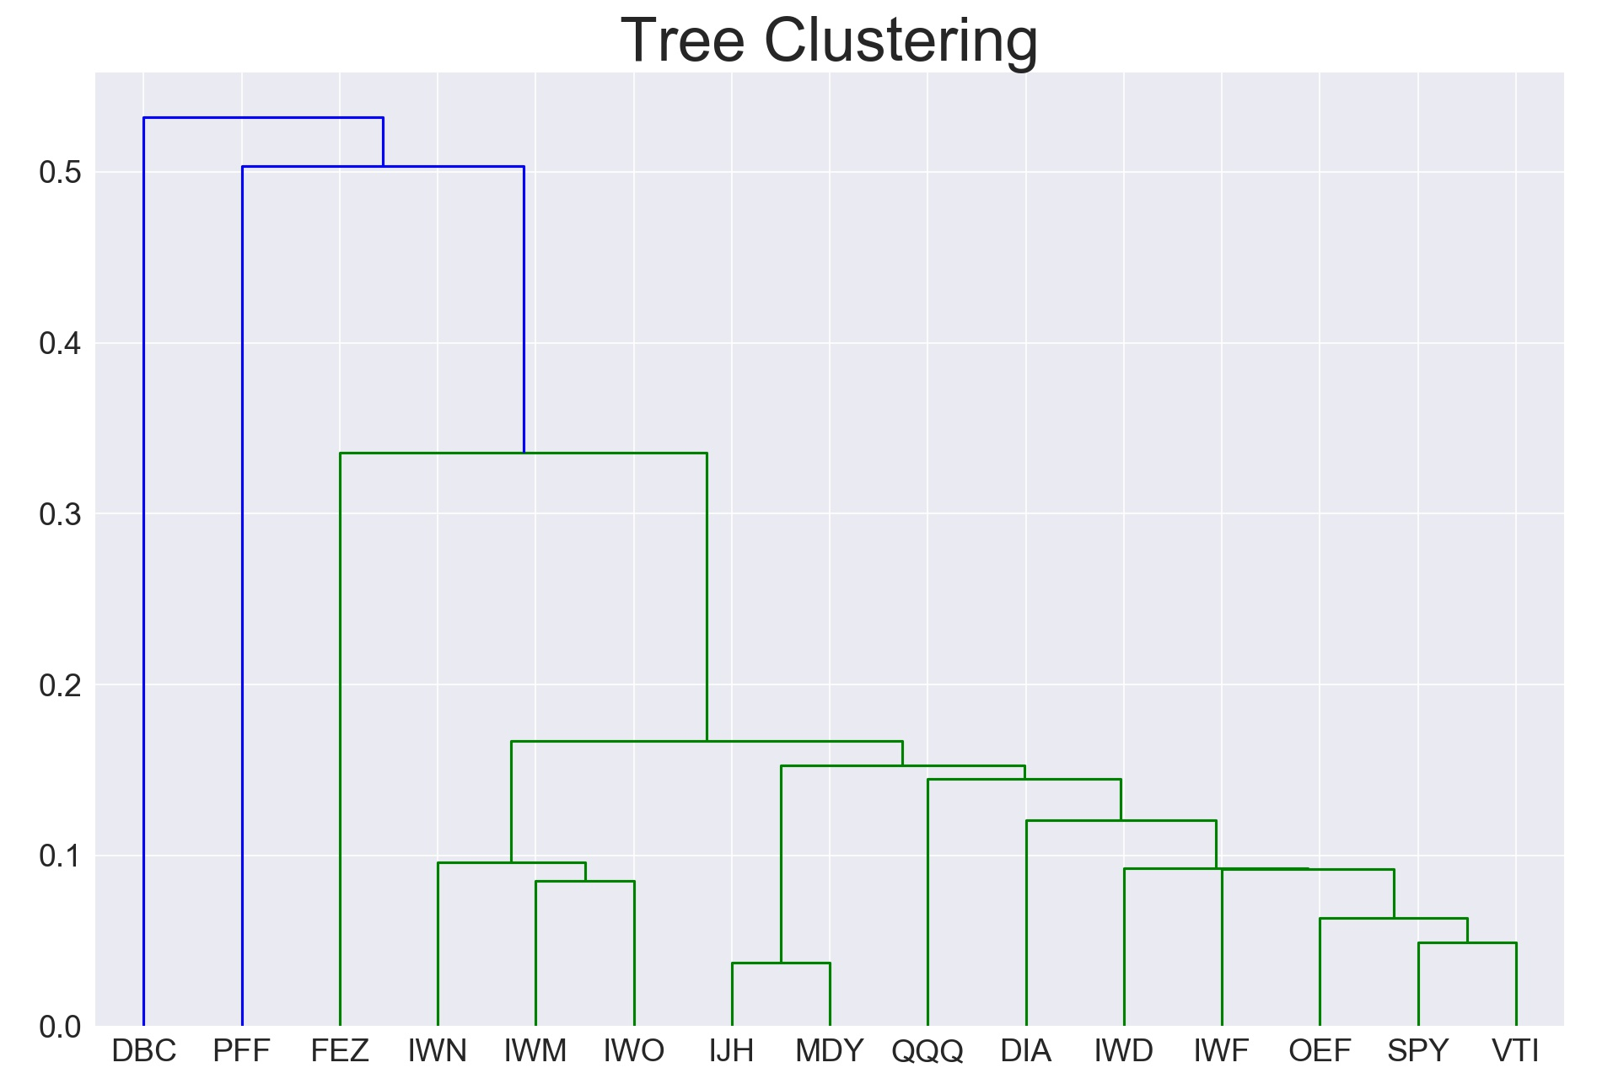
Stage 1: Tree Clustering
1
Distance
Group similar investments into clusters.
Greater correlation means Shorter distance
Hierarchical structure:
more stable
more feasible
more intuitive

Slide 15
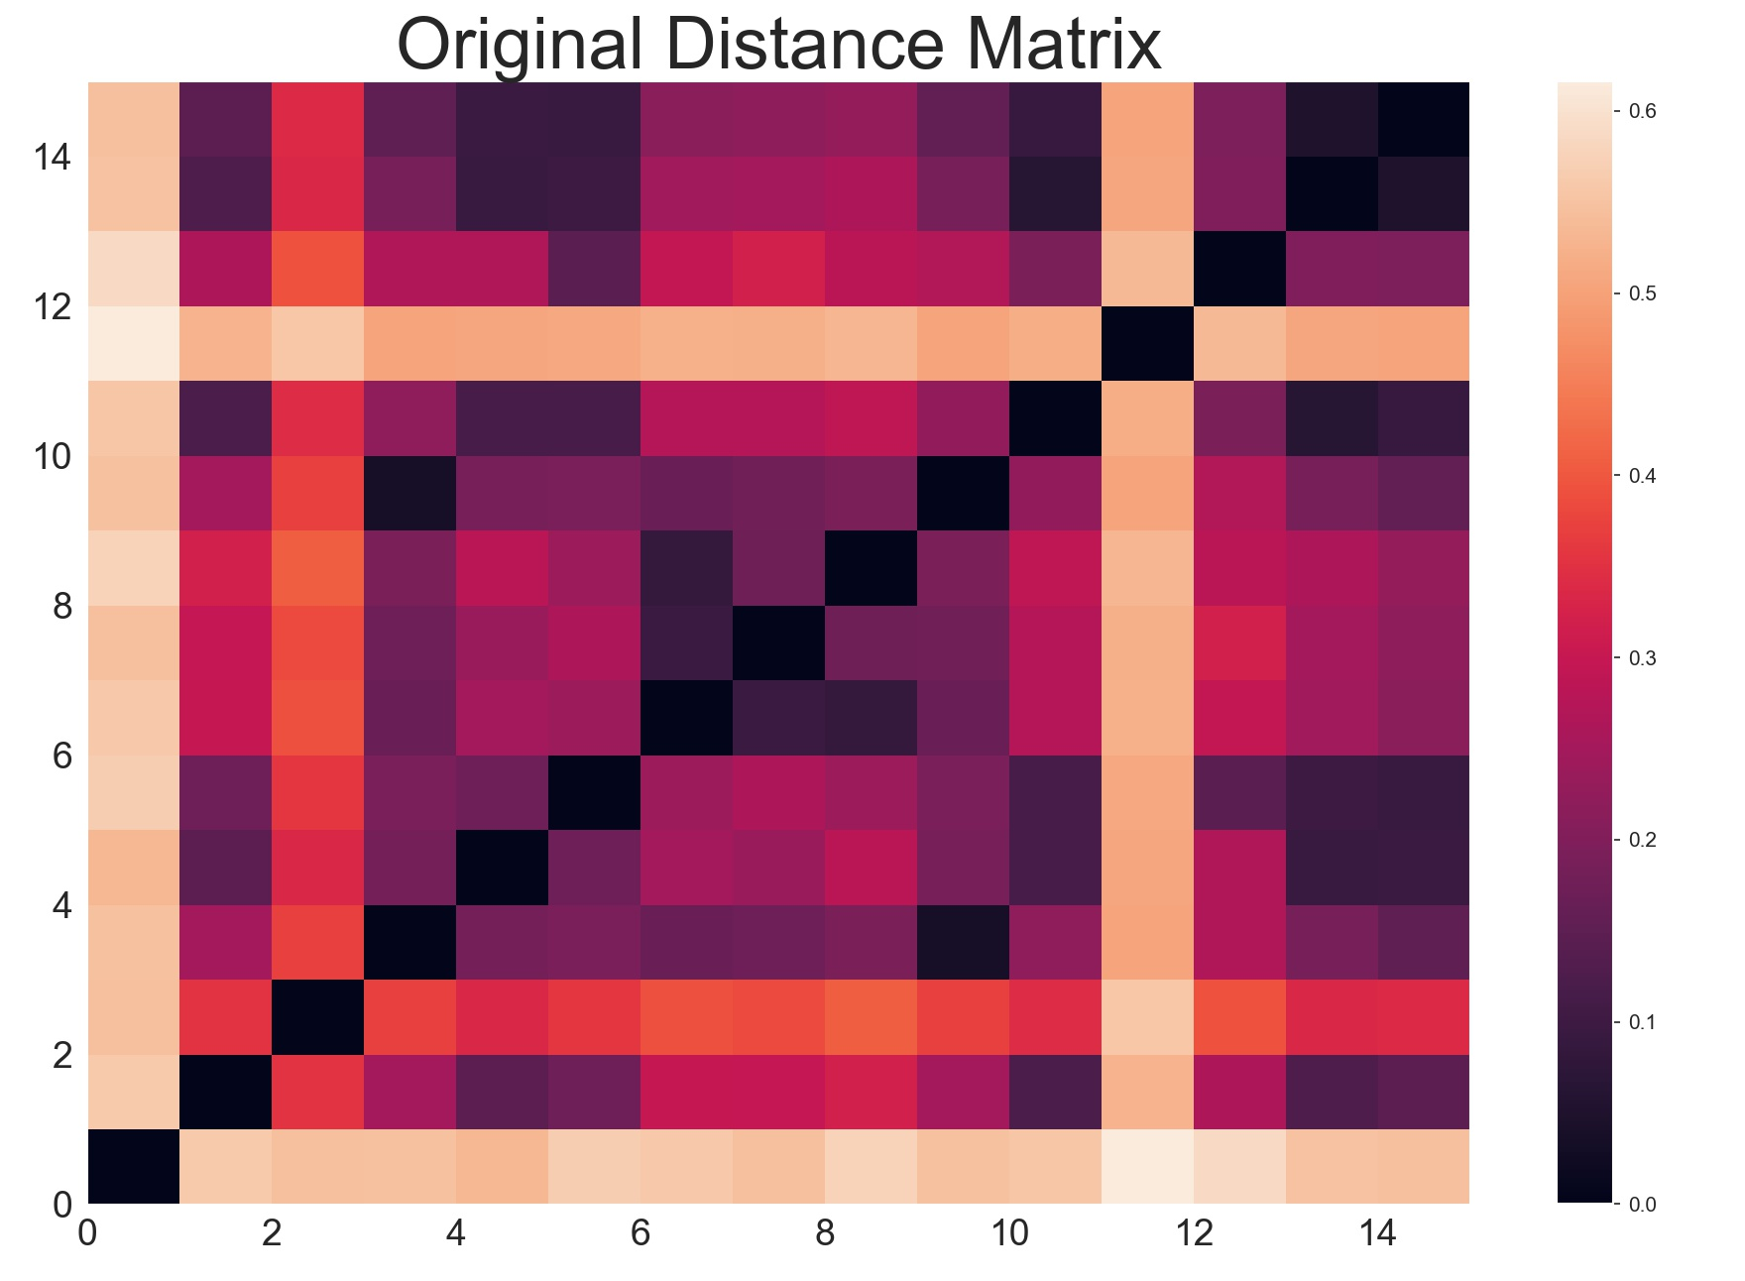
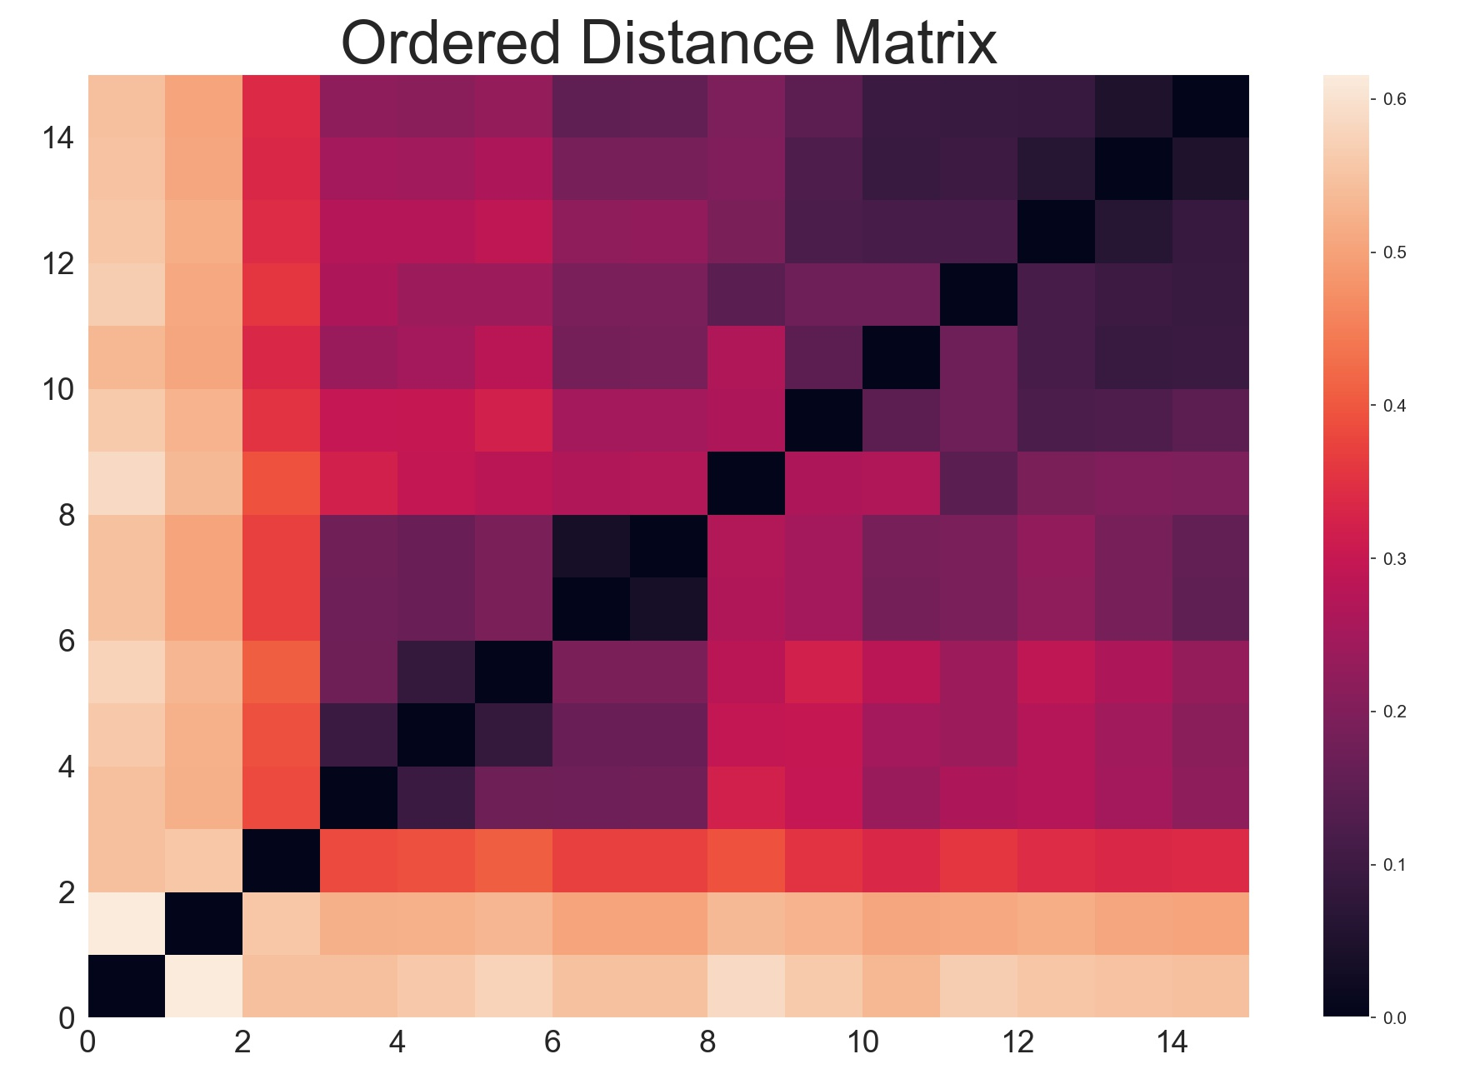
Stage 2: Quasi-Diagonalization
2
Reorganize the covariance matrix so similar investments will be placed together.
This matrix diagonalization allow us to distribute weights optimally following an inverse-variance allocation.

Slide 16
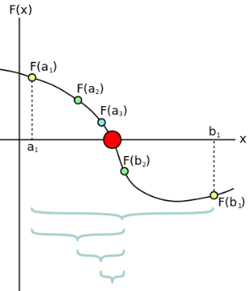
Stage 3: Recursive-Bisection
3
Distribute the allocation through recursive bisection based on cluster covariance.
The bisection method is a root-finding method that applies to any continuous functions for which one knows two values with opposite signs.

Slide 17
The pros and cons of HPR method
1
Pros
No requirement on the inversion of covariance
More stable asset allocation
Lower rebalance costs
More efficient algorithm
Cons
Exclude the short position of portfolio

Slide 18
In sample Test:
Testing period: 2012/01/01 - 2016/01/01
Testing data source: ETF

Slide 19
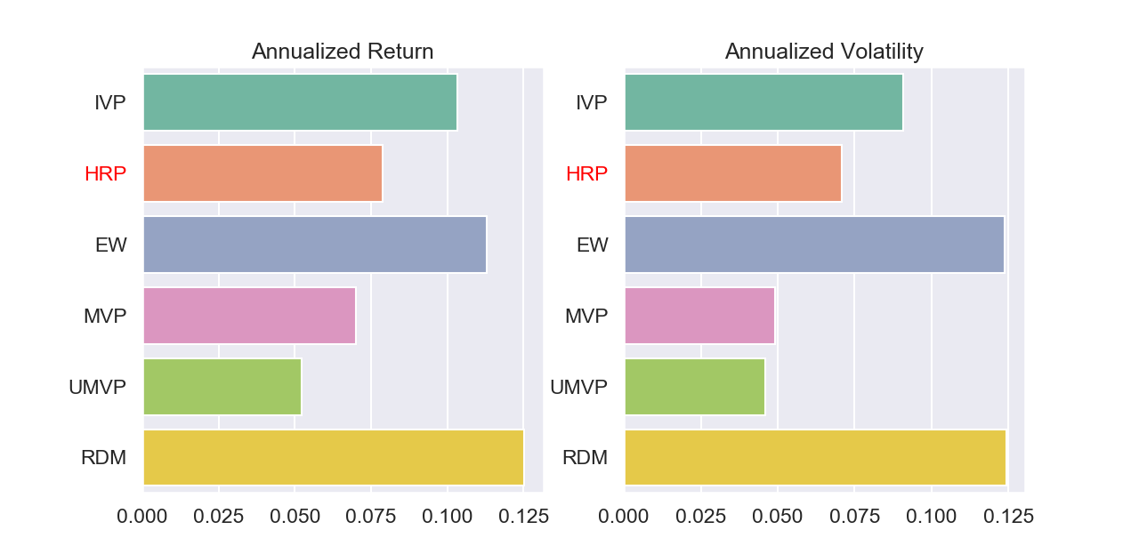
In-sample results: Annualized Return & Annualized Volatility

Slide 20
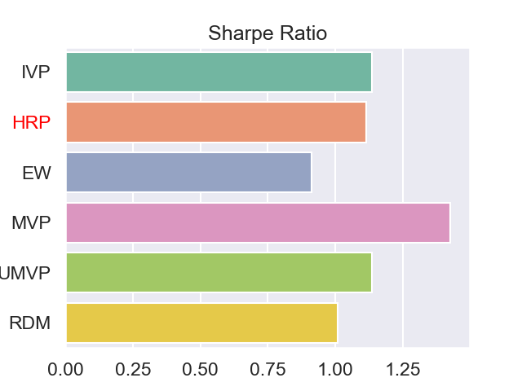
In-sample results: Sharpe Ratio

Slide 21
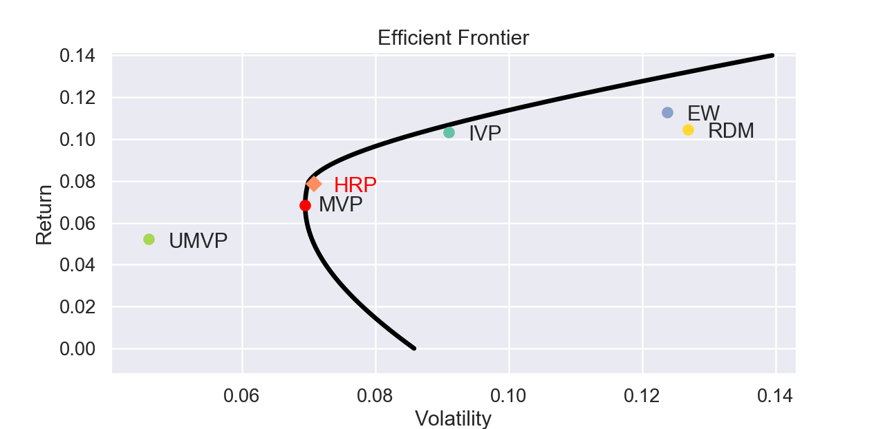
In-sample results: Efficient Frontier

Slide 22
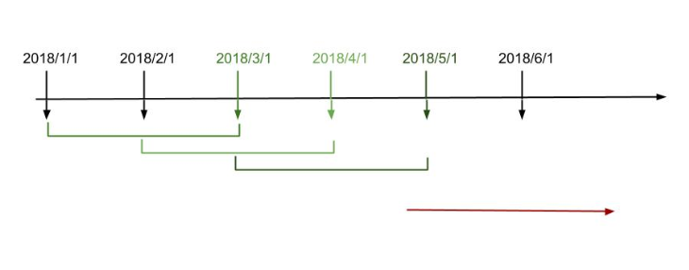
Out-of-sample Test:
Testing period: 2012/4/30 - 2019/01/01
Testing data source: ETF

Slide 23
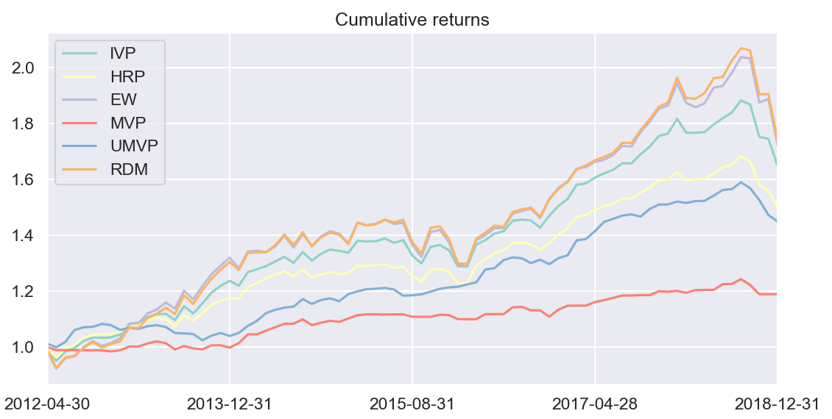
Out-of-sample Test:

Slide 24
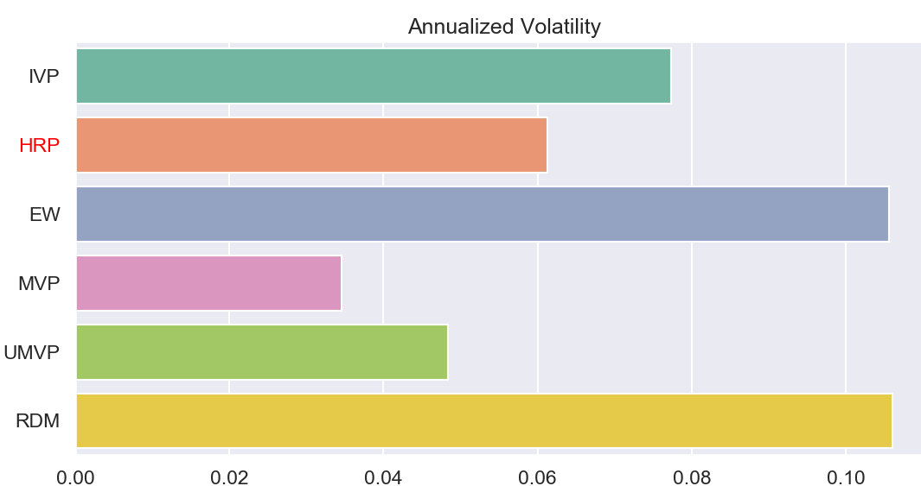
Out-of-sample Test:
Starting period: 2011/1/1 - 2019/12/06
We rebalance our portfolio every month, based on the latest HRP model trained from the last 60 trading days.

Slide 25
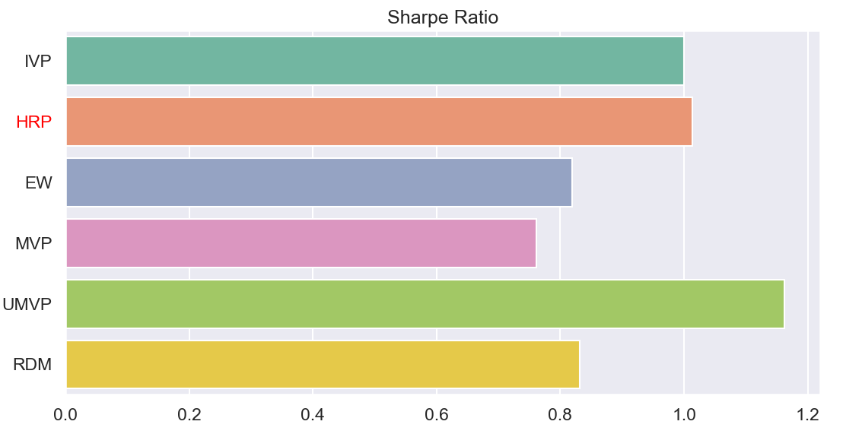
Out-of-sample Test:
Starting period: 2011/1/1 - 2019/12/06
We rebalance our portfolio every month, based on the latest HRP model trained from the last 60 trading days.

Slide 26
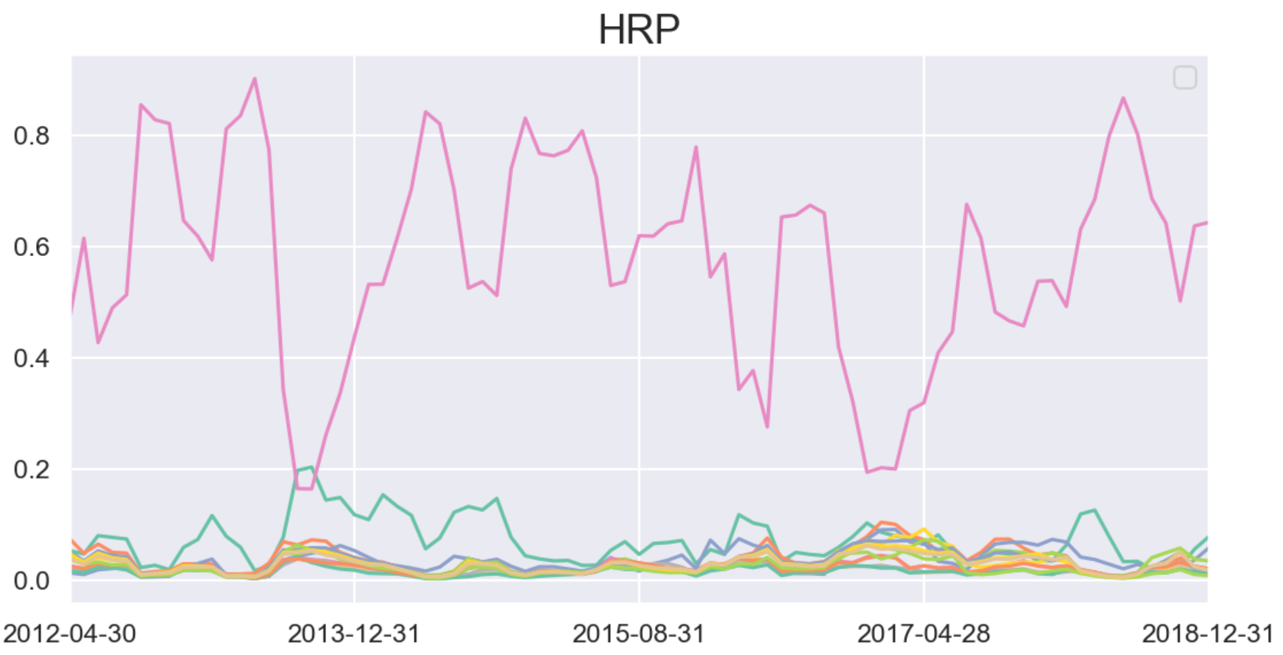
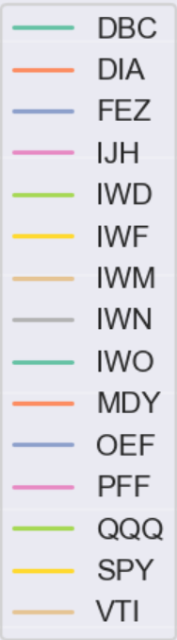
Out-of-sample Test: Weights Change

Slide 27
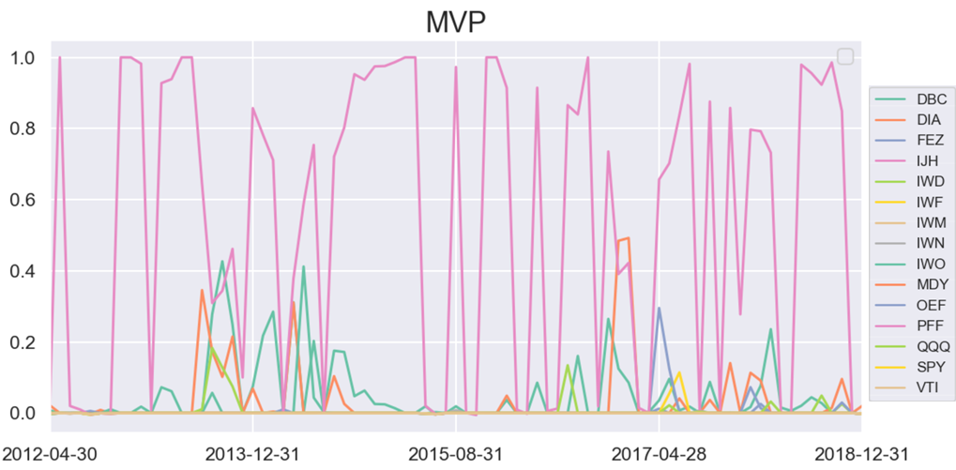
Out-of-sample Test: Weights Change

Slide 28
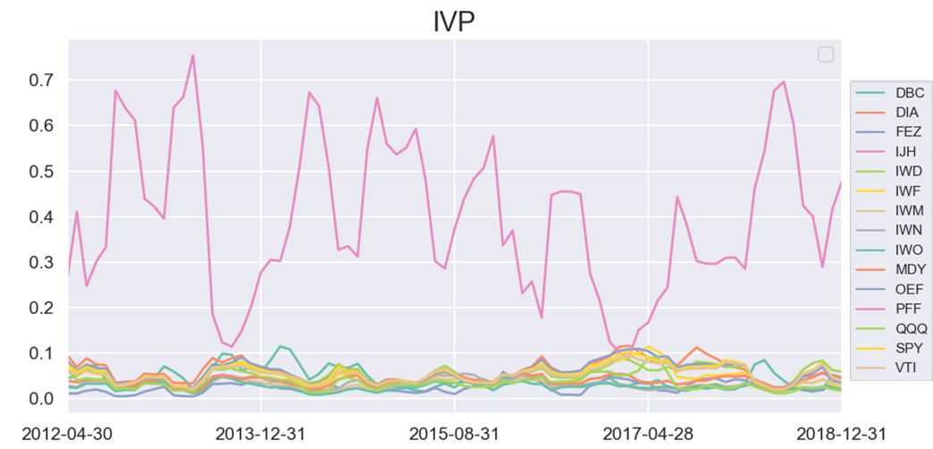
Out-of-sample Test: Weights Change

Slide 29
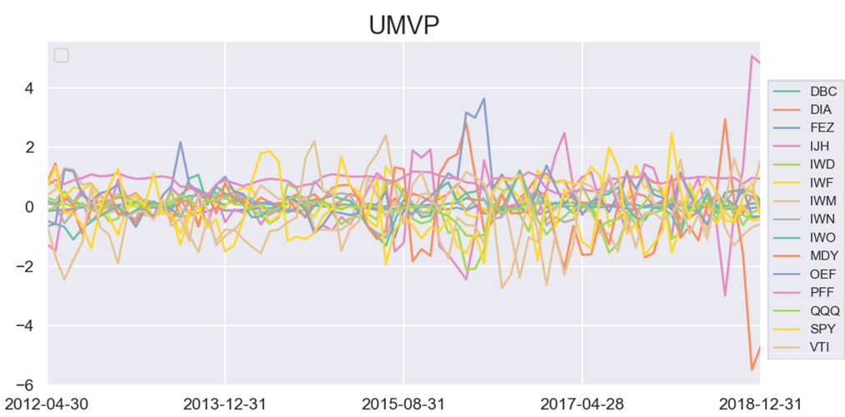
Out-of-sample Test: Weights Change

Slide 30
Summary
HRP method provides a more stable and efficient algorithm on portfolio construction
HRP performs worse than MVP in-sample.
HRP performs much better than MVP and most of other methods out-of-sample.
Although UMVP performs very well both in-sample and out-of-sample, it requires frequent rebalance and extremely high leverage

Slide 32
Index
Data source
Backtesting Detail

Slide 33
Data Source
Symbol | Underlying Index
PFF | CE Exchange-Listed Preferred & Hybrid Securities Index
DIA | Dow Jones Index
FEZ | EURO STOXX 50 Index
IJH | S&P MidCap 400 Index
IWD | Russell 1000 Value Index
IWO | Russell 2000 Growth Index
IWF | Russell 1000 Growth Index
IWM | Russell 2000 Index
IWN | Russell 2000 Value Index
MDY | S&P 400 MidCap 400 Index
OEF | S&P 100 Index
QQQ | NASDAQ-100 Index
VTI | CRSP US Total Market Index
SPY | S&P 500 Index
Back

