Slide 1









Technology for Teaching and Learning 1
Innovative Technologies for Assessment Tasks in Teaching and Learning
C.1 USE OF
ePORTFOLIO
PRESENTED BY : Juliana Deloso

Slide 2
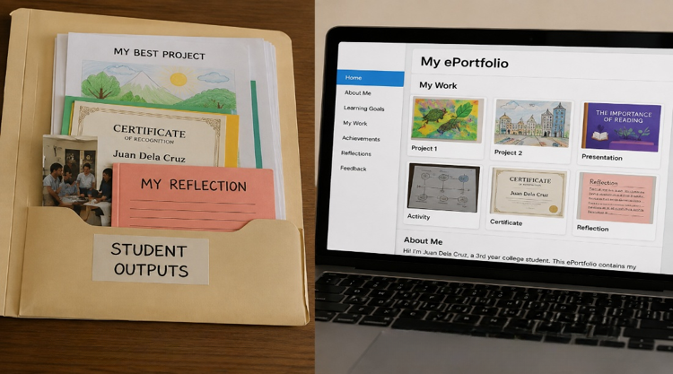
WHAT’S
INSIDE??

Slide 3

LEARNING OBJECTIVES
AT THE END OF THE LESSON, LEARNERS WILL BE ABLE TO:
  DEFINE AND DESCRIBE EPORTFOLIO AND EXPLAIN ITS PURPOSE IN ASSESSMENT.
  IDENTIFY THE ESSENTIAL COMPONENTS AND FEATURES OF AN EPORTFOLIO.
  EXPLAIN THE IMPORTANCE OF EPORTFOLIO IN DOCUMENTING LEARNING PROGRESS.
  DIFFERENTIATE TRADITIONAL PORTFOLIOS FROM EPORTFOLIOS.
  IDENTIFY THE ADVANTAGES AND CHALLENGES OF USING EPORTFOLIO.
  CREATE A SIMPLE EPORTFOLIO USING AN APPROPRIATE DIGITAL PLATFORM.

Slide 4
WHAT IS AN
ePORTFOLIO
ePortfolio or electronic portfolio is a digital collection of a learner’s:
It provides evidence of a learner’s progress and learning.
  Learning outputs
  Achievements
  Experiences
  Reflections
Unlike a traditional portfolio, an ePortfolio is created, stored, organized, and presented using digital technology.

Slide 5


PURPOSE OF AN
ePORTFOLIO
An ePortfolio is used to:
Document learning progress
Encourage self-assessment and reflection
Showcase achievements and competencies
Provide opportunities for feedback
Provide evidence of learning
Promote learner ownership of learning
Monitor learner development

Slide 6
CHARACTERISTICS
AND FEATURES
An ePortfolio:
  Uses digital technology
  Organizes learning evidence
  Shows progress over time
  Allows learners to showcase achievements
  Includes reflections and feedback
  Can be updated and accessed using appropriate digital devices

Slide 7
COMPONENTS OF AN
ePORTFOLIO
An effective ePortfolio may contain:
  Learner Profile/Introduction
  Learning Goals
  Learning Outputs
  Projects and Activities
  Achievements/Certificates
  Multimedia Evidence
  Feedback
  Personal Reflection

Slide 8

COMPONENTS OF AN
ePORTFOLIO

Slide 9
COMPONENTS OF AN
ePORTFOLIO
Identify the different materials that can be included in an ePortfolio. GIVE at least five (5) examples.
QUESTIONS
1. Why are these materials important to include in an ePortfolio?
2. How can these materials show your learning, achievements, and progress?

Slide 10
1. LEARNER PROFILE &
LEARNING GOALS
Learner Profile/Introduction
Learning Goals Describes what the learner wants to:
  Learn
  Improve
  Achieve
Contains basic information about the learner.

Slide 11
2. LEARNING OUTPUTS &
PROJECTS
Learning Outputs
Projects and Activities
  Assignments
  Projects
  Presentations
  Activities
  Other learning works
Show the learner’s participation and completed learning experiences.

Slide 12
3. ACHIEVEMENTS &
MULTIMEDIA EVIDENCE
Achievements/Certificates
Multimedia Evidence
  Certificates
  Awards
  Recognitions
  Accomplishments
  Photographs
  Videos
  Presentations
  Other digital materials

Slide 13
4. FEEDBACK &
REFLECTION
FEEDBACK
REFLECTION
Includes comments or evaluations from:
  Teachers
  Peers
Learners discuss:
  What they learned
  Challenges they encountered
  Areas for improvement

Slide 14
EPORTFOLIO AS AN
ASSESSMENT TOOL
An ePortfolio is not simply a place to store school works.
It can also be used as an assessment tool.
Teachers can examine:
  Learning outputs
  Learning progress
  Skills
  Competencies
  Reflections
This allows teachers to see what the learner produced, how the learner improved, and what the learner learned.

Slide 15
WHY USE ePORTFOLIO
FOR ASSESSMENT?
An ePortfolio helps teachers:
  Evaluate learning evidence
  Monitor progress
  Identify skills and competencies
  Review learner outputs
  Understand learners’ reflections
  Observe improvement over time

Slide 16
ADVANTAGES OF
ePORTFOLIO
1. Easy to Organize
Learning materials can be stored in one digital location.
2. Accessible
Materials can be accessed using appropriate digital devices.
3. Shows Progress
Learners can compare previous and current work.
4. Encourages Reflection
Students can think about their learning experiences.

Slide 17
MORE ADVANTAGES OF
ePORTFOLIO
5. Demonstrates Skills
Learners can showcase their abilities and accomplishments.
6. Supports Digital Learning
It develops learners’ ability to use technology responsibly.
7. Provides Evidence for Assessment
Teachers can use collected outputs and reflections to evaluate learning.

Slide 18
CHALLENGES OF USING
ePORTFOLIO
Possible challenges include:
  Limited access to devices or internet
  Lack of digital skills
  Difficulty organizing large amounts of information
  Time required to create and maintain the portfolio
  Privacy and security concerns
  Technical problems

Slide 19
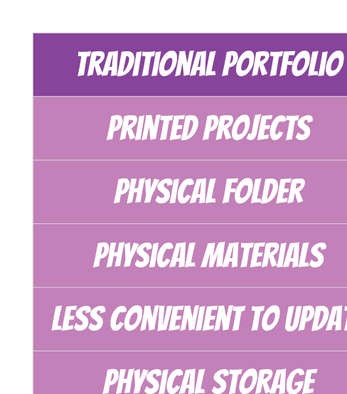
TRADITIONAL PORTFOLIO VS
ePORTFOLIO
An ePortfolio uses digital technology to create, organize, store, and present learning evidence.

Slide 20
ACTIVITY 1:
“TRADITIONAL OR ELECTRONIC?”
Instructions:
Identify whether each situation describes a Traditional Portfolio or an ePortfolio.
  A student keeps printed projects inside a folder.
  A student uploads projects, videos, and reflections to a digital platform.
  A teacher reviews printed artwork collected by a student.
  A student creates a digital collection of certificates and achievements.
  A learner uploads a reflection about a completed project.

Slide 21

ACTIVITY 1: ANSWERS
  Traditional Portfolio
  ePortfolio
  Traditional Portfolio
  ePortfolio
  ePortfolio

Slide 22
ACTIVITY 2:
BUILD MY MINI ePORTFOLIO
Objective:
Apply your understanding of ePortfolio by organizing selected learning evidence digitally.
You may use:
  PowerPoint
  Canva
  Google Slides
  Another available digital platform

Slide 23
ACTIVITY 2:
BUILD MY MINI ePORTFOLIO
PAGE 1 — PROFILE
Include:
  Name
  Course/Year
  Short Introduction
PAGE 2 — LEARNING GOALS
Answer:
What do you want to learn or improve?

Slide 24
ACTIVITY 2:
BUILD MY MINI ePORTFOLIO
PAGE 3 — MY BEST OUTPUT
Include:
  Title of output
  Picture or copy of the work
  Short description
PAGE 4 — MY ACHIEVEMENT
Include:
  Certificate
  Award
  Project
  Accomplishment

Slide 25
ACTIVITY 2:
BUILD MY MINI ePORTFOLIO
PAGE 5 — MY REFLECTION
Answer:
“What did I learn from the outputs I included in my ePortfolio, and how have I improved?”

Slide 26
PRESENTATION OF
OUTPUT
Selected learners will present their Mini ePortfolio.
During the presentation, explain:
  Why you selected your outputs
  What your outputs show about your learning progress
  What you learned from your experiences
Other learners will listen and provide constructive feedback.

Slide 27
GENERALIZATION
What is an ePortfolio?
A digital collection of learning outputs, achievements, experiences, and reflections.
What is its purpose?
It documents learning, shows progress, provides evidence, and encourages reflection.

Slide 28
GENERALIZATION
What can be included in an ePortfolio?
  Projects
  Assignments
  Pictures
  Videos
  Certificates
  Presentations
  Feedback
  Reflections
How can teachers use an ePortfolio for assessment?
Teachers can evaluate the learner’s outputs, progress, skills, and reflections.

Slide 29
CHECK YOUR UNDERSTANDING
1. What does ePortfolio mean?
A. Electronic examination
B. Electronic portfolio
C. Educational program
D. Electronic presentation

Slide 30
CHECK YOUR UNDERSTANDING
2. Which is an example of an ePortfolio material?
A. Digital project
B. School uniform
C. Classroom chair
D. School building

Slide 31
CHECK YOUR UNDERSTANDING
3. Which component allows learners to discuss what they learned from an activity?
A. Profile
B. Reflection
C. Title page
D. Attendance

Slide 32
CHECK YOUR UNDERSTANDING
4. Which is an important purpose of an ePortfolio?
A. To hide learning outputs
B. To document learning progress
C. To replace all classroom activities
D. To eliminate assessment

Slide 33
CHECK YOUR UNDERSTANDING
5. Which is an advantage of an ePortfolio?
A. It prevents reflection.
B. It makes learning outputs difficult to access.
C. It can show a learner’s progress over time.
D. It eliminates the need for learning activities.

Slide 34
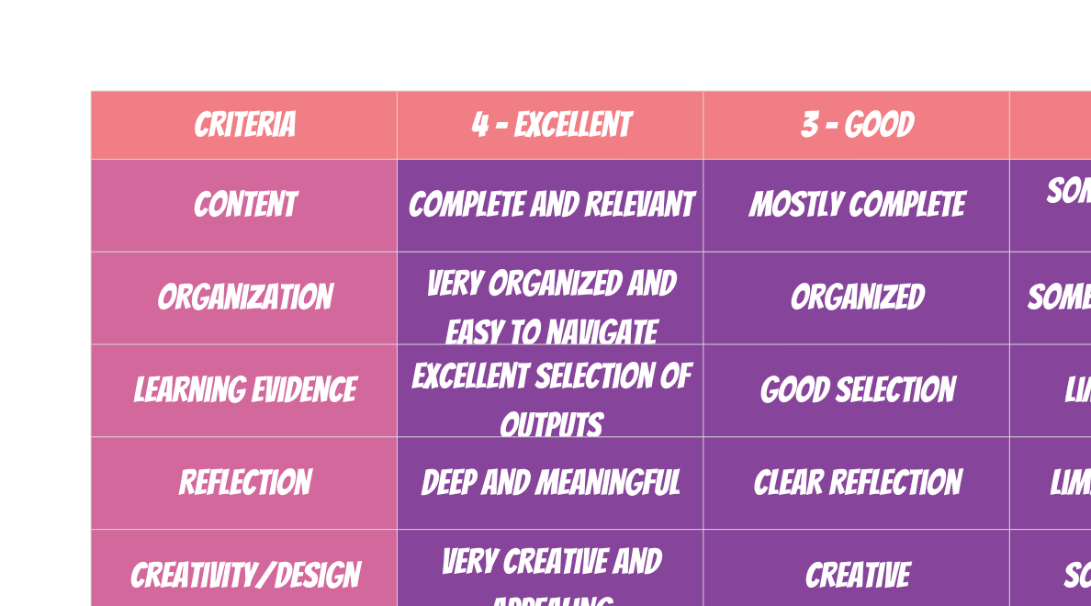
ePORTFOLIO RUBRIC

Slide 35
Questions or Clarifications?

Slide 36


Ingoude Company
Thank
You
For Your Attention
www.reallygreatsite.com

