Slide 1
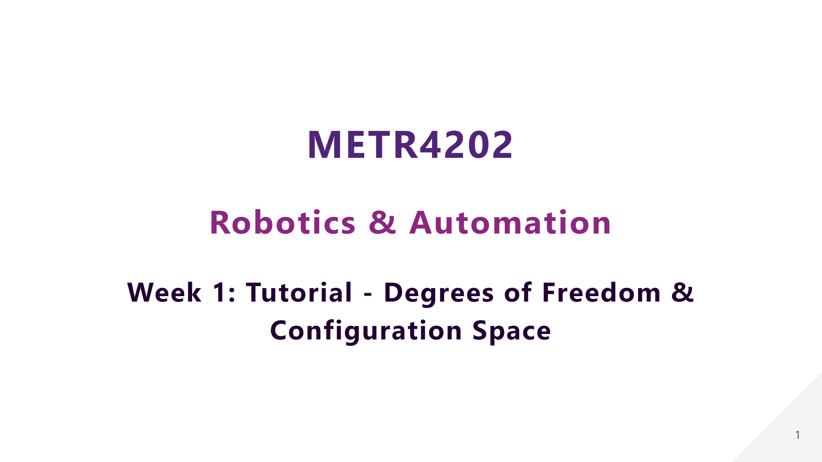

Slide 2


Slide 3
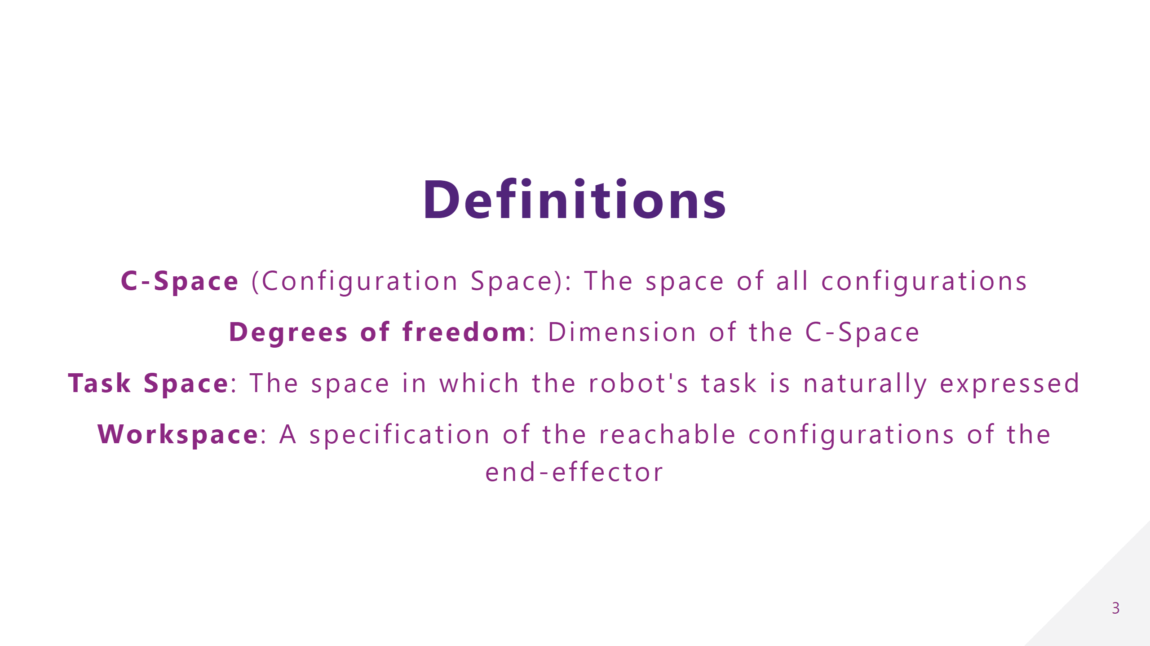

Slide 4
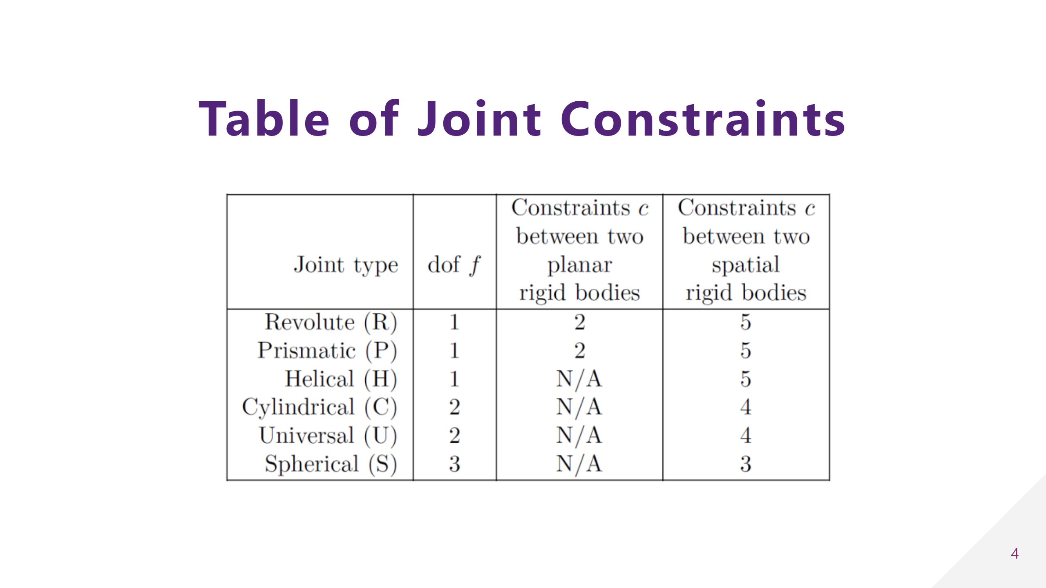

Slide 5
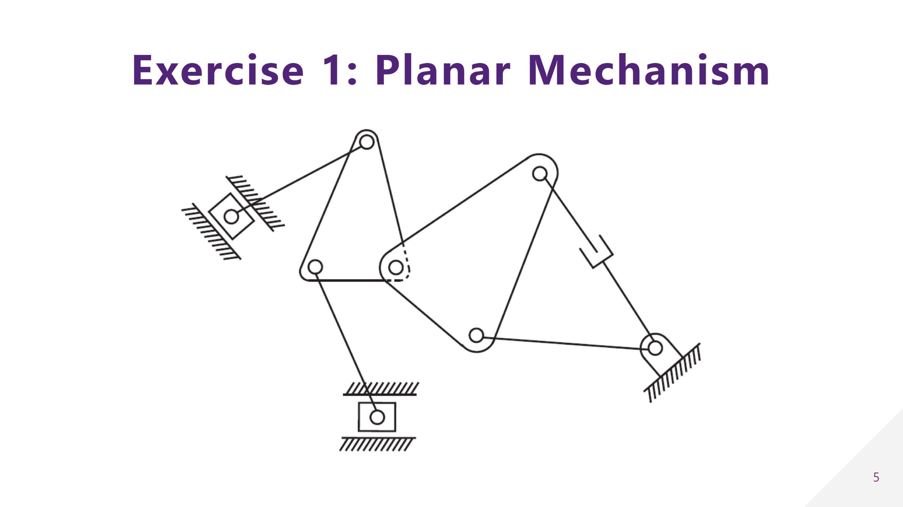

Slide 6
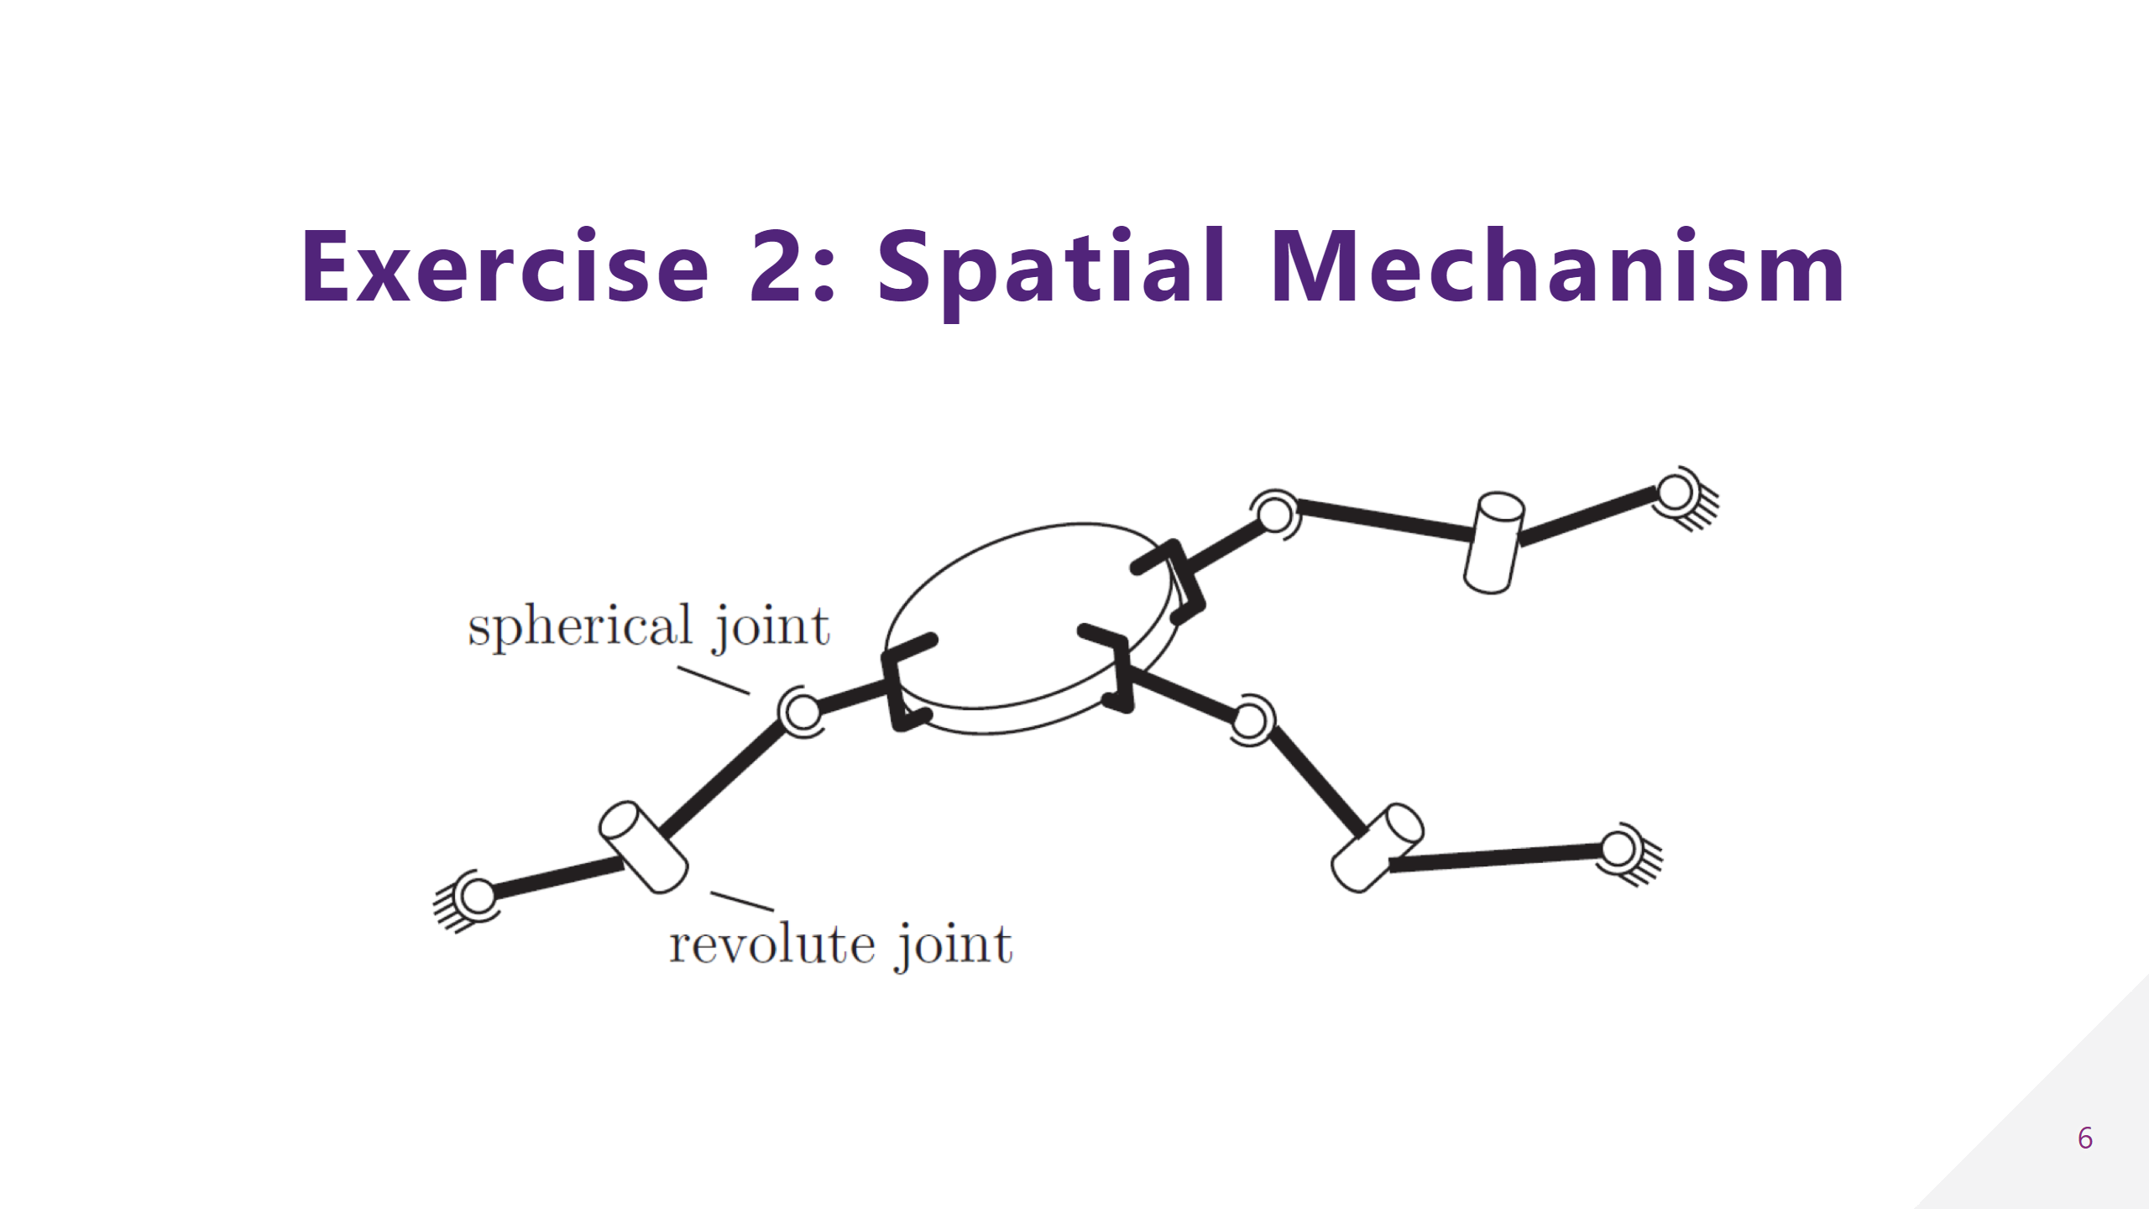

Slide 7
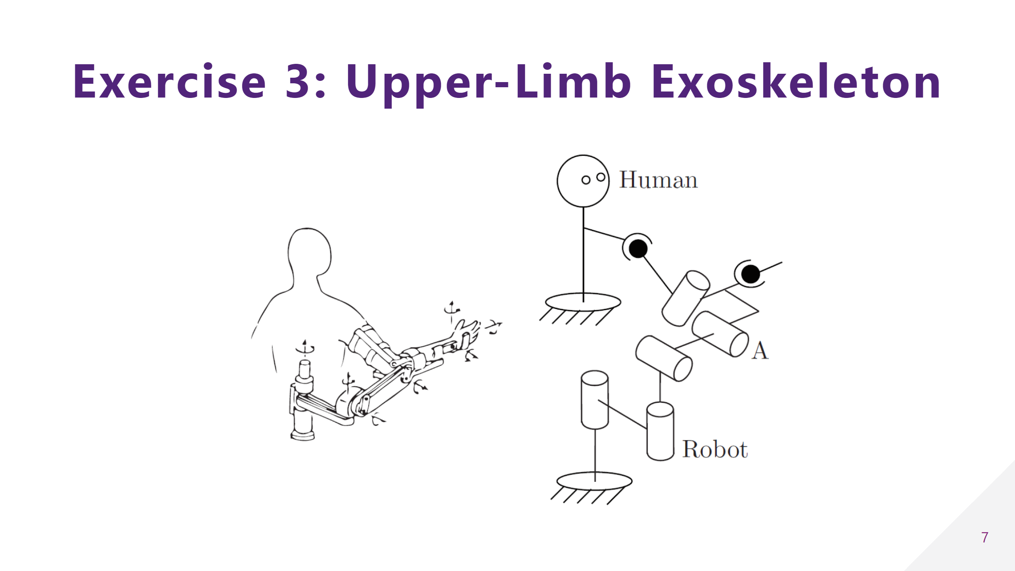

Slide 8
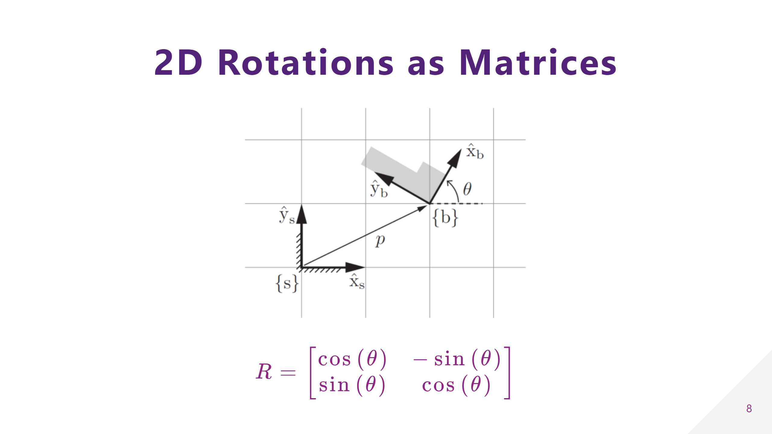
Notes:
## Rotations in 3D $$ R_x = \begin{bmatrix} \cos{(\theta)} & -\sin{(\theta)} \\ \sin{(\theta)} & \cos{(\theta)} \end{bmatrix} $$

Slide 9
