Slide 1
Analysis of Cyclistic bikes Users: annual members vs. casual riders
Presented by: Kenny Brian

Slide 2
Objective
Analyze Cyclistic’s ridership data to understand bike use between Annual members and casual riders.

Slide 3
Data
This analysis uses Cyclistic’s (Divvy’s) historical trip data recorded for the first quarter of 2023 (January, February & March) found here https://divvy-tripdata.s3.amazonaws.com/index.html.
Data Wrangling and cleaning steps taken can found in this R markdown

Slide 4
Executive Summary
Analysed Cyclistic’s ridership data for the first quarter of 2023 (January to March) to understand Bike use between Annual members and casual riders
The following insights were uncovered:
More annual members use the bikes during the weekdays as compared to the week, Bike use by casual users is varies within the week
Casual users generally have a higher trip duration compared to members. The number increases sharply on the weekends. The trip duration for members is steady on weekdays with a slight increase over the weekend.
Both customer segments prefer electric bikes. However, casual riders prefer docked bikes for longer trip duration.
Focus on bike use, day of the week and bike preference while designing marketing strategies

Slide 5
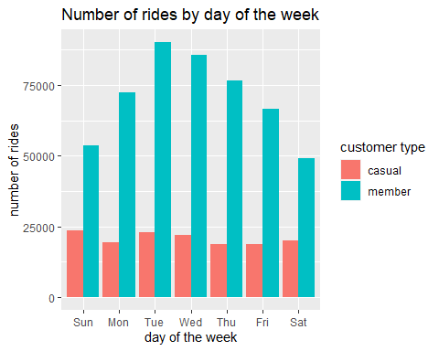
Number of rides by day of the week
The subscribed members use the bikes more on weekdays as compared to weekends.

Slide 6
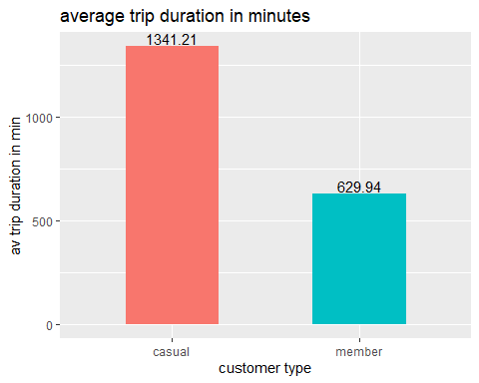
Average trip duration by customer type
The average trip duration for casual riders is more than double the average trip duration for members.

Slide 7
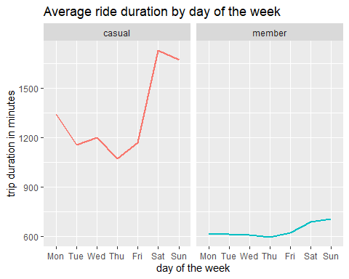
Average ride duration by day of the week
Both customer segments have relatively higher ride duration during the weekends
Casual riders have generally a higher ride duration. this number increases sharply over the weekend.

Slide 8
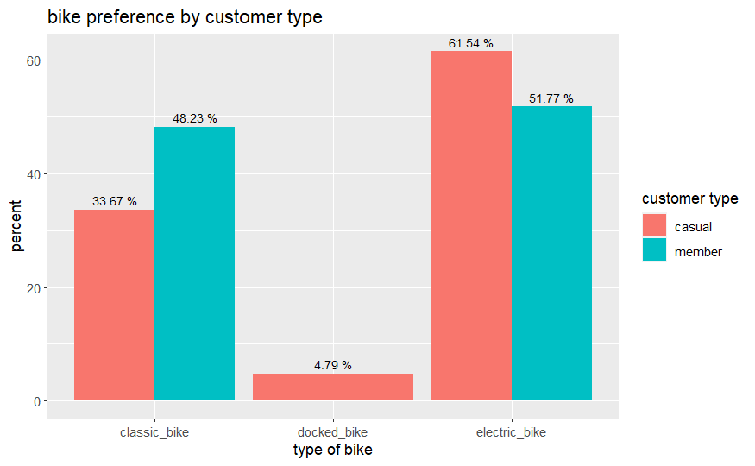
Bike preference by customer type
There are no subscribed members that used docked bikes.
A higher proportion of customers in both segments prefer electric bikes over other bike types.

Slide 9
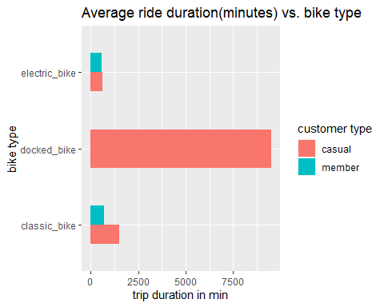
Average ride duration by bike type
Comparing the average ride duration for each bike type, we notice that docked bikes have a higher ride duration compared to other bike types.

Slide 10
Findings and Hypothesis
The average ride duration for Casual users (22.35 minutes) is more that double the average duration for members (10.5)
Average ride duration by day of the week relatively higher for casual users. This number peaks during the weekend.
we can assume that casual members use bikes for leisure/recreation
Bike use varies by the day of the week
More subscribed members use the bikes more on weekdays
Owing to the number of rides over the weekdays and shorter ride duration, we assume that annual members mostly use the bikes to commute to and from work
While Docked bikes accounted for the highest trip duration for casual riders, majority (61.5%) prefer electric bikes. Could bike range/charging stations be a factor?

Slide 11
Next steps
Further analysis needed on
Trip duration, we have trips that lasts that < 5 seconds
More data on the use of bikes by the customers
Additional demographics for analysis e.g., age of users

