Slide 1
Analysis of Cyclistic bikes Users: annual members vs. casual riders
Presented by: Kenny Brian

Slide 2
Objective
Analyze Cyclistic’s ridership data to understand bike use between Annual members and casual riders.

Slide 3
Data
This analysis uses Cyclistic’s (Divvy’s) historical trip data recorded for the first quarter of 2023 (January, February & March) found here https://divvy-tripdata.s3.amazonaws.com/index.html.
Data Wrangling and cleaning steps taken can found in this R markdown
Additional visualizations can be found here https://public.tableau.com/app/profile/kenny.brian/vizzes

Slide 4
Executive Summary
More annual members use the bikes during the weekdays as compared to the week, Bike use by casual users is varies within the week
Casual users generally have a higher trip duration compared to members. The number increases sharply on the weekends. The trip duration for members is steady on weekdays with a slight increase over the weekend.
Daily bike use by members peaks at 8am and 5pm
Both customer segments prefer electric bikes. However, casual riders prefer docked bikes for longer trip duration.
Focus on bike use, day of the week and bike preference while designing marketing strategies

Slide 5
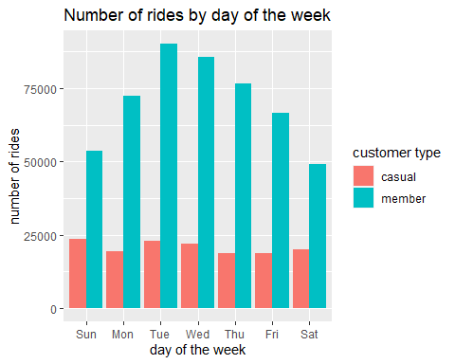
Number of rides by day of the week
The subscribed members use the bikes more on weekdays as compared to weekends.

Slide 6
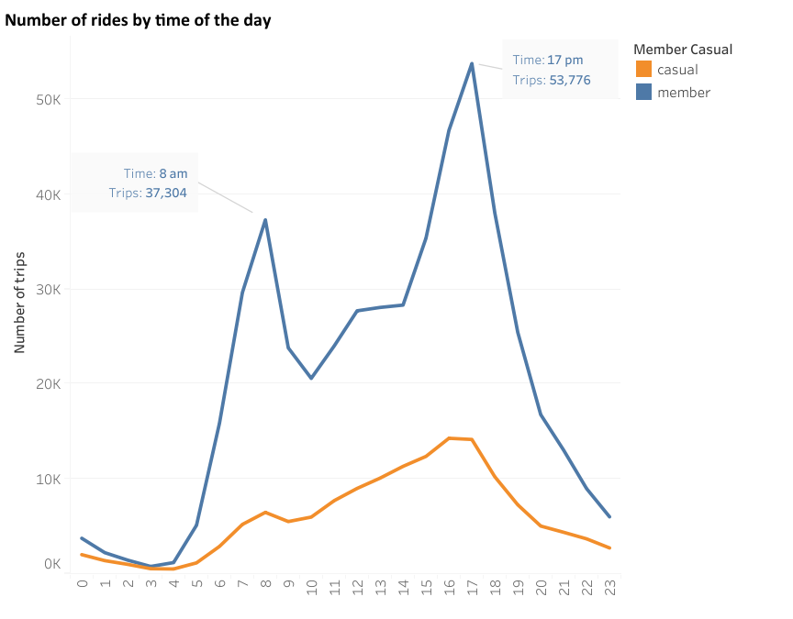
Number of rides by time of the day
Daily bike use by members peaks at 8am and 5pm while number of trips by casual riders increases steadily during the day and peaks at 4 pm

Slide 7
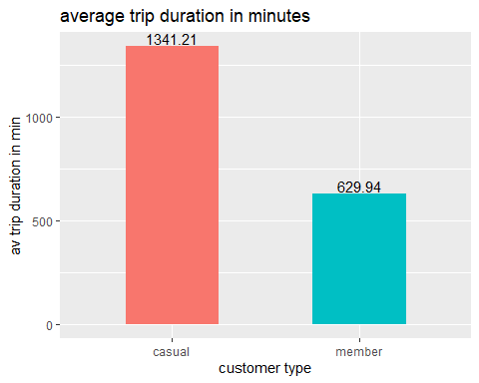
Average trip duration by customer type
The average trip duration for casual riders is more than double the average trip duration for members.

Slide 8
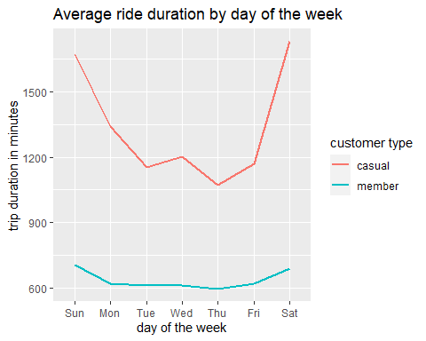
Average ride duration by day of the week
Both customer segments have relatively higher ride duration during the weekends
Casual riders have generally a higher ride duration. this number increases sharply over the weekend.

Slide 9
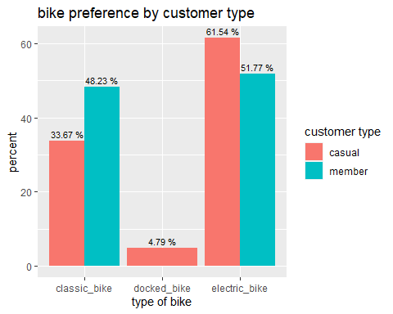
Bike preference by customer type
There are no subscribed members that used docked bikes.
A higher proportion of customers in both segments prefer electric bikes over other bike types.

Slide 10
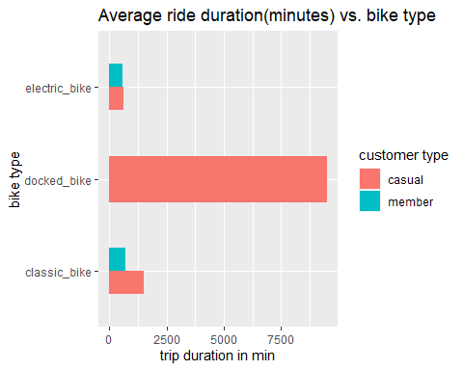
Average ride duration by bike type
Docked bikes have the highest ride duration compared to other bike types.

Slide 11
Findings and Hypothesis
The average ride duration for Casual users (22.35 minutes) is more that double the average duration for members (10.5)
Average ride duration by day of the week relatively higher for casual users. This number peaks during the weekend.
we can assume that casual members use bikes for leisure/recreation
Bike use varies by the day of the week
More subscribed members use the bikes more on weekdays
Owing to the number of rides over the weekdays, shorter ride duration and peaks hours, we postulate that annual members mostly use the bikes to commute to and from work
While Docked bikes accounted for the highest trip duration for casual riders, majority (61.5%) prefer electric bikes. Could bike range/charging stations be a factor?

Slide 12
Next steps
Further analysis needed on
Trip duration, we have trips that lasts that < 5 seconds
More data on the use of bikes by the customers
Additional demographics for analysis e.g., age of users

