Slide 1
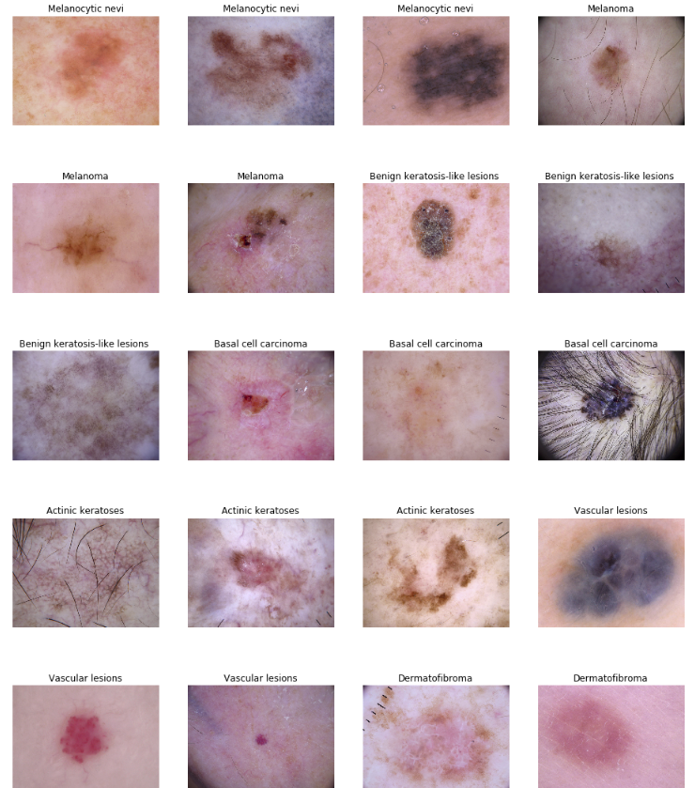
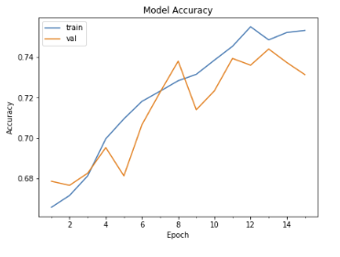
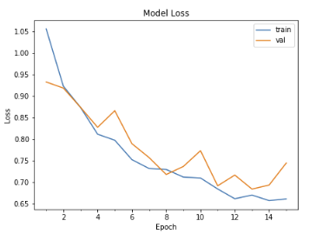
Skin Cancer Detection
Kenny Luu Sinclair Liang
kepluu@ucsc.edu wliang13@ucsc.edu
Introduction
Methodologies
Results
Vision
We are excited about applying machine learning and image processing to help with medical research and cancer diagnosis.
Data Exploration
After 50 epochs, we achieved 75.32% accuracy.

