Slide 1
Music Project

Slide 2

Objective
To create a program that can combine different types of music together
To add creativity into music

Slide 3
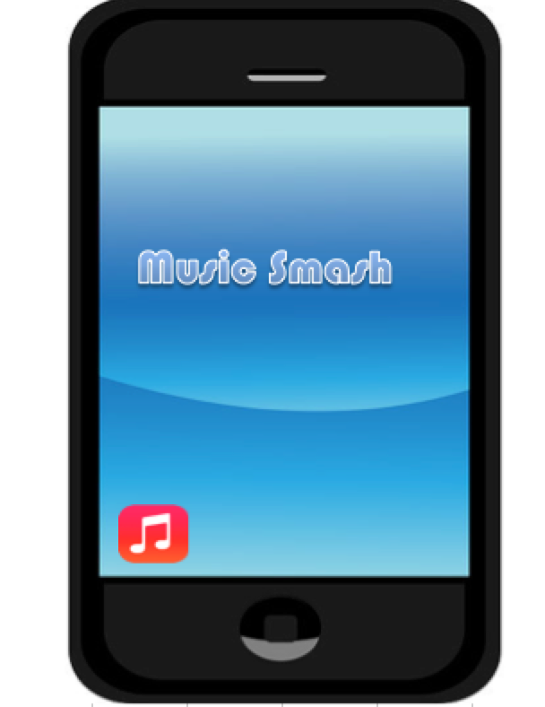
Template
Features:
Able to play a song and instrument at the same time
Able to play 2 types of instrument
Able to get information about the song
Music/start
Home

Slide 4
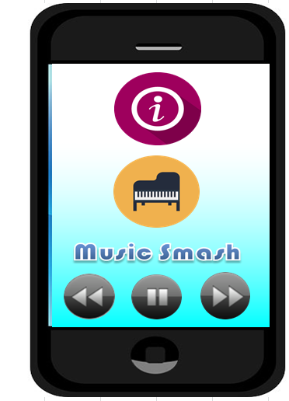
Template
Song Info
Piano
Previous song
Next Song
Pause

Slide 5
Issues
Better array formate
Camera could not be linked to excel

Slide 6
Improvements
Adding volume function
Display design

