Slide 1
ME759 High Performance Computing for Applications in Engineering [Spring 2021]
Lecture 13
02/22/2021
Dan Negrut, 2021 ME759 UW-Madison

Slide 2
Quote of the day
“I believe that children are our future. Unless we stop them now.”
-- Homer Simpson, nuclear safety inspector at the Springfield Nuclear Power Plant (1989- )

Slide 3
Is BBC recording on?
If my internet connection goes down, I’ll email from my phone to provide more information – go/no-go, next step, etc.

Slide 4
Before we get started…
__device__ volatile int X = 1, Y = 2;
__device__ void writeXY()
{
X = 10;
Y = 20;
}
__device__ void readXY()
{
int A = Y;
int B = X;
}
Last time
GPU mem operations: focus on shared memory
GPU mem operations: focus on global memory
How parallel computing makes memory operations tricky
RAW, WAW, WAR hazards
Today
Atomic operations
Things that determine the speed of execution of a kernel
Case studies: parallel reduction on the GPU
Other tidbits:
Assignment due on Th, 02/25, at 9 pm
Four or five assignments are going to be increasingly difficult
Drop two of them if you are overwhelmed. Stay focused, make the right call
Do not run your code on the Euler headnode (use Slurm)
You can download the recording onto your machine, don’t need to listen to lecture through Canvas

Slide 5
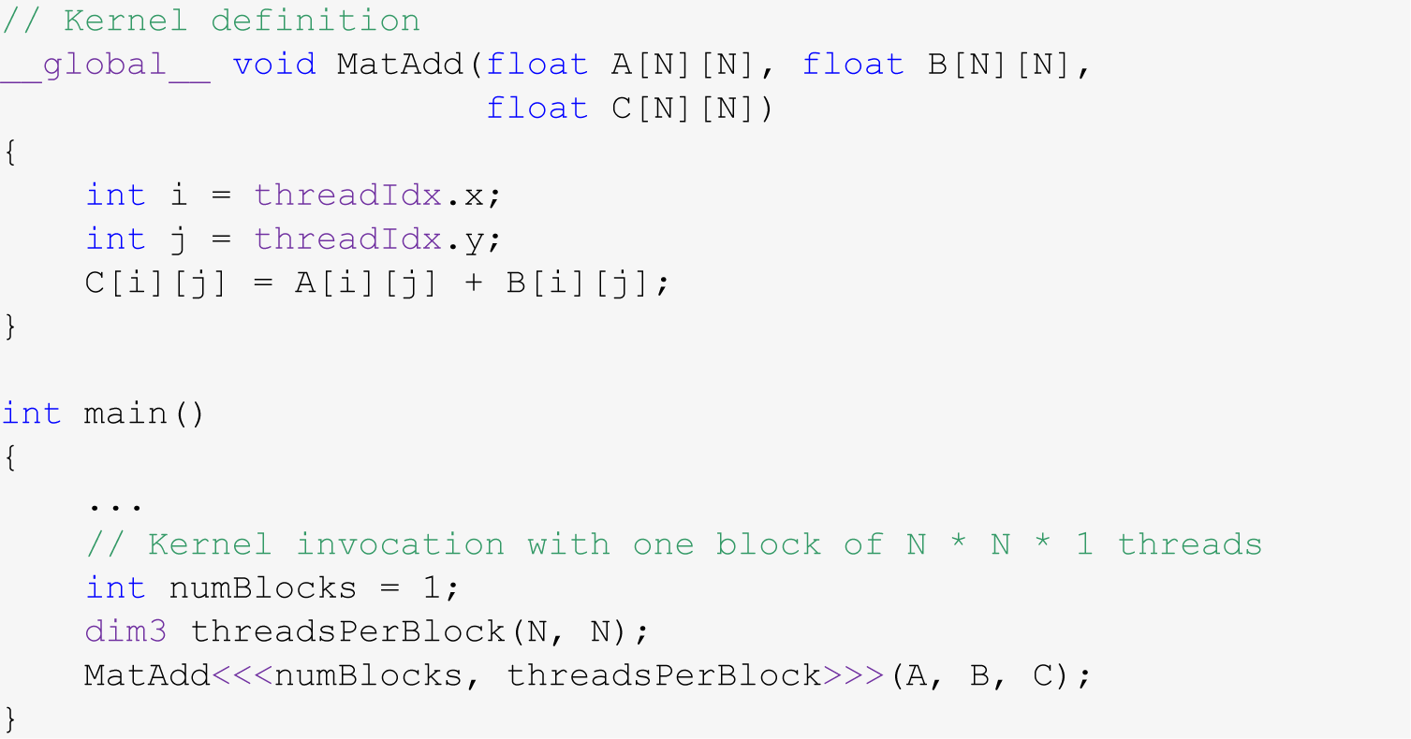
Example: Adding Two Matrices
You have two matrices A and B of dimension NxN (N=32)
You want to compute C=A+B in parallel
Code provided below (some details omitted, such as #define N 32)

Slide 6
Test Your Understanding
Given that the x field of a thread index changes the fastest, is the array indexing scheme on the previous slide good or bad?
HINT: think how threads are mapped into a set of 1D sequence of consecutive IDs
The “good or bad” refers to how data is accessed in the device’s global memory
In other words should we have
or…
C[i][j] = A[i][j] + B[i][j]
C[j][i] = A[j][i] + B[j][i]
Notes:
Mapping threads to data is not unique. Some choices are better than others… (from a memory access point of view)
Must keep in mind how 2-dimensional arrays are stored in C/C++
Answer: C[j][i] = A[j][i] + B[j][i]

Slide 7
Reflecting on Accessing Global Memory in CUDA
Assume dA is a device array, holding ints
Assume z[] is an array of unsigned ints
Which of these global memory accesses are good/bad? Why?
dA[threadIdx.x]
dA[threadIdx.x+2]
dA[7*threadIdx.x+2]
dA[z[threadIdx.x]]
NOTE: When answering 1-4 above, imagine you’re a thread and try to understand what the other 31 threads in the warp do when the warp executes the memory instruction
Notes:
Some of these scenarios can lead to out-of-bounds access as well. Particularly the last one

Slide 8
How Do You Avoid Bad Memory Accesses?
Design your data structures in a way that leads to advantageous memory accesses
Choosing a design: done before you write any line of code
Reflect on your algorithm
What data it needs, how much of it, where you read from/write to, how often
A good data structure choice for parallel computing could be quite different than a good data structure choice for sequential computing
In the beginning, as we get going, we learn programming thinking about correctness
Then, we get wiser. Other aspects to consider when writing code:
speed of execution & convenience/productivity & code legacy & large team development & portability

Slide 9
Related to Data Organization
Say you use in your program complex data constructs that could be organized using C-structures
For GPU computing, how is it more advantageous to store data in global memory?
Alternative A: as an array of structures (AoS)
Alternative B: as a structure of arrays (SoA)
If you use all the data in a struct once you bring over, question not that relevant (although there are aspects that come into play)
However, if you only use one field from a struct, stick w/ SoA
Notes:
Example: 3D points
AoS: Swiss cheese (many holes → wasted trips to memory)
SoA: Parmesan (very dense)

Slide 10
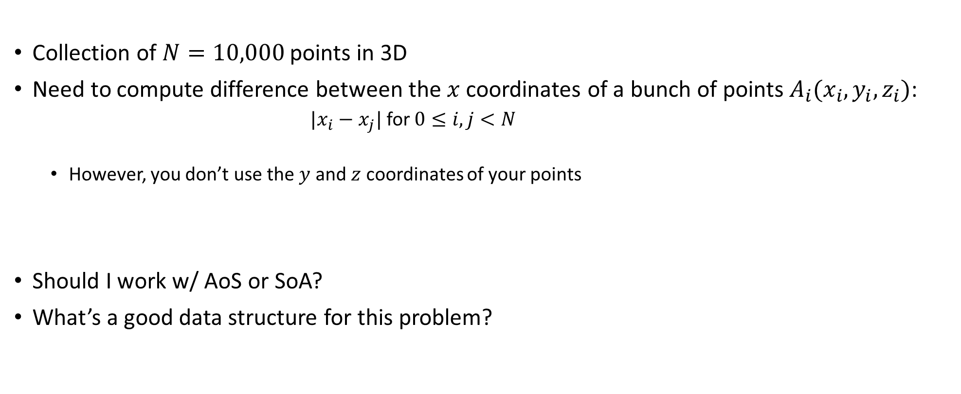
SoA or AoS?
Collection of $N=10,000$ points in 3D
Need to compute difference between the $x$ coordinates of a bunch of points $A_{i}(x_{i},y_{i},z_{i})$:
${|x}_{i}−x_{j}|$ for $0≤i,j<N$
However, you don’t use the $y$ and $z$ coordinates of your points
Should I work w/ AoS or SoA?
What’s a good data structure for this problem?

Slide 11
Latency vs. Bandwidth, or how the CPU and GPU go about hiding memory access overhead
CPU uses the low latency of the cache to hide memory access overhead
Caches have small latency (but also small capacity, unfortunately: 256 KB L2)
CPU uses TLP (recall Intel’s HTT) to hide data overhead
GPU hides memory latency via SM oversubscription
Caveat: data needs to find its way into the GPU global memory. Slow communication channel
PCIe – a good I/O bus, but not a good memory bus
NVLINK: a good memory bus

Slide 12
Atomic Operations

Slide 13
Coordinating Memory Operations to Avoid Data Hazards
Accesses to shared locations (global memory & shared memory) need to be correctly choreographed (orchestrated) to avoid race conditions
In many common shared memory multithreaded programming models, one uses coordination mechanisms such as locks to choreograph accesses to shared data
CUDA has a scalable coordination mechanism called “atomic memory operation”

Slide 14
Before diving in
Next slides: several examples that show “race conditions”

Slide 15
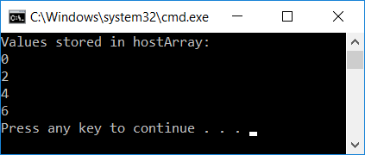
Recall a CUDA Early Example
#include<cuda.h>
#include<iostream>
__global__ void simpleKernel(int* data)
{
//this adds a value to a variable stored in global memory
data[threadIdx.x] = data[threadIdx.x] + 2*(blockIdx.x + threadIdx.x);
}
int main() {
const int numElems = 4;
int hostArray[numElems], *devArray;
//allocate memory on the device (GPU); zero out all entries in this device array
cudaMalloc((void**)&devArray, sizeof(int) * numElems);
cudaMemset(devArray, 0, numElems * sizeof(int));
//invoke GPU kernel, with one block that has four threads
simpleKernel<<<1,4>>>(devArray);
//bring the result back from the GPU into the hostArray
cudaMemcpy(&hostArray, devArray, sizeof(int) * numElems, cudaMemcpyDeviceToHost);
//print out the result to confirm that things are looking good
std::cout << "Values stored in hostArray: " << std::endl;
for (int i = 0; i < numElems; i++)
std::cout << hostArray[i] << std::endl;
//release the memory allocated on the GPU
cudaFree(devArray);
return 0;
}
Notes:
Let’s jump right into a non-trivial CUDA example.
Shows the main elements of CUDA programming (80/20 rule)
Explain:
__global__
cudaMalloc
kernel execution configuration
cudaMemcpy
nvcc looks for such keywords and separates code that is supposed to run on CPU and GPU

Slide 16
Old Question…
In our code, we invoked the kernel like this:
simpleKernel<<<1,4>>>(devArray)
What would happen if we invoke the kernel like this:
simpleKernel<<<2,4>>>(devArray)

Slide 17
Another Race Condition
A contrived (cooked up) example…
// update.cu
__global__ void update_race(int* x, int* y)
{
int i = threadIdx.x;
if (i < 2)
*x += *y;
else
*x += 2*i;
}
// main.cpp
update_race<<<1,4>>>(d_x, d_y);
cudaMemcpy(y, d_y, sizeof(int), cudaMemcpyDeviceToHost);

Slide 18
Example: Inter-Block Issue
Would this fly?
// update.cu
__global__ void updateVals(int* x)
{
int i = threadIdx.x;
if (i == 0) *x += blockIdx.x;
}
// main.cpp
// assume d_x starting value is zero
updateVals<<<2,5>>>(d_x);

Slide 19
Atomics, Introduction
Atomic memory operations (atomic functions) are used to solve access coordination problems in parallel computing
General concept: provide a mechanism for a thread to update a memory location such that the update appears to happen without interruption (atomically) with respect to all other threads
This ensures that all atomic updates issued are performed (in some unspecified order) to completion and that all threads can observe all updates

Slide 20
Atomic Functions, Example [1/3]
Atomic functions perform read-modify-write operations on data residing in global or shared memory
//example of int atomicAdd(int* addr, int val)
__global__ void update(unsigned int* x)
{
int i = threadIdx.x;
int j = atomicAdd(x, i); // j is now old value of x;
}
//-----------------------------------
// snippet of code in main.cu; mem. was already allocated on device
int x = 0;
cudaMemcpy(&d_x, &x, cudaMemcpyHostToDevice);
update<<<1,128>>>(&d_x);
cudaMemcpy(&x, &d_x, cudaMemcpyDeviceToHost);
NVIDIA [J. Balfour]→
Side-note question: in example below, are we working w/ global or shared memory?
Notes:
[DN]
This is what used to be: int j = atomicAdd(x, 1); // j = *x; *x = j + i;
This is now: int j = atomicAdd(x, 1); // j = *x;

Slide 21
Atomic Functions [2/3]
Atomic functions perform read-modify-write operations on data that can reside in global or shared memory
Synopsis of atomic function atomicOP(a,b) is typically (a and b below are pointers)
t1 = *a; // read
t2 = (*a) OP (*b); // modify
*a = t2; // write
return t1;
All statements are executed atomically without interruption by any other function/process
The atomic function returns the initial value, *not* the final value, stored at the memory location
NVIDIA [J. Balfour]→

Slide 22
Atomic Functions [3/3]
The order in which concurrent atomic updates are performed is not defined
While order is not clear, none of the atomically performed updates will be lost
Several different kinds of atomic operations:
Add (add), Sub (subtract), Inc (increment), Dec (decrement)
And (bit-wise and), Or (bit-wise or) , Xor (bit-wise exclusive or)
Exch (Exchange)
Min (Minimum), Max (Maximum)
Compare-and-Swap
Etc.
NVIDIA [J. Balfour]→

Slide 23
Histogram Example
// Compute histogram of colors in an image
//
// picturePixels – pointer to picture pixels, each w/ its own color
// picturePixels[i] – takes a value between 0 and 6 (7 colors total)
// bucket–pointer to histogram bucket of size equal to # of colors
//
__global__ void histogram(int n, int* picturePixels, int* bucket)
{
int i = threadIdx.x + blockDim.x * blockIdx.x;
if (i < n)
{
int c = picturePixels[i];
atomicAdd(&bucket[c], 1);
}
}
NVIDIA [J. Balfour]→
Notes:
picturePixels[i] returns one of say seven integers that correspond to the possible seven colors in the picture.
“bucket” is an array of int of dimension seve.

Slide 24
Performance Notes
While very convenient to use, atomics do impact the speed of the code
Performance poor when many threads attempt to perform atomic operations on a small number of locations
Bad case: all threads trying to update the same variable
NVIDIA [J. Balfour]→
Notes:
Hammad: The kepler and Maxwell architectures improved atomic performance. Maxwell improved performance for shared memory atomics.

Slide 25
No mix-and-match, please…
Atomic updates are not guaranteed to appear atomic to concurrent accesses that also use loads and stores
No mix and match, please
__global__ void broken(int n, int* x)
{
int i = threadIdx.x + blockDim.x * blockIdx.x;
if (i == 0)
{
*x = *x + 1;
}
else
{
int j = atomicAdd(x, 1); // j = *x; *x += i;
}
}
// main.cpp
broken<<<1,128>>>(128, d_x); // d_x = d_x + {1, 127, 128}
NVIDIA [J. Balfour]→

Slide 26
Rules of thumb, atomic ops
When to use: Cannot fall back on normal memory operations because of possible race conditions
Use for infrequent, sparse, and/or unpredictable global communication
Use shared memory and/or customized data structures & algorithms to avoid synchronization whenever reasonable
Compute capabilities post Maxwell improved the speed of atomic operations
NVIDIA [J. Balfour]→

Slide 27
Synchronization vs. Coordination
There is a qualitative difference between a __syncthreads() function and an atomic operation
__syncthreads() has the connotation of barrier; i.e., of synchronization
__syncthreads() establishes a point in the execution of the kernel that every thread in the **block** needs to reach before any block thread can move beyond that point. Also, all memory ops are seen through
The “atomic operation” concept instead tied to the idea of coordination in relation to operations that involve memory transactions
Threads need not synchronize their execution, it’s only that a certain memory operation in a kernel is conducted in an atomic fashion

Slide 28
Resource Management Considerations

Slide 29
What is “Resource Management”?
The GPU is a resourceful device
How do you get to use the card at capacity?
“used at capacity”: SM executes the max. number of warps it can possibly host
The three factors that come into play are
How many threads you decide to use in each block - threads/block = ?
What register requirements end up associated with a thread - registers/thread = ?
How much shared memory you assign to one block of threads - shMem/block = ?

Slide 30
Some Hard Constraints (1/2)
Max number of warps that one SM can service simultaneously:
32 on Tesla C1060 and Turing (Turing is weird)
48 on Fermi
64 on Kepler, Maxwell, Pascal, Volta, and Ampere
Max number of blocks that one SM can process simultaneously:
8 on Fermi
16 on Kepler and Turing (wow)
32 on Maxwell, Pascal, Volta, and Ampere
Notes:
Fermi: must have at least 2 blocks to even have a chance to reach 100% occupancy
Indeed, 1024 max. threads/ block → 32 max. warps / block

Slide 31
Some Hard Constraints (2/2)
The number of 32-bit registers available on each SM is limited:
16,384 registers (on Tesla C1060)
Roughly 48,000 on Fermi
Roughly 64,000 on Kepler, Maxwell, Pascal, Volta, and Ampere
The amount of shared memory available to each SM is limited
16 KB on Tesla 1060
64 KB on Fermi (16/48 or 48/16 configurable between L1 and shared memory)
64 KB on Kepler (16/48 or 48/16 or 32/32 configurable)
64 KB on Maxwell and Pascal, but not split w/ L1
96 KB on Volta (this is split-able again, w/ L1 and texture)
Up to 164 KB on Ampere (out of 196KB, which is to be shared w/ L1)
Note: there is also a max amount of ShMem that a block can get assigned
At 48 KB , sometimes 64KB, sometimes 96 KB
Notes:
Also, each thread can use a maximum of 256 registers

Slide 32
The Concept of Occupancy (1/2)
Let’s talk Ampere on this slide (discussion similar for Volta, Pascal, etc.)
On Ampere, you want to have up to 64 warps serviced at the same time by one SM (that is, 64 warps in flight)
High warp count: increases likelihood of hiding mem access latencies with useful computation
Occupancy examples:
Four blocks with 512 threads running together on one SM: 100% occupancy
Four blocks of 256 threads each running on one SM: 50% occupancy
96 blocks with 32 threads each – oops, can’t have more than 32 blocks on an Ampere SM
Effectively this scenario gives you at most 50% occupancy (up to 32 blocks w/ 32 threads each)
Notes:
maximum 48 resident warps/SM - Fermi

Slide 33
The Concept of Occupancy (2/2)
registers | ↔ | per thread
shared mem | ↔ | per block
What prevents you from getting high occupancy?
Amount of shared mem demanded by each block
Total amount of shared memory in one SM is limited: e.g., up to 64 Kb on Pascal
Number of registers used by each thread
Size of the register file in one SM: 64K four-byte registers on Kepler, Maxwell, Pascal, etc.
How do you find out how many registers and shared memory get used?
Solution 1: using the CUDA profiler
Solution 2: use the flag –ptax-options=-v when you compile your kernel w/ nvcc

Slide 34
Examples, Occupancy of hardware (Fermi example, 48 KB of ShMem)
Example 1, Fermi: If each of your block demands 80 KB of shared memory, the kernel will fail to launch
Not enough memory on the SM to run even a block
Example 2, Fermi: If your blocks each uses 15 KB of shared mem, you can have up to three blocks running on one SM (there will be some shared mem that will go unused)
Example 3, Fermi: Like Example 2 above, and you have 512 threads per block, each thread uses 30 registers. Will one SM be able to handle 2 blocks?
Total number of registers: 512 x 2 x 30 = 30,720 out of the 48,000 are used OK
Amount of shared memory: 2 x 15K = 30 KB, well below 48 KB OK
Number of warps: 2 blocks x 512 threads = 1024 threads = 32 warps < max of 48 OK
Quiz: Will the SM be able to handle 3 blocks?
Notes:
Yes, under these conditions, 3 blocks will still fit on an SM.
Moreover, we would get 100% occupancy (512 x 3 threads = 48 warps)
Attention: increasing the required number of registers per thread by only 1 or 2 can immediately drop occupancy (by limiting the number of blocks that can be assigned to one SM)
Indeed, in example 3, if each thread requires 32 registers, we can only fit 2 blocks/SM! → 66% drop in occupancy

Slide 35
NVIDIA CUDA Occupancy Calculator
There is an “occupancy calculator” that can tell you what percentage of the HW gets utilized by your kernel
Comes as an Excel spreadsheet
Requires the following input
Compute capability
Threads per block
Registers per thread
Shared memory per block
Selected Shared Memory Size Config (bytes)
Selected Global Load Caching Mode
Search online “CUDA occupancy calculator” to get the excel file
Notes:
Can also use compiler flags to report resource utilization.
For example, passing –ptax-options=-v to nvcc will report the number of registers/thread
Profiler will also give you all this information.

Slide 36
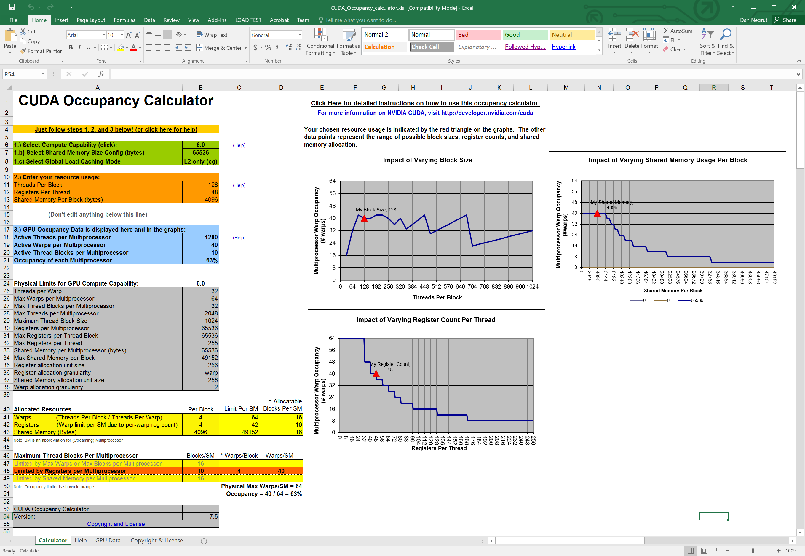
NVIDIA CUDA Occupancy Calculator
Google this term: “cuda occupancy calculator”

Slide 37
Example: Occupancy Study [NOTE: Specific to Fermi]
For Matrix Multiplication example (with shared memory), should I use 8x8, 16x16, or 64x64 threads per blocks?
For 8x8, we have 64 threads per Block. Since each Fermi SM can manage up to 1536 resident threads, it could take up to 32 Blocks. However, each SM is limited to 8 resident Blocks, so only 512 threads will go into each SM!
For 16x16, we have 256 threads per Block. Since each Fermi SM can take up to 1536 resident threads, it can take up to 6 Blocks unless other resource considerations overrule.
Next you need to see how much shared memory and how many registers get used in order to understand whether you can actually have four blocks per SM
64x64 is a no starter, you can only have up to 1024 threads in a block, the tile cannot be this big

Slide 38
Occupancy != Performance [yet a pretty good proxy]
Increasing occupancy does not necessarily increase performance
If you want to read more about this, there is a Volkov paper, assigned reading
What controls the damage is the Instruction Level Parallelism (ILP) that the compiler can capitalize on (better efficiency in pipelining, instruction reordering, etc.)
HOWEVER,
Low-occupancy multiprocessors are likely to have a hard time when it comes to hiding latency on memory-bound kernels
This latency hiding draws on Thread Level Parallelism (TLP); i.e., having enough threads (warps, that is) that are ready for execution

Slide 39
Parameterize Your Application
Parameterization helps adaptation to different GPUs
GPUs vary in many ways
# of SMs
Memory bandwidth
Shared memory size
Register file size
Max. threads per block
Max. number of warps per SM
You can even make apps self-tuning (like FFTW and ATLAS)
“Experiment” mode discovers and saves optimal configuration

Slide 40
CUDA Optimization Rules of Thumb

Slide 41
Writing CUDA Software: High-Priority Recommendations
To get the maximum benefit from CUDA, focus first on finding ways to parallelize sequential code. Expose fine grain parallelism
Minimize data transfer between the host and the device, even if it means running some kernels on the device that do not show performance gains when compared with running them on the host CPU
Very good resource: http://docs.nvidia.com/cuda/cuda-c-best-practices-guide/index.html#abstract

Slide 42
Writing CUDA Software: High-Priority Recommendations
Strive to have aligned and coalesced global memory accesses. Design your implementation such that global memory accesses are coalesced for that part of the red-hot parts of the code
Minimize the use of global memory. Prefer shared memory access where possible (consider tiling as a design solution)
http://docs.nvidia.com/cuda/cuda-c-best-practices-guide/index.html#abstract

Slide 43
Writing CUDA Software: Medium-Priority Recommendations
Accesses to shared memory should be designed to avoid serializing requests due to bank conflicts
Strive for sufficient occupancy
Keep the number of threads per block a multiple of 32 to avoid wasted lanes
http://docs.nvidia.com/cuda/cuda-c-best-practices-guide/index.html#abstract

Slide 44
Writing CUDA Software: Medium-Priority Recommendations
Use the fast math library whenever speed is very important, and you can live with a tiny loss of accuracy
Avoid thread divergence
http://docs.nvidia.com/cuda/cuda-c-best-practices-guide/index.html#abstract
Notes:
There used to be a sixth bullet above: 6. Use signed integers rather than unsigned integers as loop counters
The compiler can optimize more aggressively with signed arithmetic than it can with unsigned arithmetic (due to rules regarding overflow behavior). This is of particular note with loop counters
In the C language standard, unsigned integer overflow semantics are well defined, whereas signed integer overflow causes undefined results. Therefore, the compiler can optimize more aggressively with signed arithmetic than it can with unsigned arithmetic. This is of particular note with loop counters: since it is common for loop counters to have values that are always positive, it may be tempting to declare the counters as unsigned. For slightly better performance, however, they should instead be declared as signed.

Slide 45
Some nuts and bolts, compiler related and such

Slide 46
Compiling CUDA Code [with nvcc driver]
C/C++ CUDA
Application
NVCC
CPU Code
PTX Code
PTX to Target
Compile
P100
…
A100
Target binary cubin code
Notes:
nvcc separates what should run on CPU from GPU code
First stage is to translate into PTX code (assembly)
PTX is machine independent
FORTRAN generates PTX too
Second stage: compile PTX for target GPU

Slide 47
PTX: Parallel Thread eXecution
PTX: an assembly language used in CUDA programming environment
nvcc translates code written in CUDA’s C into the language-agnostic Intermediate Representation, and then into PTX assembly
nvcc subsequently invokes an assembler which translates the PTX into a binary code which can be run on a certain GPU
PTX for fillKernel
.entry _Z10fillKernelPii (
.param .u64 __cudaparm__Z10fillKernelPii_a,
.param .s32 __cudaparm__Z10fillKernelPii_n)
{
.reg .u16 %rh<4>;
.reg .u32 %r<6>;
.reg .u64 %rd<6>;
.reg .pred %p<3>;
.loc 14 5 0
$LDWbegin__Z10fillKernelPii:
mov.u16 %rh1, %ctaid.x;
mov.u16 %rh2, %ntid.x;
mul.wide.u16 %r1, %rh1, %rh2;
cvt.u32.u16 %r2, %tid.x;
add.u32 %r3, %r2, %r1;
ld.param.s32 %r4, [__cudaparm__Z10fillKernelPii_n];
setp.le.s32 %p1, %r4, %r3;
@%p1 bra $Lt_0_1026;
.loc 14 9 0
ld.param.u64 %rd1, [__cudaparm__Z10fillKernelPii_a];
cvt.s64.s32 %rd2, %r3;
mul.wide.s32 %rd3, %r3, 4;
add.u64 %rd4, %rd1, %rd3;
st.global.s32 [%rd4+0], %r3;
$Lt_0_1026:
.loc 14 11 0
exit;
$LDWend__Z10fillKernelPii:
}
__global__ void fillKernel(int *a, int n)
{
int tid = blockIdx.x*blockDim.x + threadIdx.x;
if (tid < n) {
a[tid] = tid;
}
}
Notes:
PTX
similar to assembly code
does not contain information on what particular GPU card the code should run (device neutral representation)
important to distribute CUDA code to clients without knowing their GPU capability
[Colin] PTX is an assembly language. There is a separate assembler called ptxas which is used to build it.
nvcc is an LLVM-based compiler (like Clang); It generates a subset of LLVM IR called NVVM IR, which is then compiled to PTX assembly.
Other CUDA compilers (Fortran, for example) generate this IR, and then the rest of the process acts as normal.

Slide 48
More on the nvcc compiler
File suffix | How the nvcc compiler interprets the file
.cu | CUDA source file, containing host and device code
.cuh | CUDA header files, containing host and device code
.cup | Preprocessed CUDA source file, containing host code and device functions
.c | C source file
.cc, .cxx, .cpp | C++ source file
.gpu | GPU intermediate file (device code only)
.ptx | PTX intermediate assembly file (device code only)
.cubin | CUDA device only binary file
Notes:
nvcc can output
C code (which must then be compiled with the rest using another tool)
ptx code (device independent)
object code (cubin)

Slide 49
The JIT story
C code gets converted into an Intermediate Representation (IR) called NVVM IR
NVVM IR is then converted to PTX assembly
PTX assembly gets assembled into binary code for some number of GPU targets (“cubin”)
Why the intermediate steps?
Brings into the picture the concept of just-in-time (JIT) compiling
Compilers for other languages can generate this intermediate representation rather than implementing a dialect of PTX assembly for each frontend language (Clang and CUDA Fortran do this)
PTX material can be converted at run-time into cubin instructions
Why bother with JIT?
CON: JIT increases the load-time of an application (since an additional compile step needs to happen)
PRO: Allows the app to benefit from newer devices (better compilers, more advanced features supported by the hardware)
The only way an app can run on a device that didn’t exist at the time the PTX was generated
Notes:
[Colin] PTX is an assembly language. There is a separate assembler called ptxas which is used to build it.
nvcc is an LLVM-based compiler (like Clang); It generates a subset of LLVM IR called NVVM IR, which is then compiled to PTX assembly.
Other CUDA compilers (Fortran, for example) generate this IR, and then the rest of the process acts as normal.

Slide 50
JIT and the magic of –code and –arch nvcc flags
How does one control how PTX is generated?
How does one control how the cubin is generated?

Slide 51
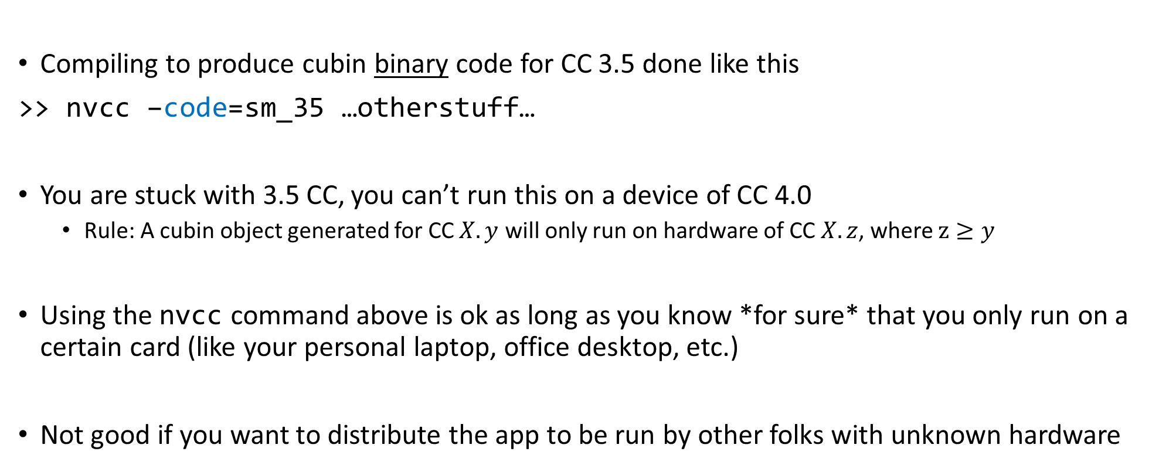
Getting stuck with a CC, via the –code flag
Compiling to produce cubin binary code for CC 3.5 done like this
>> nvcc –code=sm_35 …otherstuff…
You are stuck with 3.5 CC, you can’t run this on a device of CC 4.0
Rule: A cubin object generated for CC $X.y$ will only run on hardware of CC $X.z$, where $z≥y$
Using the nvcc command above is ok as long as you know *for sure* that you only run on a certain card (like your personal laptop, office desktop, etc.)
Not good if you want to distribute the app to be run by other folks with unknown hardware

Slide 52
A word on PTX compatibility, and the role of the –arch flag
Some CUDA features supported only on devices of higher CC
Example: unified (managed) memory
You can control the C to PTX translation so that you do/don’t pick certain CUDA features
Example: Warp Shuffle Function available only in CC 3.0 and above
Code that contains Warp Shuffle functionality should be compiled with this in mind
Accomplished by the use of the –arch=compute_30 flag on nvcc
>> nvcc –arch=compute_30 …blahblah…
NOTE: the PTX generated by the above can then be compiled to cubin to run on higher CC
Recall the cubin generation control by the –code flag

Slide 53
Example, combining –arch and –code via -gencode
>> nvcc x.cu
-gencode arch=compute_35,code=sm_35
-gencode arch=compute_50,code=sm_50
-gencode arch=compute_60,code=\'compute_60,sm_60\'
The cubin fat binary generated by this command embeds the following (it’s got bigger footprint to accommodate all):
Binary code generated to work on Kepler (CC 3.5)
Binary code generated to work on Maxwell (CC 5.0)
PTX and binary code to work on Pascal (CC 6.0)
The arch part says that the binary code in each case should be produced based on PTX code generated as you’d expect: binary for 3.5 comes from PTX for 3.5, binary for 5.0 comes from PTX for 5.0, binary for 6.0 comes from PTX for 6.0
Shortcut: you can get -gencode arch=compute_60,code=\'compute_60,sm_60\‘ by simply saying :
>> nvcc x.cu -arch=sm_60
If you don’t say anything but “nvcc x.cu” the compile driver will use default arch & code settings

