Slide 1
ME759 High Performance Computing for Applications in Engineering [Spring 2021]
Lecture 11
02/17/2021
Dan Negrut, 2021 ME759 UW-Madison

Slide 2
Quote of the day
“Success is not final, failure is not fatal: It is the courage to continue that counts.”
-- Winston Churchill

Slide 3
Is BBC recording on?
If my internet connection goes down, I’ll email from my phone to provide more information – go/no-go, next step, etc.

Slide 4
Before we get started…
Last time
GPU computing: execution scheduling
Block scheduler (at the GPU level)
Warp scheduler (at the SM level)
Thread divergence
Today
Aspects related to how GPU memory operations take place
Other tidbits:
Assignment due on Th, 02/18, at 9 pm
Do not run your code on the Euler headnode (use Slurm)
Please provide feedback here

Slide 5

Don’t panic yet…
[Robert Mankoff]$→$

Slide 6
The NVIDIA GPU Memory Ecosystem

Slide 7
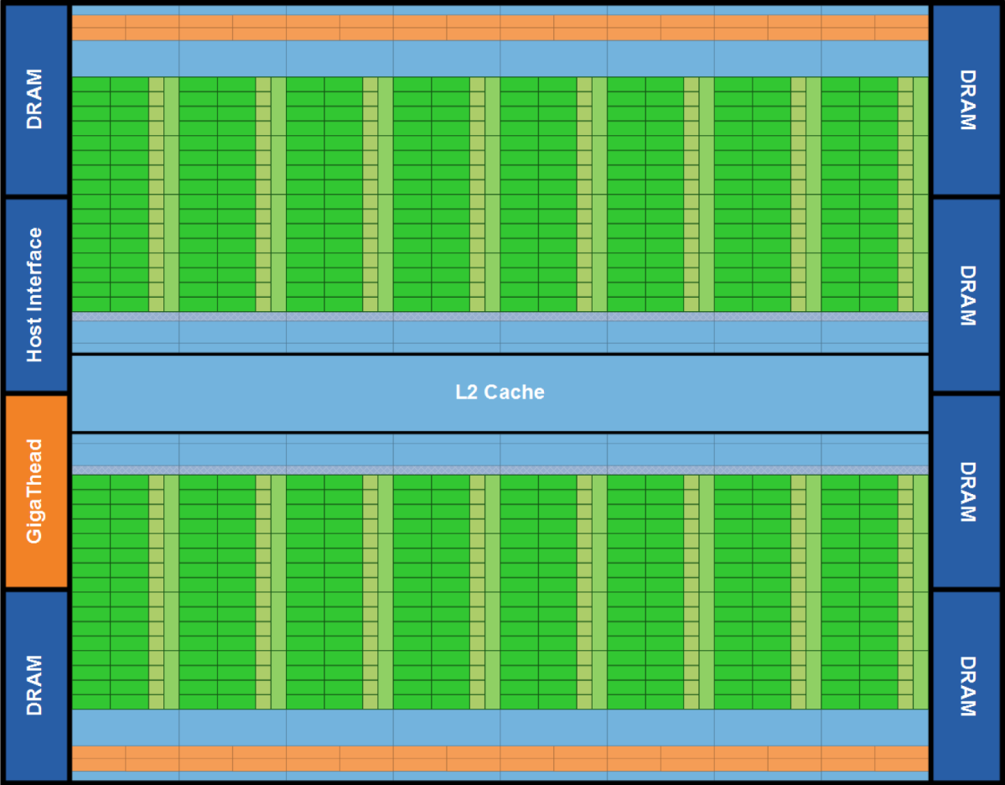
Fermi: Global Memory
Up to 6 GB of “global memory” on Fermi, see pic below
Kepler goes up to 12 GB, Pascal up to 16 GB, Volta up to 32 GB, Ampere up to 40 GB
“Global” in the sense that it doesn’t belong to an SM but rather all SMs can access it
Notes:
DDR5 memory blocks, external to the SMs.
SMs must “reach out” to global memory
L2 cache is also shared among all SMs. The rest of the memory hierarchy is inside each SM

Slide 8

CUDA Memory Ecosystem, high vantage point [Note: picture assumes two blocks, each with two threads]
One SM
Another SM
Image shows the memory hierarchy that a block sees while running on an SM
Each thread can:
R/W per-thread registers
R/W per-thread local memory
R/W per-block shared memory
R/W per-grid global memory
Read only per-grid constant memory
Read only per-grid texture memory
Read only per-grid surface memory
(Device) Grid
Block (0, 0)
Block (1, 0)
Shared Memory
Shared Memory
Registers
Registers
Registers
Registers
Thread (0, 0)
Thread (1, 0)
Thread (0, 0)
Thread (1, 0)
Local
Memory
Local
Memory
Local
Memory
Local
Memory
Host can R/W global, constant, and texture* memory
*: texture can be written only as “surface” mem
Host
Global
Memory
Constant
Memory
IMPORTANT NOTE: Global, constant, and texture memory spaces are persistent between kernels called by the same host application.
Texture
Memory
[UIUC]$→$
Notes:
Global, constant, and texture memory spaces are persistent across kernels called by the same application.
“surface” memory is like “texture”, except that the former can be written (“texture” can only be read)

Slide 9
What “register” means in CUDA
Any variable that you are using in a kernel eats up a register
The variable that you use, it needs to “live” somewhere
Then every single variable you use in a kernel will burn (at some point in the execution flow) a register
NOTE: even a variable stored in ShMem, for it to be operated on, it’ll eat up a register* at some point in the execution
As execution advances through a kernel, the number of registers occupied keeps changing
What’s relevant: max number of registers required during the execution of the kernel
*: except on Ampere, where one can actually control this…

Slide 10
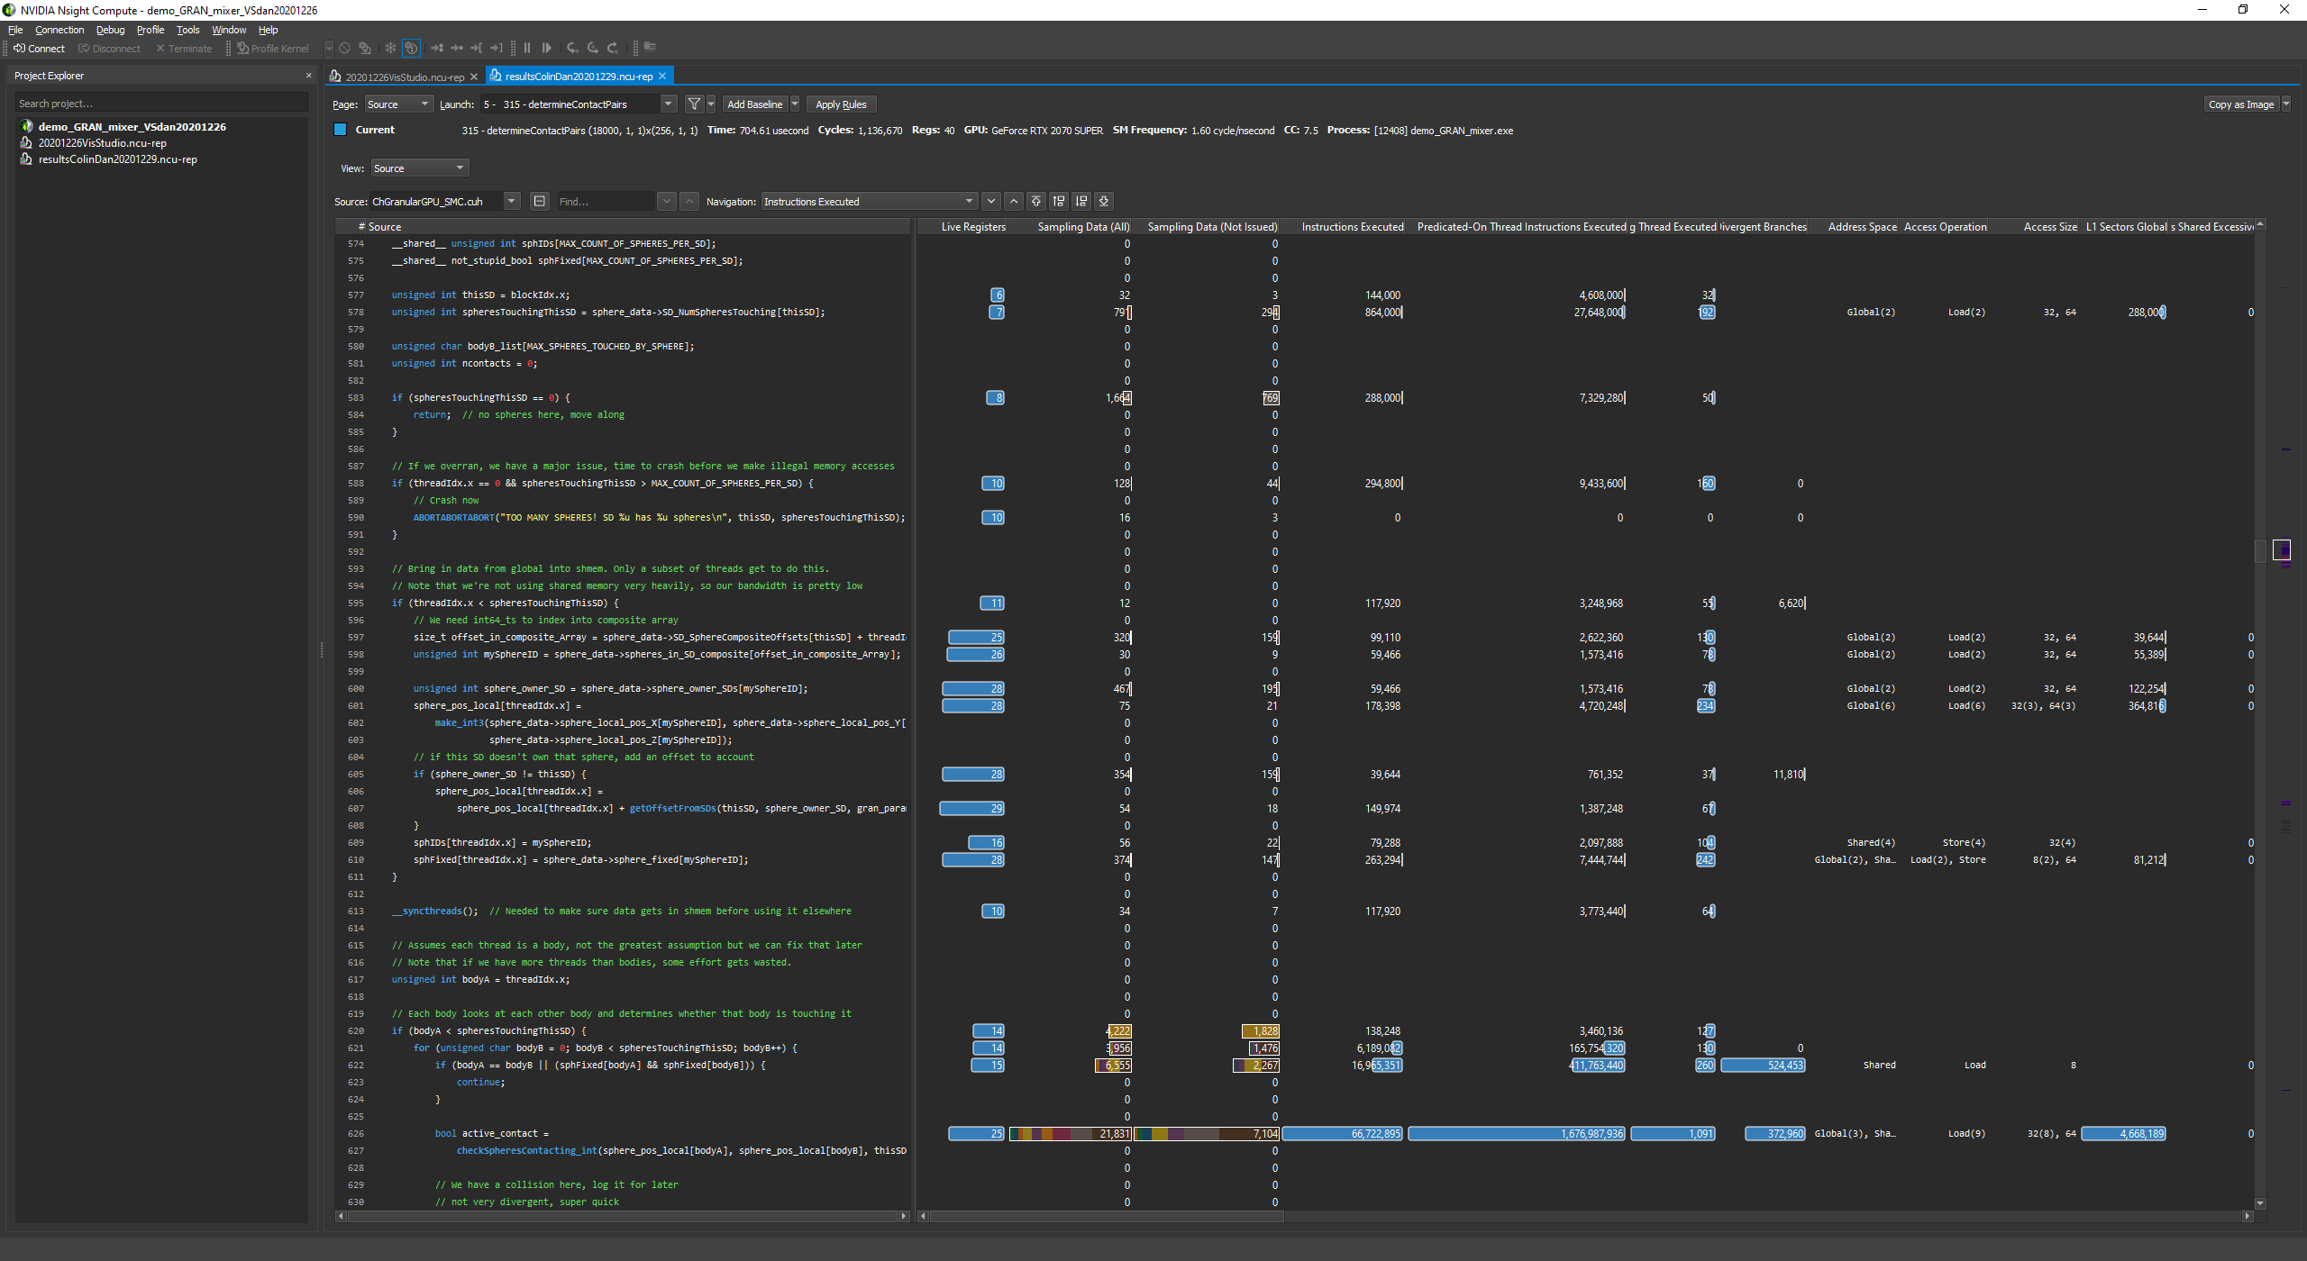
Live registers [snapshot from NVIDIA’s Nsight]

Slide 11
Programmer View of Register File
4 blocks
3 blocks
Number of 32 bit registers in one SM is as follows:
8K registers in each SM in G80
16K on Tesla
32K on Fermi
64K on Kepler and Maxwell, Pascal, Volta, and Ampere
Registers are dynamically partitioned across all Blocks assigned to the SM
Once assigned to a Block, these registers are NOT accessible by threads in other Blocks
A thread in a Block can only access registers assigned to itself
IMPORTANT: A thread can have assigned by the compiler up to 255 registers
Possible per-block partitioning scenarios of the RF available on the SM

Slide 12
Register related: a “level of parsimony” issue
Size of a register: 4 bytes
Is it that if you use a char in a kernel, then you don’t use a full register but rather ¼ of it?
Not really, unfortunately; i.e., there is no parsimony in usage of a register
Any data type that requires less then or equal to 4 bytes eats up a register
One char thus eats up an entire register
If you use a double, it eats up two registers
Notes:
See also https://devtalk.nvidia.com/default/topic/491309/int-vs-short-vs-char-in-kernels/

Slide 13
From the left field…
Q: Who do you think controls/decides the register allocation when executing a kernel?
A: The compiler

Slide 14
The Concept of Local Memory [“local”: misnomer]
(Device) Grid
Physically, local memory does not exist
In reality, data stored in “local memory” is placed in cache or the global memory at run time or by the compiler
What gets stored in local memory?
Register spill, if too many registers are needed for computation (“high register pressure”)
The stack of the thread
Quick observations:
“Local” means that it’s got local scope; i.e., it’s specific to one thread and not visible to any other thread
Local memory has the same latency as global memory, unless cached
Block (0, 0)
Block (1, 0)
Shared Memory
Shared Memory
Registers
Registers
Registers
Registers
Thread (0, 0)
Thread (1, 0)
Thread (0, 0)
Thread (1, 0)
Local
Memory
Local
Memory
Local
Memory
Local
Memory
Host
Global
Memory
Constant
Memory
Texture
Memory
Notes:
Global, constant, and texture memory spaces are persistent across kernels called by the same application.

Slide 15
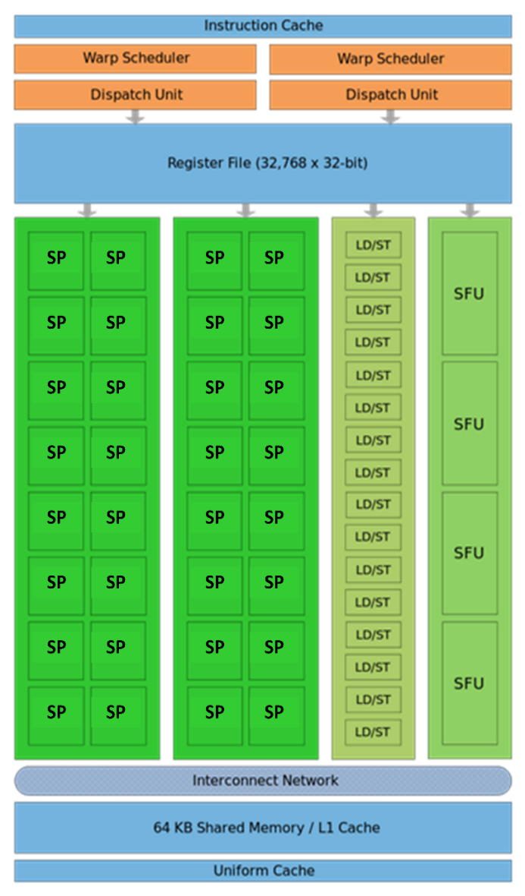
Caches & the Shared Memory
Fermi
Each SM: 64 KB L1 cache & shared memory
All SMs tap into a common 768 KB L2 cache memory
Pascal:
Each SM: Unified 24 KB L1 cache
Each SM: 64 KB shared memory
All SMs tap into 4096 KB of L2 cache memory
Volta:
L1 cache + Shared Mem = 128 KB per SM
One can carve out of 128KB shared memory as follows:
0 KB, 8 KB, 16 KB, 32 KB, 64 KB, or 96 KB
What is not taken by the ShMem becomes L1 cache:
128 KB, 120 KB, 112 KB, 96 KB, 64 KB, 32 KB
All SMs tap into 6144 KB of L2 cache memory, visible to all SMs
IMPORTANT: Numbers reported are per SM
Fermi SM
Notes:
The previous plot is bandwidth for moving data from/to global memory.
Each SM has local L1 cache (shared with shared memory, ratio under user control).
Fermi default: 48 KB shared / 16 KB L1 cache (can also do16/48)
Kepler: 48/16, 32/32, 16/48
Difference: shared memory is controlled by the user. L1 cache use is automatic. If you do not use shared memory, increase the chunk for L1 cache to allow the hardware to leverage it.

Slide 16

Global, Constant, and Texture Memories
Global memory
Main means of communicating R/W Data between host and device
Contents visible to all threads
Texture and Constant Memories
Constants initialized by host
Contents visible to all threads
Global, texture and constant memories are accessible by host
Done at high latency, low bandwidth
(Device) Grid
Block (0, 0)
Block (1, 0)
Shared Memory
Shared Memory
Registers
Registers
Registers
Registers
Thread (0, 0)
Thread (1, 0)
Thread (0, 0)
Thread (1, 0)
Local
Memory
Local
Memory
Local
Memory
Local
Memory
Host
Global
Memory
Constant
Memory
NOTE: We will not emphasize texture in ME759.
Texture
Memory
[NVIDIA]$→$

Slide 17
CUDA Device Memory Allocation/Deallocation
(Device) Grid
Block (0, 0)
Block (1, 0)
cudaMalloc()
Allocates mem in the device Global Memory
Requires two parameters
Address of a pointer to the allocated object
Size of allocated object
cudaFree()
Frees mem from device Global Memory
Requires a pointer to freed object
Shared Memory
Shared Memory
Registers
Registers
Registers
Registers
Thread (0, 0)
Thread (1, 0)
Thread (0, 0)
Thread (1, 0)
Local
Memory
Local
Memory
Local
Memory
Local
Memory
Host
Global
Memory
Constant
Memory
Texture
Memory

Slide 18
CUDA Host-Device Data Transfer
(Device) Grid
cudaMemcpy()
Memory data transfer
Requires four parameters
Pointer to source
Pointer to destination
Number of bytes copied
Type of transfer
Host to Host
Host to Device
Device to Host
Device to Device
Things happen over a PCIe connection
Up to 16 GB/s (PCIe 3.0 x16, in each direction)
Up to 32 GB/s (PCIe 4.0 x16, in each direction)
Block (0, 0)
Block (1, 0)
Shared Memory
Shared Memory
Registers
Registers
Registers
Registers
Thread (0, 0)
Thread (1, 0)
Thread (0, 0)
Thread (1, 0)
Local
Memory
Local
Memory
Local
Memory
Local
Memory
Host
Global
Memory
Constant
Memory
Texture
Memory
Notes:
PCIe 4.0 16X (expected 2017) → almost 32 GB/s
NVLink (available on Pascal) → 5-12 times faster than PCIe 3.0

Slide 19
CUDA Host-Device Data Transfer (cont.)
Example:
Transfer a number of “size” bytes
M is in host memory and Md is in device memory
cudaMemcpyHostToDevice and cudaMemcpyDeviceToHost are CUDA-defined constants
cudaMemcpy(Md.elements, M.elements, size, cudaMemcpyHostToDevice);
cudaMemcpy(M.elements, Md.elements, size, cudaMemcpyDeviceToHost);
Note: if you use gdb to debug, don’t expect to be able to read memory off a device pointer
Debugging for GPU computing relies on cuda-gdb
Notes:
Note: copy values in constant memory (from the host) using cudaMemcpyToSymbol
Example:
__device__ __constant__ pivalue;
float foo = 3.14159f;
cudaMemcpyToSymbol(&pivalue, &foo, sizeof(float));

Slide 20
Memory Access Times
Register – dedicated HW on chip - single cycle NOTE: you don’t have control over this
Shared Memory – dedicated HW on chip – a few cycles NOTE: physically, like L1 cache
Local Memory – DRAM, (if not in cache - *slow*; if cached – relatively fast)
Global Memory – DRAM, no cache - *slow*; cached, is fast…
Constant Memory – DRAM, cached, 10s…100s of cycles, depending on cache locality
Texture Memory – DRAM, cached, 10s…100s of cycles, depending on cache locality
Instruction Memory (invisible) – DRAM, cached
Notes:
Take away message: organize your code to use as much as possible the faster memory:
keep in mind the relative access times (some of these change with new hardware)
be careful how you organize data and what data you bring over (do not duplicate information)
Recall:
GPUs have much larger register files than a CPU
64K registers (each one word, i.e. 32 bits) per SM on Pascal
But you can also have up to 2048 threads resident per SM
So you end up with just 32 registers per thread!
In fact, NVIDIA sets an upper limit of 255 registers/thread

Slide 21
Storage Locations
Memory | Location | Cached | Access | Who
Register | On-chip | N/A | Read/write | One thread only
Shared | On-chip | N/A | Read/write | All threads in a block
Global | Off-chip | Yes | Read/write | All threads + host
Constant | Off-chip | Yes | Read | All threads + host
Texture | Off-chip | Yes | Read | All threads + host
Off-chip means on the GPU but not on the SM, which translates into high latency.
Notes:
Back in the day (Tesla C1060): global memory was not cached

Slide 22
Putting things in perspective: The 3 most important GPU memory spaces
Thread
Register: per-thread basis
Private per thread
Can spill into local memory (potential performance hit unless cached)
Shared Memory: per-block basis
Shared by threads of the same block
Used for: intra-block inter-thread communication
Global Memory: per-application basis
Available for use by all threads
Used for: global access, all threads
Also used for inter-grid communication
Register
Block
Shared
Memory
Grid 0
Global
Memory
. . .
Sequential
Grids
in Time
Grid 1
. . .

Slide 23
Slightly from the left field
GPU virtual memory: 49-bit virtual address space mapped to physical memory located in 3 places
On the device
On the host, pinned system memory
On a different GPU (peer memory)
Global memory is visible to all threads in the GPU
Global memory is accessed through the SM L1 and GPU L2

Slide 24
Example: Matrix Multiplication, Revisited
Purpose
See an example where the use of multiple blocks of threads plays a central role
Highlight the use/role of the shared memory
Point out the __syncthreads() function call
NOTE: A one dimensional array stores the entries in the matrix
Notes:
Here we will use a bus instead of a bunch of cars to bring over data from memory.
Savings come from the fact that bandwidth to accessing shared memory is ~10 better than global memory.
Thread synchronization becomes crucial to avoid race conditions

Slide 25
A Critique of the Old Matrix Multiplication Example
One row of M is loaded N.width times
This happens for each row of M
Moral of the story: the matrix M is loaded N.width times
One column of N is loaded M.height times
This happens for each column of N
Moral of the story: the matrix N is loaded M.height times
Loading M and N over and over → not a good idea, memory transactions are expensive
Grid 1
N
Block 1
Thread
(2, 2)
48
M
P
width

Slide 26
Why Revisit the Old Example?
In the naïve first implementation the ratio of arithmetic computation to memory transaction (“arithmetic intensity”) very low
Each arithmetic computation required one fetch from global memory
The entries in M are copied from global memory to the device N.width times
The entries in N are copied from global memory to the device M.height times
No brownie points for moving data around
Hundreds of cycles required for bringing data from global memory
When solving a problem, the goal is to go through the machine instructions in your executable, not to wait for data to come your way
Notes:
Data reuse is the goal

Slide 27
Answering the question: “Could/Should I use Shared Memory?”
Figuring out whether you should use share mem
Imagine you are a thread executing the code in the kernel
If the data that you, as a thread, use can also be used by another thread in your block, then you should consider using shared memory
Note: regardless of the above test, you can use shared memory as scratch pad memory
Don’t let it go wasted, use for storing often-used variables even if they’re not used by multiple threads

Slide 28
A Common CUDA Programming Pattern: Tiling w/ Shared Memory
Global memory access - much slower when compared to shared memory access
No brainer: Use shared memory, if possible
Partition data into data subsets (tiles) that each fits into shared memory
Handle each data subset (tile) with one thread block by:
Loading the tile from global memory into shared memory, using multiple threads to exploit memory-level parallelism
Performing the computation on the tile from shared memory; each thread can efficiently multi-pass over any data element of the tile
Notes:
Recall: global memory: DRAM Shared memory: SRAM (split with L1 - Fermi or dedicated - Pascal)
Focus on data reuse
Introduce the concept of tiling (common programming pattern)

Slide 29
Tiling used for Matrix-Matrix multiplication
tx
One block computes one square sub-matrix C_{sub} of size Block_Size
B
Block_Size
One thread computes one entry of C_{sub}
Assumption: A and B are square matrices and their dimensions of are multiples of Block_Size
Doesn’t have to be like this, but keeps example simpler and focused on the concepts of interest
In this example work with Block_Size=16x16
wA
Block_Size
A
C
C_{sub}
Block_Size
hA
ty
Block_Size
Block_Size
Block_Size
wA
wB
NOTE: A similar technique is used on CPUs to improve cache hits. See slide “Blocking Example” at
http://cseweb.ucsd.edu/classes/fa10/cse240a/pdf/08/CSE240A-MBT-L15-Cache.ppt.pdf
Notes:
We will have a first loop over tiles (moving left in A, moving down in B)
Then, inside a tile (i.e. a block), each thread will loop over a row in the A tile and a column in the B tile to calculate a piece of its final value (the red square in C)

Slide 30
A Block of 16 X 16 Threads
Notes:
We will have 256 (16x16) threads that will work in concert on a tile
They will bring together (in shared memory) one tile from A and one tile from B
Then, they each work separately on calculating an increment for their assigned C[i,j]
But they do so by sharing data!

Slide 31
// Thread block size
#define BLOCK_SIZE 16
// Forward declaration of the device multiplication func.
__global__ void Muld(float*, float*, int, int, float*);
// Host multiplication function
// Compute C = A * B
// hA is the height of A
// wA is the width of A
// wB is the width of B
void Mul(const float* A,const float* B,int hA,int wA,int wB, float* C)
{
// Load A and B to the device
float* Ad;
int size = hA * wA * sizeof(float);
cudaMalloc((void**)&Ad, size);
cudaMemcpy(Ad, A, size, cudaMemcpyHostToDevice);
float* Bd;
size = wA * wB * sizeof(float);
cudaMalloc((void**)&Bd, size);
cudaMemcpy(Bd, B, size, cudaMemcpyHostToDevice);
// Allocate C on the device
float* Cd;
size = hA * wB * sizeof(float);
cudaMalloc((void**)&Cd, size);
// Compute the execution configuration *assuming*
// the matrix dimensions are multiples of BLOCK_SIZE
dim3 dimBlock(BLOCK_SIZE, BLOCK_SIZE);
dim3 dimGrid( wB/dimBlock.x , hA/dimBlock.y );
// Launch the device computation
Muld<<<dimGrid, dimBlock>>>(Ad,Bd,wA,wB,Cd);
// Read C from the device
cudaMemcpy(C, Cd, size, cudaMemcpyDeviceToHost);
// Free global memory
cudaFree(Ad);
cudaFree(Bd);
cudaFree(Cd);
}
Notes:
Execution configuration:
blocks must all have 16x16 = 256 threads (take advantage of 2D layout)
how many blocks do we need? simple under our assumption that the matrix dimensions are multiples of the tile size
if not, more complicated (some tiles will “fall off” the matrix extent) this is messy and main part of frustration in CUDA computing

Slide 32
Notes:
bx = blockIdx.x the B (and C) matrix sub-block column index
by = blockIdx.y the A (and C) matrix sub-block row index
aBegin = wA * (by*BLOCK_SIZE) index of the first sub-matrix of A processed by the block
aEnd = aBegin + wA – 1
aStep = BLOCK_SIZE
bBegin = BLOCK_SIZE * bx;
bStep = BLOCK_SIZE * wB

Slide 33
// Shared memory for the sub-matrices (tiles) of A and B
__shared__ float As[BLOCK_SIZE][BLOCK_SIZE];
__shared__ float Bs[BLOCK_SIZE][BLOCK_SIZE];
// Loop over all the sub-matrices (tiles) of A and B required to
// compute the block sub-matrix; moving in A left to right in
// a row, and in B from top to bottom in a column
for (int a = aBegin, b = bBegin;
a <= aEnd;
a += aStep, b += bStep) {
// Load tiles from global memory into shared memory; each
// thread loads one element of the two tiles from A & B
As[ty][tx] = A[a + wA * ty + tx];
Bs[ty][tx] = B[b + wB * ty + tx];
// Synchronize to make sure the matrices are loaded
__syncthreads();
// Each thread in this block computes one element
// of the block sub-matrix (tile). Thread with indexes
// ty and tx computes in this tile the entry [ty][tx].
for (int k = 0; k < BLOCK_SIZE; ++k)
Csub += As[ty][k] * Bs[k][tx];
// Synchronize to make sure that the preceding
// computation is done before loading two new
// sub-matrices of A and B in the next iteration
__syncthreads();
}
// Write the block sub-matrix to global memory;
// each thread writes one element
int c = wB * BLOCK_SIZE * by + BLOCK_SIZE * bx;
C[c + wB * ty + tx] = Csub;
}
// Device multiplication function called by Mul()
// Compute C = A * B
// wA is the width of A
// wB is the width of B
__global__ void Muld(float* A, float* B, int wA, int wB, float* C)
{
// Block index
int bx = blockIdx.x; //the B (and C) matrix sub-block column index
int by = blockIdx.y; //the A (and C) matrix sub-block row index
// Thread index
int tx = threadIdx.x; //the column index in the sub-block
int ty = threadIdx.y; //the row index in the sub-block
// Index of the first sub-matrix of A processed by the block
int aBegin = wA * BLOCK_SIZE * by;
// Index of the last sub-matrix of A processed by the block
int aEnd = aBegin + wA - 1;
// Step size used to iterate through the sub-matrices of A
int aStep = BLOCK_SIZE;
// Index of the first sub-matrix of B processed by the block
int bBegin = BLOCK_SIZE * bx;
// Step size used to iterate through the sub-matrices of B
int bStep = BLOCK_SIZE * wB;
// The element of the block sub-matrix that is computed
// by the thread
float Csub = 0;
Notes:
if __shared__ does not appear: each thread sets aside 16x16 memory locations for As and 16x16 for Bs
that’s already double what could ever be in registers → spills to local memory
with __shared__ this memory is specific to the block and shared between all threads in the block!
attention: all threads bring over disjoint pieces of data
Why do we need the __syncthreads here? Only threads in the same warp proceed in lock-step fashion. But threads in different warps do not.
Who gets synchronized? Threads in the same block
Would it make sense to have a Cs in shared memory? No – recall the “test for using shared memory”; no other thread needs this information

Slide 34
Synchronization Function
Synchronization accomplished through a device lightweight function
void __syncthreads();
Synchronizes all threads in a block (acts as barrier for all block threads)
Does not synchronize threads from two blocks
One more condition for execution to commence once all threads in a block reached the sync point:
All global & shared mem. transactions made by these threads prior to __syncthreads() are visible to all block threads
Used to avoid RAW/WAR/WAW hazards when accessing shared or global memory (more later)
Notes:
Attention: do not put a __syncthreads in an if statement unless you can guarantee all threads in the block go through there!

Slide 35
[warning] __syncthreads() & thread divergence
#include<cuda.h>
#include<iostream>
__global__ void badIdeaSynchronization(int* data)
{
int i = threadIdx.x + blockDim.x * blockIdx.x;
if ((i & 0x01) == 0)
{
data[i] = data[i] + i; // if not odd, come here
}
else
{
data[i] = data[i] + 2 * i; // come here if you're odd
__syncthreads();
}
}
int main()
{
const int numElems = 4;
int hostArray[numElems], *devArray;
//allocate memory on the device (GPU); zero out all entries in this device array
cudaMalloc((void**)&devArray, sizeof(int) * numElems);
cudaMemset(devArray, 0, numElems * sizeof(int));
//invoke GPU kernel, with one block that has four threads
hangs<<<1, numElems >>>(devArray);
//bring the result back from the GPU into the hostArray
cudaMemcpy(&hostArray, devArray, sizeof(int) * numElems, cudaMemcpyDeviceToHost);
//print out the result to confirm that things are looking good
std::cout << "Values stored in hostArray: " << std::endl;
for (int i = 0; i < numElems; i++)
std::cout << hostArray[i] << std::endl;
//release the memory allocated on the GPU
cudaFree(devArray);
return 0;
}
Be very cautious when using a __syncthreads() in a conditional
The actual behavior is not clear
Some difference between the Programming Guide and what happens in reality
See here for discussion of how/when code deadlocks:
https://stackoverflow.com/questions/6666382/can-i-use-syncthreads-after-having-dropped-threads
https://stackoverflow.com/questions/15146886/conditional-syncthreads-deadlock-or-not

Slide 36
3 Ways to Set Aside Shared Memory
First way: Statically, declared inside a kernel
See matrix multiplication example w/ shared memory use
Second way: Through the execution configuration
Ns below indicates size (in bytes) to be allocated in shared memory
__global__ void MyFunc(float*) // __device__ or __global__ function
{
extern __shared__ float shMemArray[];
// Size of shMemArray determined through the execution configuration
// You can use shMemArray as you wish here…
}
// invoke like this
MyFunc<<< Dg, Db, Ns >>>(parameter);
Third way: Dynamically, via CUDA Driver API
Advanced feature, uses API function cuFuncSetSharedSize(), not discussed here

Slide 37
Example: Dynamic shared memory
Reverse an array using dynamic shared memory
dynamicReverse<<<1, n, n*sizeof(int)>>>(d_d, n);
size of the shared memory
__global__ void dynamicReverse(int *d, int n) {
extern __shared__ int s[]; // different syntax with the static shared memory, reading in the size from the kernel call
int t = threadIdx.x;
int tr = n-t-1;
s[t] = d[t];
__syncthreads(); // make sure all threads have completed loading into shared memory
d[t] = s[tr];
}
[https://developer.nvidia.com/blog/using-shared-memory-cuda-cc/]$→$

Slide 38
Dwelling on the fetching data into shared memory
Task at hand: load data from global memory into shared memory
Data might be in global mem or in L2 cache
On Volta and older architectures:
Data was first loaded through L1 cache into the register file with load-global instructions
Then, data was transferred from the register file to shared memory with store-shared instructions
On Ampere, there is a new asynchronous copy instruction that loads data directly from global memory into SM shared memory
Called “load-global-store-shared asynchronous copy”
Bypasses the register file
Less pressure on registers
Less overhead
Notes:
More information: see https://www.nvidia.com/content/dam/en-zz/Solutions/Data-Center/nvidia-ampere-architecture-whitepaper.pdf

Slide 39
Ampere A100 specific, Cache and Shared Memory aspects
New asynchronous copy instruction loads data directly from global memory into shared memory, optionally bypassing L1 cache, and eliminating the need for intermediate register file (RF) usage
Two other Ampere A100 footnotes:
Data cache/Share mem combo: 192 KB/SM in A100 (versus 128 KB/SM in V100)
SECDED ECC protection for L2 cache, as well as the L1 caches and register files inside all SMs
[NVIDIA Ampere whitepaper]$→$

Slide 40
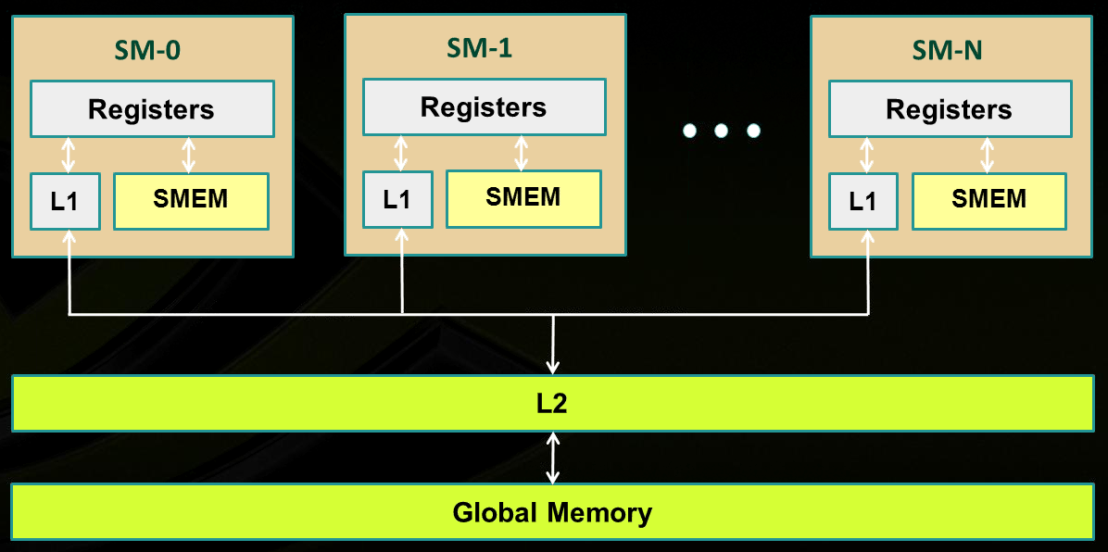
Memory Layout: All GPU units communicate to main memory through L2 cache
SM₀
SM₁
SM_{N-1}
NVIDIA→
Note: shared memory is not cached (visible in pic as well)
Notes:
Illustration of caches intermediating global memory access.
Recall: shared memory is not cached

Slide 41
How L2 is used
L2 includes hardware that performs, among other things:
data compression
global atomic operations
Opportunity for Class Participation bonus:
Not clear to the instructor how data compression is done, what the overhead is, what percentage compression is typical, lossy vs. nonlossy compression, what savings it leads to, etc.

Slide 42
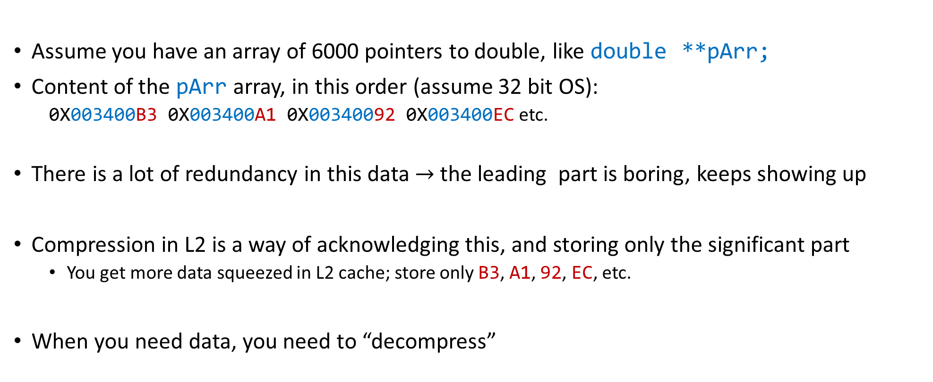
Short Trip: Compression – why bother?
Assume you have an array of 6000 pointers to double, like double **pArr;
Content of the pArr array, in this order (assume 32 bit OS):
0X003400B3 0X003400A1 0X00340092 0X003400EC etc.
There is a lot of redundancy in this data $→$ the leading part is boring, keeps showing up
Compression in L2 is a way of acknowledging this, and storing only the significant part
You get more data squeezed in L2 cache; store only B3, A1, 92, EC, etc.
When you need data, you need to “decompress”

Slide 43
L1 & L2 Cache Issues [two slide detour – 1/2]
L1 and L2 cache used to cache accesses to
Local memory
Global memory
(texture & constant as well)
L2 cache: one big mem pool available to *all* SMs (sometimes called “uniform cache”; uniformly available)
Volta: 6,144 KB
Ampere: 40,000 KB
Whether reads are cached in [L1 & L2] or in [L2 only] can be partially configured on a per-access basis using modifiers to the load or store instruction
More on this in a bit; or byte.
Notes:
Recalling some numbers for a particular card (Fermi).
On all recent cards, all memory transactions are intermediated by the cache.
Size of cache line: 128 bytes
You can determine at *compile* time (through flags: -dlcm=ca/cg) if you double cache [L1 & L2] or only cache [L2 only]
If [L1 & L2], a memory access is serviced with a 128-byte memory transaction
If [L2 only], a memory access is serviced with a 32-byte memory transaction
This can reduce over-fetch in the case of scattered memory accesses
Good for irregular pattern access (sparse linear algebra)

Slide 44
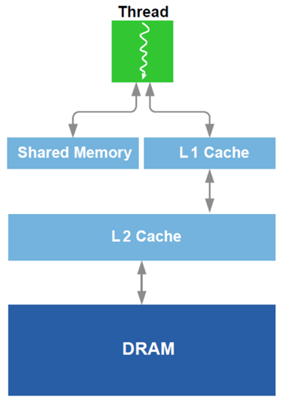
L1 Cache vs. Shared Memory [two slide detour – 2/2]
Starting w/ Fermi architecture, you can split some fast memory between shared memory and cache
Example, Fermi: you can go 48/16 or 16/48 KB for Shared Mem/Cache
OPTION 1: you choose to go w/ “Lots of Cache & Little Shared Mem”
Cache handled for you by the scheduler
No control over it
Can’t have too many blocks of threads running if blocks use Shared Mem
OPTION 2: you choose to go w/ “Lots of Shared Mem & Little Cache”
Good in tiling, you have full control
Shared Mem pretty cumbersome to manage
Notes:
On Maxwell and Pascal, dedicated shared memory (64) and unified L1 cache (24), per SM
Pre-Pascal, the L1 cache / ShMem split can be done at runtime, or through compiler option
One last note about specifying use of shared memory for a block:
statically, declared in the kernel function using the keyword __shared__ like we did before
specify requirements through the execution configuration: __global__ void my_kernel(…) { extern __shared__ float As[]; // size is Ns bytes … } my_kernel<<< grid_dim , block_dim , Ns >>> (…);
dynamically, through the CUDA driver API (low-level) cuFuncSetSharedSize();
Note: as of Fermi, no direct access to shared memory. May need to use volatile to prevent the compiler from optimizing by using registers! Not needed here because __syncthreads already has memory-fencing built-in (i.e. the registers are evicted back to shared memory at that point)

Slide 45
L1: odds and ends
The L1 data cache involved in handling
Memory reads & writes: global, local, shared, texture, and surface memories
Reduction operations
Atomic operations
Texture memory:
Opportunity for class participation
Slightly different requirements to hit the “TEX cache” compared to hitting “typical memory cache”
There is a different concept of “locality” at play
How “texture data” is stored different than how typical data is stored

Slide 46
On the architecture of the GPU’s Shared Memory [1/2]
GPU computing: many threads access the ShMem at the same time
To service more than one thread, ShMem is divided into independent banks
This layout essential to achieve high bandwidth
Each SM has ShMem organized in 32 Memory banks
Successive 32-bit words map to successive banks
Each bank has a bandwidth of 32 bits per clock cycle
Bank 0
Bank 1
Bank 2
Bank 3
Bank 4
Bank 5
Bank 6
Bank 7
Bank 31

Slide 47
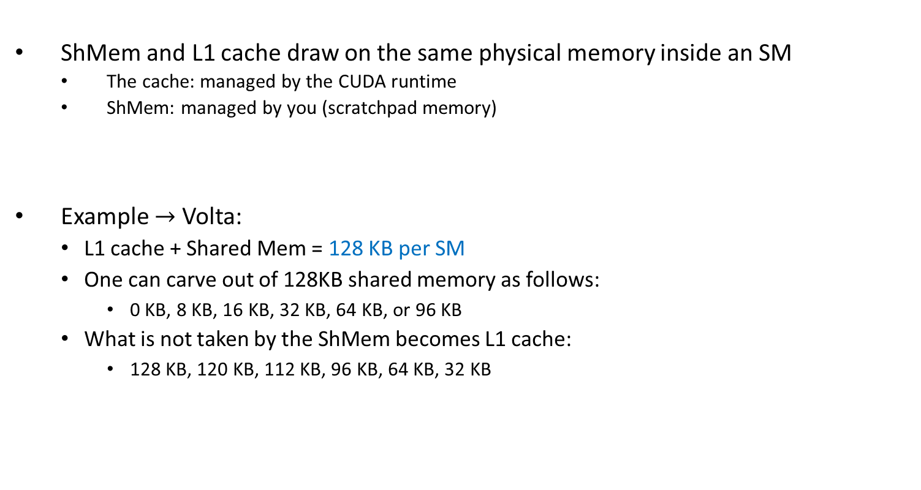
On the architecture of the GPU’s Shared Memory [1/2]
ShMem and L1 cache draw on the same physical memory inside an SM
The cache: managed by the CUDA runtime
ShMem: managed by you (scratchpad memory)
Example $→$ Volta:
L1 cache + Shared Mem = 128 KB per SM
One can carve out of 128KB shared memory as follows:
0 KB, 8 KB, 16 KB, 32 KB, 64 KB, or 96 KB
What is not taken by the ShMem becomes L1 cache:
128 KB, 120 KB, 112 KB, 96 KB, 64 KB, 32 KB
Bank 0
Bank 1
Bank 2
Bank 3
Bank 4
Bank 5
Bank 6
Bank 7
Bank 31

Slide 48
On the architecture of the GPU’s Shared Memory [2/2]
The 32 ShMem banks organized like benches in a movie theater
You have multiple rows of benches
Each row has 32 benches separated; each bench belongs to a long column
A bank: a column of benches in the movie theater, perpendicular to screen
In each bench you can “seat” a family of four bytes (32 bits total)
Each bank has a bandwidth of 32 bits per two clock cycles
I
$
There are 32 columns of benches (banks);
each column is very deep (many benches)
L
1
Bank 0
Multithreaded
Bank 1
Instruction Buffer
Bank 2
Bank 3
This is the back of the screen of the movie theater
Bank 4
R
D
$
Shared
Bank 5
F
L
1
Mem
Bank 6
Bank 7
Operand Select
Bank 31
MAD
SFU

Slide 49
Shared Memory: Transaction Rules & Bank Conflicts
When reading in four-byte words, 32 threads in a warp attempt to access shared memory simultaneously
Bank conflict: two different threads access *different* words in different rows of the same bank
Note that there is no conflict if different threads access any bytes within the same word (same row)
Notes:
DN (12/18/2020): “A shared memory request for a warp does not generate a bank conflict between two threads that access any address within the same 32-bit word (even though the two
addresses fall in the same bank). When multiple threads make the same read access, one thread receives the data and then broadcasts it to the other threads. When multiple threads write to the same location, only one thread succeeds in the write; which thread that succeeds is undefined”

Slide 50
Shared Memory: Transaction Rules & Bank Conflicts
Bank conflicts enforce the hardware to serialize a ShMem access, which adversely impacts bandwidth
If multiple threads make the same ShMem read access, one thread receives the data & then broadcasts it to the other threads.
When multiple threads write to the same ShMem location, only one thread succeeds in the write; which thread that succeeds is undefined
Notes:
DN (12/18/2020): “A shared memory request for a warp does not generate a bank conflict between two threads that access any address within the same 32-bit word (even though the two
addresses fall in the same bank). When multiple threads make the same read access, one thread receives the data and then broadcasts it to the other threads. When multiple threads write to the same location, only one thread succeeds in the write; which thread that succeeds is undefined”

Slide 51
Shared Memory Bank Conflicts
If there are no bank conflicts:
Shared memory access is fast, but not quite as fast as register access
On the bright side, latency is roughly 100x lower than global memory latency
ShMem operation, the fast case:
If all threads of a warp access different banks, there is no bank conflict
If all threads of a warp access an identical address for a fetch operation, there is no bank conflict (broadcast)
ShMem memory operation, the slow case:
Worst case: 32 threads access 32 different words in the same bank
Must serialize all the accesses
In general, cost = max # of simultaneous accesses to a single bank

Slide 52
Example: How Addresses Map to Banks, for array of float
An allotted chunk of shared memory starts at an address that is at least a multiple of 128 (if not 256)
Bank you work with = (address of offset) % 32
Example: 1D shared mem array, myShMemVar, of 1024 floats
myShMemVar[4]: accesses bank #4 (physically, the fifth one – first row)
myShMemVar[31]: accesses bank #31 (physically, the last one – first row)
myShMemVar[50]: access bank #18 (physically, the 19th one – second row)
myShMemVar[128]: access bank #0 (physically, the first one – fifth row)
myShMemVar[178]: access bank #18 (physically, the 19th one – sixth row)
If, for instance, the third thread in a warp accesses myShMemVar[50] and the eight thread in the warp accesses myShMemVar[178], then you have a two-way bank conflict, and the two transactions get serialized
IMPORTANT: There is no such thing as “bank conflicts” between threads belonging to different warps

Slide 53

Bank Addressing Examples Transactions Involving 4 Byte Words
No Bank Conflicts
Linear addressing stride == 1
No Bank Conflicts
Random 1:1 Permutation
Thread 0
Bank 0
Thread 0
Bank 0
Thread 1
Bank 1
Thread 1
Bank 1
Thread 2
Bank 2
Thread 2
Bank 2
Thread 3
Bank 3
Thread 3
Bank 3
Thread 4
Bank 4
Thread 4
Bank 4
Thread 5
Bank 5
Thread 5
Bank 5
Thread 6
Bank 6
Thread 6
Bank 6
Thread 7
Bank 7
Thread 7
Bank 7
Thread 31
Bank 31
Thread 31
Bank 31
[NVIDIA]$→$

Slide 54
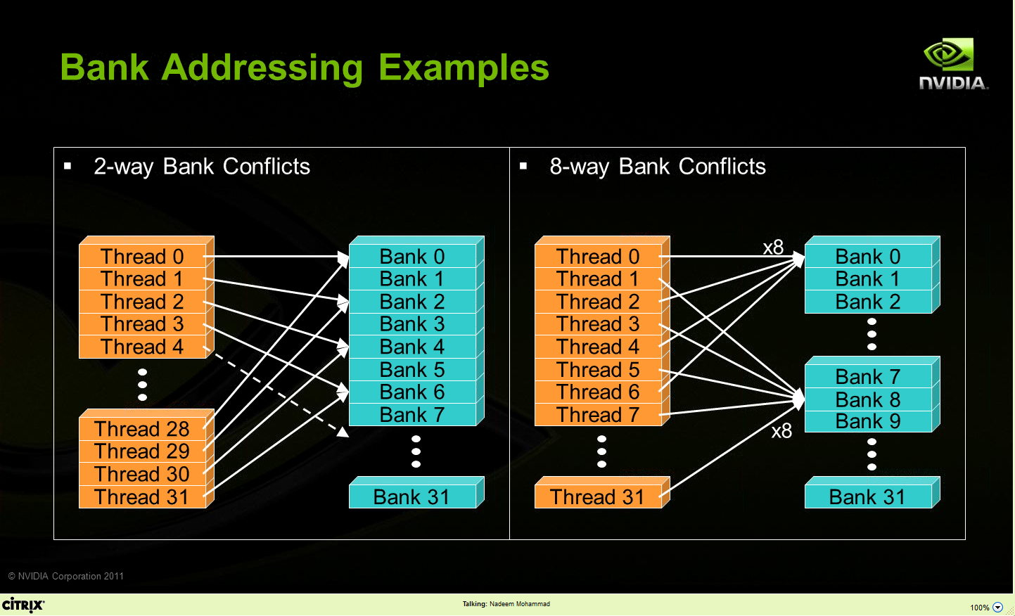
Bank Addressing Examples Transactions Involving 4 Byte Words
A case in which only the even banks end up being accessed, and the warps access different words in each bank
A case in which the 32 threads in a warp access only banks 0, 8, 16, and 24 (and different words in these four banks)
[NVIDIA]$→$

Slide 55
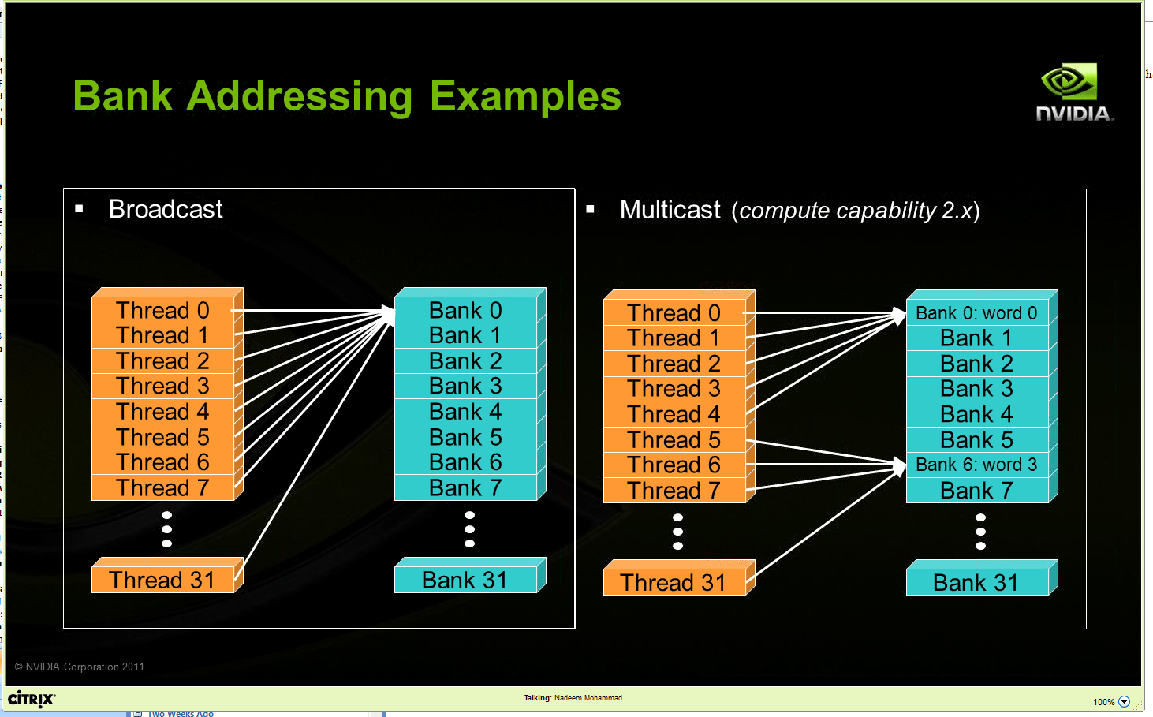
Other Examples
Two “no conflict” scenarios, reading operations:
Broadcast: all threads in a warp access the same word in a bank
Multicast: several threads in a warp access the same word in the same bank

Slide 56
Linear Addressing
Given:
__shared__ float sharedM[256];
float foo = sharedM[baseIndex + s * threadIdx.x];
This is bank-conflict-free if s shares no common factors with the number of banks
Conclusion: you are fine if s is odd
s=1
s=3
Thread 0
Bank 0
Thread 0
Bank 0
Thread 1
Bank 1
Thread 1
Bank 1
Thread 2
Bank 2
Thread 2
Bank 2
Thread 3
Bank 3
Thread 3
Bank 3
Thread 4
Bank 4
Thread 4
Bank 4
Thread 5
Bank 5
Thread 5
Bank 5
Thread 6
Bank 6
Thread 6
Bank 6
Thread 7
Bank 7
Thread 7
Bank 7
Thread 31
Bank 31
Thread 31
Bank 31
Note: baseIndex assumed 0 (zero) in these two pics

Slide 57
Data types and bank conflicts
No conflicts if shrd is a 32-bit data type:
foo = shrd[baseIndex + threadIdx.x]
Also if accessing one byte-per-thread, no conflict since *different* bytes of the same word are accessed
No conflicts:
extern __shared__ char shrd[];
foo = shrd[baseIndex + threadIdx.x];
No conflicts:
extern __shared__ short shrd[];
foo = shrd[baseIndex + threadIdx.x];
Thread 0
Bank 0
Thread 1
Bank 1
Thread 2
Bank 2
Thread 3
Bank 3
Thread 4
Bank 4
Thread 5
Bank 5
Thread 6
Bank 6
Thread 7
Bank 7
Thread 31
Bank 31
Thread 0
Bank 0
Thread 1
Bank 1
Thread 2
Bank 2
Thread 3
Bank 3
Thread 4
Bank 4
Thread 5
Bank 5
Thread 6
Bank 6
Thread 7
Bank 7
Thread 31
Bank 31

Slide 58
Exercise: Is ShMem access below good or bad?
Snippet from a kernel, each thread loads two floats into ShMem:
This makes sense for traditional CPU threads, locality in cache line usage and reduced sharing traffic
Doesn’t make sense in shared memory usage where there is no cache line effects but banking effects
2-way-interleaved loads result in 2-way bank conflicts
Adding insult to injury: you don’t have coalesced global memory loads – basically you are halving the global mem bandwidth (more on this later)
int tid = threadIdx.x;
shared[2*tid ] = global[offset+2*tid ];
shared[2*tid+1] = global[offset+2*tid+1];
Thread 0
Bank 0
Thread 1
Bank 1
Thread 2
Bank 2
Thread 3
Bank 3
Bank 4
Bank 5
Bank 6
Bank 7
Thread 16
Thread 17
Thread 18
Thread 19
Bank 31
Notes:
What is “cache line effects”?

Slide 59
A better array access pattern: Revisiting example on previous slide
Thread 0
Bank 0
Here’s a better way of doing it
Each thread loads one element in every consecutive group of blockDim elements.
Thread 1
Bank 1
Thread 2
Bank 2
Thread 3
Bank 3
shared[tid] = global[offset + tid];
shared[tid + blockDim.x] = global[offset + tid + blockDim.x];
Thread 4
Bank 4
Thread 5
Bank 5
Thread 6
Bank 6
Thread 7
Bank 7
Thread 31
Bank 31

Slide 60
Ruminations, memory related
Looking ahead (today and next lecture), ruminations on two topics
Memory operations, getting the result right (broad discussion, for parallel computing, not only GPU)
Memory operations, getting the result fast (narrower discussion, for GPU computing)

Slide 61
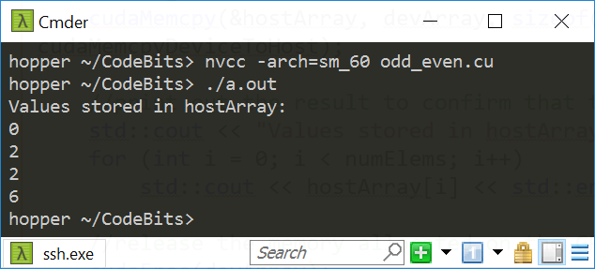
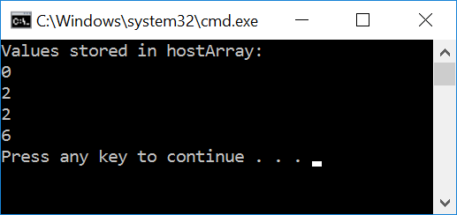
#include<cuda.h>
#include<iostream>
__global__ void odd_even(int* data) {
int i = threadIdx.x;
if ((i & 0x01) == 0)
{
data[i] = data[i] + i; // if even, come here
}
else
{
data[i] = data[i] + 2*i; // come here if you're odd
}
}
int main() {
const int numElems = 4;
int hostArray[numElems], *devArray;
//allocate memory on the device (GPU); zero out all device array entries
cudaMalloc((void**)&devArray, sizeof(int) * numElems);
cudaMemset(devArray, 0, numElems * sizeof(int));
//invoke GPU kernel, with one block that has four threads
odd_even<<<1, 4 >>>(devArray);
//bring the result back from the GPU into the hostArray
cudaMemcpy(&hostArray, devArray, sizeof(int) * numElems, cudaMemcpyDeviceToHost);
//print out the result to confirm that things are looking good
std::cout << "Values stored in hostArray: " << std::endl;
for (int i = 0; i < numElems; i++)
std::cout << hostArray[i] << std::endl;
//release the memory allocated on the GPU
cudaFree(devArray);
return 0;
}
Linux, P100
Windows, GTX1080

Slide 62
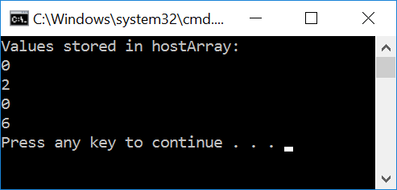
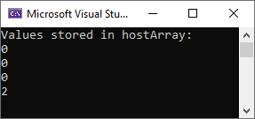
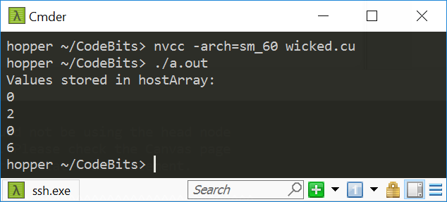
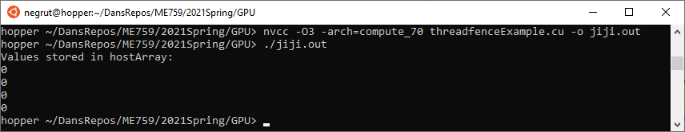
#include<cuda.h>
#include<iostream>
__global__ void wicked(int* data) {
int i = threadIdx.x;
if ((i & 0x01) == 0)
{
data[i+1] = data[i+1] + i; // if even, come here
}
else
{
data[i] = data[i] + 2*i; // come here if you're odd
}
}
int main() {
const int numElems = 4;
int hostArray[numElems], *devArray;
//allocate memory on the device (GPU); zero out all device array entries
cudaMalloc((void**)&devArray, sizeof(int) * numElems);
cudaMemset(devArray, 0, numElems * sizeof(int));
//invoke GPU kernel, with one block that has four threads
wicked<<<1, 4 >>>(devArray);
//bring the result back from the GPU into the hostArray
cudaMemcpy(&hostArray, devArray, sizeof(int) * numElems, cudaMemcpyDeviceToHost);
//print out the result to confirm that things are looking good
std::cout << "Values stored in hostArray: " << std::endl;
for (int i = 0; i < numElems; i++)
std::cout << hostArray[i] << std::endl;
//release the memory allocated on the GPU
cudaFree(devArray);
return 0;
}
Windows, GTX1080
Windows, RTX2070
Linux, P100

Slide 63
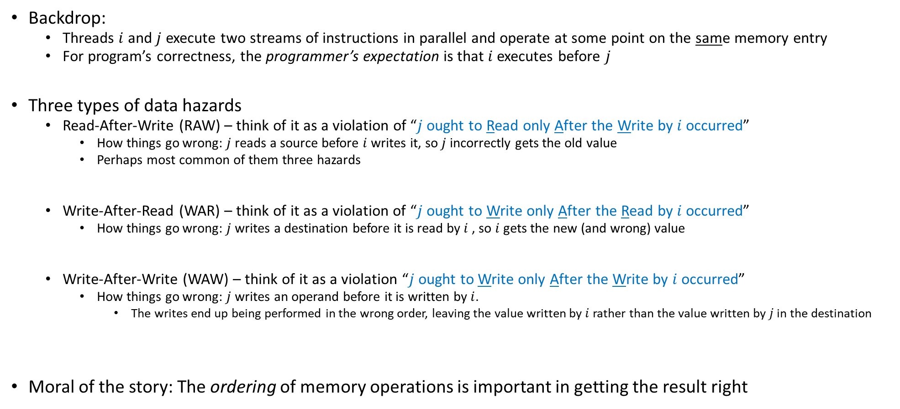
Data Hazards in Parallel Computing (not only GPU)
Backdrop:
Threads $i$ and $j$ execute two streams of instructions in parallel and operate at some point on the same memory entry
For program’s correctness, the programmer’s expectation is that $i$ executes before $j$
Three types of data hazards
Read-After-Write (RAW) – think of it as a violation of “$j$ ought to Read only After the Write by $i$ occurred”
How things go wrong: $j$ reads a source before $i$ writes it, so $j$ incorrectly gets the old value
Perhaps most common of them three hazards
Write-After-Read (WAR) – think of it as a violation of “$j$ ought to Write only After the Read by $i$ occurred”
How things go wrong: $j$ writes a destination before it is read by $i$ , so $i$ gets the new (and wrong) value
Write-After-Write (WAW) – think of it as a violation “$j$ ought to Write only After the Write by $i$ occurred”
How things go wrong: $j$ writes an operand before it is written by $i$.
The writes end up being performed in the wrong order, leaving the value written by $i$ rather than the value written by $j$ in the destination
Moral of the story: The ordering of memory operations is important in getting the result right

Slide 64
Parallel computing, bottom line
Parallel computing: previous slide, two threads led to race conditions – in absence of special measures, there is no way to know who executes what and when
A matter of “thread racing”, or “race conditions”
“special measures”, example: use of __syncthreads()
Can we at least say something about the order in which memory operations are carried out?
A matter of “sequence of memory ops”, pertains one thread (with side effects when a 2nd thread present)

Slide 65
The concept of “memory consistency”
__device__ volatile int X = 1, Y = 2;
__device__ void writeXY()
{
X = 10;
Y = 20;
}
__device__ void readXY()
{
int A = Y;
int B = X;
}
Backdrop
Thread_1 executes writeXY()
Thread_2 executes readXY()
Question: what values can A and B assume?
For sequential consistency (“strongly-ordered mem. model”), the only possible scenarios are
A=2 and B=1
A=20 and B=10
A=2 and B=10
For weak consistency (“weakly-ordered memory model”), it is possible to have this
A=20 and B=1

Slide 66
Flavors of memory consistency
Sequential consistency: all reads and all writes are in-order
Relaxed consistency: some types of reordering are allowed
Loads can be reordered after loads (for better working of cache coherency, better scaling)
Loads can be reordered after stores
Stores can be reordered after stores
Stores can be reordered after loads
Weak consistency: reads & writes arbitrarily reordered
Programmer expected to step in and use explicit memory barriers if a certain order needed to be observed

Slide 67
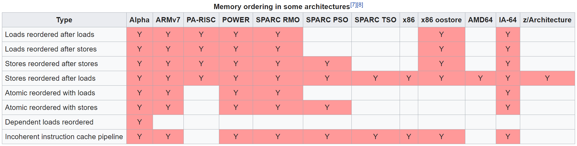

Not a GPU computing but rather a parallel computing issue
Example, memory ordering for some non-GPU architectures
[Wikipedia]$→$

