Slide 1
ME759 High Performance Computing for Applications in Engineering [Spring 2021]
Lecture 26
03/24/2021
Dan Negrut, 2021 ME759 UW-Madison

Slide 2
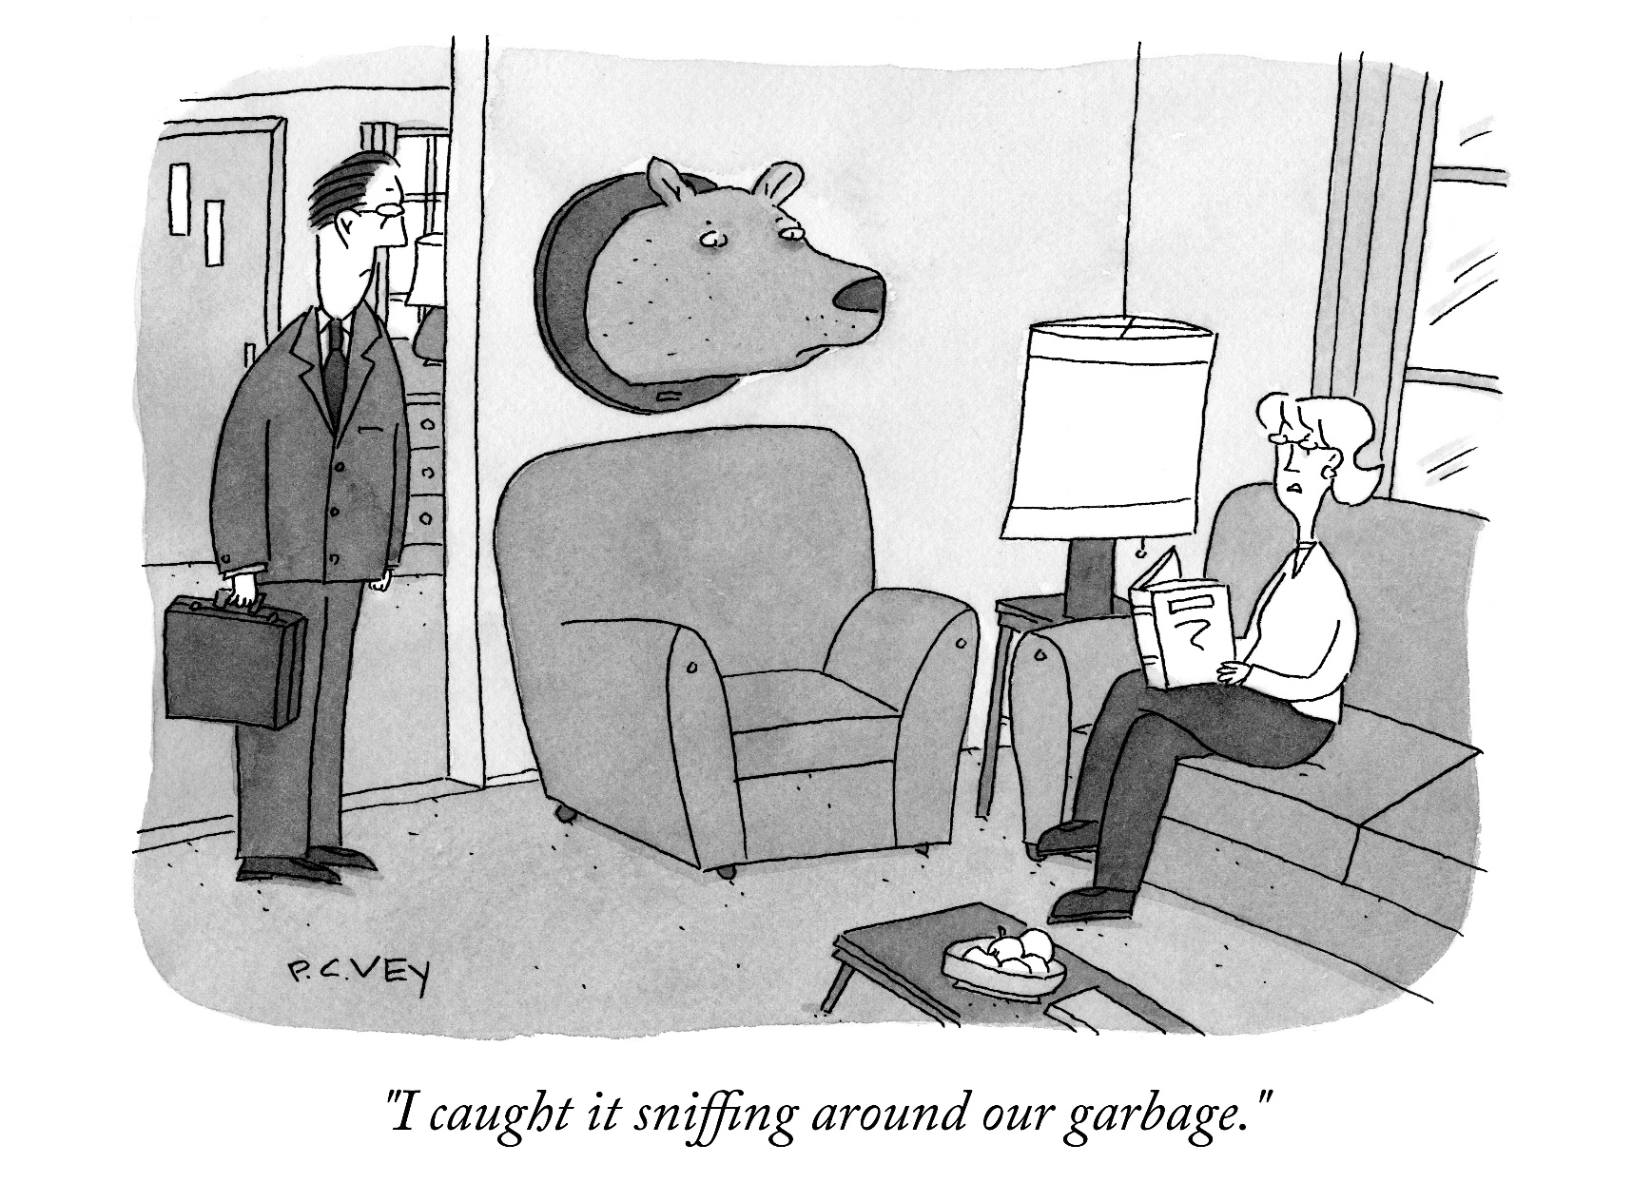
Cartoon of the day
[P.C. Vey]$→$

Slide 3
Is BBC recording on?
If my internet connection goes down, I’ll email from my phone to provide more information – go/no-go, next step, etc.

Slide 4
Before we get started…
Last time
Wrapped up “Critical thinking” segment. Went through a case study, saw more than 100X speed up
No function-call blockers; loop unrolling & re-association; dropped in the wide-register vectorization
Started discussion about parallel computing via message passing (multi-process parallel computing)
Covered the hardware aspects related to HPC
Today
HPC via MPI: discuss the basic ideas/paradigms
MPI point-to-point communication
Other tidbits:
Assignment due on Th, 03/25, at 9 pm. Two assignments left at this point
Big ME759 PDF is here
ME759 final exam: April 13, 7-9 pm, online. Post related questions on Piazza
Review: April 12, 7-9 pm, online
More details on Monday (during last lecture)
Final Project. Post related questions on Piazza
Feedback on proposal provided in Canvas
Four students have not submitted a proposal
Template for Final Project report is here
More details on Monday (during last lecture)
Do not run your code on the Euler head-node (use Slurm)

Slide 5
[new topic] HPC with the Message Passing Interface (MPI): Outline
Introduction to message passing and MPI
Point-to-Point Communication
Collective Actions
HPC w/ MPI: Closing Remarks

Slide 6
MPI: High-level overview
N instances of the same program are launched for execution independently as N distinct processes
Flynn Taxonomy classification: MIMD
MPI & Distributed Memory: enables a MIMD computing mechanism
Multiple Instruction and Multiple Data
The basic idea: just like the same kernel was run by N CUDA threads, here the same program is run by N different processes
The processes communicate with each other by messages

Slide 7
Parallel Computing w/ MPI: One way to look at it
CUDA: a small snippet of code (the “kernel”) run by all threads spawned via your exec. config.
OpenMP: all threads execute an omp parallel region; “work sharing” is the darling there
MPI: the *entire* code is executed in parallel by all processes

Slide 8
A First MPI Program
#include "mpi.h"
#include <iostream>
int main(int argc, char **argv) {
int my_rank, n;
char hostname[128];
MPI_Init(&argc,&argv);
MPI_Comm_rank(MPI_COMM_WORLD, &my_rank);
MPI_Comm_size(MPI_COMM_WORLD, &n);
gethostname(hostname, 128);
if (my_rank == 0) { /* master */
printf("I am the master: %s\n", hostname);
}
else { /* worker */
printf("I am a worker: %s (rank=%d/%d)\n", hostname, my_rank, n-1);
}
MPI_Finalize();
return 0;
}
Has to be called first, and once only
Nothing special about rank=0.
Has to be called last, and once only
[A. Snavely]→

Slide 9
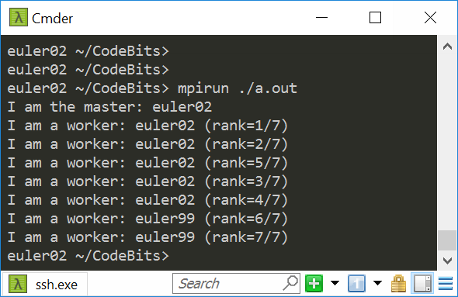
Program Output
I asked for 8 ranks
Got my 8 ranks spread out over two nodes: euler02 and euler99
Please use Slurm to run your jobs; instructions in the assignment. Colin can assist if you have questions

Slide 10
MPI: High-level Overview
Each MPI process, which runs most often on one core, executes the same executable at roughly the same time
Synchronization calls can be invoked (more later); useful to coordinate the execution of the MPI job
Unlike in CUDA, synchronization in MPI can be global

Slide 11
MPI: High-level Overview
What differentiates processes is their rank: processes with different ranks do different things (“branching based on the process rank”)
Very similar to GPU computing, where one thread did work based on its thread index
Very similar to OpenMP function omp_get_thread_num()

Slide 12
The Message-Passing Model
Each process has its own program counter *and* virtual address space
Message passing enables communication among processes that have separate address spaces
This is how different then OpenMP
Inter-process communication typically consists of
Synchronization, followed by…
… movement of data from one process’s address space to another process’s address space

Slide 13
MPI, quick remarks
MPI: Avoids cache coherence slowdowns - ranks running on different nodes, typically
There is no transparent data movement between ranks
No inter-rank data movement will happen behind your back
Your duty to manage/choreograph the data movement between ranks

Slide 14
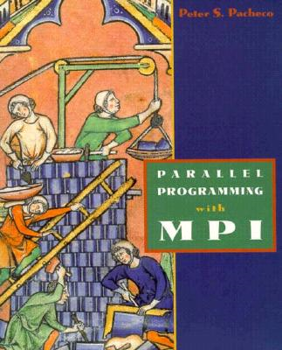
MPI: A Second Example Application
Example from Peter Pacheco’s book: “Parallel Programming with MPI”
/* greetings.c -- greetings program
*
* Send a message from all processes with rank != 0 to process 0.
* Process 0 prints the messages received.
*
* Input: none.
* Output: contents of messages received by process 0.
*
* See Chapter 3, pp. 41 & ff in PPMPI.
*/

Slide 15
MPI: A Second Example Application
#include "mpi.h"
#include <stdio.h>
#include <string.h>
int main(int argc, char* argv[]) {
int my_rank; /* rank of process */
int p; /* number of processes */
int source; /* rank of sender */
int dest; /* rank of receiver */
int tag = 0; /* tag for messages */
char message[100]; /* storage for message */
MPI_Status status; /* return status for receive */
MPI_Init(&argc, &argv); // Start up MPI
MPI_Comm_rank(MPI_COMM_WORLD, &my_rank); // Find out process rank
MPI_Comm_size(MPI_COMM_WORLD, &p); // Find out number of processes
if (my_rank != 0) {
/* Create message */
sprintf(message, "Greetings from process %d!", my_rank);
dest = 0;
/* Use strlen+1 so that '\0' gets transmitted */
MPI_Send(message, strlen(message)+1, MPI_CHAR, dest, tag, MPI_COMM_WORLD);
}
else { /* my_rank == 0 */
for (source = 1; source < p; source++) {
MPI_Recv(message, 100, MPI_CHAR, source, tag, MPI_COMM_WORLD, &status);
printf("%s\n", message);
}
}
MPI_Finalize(); // Shut down MPI
return 0;
} /* main */
Type of each sent item
Destination process rank
Identifier for this message
The receiving rank gets all messages in sequence; as such, printing will happen in a sequence
Buffer to be sent
Number of items to send
!

Slide 16
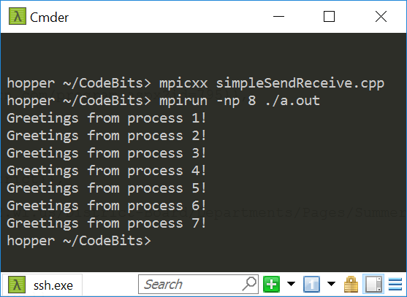
Program Output

Slide 17
The Message-Passing Programming Paradigm
The Sequential Programming Paradigm
data
memory
program
Processor/Process
Message-Passing Programming Paradigm
data
data
data
data
Distributed memory
program
program
program
program
communication network
Multiple processes
[ICHEC]→

Slide 18
Fundamental Concepts: Process/Program/Processor
A process is a software program executing in its own memory virtual space a task on a processor
In other words, each process in an MPI job runs an instance of a program:
Program is written in C, C++, or Fortran. Reason: these are the languages for scientific computing, which MPI serves
The variables of each program have the same name but live in different virtual memories and assume different values
Communicate via special send & receive routines (message passing)
What each program does is controlled by the rank of its process within the MPI job
data
data
data
data
program
program
program
program
communication network

Slide 19
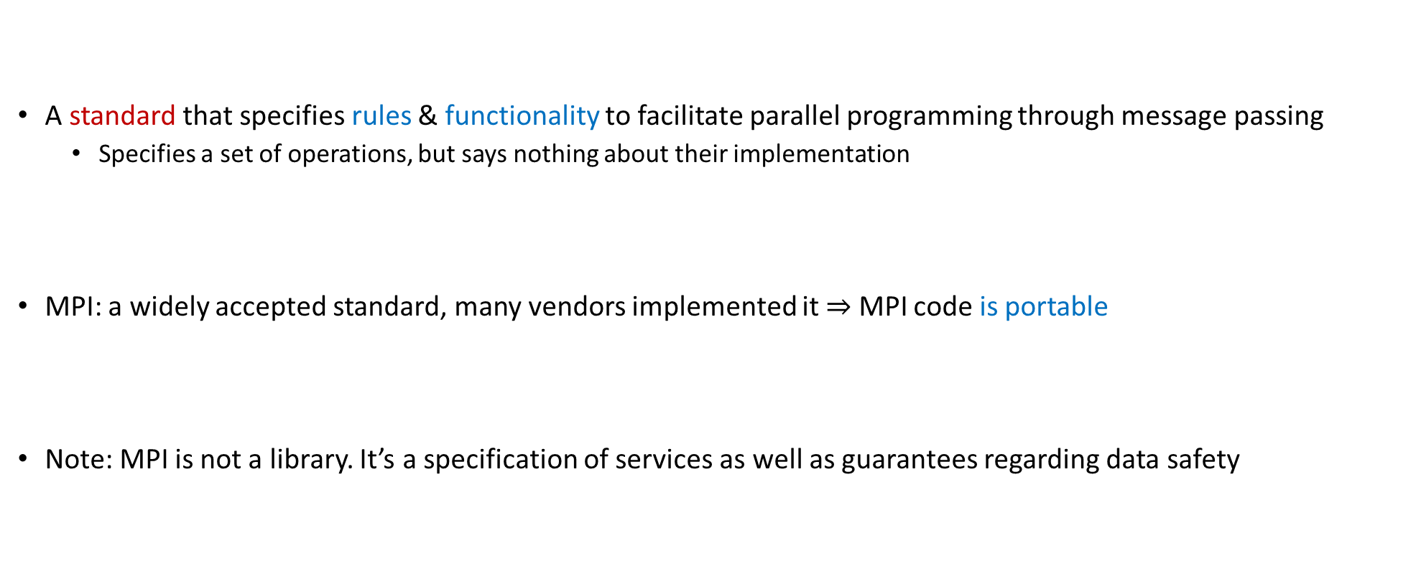
What is MPI?
A standard that specifies rules & functionality to facilitate parallel programming through message passing
Specifies a set of operations, but says nothing about their implementation
MPI: a widely accepted standard, many vendors implemented it $⇒$ MPI code is portable
Note: MPI is not a library. It’s a specification of services as well as guarantees regarding data safety

Slide 20
Two MPI implementations
Early implementation of MPI: MPICH (this is a library that implements [some of] the MPI specifications)
The CH comes from Chameleon, the software layer used in the original MPICH to provide portability to the existing message-passing systems
OpenMPI: another library that implements [some of] the MPI specifications
Joint effort of several groups from Los Alamos, Tennessee, Indiana University, Europe
Just as we discussed for OpenMP, MPI is a standard and different vendor provide libraries that implement a certain version of the standard and a certain set of features defined in that version of the standard

Slide 21
Where can we use MPI?
Message passing can be used wherever it is possible for processes to exchange messages:
Distributed memory systems
Network of workstations
Even on one workstation that has many cores
An MPI job run on one workstation does not pass data over a network; it does so through the main memory
Important Note: the ranks share the same physical memory, but they are each tied to separate virtual memory spaces

Slide 22
MPI vs OpenMP
Assume 16 threads/ranks on one workstation (assume one socket, 16-core processor)
If 16 OpenMP threads, they will operate against the same virtual memory
They are relatively lightweight
If 16 MPI ranks, they do not operate against the same virtual memory
There will be 16*distinct* processes, each with its virtual memory space
The OS will see 16 processes, they might as well be Matlab, python program running, spotify, chrome, etc.
threads as in OpenMP have a lower runtime overhead than processes as in MPI
Handling threads vs processes

Slide 23
MPI vs. CUDA
When would you use GPU computing and when would you use MPI-based parallel programming?
Use GPU
If your data fits the memory constraints associated with GPU computing
You have parallelism at a fine grain so that you the SIMD paradigm applies
Example: Image processing
Use MPI-enabled parallel programming
If you have a very large problem, with a lot of data that needs to be spread out across several machines
Example: Large-scale CFD, FEA – sophisticated, multi-stage algorithms
NOTE: there are many machines on which HPC is done using both MPI and CUDA

Slide 24
Why care about MPI?
Widely used in Scientific Computing; MPI has FORTRAN and C bindings
MPI is what enables supercomputers to run at PFlops rates
At the node level:
An MPI rank might use OpenMP the multiple cores available on a node
An OpenMP thread might use a GPU to launch kernels

Slide 25
MPI: Pluses and Minuses
Pluses:
Access to lots of memory (across many nodes…)
Access to a lot of processors (across many nodes…)
Better scalability - No cache coherence overhead at all when two ranks run on different nodes
Large MPI jobs involve tens of thousands of processes, each running heavy weight code
Minuses:
High latency in node-to-node communication
Low bandwidth compared to what we’ve seen so far (GPU & OpenMP on a workstation)
It’s your responsibility to share data amongst ranks
NOTE: up-to-date typical latencies & bandwidth of various systems available here
Ranges: 5-10 usec & 1-80 GB/s (BW depends heavily on size of the big-iron machine; more like 1-5 GB/s)

Slide 26
MPI on Euler [Selecting MPI Distribution]
What’s available: OpenMPI, MVAPICH, MVAPICH2
OpenMPI is default on Euler
To load OpenMPI environment variables:
Typically not needed, should be done automatically for you
>> module load openmpi

Slide 27
Compiling MPI Code by Hand
Most MPI distributions provide wrapper scripts named mpicc or mpicxx
Adds in –L, -l, -I, etc. flags for MPI
Passes any options to your native compiler (gcc)
Very similar to what nvcc did for CUDA – it’s a compile driver…
>> mpicxx -o integrate_mpi integrate_mpi.cpp

Slide 28
Example, Running on Euler [Context: running the executable integrate_mpi]
### BEGINNING OF submit_mpi.sh SCRIPT ###
#!/bin/bash
#SBATCH -t 0-5:0:0
#SBATCH -o output.txt
cd $SLURM_SUBMIT_DIR
mpirun ./integrate_mpi
### END OF SCRIPT ###
euler $ sbatch –p wacc --gres=infiniband:1 -N 2 --ntasks-per-node=4 submit_mpi.sh
euler $ cat output.txt
8 32.121040666358297 in 2.171963s
euler $ sbatch –p wacc --gres=infiniband:1 -N 2 --ntasks-per-node=2 submit_mpi.sh
euler $ cat output.txt
4 32.121040666358297 in 4.600204s
euler $ sbatch –p wacc --gres=infiniband:1 -N 1 --ntasks-per-node=1
euler $ cat output.txt
1 32.121040666358297 in 15.163330s

Slide 29
Running MPI, In General
mpirun [-np #] [-machinefile file] <program> [<args>]
Number of processors. Inside SLURM, this is handled automatically.
List of hostnames to use. Inside SLURM, this is handled automatically.
Your program and its arguments
-np will be set automatically by SLURM. Do not use it.
-machinefile will be set automatically by SLURM. Do not use it.
See the mpirun manpage for more options

Slide 30
Quick note…
ME759 is not about remembering how to launch (or lunch?) a job on a cluster
This is where a sysadmin person steps in. For clusters, somebody like Colin is meant to set things up
Instead, the focus is on understanding how things work, how you can get the code to run fast

Slide 31
Outline, Parallel Computing w/ MPI
Introduction to message passing and MPI
Point-to-Point (P2P) Communication
Collective Actions
MPI Closing Remarks

Slide 32
Parallel computing issue: Who am I? What’s my problem/task?
Parallel computing on the GPU, on multi-core chips, and multi-node (MPI) share one thing:
For each thread/rank a mechanism is in place to provide a unique ID
ID then used to figure out what that thread/rank ought to be doing
Specifically,
In CUDA you have threadIdx and blockIdx
In OpenMP you have the thread ID
In MPI you have a process rank

Slide 33
The Rank & The Communicator [As Facilitators for Data and Work Distribution]
To communicate with each other MPI processes need identifiers: rank = identifying number
Work distribution decisions are based on the rank
Helps establish which process works on which data
Just like we had thread and block indices in CUDA
myrank=0
data
myrank=1
data
myrank=2
data
myrank= (size-1)
data
program
program
program
program
communication network
[ICHEC]→

Slide 34
Message Passing: The Actors Involved
Messages are packets of data moving between different processes
Necessary information for the message passing system:
sending process + receiving process i.e., the two “ranks”
source mem.location + destination mem.location
source data type + destination data type
source data size + destination buffer size
data
program
communication network
[ICHEC]→

Slide 35
Point-to-Point (P2P) Communication
P2P: Simplest form of message passing communication
One process sends a message to another process
MPI_Send
MPI_Recv

Slide 36
MPI: Revisiting Previous Example
Example: MPI_Send / MPI_Recv
#include "mpi.h"
#include <stdio.h>
#include <string.h>
int main(int argc, char* argv[]) {
int my_rank; /* rank of process */
int p; /* number of processes */
int source; /* rank of sender */
int dest; /* rank of receiver */
int tag = 0; /* tag for messages */
char message[100]; /* storage for message */
MPI_Status status; /* return status for receive */
MPI_Init(&argc, &argv); // Start up MPI
MPI_Comm_rank(MPI_COMM_WORLD, &my_rank); // Find out process rank
MPI_Comm_size(MPI_COMM_WORLD, &p); // Find out number of processes
if (my_rank != 0) {
/* Create message */
sprintf(message, "Greetings from process %d!", my_rank);
dest = 0;
/* Use strlen+1 so that '\0' gets transmitted */
MPI_Send(message, strlen(message)+1, MPI_CHAR, dest, tag, MPI_COMM_WORLD);
}
else { /* my_rank == 0 */
for (source = 1; source < p; source++) {
MPI_Recv(message, 100, MPI_CHAR, source, tag, MPI_COMM_WORLD, &status);
printf("%s\n", message);
}
}
MPI_Finalize(); // Shut down MPI
return 0;
} /* main */
Could I use a different name here?
Notes:
Yes, you can use any variable you want, if it is of the appropriate type and can handle the data that is expected to store

Slide 37
Point-to-Point Communication
Communication between two processes
In pic. below: source process sends message to destination process
Communication takes place within a communicator, e.g., MY_COMM_WORLD
Processes are identified by their ranks within the communicator
Recall that the same process has different ranks in different communicators
(communicator)
MY_COMM_WORLD
0
2
message
1
5
4
3
destination
source
6
[ICHEC]→

Slide 38
P2P Communication, Syntax Issues: Sending a Message
buf is the starting point of the message with count elements, each described with datatype
dest is the rank of the destination process within the communicator comm
tag is an additional nonnegative integer piggyback information, additionally transferred with the message
The tag can be used to distinguish between different messages
Not very common, but needed occasionally
int MPI_Send(void *buf, int count, MPI_Datatype datatype, int dest, int tag, MPI_Comm comm)
[ICHEC]→

Slide 39
P2P Communication, Syntax Issues: Receiving a Message
buf/count/datatype describe the receive buffer
count says how many elements of the data type at hand can be stored in buf
Function call enables the receiving of the message sent by process with rank source in comm
Only messages with matching tag are received
Envelope information is returned in an MPI_Status object whose address status is passed as argument
int MPI_Recv(void *buf, int count, MPI_Datatype datatype, int source, int tag, MPI_Comm comm, MPI_Status *status)
[ICHEC]→

Slide 40
The MPI_COMM_WORLD Communicator
All processes of an MPI program are members of the default communicator MPI_COMM_WORLD
MPI_COMM_WORLD is a predefined handle in mpi.h
Each process has its own rank in a given communicator:
starting with 0
ending with (size-1)
MPI_COMM_WORLD
0
1
7
2
3
5
4
6
You can define a new communicator in case you find it useful
To create a new communicator MY_COMM_WORLD
MPI_Comm_create(MPI_COMM_WORLD, new_group, &MY_COMM_WORLD);
[ICHEC]→

Slide 41
MPI_Comm_create
Synopsis
Input Parameters
comm - communicator (handle)
group - subset of the family of processes making up the comm (handle)
Output Parameter
newcomm - new communicator (handle)
NOTE: Same process has different ranks in different communicators
int MPI_Comm_create(MPI_Comm comm, MPI_Group group, MPI_Comm *newcomm);

Slide 42
The Data Type
A message contains a number of elements of some particular data type
MPI data types:
Basic data type
User-defined data types – not emphasized here
Data type handles describe the type of the data moved around
Example: message with 5 integers
2345
654
96574
-12
7676
[ICHEC]→

Slide 43
MPI-defined data types, and C counterparts
MPI Datatype | C datatype
MPI_CHAR | signed char
MPI_SHORT | signed short int
MPI_INT | signed int
MPI_LONG | signed long int
MPI_UNSIGNED_CHAR | unsigned char
MPI_UNSIGNED_SHORT | unsigned short int
MPI_UNSIGNED | unsigned int
MPI_UNSIGNED_LONG | unsigned long int
MPI_FLOAT | float
MPI_DOUBLE | double
MPI_LONG_DOUBLE | long double
MPI_BYTE
MPI_PACKED
count=5
datatype=MPI_INT
int arr[5]
Example:
2345
654
96574
-12
7676
[ICHEC]→

Slide 44
Message Order Preservation
Rule for messages on the same connection; i.e., same communicator, source, and destination rank:
Messages do not overtake each other
If both receives match both messages, then the order is preserved
Recall the “memory consistency models” discussion we had back in CUDA (when we discussed threadfences)
0
2
1
5
4
3
6
[ICHEC]→

Slide 45
The Mechanics of P2P Communication: Wildcarding
Receiver can wildcard
To receive from any source – source = MPI_ANY_SOURCE
To receive from any tag – tag = MPI_ANY_TAG
Actual source and tag returned in receiver’s status argument
One more instance where the status argument comes into play
[ICHEC]→

Slide 46
MPI_Recv: The Need for an MPI_Status Argument
The MPI_Status object updated by the MPI_Recv call settles a series of questions:
The receive call does not specify the size of an incoming message, but only an upper bound on the receive buffer
The actual size only known to the sender (think about it)
The source or tag of a received message may not be known if wildcard values were used in a receive operation

Slide 47
The Mechanics of P2P Communication: Communication Envelope
int MPI_Get_count(MPI_Status *status, MPI_Datatype datatype, int *count);
INPUT: status and datatype. OUTUPT: count
From: source (rank)
tag
Envelope information is returned from MPI_RECV via the status pointer
status->MPI_SOURCE status->MPI_TAG count via MPI_Get_count()
To: destination rank
item-1
item-2
item-3 count
item-4 elements
...
item-n
[ICHEC]→

Slide 48
The Mechanics of P2P Communication: Rules of Engagement, Summary
For a communication to succeed:
Sender must specify a valid destination rank
Receiver must specify a valid source rank
The communicator must be the same
Tags must match
Message data types must match
Receiver’s buffer must be large enough
[ICHEC]→

Slide 49
On the “blocking” aspect of the point-to-point communication
By and large*, when a process enters a “send” function, it does not come out until a “receive” call in a different rank matched the “send” call
Vice-versa, when a rank makes a MPI_Recv call, it comes out only the MPI_Send call was made
This means that both sender & receiver hang. Thus, these two calls block the execution
Notes:
MPI_Send: When the call returns, the content of sbuf can be safely changed; the transaction has concluded
MPI_Recv: When the call returns, the content of rbuf can be used; the transaction has concluded
int MPI_Send(void *sbuf, int count, MPI_Datatype datatype, int dest, int tag, MPI_Comm comm)
int MPI_Recv(void *rbuf, int count, MPI_Datatype datatype, int source, int tag, MPI_Comm comm, MPI_Status *status)

Slide 50
MPI_Send & MPI_Recv: The Eager and Rendezvous Flavors
Punchline: send/receive calls are not always blocking. There are exceptions
If you send small messages via MPI_Send, the content of the buffer is picked up right away by the MPI runtime
Operation happens in “eager mode”
If you send a large amount of data, the sender function waits for the receiver to post a receive before the runtime facilitates the sending of the actual data of the message
Operation happens in “rendezvous mode”
Why this eager-rendezvous dichotomy?
Because of the size of the data and the desire to have a safe implementation
If you send a small amount of data, the MPI runtime (daemon) can afford to buffer the content and subsequently carry out the transaction later on, when the receiving process asks for that data
Doesn’t fly if you attempt to move around a big chunk of data

Slide 51
MPI_Send & MPI_Recv: Eager OR Rendezvous?
Each implementation of MPI has a default value (which might change at run time) beyond which a larger MPI_Send stops acting in “eager mode”
The MPI standard doesn’t provide specifics
You don’t know how large is too large…
Consult your implementation’s documentation or measure it yourself
Does it matter if it’s Eager or Rendezvous?
Yes, sometimes the code can hang – example to come
Remark: the Eager vs. Rendezvous modes → they exclusively concern the MPI_Send and MPI_Recv send/receive flavors.
There are other ways to send data, beyond plain vanilla MPI_Send

