Slide 1
ME759 High Performance Computing for Applications in Engineering [Spring 2021]
Lecture 27
03/26/2021
Dan Negrut, 2021 ME759 UW-Madison

Slide 2

Cartoon of the day
[F. Katz]$→$

Slide 3
Is BBC recording on?
If my internet connection goes down, I’ll email from my phone to provide more information – go/no-go, next step, etc.

Slide 4
Before we get started…
Last time
HPC via MPI: discuss the basic ideas/paradigms (multiple processes launched; each process gets work done based on its rank)
MPI point-to-point communication: the blocking flavor
Today
Wrap up point2point communication (non-blocking, or immediate communication)
Collective communication
Other tidbits:
Assignment 9 due on Th, 04/01, at 9 pm. Only Assignment 10 left in the semester
Big ME759 PDF is here
ME759 final exam: April 13, 7-9 pm, online. Post related questions on Piazza
Review: April 12, 7-9 pm, online
More details on Monday (during last lecture)
Final Project. Post related questions on Piazza
Feedback on proposal provided in Canvas
Four students have not submitted a proposal
Template for Final Project report is here
More details on Monday (during last lecture)
Do not run your code on the Euler head-node (use Slurm)

Slide 5
MPI_Send & MPI_Recv: The Eager and Rendezvous Flavors
Punchline: send/receive calls are not always blocking. There are exceptions
If you send small messages via MPI_Send, the content of the buffer is picked up right away by the MPI runtime
Operation happens in “eager mode”
If you send a large amount of data, the sender function waits for the receiver to post a receive before the runtime facilitates the sending of the actual data of the message
Operation happens in “rendezvous mode”
Why this eager-rendezvous dichotomy?
Because of the size of the data and the desire to have a safe implementation
If you send a small amount of data, the MPI runtime (daemon) can afford to buffer the content and subsequently carry out the transaction later on, when the receiving process asks for that data
Doesn’t fly if you attempt to move around a big chunk of data

Slide 6
MPI_Send & MPI_Recv: Eager OR Rendezvous?
Each implementation of MPI has a default value (which might change at run time) beyond which a larger MPI_Send stops acting in “eager mode”
The MPI standard doesn’t provide specifics
You don’t know how large is too large…
Consult your implementation’s documentation or measure it yourself
Does it matter if it’s Eager or Rendezvous?
Yes, sometimes the code can hang – example to come
Remark: the Eager vs. Rendezvous modes → they exclusively concern the MPI_Send and MPI_Recv send/receive flavors.
There are other ways to send data, beyond plain vanilla MPI_Send

Slide 7
Blocking Type: Communication Modes
“Send” communication modes:
Synchronous send → MPI_SSEND
Buffered [asynchronous] send → MPI_BSEND
Standard send → MPI_SEND
Ready send → MPI_RSEND
Receiving, all modes → MPI_RECV
[ICHEC]→

Slide 8
Point-to-Point Communication: The MPI_Bsend flavor
Another blocking P2P communication alternative that reduces the overhead associated with data transmission
Realized through MPI_Bsend (buffered)
Your data is quickly moved by the runtime to a “staging buffer” and then the call returns; the control is back to you
NOTE: *you* need to provide this additional buffer that stages the transfer. *You* should also decide how big it is
Relevant question: how *large* should that staging buffer be?
If you keep posting buffered sends that are not matched by corresponding “MPI_Recv” operations, you are going to overflow this staging buffer sooner or later
Notes:
DN: What is this slide???

Slide 9
More on the Buffered Send [1/2]
Relies on the existence of a buffer, which is set up through a call
int MPI_Buffer_attach(void* buffer, int size);
MPI_Bsend: a local operation. Does not depend on the occurrence of a matching receive in order to complete
If a bsend operation is started and no matching receive is posted, outgoing message is buffered which allows the send call to return
Return from an MPI_Bsend does not guarantee the message was sent
Message remains in the buffer until a matching receive is posted

Slide 10
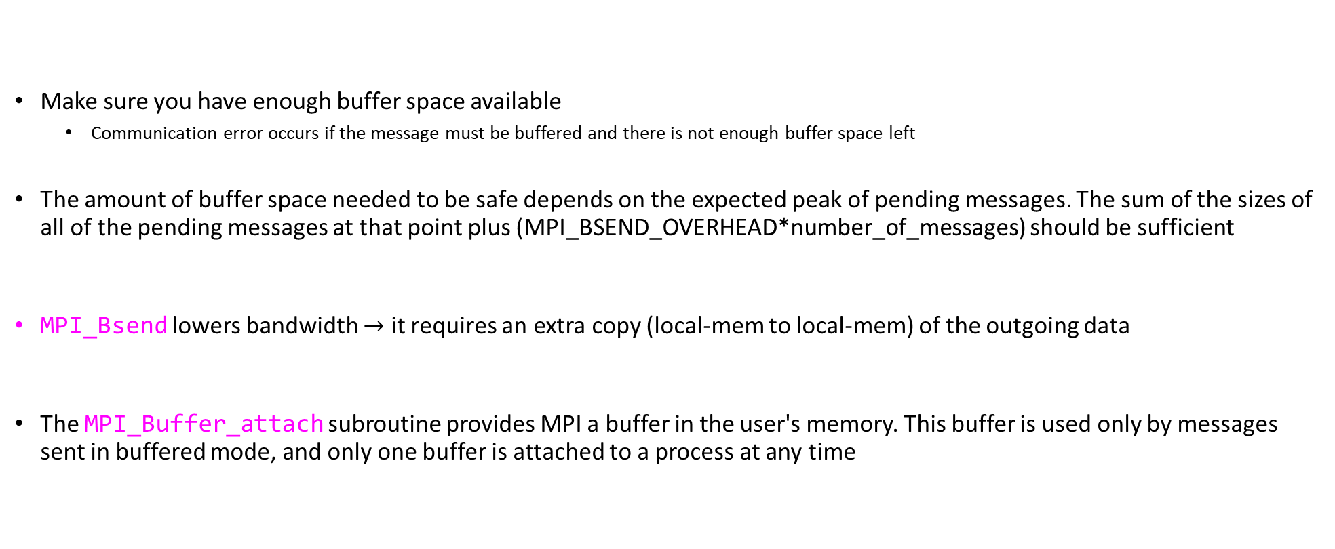
More on the Buffered Send [2/2]
Make sure you have enough buffer space available
Communication error occurs if the message must be buffered and there is not enough buffer space left
The amount of buffer space needed to be safe depends on the expected peak of pending messages. The sum of the sizes of all of the pending messages at that point plus (MPI_BSEND_OVERHEAD*number_of_messages) should be sufficient
MPI_Bsend lowers bandwidth $→$ it requires an extra copy (local-mem to local-mem) of the outgoing data
The MPI_Buffer_attach subroutine provides MPI a buffer in the user's memory. This buffer is used only by messages sent in buffered mode, and only one buffer is attached to a process at any time

Slide 11
Further comments on the four flavors for sending data in MPI
Synchronous with MPI_Ssend
In synchronous mode, a send will not complete until a matching receive is posted.
The sender has to wait for a receive to be posted
No buffering of data
Used for ensuring the code is healthy and doesn’t rely on buffering
Buffered with MPI_Bsend
Send completes once message has been buffered internally by MPI
Buffering incurs an extra memory copy
Does not require a matching receive to be posted
May cause buffer overflow if many Bsend posted and no matching receives have been posted yet
[A. Snavely]→

Slide 12
Four flavors for sending data in MPI
Standard with MPI_Send
Up to the MPI implementation to decide whether to do rendezvous or eager, for performance reasons
NOTE: If it does rendezvous, in fact the behavior is that of MPI_Ssend
Very commonly used
Ready with MPI_Rsend
Will work correctly only if the matching receive has been posted
Can be used to avoid handshake overhead when is known for sure that the receive has been posted
Rarely used, can cause major problems
Undefined behavior if a matching receive has not been posted
[A. Snavely]→

Slide 13
Side-trip: TCP/IP vs. UDP Analogy
There is a parallel between how MPI_Send and MPI_Rsend different, on the one hand, and how TCP/IP and UDP are different, on the other hand
TCP/IP: you send something out
You do not declare victory until the receiver pings you that all packets have been received and it’s all good
Very safe. You pay a premium for this
UDP: you send something out
You declare victory right away
Not safe, you don’t know if the receiver actually got your packet[s]. It’s fast
UDP and TCP/IP otherwise similar – just two APIs for sending information out over a network
Note: UDP used in online gaming, for instance
Notes:
https://www.howtogeek.com/190014/htg-explains-what-is-the-difference-between-tcp-and-udp/
https://support.holmsecurity.com/hc/en-us/articles/212963869-What-is-the-difference-between-TCP-and-UDP-

Slide 14
Cheat Sheet, Blocking Options
Sender modes | Definition | Notes
Synchronous send MPI_SSEND | Only completes when the receive has started | Used sometimes in debug mode; also used to avoid unexpected behavior from moving to system to system
Buffered send MPI_BSEND | Always completes (unless an error occurs), irrespective of receiver | needs application-defined buffer to be declared with MPI_BUFFER_ATTACH
Classic MPI_SEND | Standard send | Rendezvous or eager mode. Decided at run time
Ready send MPI_RSEND | Started right away. Will do the job only if the matching receive has already been posted! | Blindly do a send. Avoid, might cause unforeseen problems…
Receive MPI_RECV | Completes when the message (data) has arrived
[ICHEC]→

Slide 15
Concluding Remarks: Blocking P2P communication
Standard send (MPI_SEND)
less overhead if it happens in eager mode
blocks in rendezvous, switches to synchronous mode
Synchronous send (MPI_SSEND)
risk of deadlock
risk of waiting → idle time
high latency but better bandwidth then bsend
Buffered send (MPI_BSEND)
low latency / low bandwidth
Ready send (MPI_RSEND)
never use, unless 100% sure that Recv is already called in the current version and all future versions of your code
[ICHEC]→

Slide 16
P2P Communication: Deadlocking
Deadlock situations: due to a certain sequence of commands the MPI execution hangs
Process 0
Process 1
...
MPI_Ssend()
MPI_Recv()
...
...
MPI_Buffer_attach()
MPI_Bsend()
MPI_Recv()
...
...
MPI_Buffer_attach()
MPI_Bsend()
MPI_Recv()
...
...
MPI_Ssend()
MPI_Recv()
...
...
MPI_Buffer_attach()
MPI_Bsend()
MPI_Recv()
...
...
MPI_Ssend()
MPI_Recv()
...
Deadlock
No
Deadlock
No
Deadlock
[A. Snavely]→

Slide 17
Deadlocking, Another Example
MPI_Send can respond in eager or rendezvous mode
Example, on a certain machine running MPICH v1.2.1:
!
This value can be user controlled
Process 0
Deadlock
Process 1
...
MPI_Send()
MPI_Recv()
...
...
MPI_Send()
MPI_Recv()
...
Data size > 127999 bytes
Data size < 128000 bytes
No
Deadlock
[A. Snavely]→

Slide 18
Avoiding Deadlocking
Easy way to eliminate deadlock is to pair MPI_Ssend and MPI_Recv operations the right way:
Process 0
Process 1
...
MPI_Ssend()
MPI_Recv()
...
...
MPI_Recv()
MPI_Ssend()
...
No
Deadlock
Conclusion: understand how the implementation works and what its pitfalls/limitations are
[A. Snavely]→

Slide 19
Example
Always succeeds, even if no buffering is done
if(rank==0)
{
MPI_Send(...); // send to 1
MPI_Recv(...); // recv from 1
}
else if(rank==1)
{
MPI_Recv(...); // recv from 0
MPI_Send(...); // send to 0
}

Slide 20
Example
Will always deadlock, no matter the buffering mode
if(rank==0)
{
MPI_Recv(...); // recv from 1
MPI_Send(...); // send to 1
}
else if(rank==1)
{
MPI_Recv(...); // recv from 0
MPI_Send(...); // send to 0
}

Slide 21
Timing an MPI Job
int main()
{
double starttime, endtime;
starttime = MPI_Wtime();
// .... stuff to be timed ...
endtime = MPI_Wtime();
printf("That took %f seconds\n", endtime - starttime);
return 0;
}
Returns time in seconds since an arbitrary time in the past.
Resolution is typically 1E-3 seconds (see MPI_Wtick)
Time of different processes might actually be synchronized, controlled by the variable MPI_WTIME_IS_GLOBAL

Slide 22

Determine the eager/rendezvous threshold [useful for HW as well]
#include "mpi.h"
#include <stdio.h>
#include <stdlib.h>
#define LIMIT 500000
#define NLOOPS 1000
int main(int argc, char **argv) {
int rank, npes, bsize, i;
int source = 0, dest = 1, tag = 100;
double start, end;
char buf[LIMIT];
MPI_Status status;
MPI_Init(&argc, &argv);
MPI_Comm_rank(MPI_COMM_WORLD, &rank);
MPI_Comm_size(MPI_COMM_WORLD, &npes);
if (npes != 2)
MPI_Abort(MPI_COMM_WORLD, 1);
if (rank == 0)
bsize = (argc == 2) ? atoi(argv[1]) : 0;
MPI_Bcast(&bsize, 1, MPI_INT, 0, MPI_COMM_WORLD);
if (bsize <= 0 || bsize > LIMIT) {
MPI_Finalize(); // drop out, if size is not OK
return 0;
}
if (rank == source) {
for (i = 0; i < bsize; i++)
buf[i] = 'x'; // fill up the buffer with data to be sent over
start = MPI_Wtime();
for (i = 0; i < NLOOPS; i++)
MPI_Send(buf, bsize, MPI_BYTE, dest, tag, MPI_COMM_WORLD);
end = MPI_Wtime();
printf("Send: %d\t%f\n", bsize, (end - start) / NLOOPS);
start = MPI_Wtime();
for (i = 0; i < NLOOPS; i++)
MPI_Ssend(buf, bsize, MPI_BYTE, dest, tag, MPI_COMM_WORLD);
end = MPI_Wtime();
printf("Ssend: %d\t%f\n\n", bsize, (end - start) / NLOOPS);
}
if (rank == dest) {
for (i = 0; i < NLOOPS; i++)
MPI_Recv(buf, bsize, MPI_BYTE, source, tag, MPI_COMM_WORLD, &status);
for (i = 0; i < NLOOPS; i++)
MPI_Recv(buf, bsize, MPI_BYTE, source, tag, MPI_COMM_WORLD, &status);
}
MPI_Finalize();
return 0;
}
[Radu Serban]$→$

Slide 23
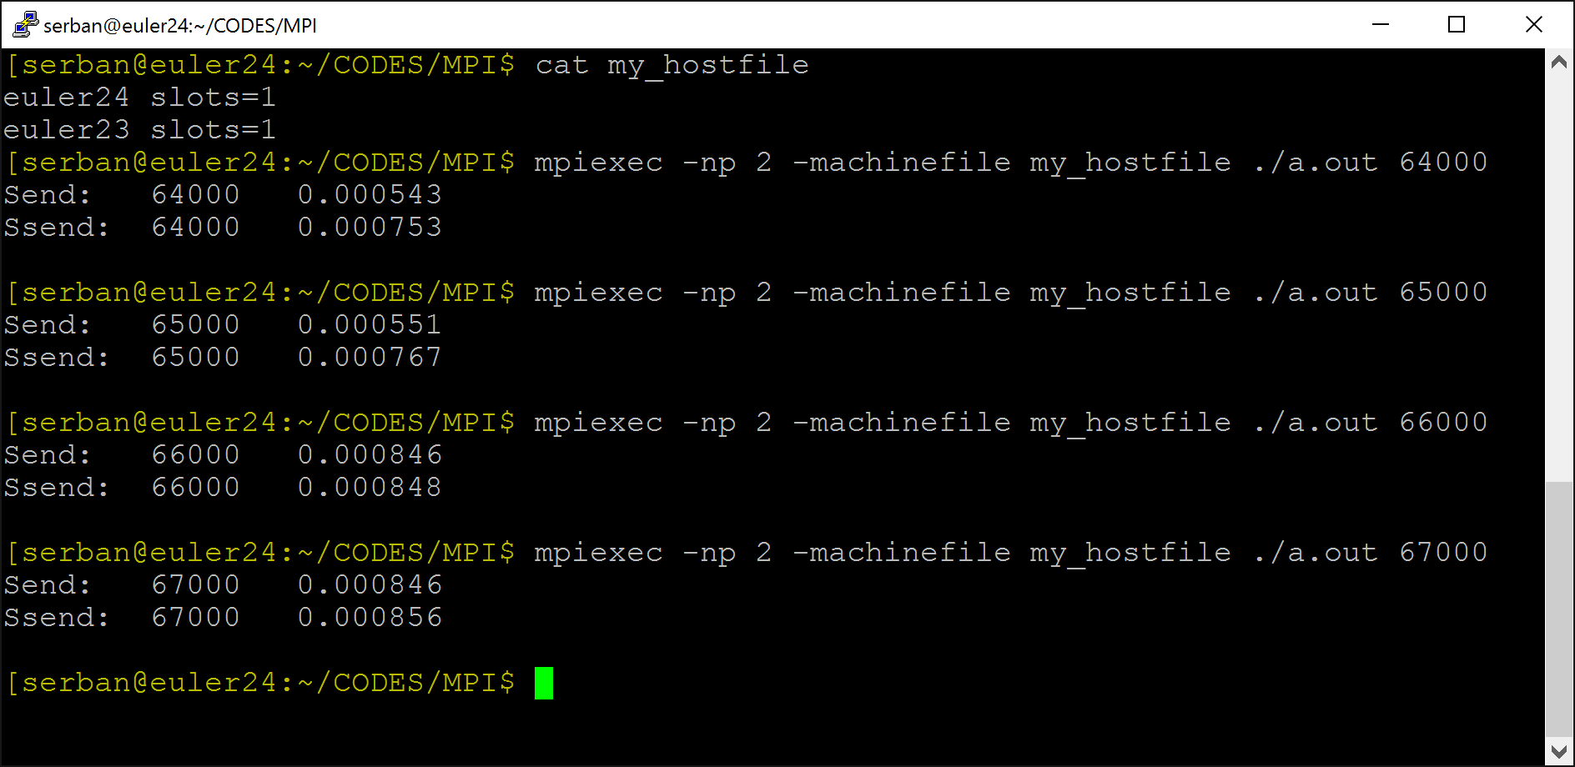
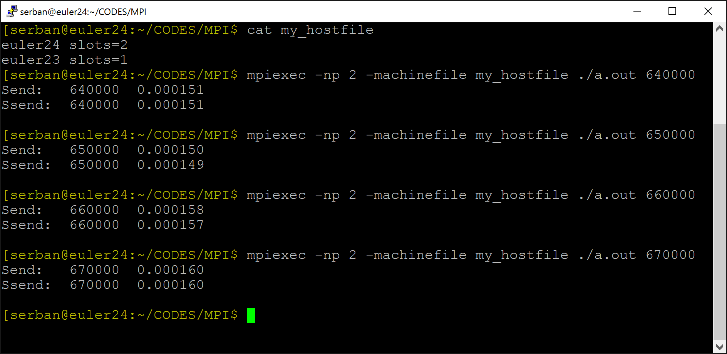
Results
Two processes on two different nodes
Threshold between 64 KB and 65 KB
Two processes on the same node
No difference between Send and Ssend (regardless of message size)
[Radu Serban]$→$

Slide 24
Non-blocking, P2P Communication

Slide 25
P2P Communication: Drawbacks of the MPI_Send (and friends)
Disadvantage with plain vanilla blocking send/receive covered thus far (that is, Send, Ssend, Bsend, Rsend):
When MPI “send” function is called, calling rank is blocked (there is no overlap of compute & data movement) (calling rank needs to wait until the send completed, which can be a while)
There is a second class of send/receive operations, which eliminates the two issues above (but brings in others)
Called “non-blocking” sends/receives

Slide 26
Send/Receives: Blocking vs. Non-blocking [important slide]
MPI send/receive operations: classified as blocking or non-blocking
Blocking send: upon return from a send operation, you can modify the content of the buffer in which you stored data to be sent since the data has been sent
MPI_Send, MPI_Ssend, MPI_Bsend, MPI_Rsend
Non-blocking send: the send call returns immediately; there is no guarantee that the data has actually been transmitted upon return from send call
MPI_Isend, MPI_Issend, MPI_Ibsend, MPI_Irsend
The blocking/non-blocking receive op has the same semantics
Upon return from a non-blocking receive call, it’s not clear whether the receive buffer has fresh data in it

Slide 27
Non-Blocking P2P Communication: How things play out
There’s three acts to the “non-blocking communication” play:
Initiate non-blocking communication
Returns Immediately
Routine name starting with MPI_I…
The calling rank gets to do some other useful work upon return from non-blocking call
This allows for the “latency hiding”
Later, wait for non-blocking communication to complete (accomplished via a synchronization call)
Bottom line: Like with CUDA kernel launch, you can overlap communication with execution

Slide 28
P2P Communication: The problem w/ non-blocking MPI_Isend
The “I” flavor switches you to an asynchronous operation mode. Improves efficiency, but no free lunch
If non-blocking, then data “lives” in your buffer – think twice before changing its content since not clear when transaction has completed. This means it’s not clear when it’s safe to mess with the content of the buffer
There are mechanisms to check for MPI_Isend completion (to give you a green light to change its content)
However, they add overhead :-(
Same looming issue for “receive” as well…
Notes:
DN: What is this slide???

Slide 29
Non-blocking Send/Receive
There was no such thing in the good old MPI_Send (and the other blocking flavors)
Syntax
int MPI_Isend(void *sbuf, int count, MPI_Datatype datatype, int dest, int tag, MPI_Comm comm, MPI_Request *req);
sbuf - [in] initial address of send buffer (choice)
count - [in] number of elements in send buffer (integer)
datatype - [in] datatype of each send buffer element (handle)
dest - [in] rank of destination (integer)
tag - [in] message tag (integer)
comm - [in] communicator (handle)
req - [out] communication request (handle)
think of it as a “discharge receipt”
int MPI_Irecv(void *rbuf, int count, MPI_Datatype datatype, int source, int tag, MPI_Comm comm, MPI_Request *req);
For the good old MPI_Recv, this used to be MPI_Status

Slide 30
Non-Blocking Send/Receive: Tools of the Trade
Key observation: the nonblocking call returns immediately. Therefore, user must worry whether …
Data to be sent is out of the send buffer before trampling over the buffer
Data to be received has arrived before using the content of the buffer
Tools that will come in handy for immediate sends & receives:
MPI_Wait – blocking: once called, makes you wait till a certain request completed
MPI_Test – non-blocking: returns quickly with status information
These helper tools: all use the MPI_Request object – it is like the “fingerprint” of a certain MPI operation
You use this fingerprint as input when you want to find information about the status of the MPI operation

Slide 31
The Screenplay: Non-Blocking P2P Communication
Non-blocking send
MPI_Isend(...)
do some other work here
MPI_Wait(...)
0
Non-blocking receive
MPI_Irecv(...)
do some other work here
MPI_Wait(...)
1
= waiting until operation locally completed
[ICHEC]→

Slide 32
Waiting for Isend/Ireceive to complete
Waiting on a single send
int MPI_Wait(MPI_Request *request, MPI_Status *status);
Waiting on multiple sends (get status of all)
Till all complete, as a barrier
int MPI_Waitall(int count, MPI_Request *requests, MPI_Status *statuses);
Till at least one completes
int MPI_Waitany(int count, MPI_Request *requests, int *index, MPI_Status *status);
Helps monitor progressive completions (see also here)
int MPI_Waitsome(int incount, MPI_Request *requests, int *outcount, int *indices, MPI_Status *statuses);
[IN]
[OUT]
[Alexander]→

Slide 33
MPI_Test
When completed, flag is true
int MPI_Test(MPI_Request *request, int *flag, MPI_Status *status);
Similar in meaning to MPI_Waitsome, except nonblocking
int MPI_Testall(int count, MPI_Request *requests, int *flag, MPI_Status *statuses);
int MPI_Testany(int count, MPI_Request *requests, int *index, int *flag, MPI_Status *status);
int MPI_Testsome(int incount, MPI_Request *requests, int *outcount, int *indices, MPI_Status *statuses);
[IN]
[OUT]
[OUT]
[Alexander]→

Slide 34
Another helper, at the receiving end: MPI_Probe / MPI_Iprobe [1/2]
The MPI_PROBE and MPI_IPROBE operations allow incoming messages to be queried prior to receiving them
The user can then decide how to receive a message, based on the information returned by the probe
The information of interest returned in the status handler
In particular, user may allocate memory for the receive buffer, according to the size of the probed message

Slide 35
Probe prior to receive [2/2]
Function comes in two flavors: blocking and non-blocking
Blocking probing, wait till match
int MPI_Probe(int source, int tag, MPI_Comm comm, MPI_Status *status);
Non-blocking probing, flag set to true if ready
int MPI_Iprobe(int source, int tag, MPI_Comm comm, int *flag, MPI_Status *status);
[Alexander]→

Slide 36
MPI P2P Communication: Take Away Points
Two types of communication:
Blocking:
Safe to change content of buffer holding on to data in the MPI send call
Non-blocking:
Be careful with the data in the buffer, since you might step on/use it too soon
MPI provides four modes for these two types
standard, synchronous, buffered, ready
Beware of possible deadlock

Slide 37
Quiz
How is MPI_Issend supposed to work?
How is MPI_Ibsend supposed to work?
Notes:
MPI_Issend:
Starts a nonblocking synchronous send
No eager mode for this guy
MPI_Ibsend:
- Starts a nonblocking buffered send; there is no guarantee that the buffer can be re-used

Slide 38
Outline, Parallel Computing w/ MPI
Introduction to message passing and MPI
Point-to-Point Communication
Collective Actions
MPI Closing Remarks

Slide 39
Collective Actions
Collective Actions: MPI actions involving a group of processes
Thus far, we’ve talked about P2P communication only
Must be called by all processes in a communicator
Many collective actions come in two flavors (just like P2P communication)
Blocking (covered in these slides)
Non-blocking - just like the “I” version of MPI_Send; i.e., MPI_Isend. Not covered here

Slide 40
Collective Actions
Three types of MPI Collective Actions:
Collective synchronization actions (barrier synchronization)
Collective communication actions (broadcast, scatter, gather, etc.)
Collective operation actions (reduce, prefix scan, user-defined, etc.)

Slide 41
Collective Actions: Synchronization Barrier
Used implicitly or explicitly to synchronize processes
all here?
[ICHEC]→

Slide 42
Collective Actions: Synchronization Barrier
Function prototype:
MPI_Barrier not needed that often:
All synchronization is done automatically by data communication (when using blocking actions)
When using blocking actions, a process cannot continue before it has the data that it needs
If barriers used for debugging, remember to remove for production release
int MPI_Barrier(MPI_Comm comm);

Slide 43
Collective Actions: Communication, Broadcast-type
Broadcast: A one-to-many communication
[ICHEC]→

Slide 44
Communication Action: Broadcast
Function prototype:
int MPI_Bcast( void *buf, int count, MPI_Datatype datatype, int root, MPI_Comm comm);
before bcast
r
e
d
after bcast
r
e
d
r
e
d
r
e
d
r
e
d
r
e
d
root=1
rank of the sending process
must be given identically by all ranks
[ICHEC]→

Slide 45
MPI_Bcast
data (buffer)
data (buffer)
A₀
A₀
processes
processes
A₀
broadcast
A₀
A₀
A₀
A₀
A₀ : any chunk of contiguous data described with MPI_Datatype and count

Slide 46
MPI_Bcast
Function prototype:
int MPI_Bcast (void *buffer, int count, MPI_Datatype type, int root, MPI_Comm comm);
INOUT : buffer (starting address, as usual)
IN : count (number of entries in buffer)
IN : type (can be user-defined)
IN : root (rank of broadcast root)
IN : com (communicator)
Broadcasts message from root to all processes (including root)
comm and root must assume identical values in all processes
On return, contents of buffer is copied to all processes in comm

Slide 47
What are all these MPI function returning???
int MPI_Bcast (void *buffer, int count, MPI_Datatype type, int root, MPI_Comm comm);
MPI_SUCCESS – No error; MPI routine completed successfully
MPI_ERR_COMM – Invalid communicator. A common error is to use a null communicator in a call
MPI_ERR_COUNT – Invalid count argument. Count arguments must be non-negative; a count of zero is often valid
MPI_ERR_TYPE – Invalid datatype argument. Additionally, this error can occur if an uncommitted MPI_Datatype
MPI_ERR_BUFFER – Invalid buffer pointer. Usually a null buffer where one is not valid
MPI_ERR_ROOT – Invalid root. The root must be specified as a rank in the communicator
(ranks must be between zero and the size of the communicator minus one)

Slide 48
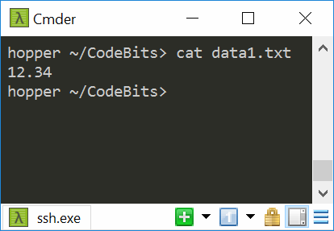
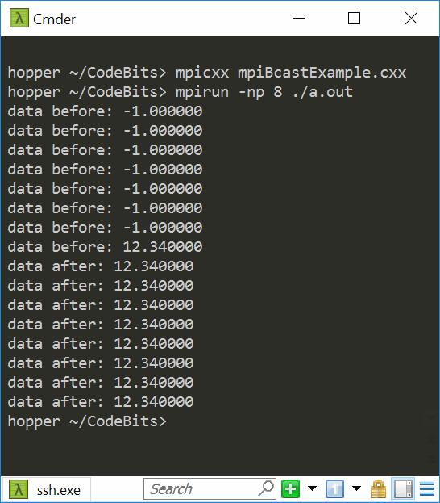
Example, MPI_Bcast
#include <mpi.h>
#include <fstream>
#include <string>
#include <cstdio>
// Read parameter from file and send to all processes
void main(int argc, char** argv){
int myRank, nprocs;
float data = -1.0;
std::fstream file;
MPI_Init(&argc, &argv);
MPI_Comm_size(MPI_COMM_WORLD, &nprocs);
MPI_Comm_rank(MPI_COMM_WORLD, &myRank);
if( myRank == 0 ) {
std::string input;
file.open("data1.txt", std::ios::in);
std::getline(file, input);
data = std::stof(input);
}
std::printf("data before: %f\n", data);
MPI_Bcast(&data, 1, MPI_FLOAT, 0, MPI_COMM_WORLD);
std::printf("data after: %f\n", data);
MPI_Finalize();
}

Slide 49
Going on a tangent…
Could you implement bcast as a p2p communication, in a for loop?
It’d go from a root to every other rank in the communicator

Slide 50
Communication Action: Gather
Function Prototype
int MPI_Gather(void *sndbuf, int sndcount, MPI_Datatype sndtype, void *rcvbuf, int rcvcount, MPI_Datatype rcvtype, int root, MPI_Comm comm);
before gather
A
B
C
D
E
after gather
A
B
C
D
E
A
B
C
D
E
root=1
rank of the collecting process
must be given identically by all ranks
[ICHEC]→

Slide 51
MPI_Gather
data (buffer)
data
A₀
A₀
A₁
A₂
A₃
A₄
A₅
processes
processes
A₁
A₁
A₂
Gather
A₂
A₃
A₃
A₄
A₄
A₅
A₅
[A. Siegel]→

Slide 52
MPI_Gather
Function prototype:
int MPI_Gather (void *sndbuf, int sndcount, MPI_Datatype sndtype, void *rcvbuf, int rcvcount, MPI_Datatype rcvtype, int root, MPI_Comm comm);
IN sndbuf (starting address of send buffer)
IN sndcount (number of elements in send buffer)
IN sndtype (type)
OUT rcvbuf (address of receive buffer)
IN rcvcount (number of elements gathered from each party)
IN rcvtype (data type of recv buffer elements)
IN root (rank of receiving process)
IN comm (communicator)

Slide 53
MPI_Gather
Each process sends content of sndbuf to the root process
NOTE: Root receives and stores in rank order
Remarks:
Receive buffer argument ignored for all non-root processes (also rcvtype, etc.)
As such, only receiving rank needs to initialize this pointer to point to a chunk of memory
rcvcount on root indicates number of items received from each process, not total. Common error
[A. Siegel]→

Slide 54
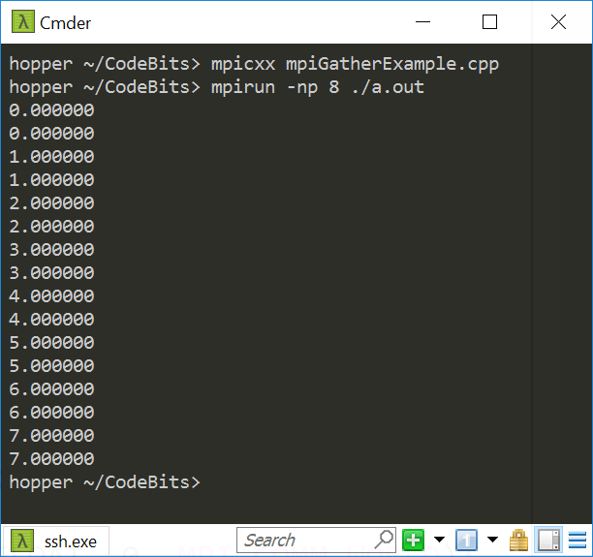
Example, MPI_Gather
#include <mpi.h>
#include <cstdio>
void main(int argc, char** argv){
int myRank, nprocs, n_loc=2, i;
float *data, *data_loc;
MPI_Init(&argc, &argv);
MPI_Comm_size(MPI_COMM_WORLD, &nprocs);
MPI_Comm_rank(MPI_COMM_WORLD, &myRank);
/* local array size on each proc = n_loc */
data_loc = new float[n_loc];
for (i = 0; i < n_loc; i++) data_loc[i] = myRank;
if (myRank == 0)
data = new float[nprocs * n_loc];
MPI_Gather(data_loc, n_loc, MPI_FLOAT, data, n_loc, MPI_FLOAT, 0, MPI_COMM_WORLD);
if (myRank == 0)
for (i = 0; i < n_loc*nprocs; i++)
std::printf("%f\n", data[i]);
MPI_Finalize();
}
Quiz: what memory should we free here?
[A. Siegel]→

Slide 55
Communication Action: Scatter
Function prototype
int MPI_Scatter(void *sndbuf, int sndcount, MPI_Datatype sndtype, void *rcvbuf, int rcvcount, MPI_Datatype rcvtype, int root, MPI_Comm comm);
A
B
C
D
E
before scatter
A
B
C
D
E
after scatter
A
B
C
D
E
root=1
rank of the sending process
must be given identically by all ranks
[ICHEC]→

Slide 56
MPI_Scatter
data (buffer)
data (buffer)
A₀
A₁
A₂
A₃
A₄
A₅
A₀
A₁
A₂
A₃
A₄
A₅
processes
Scatter
processes
A₁
A₂
A₃
A₄
A₅
[A. Siegel]→

Slide 57
MPI_Scatter
Function prototype
int MPI_Scatter(void *sndbuf, int sndcount, MPI_Datatype sndtype, void *rcvbuf, int rcvcount, MPI_Datatype rcvtype, int root, MPI_Comm comm);
IN sndbuf (starting address of send buffer)
IN sndcount (number of elements scattered to each process)
IN sndtype (type)
OUT rcvbuf (address of receive bufer)
IN rcvcount (number of elements in receive buffer)
IN rcvtype (data type of receive elements)
IN root (rank of sending process)
IN comm (communicator)
[A. Siegel]→

Slide 58
MPI_Scatter
Inverse of MPI_Gather
Data elements on root listed in rank order – each processor gets corresponding data chunk after call to scatter
Remarks:
All arguments are significant on root, while on other processes only recvbuf, recvcount, recvtype, root, and comm are significant
[A. Siegel]→

Slide 59
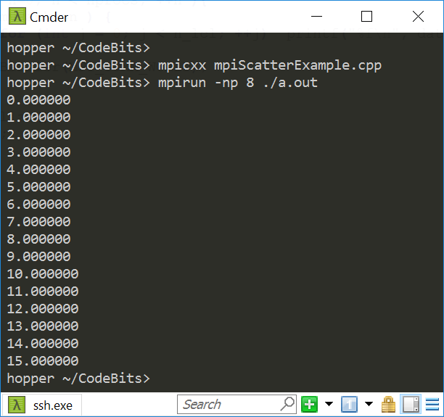
Example, MPI_Scatter
#include <mpi.h>
#include <iostream>
#include <vector>
void main(int argc, char **argv){
int myRank, nprocs, n_lcl = 2;
std::vector<float> data;
/* local array size on each proc = n_lcl */
std::vector<float> data_l(n_lcl);
MPI_Init(&argc, &argv);
MPI_Comm_size(MPI_COMM_WORLD, &nprocs);
MPI_Comm_rank(MPI_COMM_WORLD, &myRank);
if( myRank == 0 ) {
data.resize(nprocs * n_lcl);
for (int i = 0; i < nprocs * n_lcl; ++i) data[i] = i;
}
MPI_Scatter(data.data(), n_lcl, MPI_FLOAT, data_l.data(), n_lcl, MPI_FLOAT, 0, MPI_COMM_WORLD);
for (int n = 0; n < nprocs; ++n){
if( myRank==n ) {
for (int j = 0; j < n_lcl; ++j) std::cout << data_l[j] << "\n";
}
MPI_Barrier(MPI_COMM_WORLD); // this is interesting…
}
MPI_Finalize();
}
This is interesting…
What happens here?

Slide 60
MPI Communication Actions: Putting Things in Perspective…
Scatter: create a distributed array from a serial one
Also a more general form: MPI_Scatterv
Gaps are allowed between messages in source data
But the individual messages must still be contiguous
Irregular message sizes are allowed
Data can be distributed to processes in any order
Gather: create a serial array from a distributed one
Also a more general form: MPI_Gatherv
Counterpart to MPI_Scatterv
NOTE: there is a MPI_Allgather flavor, more on this later (Allreduce)

Slide 61
[New subtopic]Collective Actions: Operations
Combine data from several processes to produce a single result
sum=?
200
15
10
30
300
[ICHEC]→

Slide 62
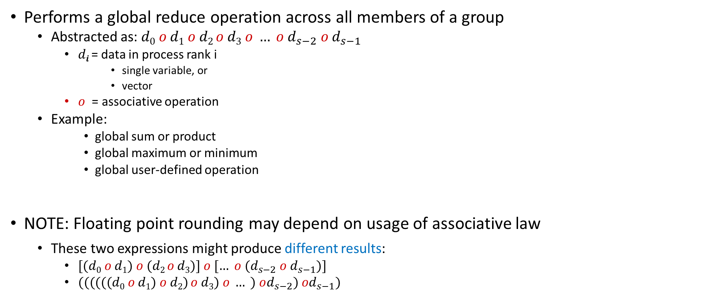
Global Reduction Operations
Performs a global reduce operation across all members of a group
Abstracted as: $d0 o d1 o d2 o d3 o … o d_{s−2} o d_{s−1}$
$di$ = data in process rank i
single variable, or
vector
$o$ = associative operation
Example:
global sum or product
global maximum or minimum
global user-defined operation
NOTE: Floating point rounding may depend on usage of associative law
These two expressions might produce different results:
$[(d0 o d1) o (d2 o d3)] o [… o (d_{s−2} o d_{s−1})]$
$((((((d0 o d1) o d2) o d3) o … ) od_{s−2}) od_{s−1})$
[ICHEC]→

Slide 63
Example of Global Reduction
Global integer sum
Sum of all inbuf values should be returned in resultbuf
The result is only placed in resultbuf at the root process.
MPI_Reduce(&inbuf, &resultbuf, 1, MPI_INT, MPI_SUM, root, MPI_COMM_WORLD);
[ICHEC]→

Slide 64
Predefined Reduction Operations
Predefined operation handle | Function
MPI_MAX | Maximum
MPI_MIN | Minimum
MPI_SUM | Sum
MPI_PROD | Product
MPI_LAND | Logical AND
MPI_BAND | Bitwise AND
MPI_LOR | Logical OR
MPI_BOR | Bitwise OR
MPI_LXOR | Logical exclusive OR
MPI_BXOR | Bitwise exclusive OR
MPI_MAXLOC | Maximum and location of the maximum
MPI_MINLOC | Minimum and location of the minimum

Slide 65
MPI_Reduce
before MPI_REDUCE
inbuf
result
A
B
C
D
E
F
G
H
I
J
K
L
M
N
O
o
o
o
o
after
A
B
C
D
E
F
G
H
I
J
K
L
M
N
O
root=1
AoDoGoJoM
[ICHEC]→

Slide 66
Reduce Operation
data (input buffer)
data (output buffer)
A0 | B0 | C0
A1 | B1 | C1
A2 | B2 | C2
A0+A1+A2 | B0+B1+B2 | C0+C1+C2
processes
reduce
Assumption: Rank 0 is the root
[A. Siegel]→

Slide 67
Example, MPI_Reduce
MPI_Reduce(sbuf,rbuf,6,MPI_INT,MPI_SUM,0,MPI_COMM_WORLD)
root (where result is reported)
rank
output
buffer
sbuf
# entries in each rank
r0
3
4
2
8
12
1
+
rbuf
r1
5
2
5
1
7
11
P0
11
16
20
22
24
18
+
r2
2
4
4
10
4
5
+
r3
1
6
9
3
1
1
11

Slide 68
MPI_Reduce
Function prototype
int MPI_Reduce(void *sndbuf, void *rcvbuf, int count, MPI_Datatype datatype, MPI_Op op, int root, MPI_Comm comm);
IN sndbuf (address of send buffer)
OUT rcvbuf (address of receive buffer)
IN count (number of elements in send buffer)
IN datatype (data type of elements in send buffer)
IN op (reduce operation)
IN root (rank of root process)
IN comm (communicator)
[A. Siegel]→

Slide 69
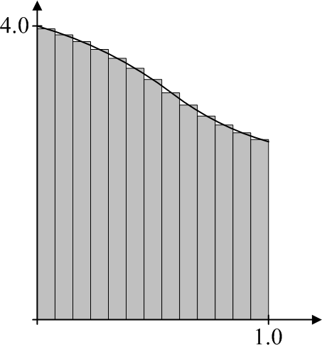
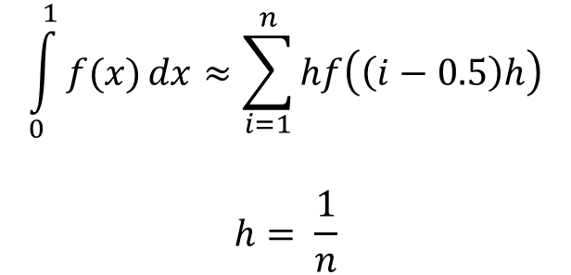
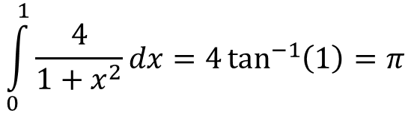
MPI Example: computing an integral (approximating $π$)
$$\int_{0}^{1}{\frac{4}{1+x^{2}}}dx=4\tan^{−1}\left(1\right)=π$$
Numerical Integration: Midpoint rule
$$\int_{0}^{1}{f(x)}dx≈\sum_{i=1}^{n}{hf\left(\left(i−0.5\right)h\right)}$$
$$h= \frac{1}{n}$$

Slide 70
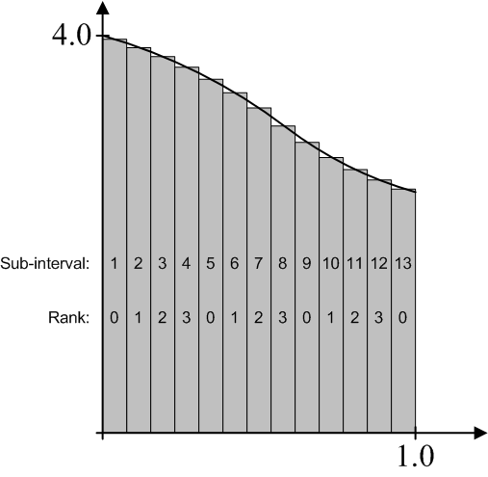
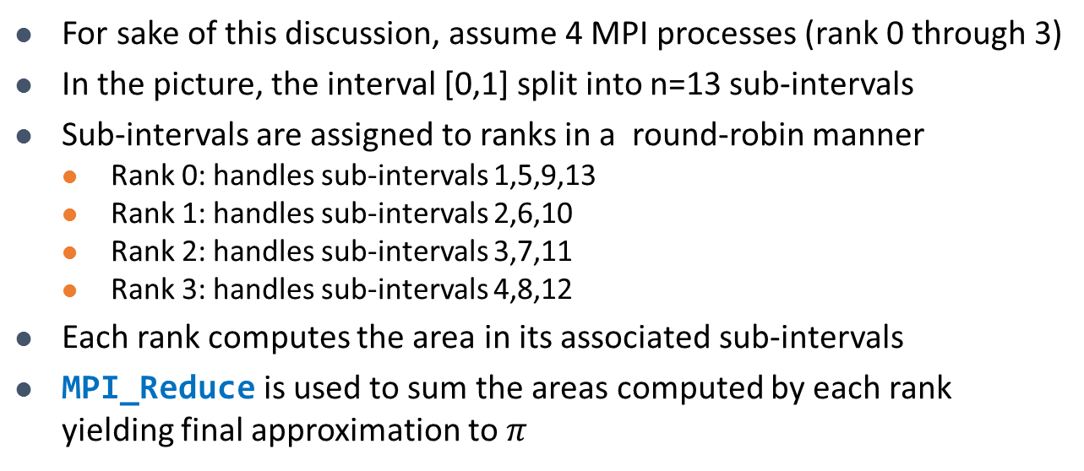
MPI Example: computing an integral (approximating $π$)
For sake of this discussion, assume 4 MPI processes (rank 0 through 3)
In the picture, the interval [0,1] split into n=13 sub-intervals
Sub-intervals are assigned to ranks in a round-robin manner
Rank 0: handles sub-intervals 1,5,9,13
Rank 1: handles sub-intervals 2,6,10
Rank 2: handles sub-intervals 3,7,11
Rank 3: handles sub-intervals 4,8,12
Each rank computes the area in its associated sub-intervals
MPI_Reduce is used to sum the areas computed by each rank yielding final approximation to $π$
[T. Heyn]→

Slide 71
MPI Example: computing an integral (approximating $π$)
#include "mpi.h"
#include <math.h>
#include <iostream>
using namespace std;
void main(int argc, char *argv[])
{
int n, rank, size, i;
double PI25DT = 3.141592653589793238462643;
double mypi, pi, h, sum, x;
char processor_name[MPI_MAX_PROCESSOR_NAME];
int namelen;
MPI_Init(&argc,&argv);
MPI_Comm_size(MPI_COMM_WORLD,&size);
MPI_Comm_rank(MPI_COMM_WORLD,&rank);
MPI_Get_processor_name(processor_name, &namelen);
cout << "Hello from process " << rank << " of " << size << " on " << processor_name << endl;

Slide 72
MPI Example: computing an integral (approximating $π$)
if (rank == 0) {
if (argc<2 || argc>2)
n=0;
else
n=atoi(argv[1]);
}
MPI_Bcast(&n, 1, MPI_INT, 0, MPI_COMM_WORLD);
if (n>0) {
h = 1.0 / (double) n;
sum = 0.0;
for (i = rank + 1; i <= n; i += size) {
x = h * ((double)i - 0.5);
sum += (4.0 / (1.0 + x*x));
}
mypi = h * sum;
MPI_Reduce(&mypi, &pi, 1, MPI_DOUBLE, MPI_SUM, 0, MPI_COMM_WORLD);
if (rank == 0)
cout << "pi is approximately " << pi << ", Error is " << fabs(pi - PI25DT) << endl;
}
MPI_Finalize();
}
How many instances of this data type are moved around
Data type we are moving around
Reduce through a “sum” operation
Root process, it ends up storing the result
Partial contribution of “this” process
Where the reduce operation stores the result

Slide 73
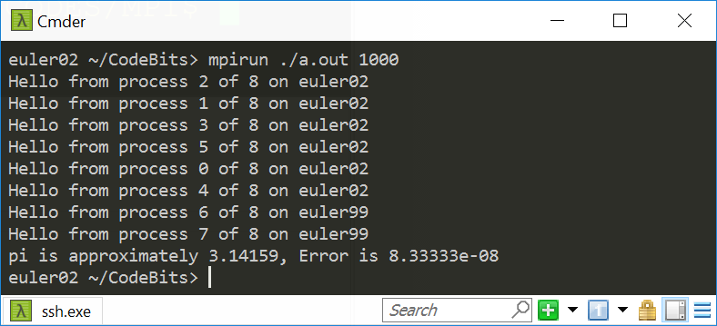
Program Output [uses 8 ranks to compute integral]

Slide 74
MPI_Reduce, MPI_Allreduce
MPI_Reduce: result is collected by the root only
The operation is applied element-wise for each element of the input arrays on each processor
MPI_Allreduce: result is sent out to all ranks in the communicator
...
MPI_Reduce(x, r, 10, MPI_INT, MPI_MAX, 0, MPI_COMM_WORLD)
...
input array
output array
array size
root
...
MPI_Allreduce(x, r, 10, MPI_INT, MPI_MAX, MPI_COMM_WORLD)
...
Credit: Allan Snavely

Slide 75
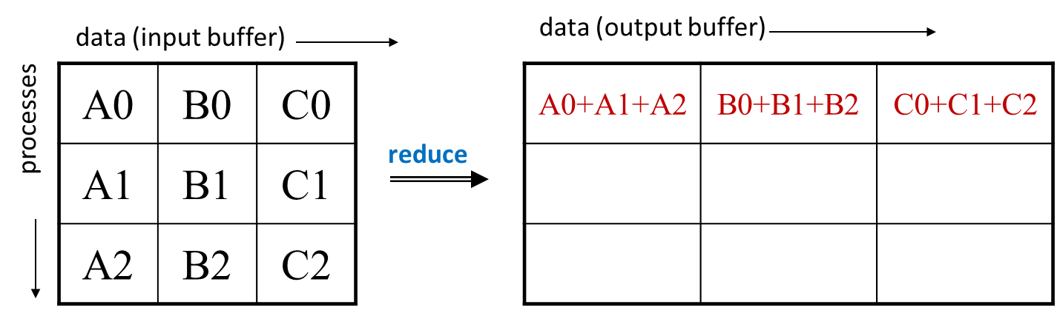
MPI_Allreduce
Here’s what MPI_Reduce does
data (buffer)
data (buffer)
A0 | B0 | C0
A1 | B1 | C1
A2 | B2 | C2
A0+A1+A2 | B0+B1+B2 | C0+C1+C2
A0+A1+A2 | B0+B1+B2 | C0+C1+C2
A0+A1+A2 | B0+B1+B2 | C0+C1+C2
processes
Allreduce
[A. Siegel]→

Slide 76
MPI_Allreduce
Function prototype
int MPI_Allreduce(void *sendbuf, void *recvbuf, int count, MPI_Datatype datatype, MPI_Op op, MPI_Comm cmm);
IN sendbuf (address of send buffer)
OUT recvbuf (address of receive buffer)
IN count (number of elements in send buffer)
IN datatype (data type of elements in send buffer)
IN op (reduce operation)
IN cmm (communicator)

Slide 77
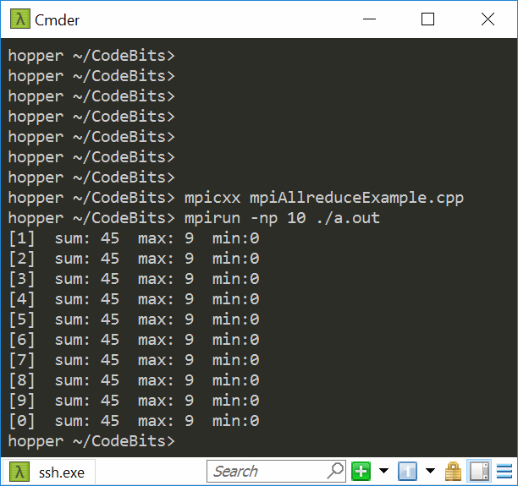
Example, MPI_Allreduce
#include <mpi.h>
#include <cstdio>
int main(int argc, char **argv) {
int myRank, nprocs, gsum, gmax, gmin;
MPI_Init(&argc, &argv);
MPI_Comm_size(MPI_COMM_WORLD, &nprocs);
MPI_Comm_rank(MPI_COMM_WORLD, &myRank);
MPI_Allreduce(&myRank, &gsum, 1, MPI_INT, MPI_SUM, MPI_COMM_WORLD);
MPI_Allreduce(&myRank, &gmax, 1, MPI_INT, MPI_MAX, MPI_COMM_WORLD);
MPI_Allreduce(&myRank, &gmin, 1, MPI_INT, MPI_MIN, MPI_COMM_WORLD);
std::printf([[%d] sum: %d max: %d min:%d\n", myRank, gsum, gmax, gmin);
MPI_Finalize();
return 0;
}

Slide 78
MPI_Scan
Performs a prefix reduction on data distributed across a communicator
The operation returns, in the receive buffer of the process with rank i, the reduction of the values in the send buffers of processes with ranks 0,...,i (inclusive)
Type of operations supported, their semantics, and constraints on send/receive buffers are as for MPI_REDUCE

Slide 79
MPI_Scan
before MPI_SCAN
inbuf
result
A
B
C
D
E
F
G
H
I
J
K
L
M
N
O
o
o
o
o
after
A
B
C
D
E
F
G
H
I
J
K
L
M
N
O
A
AoD
AoDoG
AoDoGoJ
AoDoGoJoM
done in parallel
[ICHEC]→

Slide 80
MPI_Scan: Quick example
rank $i$ receives data reduced on process 0 through i
sbuf
rbuf
r0
3
4
2
8
12
1
r0
3
4
2
8
12
1
r1
r1
Scan progresses this direction (across ranks, that is)
5
2
5
1
7
11
8
6
7
9
19
12
r2
2
4
4
10
4
5
r2
10
10
11
19
23
17
r3
1
6
9
3
1
1
r3
11
16
12
22
24
18
6 entries
MPI_Scan(sbuf,rbuf,6,MPI_INT,MPI_SUM,MPI_COMM_WORLD)
[A. Snavely]→

Slide 81
Scan Operation [inclusive flavor of it; there’s also an exclusive flavor]
data (input buffer)
data (output buffer)
A0 | B0 | C0
A1 | B1 | C1
A2 | B2 | C2
A0 | B0 | C0
A0+A1 | B0+B1 | C0+C1
A0+A1+A2 | B0+B1+B2 | C0+C1+C2
processes
scan
[A. Siegel]→

Slide 82
MPI_Scan
Function prototype
int MPI_Scan(void *sendbuf, void *recvbuf, int count, MPI_Datatype datatype, MPI_Op op, MPI_Comm comm);
IN sendbuf (address of send buffer)
OUT recvbuf (address of receive buffer)
IN count (number of elements in send buffer)
IN datatype (data type of elements in send buffer)
IN op (reduce operation)
IN comm (communicator)
Note: count refers to total number of elements that will be received into recvbuf after operation is complete
[A. Siegel]→

Slide 83
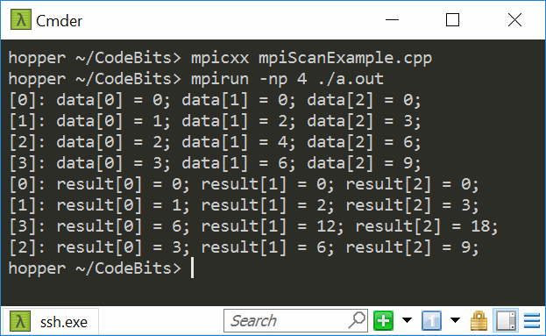
Example, MPI_Scan
#include <mpi.h>
#include <cstdio>
void main(int argc, char **argv) {
int myRank, nprocs;
MPI_Init(&argc, &argv);
MPI_Comm_size(MPI_COMM_WORLD, &nprocs);
MPI_Comm_rank(MPI_COMM_WORLD, &myRank);
const int dimArray = 3;
int* data_l = new int[dimArray];
for (int i = 0; i < dimArray; i++) data_l[i] = (i+1)*myRank;
for (int n = 0; n < nprocs; n++) {
MPI_Barrier(MPI_COMM_WORLD);
if (myRank == n) {
std::printf("[%d]: ", myRank);
for(int i = 0; i < dimArray; i++) std::printf("data[%d] = %d; ", i, data_l[i]);
std::printf("\n");
}
MPI_Barrier(MPI_COMM_WORLD);
}
int* result = new int[dimArray];
MPI_Scan(data_l, result, dimArray, MPI_INT, MPI_SUM, MPI_COMM_WORLD);
for (int n = 0; n < nprocs; n++) {
MPI_Barrier(MPI_COMM_WORLD);
if (myRank == n) {
std::printf("[%d]: ", myRank);
for(int i = 0; i < dimArray; i++) std::printf("result[%d] = %d; ", i, result[i]);
std::printf("\n");
}
MPI_Barrier(MPI_COMM_WORLD);
}
MPI_Finalize();
delete[] result; delete[] data_l;
}
Notes:
My attempt (via barriers) to get processes to print out in increasing order
of rank failed ☺

Slide 84
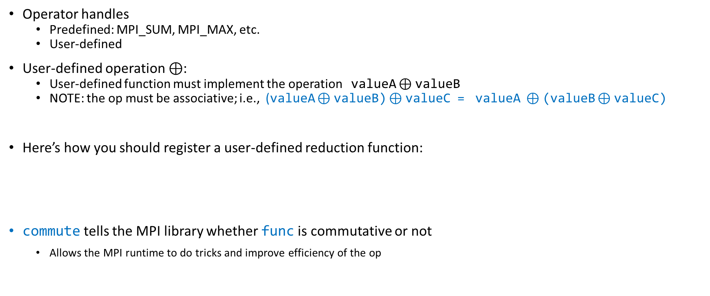
User-Defined Reduction Operations
Operator handles
Predefined: MPI_SUM, MPI_MAX, etc.
User-defined
User-defined operation $⊕$:
User-defined function must implement the operation valueA $⊕$valueB
NOTE: the op must be associative; i.e., (valueA $⊕$valueB) $⊕$valueC = valueA $⊕$(valueB $⊕$valueC)
Here’s how you should register a user-defined reduction function:
commute tells the MPI library whether func is commutative or not
Allows the MPI runtime to do tricks and improve efficiency of the op
MPI_Op_create( MPI_User_function *func, int commute, MPI_Op *op);
[ICHEC]→

Slide 85
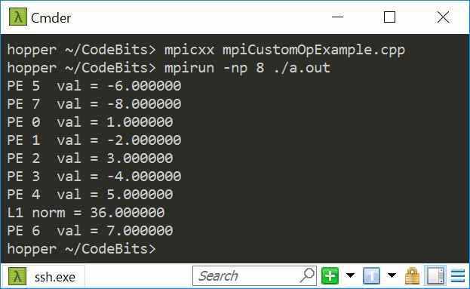
Example, MPI_Op_create
#include <cmath>
#include <cstdio>
#include <mpi.h>
#include <stdio.h>
void norm1(double *a, double *b, int *len, MPI_Datatype *type) {
*b = std::abs(*a) + std::abs(*b);
}
void main(int argc, char **argv) {
int my_rank, p;
MPI_Init(&argc, &argv);
MPI_Comm_rank(MPI_COMM_WORLD, &my_rank);
MPI_Comm_size(MPI_COMM_WORLD, &p);
MPI_Op my_op;
MPI_Op_create((MPI_User_function *)norm1, 1, &my_op);
double sendbuf = (my_rank + 1.0) * std::pow(-1.0, my_rank);
printf("PE %d val = %f\n", my_rank, sendbuf);
double recvbuf;
MPI_Reduce(&sendbuf, &recvbuf, 1, MPI_DOUBLE, my_op, 0, MPI_COMM_WORLD);
if (my_rank == 0) printf("L1 norm = %f\n", recvbuf);
MPI_Finalize();
}

Slide 86
thrust code typically much simpler
#include <thrust/transform_reduce.h>
#include <thrust/device_vector.h>
#include <thrust/host_vector.h>
#include <cmath>
template <typename T> struct absval {
__host__ __device__
T operator()(const T& x) const {
return fabs(x);
}
};
int main(void) {
// initialize host array
float x[4] = {1.0, -2.0, 3.0, -4.0};
// transfer to device
thrust::device_vector<float> d_x(x, x + 4);
absval<float> unary_op;
float res = thrust::transform_reduce(d_x.begin(), d_x.end(), unary_op, 0.f, thrust::plus<float>());
std::cout << res << std::endl;
return 0;
}

