Slide 1
ME759 High Performance Computing for Applications in Engineering [Spring 2021]
Lecture 12
02/19/2021
Dan Negrut, 2021 ME759 UW-Madison

Slide 2

Picture of the day
“Hello, world. My first look at my forever home.”
-- Perseverance Rover, on Mars. February 18, 2021.

Slide 3
Is BBC recording on?
If my internet connection goes down, I’ll email from my phone to provide more information – go/no-go, next step, etc.

Slide 4
Before we get started…
Last time
Aspects related to how GPU memory operations take place
Registers, local memory, shared memory, global memory (texture & constant memories)
Today
GPU mem operations: focus on shared memory
GPU mem operations: focus on global memory
How parallel computing makes memory operations tricky
Atomic operations
Things that determine the speed of execution of a kernel (perhaps Monday?)
Other tidbits:
Assignment due on Th, 02/25, at 9 pm
Four or five assignments are going to be increasingly difficult
Drop two of them if you are overwhelmed. Stay focused, make the right call
Do not run your code on the Euler headnode (use Slurm)

Slide 5
Example: How Addresses Map to Banks, for array of float
An allotted chunk of shared memory starts at an address that is at least a multiple of 128 (if not 256)
Bank you work with = (address of offset) % 32
Example: 1D shared mem array, myShMemVar, of 1024 floats
myShMemVar[4]: accesses bank #4 (physically, the fifth one – first row)
myShMemVar[31]: accesses bank #31 (physically, the last one – first row)
myShMemVar[50]: access bank #18 (physically, the 19th one – second row)
myShMemVar[128]: access bank #0 (physically, the first one – fifth row)
myShMemVar[178]: access bank #18 (physically, the 19th one – sixth row)
If, for instance, the third thread in a warp accesses myShMemVar[50] and the eight thread in the warp accesses myShMemVar[178], then you have a two-way bank conflict, and the two transactions get serialized
IMPORTANT: There is no such thing as “bank conflicts” between threads belonging to different warps

Slide 6

Bank Addressing Examples Transactions Involving 4 Byte Words
No Bank Conflicts
Linear addressing stride == 1
No Bank Conflicts
Random 1:1 Permutation
Thread 0
Bank 0
Thread 0
Bank 0
Thread 1
Bank 1
Thread 1
Bank 1
Thread 2
Bank 2
Thread 2
Bank 2
Thread 3
Bank 3
Thread 3
Bank 3
Thread 4
Bank 4
Thread 4
Bank 4
Thread 5
Bank 5
Thread 5
Bank 5
Thread 6
Bank 6
Thread 6
Bank 6
Thread 7
Bank 7
Thread 7
Bank 7
Thread 31
Bank 31
Thread 31
Bank 31
[NVIDIA]$→$

Slide 7
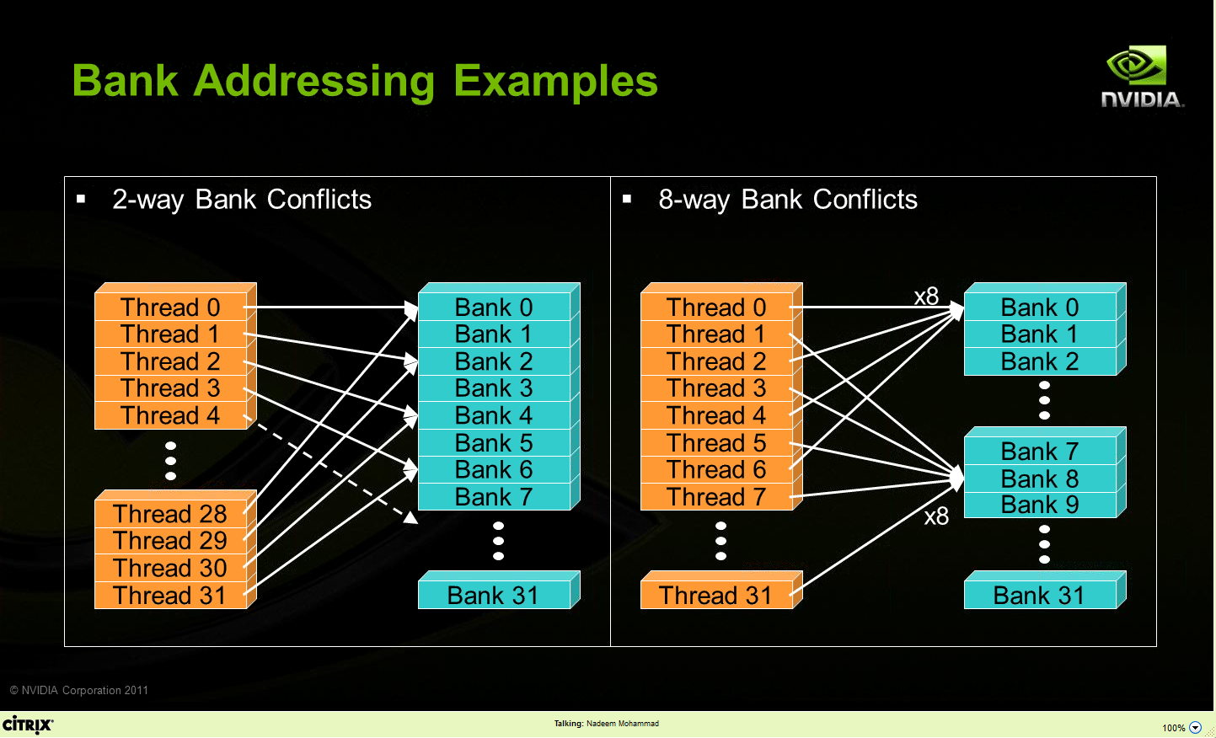
Bank Addressing Examples Transactions Involving 4 Byte Words
A case in which only the even banks end up being accessed, and the warps access different words in each bank
A case in which the 32 threads in a warp access only banks 0, 8, 16, and 24 (and different words in these four banks)
[NVIDIA]$→$

Slide 8
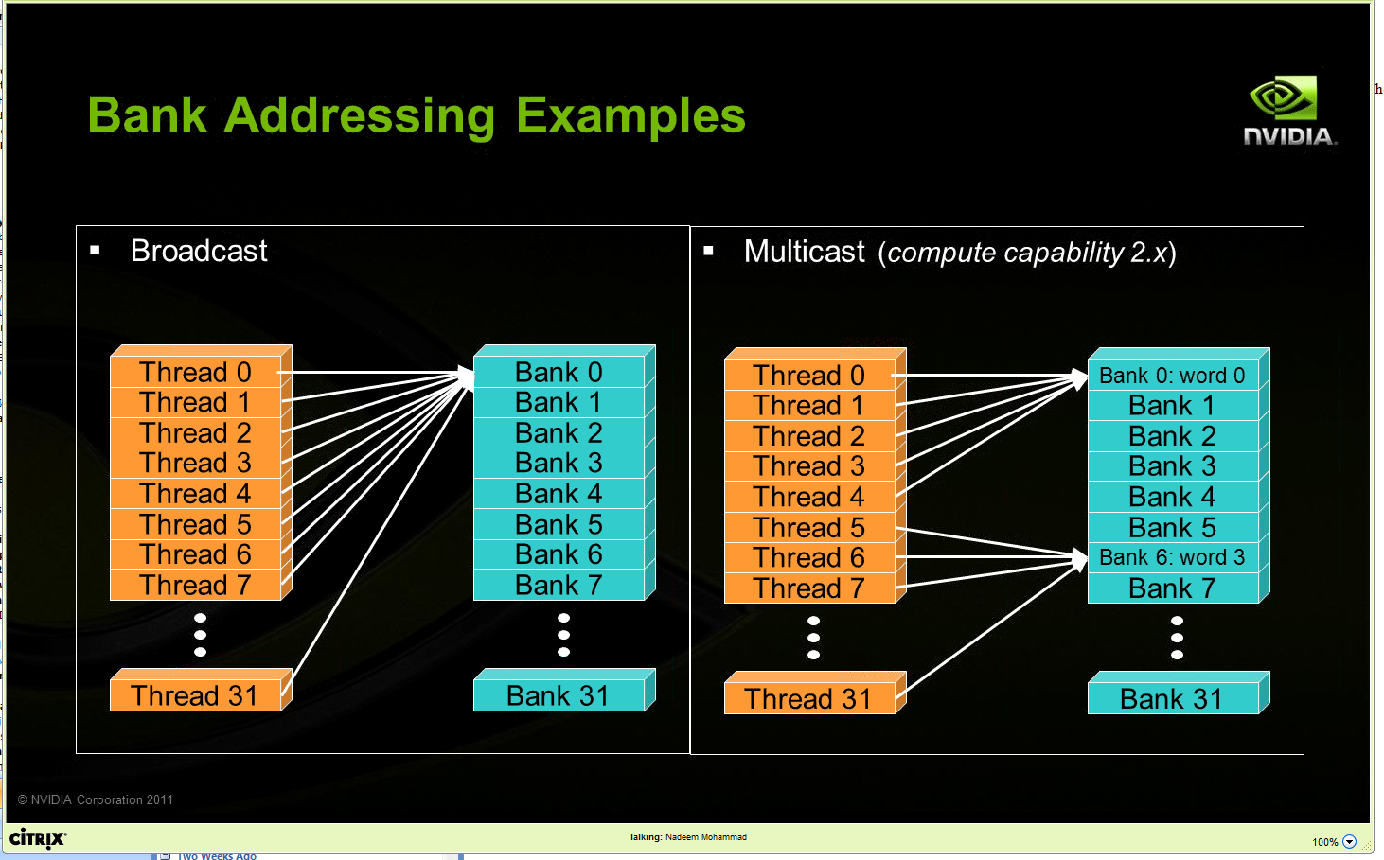
Other Examples
Two “no conflict” scenarios, reading operations:
Broadcast: all threads in a warp access the same word in a bank
Multicast: several threads in a warp access the same word in the same bank

Slide 9
Linear Addressing
Given:
__shared__ float sharedM[256];
float foo = sharedM[baseIndex + s * threadIdx.x];
This is bank-conflict-free if s shares no common factors with the number of banks
Conclusion: you are fine if s is odd
s=1
s=3
Thread 0
Bank 0
Thread 0
Bank 0
Thread 1
Bank 1
Thread 1
Bank 1
Thread 2
Bank 2
Thread 2
Bank 2
Thread 3
Bank 3
Thread 3
Bank 3
Thread 4
Bank 4
Thread 4
Bank 4
Thread 5
Bank 5
Thread 5
Bank 5
Thread 6
Bank 6
Thread 6
Bank 6
Thread 7
Bank 7
Thread 7
Bank 7
Thread 31
Bank 31
Thread 31
Bank 31
Note: baseIndex assumed 0 (zero) in these two pics

Slide 10
Data types and bank conflicts
No conflicts if shrd is a 32-bit data type:
foo = shrd[baseIndex + threadIdx.x]
Also if accessing one byte-per-thread, no conflict since *different* bytes of the same word are accessed
No conflicts:
extern __shared__ char shrd[];
foo = shrd[baseIndex + threadIdx.x];
No conflicts:
extern __shared__ short shrd[];
foo = shrd[baseIndex + threadIdx.x];
Thread 0
Bank 0
Thread 1
Bank 1
Thread 2
Bank 2
Thread 3
Bank 3
Thread 4
Bank 4
Thread 5
Bank 5
Thread 6
Bank 6
Thread 7
Bank 7
Thread 31
Bank 31
Thread 0
Bank 0
Thread 1
Bank 1
Thread 2
Bank 2
Thread 3
Bank 3
Thread 4
Bank 4
Thread 5
Bank 5
Thread 6
Bank 6
Thread 7
Bank 7
Thread 31
Bank 31

Slide 11
Exercise: Is ShMem access below good or bad?
Snippet from a kernel, each thread loads two floats into ShMem:
This makes sense for traditional CPU threads, locality in cache line usage and reduced sharing traffic
Doesn’t make sense in shared memory usage where there is no cache line effects but banking effects
2-way-interleaved loads result in 2-way bank conflicts
Adding insult to injury: you don’t have coalesced global memory loads – basically you are halving the global mem bandwidth (more on this later)
int tid = threadIdx.x;
shared[2*tid ] = global[offset+2*tid ];
shared[2*tid+1] = global[offset+2*tid+1];
Thread 0
Bank 0
Thread 1
Bank 1
Thread 2
Bank 2
Thread 3
Bank 3
Bank 4
Bank 5
Bank 6
Bank 7
Thread 16
Thread 17
Thread 18
Thread 19
Bank 31
Notes:
What is “cache line effects”?

Slide 12
A better array access pattern: Revisiting example on previous slide
Thread 0
Bank 0
Here’s a better way of doing it
Each thread loads one element in every consecutive group of blockDim elements.
Thread 1
Bank 1
Thread 2
Bank 2
Thread 3
Bank 3
shared[tid] = global[offset + tid];
shared[tid + blockDim.x] = global[offset + tid + blockDim.x];
Thread 4
Bank 4
Thread 5
Bank 5
Thread 6
Bank 6
Thread 7
Bank 7
Thread 31
Bank 31

Slide 13
Ruminations, memory related
Looking ahead (today and next lecture), ruminations on two topics
Memory operations, getting the result right (broad discussion, for parallel computing, not only GPU)
Memory operations, getting the result fast (narrower discussion, for GPU computing)

Slide 14
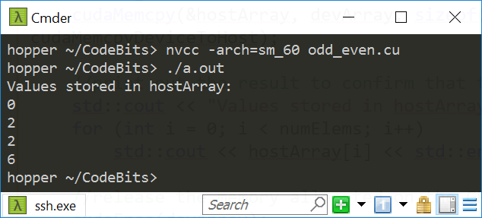
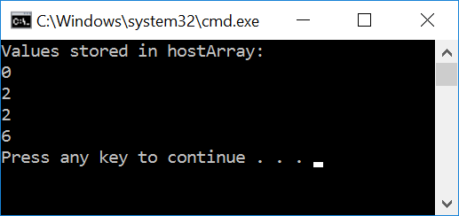
#include<cuda.h>
#include<iostream>
__global__ void odd_even(int* data) {
int i = threadIdx.x;
if ((i & 0x01) == 0)
{
data[i] = data[i] + i; // if even, come here
}
else
{
data[i] = data[i] + 2*i; // come here if you're odd
}
}
int main() {
const int numElems = 4;
int hostArray[numElems], *devArray;
//allocate memory on the device (GPU); zero out all device array entries
cudaMalloc((void**)&devArray, sizeof(int) * numElems);
cudaMemset(devArray, 0, numElems * sizeof(int));
//invoke GPU kernel, with one block that has four threads
odd_even<<<1, 4 >>>(devArray);
//bring the result back from the GPU into the hostArray
cudaMemcpy(&hostArray, devArray, sizeof(int) * numElems, cudaMemcpyDeviceToHost);
//print out the result to confirm that things are looking good
std::cout << "Values stored in hostArray: " << std::endl;
for (int i = 0; i < numElems; i++)
std::cout << hostArray[i] << std::endl;
//release the memory allocated on the GPU
cudaFree(devArray);
return 0;
}
Linux, P100
Windows, GTX1080

Slide 15
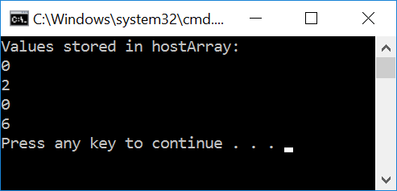
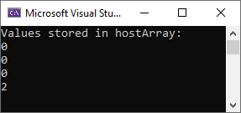
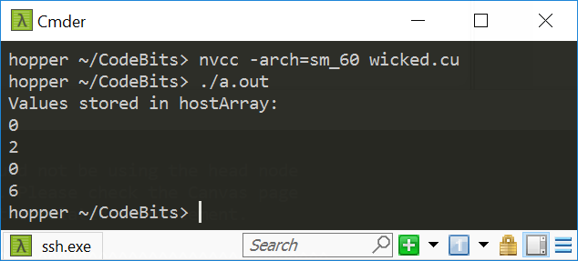
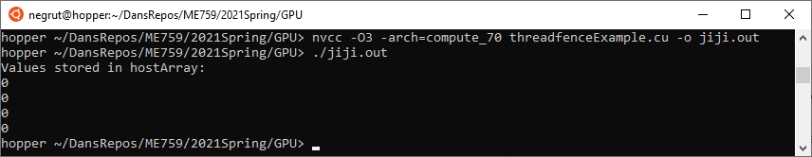
#include<cuda.h>
#include<iostream>
__global__ void wicked(int* data) {
int i = threadIdx.x;
if ((i & 0x01) == 0)
{
data[i+1] = data[i+1] + i; // if even, come here
}
else
{
data[i] = data[i] + 2*i; // come here if you're odd
}
}
int main() {
const int numElems = 4;
int hostArray[numElems], *devArray;
//allocate memory on the device (GPU); zero out all device array entries
cudaMalloc((void**)&devArray, sizeof(int) * numElems);
cudaMemset(devArray, 0, numElems * sizeof(int));
//invoke GPU kernel, with one block that has four threads
wicked<<<1, 4 >>>(devArray);
//bring the result back from the GPU into the hostArray
cudaMemcpy(&hostArray, devArray, sizeof(int) * numElems, cudaMemcpyDeviceToHost);
//print out the result to confirm that things are looking good
std::cout << "Values stored in hostArray: " << std::endl;
for (int i = 0; i < numElems; i++)
std::cout << hostArray[i] << std::endl;
//release the memory allocated on the GPU
cudaFree(devArray);
return 0;
}
Windows, GTX1080
Windows, RTX2070
Linux, P100 GPU

Slide 16
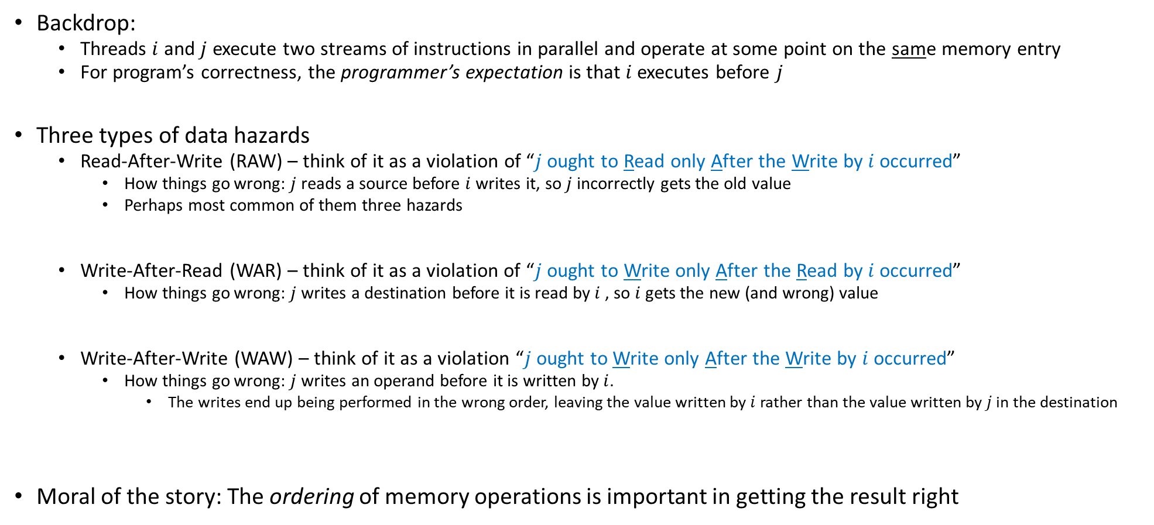
Data Hazards in Parallel Computing (not only GPU)
Backdrop:
Threads $i$ and $j$ execute two streams of instructions in parallel and operate at some point on the same memory entry
For program’s correctness, the programmer’s expectation is that $i$ executes before $j$
Three types of data hazards
Read-After-Write (RAW) – think of it as a violation of “$j$ ought to Read only After the Write by $i$ occurred”
How things go wrong: $j$ reads a source before $i$ writes it, so $j$ incorrectly gets the old value
Perhaps most common of them three hazards
Write-After-Read (WAR) – think of it as a violation of “$j$ ought to Write only After the Read by $i$ occurred”
How things go wrong: $j$ writes a destination before it is read by $i$ , so $i$ gets the new (and wrong) value
Write-After-Write (WAW) – think of it as a violation “$j$ ought to Write only After the Write by $i$ occurred”
How things go wrong: $j$ writes an operand before it is written by $i$.
The writes end up being performed in the wrong order, leaving the value written by $i$ rather than the value written by $j$ in the destination
Moral of the story: The ordering of memory operations is important in getting the result right

Slide 17
Parallel computing, bottom line
Parallel computing: previous slide, two threads led to race conditions – in absence of special measures, there is no way to know who executes what and when
A matter of “thread racing”, or “race conditions”
“special measures”, example: use of __syncthreads()
Can we at least say something about the order in which memory operations are carried out?
A matter of “sequence of memory ops”, pertains one thread (with side effects when a 2nd thread present)

Slide 18
The concept of “memory consistency”
__device__ volatile int X = 1, Y = 2;
__device__ void writeXY()
{
X = 10;
Y = 20;
}
__device__ void readXY()
{
int A = Y;
int B = X;
}
Backdrop
Thread_1 executes writeXY()
Thread_2 executes readXY()
Question: what values can A and B assume?
For sequential consistency (“strongly-ordered mem. model”), the only possible scenarios are
A=2 and B=1
A=20 and B=10
A=2 and B=10
For weak consistency (“weakly-ordered memory model”), it is possible to have this
A=20 and B=1

Slide 19
Flavors of memory consistency
Sequential consistency: all reads and all writes are in-order
Relaxed consistency: some types of reordering are allowed
Loads can be reordered after loads (for better working of cache coherency, better scaling)
Loads can be reordered after stores
Stores can be reordered after stores
Stores can be reordered after loads
Weak consistency: reads & writes arbitrarily reordered
Programmer expected to step in and use explicit memory barriers if a certain order needed to be observed

Slide 20
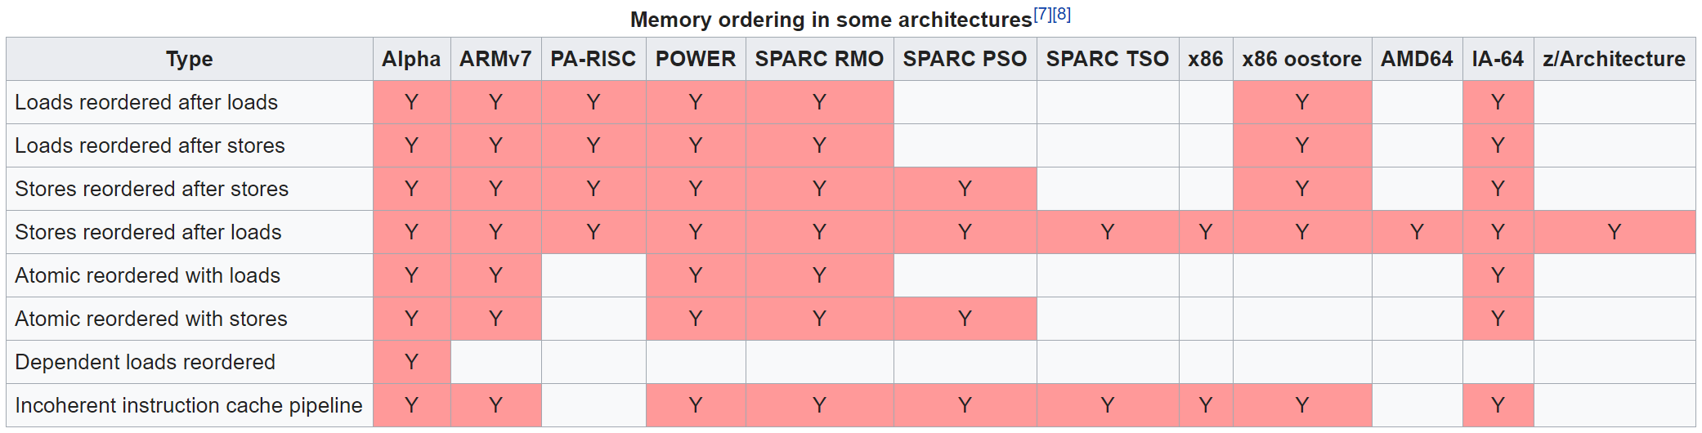

Not a GPU computing but rather a parallel computing issue
Example, memory ordering for some non-GPU architectures
[Wikipedia]$→$

Slide 21
The CUDA __threadfence function, backdrop
What we have just learned:
If a memory transaction was posted, it does not imply that it has been completed before another memory transaction that follows it
Need a guarantee that memory transaction has completed before another one is started
Comes through functionality associated w/ threadfence calls

Slide 22
The CUDA __threadfence family of functions
__threadfence_block();
Execution of the kernel by the calling thread pauses until all global and shared memory outstanding writes are visible to all threads in block
__threadfence();
Execution of kernel by a calling thread ensures all global and shared memory outstanding writes are visible to all threads in block AND all other threads in flight for global data
NOTE: the fences are NOT a synchronization mechanism
Not all threads should reach the fence function for the thread calling the fence to be allowed to move past the fence
It’s just a way to enforce that memory transactions for ONE thread can be seen by other threads

Slide 23
The CUDA __threadfence family of functions
__threadfance_system();
A thread stops in its execution of the kernel until global and shared memory accesses prior to the __threadfance_system() are visible to
all threads in the block for ShMem accesses
all threads in the device for global memory accesses,
host threads for page-locked host memory accesses

Slide 24

The nitty-gritty, has to do with enforcing ordering…
The fine print, for __threadfence_block(), two statements:
All writes to all memory made by the calling thread before the call to __threadfence_block() are observed by all threads in the block of the calling thread as occurring before all writes to all memory made by the calling thread after the call to __threadfence_block()
All reads from all memory made by the calling thread before the call to __threadfence_block() are ordered before all reads from all memory made by the calling thread after the call to __threadfence_block()
Similar semantics for __threadfence() & __threadfence_system()
[NVIDIA CUDA]$→$

Slide 25
#include<cuda.h>
#include<iostream>
__global__ void divergence(int* data)
{
int i = threadIdx.x;
if ((i & 0x01) == 0)
{
data[i+1] = data[i+1] + i; // if even, come here
}
else
{
data[i] = data[i] + 2*i; // if odd, come here
}
}
int main()
{
const int numElems = 4;
int hostArray[numElems], *devArray;
//allocate memory on the device (GPU); zero out all entries in this device array
cudaMalloc((void**)&devArray, sizeof(int) * numElems);
cudaMemset(devArray, 0, numElems * sizeof(int));
//invoke GPU kernel, with one block that has four threads
divergence <<<1, 4 >>>(devArray);
//bring the result back from the GPU into the hostArray
cudaMemcpy(&hostArray, devArray, sizeof(int) * numElems, cudaMemcpyDeviceToHost);
//print out the result to confirm that things are looking good
std::cout << "Values stored in hostArray: " << std::endl;
for (int i = 0; i < numElems; i++)
std::cout << hostArray[i] << std::endl;
//release the memory allocated on the GPU
cudaFree(devArray);
return 0;
}
Linux, P100
Windows, GTX1080

Slide 26
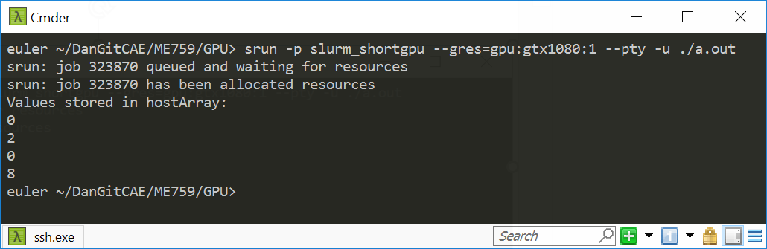
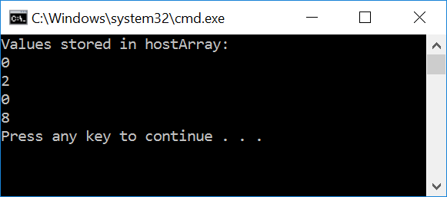
#include<cuda.h>
#include<iostream>
__global__ void divergence(int* data)
{
int i = threadIdx.x;
if ((i & 0x01) == 0)
{
data[i+1] = data[i+1] + i; // if even, come here
__threadfence_block();
}
else
{
data[i] = data[i] + 2*i; // if odd, come here
}
}
int main()
{
const int numElems = 4;
int hostArray[numElems], *devArray;
//allocate memory on the device (GPU); zero out all entries in this device array
cudaMalloc((void**)&devArray, sizeof(int) * numElems);
cudaMemset(devArray, 0, numElems * sizeof(int));
//invoke GPU kernel, with one block that has four threads
divergence <<<1, 4 >>>(devArray);
//bring the result back from the GPU into the hostArray
cudaMemcpy(&hostArray, devArray, sizeof(int) * numElems, cudaMemcpyDeviceToHost);
//print out the result to confirm that things are looking good
std::cout << "Values stored in hostArray: " << std::endl;
for (int i = 0; i < numElems; i++)
std::cout << hostArray[i] << std::endl;
//release the memory allocated on the GPU
cudaFree(devArray);
return 0;
}
Linux, P100
Windows, GTX1080

Slide 27
The volatile qualifier
From CUDA Programming Guide
Compiler is “free to optimize reads and writes to global or shared memory” provided
It respects the memory ordering semantics of memory fence functions
It respects memory visibility semantics of synchronization functions
What is the compiler allowed to do?
Example: store global reads into registers or L1 cache to speed up the computation
These “behind your back” optimizations disabled using the volatile keyword
CUDA: “If a variable located in global or shared memory is declared as volatile, the compiler assumes that its value can be changed or used at any time by another thread and therefore any reference to this variable compiles to an actual memory read or write instruction.”
[CUDA Programming Guide]→

Slide 28
The volatile qualifier: how things go south, ShMem example
To speed execution, compiler places a variable that should make it into ShMem into a register
A register is specific to a thread; another thread cannot see what’s stored in that register
Perhaps your code relies on thread B reading something that was deposited in ShMem by thread A
Thread A’s variable didn’t make it all the way to the ShMem since the compiler wrote that variable in a register, to speed up the computation
volatile prevents the compiler from playing these games and forces any variable to be written to the location in the memory where it ought to be stored – no funny business
Note: if in your kernel you do not expect any thread B to read from ShMem values deposited by thread A, then there is no need to use volatile
Notes:
See also this: https://stackoverflow.com/questions/15331009/when-to-use-volatile-with-shared-cuda-memory

Slide 29
Shared Memory: Historical Fact
It used to be that any access to Shared Memory was a direct access (in compute capability 1.x)
Fermi (2.x) and after: the load/store solution embraced can keep data into registers instead of moving them to ShMem
No guarantee for coherence between the shared memory block and the value stored in the register
Problem is typically addressed by making that shared memory volatile:
In 1.x, this was always ok:
__shared__ int myShVars[256];
Fermi and after, you might have to do this (prevents compiler from optimizing instructions related to myShVars):
volatile __shared__ int myShVars[256];

Slide 30
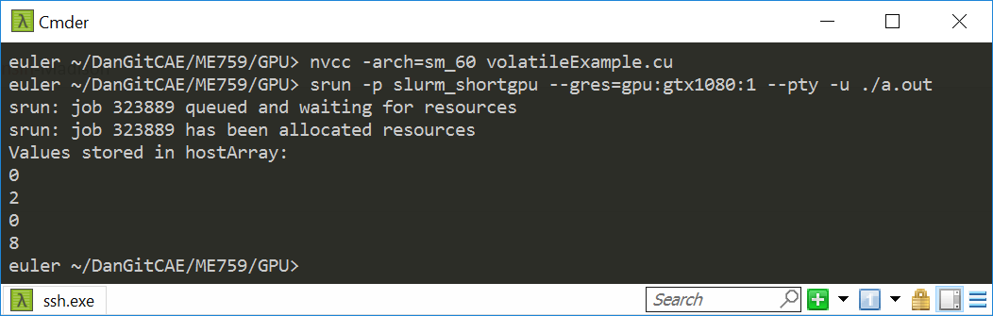

#include<cuda.h>
#include<iostream>
__global__ void divergence(volatile int* data)
{
int i = threadIdx.x;
if ((i & 0x01) == 0)
{
data[i+1] = data[i+1] + i; // if even, come here
}
else
{
data[i] = data[i] + 2*i; // if odd, come here
}
}
int main()
{
const int numElems = 4;
int hostArray[numElems], *devArray;
//allocate memory on the device (GPU); zero out all entries in this device array
cudaMalloc((void**)&devArray, sizeof(int) * numElems);
cudaMemset(devArray, 0, numElems * sizeof(int));
//invoke GPU kernel, with one block that has four threads
divergence <<<1, 4 >>>(devArray);
//bring the result back from the GPU into the hostArray
cudaMemcpy(&hostArray, devArray, sizeof(int) * numElems, cudaMemcpyDeviceToHost);
//print out the result to confirm that things are looking good
std::cout << "Values stored in hostArray: " << std::endl;
for (int i = 0; i < numElems; i++)
std::cout << hostArray[i] << std::endl;
//release the memory allocated on the GPU
cudaFree(devArray);
return 0;
}
Linux, P100
Windows, GTX1080

Slide 31
volatile vs. __threadfence(): how different?
volatile applies equally well to sequential computing
Not an appendage of CUDA, exists in the standard C
__threadfence() specific to parallel computing
Although this particular syntax is specific to CUDA, the idea of a memory fence is not

Slide 32
I actually cheated in this discussion…
If you paid attention, you notice that in the __threadfence() & volatile discussion I always assumed that the “if” branch will be executed before the “else” branch
Under this assumption, we employed __threadfence() and volatile to see them at work
This is all good, but I cheated, since one cannot count in CUDA on the fact that the “if” branch is executed before the “else” branch
However, in our case for some reason the if branch *was* always executed first (don’t count on it!)
Therefore, I could use this example to show how __threadfence() and volatile work
For more on the above assumption, see this NVIDIA developer forum question

Slide 33
Landmines everywhere???
Is parallel computing riddled with landmines all over the place?
If same memory location gets accessed by different threads: keep your eyes peeled
Up to you to take necessary steps to ensure proper sequence in memory operations (RAW, WAW, WAR)
The tools of the trade (or “tools of the thread”?):
Use of volatile qualifier
Memory fences
Thread synchronization
Note: this transcends GPU computing, applies equally well to multi-core parallel computing

Slide 34

[Gahan Wilson]$→$

Slide 35
Ruminations, memory related
Ruminations, on two topics
Memory operations, getting the result right (broad discussion, for parallel computing)
Memory operations, getting the result fast (narrower discussion, for GPU computing)

Slide 36
GPU Cache Line
All global memory accesses are cached
A cache line is 128 bytes
It maps to a 128-byte aligned segment in global memory
Note: it so happens that 128 bytes = 32 (warp size) * 4 bytes
In other words, 32 floats or 32 ints fit in one cache line (and can be brought in L2 or L1 in one trip)
If the size of the type accessed by each thread is more than 4 bytes, a memory request by a warp is first split into separate 128-byte memory requests that are issued independently
Notes:
What is important about a cache line of 128 bytes?
it maps well in a data transaction for an entire warp: 32 floats or 32 ints
in one operation services all threads in a warp
You can determine at *compile* time (through flags: -dlcm=ca/cg) if you double cache [L1 & L2] or only cache [L2 only]
If [L1 & L2], a memory access is serviced with a 128-byte memory transaction
If [L2 only], a memory access is serviced with a 32-byte memory transaction
This can reduce over-fetch in the case of scattered memory accesses
Good for irregular pattern access (sparse linear algebra)

Slide 37
Memory Access Issues
Issue 1: Not all global memory accesses are equally efficient
How can you optimize memory access?
Question is highly relevant (for fast execution)
Issue 2: Not all shared memory accesses are equally efficient
How can we optimize shared memory accesses?
Moderately relevant question
Discussed already (bottom line: avoid bank conflicts)
NOTE: Getting global memory access right has higher priority
Notes:
We discuss the 1st one:
scheduling is important here
We do not discuss the 2nd one:
physical layout of the memory banks used for L1 cache / ShMem
bank conflicts

Slide 38
Data Access “Divergence”
Concept is similar to thread divergence and often conflated
Hardware is optimized for accessing contiguous blocks of global memory when performing loads and stores
“block of global memory”: a 128-byte aligned chunk of 128 byte of memory
Becomes a GPU cache line, once it gets read in L2 (and possibly L1) memory

Slide 39
Global Memory Access
Two aspects of global memory access are relevant when fetching data into shared memory and/or registers
The layout of the access to global memory (the pattern of the access)
The alignment of the data you try to fetch from global memory
IMPORTANT:
The two attributes in red above should be interpreted in the context of a memory transaction carried out by one warp of threads
That is, not by one thread, not all threads in a block, not all threads in a grid, etc. But one warp of threads
Notes:
Recall: most programs are memory-bound, flops are cheap
Memory transactions are playing key role in the performance of your code. Getting maximum memory throughput requires you to follow certain access pattern rules.
Data “divergence”: concept similar to thread divergence
hardware is optimized for so-called coalesced memory transactions (accessing contiguous blocks of global memory)
divergence: neighboring threads access memory locations physically far from each other

Slide 40
Comment, on the “layout of the access” attribute
The basic idea:
Suppose each thread in a warp accesses a global memory address for a load operation at some point in the execution of the kernel
These threads can access global memory data that is either (a) neatly grouped, or (b) scattered all over the place
Case (a) is called a “coalesced memory access”
If you end up with (b) this will adversely impact the effective bandwidth of your program
Analogy
It’s one thing to get the timber I need from one forest
Alternatively, in case I need timber from different forests several trips will be in order to get what I need

Slide 41
Comment, on the “alignment” attribute
Fact: Any address of memory allocated in device memory with cudaMalloc is a multiple of 256
The “alignment” component of this story:
It’s great when all threads in a warp access data inside only one memory block

Slide 42
Hitting the jackpot/winning the lottery
Best memory accesses are simultaneously: (1) coalesced and (2) properly aligned

Slide 43
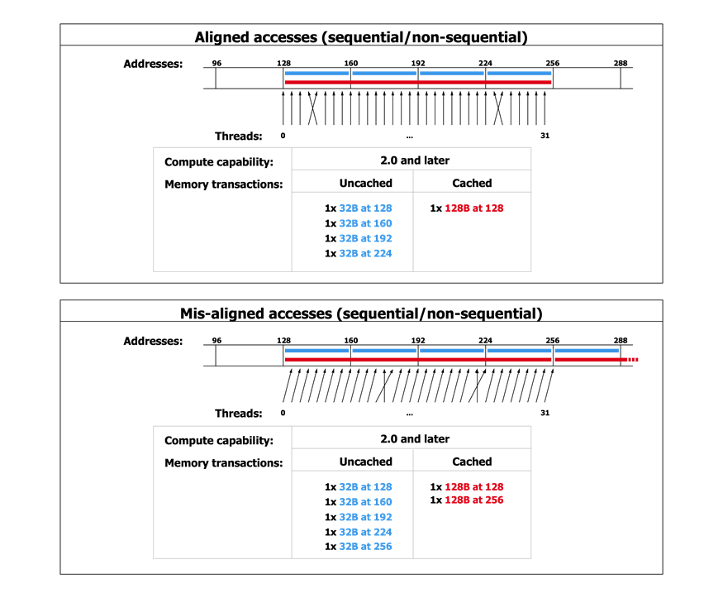
Scenario A: Coalesced and aligned – great!
[NVIDIA]$→$

Slide 44
Scenario B: Coalesced, but not aligned
[NVIDIA]$→$

Slide 45
Why is this important?
In Scenario B you have half the effective bandwidth you get in Scenario A
Just because of the alignment of your data access
If your code is memory bound and dominated by this type of access, you might see a sizeable slow down…
However, the slowdown is not by a factor of 2, since the memory transactions are pipelined too
The moral of the story:
When you reach out to fetch data from global memory, visualize how a warp of threads reaches out for access.
Is the access coalesced and well aligned?

Slide 46
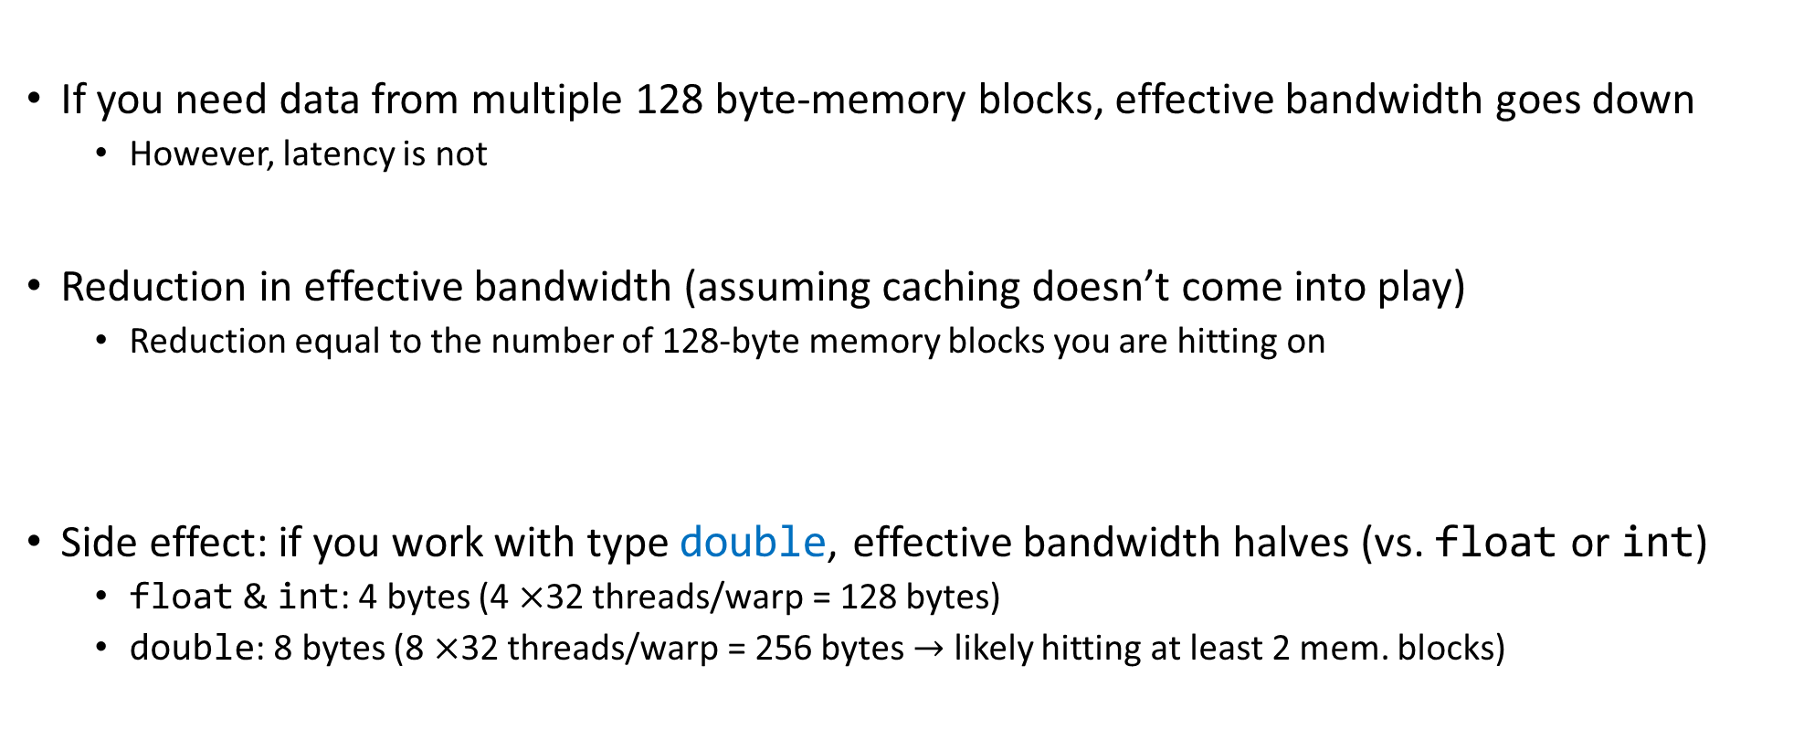
A note on the effective bandwidth
If you need data from multiple 128 byte-memory blocks, effective bandwidth goes down
However, latency is not
Reduction in effective bandwidth (assuming caching doesn’t come into play)
Reduction equal to the number of 128-byte memory blocks you are hitting on
Side effect: if you work with type double, effective bandwidth halves (vs. float or int)
float & int: 4 bytes (4 $×$32 threads/warp = 128 bytes)
double: 8 bytes (8 $×$32 threads/warp = 256 bytes $→$ likely hitting at least 2 mem. blocks)

