Slide 1
ME759 High Performance Computing for Applications in Engineering [Spring 2021]
Lecture 21
03/12/2021
Dan Negrut, 2021 ME759 UW-Madison

Slide 2
Quote of the day
“A ship is safe in a harbor, but that is not what ships are built for.”
-- John Shedd (July 20, 1850 – October 22, 1926) President, Marshall Field & Company.

Slide 3
Is BBC recording on?
If my internet connection goes down, I’ll email from my phone to provide more information – go/no-go, next step, etc.

Slide 4
Before we get started…
Last time
OpenMP nuts & bolts: nested parallelism, work sharing (for loops, sections)
Today
OpenMP nuts & bolts: nested parallelism, work sharing (tasks)
OpenMP: variable scoping, synchronization, loose ends
Other tidbits:
Assignment due on Th, 03/18, at 9 pm
Do not run your code on the Euler head-node (use Slurm)
Big PDF file contains all the slides thus far; easy to search into it to find topics covered thus far. Doc is here.

Slide 5
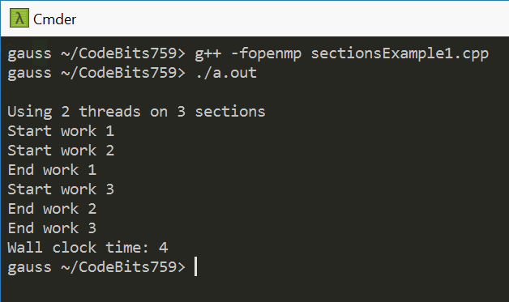
Example, sections: using 2 threads
#include <cstdio>
#include <omp.h>
using std::printf;
void spin_in_place(double duration) {
double start_time = omp_get_wtime();
while (omp_get_wtime() - start_time < duration) {}
}
int main() {
printf("\nUsing 2 threads on 3 sections\n");
double start_time = omp_get_wtime();
#pragma omp parallel sections num_threads(2)
{
#pragma omp section
{
printf("Start work 1\n"); spin_in_place(2); printf("End work 1\n");
}
#pragma omp section
{
printf("Start work 2\n"); spin_in_place(2); printf("End work 2\n");
}
#pragma omp section
{
printf("Start work 3\n"); spin_in_place(2); printf("End work 3\n");
}
}
printf("Wall clock time: %.2g\n", omp_get_wtime() - start_time);
return 0;
}
Note: The host machine (gauss) has tons of cores.

Slide 6
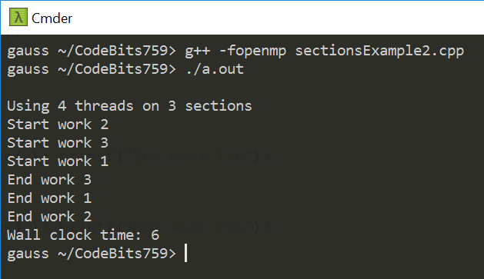
Example, sections: using 4 threads
#include <cstdio>
#include <omp.h>
using std::printf;
void spin_in_place(double duration) {
double start_time = omp_get_wtime();
while (omp_get_wtime() - start_time < duration) {}
}
int main() {
printf("\nUsing 4 threads on 3 sections\n");
double start_time = omp_get_wtime();
#pragma omp parallel sections num_threads(4)
{
#pragma omp section
{
printf("Start work 1\n"); spin_in_place(2); printf("End work 1\n");
}
#pragma omp section
{
printf("Start work 2\n"); spin_in_place(6); printf("End work 2\n");
}
#pragma omp section
{
printf("Start work 3\n"); spin_in_place(2); printf("End work 3\n");
}
}
printf("Wall clock time: %.2g\n", omp_get_wtime() - start_time);
return 0;
}
!
Note: The host machine (gauss) has tons of cores.
!

Slide 7
Work Plan, OpenMP
What is OpenMP?
Parallel regions
Work sharing – Parallel tasks
Variable Scoping Issues
Synchronization
Performance issues
Loose ends

Slide 8
Backdrop, OpenMP tasks
Handwavy idea behind the OpenMP task (in pseudo-code)
Whatever is in curly brackets is packaged as a “task” that needs to be executed at some point by some OpenMP thread
The lines of code in the block above are often organized as a function call, and the block of code (body of the task) collapses to one line of code: a function call (foo, in our example)
#pragma omp task
{
blahblah code
…
smore blahblah code
}
The collection of lines of code in here is identified by OpenMP as a “task”
(usually encountered in a for/while loop)
#pragma omp task
{
foo(p);
}

Slide 9
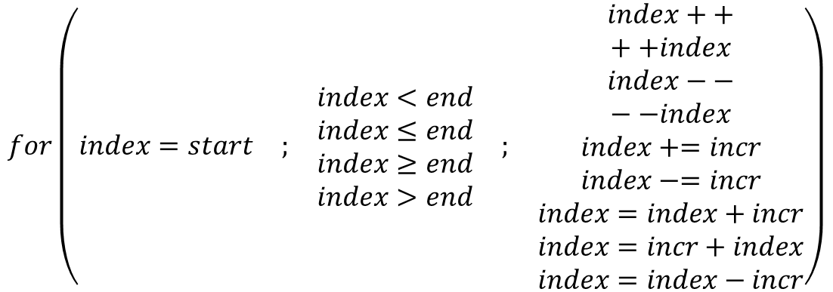
OpenMP tasks
Pros, OpenMP tasks: Allows parallelization of irregular problems
Unbounded loops
Recursive algorithms
Producer/consumer
Cons, OpenMP tasks : relatively tricky to deal with & introduce some overhead
[IOMPP]→

Slide 10
OpenMP Tasks – Motivation [1/3]
Parallelization of a dynamic list traversal: couldn’t be done in OpenMP for a long time
OpenMP was initially “somewhat tailored for large array-based applications.”
OpenMP Application Program Interface, version 2.5 – OpenMP ARB, May 2005
p = listhead;
while (p) {
process(p);
p = next(p);
}
[IEEE TPDS 20(3), pp. 404-418, 2009]→

Slide 11
OpenMP Tasks – Motivation [2/3]
Store pointers to list elements in an array called arr
Overhead of array construction (not easy to parallelize)
p = listhead;
count = 0;
while (p != listend ) {
arr [count++] = p;
p = next(p);
}
#pragma omp parallel for
for (int i = 0; i < count; i++)
process(arr[i]);
[IEEE TPDS 20(3), pp. 404-418, 2009]→

Slide 12
OpenMP Tasks – Motivation [3/3]
Use single nowait inside a parallel region
Why we shouldn’t settle for this:
Relatively high cost of the single construct
Each thread needs to traverse the entire list and determine if another thread has already processed that element
Ensuring that no other thread has processed a list element is not trivial at all
The code ensuring this is not shown here and would have to be inside the process(p) function call
#pragma omp parallel private(p)
{
p = listhead;
while (p != listend) {
#pragma omp single nowait
process(p);
p = next(p);
}
!
[IEEE TPDS 20(3), pp. 404-418, 2009]→

Slide 13
One-Slide Side-Trip: When Compiler Doesn’t Speak OpenMP
Imagine your compiler doesn’t speak OpenMP
Previous piece of code: is like ignoring all the pragmas
Ignoring pragmas: You’d get your sequential implementation that you used to have before you decorated the code w/ OpenMP directives
#pragma omp parallel private(p)
{
p = listhead;
while (p != listend) {
#pragma omp single nowait
process(p);
p = next(p);
}

Slide 14
The task Concept in OpenMP
Happens fast!
thread
Task generator
…
thread
thread
thread
Task “executors”
[Ruud van der Pas]→

Slide 15
Tasks: Who Does What and When?
The developer (you, that is), does this:
Uses a pragma to specify where & what the tasks are
Ensures that there are no dependencies (that is, tasks can be executed independently)
The OpenMP runtime system does this:
Generates a new task whenever a thread encounters a task construct
Decide the moment of execution (can be immediate or delayed)
[Ruud van der Pas]→

Slide 16
What Are Tasks? How Do They Work?
Tasks are independent units of work
One or more threads assigned to generate tasks
The OpenMP threads pick up & execute the “posted” tasks
Tasks might be executed immediately or might be deferred
The OS & runtime decide which of the above
Decision transparent to the user
Time
Serial
Tasks
[IOMPP]→

Slide 17
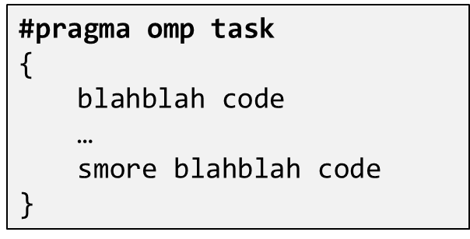
What makes an OpenMP task?
Three concepts important in the context of tasks
Code to execute
The literal code in your program enclosed by the task directive
Data environment
The shared & private data manipulated by the task
Internal control variables (ICV)
Thread scheduling and environment variables, typically associated with OpenMP

Slide 18
What Are Tasks? [The specifics…]
More formal definition:
A task is a specific instance/combo of executable code along w/ its data environment and ICV
This “instance/combo” is generated when a thread encounters a task construct
Three activities involved in the process: 1) packaging; 2) posting a task; and 3) execution of the tasks
A thread packages a new instance of a task; i.e., its code & data & ICVs
This “combo” is placed in a queue of “things to do” (like a bulletin board)
Some thread in the team executes the task at some later time

Slide 19
The task Directive
A team of threads is created at the omp parallel construct
A single thread is chosen to execute the while loop – let’s call this thread “L”
Thread L runs the while loop, creates tasks, and fetches next pointers
Each time L crosses the omp task construct it generates a new task and has a thread assigned to it
Each task run by 1 thread at some point in time
#pragma omp parallel //threads are ready to go now
{
#pragma omp single nowait
{
node *p = head_of_list;
while(p != end_of_list) {
#pragma omp task firstprivate(p)
{
process(p);
}
p = p->next;
}
}
}
All tasks complete at the barrier at the end of the parallel region’s construct
Each task has its own stack space that will be destroyed when the task is completed
[IOMPP]→

Slide 20
Why Are Tasks Useful? [Example below: assume 4 OpenMP threads]
Assume 3 big tasks
Assume 4 OpenMP threads
With tasks you have the potential to parallelize irregular patterns and recursive function calls
OpenMP this side of orange line
Single Threaded
T1
T2
T3
T4
Block 1
Block 1
Block 2
Task 1
Block 3
Block 2
Task 1
#pragma omp parallel
//threads are ready to go now
{
#pragma omp single nowait
{
// block 1
node *p = head_of_list;
while(p != end_of_list) {
#pragma omp task firstprivate(p)
{ //can have a chunk of code here
process(p); //block 2
}
p = p->next; //block 3
}
}
}
Block 3
Block 2
Task 2
Block 2
Task 3
Block 3
Block 2
Task 2
Idle
Idle
How about synchronization issues?
Block 3
Time Saved
Block 2
Task 3
Quick note: nowait construct needed since
“single” calls for implicit synchronization
[IOMPP]→

Slide 21
#include <omp.h>
#include <cstdio>
#include <list>
#include <cmath>
void doSomething(std::list<double>::iterator& itr) { *itr *= 2; }
int main() {
std::list<double> test;
for (int i = 0; i < 4; i++)
for (int j = 0; j < 8; j++)
test.push_back(std::pow(10.0, i + 1) + j);
for (auto& item : test) std::printf("%g\n", item);
std::list<double>::iterator it = test.begin();
#pragma omp parallel num_threads(8)
{
#pragma omp single nowait
{
while (it != test.end()) {
#pragma omp task firstprivate(it)
{
doSomething(it);
} // end omp task
it++;
}
std::printf("...master done\n");
} // end omp single
} // end omp parallel
for (auto& item : test) std::printf("%g\n", item);
return 0;
}

Slide 22
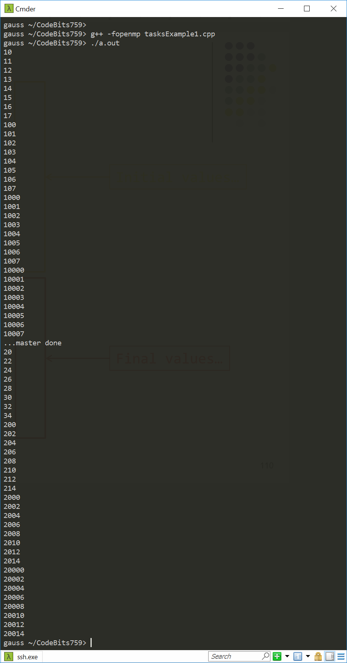
Initial values…
Final values…

Slide 23
Tasks: Synchronization Issues
Setup:
Assume Task B specifically relies on completion of Task A
You need to be in a position to guarantee completion of Task A before invoking the execution of Task B
Tasks are guaranteed to be complete at thread or task barriers:
At the directive: #pragma omp barrier
At the directive: #pragma omp taskwait
[IOMPP]→

Slide 24
Task Completion Example
Multiple foo tasks created here – one for each thread
#pragma omp parallel
{
#pragma omp task
foo();
#pragma omp barrier
#pragma omp single
{
#pragma omp task
bar();
}
}
All foo tasks guaranteed to be completed here
One bar task created here
bar task guaranteed to be completed here
[IOMPP]→

Slide 25
Comments: section vs. task
sections have a “static” attribute
Things are mostly settled at compile time
The task OpenMP construct more recent and more sophisticated
Has a “dynamic” attribute: things figured out at run time
A task can encapsulate any block of code
Can handle nested loops and scenarios when the number of jobs is not clear
Big hammer, watch your fingers…

Slide 26
Work Plan, OpenMP
What is OpenMP?
Parallel regions
Work sharing – Parallel tasks
Variable Scoping Issues
Synchronization
Performance issues
Loose ends

Slide 27
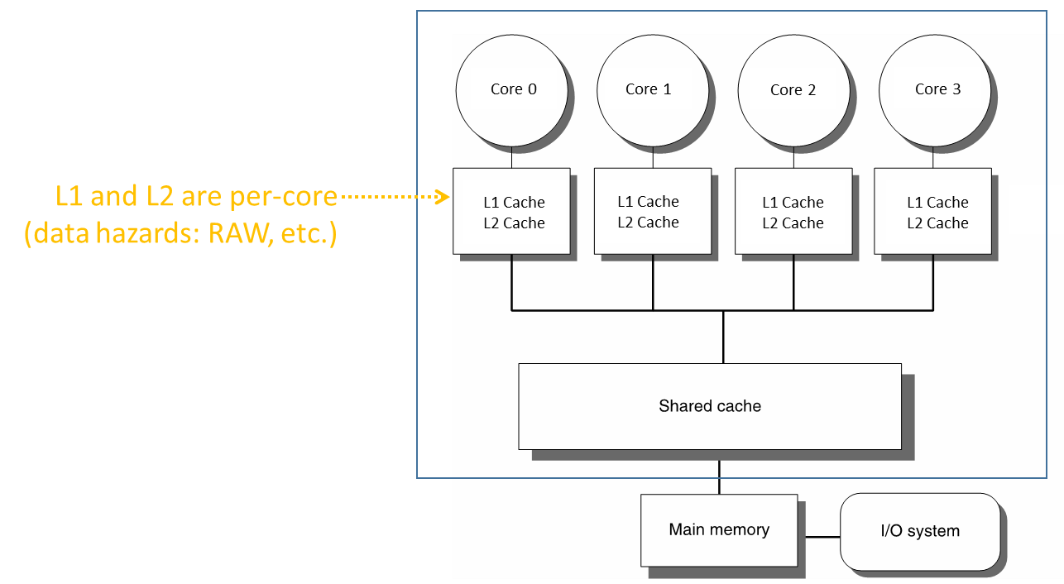
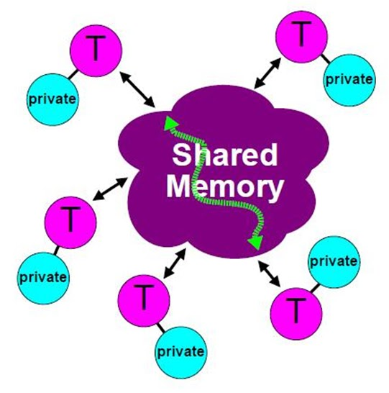
OpenMP Attributes
Parallel execution of multiple tasks via multiple threads
Threads have access to a pool of memory that is shared
Threads can have private data
Not accessible by other threads
When/How data is written/read from memory is transparent to programmer
However, programmer has some control (atomic, flush, etc.)
Synchronization in thread execution is implicit but can be made explicit as well
[CodeProject]→

Slide 28
Variable Scoping Issues in OpenMP – What is shared?
OpenMP uses a shared-memory programming model
Shared variable - a variable that can be read or written by multiple threads
Private variable – a variable whose value is only visible to a thread (for read/write)

Slide 29
Variable Scoping Issues in OpenMP
Important question: what is shared and what is not?
That is, what can a thread access, and what cannot it access?
Important why?
If a variable is shared, then you better be aware of that fact
Parallel computing data hazards, in relation to WAR, RAW, WAW
“Variable scoping in OpenMP”:
Understanding whether a variable that a thread works with is private or shared

Slide 30
Variable Scoping Issues in OpenMP – What is shared?
Basic rule:
Any variable declared prior to a parallel region is shared in that parallel region
That is, it is available for read/write to all parallel threads of the parallel region
Other examples of variables being shared among threads
Global variables
File scope variables
Namespace scope variables
Variables with const-qualified type having no mutable member
static variables which are declared in a scope inside the construct
Note: there’s a shared clause that you can use if you feel like explicitly indicating that a variable is shared

Slide 31
The private Clause
Reproduces for each thread variable[s] declared private in the pragma (see example below)
Consequence: each thread will have a private copy of that variable in the associated parallel region
The value that Thread_1 stores in x is different than value that Thread_2 stores in variable x
NOTE: Private variables are un-initialized; C++ object is default-constructed
void* work(float* c, int N) {
float x, y;
int i;
#pragma omp parallel for private(x,y)
for(i=0; i<N; i++) {
x = a[i]; y = b[i];
c[i] = x + y;
}
}
[IOMPP]→

Slide 32
Data Scoping – What is Private?
Examples of OpenMP variables treated as private by default:
Stack (local) variables in functions called from within parallel regions
Beware, in C/C++: call by copy vs. call by reference/pointer
You can end up with a shared variable inside a function, if pass by reference
Loop iteration variables
Automatic variables within a statement block
[IOMPP]→

Slide 33
Example [more dwelling on the private concept]: Is “i” shared or private?
curie ~/ME759/OpenMP> g++ firstPrivateP0.cpp -fopenmp
curie ~/ME759/OpenMP> ./a.out
threadID = 0 i = 10
threadID = 2 i = 10
threadID = 1 i = 10
threadID = 3 i = 10
i = 1003
curie ~/ME759/OpenMP> ./a.out
threadID = 3 i = 10
threadID = 0 i = 10
threadID = 2 i = 10
threadID = 1 i = 10
i = 1001
curie ~/ME759/OpenMP> ./a.out
threadID = 0 i = 10
threadID = 3 i = 10
threadID = 1 i = 10
threadID = 2 i = 10
i = 1002
curie ~/ME759/OpenMP> ./a.out
threadID = 0 i = 10
threadID = 3 i = 10
threadID = 1 i = 10
threadID = 2 i = 10
i = 1002
curie ~/ME759/OpenMP> ./a.out
threadID = 0 i = 10
threadID = 3 i = 10
threadID = 2 i = 10
threadID = 1 i = 10
i = 1001
curie ~/ME759/OpenMP>
#include <omp.h>
#include <cstdio>
using std::printf;
int main() {
int i = 10;
#pragma omp parallel num_threads(4)
{
int threadID = omp_get_thread_num();
printf("threadID = %d i = %d\n", threadID, i);
i = 1000 + threadID;
}
printf("i = %d\n", i);
return 0;
}

Slide 34
private: somewhat sneaky
#include <cstdio>
#include <omp.h>
using std::printf;
int main() {
int i = 10;
#pragma omp parallel num_threads(4) private(i)
{
int threadID = omp_get_thread_num();
printf("threadID = %d: i = %d\n", threadID, i);
i = 1000 + threadID;
}
printf("i = %d\n", i);
return 0;
}
What do we expect each thread to print?
What do we expect the master thread to print at the end?
curie ~/ME759/OpenMP> g++ firstPrivateP1.cpp -fopenmp
curie ~/ME759/OpenMP> ./a.out
threadID = 0 i = 0
threadID = 2 i = 0
threadID = 3 i = 0
threadID = 1 i = 0
i = 10
curie ~/ME759/OpenMP> g++ firstPrivateP1.cpp -Wall -fopenmp
… some stuff here…
firstPrivateP1.cpp:10:11: warning: ‘i’ is used uninitialized in this function [-Wuninitialized]
printf("threadID = %d i = %d\n", threadID, i);
~~~~~~^~~~~~~~~~~~~~~~~~~~~~~~~~~~~~~~~~~~~~~~
firstPrivateP1.cpp:5:7: note: ‘i’ was declared here
int i = 10;
^

Slide 35
private vs. firstprivate
firstprivate
Goes one step beyond where private stops
Specifies that each thread should have its own instance of a variable
Moreover, the variable is initialized using the value of the variable of the same name from the master thread
[IOMPP]→

Slide 36
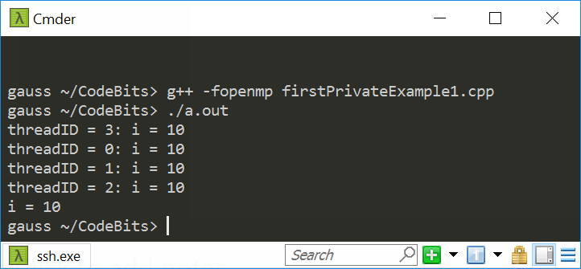
private vs. firstprivate
#include <cstdio>
#include <omp.h>
using std::printf;
int main() {
int i = 10;
#pragma omp parallel num_threads(4) firstprivate(i)
{
int threadID = omp_get_thread_num();
printf("threadID = %d: i = %d\n", threadID, i);
i = 1000 + threadID;
}
printf("i = %d\n", i);
return 0;
}
What do we expect each thread to print?
What do we expect the master thread to print at the end?

Slide 37
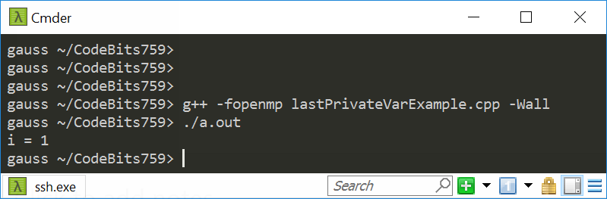
The lastprivate OpenMP directive
The enclosing context's version of the variable is set equal to the private version of whichever thread executes the final iteration of the work-sharing construct (for or section)
What do we expect the master thread to print at the end?
#include <cstdio>
#include <omp.h>
using std::printf;
int main() {
int i;
#pragma omp parallel for num_threads(4) schedule(static, 2) lastprivate(i)
for (int j = 0; j < 11; j++) {
i = omp_get_thread_num();
}
printf("i = %d\n", i);
return 0;
}

Slide 38
Harping On Data Scoping
A key tenet of OpenMP: that of data independence between threads
When parallel threads execute parallel regions, it is assumed
Data dependencies are inexistent across parallel regions, OR
If data dependencies exist, there will be no race conditions
Since you placed the omp parallel directive in your code, it is your responsibility to make sure that data dependencies do not lead to race conditions
Compilers not smart enough and sometimes can’t identify data dependency between what might look like independent parallel tasks

Slide 39
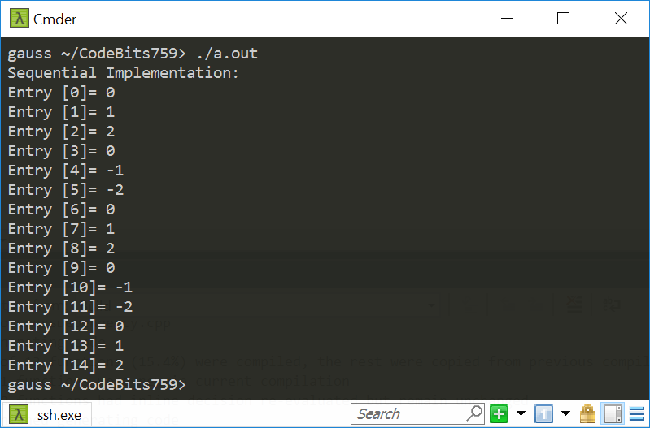
Data Dependency Example [1/5]
#include <omp.h>
#include <iostream>
#include <vector>
int main()
{
const int N = 15;
std::vector<int> a(N); // `a` is initialized with zeroes by default
//Basic idea: initialize the first "offset" entries of a and then
//populate all the other entries of a based on these first entries
const int offset = 3;
for (int i = 0; i < offset; i++)
a[i] = i;
for (int i = offset; i < a.size(); i++)
a[i] -= a[i - offset];
//print out the content of a
std::cout << "Sequential Implementation:\n";
for (int i = 0; i < a.size(); i++)
std::cout << "Entry [" << i << "]= " << a[i] << std::endl;
return 0;
}

Slide 40
Data Dependency Example [2/5]
#include <omp.h>
#include <iostream>
#include <vector>
int main()
{
const int N = 15;
std::vector<int> a(N);
//Basic idea: initialize the first "offset" entries of a and then
//populate all the other entries of a based on these first entries
const int offset = 3;
for (int i = 0; i < offset; i++)
a[i] = i;
#pragma omp parallel num_threads(2)
{
#pragma omp single
std::cout << "Running w/ this many threads: " << omp_get_num_threads() << std::endl;
#pragma omp for
for (int i = offset; i < N; i++)
a[i] -= a[i - offset];
}
//print out the content of a
for (int i = 0; i < a.size(); i++)
std::cout << "Entry [" << i << "]= " << a[i] << std::endl;
return 0;
}
We’re going to keep changing this value here

Slide 41
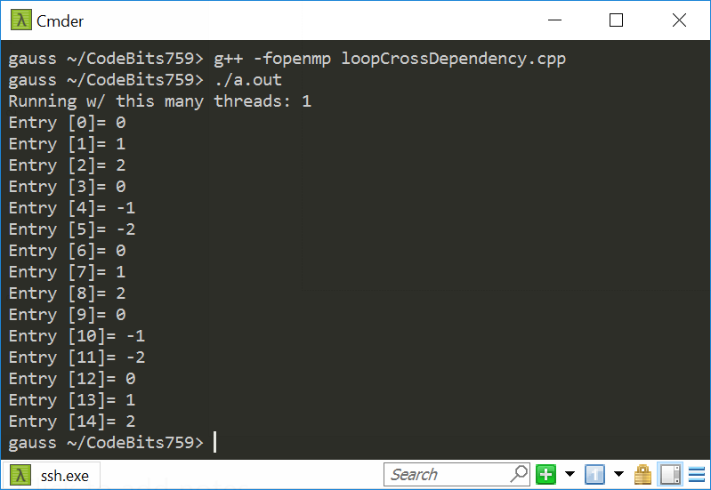
Data Dependency Example: 1 Thread [3/5]
Running OpenMP with one thread is essentially running sequentially

Slide 42
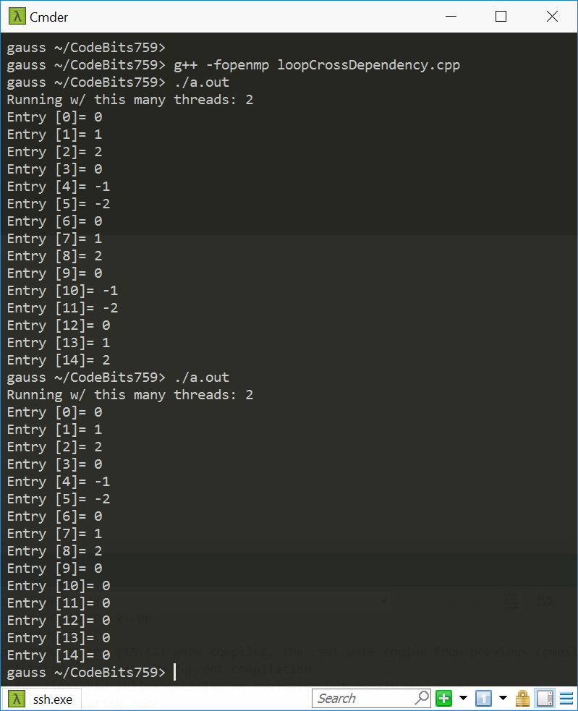
Data Dependency Example: 2 Threads [4/5]

Slide 43

Data Dependency Example: 3 Threads [5/5]

Slide 44
Quiz: what’s shared and what’s not?
float A[10];
main() {
int index[10];
#pragma omp parallel
{
Work(index);
}
printf("%d\n", index[1]);
}
extern float A[10];
void Work(int* index)
{
float temp[10];
static int count;
<...>
}
Assumed to be in another translation unit
A, index, count
A, index, and count are shared by all threads, but temp is local to each thread
A, index, count, temp: which is shared, and which is private?
temp
temp
temp
A, index, count
[IOMPP]→

Slide 45
Data Scoping – Words of Wisdom
When in doubt,
Explicitly indicate who is what
Write a toy example to experiment
OpenMP provides the clause default(none)
In this case, the compiler requires that we specify scope for each variable declared outside the block
Variable declared inside the block are private
Data scoping: a common sources of errors in OpenMP

Slide 46
Work Plan, OpenMP
What is OpenMP?
Parallel regions
Work sharing – Parallel tasks
Variable Scoping Issues
Synchronization
Performance issues
Loose ends

Slide 47
The barrier Construct
This is an explicit barrier synchronization available in OpenMP
Each thread waits until all threads arrive
Example below assumes that in DoSomework(X,Y) , X is an input and Y is the output:
#pragma omp parallel shared(A, B, C)
{
DoSomeWork(A,B); // input is A, output is B
#pragma omp barrier
DoSomeWork(B,C); // input is B, output is C
}
Quick question: how about breaking this into two parallel regions?
[IOMPP]→
Notes:
Quick question: how about breaking this into two parallel regions?
If we break, then you might have to wake up threads again – might be costly. At a barrier, they spin.

Slide 48
Implicit Barriers
Several OpenMP constructs have implicit barriers
parallel – necessary barrier – cannot be removed
for
single
sections
Unnecessary barriers hurt performance and can be removed with the nowait clause
The nowait clause is applicable to:
for directive
single directive
sections directive
[IOMPP]→

Slide 49
The nowait Clause
#pragma omp for nowait
for(…)
{ […] }
#pragma single nowait
{ […] }
Use when threads unnecessarily wait between independent computations
#pragma omp for schedule(static) nowait
for(int i=0; i<n; i++)
a[i] = bigFunc1(i);
#pragma omp for schedule(dynamic,1)
for(int j=0; j<m; j++)
b[j] = bigFunc2(j);
[IOMPP]→

Slide 50
Example, Synchronization Issue: Computing the Dot Product
float dot_prod(float* a, float* b, int N)
{
float sum = 0.0;
#pragma omp parallel for shared(sum)
for(int i=0; i<N; i++) {
sum += a[i] * b[i];
}
return sum;
}
What is wrong here?
[IOMPP]→

Slide 51
Race Condition
Race condition: two or more threads access a shared variable at the same time
Leads to nondeterministic behavior
Both Thread A and Thread B are executing the statement
sum += a[i] * b[i];
[IOMPP]→

Slide 52
Race conditions (data hazards) – two possible scenarios
Value of
sum
Thread A
Thread B
Value of
sum
Thread A
Thread B
11.667
11.667
+3.765
+3.765
15.432
11.667
15.432
15.432
+ 3.563
+ 3.563
18.995
15.230
Order of thread execution causes non-deterministic behavior in a data race
[IOMPP]→

Slide 53
Example: Computing the Dot Product, second attempt
The critical construct: protects access to shared, modifiable data
The critical section allows only one thread to enter it at a given time
float dot_prod(float* a, float* b, int N)
{
float sum = 0.0;
#pragma omp parallel for shared(sum)
for(int i=0; i<N; i++) {
#pragma omp critical
sum += a[i] * b[i];
}
return sum;
}
[IOMPP]→

Slide 54

The critical Directive
#pragma omp critical[(name)]: defines a critical region on a structured block
float* RES;
//… more stuff happens here
#pragma omp parallel num_threads(4)
{
#pragma omp for
for(int i=0; i<8; i++) {
float B = job1(i);
#pragma omp critical(RES_lock)
consum(B, RES);
job2(B);
}
}
Threads wait their turn – only one at a time calls consum() thereby preventing race conditions
Naming the critical construct RES_lock is optional but highly recommended
[IOMPP]$→$

Slide 55
OpenMP critical Construct
RES
float* RES;
#pragma omp parallel
{
#pragma omp for num_threads(4)
for(int i=0; i<8; i++) {
float B = job1(i);
#pragma omp critical(RES_lock)
consum(B, RES);
job2(B);
}
}
i=0,1
i=2,3
i=4,5
i=6,7
B=job1
B=job1
B=job1
B=job1
Time: arrow points to future
consum
job2
consum
consum
job2
job2
consum
job2
RES
[IOMPP]$→$

