Slide 1
ME759 High Performance Computing for Applications in Engineering [Spring 2021]
Lecture 22
03/15/2021
Dan Negrut, 2021 ME759 UW-Madison

Slide 2

Cartoon of the day
[P. S. Mueller]$→$

Slide 3
Is BBC recording on?
If my internet connection goes down, I’ll email from my phone to provide more information – go/no-go, next step, etc.

Slide 4
Before we get started…
Last time
OpenMP: tasks, variable scoping, synchronization (discussed about the barrier & critical constructs)
Today
Wrap up synchronization
OpenMP rules of thumb
Parallel computing w/ OpenMP: NUMA aspects & how caches come into play
Other tidbits:
Assignment due on Th, 03/18, at 9 pm. Novelty: you’ll have to deal w/ OpenMP
Final Project *Proposal*, due one week from today. Post related questions on Piazza
Details about the proposal are here
The template for the two-page proposal is here
Big ME759 PDF is here
Do not run your code on the Euler head-node (use Slurm)

Slide 5
The atomic Directive
Applies only to simple update of memory location
It’s a guarded memory access operation
Also seen in GPU computing
Special case of a critical section
Atomic introduces significantly less overhead than critical
index[0] = 2;
index[1] = 3;
index[2] = 4;
index[3] = 5;
index[4] = 4;
index[5] = 0;
index[6] = 5;
index[7] = 1;
#pragma omp parallel for shared(x, y, index)
for (i = 0; i < n; i++) {
#pragma omp atomic
x[index[i]] += work1(i);
y[i] += work2(i);
}
[IOMPP]→

Slide 6
OpenMP atomic Directive
Unlike a critical directive, the atomic directive:
Can only protect a single assignment
Applies only to simple update of memory
The assignment that can be protected by atomic must be one of: x <op>= <expression>; x++; ++x; x--; --x;
<op> can be one of: +, *, -, /, &, ^, |, <<, >>
<expression> must not reference x
Only the load and store of x is protected (not <expression>)

Slide 7
The reduction Construct
#pragma omp parallel for reduction(+:sum)
for(i=0; i<N; i++) {
sum += a[i] * b[i];
}
Local copy of sum for each thread engaged in the reduction is private
Each local sum initialized to the identity operand associated with the operator that comes into play
Here we have “+”, so it’s a zero (0)
All local copies of sum added together and stored in “global” variable
[IOMPP]→

Slide 8
The reduction Clause
#pragma omp for reduction(op:list)
The variables in list will be shared in the enclosing parallel region
Here’s what happens inside the parallel or work-sharing construct:
A private copy of each variable in the “list” is created and initialized depending on the “op”
These copies are updated locally by threads
At end of construct, local copies are combined through “op” into a single value
[IOMPP]→

Slide 9
C/C++ reduction Operations
A range of associative operands can be used with reduction
Initial values are the ones that make sense mathematically
Operand | Initial value | Notes
+ | 0
* | 1
- | 0
& | ~0 | Bitwise AND
| | 0 | Bitwise OR
^ | 0 | Bitwise XOR
&& | 1 | Logical AND
|| | 0 | Logical OR
min/max | User-set | min/max of two vals

Slide 10


reduction Example: Numerical Integration
static long num_steps=100000;
double step, pi;
void main() {
int i;
double x, sum = 0.0;
step = 1.0/num_steps;
for (i=0; i< num_steps; i++) {
x = (i+0.5)*step;
sum = sum + 4.0/(1.0 + x*x);
}
pi = step * sum;
printf("Pi = %f\n",pi);
}
4.0
$$\int_{0}^{1}{\frac{4}{1+x^{2}}dx=π}$$
$$f\left(x\right)=\frac{4}{1+x^{2}}$$
2.0
0.0
X
1.0
[IOMPP]→

Slide 11
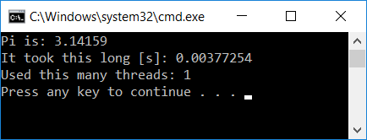
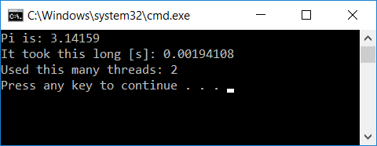
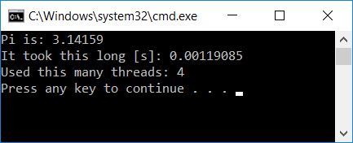
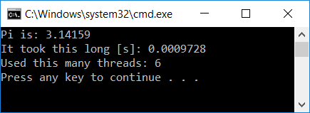
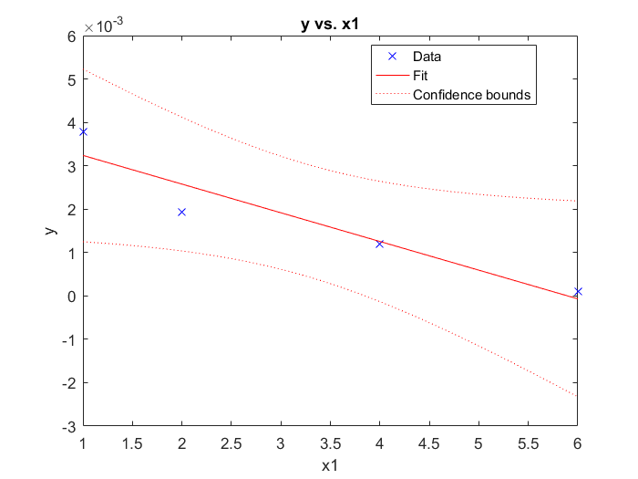
Scaling Analysis: Computation of $π$
#include <omp.h>
#include <cstdio>
void main() {
static long num_steps = 1000000;
const double step = 1.0 / (double)num_steps;
double sum = 0.0;
double startT = omp_get_wtime();
const int nThreadsUsed = 1;
#pragma omp parallel num_threads(nThreadsUsed)
{
#pragma omp for reduction(+:sum)
for (int i = 0; i < num_steps; i++) {
double x = (i + 0.5)*step;
double dummy = 1. / (1. + x*x);
sum += dummy;
}
}
double myPi = 4.*step * sum;
double timeElapsed = omp_get_wtime() - startT;
std::printf("Pi is: %f\n", myPi);
std::printf("It took this long [s]: %f\n", timeElapsed);
std::printf("Used this many threads: %d\n", nThreadsUsed);
}
Run time
nThreadsUsed

Slide 12
Wait, it can get even better: the simd directive
#include <omp.h>
#include <cstdio>
#include <chrono>
int main() {
int num_steps = 1000000;
const double step = 1.0 / (double)num_steps;
double sum = 0.0;
const int nThreadsUsed = 4;
auto start = std::chrono::high_resolution_clock::now();
#pragma omp parallel num_threads(nThreadsUsed)
{
#pragma omp for simd reduction(+:sum)
for (int i = 0; i < num_steps; i++) {
double x = (i + 0.5) * step;
double dummy = 1. / (1. + x * x);
sum += dummy;
}
}
double myPi = 4. * step * sum;
auto end = std::chrono::high_resolution_clock::now();
std::chrono::duration<double> elapsed = end – start;
std::printf("Pi is: %f\n", myPi);
std::printf("It took this long [s]: %d\n", elapsed.count());
std::printf("Used this many threads: %d\n", nThreadsUsed);
return 0;
}

Slide 13
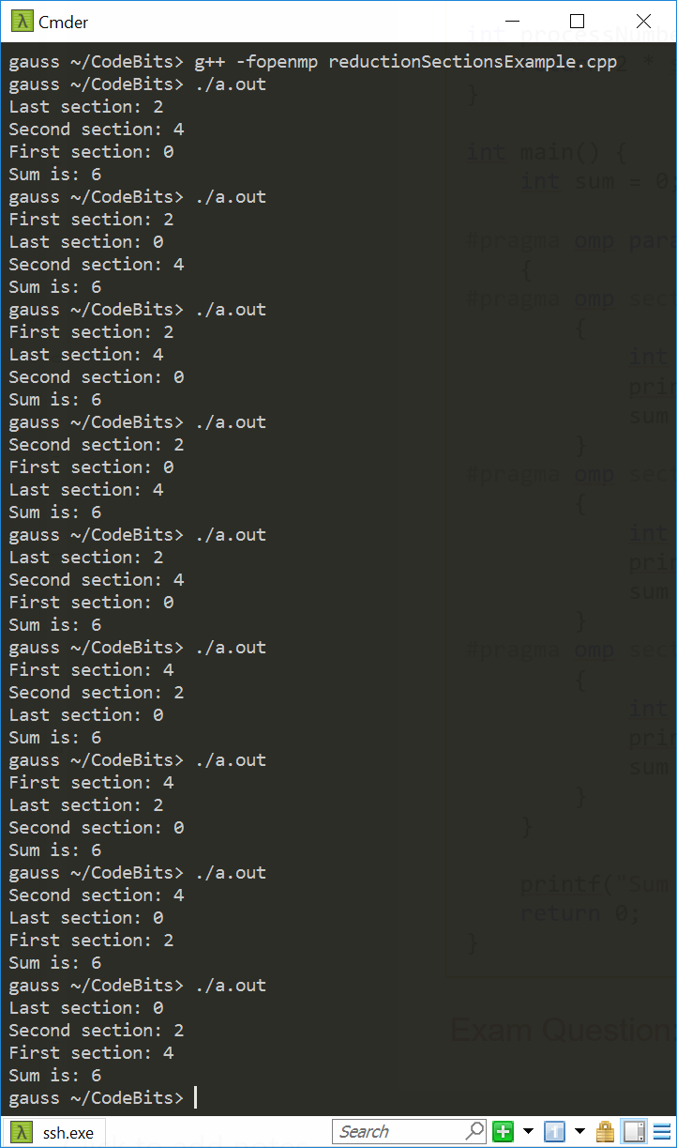
OpenMP reduction Works Beyond for Loops [1/2]
#include <cstdio>
#include <omp.h>
int processNumber(int someNumber) {
return 2 * someNumber;
}
int main() {
int sum = 0;
#pragma omp parallel sections num_threads(3) reduction(+:sum)
{
#pragma omp section
{
int someVal = processNumber(omp_get_thread_num());
std::printf("First section: %d\n", someVal);
sum += someVal;
}
#pragma omp section
{
int someOtherVal = processNumber(omp_get_thread_num());
std::printf("Second section: %d\n", someOtherVal);
sum += someOtherVal;
}
#pragma omp section
{
int dummy = processNumber(omp_get_thread_num());
std::printf("Last section: %d\n", dummy);
sum += dummy;
}
}
std::printf("Sum is: %d\n", sum);
return 0;
}
NOTE: sum is always the same. What’s called “First section” is not necessarily executed by thread with smallest id.

Slide 14
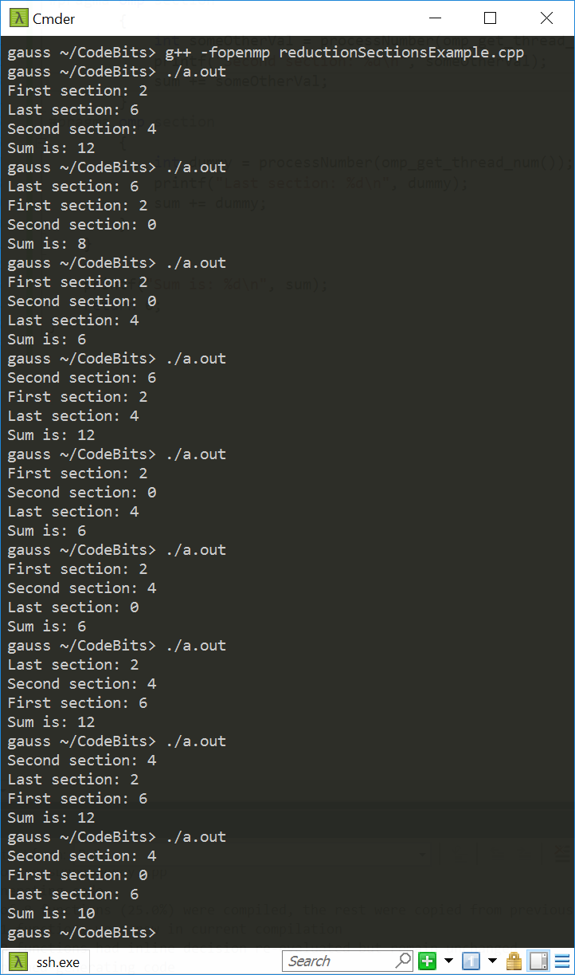
Quiz: Why different results for sum?
#include <cstdio>
#include <omp.h>
int processNumber(int someNumber) {
return 2 * someNumber;
}
int main() {
int sum = 0;
#pragma omp parallel sections num_threads(4) reduction(+:sum)
{
#pragma omp section
{
int someVal = processNumber(omp_get_thread_num());
std::printf("First section: %d\n", someVal);
sum += someVal;
}
#pragma omp section
{
int someOtherVal = processNumber(omp_get_thread_num());
std::printf("Second section: %d\n", someOtherVal);
sum += someOtherVal;
}
#pragma omp section
{
int dummy = processNumber(omp_get_thread_num());
std::printf("Last section: %d\n", dummy);
sum += dummy;
}
}
std::printf("Sum is: %d\n", sum);
return 0;
}

Slide 15

A Histogram Example [more advanced, uses reduction w/ C++ STL]
int main(int argc, char *argv[]) {
// Set number of threads
const auto num_threads = std::atoi(argv[1]);
omp_set_num_threads(num_threads);
// Read in Image
const int d1 = 1800;
const int d2 = 1200;
std::vector<int> image(d1 * d2); // initialize vector to dimensions of image
read_image("picture.img", image);
// Histogram Counter
std::vector<int> histCounter = std::vector<int>(7);
// Declaration of the std::vector addition
#pragma omp declare reduction(vec_int_add : std::vector<int> : \
std::transform(omp_out.begin(), omp_out.end(), omp_in.begin(), omp_out.begin(), std::plus<int>())) \
initializer(omp_priv = omp_orig)
double startTime = omp_get_wtime(); // Start Clock
#pragma omp parallel for reduction(vec_int_add : histCounter)
// Perform the histrogram; shared(histCounter)
for (int component : image)
(histCounter[component])++;
double endTime = omp_get_wtime(); // Stop Clock
// Ouput information
for (int element : histCounter)
std::cout << element << std::endl;
std::cout << num_threads << std::endl;
std::cout << std::setprecision(16) << (endTime - startTime) * 1000 << std::endl;
return 0;
}
#include <omp.h>
#include <algorithm>
#include <cmath>
#include <iomanip>
#include <iostream>
#include <vector>
#include <filesystem>
// Read image file into vector
void read_image(const std::filesystem::path& filename,
std::vector<int>& v) {
std::ifstream inf(filename, std::ios::binary);
for (int i = 0; i < v.size(); i++) {
inf.read(
reinterpret_cast<char*>(&v[i]),
sizeof(int)
);
}
}
[Christopher Van Damme]$→$

Slide 16
Work Plan, OpenMP
What is OpenMP?
Parallel regions
Work sharing – Parallel tasks
Variable Scoping Issues
Synchronization
Performance issues
Loose ends

Slide 17

Good OpenMP Performance: why an elusive target
Easy to write OpenMP code. Not necessarily easy to write efficient OpenMP code
Causes for performance not being what you hoped it could be
Too much sequential code in your app
Too much communication
Load imbalance
Synchronization
Compiler (non-)optimization
[Alan Real]$→$

Slide 18
Too much sequential code in your app
Beware of Amdahl’s law
If your algorithm/solution is sequential in nature, maybe it’s time to change it
Thinking within the context of OpenMP
All code outside of parallel regions is sequential
In fact, even if in parallel region, code might not run in parallel – recall the master, single and critical directives
Bottom line:
Seek to reduce amount of execution time where only one thread executes code
[Alan Real]→

Slide 19
Too much communication [that you fail to notice]
On shared memory machines, OpenMP can lead to heavy duty memory operations
Memory accesses are expensive (unless cached)
~100 cycles for a main memory access compared to 1-3 cycles for a flop
Unlike the message passing model (discussed later, for MPI), communication is spread throughout the program
Hard to analyse and monitor; transparent to user, hard to pin down
Mark of a good programmer: when he/she looks at one line of code (and perhaps a couple of lines above), programmer should know whether that line of code is expensive or not
[Alan Real]→

Slide 20
Load Imbalance
Load imbalance: one thread gets too much work, while the others idle waiting for it
Can arise from both communication and computation
Happens often in conjunction with for, sections & tasks; experiment with different scheduling options
Trick: For OpenMP for, one can use schedule(runtime)
Helps with experimentation, no need to recompile
Example: setenv OMP_SCHEDULE “dynamic,5”
If no available scheduling appropriate, contemplate taking the load balancing problem in your hands
[Alan Real]→

Slide 21
Synchronisation is costly. Avoid if possible.
Barriers can be very expensive
Typically, 1000s cycles to synchronise
Recall that there are both explicit and implicit barriers
Avoid barriers via:
Careful use of the nowait clause
Parallelize at the outermost level possible
May require re-ordering of loops / indexes
Use critical or atomic. Yet this may impact performance too
Use other OpenMP facilities, e. g. reduce

Slide 22
Compiler (non)-optimization
Sometimes the addition of parallel directives can prevent the compiler from performing sequential optimization
Symptoms:
Parallel code running with 1 thread has longer execution and higher instruction count than sequential code
Sometimes, it really helps to make shared data private and local to a function
[Alan Real]→

Slide 23
Attractive Features of OpenMP
Parallelize small parts of application, one at a time (beginning with most time-critical parts)
Can implement complex algorithms
Code size grows only modestly
Expression of parallelism flows clearly; code is easy to read
[Rebecca Hartman-Baker]→

Slide 24
Further Reading, OpenMP
Michael Quinn (2003) Parallel Programming in C with MPI and OpenMP
Chapman, Barbara, Gabrielle Jost, and Ruud van der Pas. (2008) Using OpenMP, Cambridge, MA: MIT Press.
LLNL OpenMP Tutorial, https://computing.llnl.gov/tutorials/openMP/
OpenMP.org, http://openmp.org/
OpenMP 5.0 API Syntax Reference Guide – very nice one-stop shopping:
https://www.openmp.org/wp-content/uploads/OpenMPRef-5.0-111802-print.pdf

Slide 25
Work Plan, OpenMP
What is OpenMP?
Parallel regions
Work sharing – Parallel tasks
Variable Scoping Issues
Synchronization
Performance issues
Loose ends

Slide 26
Loose ends: topics discussed
Non-uniform memory access (NUMA) issues
Cache issues

Slide 27
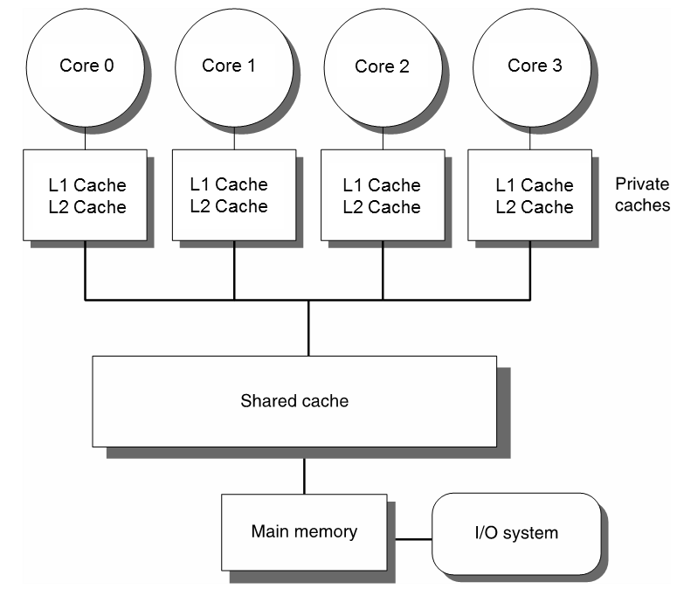
Preamble: the SMP model
Up to this point, not concerned with the mechanics of a shared memory access
Model embraced when discussing OpenMP thus far: SMP
Symmetric Multi-Processing model
All threads/cores have similar overhead when accessing shared memory
SMP model captures well the “one-chip per motherboard scenario”

Slide 28
SMP: a dated model, given today’s high-end hardware
Today’s server/cluster power nodes have many CPUs, each with many cores
“multi-socket configurations”
SMP model doesn’t quite apply
Not all memory accesses are equal (loss of “symmetry”)
A certain core has access time to certain system memory smaller than or equal to any other core on the node
Side note (nomenclature issue):
server node: used a lot by Amazon and Facebook for database manipulations
cluster node: mostly used by Oak Ridge or Argonne National Lab in their supercomputers

Slide 29
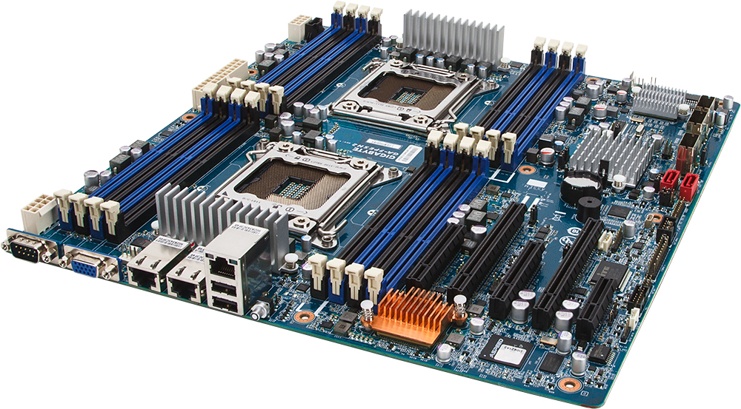
Multi-Socket Configurations [1/2] [two sockets, in this case]
Memory native to socket 0
Memory native to socket 0
Socket-0 for CPU-0
Memory native to socket 1
Socket-1 for CPU-1
Memory native to socket 1
[credit]

Slide 30
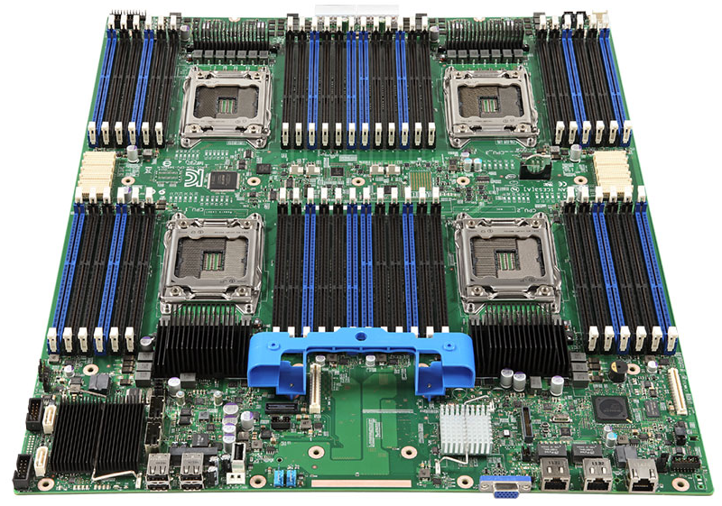
Multi-Socket Configurations [2/2] [four sockets: Intel S4600LT2 Xeon E5-4600 Chipset-C600-A Socket-R LGA-2011 1.46Tb DDR3-1600MHz Server Motherboard]
: Memory Bank
: CPU Socket
[credit]

Slide 31

Examples, Recent Layouts
AMD Zen (EPYC 7601): Two socket system
32 cores per processor $⇒$ 128 threads per socket
8 channel memory access per socket
CPUs communicate with each other via high-speed bus
Each processor: $≈$ $4,400
Intel Xeon Scalable (Platinum 8180): Eight socket system
28 cores per processor $⇒$ 56 threads per socket
6 channel memory access per socket
Each socket can only link directly to 3 neighboring sockets
Each processor$≈$ $5,000

Slide 32
Hardware Evolution: CPU count & Memory Access Solutions [Intel Specific]
Ca. 2005: RAM access streamed through Northbridge, unique Memory Controller.
* Poor scalability
Ca. 2008: RAM access streamed through Northbridge but multiple mem banks.
Still poor scalability, yet faster mem access
MC: “memory controller”
Ca. 2013: Northbridge integrated into CPU. Multiple mem banks.
* Fast mem access to local mem bank
[ Ulrich Drepper: What Every Programmer Should Know About Memory ]→

Slide 33
Non-uniform memory access (NUMA)
NUMA punchline: cost of memory access depends on which memory bank stores your data
Example:
Assume four RAM memory banks (RAM_MB): RAM_MB1, RAM_MB2, RAM_MB3, RAM_MB4
Assume four CPU sockets: CPU_A, CPU_B, CPU_C, CPU_D
Also, assume that:
RAM_MB1 bank acts as “native memory” for CPU_A
…
RAM_MB4 bank acts as “native memory” for CPU_D
Remarks:
Certainly, any CPU can access any memory bank
However, thread running on a CPU_A core takes less time to access data stored in bank RAM_MB1 than in RAM_MB3

Slide 34
The NUMA Factor
The ratio between the largest and shortest *average* amount of time for a thread running on a particular core to reach data in memory
Facts, related to the NUMA factor
A low NUMA factor is desirable, it suggests not much of a difference which bank data is stored
A high NUMA encountered in expensive hardware solutions that have hundreds to thousands of CPUs yet they have a *shared* memory layout
SGI’s Altix back in the day
Less common today
NOTE: A system w/ NUMA factor = 1 is an SMP system

Slide 35
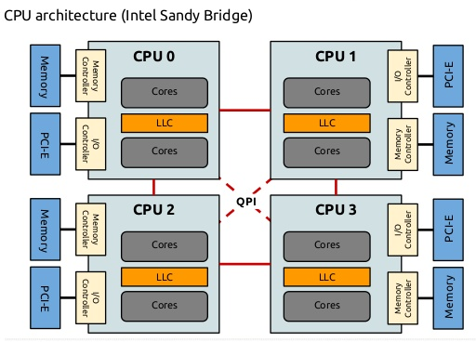
NUMA – A Schematic [Intel specific]
Image below shows a motherboard w/ four sockets
LLC: last level cache (these days, most often it is L3 cache)
QPI: QuickPath Interconnect (more later; also, replaced by Ultra Path Interconnect more recently (Xeon Skylake, 2017))

Slide 36
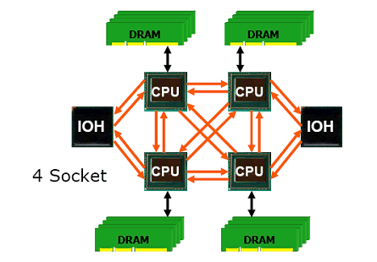
“NUMA Node”
Framing the discussion:
Focus on the case of *one* motherboard that
Hosts multiple sockets/multiple cores
Hosts multiple mem banks
This is today’s commodity hardware
NUMA node
Processors and memory bank next to it
Combines to look much like a small SMP system in its own right
Notation: IOH – Input/Output Hub
NUMA node
[ Dr. Dobb’s ]→

Slide 37
Multi-Socket Configurations [1/2] [two sockets, in this case]
Memory native to socket 0
Memory native to socket 0
Socket-0 for CPU-0
Memory native to socket 1
NUMA Node
Socket-1 for CPU-1
Memory native to socket 1
[credit]

Slide 38
Point-to-Point Technologies: a “local network” between nodes
Each CPU can access data stored in a different NUMA node
Happens over a very fast interconnect, which is like a local network
AMD’s solution name: Hyper Transport (HT)
Intel’s solution name: QuickPath Interconnect (QPI) (more recently: Ultra Path Interconnect (UPI))
The fast interconnect (local network): shown in orange in picture
Possible topologies associated with this “local network”:
2D-torus
2D-lattice (only moves in x or y direction – like 2D grid)
3D-Hypercube (3D version of lattice)
Etc.
NUMA node
[ Dr. Dobb’s ]→

Slide 39
NUMA Performance Hit, order of magnitude
What sort of slowdown should one expect if accessing memory outside a NUMA node?
Approximate values:
20% slowdown for reads
30% slowdown for writes
Values above depend on the number of hops required to reach memory bank
Closer NUMA nodes lead to lower values
[ Ulrich Drepper: What Every Programmer Should Know About Memory ]→

Slide 40
NUMA aspects: How the OS comes into play
NUMA aspects where Operating System (OS) comes into play
When a thread mallocs (or better yet callocs) memory, how should this memory be allocated?
Examples:
All memory allocated in one NUMA node
Memory split in chunks, each NUMA node being associated with one such chunk (“striping the memory”)
See next slide for implications
2) The process of having a thread assigned to execute on a certain core
Example: A thread w/ thread id 3 used to execute on Core #X, but then it runs on Core #Y, on a different NUMA node
Related concept: affinity – how you can prod the runtime/OS to assign a thread to a certain core

Slide 41
1) The malloc issue, and the “first touch” story
int main() {
const int N = 4000000;
double *x = (double*)malloc(N * sizeof(double));
double *a = (double*)malloc(N * sizeof(double));
for (i = 0; i < N; i++)
x[i] = simpleFunc(i);
omp_set_num_threads(64);
#pragma omp parallel for schedule(static,5)
for (i = 0; i < N; i++)
a[i] = someFunc(x[i]);
return 0;
}
Memory allocated with malloc not actually set aside when malloc gets hit
That only happens when data is written to it
x first touch is only by Master thread
Memory might be allocated in its NUMA node
a touched by all threads at the same time
Reflect on how chunks of the array are going to be spread all over the memory, very likely in different banks
Reflect on differences between Case 1 & 2
Case 1
int main() {
const int N = 4000000;
double *x = (double*)malloc(N * sizeof(double));
double *a = (double*)malloc(N * sizeof(double));
for (i = 0; i < N; i++)
x[i] = simpleFunc(i);
omp_set_num_threads(64);
#pragma omp parallel for schedule(dynamic,1)
for (i = 0; i < N; i++)
a[i] = someFunc(x[i]);
return 0;
}
Case 2

Slide 42
2) Affinity: Preamble/Backdrop
Imagine the following OpenMP scenario, when having 16 threads, dual socket, 8 cores/socket
The execution hits omp parallel for, with static schedule
Assume Master gets Core 0, Thread 1 gets Core 1, …, Thread 15 gets Core 15
Note: Worker threads folded back at end of parallel for
Next, after worker threads folded back, Master thread goes through a sequential segment of the code
Meanwhile, Core 2 has data in its cache that just sits there
Next yet, the execution hits a second omp parallel for, which this time has a “dynamic” schedule
A thread will be associated with Core 2 and it gets assigned to work on data that is in Core 13’s NUMA node
Can be worse: thread on Core 2 touches data that Core 13 keeps touching too – caches are not happy either

Slide 43
Affinity
Affinity: how threads executing your code get assigned/pinned to CPU cores
These cores can be physical or virtual
Why “virtual cores”?
Recall that one physical core shows up as two or sometimes four virtual cores
Example: Intel’s HTT. IBM has one physical core associated w/ 4 virtual cores
From back in the day: “virtual core” is what enables what we called TLP (thread-level parallelism)

Slide 44
Affinity
Aspects that you might be curious about and/or may want to control
Where is my master thread running ? (this is the thread with ID zero)
Can I control to which core a thread is assigned to in the first place?
Can I pin my threads to prevent migration?

Slide 45
Controlling affinity in OpenMP
Two actors come into play:
OMP_PROC_BIND – allows you to dictate a distribution policy
OMP_PLACES – allows you to control locations

Slide 46
The distribution policy as dictated by OMP_PROC_BIND
export OMP_PROC_BIND = master|close|spread|false|true
master: collocate threads with the master thread
close: place threads close to the master in the places list
spread (default): spread out threads as much as possible
false: set no binding
true: lock threads to a core
NOTE: above, we used an environment variable. Can accomplish via runtime function calls

Slide 47
How things come into play
spread (spreads out threads as much as possible)
This is useful if your code is memory bound
Likely to improve aggregate system memory bandwidth
You see more cache (less cache contention)
Example: two sockets, 8 cores per socket, you ask for 8 OpenMP threads
Have first four OpenMP threads on one socket and use its bandwidth for talking w/ main memory
Have last four OpenMP threads on the other socket and use its bandwidth for talking w/ main memory

Slide 48
How things come into play
close (places the threads close to the master)
This is useful if you don’t do many trips to main memory since you keep hitting the cache
Typically useful if you are compute bound
Likely to reduce synchronization costs (single, barrier, etc.)

Slide 49
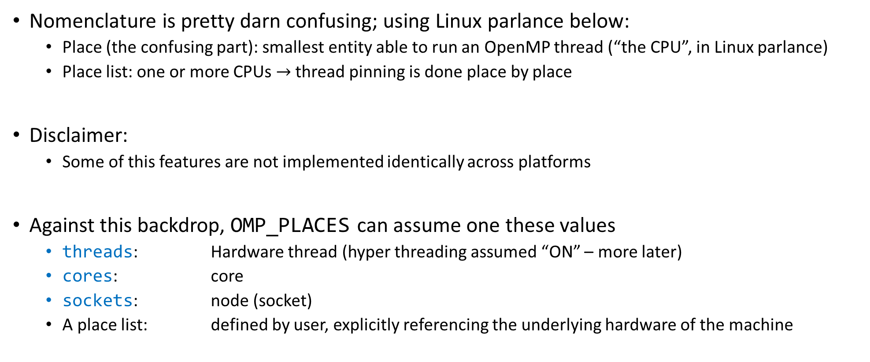
Control locations through OMP_PLACES
Nomenclature is pretty darn confusing; using Linux parlance below:
Place (the confusing part): smallest entity able to run an OpenMP thread (“the CPU”, in Linux parlance)
Place list: one or more CPUs $→$ thread pinning is done place by place
Disclaimer:
Some of this features are not implemented identically across platforms
Against this backdrop, OMP_PLACES can assume one these values
threads: Hardware thread (hyper threading assumed “ON” – more later)
cores: core
sockets: node (socket)
A place list: defined by user, explicitly referencing the underlying hardware of the machine
Notes:
The take home:
Migration (if any) of the threads allowed to occur within a place (between the CPUs of that place, that is)

Slide 50
Control locations through OMP_PLACES
(Linux nomenclature, confusing…)
threads, cores, sockets: are OpenMP abstractions, there is some liberty in how the runtime interprets them
Example: is hyper-threading on or off? Because it leads to different outcomes…
A place list is the real thing – you explicitly state the places
The numactl command shows how your hardware in organized
ME759node ~> numactl –H
available: 2 nodes (0-1)
node 0 cpus: 0 1 2 3 4 5 6 7 16 17 18 19 20 21 22 23
node 0 size: 64064 MB
node 0 free: 53060 MB
node 1 cpus: 8 9 10 11 12 13 14 15 24 25 26 27 28 29 30 31
node 1 size: 64482 MB
node 1 free: 59450 MB
node distances:
node 0 1
0: 10 21
1: 21 10
These are half of the available places for this chip

Slide 51
Side trip: the lscpu command [interesting “affinity” information highlighted in bold red]
ME759node ~> lscpu
Architecture: x86_64
CPU op-mode(s): 32-bit, 64-bit
Byte Order: Little Endian
CPU(s): 32
On-line CPU(s) list: 0-31
Thread(s) per core: 2
Core(s) per socket: 8
Socket(s): 2
NUMA node(s): 2
Vendor ID: GenuineIntel
CPU family: 6
Model: 63
Model name: Intel(R) Xeon(R) CPU E5-2640 v3 @ 2.60GHz
Stepping: 2
CPU MHz: 3116.890
CPU max MHz: 3400.0000
CPU min MHz: 1200.0000
BogoMIPS: 5187.98
Virtualization: VT-x
L1d cache: 32K
L1i cache: 32K
L2 cache: 256K
L3 cache: 20480K
NUMA node0 CPU(s): 0-7,16-23
NUMA node1 CPU(s): 8-15,24-31
(output of lscpu continued
in the block to the right)
Notes:
BogoMips (from "bogus" and MIPS) is a crude measurement of CPU speed made by the Linux kernel when it boots to calibrate an internal busy-loop. An often-quoted definition of the term is "the number of million times per second a processor can do absolutely nothing"

Slide 52
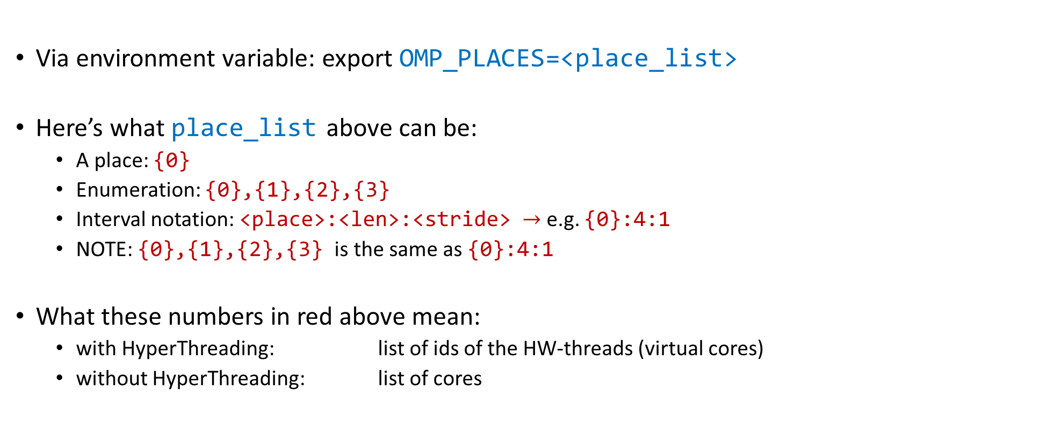
OMP_PLACES: stating the places explicitly
Via environment variable: export OMP_PLACES=<place_list>
Here’s what place_list above can be:
A place: {0}
Enumeration: {0},{1},{2},{3}
Interval notation: <place>:<len>:<stride> $→$ e.g. {0}:4:1
NOTE: {0},{1},{2},{3} is the same as {0}:4:1
What these numbers in red above mean:
with HyperThreading: list of ids of the HW-threads (virtual cores)
without HyperThreading: list of cores
List of [Linux] CPU ids
[Kent Milfeld, Lars Koesterke]$→$

Slide 53











Example [Assume 2 sockets & 4 cores per socket & no hyper-threading enabled]
core
export OMP_NUM_THREADS = 4
export OMP_PROC_BIND = close
export OMP_NUM_THREADS = 4
export OMP_PROC_BIND = spread
←bash shell
#pragma omp parallel private(tid)
{
tid = omp_get_thread_num();
// code here...
}
#pragma omp parallel private(tid)
{
tid = omp_get_thread_num();
// code here...
}
←C code
0 | 1 | 2 | 3
0 |  | 1
2 |  | 3
←thread id (tid)
←cpu id
0 1
2 3
4
5 6
7
0 1
2 3
4
5 6
7
COMPACT PACKING
SCATTER PACKING
[Kent Milfeld, Lars Koesterke]$→$

Slide 54
Example [Assume 2 sockets & 4 cores per socket & no hyper-threading enabled]
core
export OMP_NUM_THREADS = 4
export OMP_PLACES =‘{0},{1},{2},{3}’
export OMP_NUM_THREADS = 4
export OMP_PLACES = ‘{0},{2},{4},{6}’
#pragma omp parallel private(tid)
{
tid = omp_get_thread_num();
// code here...
}
#pragma omp parallel private(tid)
{
tid = omp_get_thread_num();
// code here...
}
0 | 1 | 2 | 3
0 |  | 1
2 |  | 3
←thread id (tid)
←cpu id
0 1
2 3
4
5 6
7
0 1
2 3
4
5 6
7
COMPACT PACKING
SCATTER PACKING
[Kent Milfeld, Lars Koesterke]$→$

Slide 55
Example [Assume 2 sockets & 4 cores per socket & hyper-threading not enabled]
core
export OMP_NUM_THREADS = 4
export OMP_PLACES =‘{0}:4’
export OMP_NUM_THREADS = 4
export OMP_PLACES = ‘{0}:4:2’
#pragma omp parallel private(tid)
{
tid = omp_get_thread_num();
// code here...
}
#pragma omp parallel private(tid)
{
tid = omp_get_thread_num();
// code here...
}
0 | 1 | 2 | 3
0 |  | 1
2 |  | 3
←thread id (tid)
←cpu id
0 1
2 3
4
5 6
7
0 1
2 3
4
5 6
7
COMPACT PACKING
SCATTER PACKING
[Kent Milfeld, Lars Koesterke]$→$

Slide 56








Example [Assume 2 sockets & 4 cores per socket & hyper-threading enabled]
core
export OMP_NUM_THREADS = 8
export OMP_PLACES = threads
export OMP_NUM_THREADS = 8
export OMP_PLACES = cores
←bash shell
#pragma omp parallel private(tid)
{
tid = omp_get_thread_num();
// code here...
}
#pragma omp parallel private(tid)
{
tid = omp_get_thread_num();
// code here...
}
←C code
0 | 1 | 2 | 3
4 | 5 | 6 | 7
0 | 1 | 2 | 3
4 | 5 | 6 | 7
←thread id (tid)
←cpu id
0, 8 1, 9 2, 10 3, 11
4, 12 5, 13 6, 14 7, 15
0, 8 1, 9 2, 10 3, 11
4, 12 5, 13 6, 14 7, 15
HW-thread
Binding to Single HW-thread
Binding to core
[Kent Milfeld, Lars Koesterke]$→$

Slide 57


Example [Assume 2 sockets & 4 cores per socket & hyper-threading enabled]
core
export OMP_NUM_THREADS = 8
export OMP_PLACES = ‘{0}:8’ (#1)
export OMP_PLACES = ‘{8}:8’ (#2)
export OMP_NUM_THREADS = 8
export OMP_PLACES = cores
←bash shell
#pragma omp parallel private(tid)
{
tid = omp_get_thread_num();
// code here...
}
#pragma omp parallel private(tid)
{
tid = omp_get_thread_num();
// code here...
}
←C code
0 | 1 | 2 | 3
4 | 5 | 6 | 7
(#1)
0 | 1 | 2 | 3
4 | 5 | 6 | 7
←thread id (tid)
←cpu id
0, 8 1, 9 2, 10 3, 11
4, 12 5, 13 6, 14 7, 15
0, 8 1, 9 2, 10 3, 11
4, 12 5, 13 6, 14 7, 15
0 | 1 | 2 | 3
4 | 5 | 6 | 7
(#2)
HW-thread
0, 8 1, 9 2, 10 3, 11
4, 12 5, 13 6, 14 7, 15
Binding to Single HW-thread
Binding to core
[Kent Milfeld, Lars Koesterke]$→$

Slide 58
Example [Assume 2 sockets & 4 cores per socket & hyper-threading enabled]
core
export OMP_NUM_THREADS = 4
export OMP_PLACES = threads
export OMP_PROC_BIND = close
export OMP_NUM_THREADS = 4
export OMP_PLACES = cores
export OMP_PROC_BIND = spread
←bash shell
#pragma omp parallel private(tid)
{
tid = omp_get_thread_num();
// code here...
}
#pragma omp parallel private(tid)
{
tid = omp_get_thread_num();
// code here...
}
←C code
0 | 1 | 2 | 3
0 |  | 1
2 |  | 3
←thread id (tid)
←cpu id
0, 8 1, 9 2, 10 3, 11
4, 12 5, 13 6, 14 7, 15
0, 8 1, 9 2, 10 3, 11
4, 12 5, 13 6, 14 7, 15
HW-thread
Binding to Single HW-thread
Binding to core
[Kent Milfeld, Lars Koesterke]$→$

