Slide 1
ME759 High Performance Computing for Applications in Engineering [Spring 2021]
Lecture 23
03/17/2021
Dan Negrut, 2021 ME759 UW-Madison

Slide 2
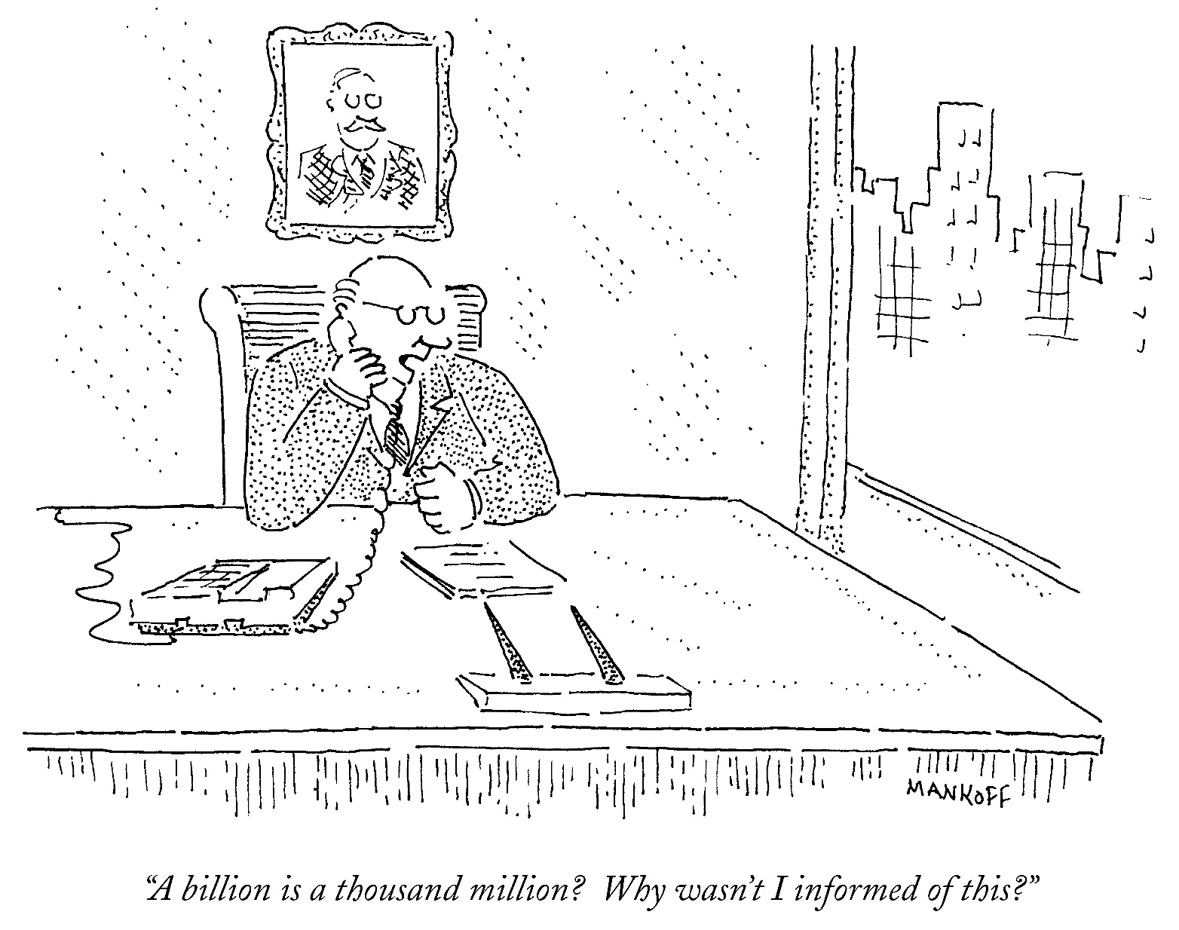
Cartoon of the day
[B. Mankoff]$→$

Slide 3
Is BBC recording on?
If my internet connection goes down, I’ll email from my phone to provide more information – go/no-go, next step, etc.

Slide 4
Before we get started…
Last time
Wrapped up synchronization (reduce)
OpenMP rules of thumb (what increases the likelihood of the code to run faster/slower)
Parallel computing w/ OpenMP: NUMA aspects
Today
Parallel computing, multi-core: how caches come into play
Critical thinking, and similar tricks for speeding up your code
Other tidbits:
Assignment due on Th, 03/18, at 9 pm. Novelty: you’ll have to deal w/ OpenMP
Final Project *Proposal*, due one week from today. Post related questions on Piazza
Details about the proposal are here
The template for the two-page proposal is here
Big ME759 PDF is here
Do not run your code on the Euler head-node (use Slurm)

Slide 5
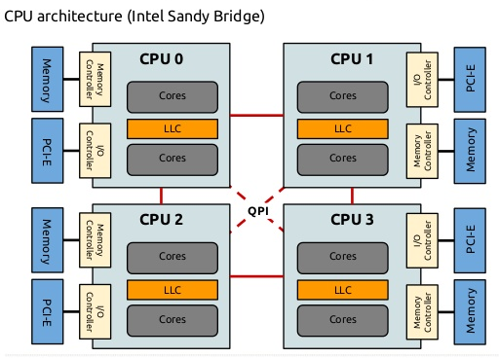
Affinity & cc-NUMA
Lack of affinity in multi-threaded execution (OpenMP):
A thread gets executed by CPU0 (using Linux parlance), but its data is stored in a different NUMA node
You want to pin that thread to a different CPU, in that remote NUMA node
Ability to control affinity is good
Sometimes you can avoid remote NUMA-node data access; i.e., costly local network hops
NOTE: overhead of cache-coherence mechanism becomes a major issue
cc-NUMA: cache-coherent NUMA
The run time must maintain coherence between caches in different NUMA nodes
Topic of next section

Slide 6
Loose ends: topics discussed
Non-uniform memory access (NUMA)
Cache issues

Slide 7
The Memory Hierarchy
[Bryant and O‘Hallaron:
Computer Systems - A Programmer's Perspective 3rd edition] →
L0:
Regs
CPU registers hold words retrieved from the L1 cache.
Smaller,
faster,
and
costlier
(per byte)
storage
devices
L1:
L1 cache
(SRAM)
L1 cache holds cache lines retrieved from the L2 cache.
L2:
L2 cache
(SRAM)
L2 cache holds cache lines
retrieved from L3 cache
L3:
L3 cache
(SRAM)
L3 cache holds cache lines
retrieved from main memory.
Larger,
slower,
and
cheaper
(per byte)
storage
devices
L4:
Main memory
(DRAM)
Main memory holds disk blocks retrieved from local disks.
L5:
Local secondary storage
(local disks)
Local disks hold files retrieved from disks
on remote servers
L6:
Remote secondary storage
(e.g., web servers, file servers)

Slide 8
Cache Memories [old slide]
Cache memories: small, fast SRAM-based memories managed transparently
Purpose: Hold frequently accessed blocks of main memory
When very useful: when execution displays locality (spatial/temporal)
Typical system structure:
CPU chip
Register file
ALU
Cache
memory
System bus
Memory bus
Main
memory
Bus interface
I/O
bridge
[Bryant and O‘Hallaron: CMU] →

Slide 9
How Cache Comes into Play [old slide, with a facelift]
Typically*, the read/write operations go through cache
Caches used to hold both data and instructions
L1: tens of KB (per core)
L2: hundreds of KB (per core)
L3: tens of MB (per CPU)
CPU Core
L1 D$
L1 I$
L2 Cache
L3 Cache
Bus
Main Memory

Slide 10
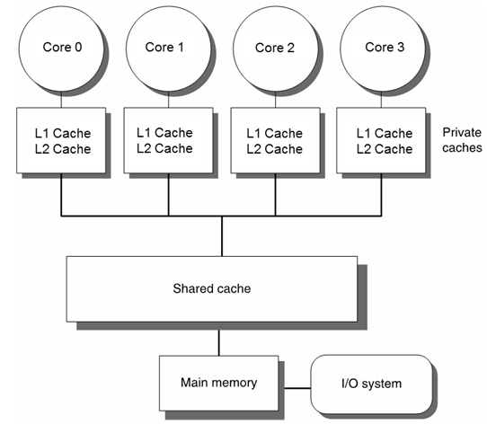
What We Are Interested in: Caches in a Multi-Core Setup
Thus far, we discussed caches in conjunction with one core
What if there is another core, and this other core changes the memory in a block that you just cached?

Slide 11
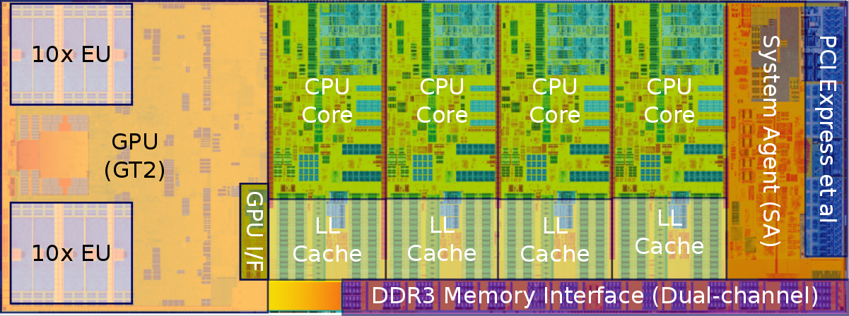
The Haswell die, with some annotations
SA: this is where the cache-coherence magic takes place (memory controller, QPI control, snoop agent pipeline)
L1I$ 32 KB/core 8-way set associative
L1D$ 32 KB/core 8-way set associative
L2$ 256 KB/core 8-way set associative
L3$ 6 MB
(for some models, Haswell might even have a L4 cache, 128 MB per package)
[https://en.wikichip.org/wiki/intel/microarchitectures/haswell_(client)]$→$

Slide 12
Multi-Core Architecture: Two Memory Aspects Coming Into Play
Memory consistency model
Memory coherence
Computer Science at UW-Madison: active in this area
Mark Hill (Emeritus), David Wood (Emeritus), Karu Sankaralingam, Matt Sinclair
Book on this very topic
PhDs granted on consistency models and/or coherence mechanisms
Topic is deep

Slide 13
The concept of “memory consistency” [OLD SLIDE]
__device__ volatile int X = 1, Y = 2;
__device__ void writeXY()
{
X = 10;
Y = 20;
}
__device__ void readXY()
{
int A = Y;
int B = X;
}
Backdrop
Thread_1 executes writeXY()
Thread_2 executes readXY()
Question: what values can A and B assume?
For sequential consistency (“strongly-ordered mem. model”), the only possible scenarios are
A=2 and B=1
A=20 and B=10
A=2 and B=10
For weak consistency (“weakly-ordered memory model”), it is possible to have this
A=20 and B=1

Slide 14
Consistency vs. Coherence
Consistency establishes a set of rules that governs the collective actions of the threads relative to the entire system memory
Think of it this way: there are at least two memory entries that come up in the discussion
Coherence regards expected behavior that *one* memory location must display relative to transactions carried out by multiple threads running on multiple cores
Think of it this way: there is exactly one memory entry that comes up in the discussion

Slide 15
Consistency vs. Coherence
Earning the “consistent memory” badge (for instance “sequential consistency”) imposes a set of stronger/stricter requirements that need to be met compared to what it takes to earn the “coherent memory” badge
Coherence: with some hand waving, it captures the expectation that if a thread running on core A changes a value in a memory location, other thread running on core B will read the updated value even though the read might occur relatively soon after the change of the value takes place per A’s action
“relatively soon”: a bit of a mystery to me
If you really need to have guarantees for memory transactions, you will have to employ barriers (or locks, at a lower level)
We’ll not get into this here, belongs to a different course

Slide 16
Consistency vs. Coherence
Cache coherence is a mechanism, a hardware protocol to ensure that memory updates propagate to other cores. Cores will then be able to agree on the values of information stored in memory, as if there were no cache at all
Memory consistency defines a programming model: how/when/in which sequence do memory writes become visible to other cores?
Pertains to the ordering of memory updates
A contract between the hardware and the programmer: if we follow the rules, the results of memory operations are guaranteed to be predictable
[Scott B. Baden ]$→$

Slide 17
Cache Coherence, in ME759 – disclaimer
We discuss cache coherence just to better understand how OpenMP gets impacted
No deep dive, by any stretch of imagination
Cache Coherence: ongoing research topic, particularly for large core counts
Think about this: a core doing out of order execution or speculative execution
How is the cache going to be handled then?
Courses both in Electrical & Computer Engineering and in Computer Sciences

Slide 18
Caches and Coherency, bottom line, the take-home message…
Speeding up sequential computing accomplished through use of large caches
Note that each OpenMP thread actually does engage in sequential computing
Caching consequence: multiple copies of a main memory location may exist at different hardware locations
For program correctness, caches must be kept coherent

Slide 19
Cache Coherence: Why is this relevant for OpenMP?
When it comes to the code below, OpenMP is butchering the cache
Below, assume N=1,000,000, 64 threads on two NUMA nodes
#pragma omp parallel for
for (int i = 0; i < N; i++) {
#pragma omp atomic
a++;
}

Slide 20
Caches Coherence Mechanisms
Cache coherence (CC) doesn’t come for free
Significant overhead associated with implementing CC
One of the main reasons why OpenMP doesn’t scale
Two established approaches for enforcing cache coherence
Directory-based
Snooping-based

Slide 21
Cache Coherence Mechanisms: Directory-Based [1/2]
Encountered in systems with large core counts
Example: Intel Xeon Phi 7290, had 72 core count (chip now discontinued)
Directory acts as a filter through which any change to cache must pass.
When an entry is changed, the directory either updates or invalidates the other caches with that entry.
Facilitated by a mechanism similar to the Page Table introduced when discussing the concept of Virtual Memory
Keep in mind that this directory is not overwhelmingly large (caches are not that large)
Pros:
Scales better than the snooping-based alternative
Relatively low time overhead (“relatively”, that is, when compared to the alternatives; still costly)
Cons: complex

Slide 22
Cache Coherence Mechanisms: Directory-Based [2/2]
Directory typically split into pieces; each piece stored by one core
Each mem. transaction needs to consider the possibility of invalidating a cache line in some other core’s cache
CC becomes particularly taxing if you have NUMA architectures
NOTE: Ultimately, it’s not OpenMP’s fault
Taxing overhead for CC: interplay between the underlying hardware and the shared memory model embraced on the multi-core CPU

Slide 23
A Second Cache Coherence Mechanism: Snooping/Sniffing-Based
Encountered in systems with small core counts
Builds on the assumption of a front-side bus; i.e., all memory transactions initiated by any core are processed through one connection/junction to the system memory
Pros: simple
Cons: doesn’t scale
Snooping happens here

Slide 24

MESI Protocol: Example of Snooping-Based Cache Coherence Protocol
MESI (Illinois) Protocol: one of the most common CC protocols that support write-back caches

Slide 25
MESI: Invalidation-Based Coherence Protocol
Cache lines have state bits used to characterize state of one cache line
MESI Protocol has four states: M: Modified, E: Exclusive, S: Shared, I: Invalid
Processor A’s Cache
Processor B’s Cache
zz
1. Read variable “zz”
I→E
“exclusive”
zz
zz
E→S
I→S
2. Read variable “zz”
“shared”
“shared”
zz
3. Write variable “zz”
S→M
S→I
Cache line
is invalidated
“modified”
“invalid”
[J. Marathe]→

Slide 26
The four states in which a cache line (CL) can find itself [NOTE: clean/dirty states: Think of them in relation to what is stored in CL vs. in main memory]
Modified (M)
CL present only in the current cache, and is dirty; i.e., there’s discrepancy w.r.t. what’s in main memory
Cache required to write back the data to main memory at some time in the future, before permitting any other read of the (no longer valid) main memory state
NOTE: The write-back changes the CL to (S)
Exclusive (E)
CL present only in this cache and it’s clean; i.e., it matches what’s in main memory
NOTE: Might change to (S) in response to a read request. Might change to (M) when writing to it
Shared (S)
CL in this cache is clean; i.e., it matches what’s in main memory. CL stored also in other cache[s] of the machine.
NOTE: Might changed to (I) due to a write in another cache of the machine
Invalid (I)
CL is invalid; i.e., it should not be used
Notes:
clean/dirty: Think of them in relation to what is stored in the main memory

Slide 27
Example: Possible state combinations (✔), for a pair of caches
System can’t be M & M (that’d be too sweet)
One cache can be I while the other one is M
One cache can be S while the other is S
System can’t be E & E
Etc.
Core 0
Core 1
Main Memory
Core 2
 | M | E | S | I
M | x | x | x | ✔
E | x | x | x | ✔
S | x | x | ✔ | ✔
I | ✔ | ✔ | ✔ | ✔
Core 1

Slide 28

Coherency, a visualization (upon further simplification of the protocol)
Further simplify MESI for sake of simple visualization on next slide
Assume now that each cache line can exist in one of 3 states:
Exclusive: the only valid copy in any cache
Read-only: a valid copy but other caches may contain it
Invalid: out of date and cannot be used
In this simplified coherency model
A READ on an invalid or absent cache line will be cached as read-only or exclusive
A WRITE on a line not in an exclusive state will cause all other copies to be marked invalid and the written line to be marked exclusive
[Alan Real]$→$

Slide 29
Cache coherency cartoon
Exclusive
Read-Only
Invalid
W
P
R
P
W
P
P
R
L1C
L1C
L1C
L1C
L2C
L2C
L2C
L2C
Interconnect
Memory
[Alan Real]→

Slide 30
[new sub-topic]Preamble: the “false sharing” issue in OpenMP
(below, assume a, and b, and c are arrays of float-type variables)
#pragma omp parallel for schedule(dynamic,2)
for (int i = 0; i < N; i++) {
c[i] = a[i] + b[i];
}

Slide 31
The “False Sharing” Pitfall
Recall cache lines typically are 64 byte long
Can store, for instance, 8 double precision values or 16 integers
IMPORTANT NOTE: as soon as one entry in a cache line is changed, all the other values in cache line get dirty
False sharing: happens when two threads are both writing into different locations within the same cache line
One write by Processor A will invalidate the cache line on Processor B
Memory transactions galore, tied to the cache coherence requirement

Slide 32
False Sharing: symptoms
Poor performance
High, non-deterministic numbers of cache misses (particularly if NUMA comes into play)
Mild, non-deterministic, unexpected load imbalance

Slide 33
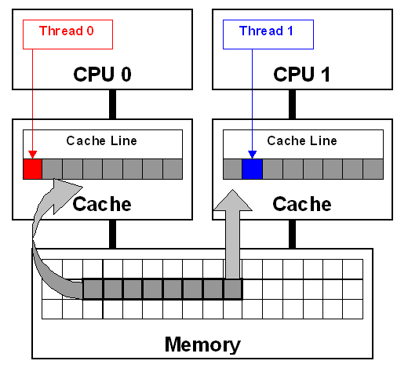
False Sharing Example [1/2]
double sum_local[8];
double sum = 0.0;
#pragma omp parallel num_threads(8)
{
int me = omp_get_thread_num();
sum_local[me] = 0.0;
#pragma omp for
for (i = 0; i < N; i++)
sum_local[me] += x[i] * y[i];
#pragma omp atomic
sum += sum_local[me];
}
How can this instance of false sharing be fixed?
[IOMPP]→

Slide 34
False Sharing Example [2/2]
Easy fix: use reduction(+,sum)
Look into other alternatives
Basic idea, use private/local variables
Fall back on “false sharing” only once, at the end

Slide 35
OpenMP, departing thoughts
The cornerstone of OpenMP was the concept of parallel region: omp parallel
However, rarely does a parallel region witness all threads executing the same code
Why?
The parallel region construct was qualified via other OpenMP directive that changed the interplay between the code and the threads:
for
sections
single
task
critical

Slide 36
OpenMP: What Speedup Should You Expect?
For N cores, to get a speed-up of a factor of N is rare
Problem should be embarrassingly parallel, and you should not max out mem bandwidth (you need high arithmetic intensity, that is)
In general scaling doesn’t materialize beyond a certain core count
CC overhead
Limited amount of main memory bandwidth
Synchronization demands on the part of the algorithm you implement
NUMA collateral damage
Question: Is fewer fat chips better than more slim chips?
slim/fat: higher/lower core count per chip

Slide 37
Parallel computing: GPU CUDA vs. OpenMP
A CUDA kernel is like an OpenMP parallel region without embellishments such as for, single, task, etc.
All CUDA/OpenMP threads execute the code in the kernel/parallel region, respectively
Caveat, CUDA: parallel execution proceeds in lock-step fashion* (for the threads in a warp, that is)
Reflect on the advantages and disadvantages of the memory ecosystem/memory operation when you compare GPU and OpenMP parallel computing

Slide 38
Critical Thinking in Code Design/Development, with an Eye Towards Improving Performance

Slide 39
Back of the envelope, ME759 opportunities for efficiency gains
Use of right compiler flags, ILP-friendly code, etc. [discussed in this segment]
Speed up factor: 2X
Inspired use of cache [already discussed this]
Speed up factor: 2-3X
Use of vectorization (AVX2/AVX512) – use mips in OpenMP parallel for [discussed before, touched upon in this segment]
Speed up factor: 1.2X
Use of multiple cores [already discussed this, OpenMP]
Speed up factor: 5 – 6X
If the planets align, ME759 knowledge should help you to gain a 30X speed up factor

Slide 40
Motivation, ME759 segment on “critical thinking/code optimization”
Understanding how things work under the hood can translate into improved performance
(to that end, we’ll hit on various ME759 aspects)

Slide 41
Acknowledgement
Some slides in this segment come from
Material from class 15-213 at CMU
Nathan Bell (while he was at NVIDIA)
Georg Hager, Jan Eitzinger, Gerhard Wellein – material presented at Supercomputing 2019
Matt Godbolt, maker of Compiler Explorer

Slide 42
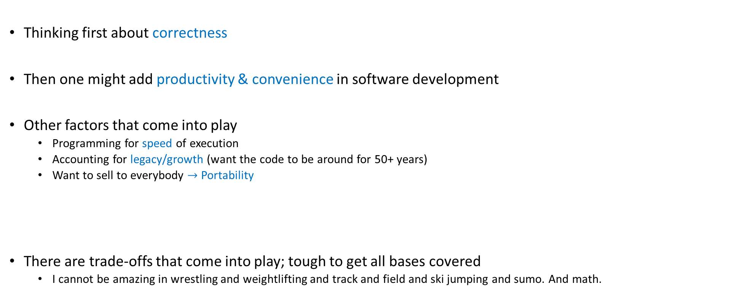
Mindsets, approaching software development
Thinking first about correctness
Then one might add productivity & convenience in software development
Other factors that come into play
Programming for speed of execution
Accounting for legacy/growth (want the code to be around for 50+ years)
Want to sell to everybody $→$ Portability
There are trade-offs that come into play; tough to get all bases covered
I cannot be amazing in wrestling and weightlifting and track and field and ski jumping and sumo. And math.

Slide 43
Angle of attack, this module
Our end goal: write code that runs fast, to handle large datasets fast
Focus of the discussion
Particularly relevant when your code runs on the CPU; thus, for OpenMP code
However, some lessons carry over to the GPU as well

Slide 44
Angle of attack, this module
Module brings together concepts we’ve covered thus far; i.e., knowledge about:
Compilers, and how they work [covered mostly in ME459, we’ll further elaborate on this]
Memory aspects: pointers, hierarchy, latencies, bandwidths
Instruction level parallelism (pipelining, jump instructions, branch prediction, wide registers, etc.)
We’ll use a couple of examples to show how a) through c) above come into play

Slide 45
Assessing performance, common sense things to keep in mind
Second quote of the day: “You can't manage what you can't measure.”
Peter Drucker -- Austrian-born American management consultant, educator
Timing and profiling needed to measure the performance of your code
Issue 1: make sure you understand the level of resolution of your timers
Example: if your code runs in 1 millisecond, your timer’s level of resolution should be at least 1 microsecond
Issue 2: steep learning curve to get to point where you get return on investment for profiling

Slide 46
Assessing performance, common sense things to keep in mind
Find out where the bottleneck of the execution is. Time/profile heavily that part
Almost always this is tied to some loop; hopefully, you have control over what happens in that loop
Try to understand how execution time is split between “user time” and “system time”
There is nothing that you can do about the speed of printf
There is not much that you can do if the “user time” for your program is 10%

Slide 47
Assessing performance, common sense things to keep in mind
Measure repeatedly to get statistical data about your program’s execution time
Timers: command-line timers or code-embedded timers
“command-line timers”: you measure the time it takes the OS to load your program from disk into memory, launch it, and then execute it
You care about the execution time only
Bottom line: when given a choice, prefer “code-embedded timers” to “command-line timers”
NOTE: if you measure repeatedly, your code is not going to be brought over from disk
Thus, you’re not going to have a “cold start” if you measure repeatedly

