Slide 1
ME759 High Performance Computing for Applications in Engineering [Spring 2021]
Lecture 02
01/27/2021
Dan Negrut, 2021 ME759 UW-Madison

Slide 2
Quote of the day
“When I authorized myself to understand another person, I found considerable value in the process. My way of formulating this can sound strange to you. Is it necessary to authorize oneself to understand someone else? I believe so. Our first reaction to what we hear from others is an immediate assessment, or a judgement, rather than an understanding of what is said. Whenever someone expresses a feeling, an attitude or a belief, we almost always immediately tend to grow a feeling that “this is appropriate”; or “it is stupid”'; “it is not normal”; “it is unreasonable”; “it is not correct”; “it is not fair”. Only very rarely do we allow ourselves to precisely understand what those words mean for him or her. I believe it is because this understanding is risky. If I really authorize myself to understand this other person, I might very well be changed by this understanding. And we are all afraid of change. So, as I said before, it is not an easy thing to authorize oneself to understand another person, to enter entirely and completely into her or his frame of reference. That is also a rare thing.”
-- Carl Rogers, former UW-Madison student (also 1964 Humanist of the Year, President of the American Psychological Association, Fellow of the American Academy of Arts and Sciences) [1902-1987]

Slide 3
Is BBC recording on?
If my internet connection goes down, I’ll email from my phone to provide more information – go/no-go, next step, etc.

Slide 4
Before we get started…
Last time
Course logistics, discussion of syllabus
Please read the “course description document” to be familiar with expectations
Super quick overview of ME759: we’ll learn how to accelerate the executions of science/engineering programs we write
General concepts + GPU Computing + Multicore Computing + MPI-enable Computing
Today
About how our code gets executed on the CPU; sequential execution
Concepts touched on: instruction, assembly code, registers, CISC vs RISC, CPU organization (CU/ALU), FDX cycle
Other tidbits:
Additional Reading: check the on-line syllabus
First assignment went out
Due on Th 02/04, at 9 pm
Please register for an Euler account (see details in email of last night)

Slide 5
Good to keep in mind…
Based on past experience, many of you will pretty soon move to “asynchronous mode”
When home enjoying a brew and listening to me at 1.5X speed, just listening to me rambling is not going to cut it
You’ll have to read the slides too
I’m not going to do it during lecture since you can do it as well as I can, if not better
I’m also not going to do it since it’s also boring – for you and for me
Finally, I’m not going to do it since I wouldn’t have time to cover all the material
The slides kind of give me a general direction of where I should be heading
Here’s a quote that captures how I feel and why I need a general direction:
“Sometimes I'll start a sentence, and I don't even know where it's going. I just hope I find it along the way.” – Michael Scott, Regional Manager, Scranton branch of Dunder Mifflin Inc.

Slide 6
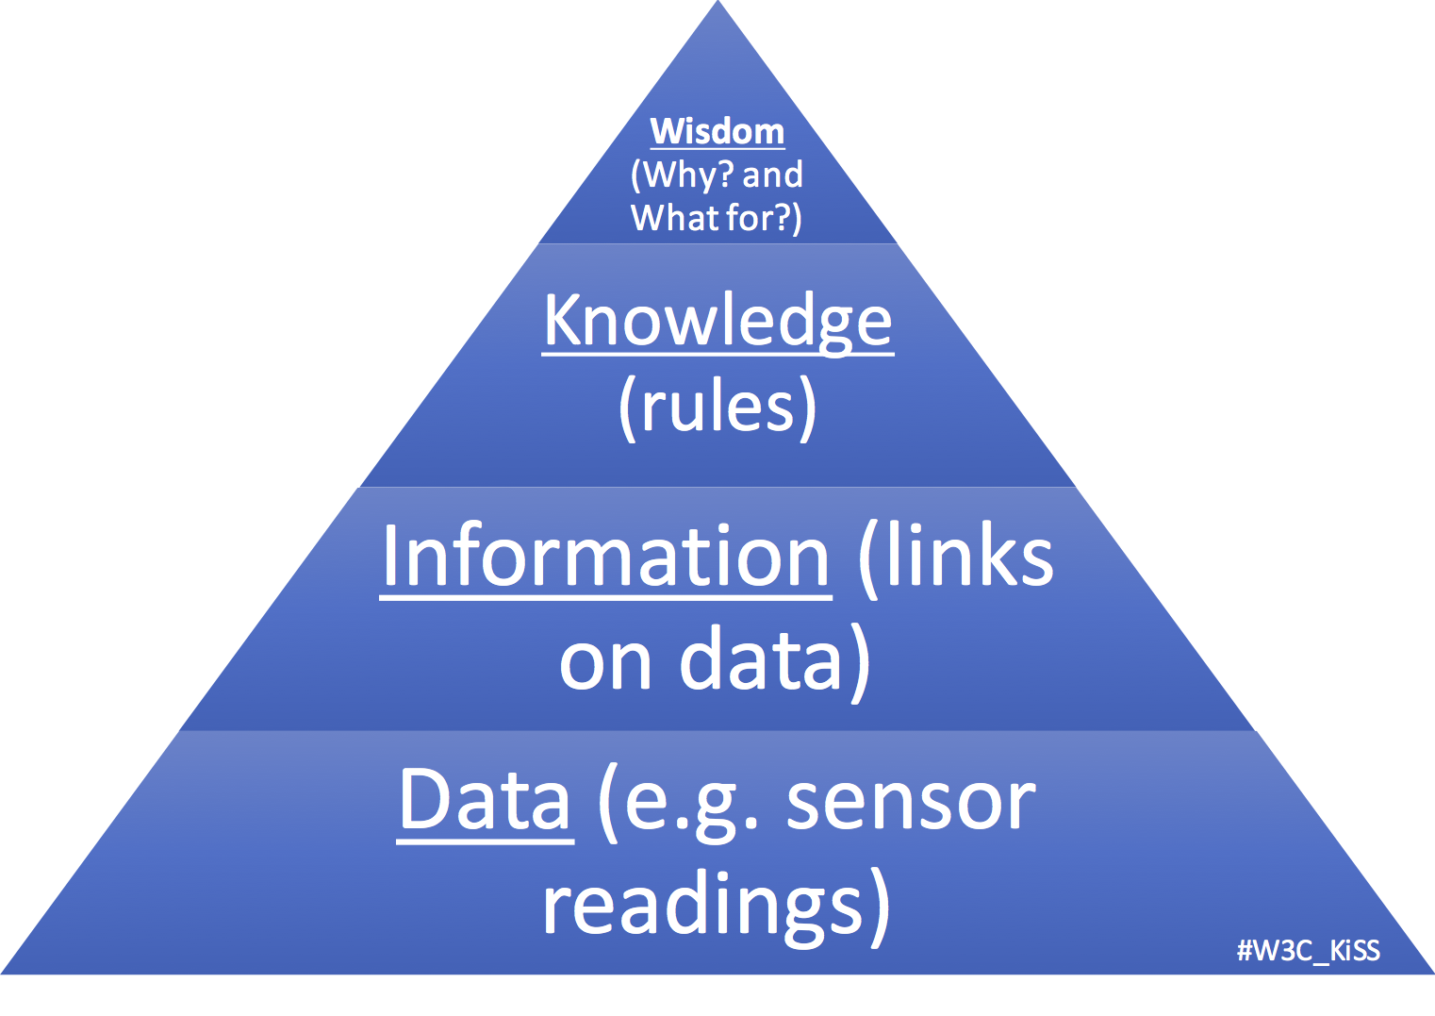
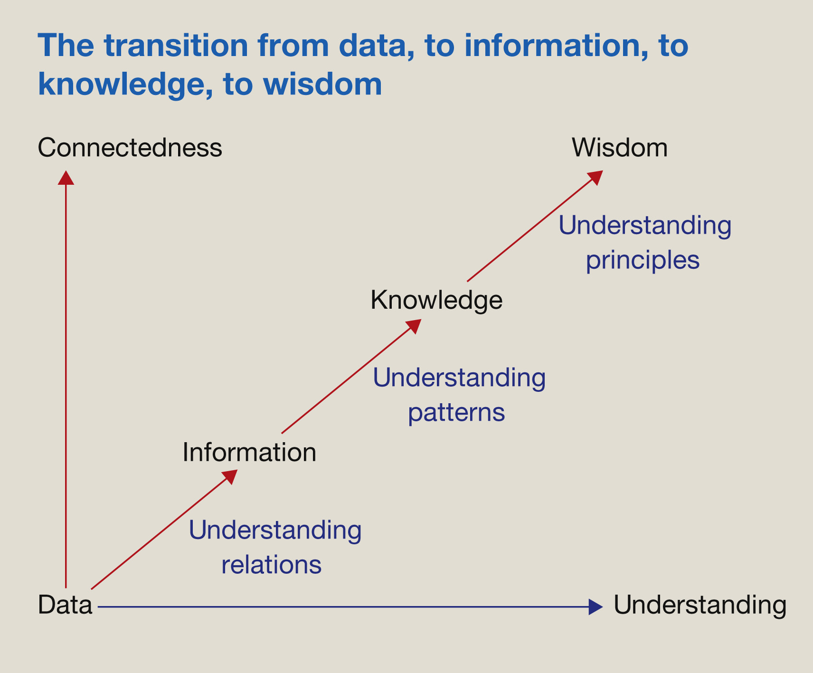
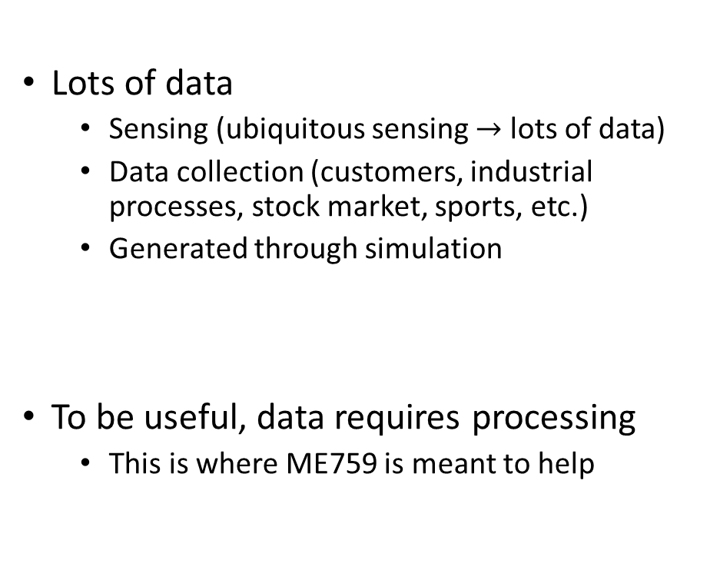
Computing, as a means to a goal: from information to wisdom
Lots of data
Sensing (ubiquitous sensing $→$ lots of data)
Data collection (customers, industrial processes, stock market, sports, etc.)
Generated through simulation
To be useful, data requires processing
This is where ME759 is meant to help
[https://www.w3.org/community/kiss/files/2017/02/DIKW.png]$→$
[https://www.sciencedirect.com/science/article/pii/S1472029916301813]$→$

Slide 7

High Performance Computing (HPC): On the semantics and where useful
Folks from Oakridge National Lab, Argonne National Lab, Los Alamos National Lab, etc.:
HPC: The activity of using, for instance, 10,000 nodes to run one very large application
This application can’t be run on one machine: not enough memory space, for instance
Folks from ME759 and other commoners
HPC: The ability to tap into the resources of commodity hardware to extract speed for data generation and/or processing
Unlikely: You might have 10,000 nodes to use
Likely: you have one GPU, or four multi-core CPUs on one motherboard, or perhaps 10 nodes in a cluster
Data Collection
Sensing Measurement
Simulation
HPC
HPC
Knowledge/Wisdom

Slide 8
The Price of reaching 1 Gflop/second
1961:
Combine 17 million IBM-1620 computers
At $64K apiece, when adjusted for inflation, this would cost $160 billion (adjusted for inflation, 2019 US dollars)
2000:
About $1,000
Kentucky Linux Athlon Testbed, a 64+2 node Beowulf cluster built by the University of Kentucky COE in 2000
2015:
8 cents
Celeron G1830 & Radeon R9 295X2 System
2018: 6 cents
NVIDIA GTX 1080 Ti @ $699 apiece
2020 (November): 3 cents
AMD Ryzen 3600 & NVIDIA RTX 3080
[Wikipedia]$→$

Slide 9
GPU Acceleration: Ampere A100
Ampere A100: 9,000,000,000,000 double precision FMA operations per second
Very high bandwidth: 1555 GB/sec (HBM2)
Previous generation, Pascal had 720 GB/s
Amazing at data processing (data parallelism)
Euler has four A100s GPUs right now; eight more to come before the end of the semester

Slide 10
The Hardware-Software Interplay

Slide 11
This segment’s purpose
Understand the basics of how the hardware works for the purpose of writing better software
Immediate focus: discuss how a sequence of instructions processes a bunch of data

Slide 12
Computing requires instructions and data
In terms of storage and movement, there is no distinction between data and instructions
Instructions are fetched & decoded & executed (more on this later)
Data is used to produce results according to rules specified by the instructions
A piece of data: stored in memory as a string of 0 and 1 bits (8 bits, or 16, or 64, etc. – can even be user defined)
An instruction: stored in memory as a string of 0 and 1 bits (often 32 or 64 bits – kind of fixed, you don’t have a say)
NOTE: the “data & instructions share same storage and pathways” paradigm formalized by von Neumann in late 1940s
The “von Neumann model” (also known as the Princeton model)
Memory Data
Instructions
Data
[registers/cache/main] Memory
Processor
(Chip)
instructions flow
Control Unit (CU)
Arithmetic Logic Unit (ALU)
data flow
internal commands (uops)
internal consumption data
Notes:
Also known as Princeton model
Harvard model (architecture): separate storage and pathways for data and instructions
This model relies on the FDX cycle
The process of processing instructions (FDX) intermediated by the processor’s CU

Slide 13
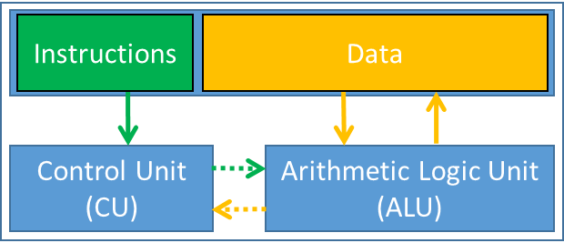
Schematic, middle-of-the-road CPU Microarchitecture
Instruction Control
Fetch
Control
Address
Instruction
Cache
Retirement
Unit
Register
File
Instruction
Decode
Instructions
Operations
Register Updates
Prediction OK?
Execution
Functional
Units
Branch
Arith.
Arith.
Arith.
Load
Store
Operation Results
Addr.
Addr.
Data
Data
Data
Cache
[Bryant and O‘Hallaron: CMU] →
Notes:
5.4.7.4. Retirement Unit
The retirement unit writes the results of speculatively executed microoperations into the user-visible registers and removes the microoperations from the reorder buffer. Like the reservation station, the retirement unit continuously checks the status of microoperations in the reorder buffer, looking for ones that have been executed and no longer have any dependencies with other microoperations in the instruction pool. It then retires completed microoperations in their original program order.
The retirement unit can retire three microoperations per clock cycle (/<-- this may be outdated/). In retiring a microoperation, it writes the results to the processor’s register file and/or memory. After the results have been written, the microoperation is removed from the re-order buffer.
http://users.utcluj.ro/~baruch/book_ssce/SSCE-Intel-Pipeline.pdf

Slide 14
The CPU’s Control Unit (CU)
The CU controls the “datapath” (i.e., the hardware collection of functional units + registers + data buses)
CU has several duties, such as
Bringing in the next instruction from memory
Decoding the instruction (possibly breaking it up into uops)
Engaging in actions to enable “instruction level parallelism” (ILP, more later)
CU manages/coordinates based on information encoded in the specific instruction it works on
Notes:
The CU controls the DATAPATH (the functional units + registers + buses)

Slide 15
The CPU’s Arithmetic Logic Unit (ALU)
Made up of a bunch of so called “execution units” or “functional units”
In charge of executing arithmetic and load/store operations
Examples:
Arithmetic multiply/add unit (for integers)
Arithmetic multiply/add unit (for floats)
Special function unit
Called upon to computes sin, cos, exp, log, etc.
Etc.

Slide 16
We keep talking about instructions/machine instructions
machine instruction - what’s this thing?

Slide 17
From C/C++ Code to Machine Instructions (1/4)
Your program is the result of a compile step in which a source file is turned into an executable
Your lines of code, converted into machine instructions
What’s an “executable”?
Sequence of machine instructions that can be processed, one by one, by the processor
Execution concludes; i.e., your program done, when last instruction was taken care of
#include <iostream>
/* Simplest C++ Program */
int main(int argc, char **argv) {
std::cout << "Hello World!\n";
return 0;
}
euler ~/ME759> gcc -o helloWorld helloWorld.cpp
euler ~/ME759> ls
helloWorld helloWorld.cpp
euler ~/ME759>./helloWorld
Hello World!
euler ~/ME759>
Notes:
Typically, a line of code maps into more (some time many) instructions.
Once the instructions are encoded into machine code, they are indistinguishable from data (it’s only location in memory that can differentiate between data and instructions)

Slide 18
From C Code to Machine Instructions (2/4)
Punch line: There is a difference between a line a code and a machine instruction
Example:
Line of C code:
a[4] = delta + a[3]; //line of C code
MIPS assembly code generated by the compiler (three instructions):
lw $t0, 12($s2) # reg $t0 gets value stored 12 bytes from address in $s2
add $t0, $s4, $t0 # reg $t0 gets the sum of values stored in reg $s4 and reg $t0
sw $t0, 16($s2) # store what’s in $t0 at mem location 16 bytes from address in $s2
Set of three corresponding MIPS instructions produced by the compiler:
10001110010010000000000000001100
00000010100010000100000000100000
10101110010010000000000000010000
Notes:
Typically, a line of code maps into more (some time many) instructions.
Once the instructions are encoded into machine code, they are indistinguishable from data (it’s only location in memory that can differentiate between data and instructions)

Slide 19
From C Code to Machine Instructions (3/4)
C code – what you write to implement an algorithm
Intermediate Representation – compiler converts your code to a specialized representation that it can optimize
Assembly code – another intermediate step for compiler, humans can still read it
Spend 5 mins here: https://godbolt.org
Machine code/Instructions – what the assembly code gets translated into and what the control unit (CU) digests
Machine code: what you see in an editor (notepad, vim , etc.) if you open an executable file (basically gibberish)
There is a direct correspondence between a line of assembly code and instructions
(this is often one-to-one; particularly true for certain processors)
19
Notes:
one-to-one correspondence between assembly and instructions. Nowadays, this is only true for x86 and certain microcontrollers. It’s not true on Arm, PPC, RISC-V, or certain some MIPS.
19

Slide 20
From C Code to Machine Instructions (4/4)
Observations:
The compiler goes from C code to machine instructions without producing anything else (unless you ask for it)
That is, no assembly is saved for you to peek at (again, unless you ask the compiler for it)
Back in the day, people programmed computers via assembly code
Today writing assembly code done only for critical parts of a program by people who want to highly optimize the execution and choose to overrule the compiler
20
Notes:
Embedded systems
20

Slide 21
More on the “assembly instructions” side of things
We’ll not cover assembly in ME759
If you really are into computing though, you should learn how to read “assembly code”
Why?
In critical cases you might want to check that the compiler does what you think it should do
Examples: you optimize the code with –O3 and want to confirm that
A for-loop got unrolled to reduce the number of jump conditions and improve changes for pipelining
A function got inlined to avoid a pair of jumps that ruin pipelining

Slide 22
Example: the same C code leads to different assembly code (and different set of machine instructions, not shown here)
int main(){
const double fctr = 3.14/180.0;
double a = 60.0;
double b = 120.0;
double c;
c = fctr*(a + b);
return 0;
}
C code
main:
.frame $fp,48,$31 # vars= 32, regs= 1/0, args= 0, gp= 8
.mask 0x40000000,-4
.fmask 0x00000000,0
.set noreorder
.set nomacro
addiu $sp,$sp,-48
sw $fp,44($sp)
move $fp,$sp
lui $2,%hi($LC0)
lwc1
…
mul.d $f0,$f2,$f0
swc1 $f0,32($fp)
swc1 $f1,36($fp)
move $2,$0
move $sp,$fp
lw $fp,44($sp)
addiu $sp,$sp,48
j $31
…
$LC0:
.word 3649767765
.word 1066523892
.align 3
$LC1:
.word 0
.word 1078853632
.align 3
$LC2:
.word 0
.word 1079902208
.ident "GCC: (Gentoo 4.6.3 p1.6, pie-0.5.2) 4.6.3"
x86 ISA
call ___main
fldl LC0
fstpl -40(%ebp)
fldl LC1
fstpl -32(%ebp)
fldl LC2
fstpl -24(%ebp)
fldl -32(%ebp)
faddl -24(%ebp)
fldl LC0
fmulp %st, %st(1)
fstpl -16(%ebp)
movl $0, %eax
addl $36, %esp
popl %ecx
popl %ebp
leal -4(%ecx), %esp
ret
LC0:
.long 387883269
.long 1066524452
.align 8
LC1:
.long 0
.long 1078853632
.align 8
LC2:
.long 0
.long 1079902208
Legend:
fldl load floating point
flmulp multiply & pop register stack
movl move from one register to another
Intermediate Representation + Optimization
Legend:
sw store word
addiu add immediate unsigned
mul.d multiply (double)
MIPS ISA
22
Notes:
x86: special case of CISC (Intel, AMD)
MIPS (Microprocessor without Interlocked Pipeline Stages): special case of RISC
fldl → load floating point
flmulp → multiply and pop the register stack
movl → move from one register to another (long operand)
sw → store word
addiu → add immediate unsigned
mul.d → multiply (double)
22

Slide 23
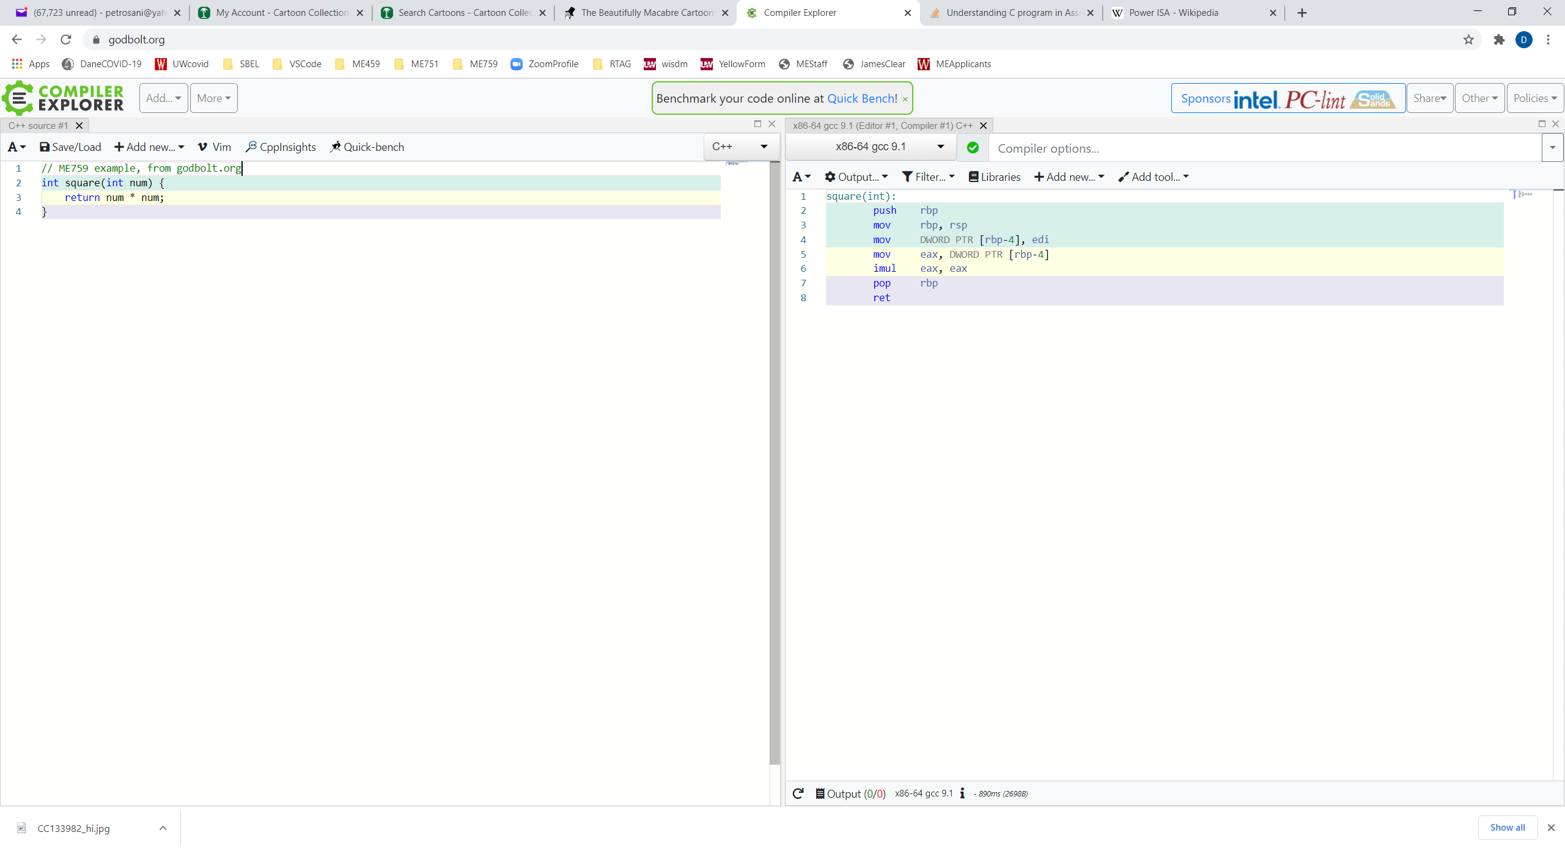
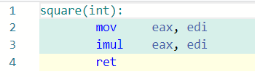
Same code, same compiler (gcc), different flags
No flag used here
-O3 flag used here
eax: 32-bit general-purpose register whose main purpose in life (but not the only one) is to store the return value of a function
[https://godbolt.org/]$→$

Slide 24
fldl, sw, addiu, lw, mul.d, … - What is this???
There is a limited number of prompts that the CU understands and thus act upon
This set of commands/prompts makes up the Instruction Set Architecture (ISA)

Slide 25
Instruction Set Architecture (ISA)
The same line of C code can lead to a different set of instructions on two different processors (CPUs)
This is so because two CPUs might implement two different ISAs
ISA: defines a “vocabulary” subsequently used by the compiler to specify the actions of a processor
Notes:
An Instruction Set Architecture is like a set tools that you have in your backpack.
If you have a task that you need to do, you’ll have to use a collection of tools to see it through.
A different ISA might have more complex tools and as such with only a small number of tools you get the job done.

Slide 26
ISA: Two more important schools of thought
One school of thought: promotes the RISC paradigm
Second school of thought: promotes the CISC paradigm
RISC or CISC? Which one is better?
Topic of perpetual debate, like Bud or Miller Draft

Slide 27
The RISC ISA flavor
RISC Architecture – Reduced Instruction Set Computing Architecture
An instruction coded into a fixed set of bits (used to be 32, now it’s 64)
Instructions operate on registers
Promoted by Stanford and UC Berkeley, in the form of the MIPS and SPARC architectures
Nowadays, Arm’s RISC-based CPUs power mobile devices everywhere
Implementations by NVIDIA, Samsung, Qualcomm, TI, and many more
Somewhere between 8 and 10 billion chips based on ARM manufactured annually
IBM also created its own RISC variant which is often used in HPC: the so called “POWER ISA”
NVIDIA acquired Arm in Sept. 2020 (for $40 billion; pending SEC approval)
27
Notes:
CISC: Much more effort required to decode; but more expressive (SIMD extensions)
variable length instruction: 32-bit, followed by 256-bit, followed by 128-bit, etc.
RISC: all instructions have fixed length; easier (and cheaper) to decode.
27

Slide 28
The CISC ISA flavor
CISC Architecture – Complex Instruction Set Computing Architecture
Instructions have various lengths
Intel’s X86 is the most common example
Promoted by Intel and subsequently embraced & augmented by AMD
Used in laptops, desktops, workstations, servers
Notes:
CISC: Much more effort required to decode; but more expressive (SIMD extensions)
variable length instruction: 32-bit, followed by 256-bit, followed by 128-bit, etc.
RISC: all instructions have fixed length; easier (and cheaper) to decode.

Slide 29
The main ISA flavors: RISC vs. CISC
RISC simpler to comprehend, provision for, and work with
CISC is more expressive
Decoding CISC instructions is not trivial and eats up power
A CISC instruction is usually broken down into several micro-operations (uops)
CISC Architectures: flexibility at the price of complexity and power
A more intricate ISA, leads to complex microarchitecture (circuitry, that is) & eats up more power
Notes:
CISC offers a much larger set of instructions, more complex (at the end of the day they are also broken down in micro-instructions which start resembling the RISC instructions)
Main reason for using RISC on mobile devices: much lower power requirements
Main reason for using CISC: more flexibility and performance (e.g. SIMD, AVX)

Slide 30
The FDX Cycle [New Topic: pertains to “what happens with an instruction?” question]
FDX stands for Fetch-Decode-Execute
FDX is what keeps the CU and ALU busy
FDX is done for instruction after instruction until program completes
Fetch: an instruction is fetched from memory
Might look something like this (on 32 bits, MIPS, lw $t0, 12($s2)):
10001110010010000000000000001100
Decode: this string of 1s and 0s are decoded by the CU
Example: here’s an “I” (eye) type instruction, made up of four fields
Execute: once all data (operands) available, instruction is executed
The execution can take several cycles of the CPU [more later]
Notes:
Whatever ISA is used, at execution time these instructions need to be:
fetched (brought over from memory)
decoded (interpreted, to some extent “undoing” what the compiler did which was an encoding into ISA)
executed (dispatched to the ALUs)
All these are performed by the CU

Slide 31
Decoding: Instructions Types
The main types of instructions in MIPS ISA:
Type I (immediate)
Type R (register)
Type J (jump)
Two more flavors for floating point operands
FI – like I but for floating point numbers
FR – like R but for floating point numbers
Notes:
Just a taste of the various MIPS instructions.
I (immediate) type: specify two registers and an immediate value; allows instruction and data to be loaded in a single cycle
R (register) type: specify three registers (two for operands, one for result)
J (jump) type: specify a jump target

Slide 32
Type I (MIPS ISA)
op (6 bits)
rs (5 bits)
rt (5 bits)
constant or address (16 bits)
The first six bits encode the basic operation to be completed (opcode)
The next group of five bits: in which register the first operand is stored
The subsequent group of five bits: the target register, rt
The 16 bit “immediate” value, usually used as the offset value in various instructions
“Immediate” means that there is no need to read other registers or jump through other hoops. Immediately good to go
Example (look at the colors used at the left and right of the sign below; colors are matching left and right):
32 bits
100011
00110
00101
0000 0000 0000 1000
lw $5, 8($6)
op
rs
rt
rd
Notes:
For I instructions, the operation is completely defined by the opcode
addi $t,$s,C $t = $s + C (signed) 001000 sssss ttttt CCCC CCCC CCCC CCCC

Slide 33
Type R (MIPS ISA)
Type R has the same first three fields op, rs, rt like I-type
Packs three additional fields:
Five bit rd field (register destination)
Five bit shamt field (shift amount, only used for “shift” instructions)
Six bit funct field, which is a function code that further qualifies the opcode
Example:
op (6 bits)
rs (5 bits)
rt (5 bits)
rd (5 bits)
shamt (5 bits)
funct (6 bits)
32 bits
000000
00011
00010
00100
00000
100000
op
rs
rt
rd
shamt
funct
add $4, $3, $2
Notes:
DAN: see http://courses.cs.washington.edu/courses/cse378/09au/lectures/cse378au09-04.pdf for a nice discussion of I and R type instructions

Slide 34
Type J (MIPS ISA)
op (6 bits)
address (26 bits)
Execution
instructions
32 bits
Type J has an op field and an address field
Jump instruction has a word address, not an offset
A 26-bit address field allows for jumps to any address between 0 and 2²⁶-1
Longer jumps use the “jump register” instruction: jr $ra # jump to address in register $ra
Procedure called
first time here
Procedure called
second time here
[http://www.divms.uiowa.edu/~ghosh/1-24-06.pdf]$→$
Notes:
For J instructions, the operation is completely defined by the opcode.
Just two J-type instructions (j and jal). These set the PC register!
Can jump to an address less than 256 MB
jr is R-type

Slide 35
Picking up the instruction type…
How does the CU figure out what instruction type it deals with?
Is it I, R, or J?
This information is baked into the operation code (opcode)

Slide 36
[New Topic] Chip Microarchitecture
ISA – defines a vocabulary
Specifies what a processor should be able to do
Load, store, jump on less than, etc.
Microarchitecture – how the silicon is organized to implement the vocabulary embodied by the ISA
Reflect on this: Intel and AMD both use the x86 ISA. However, they work off different microarchitectures
Notes:
ISA: the “contract”, the “promise” of what can be done. Similar to a standard
Microarchitecture: implementation in silicon (transistors) of that contract. Similar to an implementation of the standard
Analogy: the functions of a TV set. What’s done to implement those functions changes from company to company (Samsung vs. Sony)
2 chips can support the exact same ISA but with completely different microarchitecture. One can have better hardware for a particular instruction (specialization for supercomputing, graphics, servers, etc.)

Slide 37
FDX Cycle – The Execution Part: It All Boils Down to Transistors…
How does this FDX magic happen?
Transistors are organized into complex logical units capable of performing simple operations
More transistors present opportunities for building/implementing in silicon additional functional/control units that can operate at the same time towards a shared goal
Notes:
A transistor (when used in a CPU) is essentially a switch, like a light switch except that you don't have to turn it on or off manually. Rather, it is controlled by an electrical current. The most important thing to understand is that modern computers are two-state devices: the only thing that really matters is whether a wire has a current or not.

Slide 38

Example: Number of Transistors, on GPUs [NVIDIA architectures]
Fermi circ. 2010:
40 nm technology
Up to 3 billion transistors → about 500 scalar processors, 0.5 d.p.Tflops
Kepler circ. 2012:
28 nm technology
Chips w/ 7 billion transistors → about 2800 scalar processors, 1.5 d.p. Tflops
Maxwell 2014-2016
28 nm technology
Chips w/ 8 billion transistors → 3072 scalar processors, 6.1 s.p. Tflops
Pascal 2016-2017
16 nm technology
Chips w/ 12 billion transistors → 3584 scalar processors, 10.6 s.p. Tflops
Turing 2018 – 2020
12 nm technology
Chips w/ 19 billion transistors $→$ 4608 scalar processors, 16 s.p. Tflops
Ampere 2020 –
7 nm technology
Chips w/ 52 billion transistors $→$ 6912 scalar processors, 19.5 s.p. Tflops
Notes:
GPUs are the largest chips (in terms of number of transistors)
Overview of Maxwell is here: http://www.tomshardware.com/reviews/nvidia-geforce-gtx-titan-x-gm200-maxwell,4091.html
Pascal:
FinFET technology
Integrates NVLink technology
Intel Haswell: 1.4 billion transistors
Intel Broadwell: 7 billion transistors

Slide 39
Transistors: why we love them & want as many as possible
Step 1: how transistors are used to perform tasks (tied to CU and ALU use)
Step 2: how transistors are used to store data and instructions
Memory Data
Instructions
Data
Memory
Processor
(Chip)
instructions flow
Control Unit (CU)
Arithmetic Logic Unit (ALU)
data flow
internal consumption (uops?)
internal consumption data

Slide 40
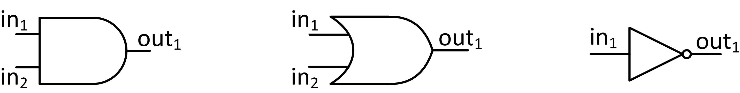
Transistors at work: AND, OR, NOT
The NOT logical operation is implemented using one transistor
AND and OR logical ops require two transistors
Truth tables for AND, OR, and NOT
AND
OR
NOT
AND | in₂=0 | in₂=1
in₁=0 | 0 | 0
in₁=1 | 0 | 1
OR | in₂=0 | in₂=1
in₁=0 | 0 | 1
in₁=1 | 1 | 1
NOT
in₁=0 | 1
in₁=1 | 0
Notes:
Functional completeness: NAND + NOR
Also: AND + NOT

Slide 41
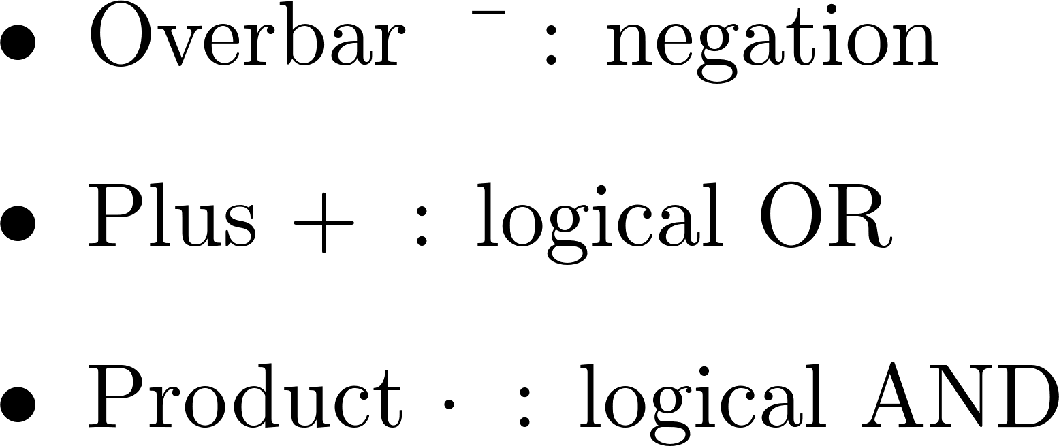
Example (1/2) [cooked up, but makes a point]
Design a digital logic block that receives three inputs via three bus wires and produces one signal that is 0 (low voltage) as soon as any of the three input signals is low voltage.
In other words, it should return 1 if and only if all three inputs are 1
A bit-wise “&”
Truth Table
Logic Equation:
in₁ | in₂ | in₃ | Out
0 | 0 | 0 | 0
0 | 0 | 1 | 0
0 | 1 | 0 | 0
0 | 1 | 1 | 0
1 | 0 | 0 | 0
1 | 0 | 1 | 0
1 | 1 | 0 | 0
1 | 1 | 1 | 1
Legend:
NOTE: There are several Logic Equations that implement the same Truth Table. There are tradeoffs that one can make (power/space/speed)
Notes:
Complex logic can be built with these building blocks (gates)
Example:
start with desired truth table
deduce logic equation
map to gates

Slide 42
Example (2/2) [cooked up, but makes a point]
Easy to figure out the transistor setup once Logic Equation is available
Truth Table
Logic Equation:
in₁ | in₂ | in₃ | Out
0 | 0 | 0 | 0
0 | 0 | 1 | 0
0 | 1 | 0 | 0
0 | 1 | 1 | 0
1 | 0 | 0 | 0
1 | 0 | 1 | 0
1 | 1 | 0 | 0
1 | 1 | 1 | 1
Solution: digital logic block is a combination of AND, OR, and NOT gates
The NOT is represented as a circle O applied to signals moving down the bus

Slide 43
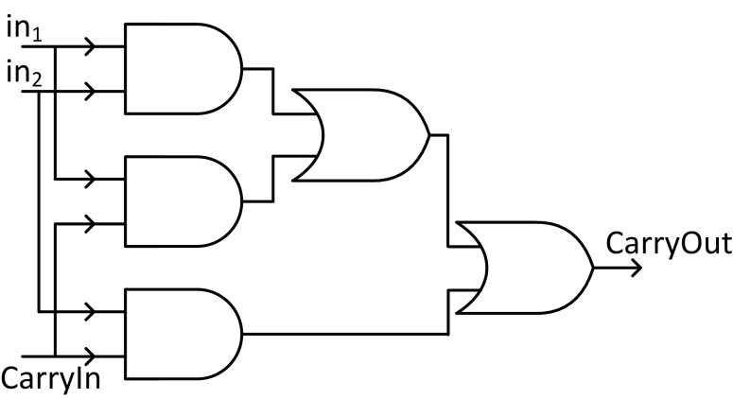
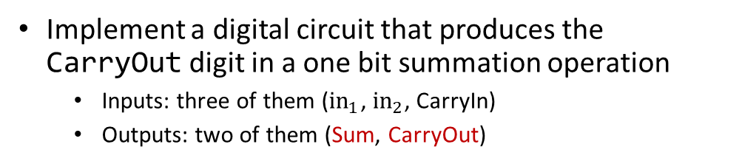
Example: One Bit Adder
visualize calculating:
567+
789
1356
Implement a digital circuit that produces the CarryOut digit in a one bit summation operation
Inputs: three of them (${in}_{1}$, $in_{2}$, CarryIn)
Outputs: two of them (Sum, CarryOut)
Truth Table
Logic Equation (for CarryOut):
Inputs |  |  | Outputs |  | Comments
in₁ | in₂ | CarryIn | Sum | CarryOut | Sum is in base 2
0 | 0 | 0 | 0 | 0
0 | 0 | 1 | 1 | 0 | 0+0 is 0; the CarryIn kicks in, makes the sum 1
0 | 1 | 0 | 1 | 0
0 | 1 | 1 | 0 | 1 | 0+1 is 1, but CarryIn is 1; sum ends up being 0, CarryOut is 1.
1 | 0 | 0 | 1 | 0
1 | 0 | 1 | 0 | 1 | 1+0 is 1, but CarryIn is 1; sum ends up being 0, CarryOut is 1.
1 | 1 | 0 | 0 | 1 | 1+1 is 0, carry 1.
1 | 1 | 1 | 1 | 1 | 1+1 is 0 and you CarryOut 1. Yet the CarryIn is 1, so the 0 in the sum becomes 1.
Notes:
Addition (in base 10 or base 2) requires two outputs: the sum and the carry_out
567+789

Slide 44
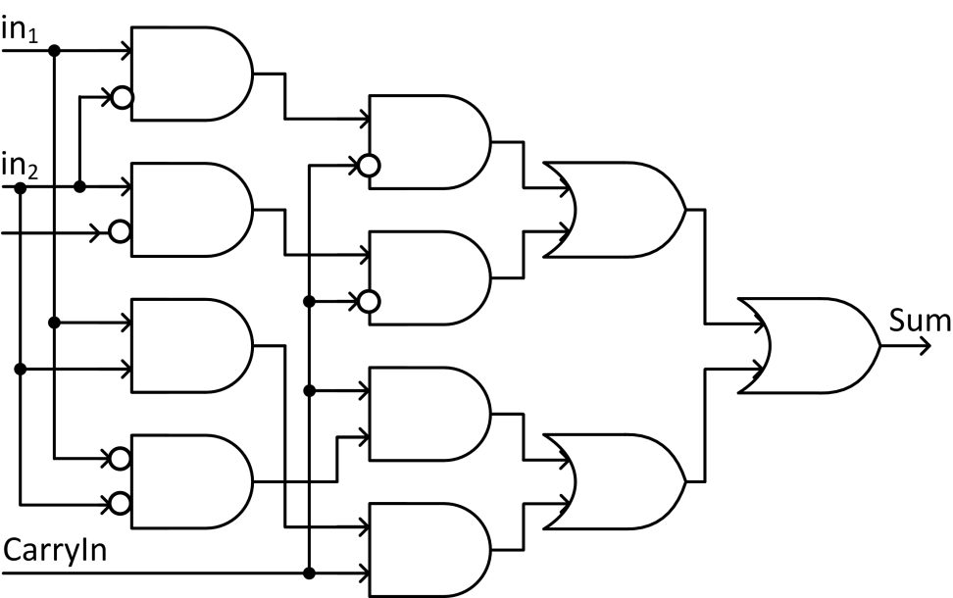
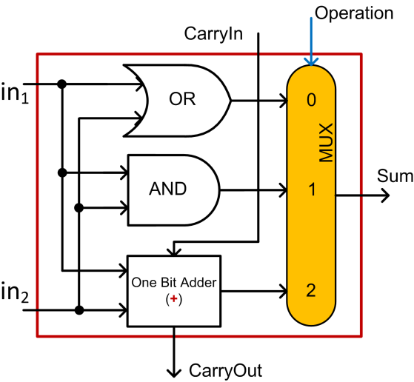
Integrated Circuits-A One Bit Combo: OR, AND, 1 Bit Adder
1 Bit Adder, the Sum part
A One Bit Combo: OR, AND, 1 Bit Sum
Controlled by the input “Operation”
result
Notes:
Main idea: combine simpler blocks to get a more complex block
Throw in a multiplexor (a “selector”) and you can build a more complex “LEGO brick”, a COMBO

Slide 45
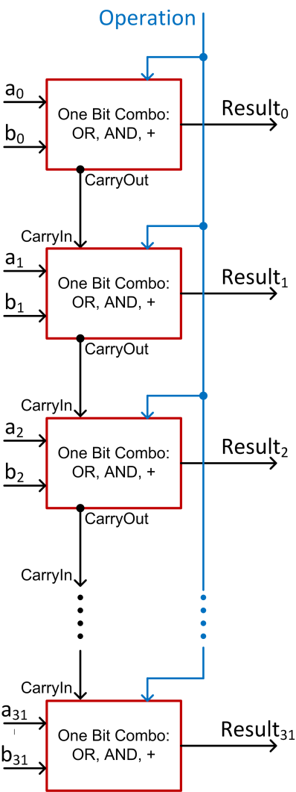
Integrated Circuits: Ripple Design of 32-Bit Combo
Combine 32 of the 1 bit combos in an array of logic elements
Get one 32 bit unit that can do OR, AND, +
This “academic example” design requires about 1152 transistors
Notes:
A 32-bit ripple-carry adder will require about 1152 transistors.
This is an academic example. Actual micro-architecture ALUs implement a different, more sophisticated logic.

Slide 46
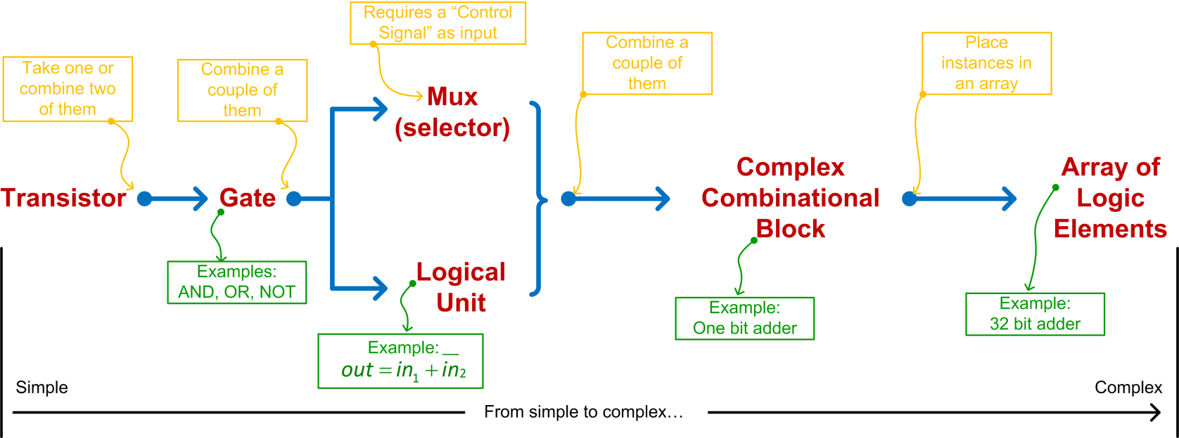
Integrated Circuits: From Transistors to Chip Microarchitecture
Notes:
Trend: simple to complex

Slide 47
[FDEX Cycle: Execution Closing Remarks] It All Boils Down to Transistors…
For 50 years, every 18 months, number of transistors per unit area doubled (Moore’s Law)
2014-2015 technology: feature length was 14 nm (Intel)
2018: 10 nm -12 nm
2019-2020: 7 nm (top of the line - AMD)
2021: 5 nm (see interesting article)
Even farther ahead (2023): 3 nm (Samsung?)
Path forward unclear, what do we use when silicon-metal transistors can’t get any smaller?
Maybe Carbon Nanotubes?
Putting thing in perspective: back in 2017, I was telling students that 5 nm is the last frontier, and that’s it…
47
Notes:
We will come back to Moore’s law and mention that it starts breaking: the pace slows down
47

Slide 48
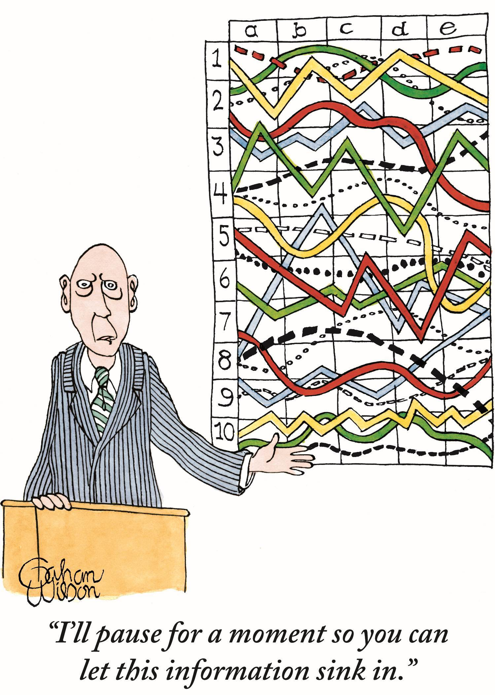
Let’s pause for a moment…
[Gahan WIlson]$→$

