Slide 1
ME759 High Performance Computing for Applications in Engineering [Spring 2021]
Lecture 03
01/29/2021
Dan Negrut, 2021 ME759 UW-Madison

Slide 2

Cartoon of the day
[Peter Steiner]$→$

Slide 3
Is BBC recording on?
If my internet connection goes down, I’ll email from my phone to provide more information – go/no-go, next step, etc.

Slide 4
Before we get started…
Last time
About how our code gets executed on the CPU; sequential execution
Concepts touched on: instruction, assembly code, registers, CISC vs RISC, CPU organization (CU/ALU)
Today
Registers
ILP, focus on pipelining
TLP, and HTT discussion
Execution times
Other tidbits:
Additional Reading: check the on-line syllabus
First assignment went out
Due on Th 02/04, at 9 pm
Please register for an Euler account (see details in email of last night)

Slide 5
Registers

Slide 6
Revisiting an older slide, to get us going
Line of C code:
a[4] = delta + a[3]; //line of C code
MIPS assembly code generated by the compiler (three instructions):
lw $t0, 12($s2) # reg $t0 gets value stored 12 bytes from address in $s2
add $t0, $s4, $t0 # reg $t0 gets the sum of values stored in reg $s4 and reg $t0
sw $t0, 16($s2) # store what’s in $t0 at mem location 16 bytes from address in $s2
Set of three corresponding MIPS instructions produced by the compiler:
10001110010010000000000000001100
00000010100010000100000000100000
10101110010010000000000000010000
Notes:
Typically, a line of code maps into more (some time many) instructions.
Once the instructions are encoded into machine code, they are indistinguishable from data (it’s only location in memory that can differentiate between data and instructions)

Slide 7
Registers, backdrop (1/2)
Review slide
Instruction cycle: fetch-decode-execute (FDX)
CU – responsible for controlling the process that will deliver the request baked into the instruction
ALU – does the busy work to fulfill the request put forward by the instruction
The instruction that is being executed needs to be stored somewhere
Fulfilling the requests baked into an instruction usually involves input values and generates output values
This data needs to be stored somewhere
Notes:
“Stored somewhere” → in registers

Slide 8
Registers, backdrop (2/2)
Registers, quick facts:
A register is a hardware asset whose role is that of information storing (information: data value or instruction)
A register is the storage type with shortest latency – it’s closest to the CU & ALU
Latency – can be of the order of hundreds of picoseconds
The number and size of registers used are specific to an ISA
The microarchitecture has to implement support per ISA’s specifications
Example: Back in the day, for the MIPS ISA, there were 32 registers of 32 bits (no more, no less)
Notes:
Typically, an n-bit register might require 4n … 8n transistors
Note: MIPS64 also uses 32 registers
Don’t expect to see too many registers: precious commodities which are located on prime real-estate

Slide 9
Register Types (1/4)
Discussion herein covers only several register types typically encountered in a CPU (abbreviation in parenthesis)
List not comprehensive, showing only the more important ones
Instruction Register (IR) – holds the instruction that is executed
Sometimes known as “current instruction register” CIR
Program Counter (PC) – holds address of the instruction executed next
NOTE: unlike IR, PC contains *address* of the instruction, not actual instruction
Sometimes called IAR: Instruction Address Register
Notes:
An utility that monitors the program counter can tell you what the hot spots of your executable are
PC is used by profilers to see which instructions are hot-spots

Slide 10
Register Types (2/4)
Memory Data Register (MDR) – holds data read in from memory or, alternatively, produced by the ALU and waiting to be stored in memory
Memory Address Register (MAR) – holds address of RAM memory location where input/output data is supposed to be read in/written out
NOTE: unlike MDR, MAR contains *address* of a mem location, not actual data
Return Address (RA) – the address where upon finishing a sequence of instructions, the execution should jump and commence with the execution of subsequent instruction
Notes:
Other typical registers:
AC (accumulator): typically resides in the ALU

Slide 11
Register Types (3/4)
Registers on previous two slides are a staple in most ISA
There are several other registers common to many chip designs
These are encountered in different numbers (also depending on ISA)
Since they come in larger numbers they don’t have an acronym
Registers for Subroutine Arguments (4) – a0 through a3
Registers for Temporary Variables (10) – t0 through t9
Registers for Saved Temporary Variables (8) – s0 through s7
Saved between function calls
Notes:
Side-note: here’s where the “common wisdom” of having fewer subroutine arguments comes from: there are only 4 registers to store them. When more, additional manipulations.

Slide 12
Register Types (4/4)
Several other registers are involved in handling function calls
Summarized below, their meaning only apparent in conjunction with the organization of the virtual memory
Stack Pointer (sp) – a register that holds an address that points to the top of the stack
Global Pointer (gp) – register that holds on to a global pointer that points into the middle of a 64KB block of memory in the heap that holds constants and global variables (these objects can be quickly accessed with a single load or store instruction)
Frame Pointer (fp) - a register that holds an address that points to the beginning of the procedure frame (for instance, the previous sp before this function changed its value)
Notes:
Virtual memory – at the end of this segment

Slide 13
Register, Departing Thoughts
Registers: we love them, we can’t have enough of them – they’re that good
If they are so good, why can’t we have more?
Increasing their number is not straightforward
Need to change the design of the chip (the microarchitecture)
Need to change the very nature of an instruction (and as such, ISA gets touched in the process)
Examples:
In 32-bit MIPS ISA, there are 32 registers
[Details in two weeks] GP100 GPU (Pascal), register file size: 14,336 MB (~3.5 million registers)
Seems impressive but it’s actually what you expect: let’s assume each CUDA thread has 32 registers set aside for it
56 SMs * 2048 threads/SM * 32 registers/thread = 3.6 million registers needed (almost exactly what the hardware made available…)
Notes:
We will see why so many registers on a GPU (don’t read too much into it right now)
Pascal: up to 2048 resident threads/SM → they all need registers
There’s a maximum of 255 registers/thread limit

Slide 14
Quiz type question…
Why is it that adding one more register might lead to ISA changes?

Slide 15
Registers, take home message
When processing one instruction, the chip needs all instruction-related operands in registers
Fallout, from above statement
You might have GBs of data to process. To be processed, this data will have to find its way in registers
We’ll talk about this data journey into registers later
Reflect on this: all those many GBs of data will have to land at some point in some of the 32 registers at hand

Slide 16
Pipelining
“Nothing is particularly hard if you divide it into small jobs.”
--Henry Ford, founder of Ford Motor Company [1863 –1947]

Slide 17

Why pipelining was embraced: Too many cooks spoil the broth
[https://t.co/kYI3Mz1iKF]$→$

Slide 18
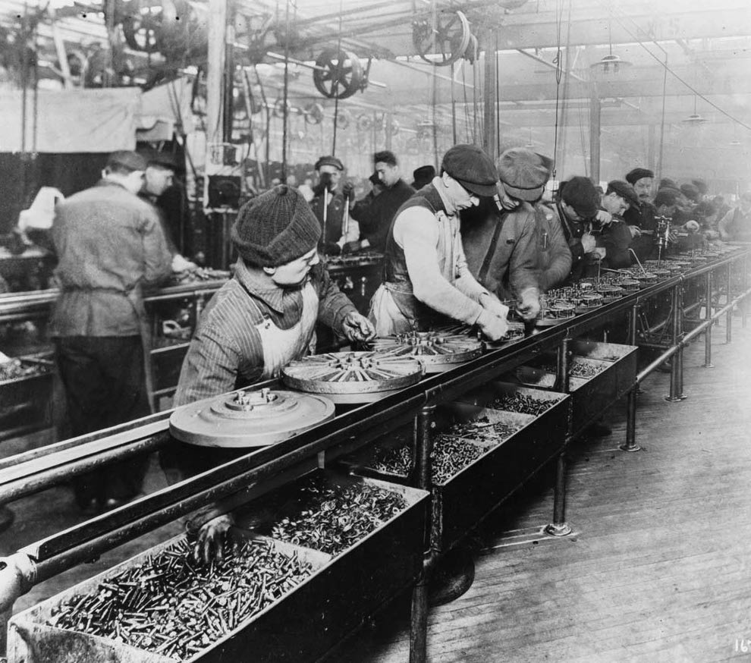
Workers on the first moving assembly line put together magnetos and flywheels for 1913 Ford autos. Highland Park, Michigan
http://www.gpschools.org/ci/depts/eng/k5/third/fordpic.htm [public domain]

Slide 19
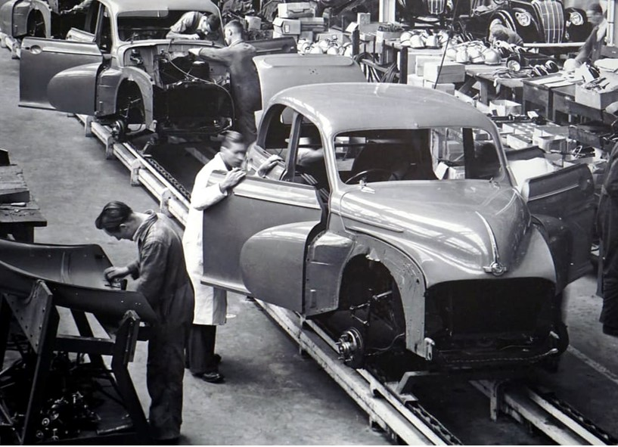
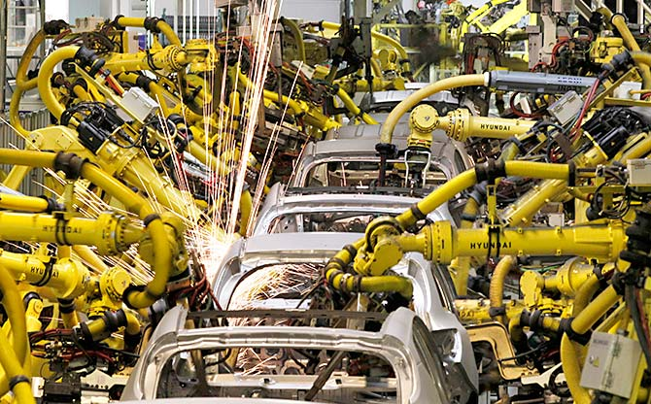
https://www.rediff.com/business/report/hyundai-uses-580-robots-in-chennai-plant-maruti-5000/20180530.htm
Historical change of the manufacturing line. Manual assembly line (left); Hyundai assembly line in Chennai, India (right)
Steve Jurvetson and Mike Bird [Creative Commons Attribution-Share Alike 4.0 International]$→$

Slide 20
Pipelining, or the Assembly Line Concept
Henry Ford: capitalized on, and improved the assembly line idea on an industrial scale and in the process shaped the automotive industry (Ford Model T)
Vehicle assembly line: a good example of a pipelined process
The output of one stage (station) becomes the input for the downstream stage
Once assembly line primed, a vehicle gets finished/manufactured during each clock cycle

Slide 21
Dwelling on the concept of “clock cycle”
Ford plant, and an assembly line therein
“clock cycle”: the time it takes from the moment a station gets its input to the moment its output leaves the station
The processor
“clock cycle”: the amount of time between two ticks of the internal clock of the microprocessor (chip)
Microprocessor clock speed typically measured in Hertz (pulses per second): number of pulses per second
How many pulses these days? What frequency?

Slide 22
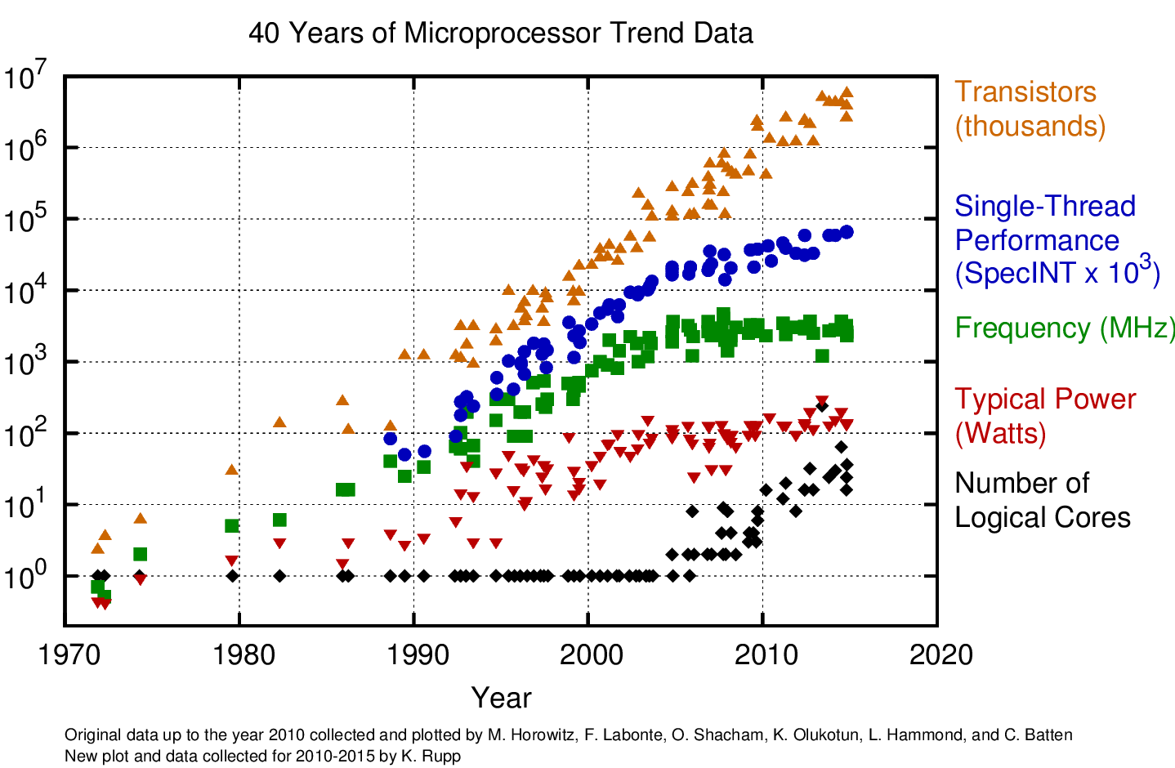
50 years of microprocessor trends: clock ticks at 4 GHz (give or take)
Look here
[https://www.karlrupp.net/2015/06/40-years-of-microprocessor-trend-data/$→$]
Notes:
How the clock ticks: at 4 GHz, it’s been like that for a while…

Slide 23
FDX cycle: sounds like 3 stages, seems to have 4, ends up being 5 or more
FDX cycle: Fetch, Decode, Execute - carried out for each machine instruction, sounds like 3 stages
Sometimes called FDXW (W: “Write”) – so it’s more like four stages
Upon a closer look at what gets fetched (instructions and data) and then what happens upon execution leads to a generic five-stage process associated with an instruction
“generic” above means that, in a first order approximation, these five stages can represent any instruction, although some instructions might not have all five stages:
Stage 1: Fetch an instruction
Stage 2: Decode the instruction
Stage 3: Data access
Stage 4: Execute the operation (e.g., might be a request to calculate an address)
Stage 5: Write-back into register file
NOTE: “FDX cycle” is a name, doesn’t have to do with “cycle time”, which is the time between two clock ticks
Think about it like this: the “FDX cycle” is done for each instruction, and for each instruction it takes several clock cycles (ticks of the clock)
[Patterson, 4th edition]→
Notes:
Modern CPU pipelines are 14-19 deep

Slide 24
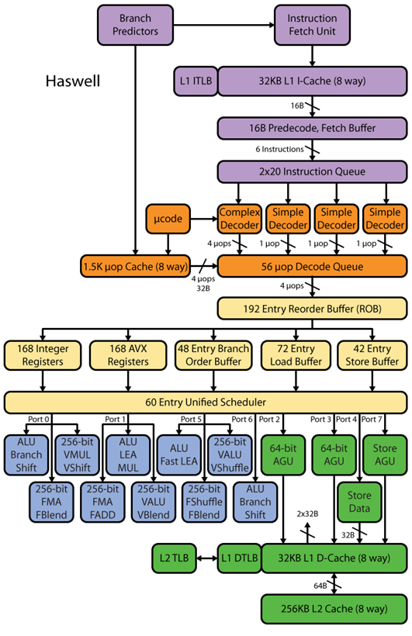
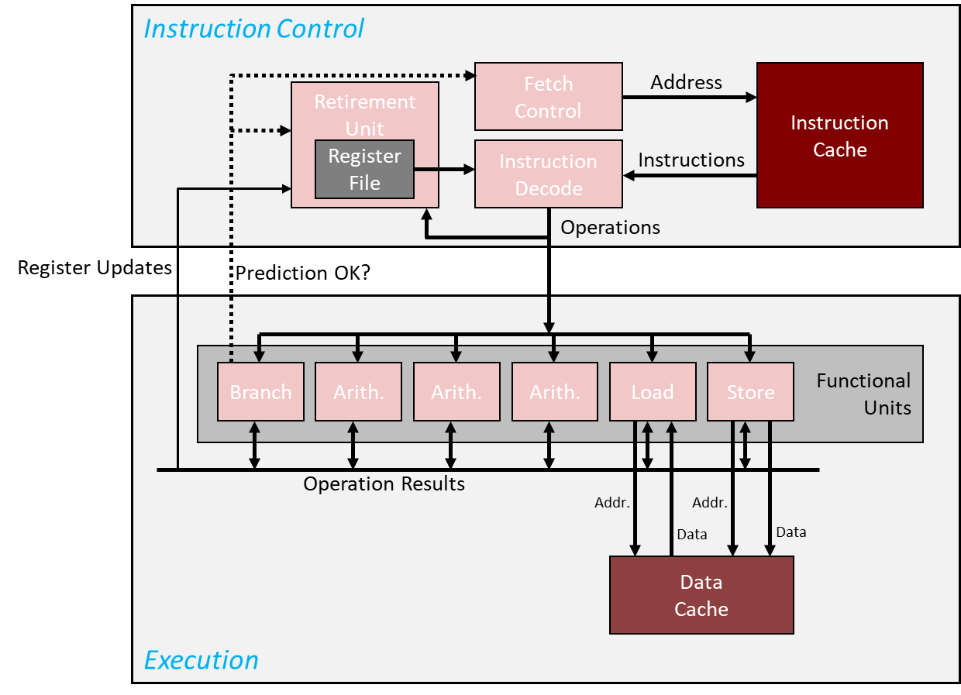
Haswell Microarchitecture: help to contextualize the FDX cycle [30,000 Feet]
Microarchitecture components:
Instruction pre-fetch support (purple)
Instruction decoding support (orange)
CISC into uops
Can be regarded as CISC to RISC step
Instruction Scheduling support (yellowish)
Instruction execution
Arithmetic (blueish)
Memory related (green)
[http://www.realworldtech.com]→
Notes:
LEA: Load effective address
The address generation unit (AGU), sometimes also called address computation unit (ACU), is an execution unit inside central processing units (CPUs) that calculates addresses used by the CPU to access main memory.

Slide 25
Rules of thumb: costs to eXecute an operation > 1 clock cycle [refers to older MIPS ISA; cost of X in FDX]
Four clock cycles for SW
Five clock cycles for LW
Four clock cycles for add
Etc.
25
Notes:
The numbers for the X86 family of chips is usually different

Slide 26
Pipelining, the basics
Assume a five-stage pipeline (btw, it gets to be somewhere between 10-20 stages deep)
Pipelining, cornerstone idea: the following tasks can be worked upon simultaneously when processing five instructions:
Instruction 1 is in the 5th stage of the FDX cycle
Instruction 2 is in the 4th stage of the FDX cycle
Instruction 3 is in the 3rd stage of the FDX cycle
Instruction 4 is in the 2nd stage of the FDX cycle
Instruction 5 is in the 1st stage of the FDX cycle
Notes:
Balance issue:
For the simple 5-stage RISC pipeline discussed here, this is mostly true:
register read/write ~100 ns
fetch/ALU/data read ~200 ns
Modern processor: deep pipelines, because instructions are further broken down to be comparable in time

Slide 27
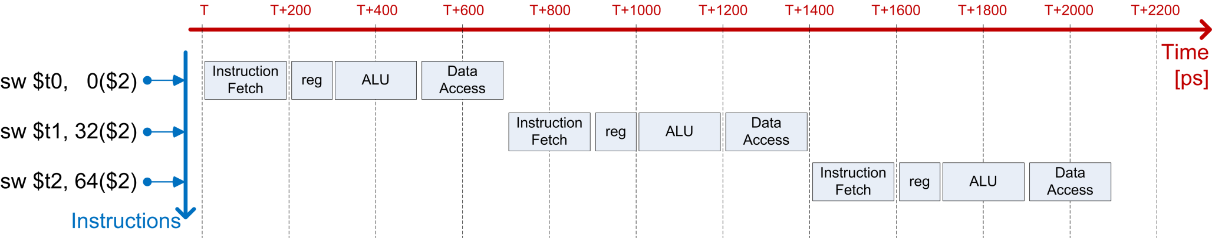
Example: Streaming for execution 3 SW instructions
sw $t0, 0($s2) //store what is in register $t0 at mem location 0 bytes from address in register $s2
sw $t1, 32($s2) //store what is in register $t1 at mem location 32 bytes from address in register $s2
sw $t2, 64($s2) //store what is in register $t0 at mem location 64 bytes from address in register $s2
Case 1: No pipelining – 2100 picoseconds [ps]
Notes:
sw: in MIPS means ‘store word’
ALU used to add offset
sw: no data access needed (missing stage 3)
sw $t0, 32($s2) # store what’s in $t0 at mem location bytes from address in $s2

Slide 28
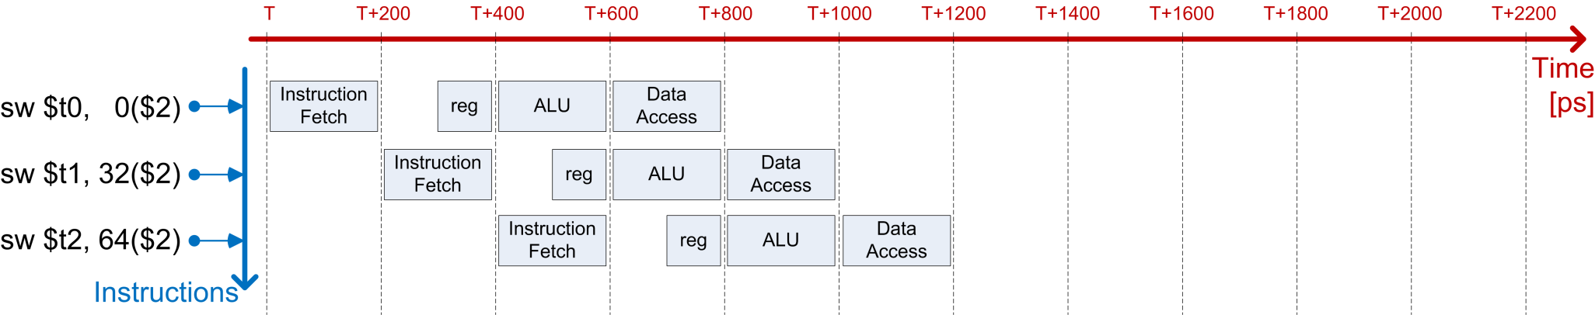
Example: Streaming for execution 3 SW instructions
sw $t0, 0($s2)
sw $t1, 32($s2)
sw $t2, 64($s2)
Case 2: With pipelining – 1200 picoseconds [ps] (5 GHz clock cycle)
Notes:
Pipelining in use since the 1990s

Slide 29
Pipelining: on its “balanced” attribute
An ideal situation is when each of pipeline stage takes the same amount of time for completion
The pipeline is then balanced
If pipeline not balanced, there will be stations that wait for the laggard station at every single cycle
Common sense: If there is a station that takes a significantly longer time since it does significantly more than other stations, it should be broken into two and the length of the pipeline increases by one station
Leads to deeper pipelines
Typical pipeline depth today: 12-15 stages

Slide 30
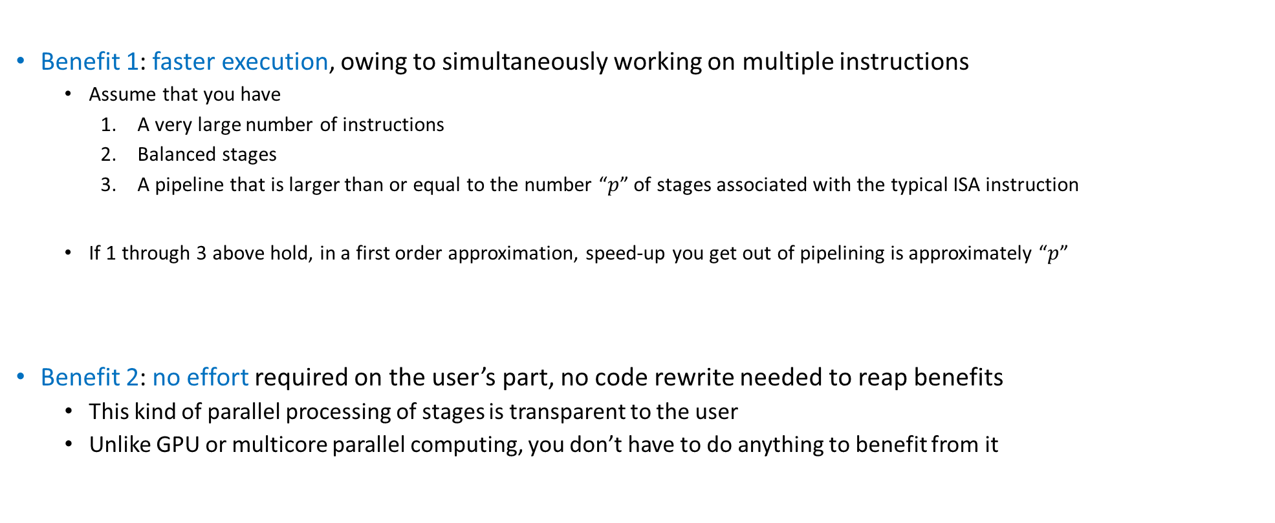
Pipelining Benefits: speed up & no code rewrite
Benefit 1: faster execution, owing to simultaneously working on multiple instructions
Assume that you have
A very large number of instructions
Balanced stages
A pipeline that is larger than or equal to the number “$p$” of stages associated with the typical ISA instruction
If 1 through 3 above hold, in a first order approximation, speed-up you get out of pipelining is approximately “$p$”
Benefit 2: no effort required on the user’s part, no code rewrite needed to reap benefits
This kind of parallel processing of stages is transparent to the user
Unlike GPU or multicore parallel computing, you don’t have to do anything to benefit from it
Notes:
Ideally: at each cycle you complete one instruction
This ignores the need to “prime” the pipeline and to pipeline shutdown.
This ignores hazards (see next)
NOTE: this is not parallel programing, but rather parallel execution (it’s out of the programmer’s hands)

Slide 31
Pipelining, Good to Remember
The amount of time required to complete one stage of the pipeline: one clock cycle
Pipelined processor: one instruction finished in each clock cycle
Non-pipelined processor: no overlap when executing instructions
Important Remark:
Pipelining does not decrease the time to complete one instruction but rather it increases the throughput of the processor by overlapping different stages of processing of different instructions
Notes:
NOTE: an individual instruction may take longer to complete (because some stages are delayed to fit the common tick)
The issue here is so-called INSTRUCTION HETEROGENEITY
Ford solved this problem by limiting the number of options:
“Any customer can have a car painted any color that he wants so long as it is black.”
But the benefit is THROUGHPUT

Slide 32
Pipelining Hazards
Q: if deep pipelines are good, why not make them deeper?
A: deep pipelines plagued by pipelining hazards
Structural hazards
Data hazards
Control hazards
[Patterson, 4th edition]→

Slide 33
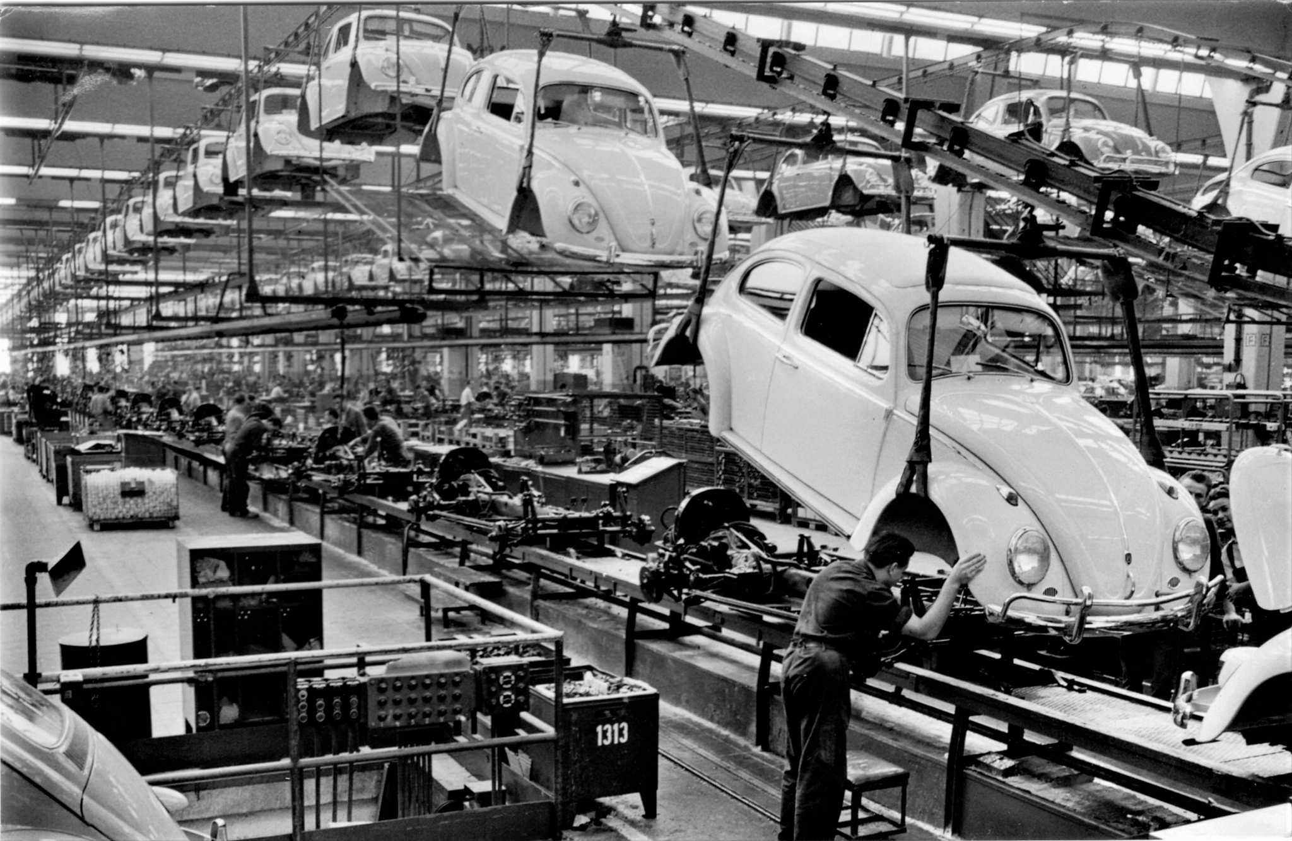
Pipeline Structural Hazards: The problem at hand
A real world assembly line assembles the same product for a period of time
Typically, it can be quickly reconfigured to assemble a different product
The chip processes a broad spectrum of instructions that come one after another
Example: A J-type instruction coming after a R-type instruction, which comes after three I-Type instructions
If they were the same instructions (vehicles), designing a pipeline (assembly line) is straightforward
A structural hazard: the possibility of having a combination of instructions in the pipeline contending for the same hardware asset
Not encountered when you assembly the same car model (things are “deterministic” in this case)
21,529,464 VW Beetle vehicles produced (1938 until 2003)
[Alden Jewell: https://www.flickr.com/photos/autohistorian/32637661426]$→$
Notes:
CONTENTION for hardware

Slide 34

Claw Hammer
This can lead to a structural hazard – one will want to use to nail nails; somebody else might contend it for removing nails in a different job (“instruction”)

Slide 35
Pipeline Structural Hazards: Fixing the problem
Example, how things can go south
15-stage pipeline: instruction in stage 5 and instruction in stage 9 both need to use the same special register to store a temp variable
Solution 1: perhaps a register can be commandeered somehow, for temporary use
Solution 2: serialize the access, basically introduce a bubble in the pipeline so that there is no contention
“bubble in the pipeline” – think of it as a skipped issue slot (the scheduler doesn’t issue anything)
Solution 3: Out of order execution (OOOE) done statically (at compile time) or perhaps dynamically (at run time)

Slide 36
Pipeline Structural Hazards: Fixing the problem - comments
Comment, Solution 1:
Fortuitous, a matter of serendipity
Increase number of registers?
Brute force solution; expensive and consequential (requires a chip design change, perhaps even ISA)
Note that “needing one extra register” is just one possible scenarios; there are might be other contention scenarios lurking
Comment, Solution 2:
Introducing bubbles into the pipeline at run time slows down the execution
Comment, Solution 3 (OOOE):
This is a good compromise: it’s general and when you can re-order instructions there is no slowdown

Slide 37
Pipeline Data Hazards (1/2) [very common]
Example, to get the discussion going – Consider assembly below, with a five-stage pipeline chip:
add $t0, $t2, $t4 // $t0 = $t2 + $t4
addi $t3, $t0, 16 // $t3 = $t0 + 16 “add immediate instruction”
The first instruction is eXecuted in five clock cycles
Its output (value stored in register $t0) is needed in the very next instruction
Data hazard: unavailability of $t0 to the second instruction, which references this register
Resolution (less than ideal)
Put bubbles in the pipeline to wait for the first instruction to fully complete
Notes:
Data DEPENDENCIES
2nd stage of instruction 2 depends on data available only after 5th stage of instruction 1
Sub-optimal solution: introduce “bubbles” in the pipeline

Slide 38
Pipeline Data Hazards (2/2)
add $t0, $t2, $t4 # $t0 = $t2 + $t4
addi $t3, $t0, 16 # $t3 = $t0 + 16 (“add immediate”)
Alternative [the good] Resolution: use “forwarding” or “bypassing”
Key observation: the value that will eventually be placed in $t0 is available after stage 3 of the pipeline (where the ALU actually computes this value)
Analogy: we finished eating well before the dinner table is clean, the plates are in the dishwasher, and the floor is swept
Provide the means for that value in the ALU to be made available to other stages of the pipeline right away
Avoids bubbling - don’t have to wait several cycles before the value made its way into $t0
This process is called “intermediate result forwarding”
Supporting forwarding does not guarantee resolution of all scenarios
Occasionally the pipeline ends up with bubbles for a couple of cycles
OOOE helps (insert unrelated instruction, wedged between two instructions that depend on each other)
Notes:
Analogy: we finished eating well before the dinner table is clean, the plates are in the dishwasher, and the floor is swept

Slide 39
Pipeline Control Hazards (1/2)
What happens when there is an “if” statement in a piece of C code?
Example: if (sin(x)/x>0.5) …
A corresponding machine instruction decides the program flow
Specifically, should the “if” branch be taken or not?
Processing this very instruction to figure out next instruction (branch or no-branch) will take a number of cycles
Should we bubble the pipeline while this instruction is fully processed and branching decision becomes clear?
If yes: strategy always works, but slows down execution
If no: rely on branch prediction and proceed fast but cautiously
Notes:
BRANCHING
What is the instruction that should be inserted in the pipeline right after the one that actually decides the branch?

Slide 40
Pipeline Control Hazards (2/2): Branch Prediction
Static Branch Prediction (1st strategy out of two):
Always predict that the branch will not be taken and schedule accordingly
That is, always schedule the “then” branch, never the “else” branch
There are other heuristics for proceeding: for instance, for a do-while construct it makes sense to always be jumping back at the beginning of the loop
Similar heuristics can be produced in other scenarios (a “for” loop, for instance)
Dynamic Branch Prediction (2nd strategy out of two):
At a branching point, the branch/no-branch decision can change during the life of a program based on recent history
In some cases branch prediction accuracy hits 90%
Note: when your prediction is wrong you have to discard the [micro]instruction[s] executed speculatively and take the correct execution path
Notes:
Dynamic branch prediction: requires more hardware to implement the logic (keep track of previous paths)

Slide 41
[New topic]Pipelining vs. Multiple-Issue (1/2)
Multiple-issue: what is that?
In sequential computing, a multiple-issue processor core has the hardware chops to issue more than one instruction per cycle
Pipelining different than “Multiple-Issue,” which is another way of speeding up execution
Example: the C code below leads to a set of instructions that can be launched for execution at the same time
IMPORTANT: No cross-dependency in updating a and c
int a, b;
float c, d;
//some code setting up a, b, c, d
a += b;
c += d;
Notes:
Depart from the “assembly line” analogy. Here, think of a car manufacturing plant where more car models are produced simultaneously, by sharing common available resources (stations).
It’s actually good here to have very different “car models”: it’s less likely to have competition for same resources (stations).

Slide 42
Pipelining vs. Multiple-Issue (2/2)
On average, more than one instruction is processed by the same core in the same clock cycle
Multiple-Issue can be done statically or dynamically
Static multiple-issue:
Predefined, doesn’t change at run time
Who uses it: Intel, in AVX512 (but not only)
Dynamic multiple-issue:
Determined at run time, the chip has dedicated hardware resources that can identify and execute additional work
Who uses it: Intel, AMD, IBM, NVIDIA, etc.
Notes:
Dynamic multiple-issue makes use of a buffer for instructions to be able to look ahead.
We already alluded to other ILP techniques:
out of order execution
speculative execution and branch prediction
also, register renaming, etc.

Slide 43

Pipelining vs. Multiple Issue
(a) Three-stage pipeline
(b) Multiple issue processor
[Modern Operating System, Tanenbaum-Bos]→

Slide 44
Attributes of Dynamic Multiple-Issue
The data dependencies between instruction being processed takes place at run time
Checking for dependencies is complex, requires high cost in time and energy
Checks in place to make sure result is ok
“ok”: no difference if the instructions are executed “multiple-issue” or “single issue”
NOTE: a chip that can do multiple-issue is also called a superscalar architecture
Notes:
CU acts as supervisor to see what instructions can be issued and dispatched simultaneously

Slide 45
The “Instruction-Level Parallelism” (ILP) concept
Pipelining, OOOE, and multiple-issue are presentations of what’s called Instruction-Level Parallelism (ILP)
ILP pursues various strategies to execute simultaneously multiple instructions
Important: these instructions belong to the same program or process; i.e., belong to *one* thread
“process” – how the operating systems calls your program
Notes:
Dynamic multiple-issue makes use of a buffer for instructions to be able to look ahead.
We already alluded to other ILP techniques:
out of order execution
speculative execution and branch prediction
also, register renaming, etc.

Slide 46
ILP: various angles of attack (quick summary of ILP’s bag of tricks)
Instruction pipelining: execution of multiple instructions can be partially overlapped; each instructions divided into sub-steps (termed: micro-operations)
Superscalar execution: multiple execution units are used to execute multiple instructions in parallel
Out-of-order execution: instructions execute in any order but without violating data dependencies
Register renaming: a technique used to avoid data hazards and thus lead to unnecessary serialization of program instructions caused by the reuse of registers
Speculative execution: allows the execution of complete instructions or parts of instructions before being sure whether this execution is required
Branch prediction: used to avoid delays (termed: stalls in execution). Used in combination with speculative execution.
Notes:
Various techniques. Most rely on available extra capacity (hardware/transistors).
For ILP to make a dent, you need large blocks of instructions that can be [attempted to be] run in parallel
Duplicate hardware speculatively executes future instructions before the results of current instructions are known, while providing hardware safeguards to prevent the errors that might be caused by out of order execution
Branches must be “guessed” to decide what instructions to execute simultaneously
If you guessed wrong, you throw away that part of the result
Data dependencies may prevent successive instructions from executing in parallel, even if there are no branches

Slide 47
Thread Level Parallelism (TLP) [happens on a single core]
ILP not the only “parallel” show in town
Another one: chip executes simultaneously instructions from different processes or different threads
Called Thread-Level Parallelism (TLP)
Important to keep in mind: we are talking about parallelism on one hardware core, not multicore

Slide 48
ILP vs. TLP: how are they different
Recall concept of “Program Counter” (PC): a register that holds address of next instruction
If all instructions executed by the chip in parallel are associated with one PC, we have ILP
TLP: the stream of instructions simultaneously processed by the chip associated with more than one PC

Slide 49
Process vs. thread – getting a bit into the weeds [1/2]
TLP: chip executes simultaneously instructions from different processes or different threads
There is a subtle difference between processes & threads:
TLP is what happens when two processes such as Matlab and Microsoft Word run on the chip
Because two different processes, there are two different PCs
TLP: two (or even more) OpenMP or POSIX threads simultaneously run on the chip
Because two different threads, there are two different PCs

Slide 50
Process vs. thread – getting a bit into the weeds [2/2]
How similar: Both processes and threads are independent sequences of execution
How different:
Threads (of the same process) run in a shared memory space
This is how shared-memory parallel computing takes place. Like OpenMP
Processes run in separate memory spaces
This is how distributed-memory parallel computing takes place. Like MPI*
What is a memory space?
To be continued, in one week (after discussing the concept of Virtual Memory)

Slide 51
Why did folks come up with this TLP idea?
Over time, transistor budget ballooned
Owing to Moore’s Law
As such, many Functional Units available
TLP allows us to put them to good use

Slide 52
An example of TLP: Intel’s HTT feature
Typical Intel core supports the “Hyper-Threading Technology” (HTT)
HTT: two threads/processes, each seeing its own stream of machine instructions, active at any given time
“active”: also called “in flight”
The scheduler tries to issue instructions from both processes, at the same time
The beefing up of the CU/ALU hardware required to support HTT is actually pretty minor
Extra hardware required to save execution state of a thread when idle and not running (for lack of data or available functional units)
[Intel]→
Notes:
Intel HT Technology improves performance through increased instruction level parallelism by having two threads with independent instruction streams, eliminating data dependencies between threads and increasing utilization of the available execution units. This effect typically increases the number of instructions executed in a given amount of time within a core, as shown in Figure 3. The impact of this greater efficiency is experienced by users as higher throughput (since more work gets completed per clock cycle) and higher performance per watt (since fewer idle execution units consume power without contributing to performance). In addition, when one thread has a cache miss, branch mispredict, or any other pipeline stall, the other thread continues processing instructions at nearly the same rate as a single thread running on the core. Intel HT Technology augments other advanced architectural features, higher clock speeds, and additional cores with a capability that is relatively inexpensive in terms of space on the silicon and production cost.

Slide 53
Intel’s HTT Feature
In general, TLP requires the participation of the Operating System (OS)
The OS sees one physical chip as two virtual chips; OS “talks” to both of them
Is HTT helpful?
Yes: when running two modestly demanding processes
Example: Running MS-Word and Spotify at the same time
Execution threads are independent, when one execution thread stalls the other can be picked up and its PC advanced
No: high performance computing, when one stream of instruction saturates the memory bandwidth
Nothing left for anybody else to step in and nibble on excess-hardware leftover
NOTE: as of recently, the trend has been for TLP to be scaled back owing to security issues
Notes:
Intel HT Technology improves performance through increased instruction level parallelism by having two threads with independent instruction streams, eliminating data dependencies between threads and increasing utilization of the available execution units. This effect typically increases the number of instructions executed in a given amount of time within a core, as shown in Figure 3. The impact of this greater efficiency is experienced by users as higher throughput (since more work gets completed per clock cycle) and higher performance per watt (since fewer idle execution units consume power without contributing to performance). In addition, when one thread has a cache miss, branch mispredict, or any other pipeline stall, the other thread continues processing instructions at nearly the same rate as a single thread running on the core. Intel HT Technology augments other advanced architectural features, higher clock speeds, and additional cores with a capability that is relatively inexpensive in terms of space on the silicon and production cost.

Slide 54
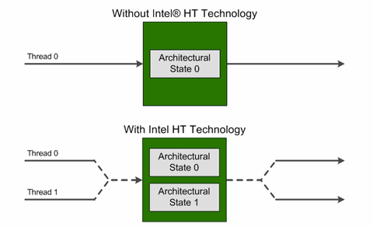
HTT, Intel’s perspective
Highlights:
The processor core maintains two architectural states, each of which can support its own execution thread
Many of the internal microarchitectural hardware resources are shared between the two threads
[Intel]→
Notes:
DAN - Lots of good stuff here: https://software.intel.com/en-us/articles/performance-insights-to-intel-hyper-threading-technology (article by Antonio Valles (Intel))

Slide 55
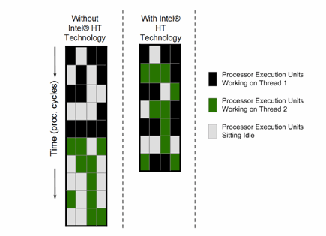
HTT: The Bottom Line
Essentially, one physical core shows up as two virtual cores
Why is it good?
More execution units within the ALU are used at any given time
Higher utilization rate of the hardware assets
When one execution thread stalls (has a cache miss, branch mispredict, pipeline bubble, etc.), the other execution thread continues processing instructions at nearly the same rate as a single thread running on the core
Functional Unit D
Functional Unit A
Functional Unit C
Functional Unit A
Functional Unit B
Functional Unit C
Functional Unit B
Functional Unit D
[Intel]→
Notes:
DAN - Lots of good stuff here: https://software.intel.com/en-us/articles/performance-insights-to-intel-hyper-threading-technology

Slide 56
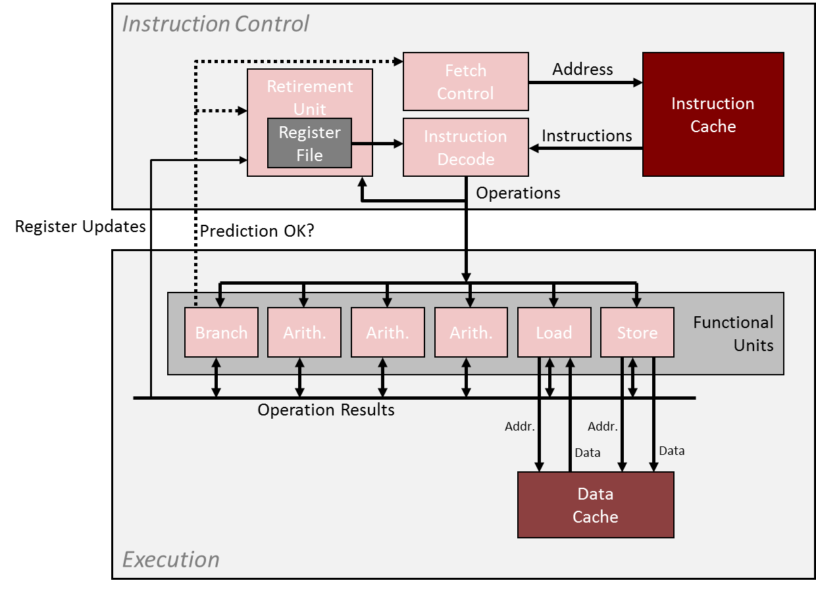
TLP: further discussion
Multi-threading, a possible taxonomy (Hennessey & Paterson)
Coarse grain multi-threading
Fine grain multi-threading
Simultaneous multi-threading
This taxonomy: It all goes back to what goes through this pipe at each clock cycle
The “brain”
The “executioner”

Slide 57
Coarse multi-threading
The Instruction Control issues instructions from one thread for many cycles
Bursts of tens or hundreds of instructions
Instruction Control switches to issuing from another thread only when the first thread runs into a long-latency operation
Examples: cache miss, interrupt, etc.
“long-latency”: Hundreds of cycles or so
!!!!!

Slide 58
Fine multi-threading
Instruction Control can issue instructions from a different thread each cycle
“Barrel-gun style” processing: thread from where next instruction is picked for execution can change at every cycle
GPU computing similar to this
More nimble/sophisticated compared to coarse multi-threading
!!!!!

Slide 59
Simultaneous multi-threading
Simultaneous multi-threading is like fine multi-threading with one caveat:
Instruction Control can issue instructions from different threads in the same cycle
NOTE:
Intel’s HTT is a “simultaneous multi-threading” technology
!!!!!

Slide 60
Superscalar processor or TLP processor. Wrapping it up
Superscalar vs. TLP
Superscalar: instructions associated with one PC
TLP: instructions associated with two PCs
Superscalar: one PC on the chip
HW has the means to execute more than one instruction per cycle
Superscalar: it’s more than a “scalar”; i.e., one thread
TLP: Processor handles instructions from different threads/processes
NOTE: we are not talking about multiple-cores; we are still talking about one CPU core here

Slide 61
Quiz: TLP flavors
Left-side pic: coarse TLP, fine TLP, or SMT?
Not clear from the pic if it’s TLP coarse, TLP fine, or even non TLP (might be the operating system engaging in time slicing)
To understand if it’s TLP or not one needs to know whether the processor is capable of maintaining more than one architectural state in flight
Right-side pic: coarse TLP, fine TLP, or SMT?
Functional Unit D
Functional Unit A
Functional Unit C
Functional Unit A
Functional Unit B
Functional Unit C
Functional Unit B
Functional Unit D

