Slide 1
ME759 High Performance Computing for Applications in Engineering [Spring 2021]
Lecture 14
02/24/2021
Dan Negrut, 2021 ME759 UW-Madison

Slide 2


Cartoon of the day
[Lila Ash]$→$

Slide 3
Is BBC recording on?
If my internet connection goes down, I’ll email from my phone to provide more information – go/no-go, next step, etc.

Slide 4
Before we get started…
Last time
Atomic operations
Things that determine the speed of execution of a kernel
The concept of “occupancy” and what impacts it (how many threads per block, how many registers/thread, how much ShMem/block)
Rules of thumb, for good execution speed in GPU computing
The nvcc toolchain, and how code is sent to host or gpu compilers
Today
Case studies: parallel reduction on the GPU & 1D convolution
Looking beyond today: some more GPU computing feature, but looking for a while into optimization features
Other tidbits:
Assignment due on Th, 02/25, at 9 pm
Next four assignments are going to be difficult
Drop two of them if you are overwhelmed. Stay focused, make the right call
Do not run your code on the Euler headnode (use Slurm)
You can download the recording onto your machine, don’t need to listen to lecture through Canvas
Big PDF file contains all the slides thus far; easy to search into it to find topics covered thus far. Doc is here.
After today’s lecture, we are past half of course (done on March 29)

Slide 5
GPU Computing: Case studies
Three Case Studies:
a) 1D Stencil Operation
b) Vector Reduction in CUDA
c) Parallel Prefix Scan on the GPU

Slide 6
Problem at hand: Performing a 1D Stencil
Applying a 1D stencil to a 1D array of elements
Function of input elements within a radius
Operation is fundamental to many algorithms
Standard discretization methods, interpolation, convolution, filtering, etc.
This example will use weighted arithmetic mean
radius
radius
NVIDIA [S. Satoor]→
Notes:
Now lets talk about a specific, realistic optimization example.

Slide 7
Serial Algorithm
= CPU Thread
(radius = 3)
in
…
…
f
out
…
…
NVIDIA [S. Satoor]→
Notes:
Describe how algorithm works from perspective of calculating each output element.

Slide 8
Serial Algorithm
= CPU Thread
(radius = 3)
…
…
in
f
out
…
…
…
Repeat for each element
NVIDIA [S. Satoor]→
Notes:
Serial, so thread moves from output-element to output-element.

Slide 9
Serial Implementation [assume N=16 mil.]
int main() {
// allocate resources
float *weights = new float[2 * RADIUS + 1];
float *in = new float[N];
float *out= new float[N];
initializeWeights(weights, RADIUS);
initializeArray(in, N);
applyStencil1D(RADIUS, N-RADIUS, weights, in, out);
// free resources
delete[] weights; delete[] in; delete[] out;
}
void applyStencil1D(int sIdx, int eIdx, const float *weights, float *in, float *out) {
for (int i = sIdx; I < eIdx; i++) {
out[i] = 0;
// loop over all elements in the stencil
for (int j = -RADIUS; j <= RADIUS; j++) {
out[i] += weights[j + RADIUS] * in[i + j];
}
out[i] = out[i] / (2 * RADIUS + 1);
}
}
NVIDIA [S. Satoor]→
Notes:
Here’s a straight-forward implementation of the stencil algorithm in C.
RADIUS is relative small, 15 in this example.
N is large, 16 Melements

Slide 10
Serial Implementation
Allocate and initialize
int main() {
// allocate resources
float *weights = new float[2 * RADIUS + 1];
float *in = new float[N];
float *out= new float[N];
initializeWeights(weights, RADIUS);
initializeArray(in, N);
applyStencil1D(RADIUS, N-RADIUS, weights, in, out);
// free resources
delete[] weights; delete[] in; delete[] out;
}
void applyStencil1D(int sIdx, int eIdx, const float *weights, float *in, float *out) {
for (int i = sIdx; I < eIdx; i++) {
out[i] = 0;
// loop over all elements in the stencil
for (int j = -RADIUS; j <= RADIUS; j++) {
out[i] += weights[j + RADIUS] * in[i + j];
}
out[i] = out[i] / (2 * RADIUS + 1);
}
}
Apply stencil
Cleanup
NVIDIA [S. Satoor]→

Slide 11
Serial Implementation
For each element…
int main() {
// allocate resources
float *weights = new float[2 * RADIUS + 1];
float *in = new float[N];
float *out= new float[N];
initializeWeights(weights, RADIUS);
initializeArray(in, N);
applyStencil1D(RADIUS, N-RADIUS, weights, in, out);
// free resources
delete[] weights; delete[] in; delete[] out;
}
void applyStencil1D(int sIdx, int eIdx, const float *weights, float *in, float *out) {
for (int i = sIdx; I < eIdx; i++) {
out[i] = 0;
// loop over all elements in the stencil
for (int j = -RADIUS; j <= RADIUS; j++) {
out[i] += weights[j + RADIUS] * in[i + j];
}
out[i] = out[i] / (2 * RADIUS + 1);
}
}
Weighted mean over radius
NVIDIA [S. Satoor]→
Notes:
Because this is a serial implementation, note that we use a single thread to iterate over all output elements.

Slide 12
Serial Implementation
int main() {
// allocate resources
float *weights = new float[2 * RADIUS + 1];
float *in = new float[N];
float *out= new float[N];
initializeWeights(weights, RADIUS);
initializeArray(in, N);
applyStencil1D(RADIUS, N-RADIUS, weights, in, out);
// free resources
delete[] weights; delete[] in; delete[] out;
}
void applyStencil1D(int sIdx, int eIdx, const float *weights, float *in, float *out) {
for (int i = sIdx; I < eIdx; i++) {
out[i] = 0;
// loop over all elements in the stencil
for (int j = -RADIUS; j <= RADIUS; j++) {
out[i] += weights[j + RADIUS] * in[i + j];
}
out[i] = out[i] / (2 * RADIUS + 1);
}
}
CPU | MElements/s
i7-930 | 30
NVIDIA [S. Satoor]→
Notes:
Because this is a serial implementation, note that we use a single thread to iterate over all output elements.

Slide 13
Application Optimization Process
Identify Optimization Opportunities
1D stencil algorithm
Parallelize with CUDA and confirm functional correctness
cuda-gdb, cuda-memcheck
Note: cuda-memcheck useful for memory debugging
Out of bounds accesses
Accessing misaligned data
Race conditions
Memory leaks
Optimize
…dealing with this next, using nvvp
NVIDIA [S. Satoor]→
Notes:
Application optimization process: we identified and parallelized
Used CUDA to expose parallelism
Used memory checking, debugging tools to get functional correctness
What about optimize?

Slide 14
Parallel Algorithm
= Thread
in
Serial: One element at a time
…
…
…
…
out
in
Parallel: Many elements at a time
…
…
…
…
out
…
…
NVIDIA [S. Satoor]→
Notes:
This algorithm can be parallelized. Calculation of each output element is independent of others, so we can have multiple threads working in parallel. Each thread calculates a different output element value.

Slide 15
The Parallel Implementation
int main() {
int wsize = 2 * RADIUS + 1;
//allocate resources
float *weights = new float[wsize];
float *in = new float[N];
float *out= new float[N];
initializeWeights(weights, RADIUS);
initializeArray(in, N);
float *d_weights; cudaMalloc(&d_weights, wsize * sizeof(float));
float *d_in; cudaMalloc(&d_in, N * sizeof(float));
float *d_out; cudaMalloc(&d_out, N * sizeof(float));
cudaMemcpy(d_weights, weights, wsize, cudaMemcpyHostToDevice);
cudaMemcpy(d_in, in, size, cudaMemcpyHostToDevice);
applyStencil1D<<<N / 512, 512>>>(RADIUS, N-RADIUS, d_weights, d_in, d_out);
cudaMemcpy(out, d_out, size, cudaMemcpyDeviceToHost);
//free resources
delete[] weights; delete[] in; delete[] out;
cudaFree(d_weights); cudaFree(d_in); cudaFree(d_out);
}
The GPU kernel
__global__ void applyStencil1D(int sIdx, int eIdx, const float *weights, float *in, float *out) {
int i = sIdx + blockIdx.x * blockDim.x + threadIdx.x;
if ( i < eIdx ) {
out[i] = 0;
//loop over all elements in the stencil
for (int j = -RADIUS; j <= RADIUS; j++) {
out[i] += weights[j + RADIUS] * in[i + j];
}
out[i] = out[i] / (2 * RADIUS + 1);
}
}
NVIDIA [S. Satoor]→

Slide 16
The Parallel Implementation
int main() {
int wsize = 2 * RADIUS + 1;
//allocate resources
float *weights = new float[wsize];
float *in = new float[N];
float *out= new float[N];
initializeWeights(weights, RADIUS);
initializeArray(in, N);
float *d_weights; cudaMalloc(&d_weights, wsize * sizeof(float));
float *d_in; cudaMalloc(&d_in, N * sizeof(float));
float *d_out; cudaMalloc(&d_out, N * sizeof(float));
cudaMemcpy(d_weights, weights, wsize, cudaMemcpyHostToDevice);
cudaMemcpy(d_in, in, size, cudaMemcpyHostToDevice);
applyStencil1D<<<N / 512, 512>>>(RADIUS, N-RADIUS, d_weights, d_in, d_out);
cudaMemcpy(out, d_out, size, cudaMemcpyDeviceToHost);
//free resources
delete[] weights; delete[] in; delete[] out;
cudaFree(d_weights); cudaFree(d_in); cudaFree(d_out);
}
Device | Algorithm | MElements/s | Speedup
i7-930* | Optimized & Parallel | 130 | 1x
Tesla C2075 | Simple | 285 | 2.2x
__global__ void applyStencil1D(int sIdx, int eIdx, const float *weights, float *in, float *out) {
int i = sIdx + blockIdx.x * blockDim.x + threadIdx.x;
if ( i < eIdx ) {
out[i] = 0;
//loop over all elements in the stencil
for (int j = -RADIUS; j <= RADIUS; j++) {
out[i] += weights[j + RADIUS] * in[i + j];
}
out[i] = out[i] / (2 * RADIUS + 1);
}
}
NVIDIA [S. Satoor]→

Slide 17
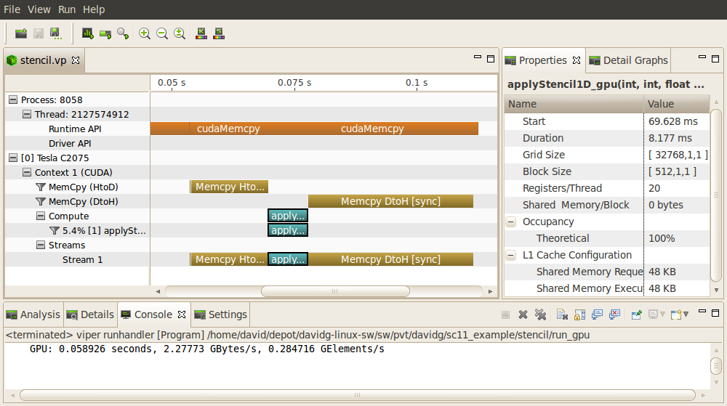
NVIDIA Visual Profiler
CUDA API activity on CPU
The interesting part, done on the GPU
Memcpy and kernel activity on GPU
NVIDIA [S. Satoor]→
Notes:
General layout… timeline for visualization plus additional information…
Timeline shows GPU and CPU activity
Additional information available for kernels and memcpys

Slide 18
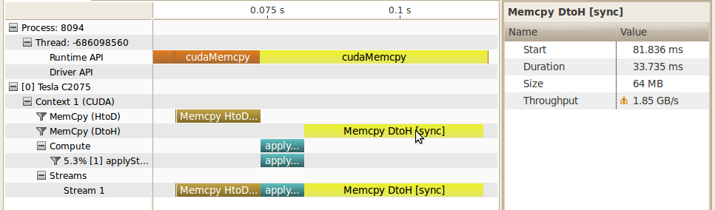
Quiz: Why is CPU thread shown with two contiguous cudaMemcpy?
Why contiguous on the CPU side?
Notes:
Why contiguous: there is nothing after the kernel launch, the CPU waits before it starts the copy for the kernel to get done
From timeline we can easily see that majority of time for stencil algorithm is spent moving data to and from GPU
By looking at the memcpy details we see that BW is quite low…
Note that VP highlights the problem with ! indication

Slide 19
Detecting Low Memory Throughput
Spent majority of time in data transfer
Often can be overlapped with preceding or following computation
From timeline can see that throughput is low
PCIe x16 can sustain significantly more than this
NVIDIA [S. Satoor]→
Notes:
From timeline we can easily see that majority of time for stencil algorithm is spent moving data to and from GPU
By looking at the memcpy details we see that BW is quite low…
Note that VP highlights the problem with ! indication

Slide 20
Visual Profiler Analysis
How do we know when there is an optimization opportunity?
Timeline visualization seems to indicate an opportunity
Documentation gives guidance and strategies for tuning
CUDA Best Practices Guide
CUDA Programming Guide
Visual Profiler analyzes your application
Uses timeline and other collected information
Highlights specific guidance from Best Practices
Like having a customized Best Practices Guide for your application
NVIDIA [S. Satoor]→
Notes:
What if not a PCIe expert… can see that memcpy is taking a lot of time but how do we know if that is an opportunity for optimization or not?

Slide 21
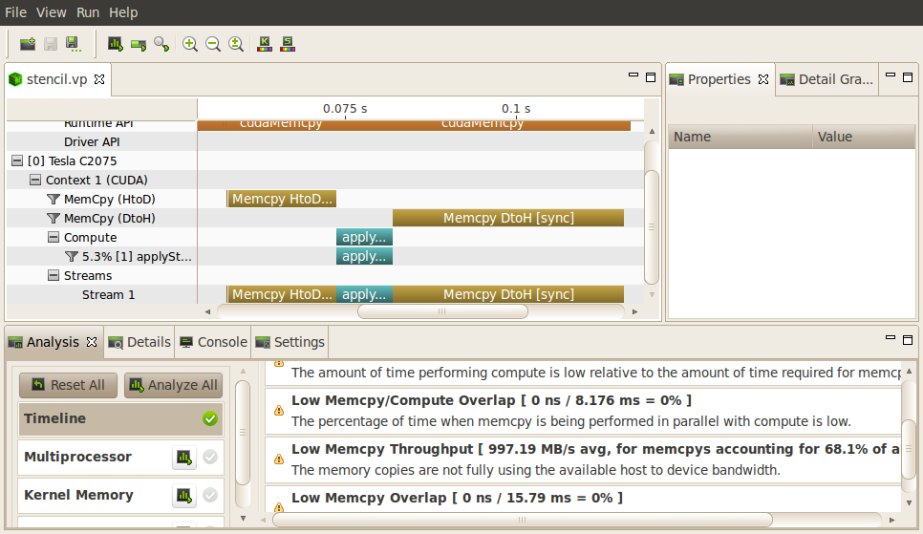
Visual Profiler Analysis
Analysis pointing out low memcpy throughput
Several types of analysis are provided
NVIDIA [S. Satoor]→
Notes:
Transition… accessing the analysis portion of visual profiler is easy. Simply click one button and vp will collect the necessary information to perform the analysis and then present the results.

Slide 22
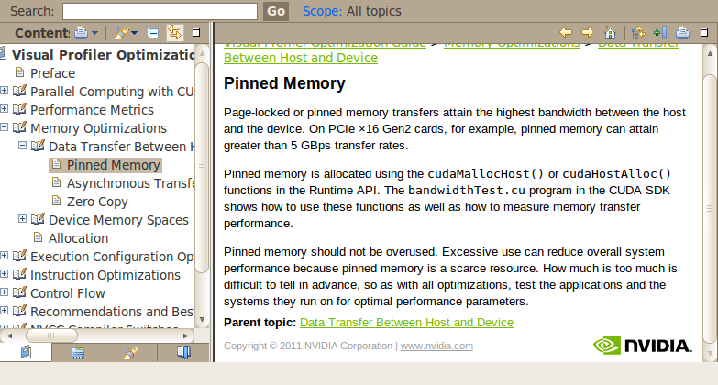
Online Optimization Help
Each analysis has link to Best Practices documentation
NVIDIA [S. Satoor]→
Notes:
Best practices information is included, online in the visual profiler
Each result has link to get more details Best Practices information…

Slide 23
Pinned CPU Memory Implementation
int main() {
int size = N * sizeof(float);
int wsize = (2 * RADIUS + 1) * sizeof(float);
//allocate resources
float *weights; cudaMallocHost(&weights, wsize);
float *in; cudaMallocHost(&in, size);
float *out; cudaMallocHost(&out, size);
initializeWeights(weights, RADIUS);
initializeArray(in, N);
float *d_weights; cudaMalloc(&d_weights);
float *d_in; cudaMalloc(&d_in);
float *d_out; cudaMalloc(&d_out);
…
CPU allocations use pinned memory to enable fast memcpy
No other changes
NVIDIA [S. Satoor]→
Notes:
Spend some time reading best practices, understanding some additional CUDA features… and we learn that pinned memory can significantly increase memcpy BW
Also learn what code modification is needed… very simple in this case

Slide 24
Pinned Memory
DMA (direct memory access) uses physical addresses
The OS could accidentally page out the data that is being read or written by a DMA and page in another virtual page into the same location
Pinned memory cannot not be paged out
If a source or destination of a cudaMemCpy() in the host memory is not pinned, it needs to be first copied to a pinned memory – extra overhead
cudaMemcpy faster with pinned host memory source or destination

Slide 25
Allocate/Free Pinned Memory (a.k.a. Page Locked Memory)
cudaHostAlloc()
Three parameters
Address of pointer to the allocated memory
Size of the allocated memory in bytes
Option – use cudaHostAllocDefault for now
cudaFreeHost()
One parameter
Pointer to the memory to be freed

Slide 26
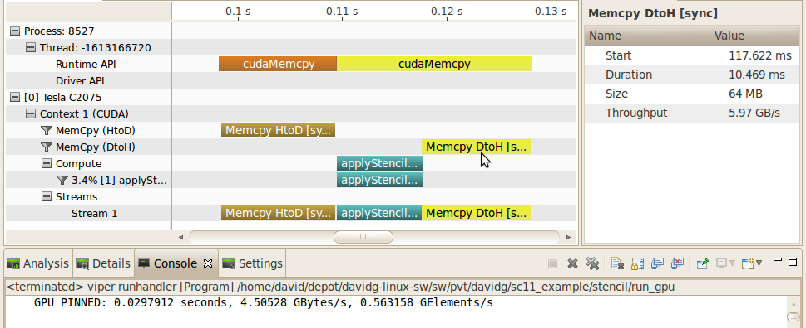
Pinned CPU Memory Result
NVIDIA [S. Satoor]→
Notes:
Can see that portion of overall time required by memcpy is significantly reduced
Details also show that BW is now much higher (from < 2GB/s to almost 6GB/s)… other memcpy is similar (going from < 4GB/s to almost 6GB/s)

Slide 27
Pinned CPU Memory Result
Device | Algorithm | MElements/s | Speedup
i7-930* | Optimized & Parallel | 130 | 1x
Tesla C2075 | Simple | 285 | 2.2x
Tesla C2075 | Pinned Memory | 560 | 4.3x
NVIDIA [S. Satoor]→
Notes:
Can see that portion of overall time required by memcpy is significantly reduced
Details also show that BW is now much higher (from < 2GB/s to almost 6GB/s)… other memcpy is similar (going from < 4GB/s to almost 6GB/s)

Slide 28

Application Optimization Process [Revisited]
Identify Optimization Opportunities
1D stencil algorithm
Parallelize with CUDA, confirm functional correctness
Debugger
Memory Checker
Optimize
Profiler (pinned memory)
NVIDIA [S. Satoor]→
Notes:
Complete entire optimization process? Can we do more… of course

Slide 29
Application Optimization Process [Revisited]
Identify Optimization Opportunities
1D stencil algorithm
Parallelize with CUDA, confirm functional correctness
Debugger
Memory Checker
Optimize
Profiler (pinned memory)
NVIDIA [S. Satoor]→
Notes:
Iterate optimization step to see if there are more opportunities…

Slide 30
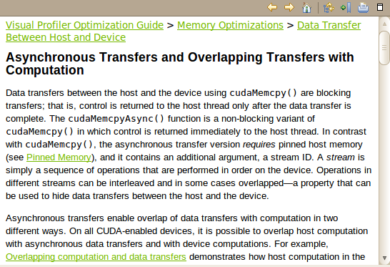
Advanced optimization
Larger time investment
Potential for larger speedup
NVIDIA [S. Satoor]→
Notes:
More advanced optimization if you want to spend more time
Chunking is similar to partitioning data on a multi-core CPU, so that each core works on a different part of the problem
Visual profiler analysis identifies this opportunity and points to best practices details…

Slide 31
Data Partitioning Example
Partition data into TWO chunks
chunk 1
chunk 2
On the CPU
in
On the CPU
out
NVIDIA [S. Satoor]→

Slide 32
Data Partitioning Example
On the CPU
chunk 1
chunk 2
in
memcpy
compute
memcpy
On the GPU
On the CPU
out
NVIDIA [S. Satoor]→

Slide 33
Data Partitioning Example
On the CPU
chunk 1
chunk 2
in
memcpy
compute
memcpy
On the GPU
memcpy
compute
memcpy
On the CPU
out
NVIDIA [S. Satoor]→

Slide 34
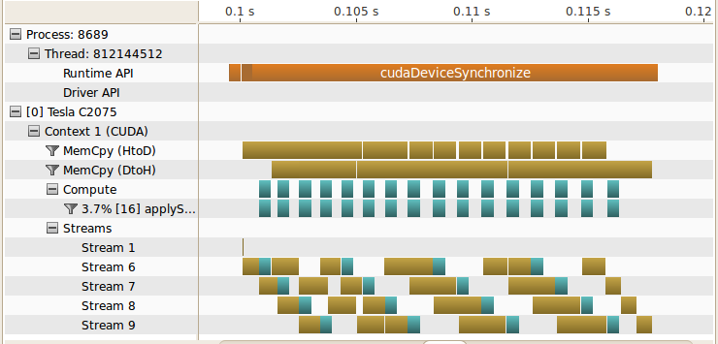
Overlapped Compute/Memcpy [problem broken into 16 chunks]
NVIDIA [S. Satoor]→
Notes:
Broke stencil problem into 16 chunks
Show in->compute->out for each chunk
Streams are a way to represent different groups of work that are independent

Slide 35
Overlapped Compute/Memcpy
Exploit dual memcpy engines
Compute time completely “hidden”
ME759: Use of multiple streams covered later
NVIDIA [S. Satoor]→
Notes:
Broke stencil problem into 16 chunks
Show in->compute->out for each chunk
Streams are a way to represent different groups of work that are independent

Slide 36
Overlapped Compute/Memcpy
Device | Algorithm | MElements/s | Speedup
i7-930* | Optimized & Parallel | 130 | 1x
Tesla C2075 | Simple | 285 | 2.2x
Tesla C2075 | Pinned Memory | 560 | 4.3x
Tesla C2075 | Overlap | 935 | 7.2x
NVIDIA [S. Satoor]→

Slide 37
Optimization Summary [Looking Back at 1D Stencil Example…]
Initial CUDA parallelization
Expeditious, kernel almost word-for-word replica of sequential code
2.2x speedup
Optimize memory throughput
Minimal code change, yet need to know about pinned memory
4.3x speedup
Overlap compute and data movement
More involved, need to know about the inner works of CUDA
Problem should be large enough to justify mem-transfer/execution
7.2x speedup

Slide 38
Iterative Optimization
Identify Optimization Opportunities
Parallelize
Optimize
NOTE: NVIDIA is gradually moving away from NVVP, migrating to NVIDIA Nsight Tools, see here.
NVIDIA [S. Satoor]→
Notes:
But that doesn’t mean no additional speedup is possible…
Can iterate entire process to find new function/algorithm that can be optimized.

Slide 39
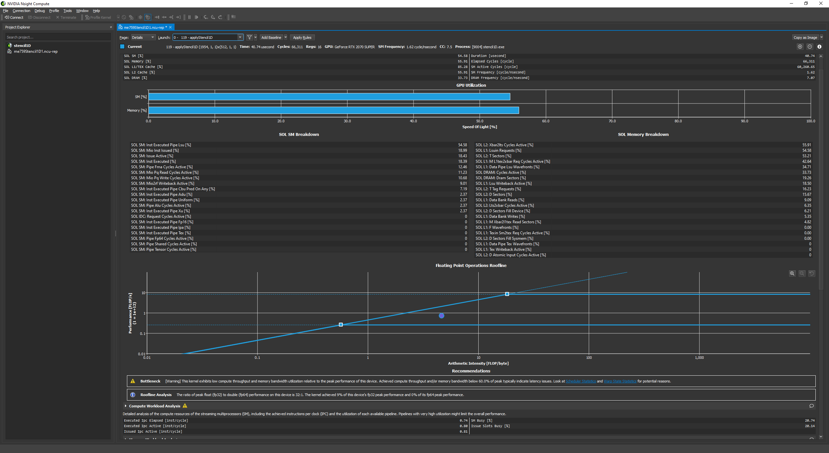
NSIGHT demo, for 1D stencil

Slide 40
CUDA Case Study: Parallel Reduction

Slide 41
Parallel Reduction in CUDA
Exercise draws on material made available by Mark Harris of NVIDIA
Parallel Reduction: Common and important data parallel primitive
Example: Used to compute the norm of a large vector
Easy to implement in CUDA
Challenging to get it to run fast though
Serves as a good optimization example
Walk step by step through several different versions
Demonstrates several important optimization strategies
Results are for old CC, yet it’s instructive to understand how far folks went to get top performance
NVIDIA [M. Harris]→

Slide 42
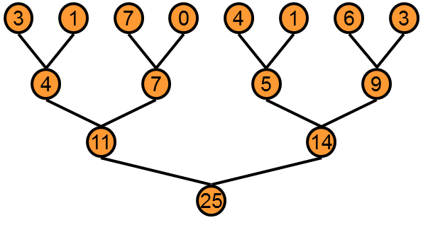
Parallel Reduction: Sum all entries in an array
Basic Idea: tree-based approach used within each thread block
Backdrop: assume you have very large arrays – 100,000 entries and beyond
Keep all multiprocessors on the GPU busy
Each thread block reduces a portion of the array to one single value
Q: How do we communicate partial results between thread blocks?
NVIDIA [M. Harris]→

Slide 43
Problem: Global, grid-level synchronization missing in CUDA
If we could synchronize across all thread blocks, could easily reduce very large arrays
Global sync after each block produces its result
Once all blocks reach sync, continue recursively
But CUDA has no global synchronization
Only synchronization of threads that belong to the same block
Solution: decompose into multiple kernels
Kernel launch serves as a global synchronization point
Kernel launch has negligible overhead
NVIDIA [M. Harris]→

Slide 44
Multiple Kernel Calls [An Example, and how it all works out…]
Imagine you launch a 1D grid in which each 1D block has 256 threads
Assume that the number or elements in the array is N=100,000
Note that 100,000= 390*256 + 160, therefore [(N+255)/256]=391 blocks needed
For the first stage, you launch 391 blocks of 256 threads
At the end of this stage you still have to operate on 391 elements
For the second stage, you launch two blocks of 256 threads
At the end of this stage you only have to operate on two elements
For the third and last stage, you launch one block of 32 threads
Almost all threads will be idle in this case…
NOTE: after the first stage, each subsequent stage operates on a number of entries equal to the number of blocks in the previous stage

Slide 45
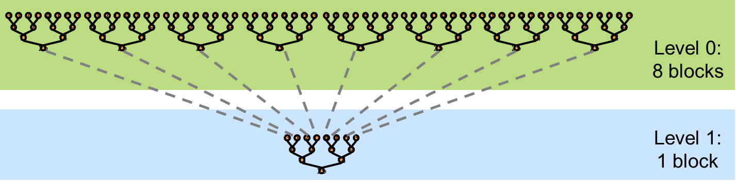
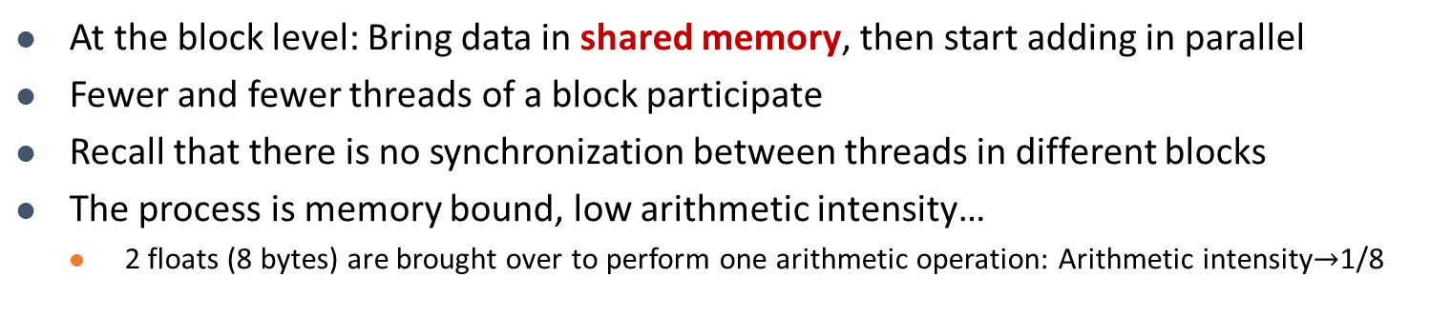
Vector Reduction: 30,000 Feet Perspective
At the block level: Bring data in shared memory, then start adding in parallel
Fewer and fewer threads of a block participate
Recall that there is no synchronization between threads in different blocks
The process is memory bound, low arithmetic intensity…
2 floats (8 bytes) are brought over to perform one arithmetic operation: Arithmetic intensity$→$1/8
Data staged in shared memory
A small number of threads finishes off
NVIDIA [M. Harris]→

Slide 46
What is Our Optimization Goal?
We should strive to reach GPU peak performance
Choose the right metric:
GFLOP/s: for compute-bound kernels
Bandwidth: for memory-bound kernels
Reductions have very low arithmetic intensity
1 flop per two elements loaded
Therefore we should strive for peak bandwidth
We’ll go through an old example - results generated using an old G80 GPU
Compute capability (CC) 1.0
384-bit memory interface, 900 MHz DDR
384 * 0.900 *2 / 8 = 86.4 GB/s
Example carries over to other CCs – on NVIDIA hardware this algorithm will always be memory bound
NVIDIA [M. Harris]→

Slide 47
Parallel Reduction: Interleaved Addressing
Values (SHARED memory)
10 | 1 | 8 | -1 | 0 | -2 | 3 | 5 | -2 | -3 | 2 | 7 | 0 | 11 | 0 | 2
Step 1 Stride 1
Thread IDs
0
2
4
6
8
10
12
14
Values
11 | 1 | 7 | -1 | -2 | -2 | 8 | 5 | -5 | -3 | 9 | 7 | 11 | 11 | 2 | 2
Step 2 Stride 2
Thread IDs
0
4
8
12
Values
18 | 1 | 7 | -1 | 6 | -2 | 8 | 5 | 4 | -3 | 9 | 7 | 13 | 11 | 2 | 2
Step 3 Stride 4
Thread IDs
0
8
Values
24 | 1 | 7 | -1 | 6 | -2 | 8 | 5 | 17 | -3 | 9 | 7 | 13 | 11 | 2 | 2
Step 4 Stride 8
Thread IDs
0
Values
41 | 1 | 7 | -1 | 6 | -2 | 8 | 5 | 17 | -3 | 9 | 7 | 13 | 11 | 2 | 2
Note: in stage s, only threads divisible to 2^s get to do work. Stride: 2^(s-1)
NVIDIA [M. Harris]→
Notes:
In stage s, only thread who’s divisible to 2^s gets to work

Slide 48
Reduction #1: Interleaved Addressing
__global__ void reduce1(int *g_idata, int *g_odata) {
extern __shared__ int sdata[];
// each thread loads one element from global to shared mem
unsigned int tid = threadIdx.x;
unsigned int i = blockIdx.x*blockDim.x + threadIdx.x;
sdata[tid] = g_idata[i];
__syncthreads();
// do reduction in shared mem
for(unsigned int s=1; s < blockDim.x; s *= 2) {
if (tid % (2*s) == 0) {
sdata[tid] += sdata[tid + s];
}
__syncthreads();
}
// write result for this block to global memory
if (tid == 0) g_odata[blockIdx.x] = sdata[0];
}
Why do we need
to sync threads?
First, threads w/ ID multiple of 2 do work
Next, threads w/ ID multiple of 4 do work
Next, threads w/ ID multiple of 8 do work
And so on…
Problem: highly divergent
warps are inefficient, and %
operator is very slow
NVIDIA [M. Harris]→
Notes:
DN: the number of elements after one stage = number of blocks that were launched to deal with that stage
First, threads multiple of 2 do work
Next, threads multiple of 4 do work
Next, threads multiple of 8 do work
And so on…

Slide 49
Performance for 4 Million element reduction
Time (2²² ints)
Bandwidth
Kernel 1: interleaved addressing with divergent branching | 8.054 ms | 2.083 GB/s
Note: Block Size = 128 threads for all tests
NVIDIA [M. Harris]→

Slide 50
Parallel Reduction: Interleaved Addressing
Values (shared memory)
10 | 1 | 8 | -1 | 0 | -2 | 3 | 5 | -2 | -3 | 2 | 7 | 0 | 11 | 0 | 2
Step 1 Stride 2⁰
Thread IDs
0
1
2
3
4
5
6
7
Values
11 | 1 | 7 | -1 | -2 | -2 | 8 | 5 | -5 | -3 | 9 | 7 | 11 | 11 | 2 | 2
Step 2 Stride 2¹
Thread IDs
0
1
2
3
Values
18 | 1 | 7 | -1 | 6 | -2 | 8 | 5 | 4 | -3 | 9 | 7 | 13 | 11 | 2 | 2
Step 3 Stride 2²
Thread IDs
0
1
Values
24 | 1 | 7 | -1 | 6 | -2 | 8 | 5 | 17 | -3 | 9 | 7 | 13 | 11 | 2 | 2
Step 4 Stride 2³
Thread IDs
0
Values
41 | 1 | 7 | -1 | 6 | -2 | 8 | 5 | 17 | -3 | 9 | 7 | 13 | 11 | 2 | 2
New Problem: Shared Memory Bank Conflicts
NVIDIA [M. Harris]→

Slide 51
Reduction #2: Interleaved Addressing
Just replace divergent branch in inner loop…
for (unsigned int s=1; s < blockDim.x; s *= 2) {
if (tid % (2*s) == 0) {
sdata[tid] += sdata[tid + s];
}
__syncthreads();
}
Previous case: one thread works, several next to it don’t.
This case: thread A works & A+1 works too, except that A+1 goes far from the memory location where thread A goes
…with strided index and non-divergent branch:
for (unsigned int s=1; s < blockDim.x; s *= 2) {
int index = 2 * s * tid;
if (index < blockDim.x) {
sdata[index] += sdata[index + s];
}
__syncthreads();
}
NVIDIA [M. Harris]→
Notes:
First case: one thread works, several next to it don’t.
Second case: thread A works and A+1 works too, except that it goes far from the memory location where thread A goes

Slide 52
Performance for 4M element reduction
Step Speedup
Cumulative Speedup
Time (2²² ints)
Bandwidth
Kernel 1: interleaved addressing with divergent branching | 8.054 ms | 2.083 GB/s
Kernel 2: interleaved addressing with bank conflicts | 3.456 ms | 4.854 GB/s | 2.33x | 2.33x
NVIDIA [M. Harris]→

Slide 53
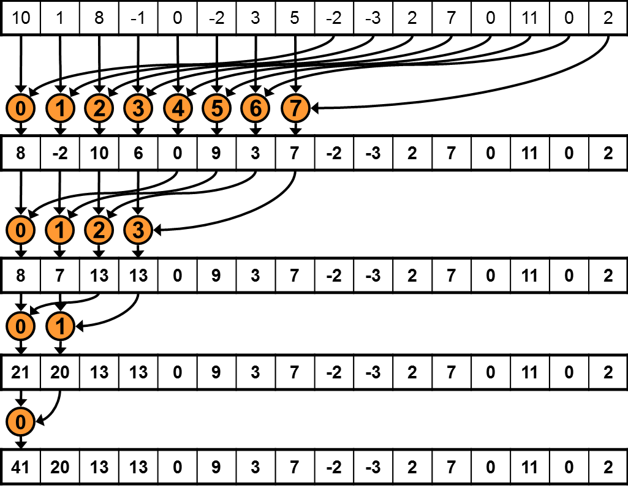
Parallel Reduction: Sequential Addressing
Values (shared memory)
Step 1 Stride 8
Thread IDs
Values
Step 2 Stride 4
Thread IDs
Values
Step 3 Stride 2
Thread IDs
Values
Step 4 Stride 1
Thread IDs
Values
Sequential addressing is Shared Mem. conflict free
NVIDIA [M. Harris]→

Slide 54
Reduction #3: Sequential Addressing
Just replace strided indexing in inner loop…
for (unsigned int s=1; s < blockDim.x; s *= 2) {
int index = 2 * s * tid;
if (index < blockDim.x) {
sdata[index] += sdata[index + s];
}
__syncthreads();
}
…with reversed loop and threadID-based indexing:
for (unsigned int s=blockDim.x/2; s>0; s>>=1) {
if (tid < s) {
sdata[tid] += sdata[tid + s];
}
__syncthreads();
}
First you go out 1/2 the block size to match a thread with its second operand
Then you go out 1/4 of the block size
Then you go out 1/8 of the block size
Etc.
NVIDIA [M. Harris]→
Notes:
DN:
- First you go half the size of the block to match a thread with its second operand
- Then you go ¼ of the block size
- Then you go 1/8 of the block size, etc.

Slide 55
Performance for 4M element reduction
Step Speedup
Cumulative Speedup
Time (2²² ints)
Bandwidth
Kernel 1: interleaved addressing with divergent branching | 8.054 ms | 2.083 GB/s
Kernel 2: interleaved addressing with bank conflicts | 3.456 ms | 4.854 GB/s | 2.33x | 2.33x
Kernel 3: sequential addressing | 1.722 ms | 9.741 GB/s | 2.01x | 4.68x
NVIDIA [M. Harris]→

Slide 56
Idle Threads…
Current solution:
for (unsigned int s=blockDim.x/2; s>0; s>>=1) {
if (tid < s) {
sdata[tid] += sdata[tid + s];
}
__syncthreads();
}
Half of the threads are idle on first loop iteration. This is wasteful…
NVIDIA [M. Harris]→

Slide 57
Reduction #4: First Add During Load
Replace single load:
// each thread loads one element from global to shared mem
unsigned int tid = threadIdx.x;
unsigned int i = blockIdx.x*blockDim.x + threadIdx.x;
sdata[tid] = g_idata[i];
__syncthreads();
…With two loads and first add of the reduction:
// perform first level of reduction upon reading from
// global memory and writing to shared memory
unsigned int tid = threadIdx.x;
unsigned int i = blockIdx.x*(blockDim.x*2) + threadIdx.x;
sdata[tid] = g_idata[i] + g_idata[i+blockDim.x];
__syncthreads();
Side-effect: number of blocks needed half of what it used to be…
NVIDIA [M. Harris]→
Notes:
DN: Instead of fetching one number, each thread now fetches two numbers. Therefore, the number of blocks is ½ of what used to be.
DN: A thread T brings from some position and also what used to be one block away. That’s why you have the “blockDim.x*2” in the computation of i

Slide 58
Performance for 4M element reduction
Step Speedup
Cumulative Speedup
Time (2²² ints)
Bandwidth
Kernel 1: interleaved addressing with divergent branching | 8.054 ms | 2.083 GB/s
Kernel 2: interleaved addressing with bank conflicts | 3.456 ms | 4.854 GB/s | 2.33x | 2.33x
Kernel 3: sequential addressing | 1.722 ms | 9.741 GB/s | 2.01x | 4.68x
Kernel 4: first add during global load | 0.965 ms | 17.377 GB/s | 1.78x | 8.34x
NVIDIA [M. Harris]→

Slide 59
Instruction Bottleneck
At 17 GB/s, we’re far from bandwidth bound
Therefore, a likely bottleneck is instruction overhead
Ancillary instructions that are not loads, stores, or core arithmetic
In other words: address arithmetic and loop overhead
Strategy: unroll loops
NVIDIA [M. Harris]→

Slide 60
Unrolling the Last Warp
As reduction proceeds, the number of “active” threads decreases
When s <= 32, we have only one warp left
Instructions executed in lockstep fashion within a warp (NOTE: Volta & more recent: use shfl_down_sync())
That means when s <= 32:
We don’t need to __syncthreads()
We don’t need “if (tid < s)” because it doesn’t save any work
The key idea: unroll the last 6 iterations of the inner loop, which involve 32 or less threads
NVIDIA [M. Harris]→

Slide 61

“unroll the last 6 iterations of the inner loop, which involve 32 or less threads”
- Array entry that gets updated, and accumulates result
Legend:
- Array entry that is read in order to update a “blue” entry
[https://www.amazon.com/ZXUY-Measurement-Also-Centimetre-Reverse/dp/B008U4E7RU]$→$

Slide 62
Reduction #5: Unroll the Last Warp
// and use later like this…
for (unsigned int s=blockDim.x/2; s>32; s>>=1) {
if (tid < s)
sdata[tid] += sdata[tid + s];
__syncthreads();
}
if (tid < 32) warpReduce(sdata, tid);
This used to be:
S>0
__device__ void warpReduce(volatile int* sdata, int tid) {
sdata[tid] += sdata[tid + 32];
sdata[tid] += sdata[tid + 16];
sdata[tid] += sdata[tid + 8];
sdata[tid] += sdata[tid + 4];
sdata[tid] += sdata[tid + 2];
sdata[tid] += sdata[tid + 1];
}
IMPORTANT: For this to be correct, we must use the “volatile” keyword!
Note: This saves useless work in all warps, not just the last one!
Without unrolling, all warps execute every iteration of the for loop and if statement
NVIDIA [M. Harris]→

Slide 63
Performance for 4M element reduction
Step Speedup
Cumulative Speedup
Time (2²² ints)
Bandwidth
Kernel 1: interleaved addressing with divergent branching | 8.054 ms | 2.083 GB/s
Kernel 2: interleaved addressing with bank conflicts | 3.456 ms | 4.854 GB/s | 2.33x | 2.33x
Kernel 3: sequential addressing | 1.722 ms | 9.741 GB/s | 2.01x | 4.68x
Kernel 4: first add during global load | 0.965 ms | 17.377 GB/s | 1.78x | 8.34x
Kernel 5: unroll last warp | 0.536 ms | 31.289 GB/s | 1.8x | 15.01x
NVIDIA [M. Harris]→

Slide 64
Complete Unrolling
If we knew the number of iterations (or equivalently, of threads in a block) at compile time, we could completely unroll the reduction
Luckily, the block size on G80 is limited by the GPU to 512 threads
1024 on Fermi GPUs and newer
Also, we are sticking to power-of-2 block sizes
Basic idea: unroll everything for a fixed block size
But we need to be generic – how can we unroll for block sizes that we don’t know at compile time?
Use of templates can solve this issue…
CUDA supports C++ template parameters on device and host functions
NVIDIA [M. Harris]→

Slide 65
Unrolling with Templates
Specify block size as a function template parameter
The kernel is parameterized:
template <unsigned int blockSize>
__global__ void reduce6(int *g_idata, int *g_odata)
NVIDIA [M. Harris]→

Slide 66
Reduction #6: Completely Unrolled
This is the key part of the kernel
if (blockSize >= 512) {
if(tid < 256){ sdata[tid] += sdata[tid + 256]; } __syncthreads();}
if (blockSize >= 256) {
if(tid < 128){ sdata[tid] += sdata[tid + 128]; } __syncthreads();}
if (blockSize >= 128) {
if(tid < 64){ sdata[tid] += sdata[tid + 64]; } __syncthreads();}
if (tid < 32) warpReduce<blockSize>(sdata, tid); // last warp only
This is a helper function (device only)
template <unsigned int blockSize>
__device__ void warpReduce(volatile int* sdata, int tid) {
if (blockSize >= 64) sdata[tid] += sdata[tid + 32];
if (blockSize >= 32) sdata[tid] += sdata[tid + 16];
if (blockSize >= 16) sdata[tid] += sdata[tid + 8];
if (blockSize >= 8) sdata[tid] += sdata[tid + 4];
if (blockSize >= 4) sdata[tid] += sdata[tid + 2];
if (blockSize >= 2) sdata[tid] += sdata[tid + 1];
}
All code in RED will be evaluated at compile time. Results in a very efficient inner loop.
For Fermi and newer CC, you’d have one more if statement that covers the case when blockSize>=1024
You can call the warpReduce function only when you got to one warp. Reason: you don’t have to synchronize at that point.
NVIDIA [M. Harris]→
Notes:
You can call the warpReduce function only when you got to one wrap. Reason: you don’t have to synchronize at that point.

Slide 67
Invoking Template Kernels
Don’t we still need block size at compile time?
There is a way out, use a switch statement for 10 possible block sizes:
This is code on the host, calling the appropriate kernel
switch (threads) {
case 512:
reduce6<512><<< dimGrid, dimBlock, smemSize >>>(d_idata, d_odata); break;
case 256:
reduce6<256><<< dimGrid, dimBlock, smemSize >>>(d_idata, d_odata); break;
case 128:
reduce6<128><<< dimGrid, dimBlock, smemSize >>>(d_idata, d_odata); break;
case 64:
reduce6< 64><<< dimGrid, dimBlock, smemSize >>>(d_idata, d_odata); break;
case 32:
reduce6< 32><<< dimGrid, dimBlock, smemSize >>>(d_idata, d_odata); break;
case 16:
reduce6< 16><<< dimGrid, dimBlock, smemSize >>>(d_idata, d_odata); break;
case 8:
reduce6< 8><<< dimGrid, dimBlock, smemSize >>>(d_idata, d_odata); break;
case 4:
reduce6< 4><<< dimGrid, dimBlock, smemSize >>>(d_idata, d_odata); break;
case 2:
reduce6< 2><<< dimGrid, dimBlock, smemSize >>>(d_idata, d_odata); break;
case 1:
reduce6< 1><<< dimGrid, dimBlock, smemSize >>>(d_idata, d_odata); break;
}
NVIDIA [M. Harris]→
Notes:
DN: You don’t know at compile time the value of “threads” in the “switch” statement but you are covered since for each “case” the compiler generates optimal code since you provided the template argument.

Slide 68
Performance for 4 Million element reduction
Step Speedup
Cumulative Speedup
Time (2²² ints)
Bandwidth
Kernel 1: interleaved addressing with divergent branching | 8.054 ms | 2.083 GB/s
Kernel 2: interleaved addressing with bank conflicts | 3.456 ms | 4.854 GB/s | 2.33x | 2.33x
Kernel 3: sequential addressing | 1.722 ms | 9.741 GB/s | 2.01x | 4.68x
Kernel 4: first add during global load | 0.965 ms | 17.377 GB/s | 1.78x | 8.34x
Kernel 5: unroll last warp | 0.536 ms | 31.289 GB/s | 1.8x | 15.01x
Kernel 6: completely unrolled | 0.381 ms | 43.996 GB/s | 1.41x | 21.16x
NVIDIA [M. Harris]→

Slide 69
Parallel Reduction Complexity
Assume that the number of elements in array is of the form N=2^{D}
Log N parallel stages, each stage S requires N/2^{S} independent ops
Stage Complexity is O(log N)
For N=2^{D}, approach requires a total of ∑_{S∈[1..D]}2^{D-S} = N-1 operations
Work Complexity is O(N) – It is work-efficient
That is, it does not perform more operations than a sequential algorithm
Time complexity, for P threads physically in parallel (P processors): O(N/P + log N)
Compare to O(N) for sequential reduction
In a thread block, N=P, so O(log N)
NVIDIA [M. Harris]→

Slide 70
What About Cost?
Cost of a parallel algorithm is processors × time complexity
Allocate threads instead of processors: O(N) threads
Time complexity is O(log N), so cost is O(N log N) : not cost efficient!
Brent’s theorem suggests O(N/log N) threads
Each thread does O(log N) sequential work
Then all O(N/log N) threads cooperate for O(log N) stages
Cost = O((N/log N) * log N) = O(N) → cost efficient
Sometimes called algorithm cascading
Can lead to significant speedups in practice
NVIDIA [M. Harris]→

Slide 71
Algorithm Cascading
Combine sequential and parallel reduction
Each thread loads and sums multiple elements into shared memory
Tree-based reduction in shared memory
Brent’s theorem says each thread should sum O(log N) elements
i.e. 1024 or 2048 elements per block vs. 256
Probably beneficial to push it even further
Possibly better latency hiding with more work per thread
More threads per block reduces levels in tree of recursive kernel invocations
High kernel launch overhead in last levels with few blocks
On G80, best performance with 64-256 blocks of 128 threads
1024-4096 elements per thread
NVIDIA [M. Harris]→

Slide 72
Kernel 7, Comments
For the first six approaches discussed a large number of blocks was used to “tile” the array
Approach 7: a thread does more work than fetch one or two values from global to shared memory
This will reduce the number of blocks needed to see the job through
Example [cooked up, not related to actual CUDA warp size, typical CUDA block dim, etc.]:
Say you have 1024 elements stored in an array; you need to reduce that array
You start with 32 blocks, each with 4 threads
Then, 128 threads total. It means that a thread, say in block 11, would have to add two numbers, then two numbers, then two numbers, then two more numbers.
At this point, everything is in the union of the shared memory associated with the 32 blocks. At this point proceed like before with kernel 6.

Slide 73
Reduction #7: Multiple Adds / Thread
Replace load and add of two elements:
unsigned int tid = threadIdx.x;
unsigned int i = blockIdx.x*(blockDim.x*2) + threadIdx.x;
sdata[tid] = g_idata[i] + g_idata[i+blockDim.x];
__syncthreads();
With a while loop to add as many as necessary:
unsigned int tid = threadIdx.x;
unsigned int i = blockIdx.x*(blockSize*2) + threadIdx.x;
unsigned int gridSize = blockSize*2*gridDim.x;
sdata[tid] = 0;
while (i < n) {
sdata[tid] += g_idata[i] + g_idata[i+blockSize];
i += gridSize;
}
__syncthreads();
Note: gridSize loop stride to maintain coalescing!
NVIDIA [M. Harris]→

Slide 74
Performance for 4 Million element reduction
Step Speedup
Cumulative Speedup
Time (2²² ints)
Bandwidth
Kernel 1: interleaved addressing with divergent branching | 8.054 ms | 2.083 GB/s
Kernel 2: interleaved addressing with bank conflicts | 3.456 ms | 4.854 GB/s | 2.33x | 2.33x
Kernel 3: sequential addressing | 1.722 ms | 9.741 GB/s | 2.01x | 4.68x
Kernel 4: first add during global load | 0.965 ms | 17.377 GB/s | 1.78x | 8.34x
Kernel 5: unroll last warp | 0.536 ms | 31.289 GB/s | 1.8x | 15.01x
Kernel 6: completely unrolled | 0.381 ms | 43.996 GB/s | 1.41x | 21.16x
Kernel 7: multiple elements per thread | 0.268 ms | 62.671 GB/s | 1.42x | 30.04x
Kernel 7 on 32M elements: 73 GB/s!
NVIDIA [M. Harris]→

Slide 75
Final Kernel…
template <unsigned int blockSize>
__device__ void warpReduce(volatile int *sdata, unsigned int tid) {
if (blockSize >= 64) sdata[tid] += sdata[tid + 32];
if (blockSize >= 32) sdata[tid] += sdata[tid + 16];
if (blockSize >= 16) sdata[tid] += sdata[tid + 8];
if (blockSize >= 8) sdata[tid] += sdata[tid + 4];
if (blockSize >= 4) sdata[tid] += sdata[tid + 2];
if (blockSize >= 2) sdata[tid] += sdata[tid + 1];
}
template <unsigned int blockSize>
__global__ void reduce7(int *g_idata, int *g_odata, unsigned int n) {
extern __shared__ int sdata[];
unsigned int tid = threadIdx.x;
unsigned int i = blockIdx.x*(blockSize*2) + tid;
unsigned int gridSize = blockSize*2*gridDim.x;
sdata[tid] = 0;
while (i < n) { sdata[tid] += g_idata[i] + g_idata[i+blockSize]; i += gridSize; }
__syncthreads();
if (blockSize >= 512) { if (tid < 256) { sdata[tid] += sdata[tid + 256]; } __syncthreads(); }
if (blockSize >= 256) { if (tid < 128) { sdata[tid] += sdata[tid + 128]; } __syncthreads(); }
if (blockSize >= 128) { if (tid < 64) { sdata[tid] += sdata[tid + 64]; } __syncthreads(); }
if (tid < 32) warpReduce(sdata, tid);
if (tid == 0) g_odata[blockIdx.x] = sdata[0];
}
NVIDIA [M. Harris]→
Notes:
DN: you have a relatively small number of blocks. Therefore, one thread does a lot of ops to shrink the total number of entries that need to be added.
Cooked up example, not related to size of warps, typical CUDA block dim, etc.:
Say you have 1024 numbers. You start with 32 blocks, each with 4 threads. Then, 128 threads total. It means that a thread in block 11 would have to add two numbers, then two numbers, then two numbers, then two more numbers. At this point, everything is in shared memory.

Slide 76
Performance Comparison
NVIDIA [M. Harris]→

Slide 77
Sources of Efficiency Improvement
Algorithmic optimizations
Changes to addressing, algorithm cascading
11.84x speedup, combined
Code optimizations
Loop unrolling
2.54x speedup, combined
NVIDIA [M. Harris]→

Slide 78
Lessons Learned, Array Reduction
Understand CUDA performance characteristics
Memory coalescing
Warp divergence
Bank conflicts
Latency hiding
Use peak performance metrics to guide optimization
Know how to identify type of bottleneck
E.g. memory, core computation, or instruction overhead
Optimize your algorithm, then unroll loops
Use template parameters to generate optimal code
Understand parallel algorithm complexity theory (was required in “Approach 7”)
NVIDIA [M. Harris]→

Slide 79
CUDA Case Study: Parallel Prefix Scan on the GPU
Serial implementation – assigned as HW early in the semester
Parallel implementation: topic of next assignment; probably the hardest this semester

Slide 80
Software Design Exercise: Parallel Prefix Scan
Goal 1: Getting additional exposure to CUDA programming and thinking that goes behind it
Goal 2: Understand that
Different algorithmic designs lead to different performance levels
Hardware constraints come into play in different ways in different algorithms
Goal 3: Identify design patterns that can result in superior parallel performance
Understand that there are patterns and it’s worth being aware of them
To a large extend, patterns are shaped up by the underlying hardware
Notes:
DN: Patterns are the tricks of the trade

Slide 81
Parallel Prefix Sum (Scan)
Definition:
The all-prefix-sums operation takes a binary associative operator ⊕ with identity I, and an array of n elements
[a₀, a₁, …, a_{n-1}]
and returns the ordered set
[I, a₀, (a₀ ⊕ a₁), …, (a₀ ⊕ a₁ ⊕ … ⊕ a_{n-2})].
Example: If ⊕ is addition, then scan on the set
[3 1 7 0 4 1 6 3]
returns the set
[0 3 4 11 11 15 16 22]
Exclusive scan: last input element is not included in the result
(From Blelloch, 1990, “Prefix Sums and Their Applications”)

Slide 82
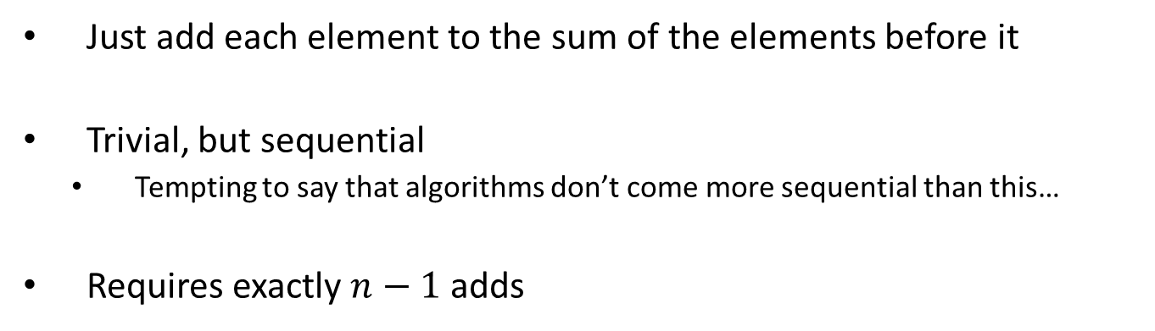
Scan on the CPU
void scan( float* scanned, float* input, int length)
{
scanned[0] = 0;
for(int i = 1; i < length; ++i)
{
scanned[i] = scanned[i-1] + input[i-1];
}
}
Just add each element to the sum of the elements before it
Trivial, but sequential
Tempting to say that algorithms don’t come more sequential than this…
Requires exactly $n−1$ adds
Notes:
(Dan): n-1 instead of n adds

Slide 83
Applications of prefix scan
Scan is a simple and useful parallel building block
Convert recurrences from sequential … out[0] = f(0)
for(j=1;j<n;j++) out[j] = out[j-1] + f(j);
… into parallel:
forall(j) in parallel
temp[j] = f(j); scan(out, temp);
Reflect on this: neat way of opening a door for parallel computing…
HK-UIUC

Slide 84
Applications of prefix scan
Radix sort
Quicksort
String comparison
Lexical analysis
Stream compaction
Polynomial evaluation
Solving recurrences
Tree operations
Histograms
Etc.
[HK-UIUC]$→$

