Slide 1
ME759 High Performance Computing for Applications in Engineering [Spring 2021]
Lecture 15
02/26/2021
Dan Negrut, 2021 ME759 UW-Madison

Slide 2


Cartoon of the day
[Zachary Kanin]$→$

Slide 3
Is BBC recording on?
If my internet connection goes down, I’ll email from my phone to provide more information – go/no-go, next step, etc.

Slide 4
Before we get started…
Last time
Case studies: parallel reduction on the GPU & 1D convolution
Looking beyond today: some more GPU computing feature, but looking for a while into optimization features
Today
One more case study: parallel prefix scan
Using streams in GPU computing: increasing problem size; improving execution speeds
Other tidbits:
Assignment due on Th, 03/04, at 9 pm
Next two assignments are probably most difficult
Drop them if you are overwhelmed. Stay focused, make the right call
Do not run your code on the Euler headnode (use Slurm)
You can download the recording onto your machine, don’t need to listen to lecture through Canvas
Big PDF file contains all the slides thus far; easy to search into it to find topics covered thus far. Doc is here.

Slide 5
GPU Computing: Case studies
Three Case Studies:
a) 1D Stencil Operation
b) Vector Reduction in CUDA
c) Parallel Prefix Scan on the GPU

Slide 6
CUDA Case Study: Parallel Prefix Scan on the GPU
Serial implementation – assigned as HW early in the semester
Parallel implementation: topic of next assignment; probably the hardest this semester

Slide 7
Software Design Exercise: Parallel Prefix Scan
Goal 1: Getting additional exposure to CUDA programming
Goal 2: Understanding that hardware constraints come into play and shape the algorithmic design
E.g., lack of grid-level synchronization
Goal 3: Understanding that different algorithmic designs lead to different performance levels
Notes:
DN: Patterns are the tricks of the trade

Slide 8
Parallel Prefix Sum (Scan)
Definition:
The all-prefix-sums operation takes a binary associative operator ⊕ with identity I, and an array of n elements
[a₀, a₁, …, a_{n-1}]
and returns the ordered set
[I, a₀, (a₀ ⊕ a₁), …, (a₀ ⊕ a₁ ⊕ … ⊕ a_{n-2})].
Example: If ⊕ is addition, then scan on the set
[3 1 7 0 4 1 6 3]
returns the set
[0 3 4 11 11 15 16 22]
Exclusive scan: last input element is not included in the result
(From Blelloch, 1990, “Prefix Sums and Their Applications”)

Slide 9
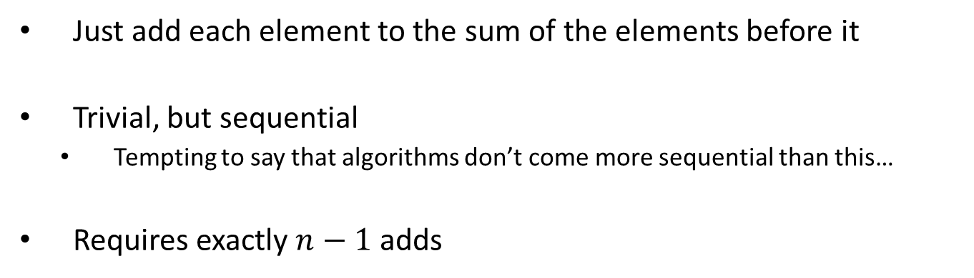
Scan on the CPU
void scan( float* scanned, float* input, int length)
{
scanned[0] = 0;
for(int i = 1; i < length; ++i)
{
scanned[i] = input[i-1] + scanned[i-1];
}
}
Just add each element to the sum of the elements before it
Trivial, but sequential
Tempting to say that algorithms don’t come more sequential than this…
Requires exactly $n−1$ adds
Notes:
(Dan): n-1 instead of n adds

Slide 10
Applications of prefix scan
Scan is a simple and useful parallel building block
Convert recurrences from sequential … out[0] = f(0)
for(j=1;j<n;j++) out[j] = out[j-1] + f(j);
… into parallel:
forall(j) in parallel
temp[j] = f(j); scan(out, temp);
Reflect on this: ingenious way of opening a door for parallel computing…
HK-UIUC

Slide 11
Applications of prefix scan
Radix sort
Quicksort
String comparison
Lexical analysis
Stream compaction
Polynomial evaluation
Solving recurrences
Tree operations
Histograms
Etc.
[HK-UIUC]$→$

Slide 12
Before presenting two algorithms…
Keep int mind:
Both algorithms update entries in the array by starting from the last entry in the array
The update “wave” proceeds from the last entry towards the front end of the array

Slide 13
Parallel Scan Algorithm Solution #1: Hillis & Steele (1986)
Implementation of the algorithm shown requires two buffers of length n (shown is the case n=8=2³)
Assumption: the number n of elements is a power of 2: n=2^{M}
Note: There are race conditions, unless you take precautionary measures
NVIDIA [M. Harris]→

Slide 14
The Plain English Perspective
First iteration, I go with stride 1=2⁰
Start at x[2^{M}] and apply this stride to all the array elements before x[2^{M}] to find the mate of each of them. When looking for the mate, the stride should not land you before the beginning of the array. The sum replaces the element of higher index.
This means that I have 2^{M}- 2⁰ additions
Second iteration, I go with stride 2=2¹
Start at x[2^{M}] and apply this stride to all the array elements before x[2^{M}] to find the mate of each of them. When looking for the mate, the stride should not land you before the beginning of the array. The sum replaces the element of higher index.
This means that I have 2^{M} – 2¹ additions
Third iteration: I go with stride 4=2²
Start at x[2^{M}] and apply this stride to all the array elements before x[2^{M}] to find the mate of each of them. When looking for the mate, the stride should not land you before the beginning of the array. The sum replaces the element of higher index.
This means that I have 2^{M} – 2² additions
… (and so on)

Slide 15
The Plain English Perspective
Consider the k^{th} iteration (where 1<k<M-1): I go with stride 2^{k-1}
Start at x[2^{M}] and apply this stride to all the array elements before x[2^{M}] to find the mate of each of them. When looking for the mate, the stride should not land you before the beginning of the array. The sum replaces the element of higher index.
This means that I have 2^{M}-2^{k-1} additions
…
Mth iteration: I go with stride 2^{M-1}
Start at x[2^{M}] and apply this stride to all the array elements before x[2^{M}] to find the mate of each of them. When looking for the mate, the stride should not land you before the beginning of the array. The sum replaces the element of higher index.
This means that I have 2^{M}-2^{M-1} additions
NOTE: There is no (M+1)^{th} iteration since this would automatically put me beyond the bounds of the array (if you apply an offset of 2^{M} to “&x[2^{M}] ” it places you right before the beginning of the array – not good…)

Slide 16
Hillis & Steele Parallel Scan Algorithm
Algorithm looks like this:
for d := 0 to M-1 do
forall k do in parallel
if k – 2^{d} ≥0 then
x[out][k] := x[in][k] + x[in][k − 2^{d}]
else
x[out][k] := x[in][k]
endforall
swap(in,out)
endfor
Double-buffered version of the sum scan
NVIDIA [M. Harris]→

Slide 17
Hillis & Steele, Operation Count
The number of operations tally:
(2^{M}-2⁰) + (2^{M}-2¹) + … + (2^{M}-2^{k-1}) +…+ (2^{M}-2^{M-1})
Final operation count:
This is an algorithm with O(n*log(n)) work
Concluding remarks: is this approach good or not?
Sequential scan algorithm only needs n-1 additions
A factor of log₂(n) might hurt: 20x more work for 10⁶ elements!
Homework requires a scan of about 16 million elements
One more drawback: you need two buffers…
Notes:
DN: there was a bullet like this (not clear what it meant):
* A parallel algorithm can be slow when execution resources are saturated due to low algorithm efficiency

Slide 18
Hillis & Steele: Kernel Function
__global__ void scan(float *g_odata, float *g_idata, int n) {
extern volatile __shared__ float temp[]; // allocated on invocation
int thid = threadIdx.x;
int pout = 0, pin = 1;
// load input into shared memory.
// **exclusive** scan: shift right by one element and set first output to 0
temp[thid] = (thid == 0) ? 0: g_idata[thid-1];
__syncthreads();
for( int offset = 1; offset<n; offset *= 2 ) {
pout = 1 - pout; // swap double buffer indices
pin = 1 - pout;
if (thid >= offset)
temp[pout*n+thid] = temp[pin*n+thid] + temp[pin*n+thid - offset];
else
temp[pout*n+thid] = temp[pin*n+thid];
__syncthreads(); // I need this here before I start next iteration
}
g_odata[thid] = temp[pout*n+thid]; // write output
}

Slide 19
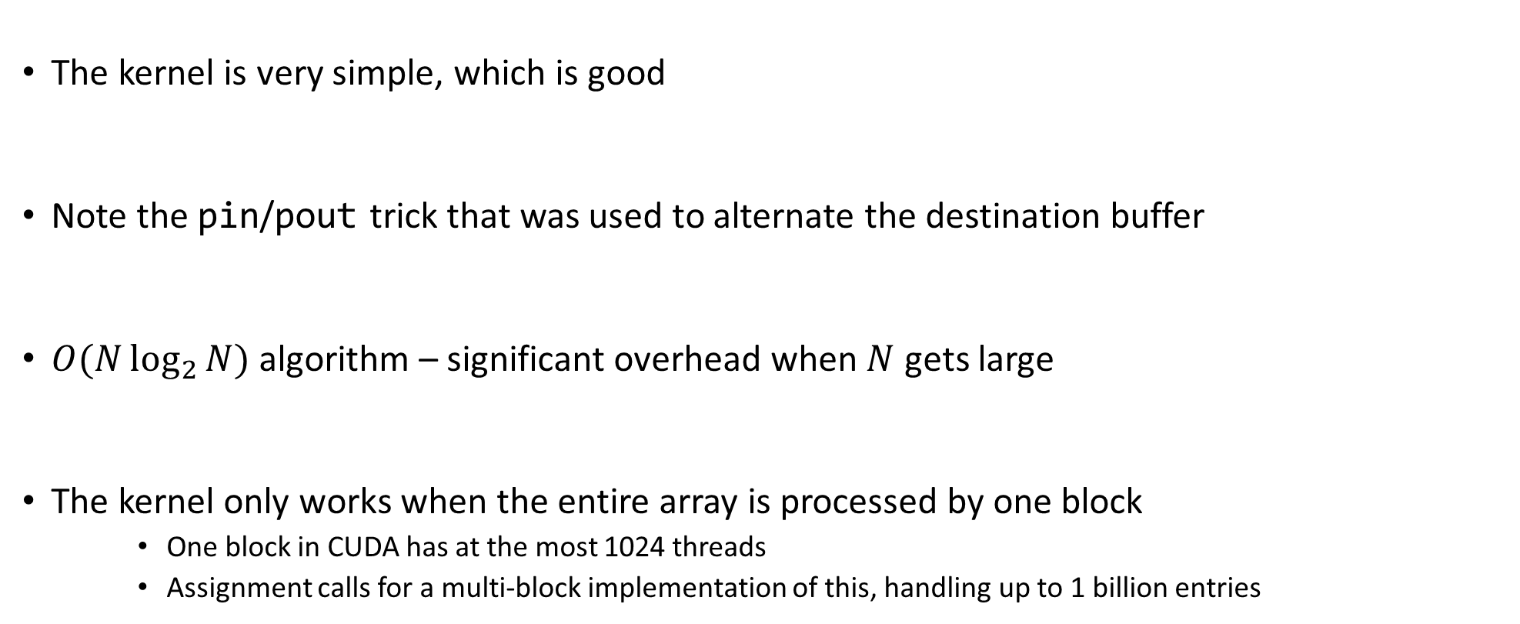
Hillis & Steele: Kernel Function, Quick Remarks
The kernel is very simple, which is good
Note the pin/pout trick that was used to alternate the destination buffer
$O(N\log_{2}{N})$ algorithm – significant overhead when $N$ gets large
The kernel only works when the entire array is processed by one block
One block in CUDA has at the most 1024 threads
Assignment calls for a multi-block implementation of this, handling up to 1 billion entries

Slide 20
Parallel Scan Algorithm: Solution #2: Harris-Sengupta-Owen (2007)
A common parallel algorithm pattern:
Balanced Trees
Build a balanced binary tree on the input data and sweep from roots to the main trunk, and then back into the roots
Tree is not an actual data structure, but a concept to determine what each thread does at each step
For scan: there are two stages
Stage 1: Traverse from roots to main trunk building partial sums at internal nodes in the tree
Halfway through the algorithm, the main trunk holds sum of all leaves → nice, this is a reduction algorithm!
Stage 2: Traverse the tree back, from main trunk down to roots, building the scan from the partial sums
Called down-sweep phase
20

Slide 21
Picture and Pseudocode: The Reduction Step (“roots to main trunk”)
j·2^{k+1}-1 =
1 3 5 7
3 7 -1 -1
7 -1 -1 -1
j·2^{k+1}-2^{k}-1 =
0 2 4 6
1 5 -1 -1
3 -1 -1 -1
for k=0 to M-1
offset = 2^{k}
for j=1 to 2^{M-k-1} do in parallel
x[j·2^{k+1}-1] = x[j·2^{k+1}-1] + x[j·2^{k+1}-2^{k}-1]
endfor
endfor
NOTE: “-1” entries
indicate no-ops
NVIDIA [M. Harris]→

Slide 22
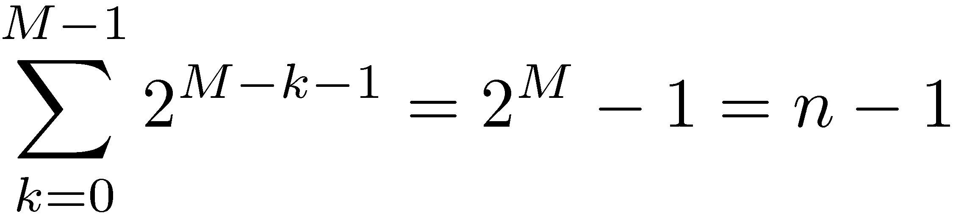
Operation Count, Reduce Phase
for k=0 to M-1
offset = 2^{k}
for j=1 to 2^{M-k-1} do in parallel
x[j·2^{k+1}-1] = x[j·2^{k+1}-1] + x[j·2^{k+1}-2^{k}-1]
endfor
endfor
By inspection:
Looks promising in terms of
operation count…

Slide 23
The “main trunk to roots” sweep (the down sweep)
NOTE: This is just a mirror
image of the reduction
stage. Easy to come up with
the indexing scheme…
for k=M-1 to 0
offset = 2^{k}
for j=1 to 2^{M-k-1} do in parallel
dummy = x[j·2^{k+1}-2^{k}-1]
x[j·2^{k+1}-2^{k}-1] = x[j·2^{k+1}-1]
x[j·2^{k+1}-1] = x[j·2^{k+1}-1] + dummy
endfor
endfor
Set aside
Overwrite op.
Use
NVIDIA [M. Harris]→

Slide 24
“main trunk-to-roots” phase, remarks
Number of operations for the down-sweep phase:
Additions: n-1
Overwrite ops. : n-1 (each overwrite shadows an addition)
Total number of operations associated with this algorithm
Additions: 2n-2
Overwrite ops: n-1
Looks comparable with the work load in the sequential solution
Convoluted algorithm, indexing tricky to figure out
Kernel shown on next slide

Slide 25
01| __global__ void prescan(float *g_odata, float *g_idata, int n)
02| {
03| extern volatile __shared__ float temp[];// allocated on invocation
04|
05|
06| int thid = threadIdx.x;
07| int offset = 1;
08|
09| temp[2*thid] = g_idata[2*thid]; // load input into shared memory
10| temp[2*thid+1] = g_idata[2*thid+1];
11|
12| for (int d = n>>1; d > 0; d >>= 1) // build sum in place up the tree
13| {
14| __syncthreads();
15|
16| if (thid < d) {
18| int ai = offset*(2*thid+1)-1;
19| int bi = offset*(2*thid+2)-1;
20|
21| temp[bi] += temp[ai];
22| }
23| offset <<= 1; //multiply by 2 implemented as bitwise operation
24| }
25|
26| if (thid == 0) { temp[n - 1] = 0; } // clear the last element
27|
28| for (int d = 1; d < n; d *= 2) // traverse down tree & build scan
29| {
30| offset >>= 1;
31| __syncthreads();
32|
33| if (thid < d)
34| {
35| int ai = offset*(2*thid+1)-1;
36| int bi = offset*(2*thid+2)-1;
37|
38| float t = temp[ai];
39| temp[ai] = temp[bi];
40| temp[bi] += t;
41| }
42| }
43|
44| __syncthreads();
45|
46| g_odata[2*thid] = temp[2*thid]; // write results to device memory
47| g_odata[2*thid+1] = temp[2*thid+1];
48| }
Argument list:
g_odata – pointer to output data, stored in device global memory
g_idata – pointer to input data, stored in device global memory
n – size of array on which prefix scan performed (assumed a power of 2)
NVIDIA [M. Harris]→

Slide 26
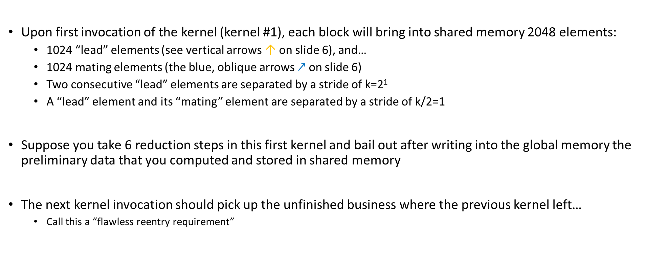
Going beyond 2048 entries handled by one CUDA block [1/3]
Upon first invocation of the kernel (kernel #1), each block will bring into shared memory 2048 elements:
1024 “lead” elements (see vertical arrows ↑ on slide 6), and…
1024 mating elements (the blue, oblique arrows $↗$ on slide 6)
Two consecutive “lead” elements are separated by a stride of k=2¹
A “lead” element and its “mating” element are separated by a stride of k/2=1
Suppose you take 6 reduction steps in this first kernel and bail out after writing into the global memory the preliminary data that you computed and stored in shared memory
The next kernel invocation should pick up the unfinished business where the previous kernel left…
Call this a “flawless reentry requirement”

Slide 27
Going beyond 2048 entries handled by one CUDA block [2/3]
Upon the second kernel call, each block will bring into shared memory 2048 elements:
1024 “lead” elements, and…
1024 “mating” elements
Two consecutive “lead” elements that you bring in will be separated in global memory by a stride of k=2⁶
A “lead” element and its “mating” element are separated by a stride of k/2=2⁵
Thus, when brining in data from global memory, you are not going to bring over a contiguous chunk of memory of size 2048, rather you’ll have to jump 2⁵ locations between successive “lead and mating element” pairs
However, once you bring data in shared memory, you process as before
Before you exit kernel #2 you have to write back data from shared memory into global memory
Again, you have to choreograph this shared to global memory store since there is a 2⁵ stride that comes into play
If you exit kernel #2 after say 4 more reduction steps, the next time you re-enter the kernel (#3) you will have k=2¹⁰

Slide 28
Going beyond 2048 entries handled by one CUDA block [3/3]
You will continue the reduction stage until the stride is 2^{M-1}
At this point you are ready to start the main trunk-to-roots sweep phase
“main trunk-to-roots” sweep phase carried out in a similar fashion: we will have to invoke the kernel several times
Always work in shared memory and copy back data to global memory before bailing out
The challenges here are:
Understanding the indexing into the global memory to bring data into ShMem
How to loop across the data in shared memory
Numerous shared memory bank conflicts since strides are powers of 2
Advanced topic: get rid of the bank conflict through padding

Slide 29
Concluding Remarks, Parallel Scan
Intuitively, the scan operation is not the type of procedure ideally suited for parallel computing
Even if it doesn’t fit like a glove, leads to good speedup:
# elements | CPU Scan (ms) | GPU Scan (ms) | Speedup
1024 | 0.002231 | 0.079492 | 0.03
32768 | 0.072663 | 0.106159 | 0.68
65536 | 0.146326 | 0.137006 | 1.07
131072 | 0.726429 | 0.200257 | 3.63
262144 | 1.454742 | 0.326900 | 4.45
524288 | 2.911067 | 0.624104 | 4.66
1048576 | 5.900097 | 1.118091 | 5.28
2097152 | 11.848376 | 2.099666 | 5.64
4194304 | 23.835931 | 4.062923 | 5.87
8388688 | 47.390906 | 7.987311 | 5.93
16777216 | 94.794598 | 15.854781 | 5.98
Source: 2007 paper of Harris, Sengupta, Owens

Slide 30
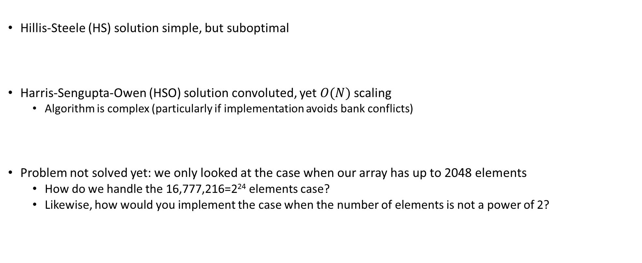
Concluding Remarks, Parallel Scan
Hillis-Steele (HS) solution simple, but suboptimal
Harris-Sengupta-Owen (HSO) solution convoluted, yet $O(N)$ scaling
Algorithm is complex (particularly if implementation avoids bank conflicts)
Problem not solved yet: we only looked at the case when our array has up to 2048 elements
How do we handle the 16,777,216=2²⁴ elements case?
Likewise, how would you implement the case when the number of elements is not a power of 2?

Slide 31
Final Project topic
Dwelling on the sad thing called “lack of synchronization between threads belonging to different blocks”
There might be a way to alleviate it
Have all the blocks in flight, and use atomic operations for synchronization
Might be a neat Final Project topic: see what level of performance can be reached with your new “grid synchronization mechanism”
For instance, see what you can accomplish if you don’t launch multiple kernels, but use your new inter-block synchronization algorithm when computing a prefix scan, or a reduction algorithm
Now that I’m thinking about it, this “grid synchronization” would allow some a recasting of algorithms for GPU computing (if the “grid synchronization” turns out to be fast)

Slide 32
CUDA Streams

Slide 33
Read this blog post: https://devblogs.nvidia.com/parallelforall/gpu-pro-tip-cuda-7-streams-simplify-concurrency

Slide 34
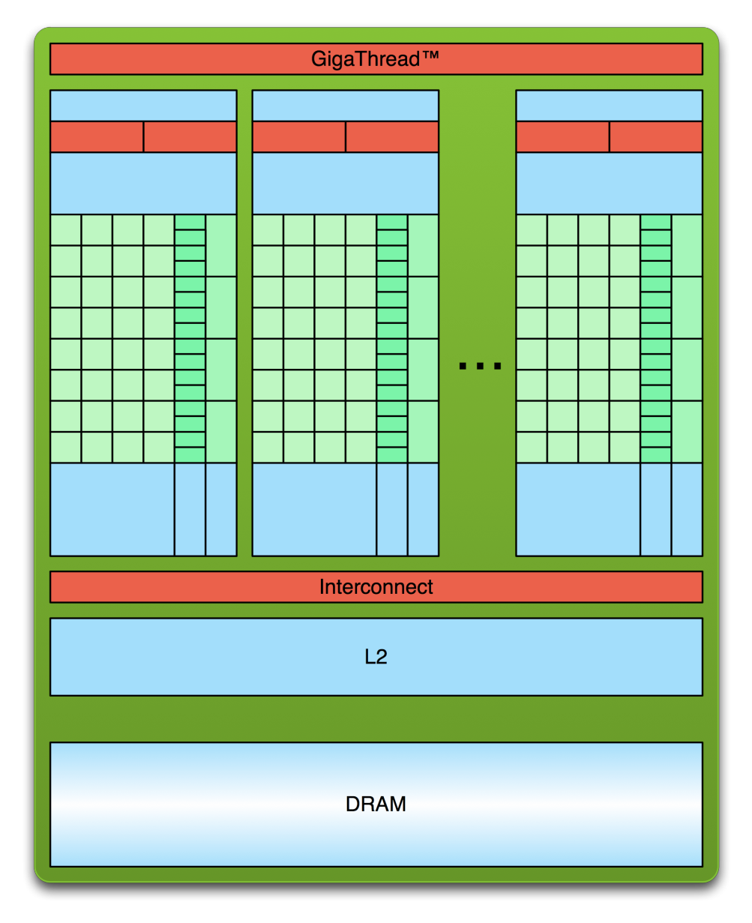
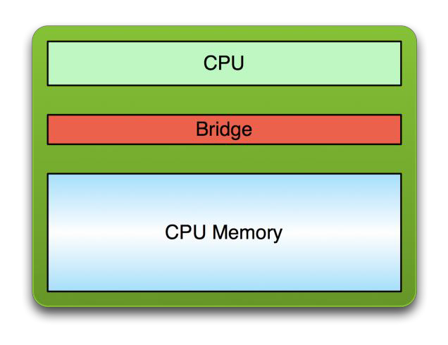
The “GPU computing” process
PCI Bus
Copy input data from CPU memory to GPU memory
Launch a GPU Kernel
Copy results from GPU memory to CPU memory
Repeat Many Times
[Justin Luitjens - NVIDIA]$→$

Slide 35
CUDA Streams: Prelude
A CUDA enabled GPU has two engines
An execution engine
A copy engine, which has 2 sub-engines that can work simultaneously
A H2D copy sub-engine
A D2H copy sub-engine
Goal of the “streams” segment of ME759: Learn how to simultaneously use both GPU engines
NOTE (in relation to this “streams” segment of the course):
The important things happen on the host side, not on the device side

Slide 36
[“Streams” Preamble: 1/3] Asynchronous Concurrent Execution
In order to facilitate concurrent execution on host and device, some function calls are asynchronous
Control is returned to the host thread before the device has completed the requested task
Examples of asynchronous calls
Kernel launches
device ↔ device memory copies
host ↔ device memory copies of a memory block of 64 KB or less
Memory copies performed by functions that are suffixed with Async (e.g., cudaMemcpyAsync)
NOTE: When an application is run via a (cuda-gdb, nvprof), all launches are synchronous

Slide 37
[“Streams” Preamble: 2/3] Non-blocking Host-Device Data Transfer Issues
In general, host ↔ device data transfers using cudaMemcpy() are blocking
Control is returned to the host thread only after the data transfer is complete
There is a non-blocking variant, cudaMemcpyAsync()
The host does not wait on the device to finish the mem copy or on the completion of the kernel call for it to start execution of the cpuFunction() call
The launch of “myKernel” only happens after the mem copy call finishes
NOTE: the asynchronous transfer version requires pinned host memory (allocated with cudaHostAlloc()), and it contains an additional argument (a stream ID)
The cudaHosAlloc() replaces malloc() typical call on the host side
What does this buy us?
We have the CPU busy while copying data to/from device
cudaMemcpyAsync(a_d, a_h, size, cudaMemcpyHostToDevice, 0);
myKernel<<<grid,block>>>(a_d);
cpuFunction();

Slide 38
[“Streams” Preamble: 3/3] Overlapping Host ↔ Device Data Transfer with Device Execution
When is this overlapping useful?
Imagine a kernel executes on the device and only works with a portion (say lower half) of the device global memory
While kernel works on lower half, you can copy data from host to device into the upper half of the device global memory
Punch line: The kernel execution and the copy operations can take place simultaneously
Note that there is an issue with this idea:
The device execution stack is FIFO:
One function call on the device is not serviced until all the previous device function calls completed
This would prevent overlapping execution with data transfer
This issue was addressed by the use of CUDA “streams”

Slide 39
CUDA Streams: Two flavors of concurrency enabled by streams
A programmer can manage concurrency through streams
“concurrency” refers to one of two things
The copy and the execution engines of the GPU working at the same time
Several different kernels (like kerA, kerB, etc.) being executed at the same time on the GPU

Slide 40
CUDA Streams: Overview
A stream is a sequence of CUDA commands issued by the host that execute on the GPU in issue-order
CUDA stream: a queue of GPU operations; i.e., of device work
The execution order in a stream defines the order in which the GPU operations are added to the stream (FIFO)
NOTE: an operation in a stream does not commence prior to the previous operation in that stream being fully completed
There is a distinction between queuing an operation in a stream and the moment when it actually starts to be executed on the GPU

Slide 41
CUDA Streams: Overview [Cntd.]
One host thread can define multiple CUDA streams
What are the typical operations in a stream?
Invoking a data transfer
Invoking a kernel execution
Handling events
The CUDA runtime executes commands from different streams as it sees fit
No inter-stream relative synchronization unless the user explicitly takes care of synchronization process
Also, streams can be synchronized at barrier points, but correlation of sequence execution between different streams not supported

Slide 42
CUDA Streams: Quick notes
As soon as you invoke a CUDA function you create a default stream (stream 0)
If you don’t explicitly state a stream in the execution configuration of a kernel it is assumed it’s launched as part of “Stream 0” (zero)
Programming model used to effect concurrency
CUDA operations in different streams may run concurrently
CUDA operations from different streams may be interleaved

Slide 43
CUDA Streams: Creation
A stream is defined by creating a stream object
It is subsequently used by specifying it as the stream parameter to a sequence of kernel launches and host-to/from-device memory copies
The following code sample creates two streams and allocates an array “hostPtr” of float in page-locked memory
hostPtr will be used in asynchronous host ↔ device memory transfers
cudaStream_t stream[2];
for (int i = 0; i < 2; ++i)
cudaStreamCreate(&stream[i]);
float* hostPtr;
cudaMallocHost(&hostPtr, 2 * size);
Note the length of the array. Recall previous upper/lower side of the memory discussion.

Slide 44
CUDA Streams: Making Use of Them
In the code below, each of the two streams is defined as a sequence of
One memory copy from host to device,
One kernel launch, and
One memory copy from device to host
There are some wrinkles to it, we’ll revisit shortly…
for (int i = 0; i < 2; ++i) {
cudaMemcpyAsync(inputDevPtr + i * size, hostPtr + i * size, size, cudaMemcpyHostToDevice, stream[i]);
MyKernel<<<100, 512, 0, stream[i]>>>(outputDevPtr + i * size, inputDevPtr + i * size, size);
cudaMemcpyAsync(hostPtr + i * size, outputDevPtr + i * size,size, cudaMemcpyDeviceToHost, stream[i]);
}

Slide 45
CUDA Streams: Clean Up Phase
Streams are folded by calling cudaStreamDestroy()
cudaStreamDestroy() waits for all preceding commands in the given stream to complete before destroying the stream and returning control to the host thread
for (int i = 0; i < 2; ++i)
cudaStreamDestroy(stream[i]);

Slide 46
CUDA Streams: Caveats
The following operations prevent concurrency on the GPU:
A device memory allocation
A device memory set
A device ↔ device memory copy
A CUDA command to stream 0 (including kernel launches and host ↔ device memory copies that do not specify any stream parameter)
A page-locked host memory allocation
A switch between the L1/shared memory configurations

Slide 47
CUDA Stream: More Caveats
All GPU calls (memcpy, kernel execution, etc.) are placed into default stream unless otherwise specified
Stream 0 is special (has special synchronization rules)
Synchronous with all streams
Meaning: Things done in stream 0 cannot overlap other streams
Exception: see next bullet
Streams with non-blocking flag are exception
cudaStreamCreateWithFlags(&stream, cudaStreamNonBlocking)

Slide 48
CUDA Streams: Synchronization Aspects
cudaDeviceSynchronize() halts execution on the host until all preceding commands in all CUDA streams have completed
Halts execution of the host
cudaStreamSynchronize() takes a stream as a parameter and halts execution on the host until all preceding commands in the given CUDA stream have completed. It can be used to synchronize the host with a specific stream, allowing other streams to continue executing on the device
Halts execution of the host
cudaStreamWaitEvent() takes a CUDA stream and an event as parameters and makes all the commands added to the given stream after the call to cudaStreamWaitEvent() delay their execution until the given event has completed.
Halts execution within a stream
cudaStreamQuery() provides applications with a way to know if all preceding commands in a stream have completed
NOTE: To avoid unnecessary slowdowns, use these synchronization functions sparingly
Notes:
It only blocks the specified stream processing, at the point at which the WaitEvent was inserted into the stream queue. The host processing will continue. You can use cudaStreamSynchronize() to force the host to wait on completion of the processing in a particular stream.

Slide 49
Example: Use of cudaStreamWaitEvent
Assume stream1 and stream2 have been defined/initialized already
The point of this example:
Use the two copy sub-engines at the same time
Wait on the Stream 2 launching of the myKernel until the copy operation in Stream 1 is completed
cudaEvent_t event;
cudaEventCreate (&event); // create event
cudaMemcpyAsync ( d_in, in, size, H2D, stream1 ); // 1) H2D copy of new input
cudaEventRecord (event, stream1); // record event
cudaMemcpyAsync ( out, d_out, size, D2H, stream2 ); // 2) D2H copy of previous result
cudaStreamWaitEvent ( stream2, event ); // wait for event in stream1
myKernel<<< 1000, 512, 0, stream2 >>> ( d_in, d_out ); // 3) GPU must wait for 1 and 2
someCPUfunction ( blah, blahblah ) // this gets executed right away
[S. Rennich, NVIDIA]→

Slide 50
Example 1: Using One Stream [Enable both CPU and GPU to mind their business at the same time]
Example draws on material presented in the “CUDA By Example” book
J. Sanders and E. Kandrot, authors
What is the purpose of this example?
Shows strategy that you can invoke when dealing with applications that require more memory than you can accommodate on the GPU
Remark:
In this example the magic happens on the host side. Focus on host code, not on the kernel executed on the GPU (the kernel code is basically irrelevant)

Slide 51
This Example’s Kernel
Computes some average, it’s not important, simply something that gets done and allows us later on to gauge efficiency gains when using *multiple* streams (for now dealing with one stream only)
Inputs: a and b
Output: c
#include "../common/book.h"
#define N 1048576 // this is 1024*1024
#define FULL_DATA_SIZE (N*20)
__global__ void kernel( int *a, int *b, int *c ) {
int idx = threadIdx.x + blockIdx.x * blockDim.x;
if (idx < N) {
int idx1 = (idx + 1) % 256;
int idx2 = (idx + 2) % 256;
float as = (a[idx] + a[idx1] + a[idx2]) / 3.0f;
float bs = (b[idx] + b[idx1] + b[idx2]) / 3.0f;
c[idx] = (as + bs) / 2;
}
}

Slide 52
The “main()” Function
01| int main( void ) {
02| cudaEvent_t start, stop;
03| float elapsedTime;
04|
05| cudaStream_t stream;
06| int *host_a, *host_b, *host_c;
07| int *dev_a, *dev_b, *dev_c;
08|
09| // start the timers
10| cudaEventCreate( &start );
11| cudaEventCreate( &stop );
12|
13| // initialize the stream; only one stream for now…
14| cudaStreamCreate( &stream );
15|
16| // allocate the memory on the GPU
17| cudaMalloc( (void**)&dev_a, N * sizeof(int) );
18| cudaMalloc( (void**)&dev_b, N * sizeof(int) );
19| cudaMalloc( (void**)&dev_c, N * sizeof(int) );
20|
21| // allocate host pinned memory, used to stream
22| cudaHostAlloc( (void**)&host_a, FULL_DATA_SIZE * sizeof(int), cudaHostAllocDefault );
23| cudaHostAlloc( (void**)&host_b, FULL_DATA_SIZE * sizeof(int), cudaHostAllocDefault );
24| cudaHostAlloc( (void**)&host_c, FULL_DATA_SIZE * sizeof(int), cudaHostAllocDefault );
25|
26| for (int i=0; i<FULL_DATA_SIZE; i++) {
27| host_a[i] = rand();
28| host_b[i] = rand();
29| }
Stage 1
Stage 2

Slide 53
The “main()” Function [Cntd.]
30|
31| cudaEventRecord( start, 0 );
32| // now loop over full data, chunk by chunk
33| for (int i=0; i<FULL_DATA_SIZE; i+= N) {
34| // copy the locked memory to the device, async
35| cudaMemcpyAsync( dev_a, host_a+i, N * sizeof(int), cudaMemcpyHostToDevice, stream );
36| cudaMemcpyAsync( dev_b, host_b+i, N * sizeof(int), cudaMemcpyHostToDevice, stream );
37|
38| kernel<<<(N+255)/256,256,0,stream>>>( dev_a, dev_b, dev_c );
39|
40| // copy the data from device to locked memory
41| cudaMemcpyAsync( host_c+i, dev_c, N * sizeof(int), cudaMemcpyDeviceToHost, stream );
42|
43| }
44|
45| cudaStreamSynchronize( stream );
46|
47| cudaEventRecord( stop, 0 );
48|
49| cudaEventSynchronize( stop );
50| cudaEventElapsedTime( &elapsedTime, start, stop ) );
51| printf( "Time taken: %3.1f ms\n", elapsedTime );
52|
53| // cleanup the streams and memory
54| cudaFreeHost( host_a );
55| cudaFreeHost( host_b );
56| cudaFreeHost( host_c );
57| cudaFree( dev_a );
58| cudaFree( dev_b );
59| cudaFree( dev_c );
60| cudaStreamDestroy( stream );
61|
62| return 0;
63|}
Stage 3
Stage 4
Stage 5

Slide 54
Example 1, Summary
Stage 1 sets up the events needed to time the execution of the program
Stage 2 allocates page-locked memory on the host side so that we can fall back on asynchronous memory copy operations between host and device
Stage 3 enques the set of GPU operations that need to be undertaken (the “chunkification”)
Stage 4 needed for timing reporting
Stage 5: clean up time

Slide 55
Example 1, Summary
Note that Example 1 only dealt w/ handling a very large problem via “chunkification”
“chunkification” somewhat similar to “tiling”
However,
“tiling” is something that happens exclusively on the device (from global to shared memory).
“chunkification” happens on the host
Focus next: using streams to gain speed

Slide 56
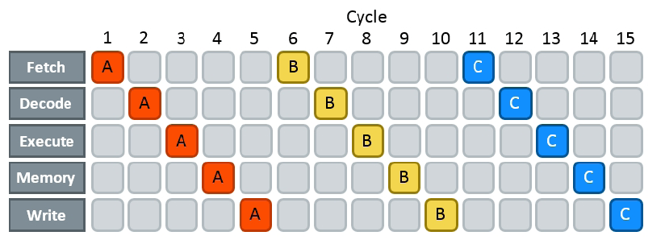
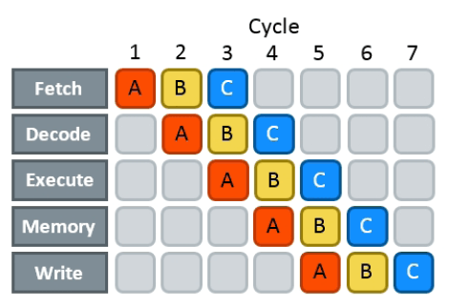

Warmup slide: Using streams is similar to pipelining (from ILP)
No pipelining:
With pipelining:
[https://techdecoded.intel.io/resources/understanding-the-instruction-pipeline/#gs.665w4j]$→$

Slide 57

Gaining speed through concurrency. Looks like “manual pipelining”
Legend: DH-device2host copy ; K-kernel execution ; HD-host2device copy
No concurrency (1x)
4-way concurrency (3x+)
cudaMemcpyAsync(HD)
Kernel <<< >>>
cudaMemcpyAsync(DH)
HD1
K1
DH1
Time
HD2
K2
DH2
HD3
K3
DH3
thread on CPU
thread on CPU
2-way concurrency (up to 2x speedup)
K4 on CPU
Time
cudaMemcpyAsync(H2D)
K1 DH1
K2
DH2
K3
DH3
5+ way concurrency
K4
DH4
K1.1 K1.2 K1.3
HD1
DH1
Time
HD2
K2.1 K2.2 K2.3
DH2
HD3 K3.1 K3.2 K3.3 DH3
3-way concurrency (up to 3x speedup)
HD4
K4.1 K4.2 K4.3
DH4
HD5
K5.1 K5.2 K5.3
DH5
K1
HD6 K6.1 K6.2 K6.3 DH6
HD1
DH1
thread on CPU
HD2
K2
DH2
thread on CPU
HD3
K3
DH3
thread on CPU
HD4 K4 DH4
Time
Time
[Justin Luitjens - NVIDIA]$→$

Slide 58
Example 2: Using Multiple Streams [Version 2.1]
Similar to Example1, but use two streams
Goal this time around: increase speed of execution
Why would you want to use multiple streams?
Overlapping GPU execution with host ↔ device data movement can improve overall performance
See previous slide, use “manual pipelining”
Two ideas underlie the process
The idea of “chunkification” of the computation
Computation is broken into pieces that are queued up for execution on the device (we already saw this in Example 1, which uses one stream)
The idea of overlapping execution with PCI host ↔ device data movement

Slide 59
Overlapping Execution and Data Transfer: A Desirable Scenario
 | Stream0 |  | Stream1
 | memcpy a0 to GPU
 | memcpy b0 to GPU
 | kernel |  | memcpy a1 to GPU
 |  |  | memcpy b1 to GPU
 | memcpy c0 from GPU |  | kernel
 |  |  | memcpy c1 from GPU
 | memcpy a0 to GPU
 | memcpy b0 to GPU
 | kernel |  | memcpy a1 to GPU
 |  |  | memcpy b1 to GPU
 | memcpy c0 from GPU |  | kernel
 |  |  | memcpy c1 from GPU
 | Timeline of intended application execution
 | using two independent streams
Time
Observations:
“memcpy” actually represents an asynchronous cudaMemcpyAsync() memory copy call
White (empty) box: time when one stream is waiting to execute an operation that it cannot overlap with other stream’s operation
The goal: keep both GPU engine types (execution and mem copy) busy
Note: recent hardware allows two copies to take place simultaneously: one from host to device, at the same time one goes on from device to host (you have two copy subengines). This example shows only one copy-engine (old CC).

Slide 60
The “main()” Function, Two Streams
01| int main( void ) {
02| cudaDeviceProp prop;
03| int whichDevice;
04| HANDLE_ERROR( cudaGetDevice( &whichDevice ) );
05| HANDLE_ERROR( cudaGetDeviceProperties( &prop, whichDevice ) );
06| if (!prop.deviceOverlap) {
07| printf( "Device will not handle overlaps, so no speed up from streams\n" );
08| return 0;
09| }
10|
11| cudaEvent_t start, stop;
12| float elapsedTime;
13|
14| cudaStream_t stream0, stream1;
15| int *host_a, *host_b, *host_c;
16| int *dev_a0, *dev_b0, *dev_c0;
17| int *dev_a1, *dev_b1, *dev_c1;
18|
19| // start the timers
20| cudaEventCreate( &start );
21| cudaEventCreate( &stop );
22|
23| // initialize the streams
24| cudaStreamCreate( &stream0 );
25| cudaStreamCreate( &stream1 );
26|
27| // allocate the memory on the GPU
28| cudaMalloc( (void**)&dev_a0, N * sizeof(int) );
29| cudaMalloc( (void**)&dev_b0, N * sizeof(int) );
30| cudaMalloc( (void**)&dev_c0, N * sizeof(int) );
31| cudaMalloc( (void**)&dev_a1, N * sizeof(int) );
32| cudaMalloc( (void**)&dev_b1, N * sizeof(int) );
33| cudaMalloc( (void**)&dev_c1, N * sizeof(int) );
34|
35| // allocate host locked memory, used to stream
36| cudaHostAlloc( (void**)&host_a, FULL_DATA_SIZE * sizeof(int), cudaHostAllocDefault );
37| cudaHostAlloc( (void**)&host_b, FULL_DATA_SIZE * sizeof(int), cudaHostAllocDefault );
38| cudaHostAlloc( (void**)&host_c, FULL_DATA_SIZE * sizeof(int), cudaHostAllocDefault );
Stage 1
Stage 2
Stage 3

Slide 61
The “main()” Function, Two Streams [Cntd.]
39| for (int i=0; i<FULL_DATA_SIZE; i++) {
40| host_a[i] = rand();
41| host_b[i] = rand();
42| }
43|
44| cudaEventRecord( start, 0 );
45| // now loop over full data, in bite-sized chunks
46| for (int i=0; i<FULL_DATA_SIZE; i+= 2*N) {
47| // copy data from pinned memory to the device, async
48| cudaMemcpyAsync( dev_a0, host_a+i, N * sizeof(int), cudaMemcpyHostToDevice, stream0 );
49| cudaMemcpyAsync( dev_b0, host_b+i, N * sizeof(int), cudaMemcpyHostToDevice, stream0 );
50|
51| kernel<<<(N+255)/256,256,0,stream0>>>( dev_a0, dev_b0, dev_c0 );
52|
53| // copy the data from device to locked memory
54| cudaMemcpyAsync( host_c+i, dev_c0, N * sizeof(int), cudaMemcpyDeviceToHost, stream0 );
55|
56|
57| // copy the locked memory to the device, async
58| cudaMemcpyAsync( dev_a1, host_a+i+N, N * sizeof(int), cudaMemcpyHostToDevice, stream1 );
59| cudaMemcpyAsync( dev_b1, host_b+i+N, N * sizeof(int), cudaMemcpyHostToDevice, stream1 );
60|
61| kernel<<<(N+255)/256,256,0,stream1>>>( dev_a1, dev_b1, dev_c1 );
62|
63| // copy the data from device to locked memory
64| cudaMemcpyAsync( host_c+i+N, dev_c1, N * sizeof(int), cudaMemcpyDeviceToHost, stream1 );
65| }
66|
Still Stage 3
Stage 4

Slide 62
The “main()” Function, Two Streams [Cntd.]
67| cudaStreamSynchronize( stream0 );
68| cudaStreamSynchronize( stream1 );
69|
70| cudaEventRecord( stop, 0 );
71|
72| cudaEventSynchronize( stop );
73| cudaEventElapsedTime( &elapsedTime, start, stop ) );
74| printf( "Time taken: %3.1f ms\n", elapsedTime );
75|
76| // cleanup the streams and memory
77| cudaFreeHost( host_a );
78| cudaFreeHost( host_b );
79| cudaFreeHost( host_c );
80| cudaFree( dev_a0 );
81| cudaFree( dev_b0 );
82| cudaFree( dev_c0 );
83| cudaFree( dev_a1 );
84| cudaFree( dev_b1 );
85| cudaFree( dev_c1 );
86| cudaStreamDestroy( stream0 );
87| cudaStreamDestroy( stream1 );
88|
89| return 0;
90|}
Stage 5
NOTE: the kernel doesn’t actually change…

Slide 63
Example 2.1 [Version 1], Summary
Stage 1 ensures that your device supports your attempt to overlap kernel execution with host↔device data transfer
Stage 2 sets up the events needed to time the execution of the program
Stage 3 allocates page-locked memory on the host side so that we can fall back on asynchronous memory copy operations between host and device and initializes data
Stage 4 enques the set of GPU operations that need to be undertaken (the “chunkification”)
Stage 5 takes care of timing reporting and clean up

Slide 64
Comments, Using Two Streams [Version 2.1]
Timing results provided by “CUDA by Example: An Introduction to General-Purpose GPU Programming,”
Sanders and Kandrot reported results on NVIDIA GTX285
Using one stream (in Example 1): 62 ms
Using two streams (this example, version 1): 61 ms
Lackluster performance goes back to the way the two GPU engines (kernel execution and copy) are scheduled

Slide 65
The Two Stream Example, Version 2.1 Looking Under the Hood
Stream 0 |  | Copy Engine
memcpy a0 |  | memcpy a0
memcpy b0 |  | memcpy b0
kernel 0 |  | memcpy c0
memcpy c0 |  | memcpy a1
 |  | memcpy b1
Stream 1 |  | memcpy c1
memcpy a1
memcpy b1 |  | Kernel Engine
kernel 1 |  | kernel 0
memcpy c1 |  | kernel 1
Mapping of CUDA streams onto GPU engines
Copy Engine |  | Kernel Engine
Stream 0: memcpy a0 |  | Stream 0: kernel
Stream 0: memcpy b0 |  | Stream 1: kernel
Stream 0: memcpy c0
Stream 1: memcpy a1
Stream 1: memcpy b1
Stream 1: memcpy c1
Arrows depicting the dependency of cudaMemcpyAsync ()
calls on kernel executions in the 2 Streams example
At the left:
An illustration of how the work queued up in the streams ends up being assigned by the CUDA driver to the two GPU engines (copy and execution)
Important remark: FIFO is also observed in relation to scheduling the engines (not only the streams)
At the right
Image shows dependency that is implicitly set up in the two streams given the way the streams were defined in the code
The queue in the Copy Engine combined with the implied stream dependencies determines the scheduling of the Copy and Kernel Engines (next slide)

Slide 66
The Two Stream Example Looking Under the Hood
 | Copy Engine |  | Kernel Engine
 | Stream 0: memcpy a0
 | Stream 0: memcpy b0
 |  |  | Stream 0: kernel
 | Stream 0: memcpy c0
 | Stream 1: memcpy a1
 | Stream 1: memcpy b1
 |  |  | Stream 1: kernel
 | Stream 1: memcpy c1
 | Execution timeline of the 2 Stream example (blue line shows dependency; empty boxes represent idle segments)
Time
Note that due to the *specific* way in which the streams were defined (depth first), basically there is no overlap of copy & execution…
Explains the no net-gain in efficiency compared to the one stream example
Remedy: go breadth first, instead of depth first
In the current version, execution on the two engines was inadvertently blocked by the way the streams have been set up and the existing scheduling and lack of dependency checks available in the current version of CUDA

Slide 67
The Two Stream Example [Version 2.2: A More Effective Implementation: Breadth First]
The way we just went about business (the depth first approach):
Assign the copy of a0, copy of b0, kernel execution, and copy of c0 to stream0
Assign the copy of a1, copy of b1, kernel execution, and copy of c1 to stream1
New way (the breadth first approach):
Add the copy of a0 to stream0, and then add the copy of a1 to stream1
Next, add the copy of b0 to stream0, and then add the copy of b1 to stream1
Next, enqueue the kernel invocation in stream0, then enqueue one in stream1
Finally, enqueue the copy of c0 back to the host in stream0 followed by the copy of c1 in stream1

Slide 68

The Two Stream Example
A| // loop over full data, in bite-sized chunks
B| for (int i=0; i<FULL_DATA_SIZE; i+= N*2) {
C| // enqueue copies of a in stream0 and stream1
D| cudaMemcpyAsync( dev_a0, host_a+i, N * sizeof(int), cudaMemcpyHostToDevice, stream0 );
E| cudaMemcpyAsync( dev_a1, host_a+i+N, N * sizeof(int), cudaMemcpyHostToDevice, stream1 );
F| // enqueue copies of b in stream0 and stream1
G| cudaMemcpyAsync( dev_b0, host_b+i, N * sizeof(int), cudaMemcpyHostToDevice, stream0 );
H| cudaMemcpyAsync( dev_b1, host_b+i+N, N * sizeof(int), cudaMemcpyHostToDevice, stream1 );
I|
J| // enqueue kernels in stream0 and stream1
K| kernel<<<(N+255)/256,256,0,stream0>>>( dev_a0, dev_b0, dev_c0 );
L| kernel<<<(N+255)/256,256,0,stream1>>>( dev_a1, dev_b1, dev_c1 );
M|
N| // enqueue copies of c from device to locked memory
O| cudaMemcpyAsync( host_c+i , dev_c0, N * sizeof(int), cudaMemcpyDeviceToHost, stream0 );
P| cudaMemcpyAsync( host_c+i+N, dev_c1, N * sizeof(int), cudaMemcpyDeviceToHost, stream1 );
Q| }
Replaces Previous Stage 4
Copy Engine |  | Kernel Engine
Stream0: memcpy a0
Stream1: memcpy a1
Stream0: memcpy b0
Stream1: memcpy b1 |  | Stream0: kernel
Stream0: memcpy c0 |  | Stream1: kernel
Stream1: memcpy c1
Execution timeline of the breadth-first approach (blue line shows dependency)
A 20% More Effective Implementation (48 vs. 61 ms)

Slide 69
Using Streams, Lessons Learned
Streams provide a basic mechanism that enables “manual pipelining”
Two requirements underpin the use of streams in CUDA C
1. cudaHostAlloc() should be used to allocate memory on the host so that it can be used in conjunction with a cudaMemcpyAsync() non-blocking copy command
Use of pinned host memory improves data transfer performance even when only working with one stream
2. Effective latency hiding of kernel execution with memory copy operations requires a breadth-first approach to enqueuing operations in different streams
This is a consequence of the two-engine setup associated with a GPU

Slide 70
CUDA Streams: Two flavors of concurrency enabled by streams [old slide]
A programmer can manage concurrency through streams
“concurrency” refers to one of two things
The copy and the execution engines of the GPU working at the same time
Several different kernels (like kerA, kerB, etc.) being executed at the same time on the GPU

Slide 71
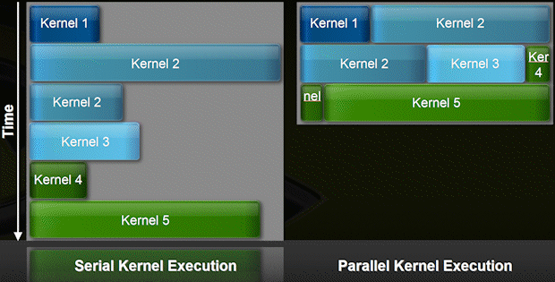
Concurrent Kernel Execution [second type of concurrency enabled by use of CUDA streams]
As early as Fermi one can have multiple kernels run on the device at the same time
Example: up to 16 on Fermi
When is this useful?
A kernel might be launched with an execution configuration that doesn’t fully utilize entire GPU
Main idea: two or three independent kernels can be “squeezed” on GPU at the same time
GPU looks like a MIMD architecture
Requires use of multiple streams
[NVIDIA]→

Slide 72
CUDA Streams: More recent developments
Since CUDA 5.0
Stream Callbacks, will call host function when stream has finished all work
cudaStreamAddCallback( cudaStream_t stream, cudaStreamCallback_t callback, void* userData, unsigned int flags )
Since CUDA 5.5
You can give streams priority
cudaStreamCreateWithPriority
Use cudaDeviceGetStreamPriorityRange to get the available priorities
Since CUDA 7:
nvcc –default-stream per-thread
Each host thread will get its own stream
Each stream becomes a regular non-blocking stream

Slide 73
CUDA basics, wrapping up

Slide 74
GPU Computing: Good in Engineering?
What applications stand to benefit in the Engineering?
Image processing
FEA
Molecular Dynamics
Granular Dynamics
Finite Differences schemes
Quantum Chemistry
…
Generally, any application that fits the SIMD paradigm

Slide 75
Topics not covered, or not covered yet
Debugging & profiling in CUDA (next)
Dynamic parallelism (not covered)
Unified memory (since CUDA 6.0) cudaMallocManaged, cudaDeviceSynchronize (later)
Using multiple GPUs (probably not covered)
Notes:
CUDA runtime API → cuda.h
Atomic operations → called in kernel functions
Streams unleash the full potential of the GPU (full utilization of the 3 engines)
Streams must be used with pinned memory
Pinned memory → prevent paging (use with caution)
Dynamic parallelism useful for example in AMR

Slide 76
Departing Thoughts
Hardware changes at faster pace than software
CUDA – a bright spot in the software landscape
For SIMD applications, GPU can deliver good speedups at small time and financial investments
In general, investing in parallel programming skills bound to pay off

Slide 77
Further Information
CUDA tutorials video/slides at GTC
http://www.gputechconf.com
CUDA webinars covering many introductory to advanced topics
http://developer.nvidia.com/gpu-computing-webinars
CUDA Tools Download: http://www.nvidia.com/getcuda
Notes:
Other available tool: the visual profiler
To visualize where the time is being spent.
All the tools & documentation available for download for free.

Slide 78
Further Reading
Read, in this order:
NVIDIA CUDA Development Tools: Getting Started
NVIDIA CUDA Programming Guide
NVIDIA CUDA C Programming Best Practices Guide
NVIDIA CUDA Reference Manual
Lots of very good examples come with the CUDA SDK distribution
More than 50 applications ready to compile/run
Makefiles available, ready for use
Lots of good code available for reuse + templates for applications
Online material
NVIDIA website: code available for many application fields
Libraries: thrust (http://code.google.com/p/thrust/), cudpp (http://gpgpu.org/developer/cudpp)

Slide 79
End of CUDA basics

