Slide 1
ME759 High Performance Computing for Applications in Engineering [Spring 2021]
Lecture 19
03/08/2021
Dan Negrut, 2021 ME759 UW-Madison

Slide 2


Cartoon of the day
[P.C.Vey]$→$

Slide 3
Is BBC recording on?
If my internet connection goes down, I’ll email from my phone to provide more information – go/no-go, next step, etc.

Slide 4
Before we get started…
Last time
GPU computing, from a distance (via thrust & CUB)
Today
Final Project *Proposal* discussion
Parallel computing on the CPU: the “know your hardware part” & OpenMP generalities
Other tidbits:
Assignment due on Th, 03/11, at 9 pm
Do not run your code on the Euler head-node (use Slurm)
Big PDF file contains all the slides thus far; easy to search into it to find topics covered thus far. Doc is here.

Slide 5
ME759 Final Project aspects

Slide 6
Final Project Proposals
Proposal Issues:
Two pages long (shorter, if it makes sense).
PDF file to be uploaded in folder FinalProjectProposal
Due on 03/22/2021 at 9 pm
Proposal doc template available here. You must use this template for your proposal
Simply populate the fields in there
Template use: Everybody stays on the same page (actually, two pages)
I will try to provide feedback by March 29
This will give you more than a month to work on the Final Project

Slide 7
Final Project, good to know
Project can be individual or team-based
Teams can have up to three students
Multi-student proposals: need to spell out who does what
Each student submits project proposal, intermediate progress, and final project docs
The docs can be clones, it’s ok
Use Piazza in case you want to team up to work on a bigger project.
Collaborations are encouraged.

Slide 8
Nature of the project
Use CUDA, OpenMP, or MPI
Ok if you want to explore some other way of leveraging HPC for practical apps
Examples:
Choose a project to get more familiar with posix threads
Choose a project to get more familiar with FPGAs and compare its performance with that of the GPU
Learn more about TPU
Etc.

Slide 9
Things to touch on in your Project Proposal document
Project Title: state the title
Link to GitLab git repo for project: this is your regular ME759 repo; your code will go in here
Problem statement: explain in clear terms what you want to do
Motivation/Rationale: explain why you chose to work on this project
Explain how you contemplate going about it: indicate if you’ll use GPU/OpenMP/MPI parallel computing, what libraries, etc. Indicate what algorithms/approaches you are considering
ME759 aspects the proposed work draws on: bulleted list, be brief
How you will demonstrate what you accomplished: particularly important if what you do is a small piece of a bigger project that you will continue to pursue after wrapping up ME759.
Team member[s]: Name + email + home department + advisor (if one exists).
If more students, also indicate each student’s anticipated role.
Deliverables: what you expect to deliver on May 7 at 10:05 am
Other remarks: say here anything else that you think Dan should be aware of

Slide 10
Final Project Tied to Your Research
OK to propose a small part of a big undertaking that would be too large to accomplish within one month
This is fine as long as
Project proposed represents a step towards something that is ambitious
You structure the Final Project so that progress can be measured/demonstrated
You leave behind a trail of git commits that demonstrate that you work diligently on your proposal
IMPORTANT: Your score will reflect how well you accomplish what’s spelled out in Project Proposal, not the big task that can’t be done in one month
Seeing a steady progression in your git repo is an important decision factor. It shows that you tried

Slide 11
10/23/2014 Email – From Todd T. [former 759 Student, Spring 2012]
“Hi Dan and Andrew,
Hope time finds you well! Recall my ME964 project to add first-class CUDA discovery, scheduling, management into HTCondor? Well, at long last, earlier this year it all got released into the mainstream stable version of HTCondor, announced at HTCondor Week 2014 back in May, and pushed into all the various distros (Debian, Fedora, etc). It is being used on big clusters in industry and academia. Long ago we talked about telling Nvidia about this, and giving credit to this happening as a 'success story' for nvidia's support of SBEL as a center of excellence…”

Slide 12
Example, 2012 Final Project: GPU Scheduling on a Cluster
Spring 2012 Final Project
Tied to the Condor Project
Condor: started at UW-Madison by Professor Miron Livny (in 1985)
Two students working for Professor Livny took 759 in back in the day
Places where GPU Scheduler used for science today
Large Hadron Collider (LHC) – CERN, Switzerland
Hadron collider: 2013 Nobel Prize in Physics for Higgs boson
Laser Interferometer Gravitational-wave Observatory (Ligo) – WA / LA, USA
Space/Time wrinkle, 2017 Nobel Prize in Physics
Ice Cube, Antarctica
South Pole Neutrino Observer, run by UW-Madison
Last year: $35 million NSF to UW-Madison

Slide 13
Words of wisdom
If you are stress-adverse, propose something that is clearly doable
Keep in mind that all you have about a month
Factor in exams, final reports, etc. for other classes. You have less time than you think you do
My advice (doesn’t apply to all):
Tie the Final Project to your research
If no research topic yet, tie it to something that you are curious about
Be ambitious, yet propose something that demonstrates quantifiable progress
Failing is totally ok
What matters is that you worked had, tried bold ideas, and showed independent thinking

Slide 14
Milestones and deliverables
Final Project proposal (PDF doc) – March 22, 9 pm
Canvas folder: FinalProjectProposal
Final Project report (PDF doc) – May 7, 10:05 am
Canvas folder: FinalProject
Code in your git repo – May 7, 10:05 am
Used to verify results reported in Final Project document

Slide 15
Default Final Projects
If you can’t think of any project, we have a couple of options for you to choose from
If you choose one of the default projects, you still need to submit a Final Project Proposal doc

Slide 16
Option 1: Image processing
For more details, see here
Issues of interest:
Finding edges in a pic
Image stitching

Slide 17

Option 2 : Solving $Ax=b$
For more details, see here
Task: Implement a parallel solution to solving $Ax=b$
There are two flavors that you might consider
Iterative solvers
Direct solvers
To make it even more interesting:
Dense problems
Sparse problems

Slide 18
Option 3: Break password through brute force
For more details, see here
Task: write a parallel code that attempts to break a password through brute force
Important: your implementation should only be used for academic purposes and should never be used to engage in any illegal or otherwise dubious activity of a nefarious nature

Slide 19
One more idea…
Not a default project, but a neat project:
Design a mechanism that accomplishes grid-level thread synchronization
Might have to make some limiting assumptions regarding the grid size (execution configuration), but that’s ok
Look at how various algorithms change if you do have grid-level synchronization
Find out whether the new algorithms run faster than the older algorithms (for instance, for reduce, or scan)
Why not “default project”?
It’s more involved. In fact, might lead to a nice poster at a poster session or technical report
BTW, here’s a tech report that came out of a 2020 ME759 project.

Slide 20
Multi-core parallel computing with OpenMP

Slide 21
Opportunities for Efficiency Gains
Cluster (distributed mem.)
Group of nodes communicate through fast interconnect
MPI, Charm++, Chapel
Multi-Socket Node
Group of CPUs on the same node, talk through main mem.
OpenACC, OpenMP, MPI
Acceleration (GPU/Phi)
Compute devices accelerating parallel computation on one node
CUDA, OpenCL, OpenMP, OpenACC
Multi-Core Processor
Communication through shared caches and main mem.
OpenMP, TBB, pthreads, OpenACC
Vectorization
Higher operation throughput via special/fat registers
AVX, SSE, OpenMP
Pipelining
Sequence of instruction sharing functional units
Assembly
Superscalar
Non-sequence instructions sharing functional units
Assembly
We have full control →
We have little to no control →
Any pipeline issues that we can address?
Do the threads work together harmoniously? Any NUMA issues to be aware of?
Hitting the cache?
Any opportunities for SIMD? Use GPU or AVX?
Communication/synchronization reduced as much as possible?

Slide 22
OpenMP: Step #1 – Know your hardware

Slide 23
Feature Length on a Chip: Moore’s Law at Work
2013 – 22 nm
2015 – 14 nm
2017 – 10 nm
2019 – 7 nm
2021 – 5 nm
2023 – 3 nm (Samsung?)

Slide 24
Implications, larger transistor counts
One can take the transistor bonanza in two directions
Reduce chip size: Keep the number of transistors constant on a chip, but decrease its size
More performant chip: Keep size constant, but increase speed and/or smarts by adding more transistors

Slide 25
Keeping the Transistor Count Constant [slide as of 2013]
A 12 cores chip, which was top of line in 2013, how much space will it take in the future?
Back of the envelope numbers
Size of chip – assume a square of length “L”
2013: L about 20 mm
2015: L ≈ 14 mm
2017: L ≈ 10 mm
2019: L ≈ 7 mm
2021: L ≈ 5 mm → a fifth of an inch fits on your phone

Slide 26
Keeping the Area Constant
October 2015:
Intel Xeon w/ 18 cores – 5.7 billion transistors (E7-8890 v3, $7200)
June 2017:
AMD EPYC – 32 cores, 19.2 billion transistors (EPYC 7601, $4,200)
February 2020:
AMD Ryzen™ Threadripper™ 3990X – 64 cores, 39.54 billion transistors, 288MB of cache, 7nm, $3990

Slide 27
Illustrating Hardware, OpenMP
Intel Haswell
Released in June 2013
22 nm technology
Transistor budget: 1.4 billions
Typically comes in four cores
Has an integrated GPU
Deep pipeline – 16 stages
Sophisticated infrastructure for ILP acceleration
Superscalar
Supports HTT
Good source of information for these slides: http://www.realworldtech.com/

Slide 28
General Schematic, Haswell
Core 0
Core 1
Core 2
Core 3
L1 and L2 are per-core
(data hazards: RAW, WAW, etc.)
L1 Cache
L2 Cache
L1 Cache
L2 Cache
L1 Cache
L2 Cache
L1 Cache
L2 Cache
The Haswell Chip

Slide 29
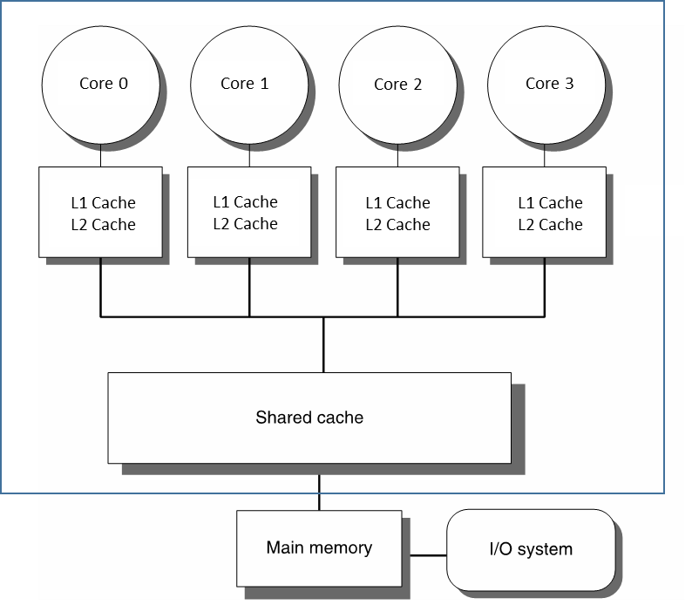
SMP: Symmetric Multi-Processing
A chip like Haswell supports what is called “symmetric multi-processing”
The “symmetric” attribute: Any core on the chip has identical access to memory on the chip
No core that does processing is any more special than the rest; the chip is symmetric, as far as its cores are concerned
Core 0 sees the same amount of L1 cache as does Core 1; they have the same latencies for reaching L1
They also see and access the same amount of L3. Same amount of L3 memory, and same latency
They also see and access the same amount of RAM

Slide 30
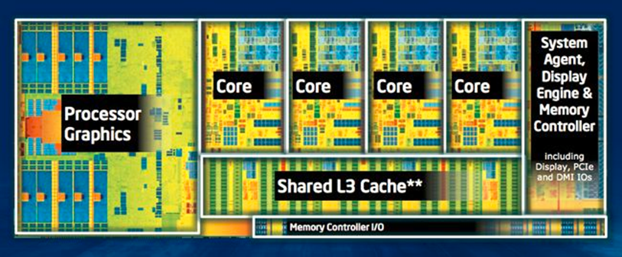
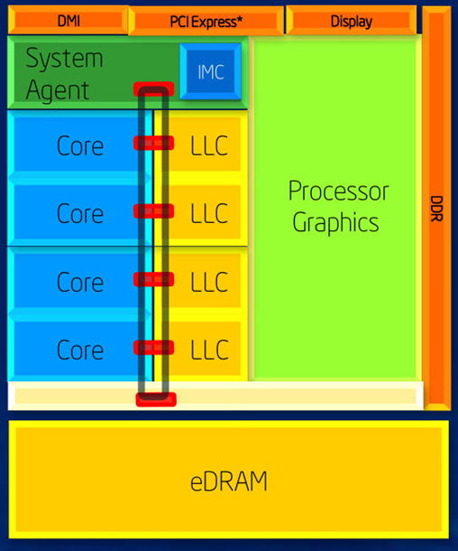
Illustrating Hardware, Haswell
Actual layout of the chip:
Schematic of the chip organization
LLC: last level cache (L3)
Three clocks:
A core’s clock ticks at 2.7 to 3.0 GHz but adjustable up to 3.7-3.9 GHz
Graphics processor ticking at 400 MHz but adjustable up to 1.3 GHz
Ring bus and shared L3 cache - a frequency that is close to but not necessarily identical to that of the cores

Slide 31
Caches
Data:
L1 – 32 KB per core
L2 – 512 KB or 1024 KB per core
L3 – 8 MB per CPU
This is LLC – last level cache for this chip
Instruction:
L0 – room for about 1500 microoperations (uops) per core
L1 – 32 KB per core
Cache is a black hole for transistors
Example: 8 MB of L3 translates into:
8*1024*1024*8 (bits) * 6 (transistors per bit, SRAM) = 402 million transistors out of 1.4 billions

Slide 32
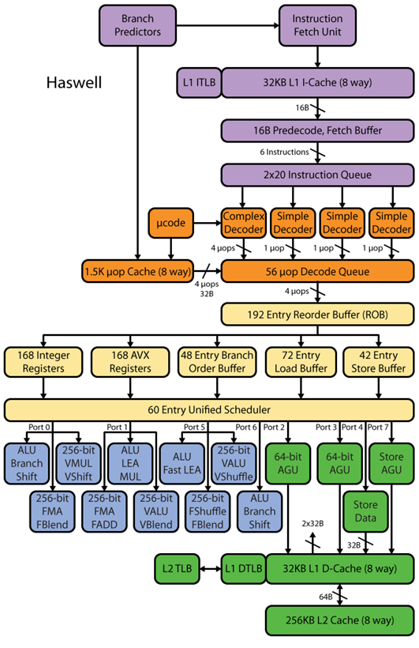
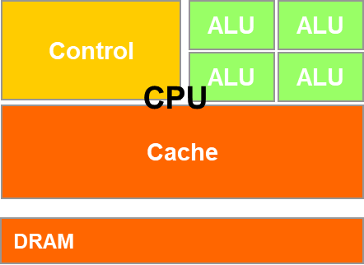
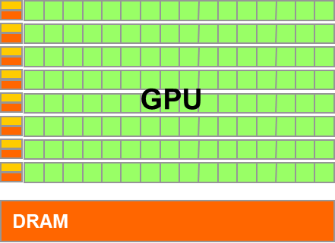
Haswell Microarchitecture [30,000 Feet]
Microarchitecture components:
Instruction pre-fetch support (purple)
Instruction decoding support (orange)
CISC into uops
Can be regarded as CISC to RISC step
Instruction Scheduling support (yellowish)
Instruction execution
Arithmetic (blueish)
Memory related (green)
Control-side
ALU-side
[http://www.realworldtech.com]→
Notes:
LEA: Load effective address
The address generation unit (AGU), sometimes also called address computation unit (ACU), is an execution unit inside central processing units (CPUs) that calculates addresses used by the CPU to access main memory.

Slide 33
Moving from HW to SW

Slide 34
Acknowledgements
Many OpenMP slides are from Intel’s library of OpenMP presentations
Many slides associated with the IOMPP (Intel OpenMP Presentation)
Several code examples originate in the Microsoft’s Developer Network (MSDN) collection of OpenMP code snippets
Other slides contain input from various sites on the internet
I tried whenever possible to give credit where due
Apologies for omitting any source
Mistakes are most likely due to massaging I did

Slide 35
OpenMP: When Used
CUDA: targeted parallelism on the GPU
OpenMP: targets parallelism on SMP architectures
Handy when
You have a multi-core processor, say 16 cores/socket
Might have multiple sockets, say 2
You have a good amount of system memory, say 64 GB
MPI: targeted parallelism on a cluster (distributed computing)
Note that MPI implementation can handle transparently an SMP architecture such as a workstation with two hexcore CPUs that draw on a good amount of shared memory

Slide 36
process vs. thread
How similar: Both processes and threads are independent sequences of execution
How different:
Threads (of the same process) run in a shared memory space (have one Translation Page)
However, each thread has its own PC
Who draws on it: OpenMP
Processes run in separate memory spaces
Each process has its Page Table
Who draws on it: MPI

Slide 37
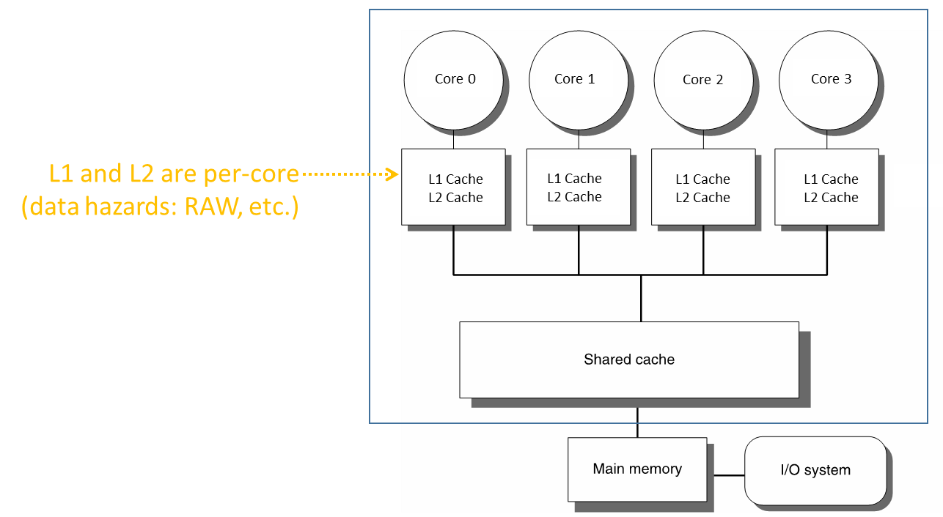
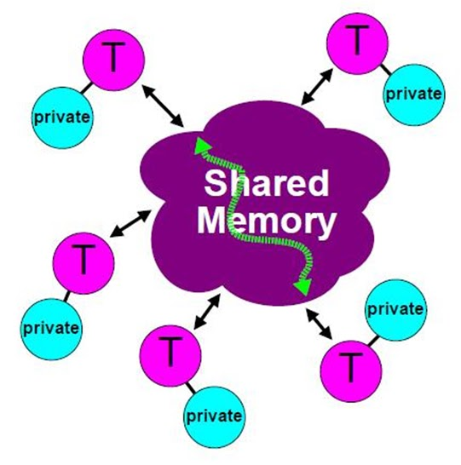
OpenMP Attributes
Parallel execution of multiple tasks via multiple threads
Threads have access to a pool of memory that is shared
Threads can have private data
Not accessible by other threads
When/How data is written/read by threads to/from memory is transparent to programmer
However, programmer has some control (atomic, flush, etc.)
Synchronization in thread execution is implicit, but can be made explicit as well
[CodeProject]→

Slide 38
OpenMP: What’s Reasonable to Expect
If you have more than 16 cores or so in an SMP setup, it’s unlikely that you can get a speed-up on that scale. All sorts of overheads kick in to slow you down
Beyond 16: law of diminishing return
Some of the reasons for lack of scaling:
Cache coherence (more in a couple of lectures)
False cache sharing (more in a couple of lectures)
No significant over-commitment of hardware (recall CUDA/GPU computing and over-subscription of the SM hardware assets)
Notes:
Nice discussion of HTT: https://software.intel.com/en-us/articles/performance-insights-to-intel-hyper-threading-technology

Slide 39
Data vs. Task Parallelism
Data parallelism (aka fine-grain parallelism)
You have a large amount of data elements and each data element needs to be processed to produce a result
When this processing can be done in parallel, we have data parallelism
Example:
Adding two long arrays of doubles to produce yet another array of doubles
Task parallelism (aka coarse-grain parallelism)
You have a collection of tasks that need to be completed
Task parallelism: these tasks can be performed in parallel
Example, task parallelism:
Prepare a soup, make a salad, bake a cake, microwave popcorn

Slide 40
Objectives, ME759
Understand OpenMP at the level where you can
Implement data parallelism
Implement task parallelism
Notes:
Script:
The objectives of the course are to prepare students and faculty to use OpenMP to parallelize C, C++, Fortran applications using either task or data parallelism. The course is expected to take 2 hours for the lecture – plus additional time for the labs or demos up to about an hour

Slide 41
OpenMP: What Is It?
Portable programming environment that invokes at run-time a shared-memory multi-threading execution of the code
Language bindings: Fortran, C, and C++
Multi-vendor support for both Linux and Windows
Alternative to using posix threads
Standardizes task & loop-level parallelism
Combines serial and parallel code in single source
[IOMPP]→
Notes:
Script:
What is OpenMP?
OpenMP is a portable (OpenMP codes can be moved between linux & windows for example), shared-memory threading API that standardizes task & loop level parallelism. Because OpenMP clauses have both lexical and dynamic extent, it is possible support a broad multi-file course grained parallelism. Often, the best parallelism technique is to parallel at the coarsest grain possible often parallelizing tasks or loops from with the main driver itself – as this gives the most bang for the buck (the most computation for the necessary threading overhead costs).
Another key benefits is that OpenMP allows for a developer to parallelize their applications incrementally. Since OpenMP is primarily a pragma or directive based approach we can easily combine serial & parallel code in a single source. By simply compiling with or without the /OpenMP compiler flag we can turn OpenMP on or off. Code compiled without the /OpenMP flag simply ignores the OpenMp pragmas which allows simple access back to the original serial application.
Openmp also standardizes about 20 years of compiler directed threading experience.
For more information or to review the latest OpenMP spec (currently the latest spec is OpenMP 3.0) – goto www.openmp.org

Slide 42
OpenMP Mission Statement
Straight from the horse’s mouth:
“Standardize directive-based multi-language high-level parallelism that is performant, productive and portable.”

Slide 43
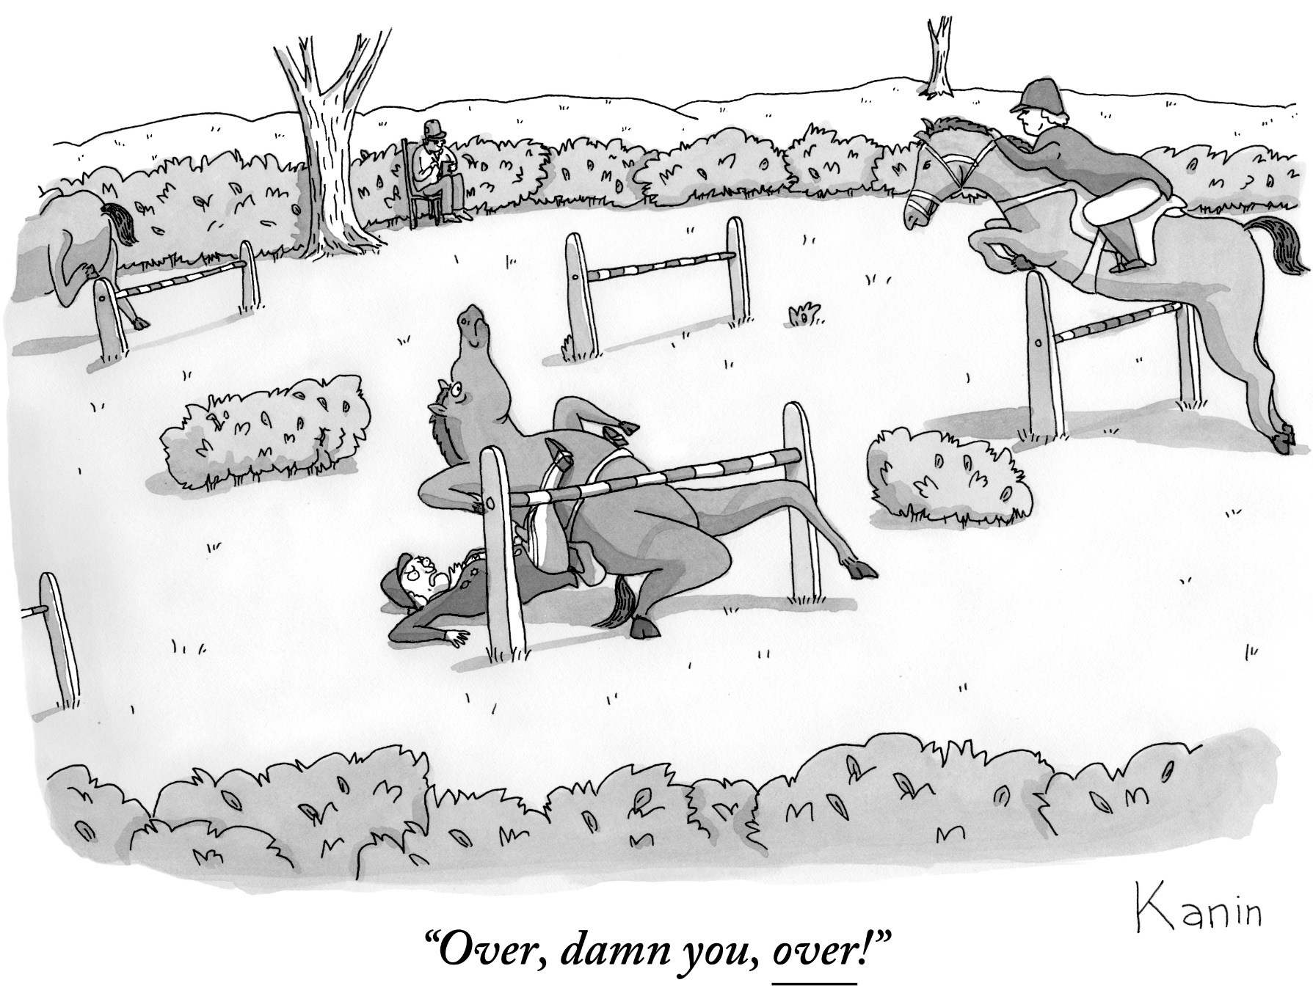
Speaking of horses…
[Zach Kanin]$→$

Slide 44
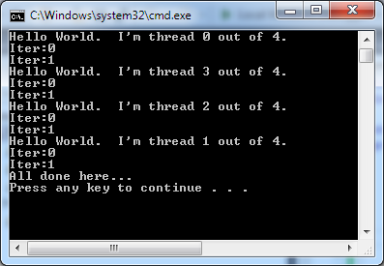
Example: Hello World
#include <iostream>
#include <omp.h>
int main() {
#pragma omp parallel
{
int myId = omp_get_thread_num();
int nThreads = omp_get_num_threads();
std::cout << "Hello World. I'm thread " << myId
<< " out of " << nThreads << ".\n";
for( int i = 0; i < 2; i++ )
std::cout << "Iter:" << i << "\n";
}
std::cout << "All done here..." << std::endl;
}
Here’s a two core laptop, with HTT:
Intel Core i5-3210M @ 2.50GHz 3 MB L3 Cache, TDP 35 Watts, Two-Core Four-Thread Processors
Notes:
Script:
Take about 5 minutes to build and run the hello world lab. In this example – we will print “hello world” from several threads. Run the code several times. Do you see any issues with the code – do you always get expected results? Does anyone in the class have weird behavior in terms of the sequence of the words that are printed out?
Since printf is a function of state – it can only print one thing to one screen at a time – some students are likely to see “race conditions” where one printf in a thread is writing over the results of another printf in an other thread.

Slide 45
Comments, “Hello World!” Example
OMP parallel region on previous slide just like a CUDA kernel
Each CUDA thread executes the kernel
In OpenMP, each thread executes the parallel region
Important difference:
Variables inside GPU kernel are truly local variables, stored in registers
OMP variables in a parallel region may or may not be visible to other threads executing the code of the parallel region
Scoping of a variable in OpenMP is tricky
Discussed later
Important Note: In reality, an OpenMP structured block that marks a “parallel region” is rarely used like a kernel used to be used in GPU computing
Most often, “parallel regions” come in play in a different context (such as for work sharing, more to come)

Slide 46
OpenMP: Historical Perspective
Current spec is 5.1
Released on November 13, 2020, http://www.openmp.org
More than 600 Pages
Not yet fully implemented by any compiler
Not all compilers are equally up-to-date with the standard
Examples:
GNU compiler supports up to OpenMP 4.5 , but does not fully support GPU offloading
LLVM is the new kind in town, good support, up to features of 5.0 (partial features)
Microsoft compiler lagging behind (Version 2.0 as of Jan 2019)
[IOMPP]→
Notes:
Script:
What is OpenMP?
OpenMP is a portable (OpenMP codes can be moved between linux & windows for example), shared-memory threading API that standardizes task & loop level parallelism. Because OpenMP clauses have both lexical and dynamic extent, it is possible support a broad multi-file course grained parallelism. Often, the best parallelism technique is to parallel at the coarsest grain possible often parallelizing tasks or loops from with the main driver itself – as this gives the most bang for the buck (the most computation for the necessary threading overhead costs).
Another key benefits is that OpenMP allows for a developer to parallelize their applications incrementally. Since OpenMP is primarily a pragma or directive based approach we can easily combine serial & parallel code in a single source. By simply compiling with or without the /OpenMP compiler flag we can turn OpenMP on or off. Code compiled without the /OpenMP flag simply ignores the OpenMp pragmas which allows simple access back to the original serial application.
Openmp also standardizes about 20 years of compiler directed threading experience.
For more information or to review the latest OpenMP spec (currently the latest spec is OpenMP 3.0) – goto www.openmp.org

Slide 47
OpenMP: My two cents (speaking for myself, not OpenMP guru)
Over time, folks have come to judge OpenMP as good at coarse-grained, task parallelism
OpenMP is somewhat quirky; it has many idiosyncrasies
Easy to pick up, not easy to master
See upcoming example w/ computing entries in a table, the values of sin function
[IOMPP]→

Slide 48
OpenMP Programming Model
Master thread spawns a team of threads as needed
This “spawning” managed transparently on your behalf
Relies on low-level thread fork/join methodology to implement parallelism
Straightforward to ease into the use of OpenMP
Parallelism is added incrementally
The sequential program evolves into a parallel program
[IOMPP]→
Notes:
Script:
OpenMP uses a fork join methodology to implement parallelism. A master thread, shown in red, begins executing code. At an OMP PARALLEL directive, the master thread forks other threads to do work. At a specified point in the code called a barrier, the master thread will wait for all the child threads to finish work before proceeding. Because we can have multiple parallel regions each created as above, we see that parallelism can be added incrementally. We can work on one region of code and get it running well as a parallel region and we can simply turn off openmp in other more problematic parallel regions, until we get the desired program behaviour.
That’s the high level overview of OpenMP, now we will look at some of the details to get us started.
More Background info:
In case someone asks if the threads are really created and destroyed between parallel regions – here is some background info:
The Intel OpenMP implementation maintains a thread pool to minimize overhead from thread creation. Worker threads are reused from one parallel region to the next. In serial regions, the worker threads either sleep, spin, or spin for a user-specified amount of time before going to sleep. This behavior is controlled by the KMP_BLOCKTIME environment variable or the KMP_SET_BLOCKTIME function, which are described in the compiler documentation. Worker thread behavior in the serial regions can affect application performance. On shared systems, for example, spinning threads consume CPU resources that could be used by other applications. However, there is overhead associated with waking sleeping threads.

Slide 49
OpenMP Execution Model
A small window into the execution flow of an OpenMP program
Sequential execution regions
F o r k
Join
F o r k
J o i n
F o r k
J o i n
Fork
Join
Another parallel region
A parallel region
Yet another parallel region
Master thread
Slave thread

Slide 50
OpenMP, Compiling Using the Command Line
Method depends on compiler
GCC/Clang:
ICC:
MSVC:
$ g++ -o integrate_omp integrate_omp.cpp –fopenmp
$ icpc -o integrate_omp integrate_omp.cpp –openmp
$ cl /openmp integrate_omp.cpp

Slide 51
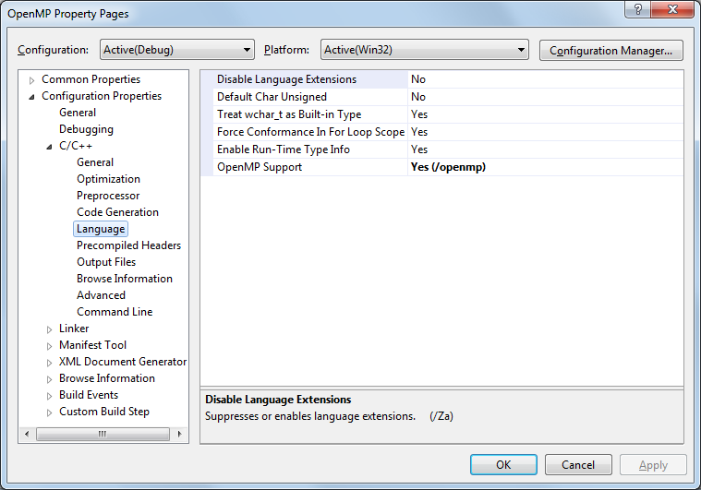
Visual Studio Specific
Step 2:
Select /openmp
Step 1:
Go here

Slide 52
Example: Calculate Entries in a Table
Version 0: Fill up the table, use a for loop to visit each entry
#include <cmath>
constexpr auto M_PI = 3.14159265358979323846;
int main()
{
const int size = 256;
double sinTable[size]; // sin table to be initialized
for (int n = 0; n<size; ++n)
sinTable[n] = std::sin(2 * M_PI * n / size);
// the table is now initialized
}

Slide 53
Example: Calculate Entries in a Table in Parallel w/ OpenMP
Version 1:
What gets used most of the time
#include <omp.h>
#include <cmath>
constexpr auto M_PI = 3.14159265358979323846;
int main()
{
const int size = 256;
double sinTable[size]; // sin table to be initialized
#pragma omp parallel for
for (int n = 0; n<size; ++n)
sinTable[n] = std::sin(2 * M_PI * n / size);
// the table is now initialized
}
[ http://bisqwit.iki.fi/story/howto/openmp/ ]→

Slide 54
Example: Calculate Entries in a Table in Parallel w/ OpenMP
Version 2:
Uses wide registers & vector operations (CPU needs to have special chops to support this)
Not supported by MS compiler
#include <omp.h>
#include <cmath>
constexpr auto M_PI = 3.14159265358979323846;
int main()
{
const int size = 256;
double sinTable[size]; // sin table to be initialized
#pragma omp simd
for (int n = 0; n<size; ++n)
sinTable[n] = std::sin(2 * M_PI * n / size);
// the table is now initialized
}
[ http://bisqwit.iki.fi/story/howto/openmp/ ]→

Slide 55
Example: Calculate Entries in a Table in Parallel w/ OpenMP
Version 3:
Offloading code to different devices, such as a GPU
The sin function must also exist on the target device
Not supported by MS compiler
#include <omp.h>
#include <cmath>
constexpr auto M_PI = 3.14159265358979323846;
int main()
{
const int size = 256;
double sinTable[size]; // sin table to be initialized
#pragma omp target teams distribute parallel for map(from:sinTable[0:256])
for (int n = 0; n<size; ++n)
sinTable[n] = std::sin(2 * M_PI * n / size);
// the table is now initialized
}
[ http://bisqwit.iki.fi/story/howto/openmp/ ]→

Slide 56
A Few Syntax Details to Get Started
Picking up the OpenMP header file
#include <omp.h> (for C/C++)
use omp_lib (for FORTRAN)
Most OpenMP constructs are compiler directives
C and C++: the directives take the form of pragmas:
#pragma omp construct [clause [clause]…]
Fortran: the directives take one of the forms:
C$OMP construct [clause [clause]…]
!$OMP construct [clause [clause]…]
*$OMP construct [clause [clause]…]
[IOMPP]→
Notes:
Script:
Most of the constructs we will looking at in OpenMP are compiler directives or pragmas.
The C/C++ and Fortran versions of these directives are shown here.
C and C++, the pragmas take the form:
#pragma omp construct [clause [clause] where clauses are optional modifiers
Be sure to include “omp.h” if you intend to use any routines from the OpenMP Library.
Now let look at some environment variables that control OpenMP behavior
Note to Fortran Users:
For Fortran, you can also use other sentinel’s (!$OMP), but these must exactly line up on columns 1-5. Column 6 must be blank or contain a + indicating that this line is a continuation from the previous line.

Slide 57
Why Compiler Directives?
A code design principle facilitated (withing certain limits) by OpenMP:
One can have the same code, with no modifications, run with or without OpenMP
Accounts for the case when the OpenMP runtime is not available or not used
Implications: you have to “hide” all the compiler directives behind pragmas (comments, in Fortran)
Directives are picked up by the compiler only if instructed to do so
Example: Visual Studio – you have to have the /openmp flag on

